Slide 1
Updating the Dependency Equations Proposed in THERP Using Experimental Data
PSAM 18 | July 19–24, 2026, Pittsburgh, Pennsylvania
Taewon Yangª, and Jooyoung Park^{b*}
ªKorea Advanced Institute of Science and Technology
^{b}Korea National University of Transportation
Notes:
Good morning, everyone. Thank you for being here.
My name is Taewon Yang, from the Korea Advanced Institute of Science and Technology.
This work was done together with Professor Jooyoung Park at the Korea National University of Transportation.
Today, I will present our study on updating the dependency equations proposed in THERP using experimental data.

Slide 2
Contents
1. Introduction
2. Methodology
3. Experimental Data
4. Data Analysis
5. Summary
Notes:
Here is the outline of my talk.

Slide 3
1. Introduction
Notes:
Let me begin with the introduction.

Slide 4
1. Introduction
Dependency Analysis in Human Reliability Analysis (HRA)
  Adjusts the failure probability of a subsequent human action according to the influence of a preceding action
  Neglecting dependence can substantially underestimate the overall human error probability (HEP).
THERP Dependency Model (Swain & Guttmann, 1983)
  One of the most widely used first-generation HRA methods
  Five discrete levels of dependence, selected from factors (functional/spatial relatedness, closeness in time)
    Zero (ZD), Low (LD), Moderate (MD), High (HD), and Complete Dependence (CD)
  Each level has a closed-form equation for the conditional human error probability (CHEP).
Task_{N−1}
Failure
Task_{N}
Failure probability : P(F_{N})
Independence
Task_{N}
Failure probability increases:
P(F_{N}) → P(F_{N} | F_{N−1}) > P(F_{N})
Dependence
If two tasks are not independent, the failure of the preceding task raises the failure probability of the subsequent one.
Notes:
Dependency analysis is a method used in human reliability analysis, or HRA. It adjusts the failure probability of a subsequent human action according to the influence of a preceding action.
As shown in this diagram, if two tasks are independent, the failure probability of Task N is simply P of F-N. But if they are not independent, the failure of the preceding task raises the failure probability of the subsequent one. Neglecting this dependence can substantially under-estimate the overall human error probability.
THERP, proposed by Swain and Guttmann in 1983, is one of the most widely used first-generation HRA methods. It handles this dependence through five discrete levels — zero, low, moderate, high, and complete dependence — and each level has a closed-form equation for the conditional human error probability, the CHEP.

Slide 5
1. Introduction
Problem Statement
  The degree-of-dependence values underlying the THERP equations were assigned without a documented technical basis.
    The THERP handbook itself recommended revising them as supporting data became available.
  Other studies have proposed new dependency analysis methods, but many organizations still rely on the original THERP approach.
    This study therefore proposes updating the THERP equations, rather than introducing a new method.
Notes:
So what is the problem? The degree-of-dependence values underlying the THERP equations were assigned without a documented technical basis. In fact, the THERP handbook itself recommended revising them as supporting data became available. Other studies have proposed new dependency analysis methods, but many organizations still rely on the original THERP approach. Therefore, this study proposes updating the THERP equations, rather than introducing a new method.

Slide 6
1. Introduction
Updating the THERP Dependency Equations Using Experimental Data
  Estimate degrees of dependence and update the THERP dependency equations using experimental data
  Refine the current discrete classification of dependency levels
  Investigate whether the current HRA dependency factors meaningfully influence dependence
  Identify new dependency factors from the experimental data
Contents
  Unify the five THERP equations into a single generalized expression with a continuous degree of dependence
  Derive an estimation formula that computes the degree of dependence from experimental failure counts
  Demonstrate the approach with SHEEP (Simplified Human Error Experimental Program) Framework data and identify influential dependency factors via regression analysis
    SHEEP data collected from collaboration between INL and Chosun University (2021~2023)
Notes:
Our research questions are listed here — in short, we aim to estimate degrees of dependence from experimental data, refine the discrete classification of dependency levels, and examine which dependency factors actually influence dependence.
In this presentation, we do three things.
First, we unify the five THERP equations into a single generalized expression with a continuous degree of dependence.
Second, we derive an estimation formula that computes the degree of dependence from experimental failure counts.
And third, we demonstrate the approach with data from the SHEEP framework— the Simplified Human Error Experimental Program — and identify influential dependency factors through regression analysis. The SHEEP data were collected through a collaboration between Idaho National Laboratory and Chosun University from 2021 to 2023.

Slide 7
2. Methodology
Notes:
Now, let me move on to the methodology.

Slide 8
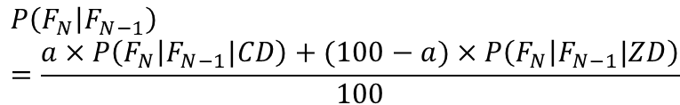
2. Methodology
THERP Dependency Equations
  CHEP of Task_{N} given failure of the preceding Task_{N−1}; k = basic HEP (BHEP) of Task_{N}
  CHEP rises monotonically from the independent value k (ZD) to unity (CD).
  Intermediate levels (LD–HD) = weighted average of k and the complete-dependence bound of 1.0
Dependence Level | CHEP Equation | Degree of Dependence
Zero (ZD) | P = k | 0%
Low (LD) | P = (1 + 19k) / 20 | 5% (1/20)
Moderate (MD) | P = (1 + 6k) / 7 | 14.3% (1/7)
High (HD) | P = (1 + k) / 2 | 50% (1/2)
Complete (CD) | P = 1.0 | 100%
Generalized expression of the dependency equations
$$P\left(F_{N} | F_{N−1}\right)=\frac{a×P\left(F_{N} | F_{N−1}|CD\right)+(100−a)×P\left(F_{N} | F_{N−1}|ZD\right)}{100}$$
a : degree of dependence — a continuous interpolation weight between the ZD (=0%) and CD (=100%) bounds
Notes:
This table shows the five THERP dependency equations. Each equation gives the CHEP of Task N, given failure of the preceding Task N minus one, where k is the basic human error probability of Task N.
As you can see, the CHEP rises monotonically from the independent value kat zero dependence, up to unity at complete dependence. The intermediate levels can be interpreted as a weighted average of k and the complete-dependence bound of one.
This observation leads to the generalized expression at the bottom. Here, a is the degree of dependence — a continuous interpolation weight between the zero-dependence bound of zero percent and the complete-dependence bound of one hundred percent. Setting a to five, fourteen-point-three, or fifty percent recovers the low, moderate, and high dependence equations.

Slide 9
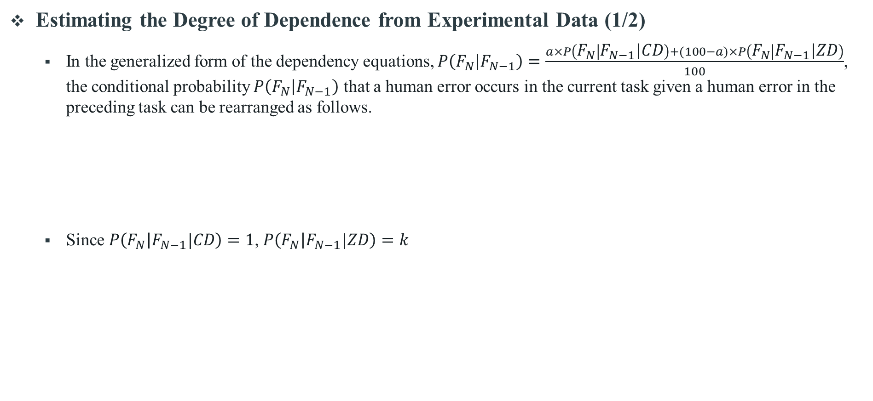
2. Methodology
Estimating the Degree of Dependence from Experimental Data (1/2)
  In the generalized form of the dependency equations, $P\left(F_{N} | F_{N−1}\right)=\frac{a×P\left(F_{N} | F_{N−1}|CD\right)+(100−a)×P\left(F_{N} | F_{N−1}|ZD\right)}{100}$, the conditional probability $P\left(F_{N} | F_{N−1}\right)$ that a human error occurs in the current task given a human error in the preceding task can be rearranged as follows.
  Since $P\left(F_{N} | F_{N−1}|CD\right)=1$, $P\left(F_{N} | F_{N−1}|ZD\right)=k$
$$P\left(F_{N} | F_{N−1}\right)=\frac{P(F_{N}∩F_{N−1})}{P(F_{N−1})}=\frac{a×P\left(F_{N} | F_{N−1}|CD\right)+(100−a)×P\left(F_{N} | F_{N−1}|ZD\right)}{100}$$
$$\frac{a×P\left(F_{N} | F_{N−1}|CD\right)+(100−a)×P\left(F_{N} | F_{N−1}|ZD\right)}{100}=\frac{a+(100−a)×k}{100}$$
Notes:
The next step is to estimate a from experimental data.
Starting from the generalized form of the dependency equations, and since the CHEP under complete dependence equals one and under zero dependence equals k, the conditional probability that a human error occurs in the current task, given a human error in the preceding task, can be rearranged as shown here — a plus, one hundred minus a, times k, all over one hundred.

Slide 10

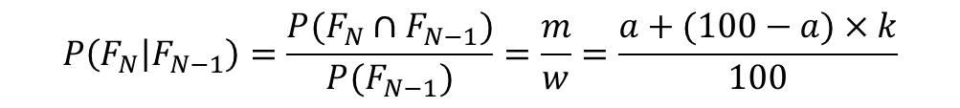

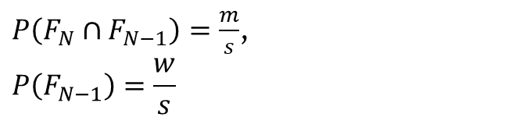
2. Methodology
Estimating the Degree of Dependence from Experimental Data (2/2)
  Here, let s denote the number of opportunities for human error, (i.e., the total number of scenario trials); m the number of trials in which human errors occurred in both the preceding and current tasks; and w the number of trials in which a human error occurred in the preceding task. Then$P\left(F_{N}∩F_{N−1}\right)$, $P(F_{N−1})$ can be expressed as follows.
  Therefore, the degree of dependence a can be derived as follows.
F_{N-1}
F_{N}
$P\left(F_{N}∩F_{N−1}\right)=\frac{m}{s}$,
$$P\left(F_{N−1}\right)=\frac{w}{s}$$
w
m
s
$$P\left(F_{N} | F_{N−1}\right)=\frac{P(F_{N}∩F_{N−1})}{P(F_{N−1})}=\frac{m}{w}=\frac{a+(100−a)×k}{100}$$
$$a=\frac{100(m−wk)}{w(1−k)}$$
Notes:
Now we express this conditional probability in terms of quantities we can actually observe in the experiments.
Let s denote the number of opportunities for human error — that is, the total number of scenario trials. Let m be the number of trials in which human errors occurred in both the preceding and current tasks, and w the number of trials in which a human error occurred in the preceding task. Then the joint probability is m over s, and the probability of the preceding failure is w over s, as illustrated in this diagram.
Substituting these into the equation and solving for a, we obtain the estimation formula at the bottom: a equals one hundred times m minus w-k, divided by w times one minus k. With this formula, the degree of dependence can be computed directly from observed failure counts.

Slide 11
3. Experimental Data
Notes:
Next, let me describe the experimental data.

Slide 12
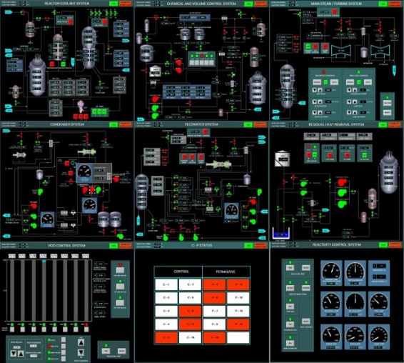
3. Experimental Data
The SHEEP data
  Collected by Chosun University
  Uses simplified simulators and non-expert operators to complement full-scope HRA data collections
    (e.g., HuREX, SACADA)
  Database: 36 student + 36 professional operators on the Rancor Microworld (INL) and the Compact Nuclear Simulator (CNS, KAERI)
  Collected data: task completion time, errors, workload, and situation awareness
Data Used in This Study
  Student operator error data on the CNS
    Students had completed curricula of nuclear engineering.
    Professional operators rarely committed human errors on such a simplified simulator.
    Future work will estimate a using the entire SHEEP database.
CNS Simulator
Designed to reproduce characteristics of Westinghouse-900MWe 3-Loop (PWR)
13 interface screens present
Used for observing the impact of certain decisions and acquiring fundamental knowledge and principles of plant operation.
Notes:
The SHEEP data were collected by Chosun University. The framework uses simplified simulators and non-expert operators to complement full-scope HRA data collections such as HuREX and SACADA. The database includes thirty-six student and thirty-six professional operators, on the Rancor Microworld and the Compact Nuclear Simulator, CNS, shown on the right.
In this study, we used the student operator error data on the CNS, because professional operators rarely committed human errors on such a simplified simulator.
Please note that this is a preliminary analysis — future work will estimate a using the entire SHEEP database.

Slide 13
3. Experimental Data
Analyzed Scenario: Startup Operation (2% → 50%)
  Increase reactor power from 2% to 50% in fully automatic mode
  Success criteria: power = 50%, no reactor trip
  Primarily governed by procedure OP-01-Start up
Major Tasks (11 Tasks)
  Cases in which a single operator committed errors in two or more tasks within a scenario
Task No. | Task | Interface | Procedure page | Cognitive activity | Task type | Component | Error type
1 | Inject makeup water (300 L) | CVCS | 4 | Execution | Action | Button | EOC
2 | Inject additional makeup water (200 L) | CVCS | 4 | Execution | Action | Button | EOO
3 | Set Makeup Mode to Auto | CVCS | 4 | Execution | Action | Button | EOO
4 | Set turbine speed setpoint (1800 rpm) | Turbine | 5 | Information gathering and reporting | Diagnosis | Dash board | EOC
5 | Set RCS-IR TRIP BLOCK | Rod control | 6 | Information gathering and reporting | Diagnosis | Button | EOC
6 | Set RCS-PR TRIP BLOCK | Rod control | 6 | Information gathering and reporting | Diagnosis | Button | EOC
7 | Set TBN-Press Setpoint Controller to Auto | Turbine | 8 | Response planning and instruction | Diagnosis | Button | EOO
8 | Adjust Tref/Tavg mismatch ΔT to within ±1°C | Reactivity control | 8 | Info gathering / Execution | Diagnosis | Dash board | EOC
9 | Set RCS-IR TRIP BLOCK | Rod control | 8 | Information gathering and reporting | Diagnosis | Button | EOC
10 | Set RCS-PR TRIP BLOCK | Rod control | 8 | Information gathering and reporting | Diagnosis | Button | EOC
11 | Bypass orifice valve alignment | Feedwater | 10 | Response planning and instruction | Action | Procedure (understanding) | EOO
Notes:
The analyzed scenario is the startup operation, increasing reactor power from two to fifty percent in fully automatic mode. The success criteria are reaching fifty percent power with no reactor trip, and the operation is primarily governed by procedure OP-01.
From this scenario, we defined eleven major tasks — focusing on cases in which a single operator committed errors in two or more tasks within a scenario. As shown in the table, for each task we recorded the interface, the procedure page, the cognitive activity, the task type, the component, and the error type. These attributes will be used later as dependency factors.

Slide 14
4. Data Analysis
Notes:
Now let me present the data analysis results.

Slide 15
4. Data Analysis
Estimated Degrees of Dependence for Consecutive Major Tasks
  Estimates vary widely (≈ 20–100%) → a single discrete dependency level cannot adequately represent the observed dependence.
No. | Task Pair | M | s | P(Fₙ₋₁) | P(Fₙ∩Fₙ₋₁) | CHEP | a (%)
1 | Task #1 + Task #8 | 2 | 15 | 0.25 | 0.13 | 0.53 | 53.29
2 | Task #1 + Task #11 | 1 | 12 | 0.25 | 0.08 | 0.33 | 33.27
3 | Task #2 + Task #3 | 1 | 16 | 0.06 | 0.06 | 1.00 | 100.00
4 | Task #4 + Task #5 | 1 | 15 | 0.13 | 0.07 | 0.53 | 53.29
5 | Task #5 + Task #6 | 2 | 15 | 0.13 | 0.13 | 1.00 | 100.00
6 | Task #6 + Task #7 | 1 | 15 | 0.13 | 0.07 | 0.50 | 49.95
7 | Task #8 + Task #9 | 1 | 15 | 0.33 | 0.07 | 0.20 | 19.92
8 | Task #8 + Task #11 | 1 | 12 | 0.33 | 0.08 | 0.25 | 24.93
Estimated degrees of dependence using SHEEP data (startup operation, CNS)
Notes:
Using the estimation formula and the experimental data, we calculated the degrees of dependence for eight consecutive task pairs, as shown in this table.
The key observation is that the estimates vary widely — from about twenty to one hundred percent. This suggests that a single discrete dependency level cannot adequately represent the observed dependence between human tasks.

Slide 16
4. Data Analysis
Six Candidate Dependency Factors Coded for Each Task Pair
  Area of Interest (AOI), Paper Procedure Page (PPP), Cognitive Activity (CA), Task Type (TT), Component Type (CT), and Error Type (ET)
    Area of Interest: Whether the two tasks in a task pair are performed on the same screen (window) of the simulator
    Paper Procedure Page: Whether the steps directing the two tasks in a task pair are on the same page of the procedure
    Cognitive Activity: Whether the two tasks in a task pair have the same cognitive type
      Four cognitive type: Info gathering and reporting / Response planning and instruction / Situation interpreting / Execution
    Task Type: Whether the two tasks in a task pair are the same type of task
      Task type: Diagnosis, Action
    Component Type: Whether the two tasks in a task pair are related to the same type of component (e.g., valve, pump, button, dash board, ...)
    Error Type: Whether the errors of the two tasks in a task pair are the same type of error
      Error type: Error of Omission, Error of Commission
Notes:
To investigate what drives these differences, we coded six candidate dependency factors for each task pair, as defined here.
For example, Area of Interest is whether the two tasks are performed on the same screen of the simulator, and Cognitive Activity is whether the two tasks have the same cognitive type.
The remaining factors — Paper Procedure Page, Task Type, Component Type, and Error Type — are defined in the same way, each asking whether the two tasks share the same attribute.

Slide 17
4. Data Analysis
Coding of Dependency Factors for each Task Pair
  Same = 0, Different = 1
  e.g., Pair 1: Task #1 performed in the CVCS window vs. Task #8 in the Reactivity Control System window → AOI = “Different”
No. | Action Pair | Area of Interest | Paper Procedure Page | Cognitive Activity | Task Type | Component Type | Error Type
1 | Task #1 + Task #8 | Diff. | Diff. | Diff. | Same | Diff. | Same
2 | Task #1 + Task #11 | Diff. | Diff. | Same | Same | Diff. | Diff.
3 | Task #2 + Task #3 | Same | Same | Same | Same | Same | Same
4 | Task #4 + Task #5 | Diff. | Diff. | Same | Same | Diff. | Same
5 | Task #5 + Task #6 | Same | Same | Same | Same | Same | Same
6 | Task #6 + Task #7 | Diff. | Diff. | Diff. | Same | Same | Diff.
7 | Task #8 + Task #9 | Diff. | Same | Same | Same | Same | Same
8 | Task #8 + Task #11 | Diff. | Diff. | Diff. | Diff. | Diff. | Diff.
Notes:
Each factor was coded as a binary variable — zero for "Same" and one for"Different.“
For example, in Pair 1, Task 1 is performed in the CVCS window while Task 8 is in the Reactivity Control System window, so the Area of Interest was coded as "Different." This table shows the coding results for all eight task pairs.

Slide 18
4. Data Analysis
Regression of Degrees of Dependence on the Six Factors (Same = 0, Different = 1)
  Area of Interest, Cognitive Activity , Task Type , and Error Type are statistically significant at the 0.05 level (PPP and CT are not).
    (−): actions in different interface areas → indirect dependence from a shared interface is weakened
    (+): pairs with different cognitive activities may be successive phases of a single continuous task → stronger dependence
  Regression Equation
    Degrees of dependence a=88.829-49.772(AOI)+7.392(PPP)+40.060(CA)-37.689(TT)+16.265(CT)-19.274(ET) (R²=0.548)
Factor | B | Std. Error | β (std.) | t | p-value
Constant | 88.829 | 7.421 | – | 11.969 | <0.001
Area of Interest | -49.772 | 10.960 | -0.826 | -4.541 | <.001
Paper Procedure Page | 7.392 | 8.066 | 0.110 | 0.916 | 0.365
Cognitive Activity | 40.060 | 11.360 | 0.649 | 3.527 | 0.001
Task Type | -37.689 | 12.437 | -0.536 | -3.030 | 0.004
Component Type | 16.265 | 9.474 | 0.259 | 1.717 | 0.094
Error Type | -19.274 | 7.992 | -0.288 | -2.411 | 0.021
Regression results factors in red are significant at the 0.05 level
Notes:
We then regressed the estimated degrees of dependence on the six factors.
Among them, Area of Interest, Cognitive Activity, Task Type, and Error Type were statistically significant at the 0.05 level, while Paper Procedure Page and Component Type were not.
Looking at the signs: the negative coefficients mean that tasks in different interface areas show weaker dependence — the indirect dependence from a shared interface is weakened. In contrast, Cognitive Activity has a positive coefficient: pairs with different cognitive activities may be successive phases of a single continuous task, which leads to stronger dependence. The resulting regression equation has an R-squared of 0.548.

Slide 19
4. Data Analysis
Regression of Degrees of Dependence on the Significance Factors
  Regression Equation (Update)
    Degrees of dependence a=93.399-35.665(AOI)+35.876(CA)-41.033(TT) -19.510(ET) (R²=0.500)
      Constant: 88.829 → 93.399 (+4.570)
      Area of Interest: -49.772 → -35.665 (+14.107)
      Cognitive Activity : 40.060 → 35.876 (-4.184)
      Task Type : -37.689 → -41.033 (-3.344)
      Error Type : -19.274 → -19.510 (-0.230)
Factor | B | Std. Error | β (std.) | t | p-value
Constant | 93.399 | 5.495 |  | 16.998 | <0.001
Area of Interest | -35.665 | 8.252 | -0.592 | -4.322 | <0.001
Cognitive Activity | 35.876 | 11.386 | 0.581 | 3.151 | 0.003
Task Type | -41.033 | 11.386 | -0.613 | -3.604 | <0.001
Error Type | -19.510 | 8.163 | -0.291 | -2.398 | 0.021
Regression results
Notes:
We then refitted the regression using only the significant factors. The updated equation is shown here, with an R-squared of 0.500.
As you can see from the comparison, the coefficients remain stable — for example, Area of Interest changes from minus 49.8 to minus 35.7, and Error Type barely changes at all. So with a simpler, four-factor model, we retain most of the explanatory power.

Slide 20
5. Summary
Notes:
Finally, let me summarize.

Slide 21

5. Summary
Discussion: What the Analysis Results Imply
  Dependence is a continuous spectrum, not five discrete levels
    Estimated degrees of dependence spread widely (≈ 20–100%) across only eight task pairs, without clustering near the THERP-assumed values (5%, 14.3%, 50%).
    The generalized expression with a continuous a can represent the observed dependence more faithfully than the discrete levels.
  Which factors govern dependence between tasks?
    Area of Interest, Task Type , and Error Type: task pairs differing in interface area, task type, or error type exhibit weaker dependence (-)
    Cognitive Activity: pairs with different cognitive activities may be successive phases of a single continuous task → stronger dependence (+)
    Paper Procedure Page and Component Type were not significant.
  Toward a predictive equation for the degree of dependence
    Refitting with only the significant factors retained most of the explanatory power (R² = 0.548 → 0.500) with a simpler form.
      The slight decrease in R² reflects the simpler model; the estimates are expected to improve as more data are analyzed in future work.
    a can be predicted from observable task-pair characteristics, instead of subjectively selecting one of five levels.
$$a=\frac{100(m−wk)}{w(1−k)}$$
Notes:
Three points from the discussion.
First, dependence appears to be a continuous spectrum, not five discrete levels. As we saw, the estimates spread widely without clustering near the THERP-assumed values, and the generalized expression with a continuous a can represent this more faithfully.
Second, which factors govern dependence? Area of Interest, Task Type, and Error Type weaken dependence when they differ, while Cognitive Activity strengthens it.
Third, toward a predictive equation: the four-factor model retains most of the explanatory power, and we expect the estimates to improve as more data are analyzed. Ultimately, a can be predicted from observable task-pair characteristics, instead of subjectively selecting one of five levels.

Slide 22
5. Summary
Conclusions
  This study presented a preliminary analysis toward updating the THERP dependency equations using experimental data.
    Generalization: unified the five THERP equations into a single expression with a continuous degree of dependence a
    Estimation: derived a formula that computes a from experimentally observable failure counts (m, w, s)
    Demonstration: provided an empirical estimation of degrees of dependence using the SHEEP data (CNS startup scenario)
  Key contributions and implications
    Provides an empirical basis for the THERP dependency values — as the handbook itself recommended when data become available
    Establishes a regression-based framework that links dependency factors to a, enabling data-driven dependency assessment within the familiar THERP formulation
    More realistic conditional HEPs can lead to more accurate overall HEP estimates in PSA models.
Notes:
To conclude, this study presented a preliminary analysis toward updating the THERP dependency equations using experimental data. We unified the five equations into a single expression with a continuous degree of dependence, derived a formula that computes a from observable failure counts, and provided an empirical estimation using the SHEEP data.
In terms of contributions: this work provides an empirical basis for the THERP dependency values — as the handbook itself recommended when data become available. It establishes a regression-based framework linking dependency factors to a, enabling data-driven dependency assessment within the familiar THERP formulation. And more realistic conditional HEPs can lead to more accurate overall HEP estimates in PSA models.

Slide 23
5. Summary
Future Work
  Estimate a using the entire SHEEP database, including other scenarios and professional operator data
    Non event scenario: Shut-down
    Event scenarios: Loss of All Feedwater, Steam Generator Tube Rupture
  Refine the estimation of the basic HEP rather than assuming the SPAR-H nominal value
  Explore additional dependency factors and refine the current discrete classification of dependency levels
  Explore other data sources (e.g., licensee event reports) to update the dependency equations
Notes:
For future work, we will estimate a using the entire SHEEP database, including other scenarios — the shutdown operation as a non-event scenario, and event scenarios such as loss of all feedwater and steam generator tube rupture — as well as professional operator data.
We will also refine the estimation of the basic HEP rather than assuming the SPAR-H nominal value, explore additional dependency factors, refine the current discrete classification of dependency levels, and explore other data sources, such as licensee event reports, to update the dependency equations.

Slide 24
Thank You! taewon.yang@kaist.ac.kr
Notes:
That concludes my presentation. Thank you very much for your attention.

