Slide 1

July 19 – July 24, 2026
Zhegang Ma, Ph.D., P.E.
Zhegang.Ma@inl.gov
INL/CON-26-94066
Operating Experience Data Analysis for U.S. Nuclear Power Plants:
The HOPE Manual and the NRC OpE Program
Zhegang Maª and John Lane^{b}
ª Idaho National Laboratory, Idaho Falls, Idaho, USA
^{b} Nuclear Regulatory Commission, Washington D.C., USA
Notes:
Before I begin, I would like to dedicate this presentation to the memory of Dr. Cory Atwood, the primary author of the original Handbook of Parameter Estimation for Probabilistic Risk Assessment (the HOPE Manual) and a co-author of its current revision. Dr. Atwood made tremendous contributions to probabilistic risk assessment and operating experience analysis, and his work has influenced generations of PRA practitioners. Sadly, he passed away in February 2026. It is an honor to continue building upon the foundation that he established.

Slide 2
Acronyms
ASP Accident Sequence Precursor
CCF common cause failure
CFR Code of Federal Regulations
EB empirical Bayes
EN event notification
EPIX Equipment Performance Exchange System
FTS fails to start
ICES INPO Consolidated Events Database
IDCCS Integrated Data Collection and Coding
IE initiating event
INL Idaho National Laboratory
INPO Institute of Nuclear Power Operations
IRIS Industry Reporting and Information System
LER licensee event report
LOOP loss of offsite power
MDP motor-driven pump
MOR monthly operating report
NPP nuclear power plant
NROD NRC Reactor Operating Experience Data
NRC Nuclear Regulatory Commission
OpE operating experience
PRA probabilistic risk assessment
RADS Reliability and Availability Data System
SNL Sandia National Laboratories
SPAR Standardized Plant Analysis Risk
UA unavailability
UR unreliability

Slide 3
U.S. NRC Operating Experience Program
The NRC Operating Experience (OpE) Program uses U.S. nuclear power plant (NPP) operating experience to support risk-informed regulatory activities, performance monitoring, and PRA model development
A key part of this program is the systematic collection, coding, review, and analysis of operating events and component performance data
The parameter estimates developed from this program are used in the NRC’s Standardized Plant Analysis Risk (SPAR) models
They are also used by the nuclear industry as generic priors that can be updated with plant-specific operating experience using Bayesian methods to develop plant-specific PRA parameters

Slide 4
U.S. NRC OpE Program and HOPE Manual
NUREG/CR-6823, Handbook of Parameter Estimation for Probabilistic Risk Assessment, a.k.a., the HOPE Manual, provides the technical basis and guidance for ensuring that OpE data are coded and analyzed consistently
Published in 2003, it was authored by Dr. Cory Atwood and his colleagues
Sources of information and methods for estimating PRA parameters and for quantifying the uncertainties in the estimates
Plant-specific and generic estimates for initiating event frequencies, component failure rates and unavailabilities, and equipment non-recovery probabilities
The HOPE Manual is currently being revised to incorporate the updates that reflect developments in PRA practice, improvements in event data collection and analysis processes, and the availability of more recent references and data sources

Slide 5
U.S. NRC OpE Program Overall Process
Collect Data
Characterize Data
Evaluate Data
Review and Revise
The NRC OpE program includes two parts
  Data collection and coding
  Data computations and trending
COLLECT data
  Data is collected from a variety of sources
CHARACTERIZE data
  Data from source documents are reviewed and coded into different studies maintained by INL for the NRC
EVALUATE data
  PRA parameter estimation
  Component performance and system studies
REVIEW, REFINE, and DISSEMINATE results
  Self-review, peer review, revision, publishing, and continuous improvement

Slide 6
Collect Data – Primary Data Sources
Institute for Nuclear Power Operations (INPO) Database
  Nuclear power plants report the equipment failure data as well as demand and run time data to INPO
    Industry Reporting and Information System (IRIS), Previously called the Equipment Performance Exchange System (EPIX) and INPO Consolidated Events Database (ICES)
Licensee Event Reports (LERs)
  Reportable events required by 10 CFR 50.73
    Manual or automatic reactor scram
    Inadvertent actuation of the emergency diesel generators, emergency core cooling system, containment isolation system, and containment heat removal system
Event Notification (EN) reports
Monthly Operating Reports (MORs)
  Nuclear power plants’ online hours, critical hours, and shutdown information
Notes:
Institute for Nuclear Power Operations (INPO) Database
INPO is the U.S. industry organization that promotes safety and reliability in nuclear power plants
Nuclear power plants report the equipment failure data as well as demand and run time data to INPO
Industry Reporting and Information System (IRIS)
Previously called the Equipment Performance Exchange System (EPIX) and INPO Consolidated Events Database (ICES)
INPO provides data to the NRC and INL quarterly for data analysis purposes
Data is proprietary
Licensee Event Reports (LERs)
Submitted by nuclear power plants as required by 10 CFR 50.73 within 60 days of a reportable event
Plant shutdown resulting from a Tech Spec requirement
Safety barriers degraded
Manual or automatic reactor scram
Inadvertent actuation of the emergency diesel generators (EDGs), emergency core cooling system, containment isolation system, and containment heat removal system
INL downloads LERs from the NRC’s Agency-wide Document Access and Management System (ADAMS) database weekly
Event Notification (EN) reports
Immediate notification report
Monthly Operating Reports (MORs)
Includes each nuclear power plant’s online hours, critical hours, and shutdown information
Sent to the NRC by each utility
Forwarded to INL from the NRC quarterly

Slide 7
Characterize Data
In the early 2000s, INL developed the Integrated Data Collection and Coding System (IDCCS) which serves as the central repository for capturing and characterizing nuclear industry OpE data
OpE data from source documents (e.g., LERs and INPO IRIS) are coded into different studies in IDCCS
  Initiating event (IE): initial plant fault, functional impact group
  Shutdown initiating event
  Loss of offsite power (LOOP): category, timeline, operating status, cause
  Component failure: system, component type, failure mode, p-value, cause, detection, recovery
  Common cause failure (CCF): shared cause factor, time delay factor, failure mode applicability, failure cause, coupling factor, shock type, defense
  Accident Sequence Precursor (ASP) Program
  Relief Valve
  Fire (archived)

Slide 8
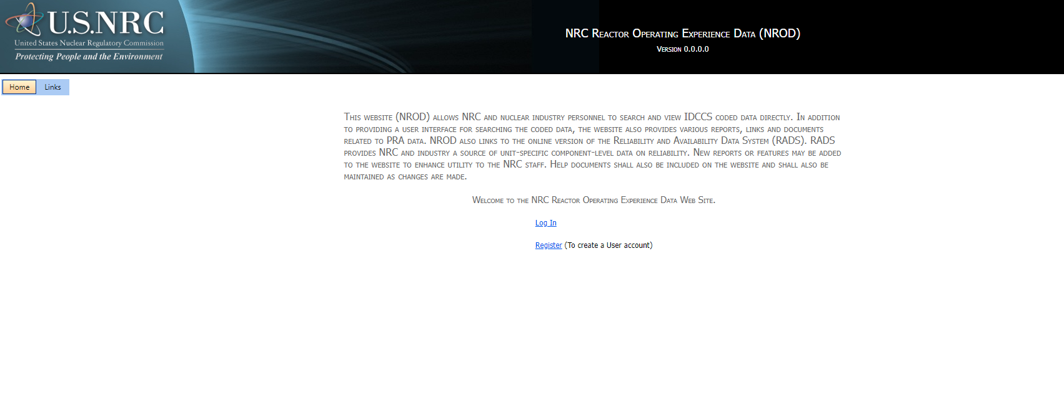
Characterize Data – NROD
  NROD (NRC Reactor Operating Experience Data), https://nrod.inl.gov
    An interface to IDCCS that can be used to search for events in IDCCS
    Available to NRC and INPO members only due to proprietary information

Slide 9
Evaluate Data – Parameter Estimates
Industry-average parameter estimation for components, initiating events, and CCFs are performed approximately every 5 years
  NUREG/CR-6928, completed in February 2007
  2010 Update, completed in September 2012
  2015 Update, completed in December 2016
  2020 Update, completed in November 2021
  2025 Update, ongoing
NUREG/CR-6928
(1998–2002)
2010 Update
(1998–2010)
2015 Update
(1998–2015)
2020 Update
(2006–2020)

Slide 10
Evaluate Data – Parameter Estimates (cont.)
Four main types of parameters
  Component unreliability (UR)
    Approximately 300 component unreliability templates
    E.g., MDP-FTS for motor-driven pump fails-to-start
  Component or train unavailability (UA)
    Test or maintenance outages
    Approximately 60 unavailability templates
  Initiating event frequencies
    Approximately 50 initiating events
    E.g., general transients, loss of main feedwater …
  CCF parameters
    Alpha factors (and multiple Greek letter parameters)
    Approximately 150 CCF templates

Slide 11
Evaluate Data – Parameter Estimates (cont.)
Use the Handbook of parameter estimation for Probabilistic Risk Assessment (NUREG/CR-6823)
  Failure on demand: beta distribution, which is the conjugate prior to the binomial distribution
  Failure to run: gamma distribution, which is the conjugate prior to the Poisson distribution
  The Empirical Bayes (EB) method is used to look at variability in the data from different sources
Use the CCF database and analysis system as documented in NUREG/CR-6268
  Alpha factor model
  Impact vector assessment on CCF events
  Mapping up and mapping down of impact vectors
  CCF generic prior distributions
Use the web-based calculation tool, Reliability and Availability Database System (RADS), https://rads.inl.gov, to estimate the parameters

Slide 12
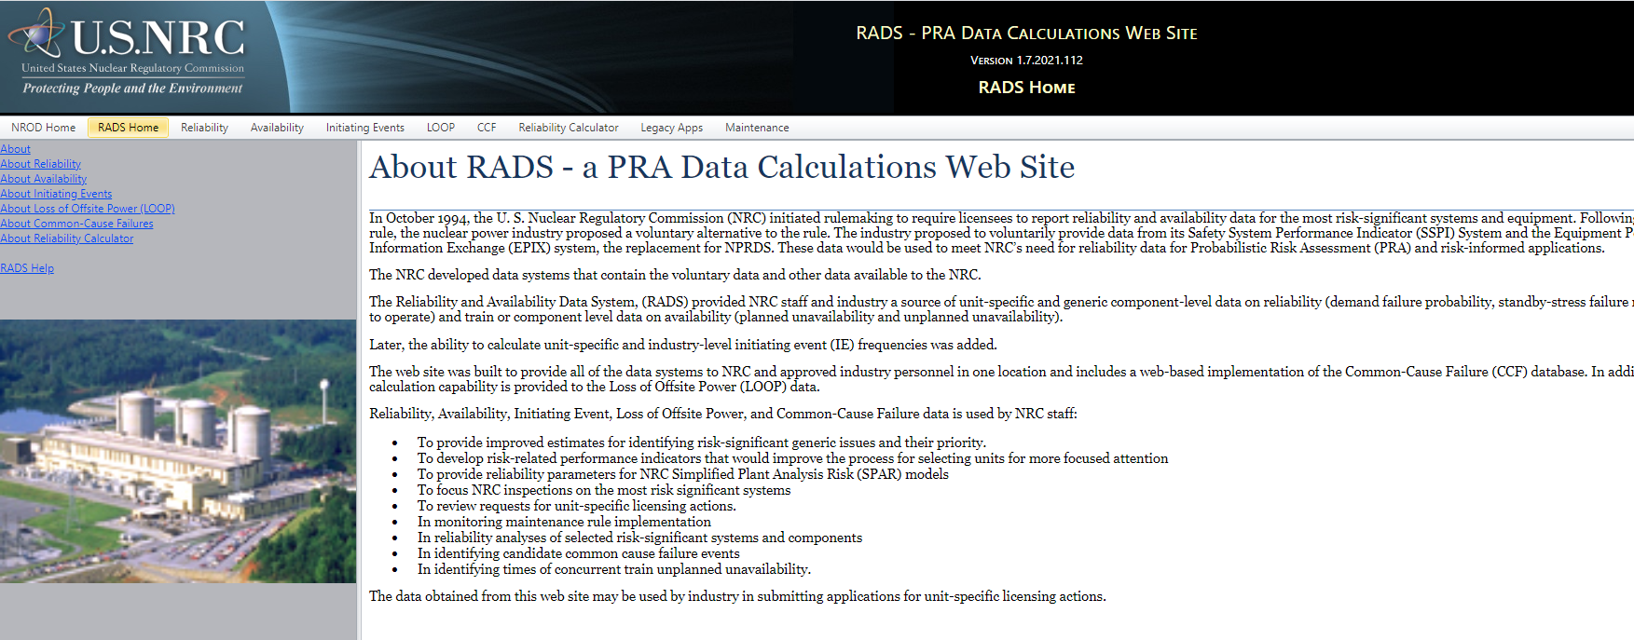
Evaluate Data – RADS
Web-based calculation tool, Reliability and Availability Database System (RADS), https://rads.inl.gov, is used to estimate the parameters
Note: same as NROD, RADS is available to NRC and INPO members only due to proprietary information

Slide 13
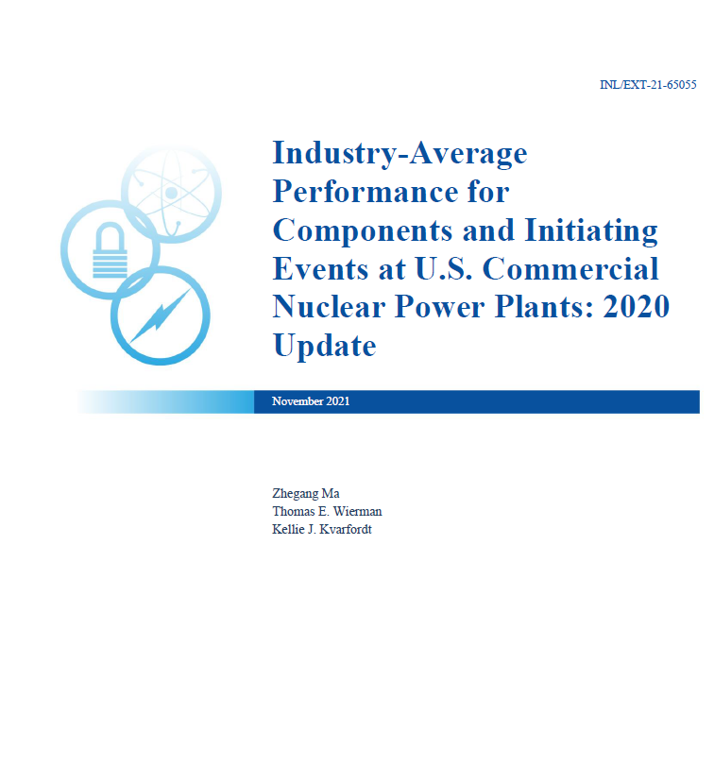
Evaluate Data – 2020 Parameter Update
The latest parameter estimates (2020 update) results were documented in two INL technical reports that provide the generic parameter estimates used throughout NRC SPAR models.
  INL/EXT-21-65055, Industry-Average Performance for Components and Initiating Events at U.S. Commercial Nuclear Power Plants: 2020 Update
  INL/EXT-21-62940, Rev. 1, CCF Parameter Estimation, 2020 Update
    CCF alpha parameters
    CCF insights

Slide 14
Evaluate Data – Initiating Event
Analyze initiating event frequencies and trends at U.S. commercial NPPs
  Initial study on initiating event is documented in NUREG/CR-5750
  Updates are performed annually
All unexpected reactor trips during power operations at commercial NPPs are reviewed and categorized according to the initial event and are additionally marked when other risk-significant events occurred
Initiating event raw counts and trends are reported, along with the best estimate for initiating event frequencies

Slide 15
Evaluate Data – Initiating Event (cont.)
Table 2. Initiating event counts
The latest update for initiating event analysis – INL/RPT-24-79433, Initiating Event 2023 Update
Figure 16. PWR general transients initiating event frequency

Slide 16
Evaluate Data – LOOP
NRC LOOP analysis provides the following important LOOP parameters as inputs to SPAR models
  LOOP event frequencies
  LOOP recovery times
  Conditional probability of consequential LOOP
  Conditional probability of multi-unit LOOP
Annual LOOP update analysis follows NUREG/CR-6890

Slide 17
Evaluate Data – LOOP (cont.)
NUREG-1032
Evaluation of Station Blackout Accidents at Nuclear Power Plants
1968–1985
NUREG/CR-5750
Rates of Initiating Events at U.S. Nuclear Power Plants: 1987–1995
Analysis of LOOP Events 2007 Update
1997–2007
INL/RPT-22-68809
Analysis of LOOP Events
2021 Update
2007–2021
NUREG/CR-5496
Evaluation of Loss of Offsite Power Events at Nuclear Power Plants:
1980–1996
NUREG/CR-6890
Analysis of Loss of Offsite Power Events:
1986–2004
LOOP Analysis Annual Updates
1997–20xx

Slide 18
Evaluate Data – LOOP (cont.)
The latest update for LOOP analysis – INL/RPT-24-79969, LOOP 2023 Update
Table 3. U.S. NPPs LOOP frequencies (2009–2023)
Figure 17. LOOP non-recovery probability (1997–2021)

Slide 19
Evaluate Data – Component Performance and System Studies
Update component and system reliability and trending
Conducted every other year since 2016
Risk-informed performance monitoring, risk-based analysis of operating data, and engineering evaluation of performance trends
Provide insights into the performance of safety-related components on an industry level
  Emergency diesel generator
  Turbine-driven pump
  Motor-driven pump
  Air-operated valve
  Motor-operated valve

Slide 20
Evaluate Data – Component Performance and System Studies (cont.)
Evaluate safety system performance for the following systems
  Boiling-Water Reactor Systems
    High Pressure Coolant Injection System
    High Pressure Core Spray System
    Isolation Condenser System
    Reactor Core Isolation Cooling System
  Pressurized-Water Reactor Systems
    Auxiliary Feedwater System
    High Pressure Safety Injection System
  Common Systems
    Emergency Power System
    Residual Heat Removal System

Slide 21
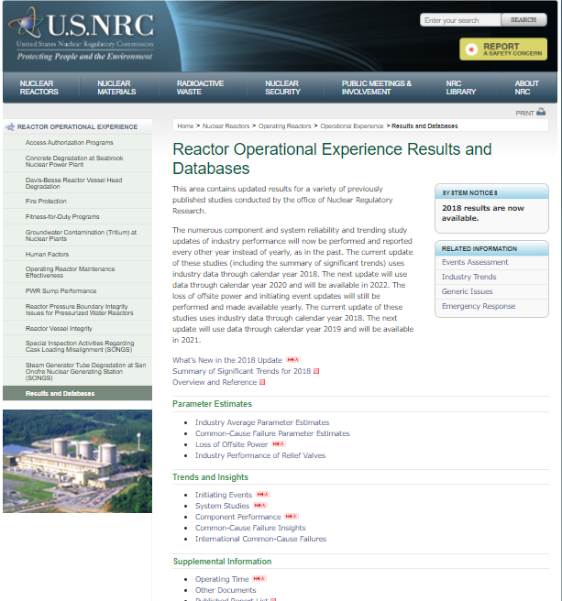
NRC OpE Program Website
Public reports and analysis results are available through the NRC Reactor Operating Experience Results and Database website https://nrcoe.inl.gov/

Slide 22
Summary
The NRC OpE Program systematically transforms decades of nuclear power plant operating experience into high-quality PRA data through standardized collection, coding, review, and analysis
The resulting parameter estimates support NRC SPAR models, industry PRA applications, risk-informed regulatory activities, and reliability and performance trending
The HOPE Manual provides the technical foundation for consistent PRA parameter estimation and continues to evolve to reflect advances in PRA methods, operating experience analysis, and data sources
The ongoing revision of the HOPE Manual builds upon the foundation established by Dr. Cory Atwood and his colleagues, ensuring that future PRA practitioners continue to benefit from consistent, technically sound parameter estimation methods

Slide 23
References
[1] Atwood, C. L., J. L. LaChance, H. F. Martz, D. J. Anderson, M. Engelhardt, D. Whitehead, and T. Wheeler, 2003, Handbook of Parameter Estimation for Probabilistic Risk Assessment, NUREG/CR-6823, SAND2003-3348P, Sandia National Laboratories, Albuquerque, NM.
[2] INPO, 2011, Operating Experience Program and Construction Experience Program Descriptions, INPO 10-006, Rev. 2, Institute of Nuclear Power Operations, Atlanta, GA.
[3] INPO, 2015, INPO Consolidated Event System (ICES) Reporting Requirements and Standards, INPO 12-009, Rev. 8, Institute of Nuclear Power Operations, Atlanta, GA.
[4] INPO, 2017, Data Element Manual, INPO 04-004, Rev. 17, Institute of Nuclear Power Operations, Atlanta, GA.
[5] INPO, 2019, Industry Reporting and Information System (IRIS) Reporting Requirements, INPO 19-002, Rev. 1, Institute of Nuclear Power Operations, Atlanta, GA.
[6] Eide, S. A., T. E. Wierman, C. D. Gentillon, D. M. Rasmuson, and C. L. Atwood, 2007, Industry-Average Performance for Components and Initiating Events at U.S. Commercial Nuclear Power Plants, NUREG/CR-6928, INL/EXT-06-11119, Idaho National Laboratory, Idaho Falls, ID.
[7] Ma, Z., T. E. Wierman, and K. J. Kvarfordt, 2021c, Industry-Average Performance for Components and Initiating Events at U.S. Commercial Nuclear Power Plants: 2020 Update, INL/EXT-21-65055, Idaho National Laboratory, Idaho Falls, ID.
[8] Ma, Z., and K. Kvarfordt, 2022, CCF Parameter Estimations, 2020 Update, INL/EXT-21-62940, Revision 1, Idaho National Laboratory, Idaho Falls, ID.
[9] Johnson, N., and Z. Ma, 2024a, Initiating Event Rates at U.S. Nuclear Power Plants: 2023 Update, INL/RPT-24-79433, Idaho National Laboratory, Idaho Falls, ID.
[10] Johnson, N., and Z. Ma, 2024b, Analysis of Loss-of-Offsite-Power Events 2023 Update, INL/RPT-24-79969, Idaho National Laboratory, Idaho Falls, ID.

