Slide 1

July 19 – July 24, 2026
Zhegang Ma, Ph.D., P.E.
Zhegang.Ma@inl.gov
INL/CON-26-90551
Common-Cause Failure Parameter Estimates with Causal Alpha Factor Model, Component-Specific Priors, and More
Zhegang Maª, Ali Mosleh^{b}, Chris Hunter^{c}, Sai Zhangª, James Knudsenª, John Lane^{c}, Kevin Coyne^{c}
ª Idaho National Laboratory; ^{b} UCLA; ^{c} Nuclear Regulatory Commission

Slide 2
Outline
Introduction
From Alpha Factor Model to Causal Alpha Factor Model
Causal Alpha Factor Parameter Estimates
Alpha Factor Parameter Estimates using Component-Specific Priors
Issues and Other Thoughts
Summary

Slide 3
I. Introduction
Common-cause failures (CCFs) are recognized as significant risk contributors to commercial nuclear power plants because they can defeat system redundancy and diversity
Since the 1980s, a series of CCF related activities were performed to provide guidelines on modeling CCFs and estimating CCF parameters in probabilistic risk assessment (PRA)
  NUREG/CR-4780, NUREG/CR-5485, NUREG/CR-5497, NUREG/CR-6268
  Alpha factor and Multiple Greek Letter parameter models
Although the Alpha Factor Model has served the PRA community well for decades, recent NRC research has focused on reducing parameter uncertainty and improving the applicability of CCF parameter estimates for risk-informed applications
  INL/EXT-21-33376 evaluated alternative CCF models and recommended the Causal Alpha Factor Model
  INL/EXT-21-43723 developed CCF generic prior and causal CCF prior distributions
  INL/EXT-21-65527 developed component-specific CCF prior distributions
Notes:
INL/EXT-21-33376 evaluated alternative CCF models developed by University of Maryland and recommended the Causal Alpha Factor Model (CAFM) as the alternative CCF model for the NRC event and condition assessments (ECAs)
INL/EXT-21-43723 developed CCF generic prior and causal CCF prior distributions using the new data available at the time
INL/EXT-21-65527 developed component-specific CCF prior distributions for five component types—pump, valve, strainer, generator, and “other”—after a study determined that different component types can have drastically different alpha factors and should thus be analyzed separately

Slide 4
I. Introduction (cont.)
Multiple sets of CCF parameter estimates using the same 2006–2020 data were developed over the past few years that could be used for the NRC’s Standardized Plant Analysis Risk (SPAR) models or Event and Condition Assessments (ECAs)
  The classical alpha factors estimated using the generic CCF priors
  The causal alpha factors estimated using the causal CCF priors
  The alpha factors estimated using the component-specific CCF priors
This paper presents an overview of the causal alpha factor parameter estimates and the alpha factor parameter estimates using component-specific CCF priors
The paper also provides the plan for future periodic CCF parameter update and discusses the potential issues or challenges in the CCF parameter estimation

Slide 5
I. Introduction (cont.)
Reactor Operational Experience Results and Databases -- CCF Parameter Estimates
https://nrcoe.inl.gov/ccf_pe/
WASH-1400, Reactor Safety Study, 1975
NUREG/CR-2300, PRA Procedures Guide, 1983
NUREG/CR-4780, Procedures for Treating Common Cause Failures in Safety and Reliability Studies, 1988
NUREG/CR-5485, Guidelines on Modeling CCFs in PRA, 1998
NUREG/CR-6268, CCF Database and Analysis System, 1998
INL/EXT-21-43723, Generic and Causal CCF Priors, 2017
NUREG-2225, CCF in SDP, 2018
INL/EXT-21-62940, CCF Parameter 2020 Update, 2022
INL/RPT-23-72728, Causal CCF Parameter 2020, 2023
INL/EXT-21-65527, Component-Specific CCF Priors, 2023
NUREG/CR-5497, CCF Parameter Estimations, 1998
2003 Update, 2006
2010 Update, 2012
2015 Update, 2016
Notes:
WASH-1400, “Reactor Safety Study,” (1975) defines dependent failure as a common-mode failure.
NUREG/CR‑2300, “PRA Procedures Guide,” (1983) identified nine types of dependent failures in three categories
Common‑Cause Initiating Events (e.g., earthquake)
Intersystem Dependencies (e.g., shared support system)
Intercomponent Dependencies (e.g., CCFs)
NUREG/CR-4780, Procedures for Treating Common Cause Failures in Safety and Reliability Studies, January 1988
Presents the framework for including CCFs in risk and reliability evaluations with four major stages
System logic model development
Identification of common cause component groups
Common cause modeling and data analysis
System quantification and interpretation of results
Introduces the concept of impact vectors and the mapping method
The concept of impact vectors is used for CCF event classification and representation
The mapping method is used to adjusts the original impact vectors to account for common cause group size differences in CCF parameter estimation
NUREG/CR-5485, Guidelines on Modeling Common-Cause Failures in Probabilistic Risk Assessment, November 1998
Guidelines to model CCF events in PRA
Additional insights obtained from the CCF applications
CCF software capabilities and how to apply the CCF database information to PRA studies
NUREG/CR-6268, Common Cause Failure Database and Analysis System, June 1998
Method to collect industry failure data, identify and characterize CCF events, and estimate CCF parameters and uncertainties with a computer software
A CCF database system was developed with a CCF database and a CCF software that can be used to estimate CCF parameters
The CCF software stores CCF events, independent failure counts, and estimate CCF parameters for Alpha Factor and Multiple Greek Letter Models based on the CCF event impact vectors and the mapping method
NUREG/CR-5497, Common-Cause Failure Parameter Estimations, October 1998
Quantitative results with the CCF parameter estimates for the majority of the risk important safety systems and components in commercial nuclear power plants
Insights from the CCF data analysis It contains
Data Sources: LERs, NPRDS (Nuclear Plant Reliability Data System), 1980-1995
CCF Parameter 2010 Update, January 2012
Data Sources: NPRDS (prior to 1997); EPIX (Equipment Performance and Information Exchange, since 1997); and SCSS (Sequence Coding and Search System) for LERs), 1997-2010
CCF Parameter 2012 Update, November 2013
Data Sources: NPRDS (prior to 1997); EPIX (Equipment Performance and Information Exchange, since 1997); and SCSS (Sequence Coding and Search System) for LERs), 1997-2010
CCF Parameter 2015 Update, October 2016
Data Sources: NPRDS (prior to 1997); ICES (INPO Consolidated Events Database, formerly EPIX); and LERSearch (Licensee Event Report Search, formerly SCSS) for LERs), 1997-2015
INL/EXT-21-43723, Developing Generic Prior Distributions for Common Cause Failure Alpha Factors and Causal Alpha Factors, August 2021, (Revision of INL/LTD-17-43723, Nov 2017)
INL/EXT-21-62940, CCF Parameter 2020 Update, August 2022
Data Sources: NPRDS (prior to 1997); IRIS (Industry Reporting and Information System, formerly EPIX and ICES); and LERSearch, 2006-2020
INL/RPT-23-72728, Causal CCF Parameter 2020, May 2023
Data Sources: NPRDS (prior to 1997); IRIS (Industry Reporting and Information System, formerly EPIX and ICES); and LERSearch, 2006-2020
INL/EXT-21-65527, Developing Component-Specific Prior Distributions for Common Cause Failure Alpha Factors, January 2023

Slide 6
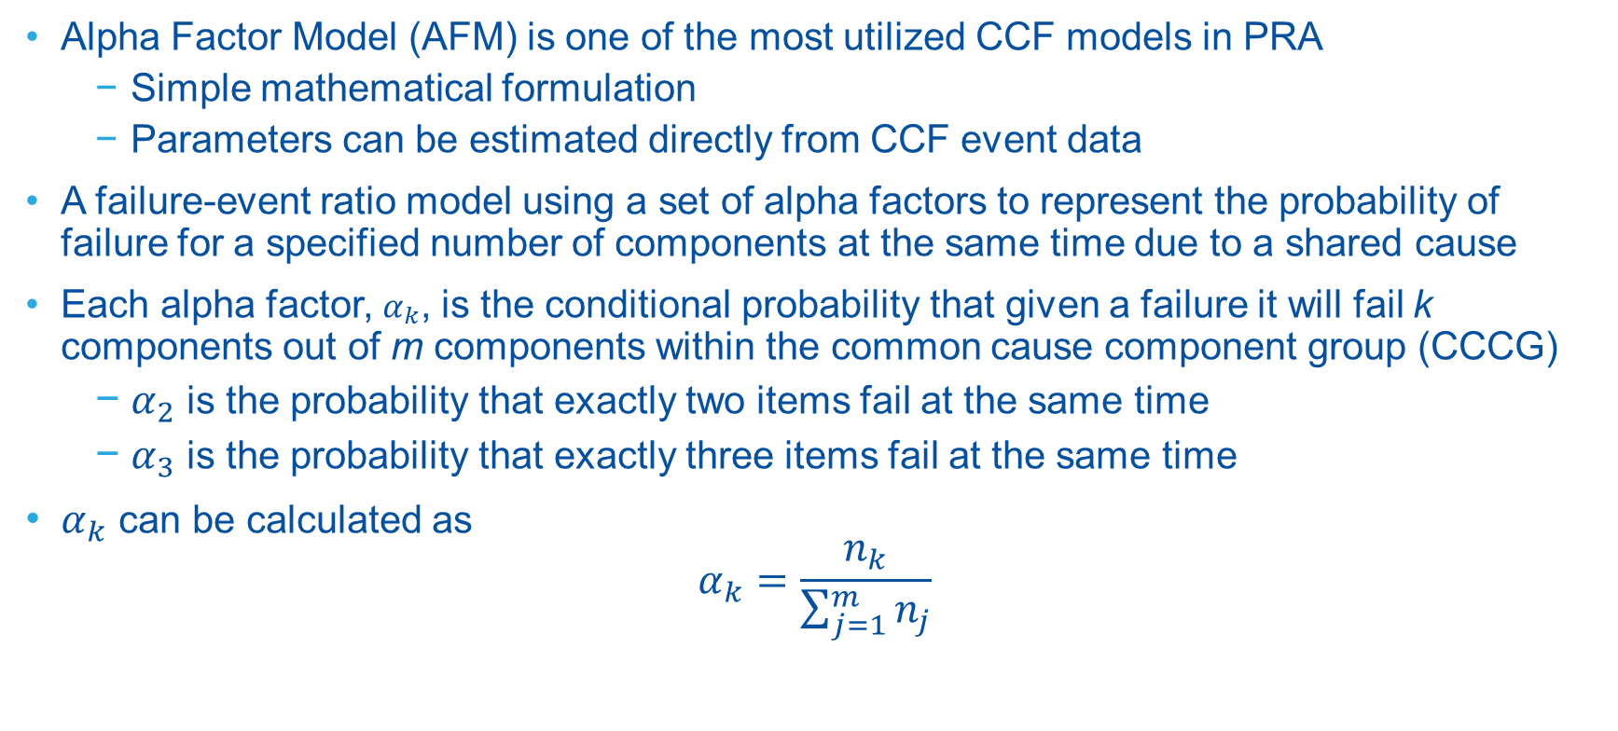
II. From Alpha Factor Model to Causal Alpha Factor Model
Alpha Factor Model (AFM) is one of the most utilized CCF models in PRA
  Simple mathematical formulation
  Parameters can be estimated directly from CCF event data
A failure-event ratio model using a set of alpha factors to represent the probability of failure for a specified number of components at the same time due to a shared cause
Each alpha factor, $α_{k}$, is the conditional probability that given a failure it will fail k components out of m components within the common cause component group (CCCG)
  $α_{2}$ is the probability that exactly two items fail at the same time
  $α_{3}$ is the probability that exactly three items fail at the same time
$α_{k}$ can be calculated as
$$α_{k}=\frac{n_{k}}{\sum_{j=1}^{m}{n_{j}}}$$
  k = the # of failed components
  m = the # of redundant components in the CCCG
  n_{k} = the # of failure events, which resulted in k components failing within a CCCG of size m due to the same cause

Slide 7
II. From AFM to CAFM (cont.)
The industry had concerns that AFM includes all failure causes in the CCF parameter
  Using generic alpha factors in an ECA implicitly include all failure causes rather than the one led to the observed failure
  For example, if the cause is a deficient maintenance program, common cause due to environment and design should not be included in the ECA
To address this issue, NRC investigated and identified the Causal Alpha Factor Model (CAFM) as an alternative CCF model to be used in ECAs
Five failure cause groups in the NRC CCF database
  Component
  Design
  Human
  Environment
  Other
Cause Group | Failure Cause
Component | Internal to component; piece part
 | Setpoint drift
 | Age or wear
Design | Construction or installation error or inadequacy
 | Design error or inadequacy
 | Manufacturing error or inadequacy
Environment | Ambient environmental stress
 | Extreme environmental stress
 | Internal environment
Human | Accidental human action
 | Inadequate maintenance
 | Human action procedure
 | Inadequate procedure
Other | State of another component
 | Other
 | Unknown

Slide 8
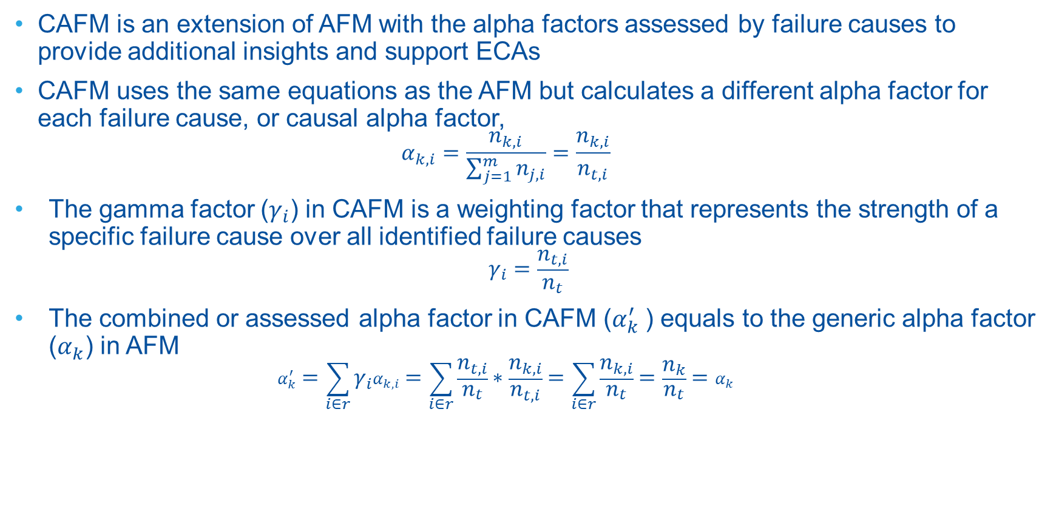
II. From AFM to CAFM (cont.)
CAFM is an extension of AFM with the alpha factors assessed by failure causes to provide additional insights and support ECAs
CAFM uses the same equations as the AFM but calculates a different alpha factor for each failure cause, or causal alpha factor,
  $$α_{k,i}=\frac{n_{k,i}}{\sum_{j=1}^{m}{n_{j,i}}}=\frac{n_{k,i}}{n_{t,i}}$$
  The gamma factor ($γ_{i}$) in CAFM is a weighting factor that represents the strength of a specific failure cause over all identified failure causes
  $$γ_{i}=\frac{n_{t,i}}{n_{t}}$$
  The combined or assessed alpha factor in CAFM ($α_{k}^{′}$) equals to the generic alpha factor ($α_{k}$) in AFM
  $$α_{k}^{′}=\sum_{i∈r}{γ_{i}α_{k,i}}=\sum_{i∈r}{\frac{n_{t,i}}{n_{t}}∗\frac{n_{k,i}}{n_{t,i}}}=\sum_{i∈r}{\frac{n_{k,i}}{n_{t}}}=\frac{n_{k}}{n_{t}}=α_{k}$$
  i = the i^{th} failure cause, $i∈r$ with r different failure causes
  n_{k,i} = the # of failure events, which resulted in k components failing within a CCCG of size m due the i^{th} failure cause
  n_{t,i} = the total # of failure events due the i^{th} failure cause

Slide 9
II. From AFM to CAFM (cont.)
The causal alpha factor parameter estimation in general follows the same classical alpha factor estimation process presented in NUREG/CR-5485 and NUREG/CR-6268
  CCF event impact vector
  Mapping methodology
  The NRC Reliability and Availability Data System (RADS) web application
An additional normalization process was introduced to ensure the consistency between AFM and CAFM estimates
A comparison of the 2015 generic and causal CCF priors on the mean values of the common-cause alpha factors (e.g., α2 in the CCCG size of two; α2 and α3 in the CCCG size of three) shows that
  The Component, Human, and “Other” causal priors are about 25%–80% lower than the Generic priors
  The Design and Environment causal priors are about 40%–300% higher than the Generic priors

Slide 10
II. From AFM to CAFM (cont.)
Depending on the observed data in specific CCF templates, the posterior mean values of causal alpha factors (e.g., α2 for CCCG size of two) for the CCF templates could be lower or higher than the corresponding generic alpha factors
The causal alpha factors could better characterize the potential CCF risk impact in ECAs by focusing on a specific failure cause as a result of the licensee performance deficiency (PD).
However, using the causal alpha factors also has limitations
  The failure cause categories in the NRC CCF database do not often align well with the licensee PDs being evaluated in the ECAs
  Causal alpha factor estimates further partition the available data into smaller cause groups
  Causal alpha factor estimates use data from all component types
Notes:
The Component causal alpha factors could range from approximately 90% lower to 20% higher than the Generic alpha factors
The Human causal alpha factors could range from approximately 90% lower to 100% higher than the Generic alpha factors
The “Other” causal alpha factors could range from approximately 0% to 100% lower than the Generic alpha factors
The Design causal alpha factors could range from approximately 90% lower to 230% higher than the Generic alpha factors
The Environment causal alpha factors could range from approximately 0% to 1500% higher than the Generic alpha factors

Slide 11
III. Alpha Factor Parameter Estimates using Component-Specific Prior
During the development of the new CCF prior distributions, a study found that different component types can have substantially different alpha factors and should be analyzed separately
Component-specific CCF priors were developed for five component types
  Pump
  Valve
  Strainer
  Generator
  Other
New sets of alpha factor parameters were estimated using the component-specific CCF priors

Slide 12
III. Alpha Factor Parameter Estimates using Component-Specific Prior (cont.)
A comparison of the 2015 generic and component-specific CCF priors on the mean values of the common-cause alpha factors shows that
  The Pump, Generator, and “Other” priors are about 40–70% lower than the Generic priors
  The Valve priors are about 20–100% higher than the Generic priors
  The Strainer priors are about 2–3 times higher than the Generic priors
The differences between the component-specific and generic posterior estimates are generally smaller than those between the corresponding priors
  The posterior mean values for the Pump-, Generator-, and “Other”-related CCF templates are about 10–70% lower than those obtained using generic priors.
  The posterior mean values for the Valve-related CCF templates are about 20% lower to 100% higher than those obtained using generic priors.
  The posterior mean values for the Strainer component type are about 1.0–1.3 times higher than those obtained using generic priors

Slide 13
IV. Issues and Other Thoughts in CCF Parameter Estimates
Use of Different Sets of Alpha Factors
  With multiple sets of alpha factors available for use, we think the uncertainties existing in the causal CCF parameters are larger than those in the CCF parameters using component-specific priors
  The 2025 Parameter Update will develop CCF parameters using component-specific priors
  At the same time, a new set of component-specific priors will be developed to address the concerns raised in the EPRI CCF white paper, for example,
    Separate relief valves from the remaining valve component types
    Add Electrical component type
    Remove failure modes such as Setpoint and Leakage from the CCF parameter estimation process

Slide 14
IV. Issues and Other Thoughts in CCF Parameter Estimates (cont.)
There are still issues and challenges remaining in the future CCF parameter estimates
  One of the most significant challenges is the decreasing number of CCF events
  The current CCF parameter estimation process will become more difficult due to the lack of failure data
  A new methodology or process may need to be developed to provide meaningful parameter estimates.
5–Year Period | 1997–2001 |  | 2002–2006 |  | 2007–2011 |  | 2012–2016 |  | 2017–2020
 | Total | Per Year | Total | Per Year | Total | Per Year | Total | Per Year | Total | Per Year
All CCF Events | 164 | 32.8 | 106 | 21.2 | 78 | 15.6 | 44 | 8.8 | 13 | 3.3
Complete CCF | 25 | 5.0 | 23 | 4.6 | 14 | 2.8 | 5 | 1.0 | 2 | 0.5

Slide 15
V. Summary
CCFs are modeled in PRAs for commercial NPPs as important risk contributors, predominantly using the Alpha Factor or MGL parametric models
Recent NRC efforts on CCF have focused on the development of new CCF models and parameter estimates to reduce the uncertainties in the CCF parameters
The evolution from generic alpha factors toward cause-specific and component-specific parameter estimation represents a significant step toward more realistic CCF modeling
The CAFM addresses uncertainty by conditioning CCF parameters on failure causes, while the component-specific priors address uncertainty by recognizing that different component types exhibit different CCF behavior
Component-specific alpha factor parameter estimates will be developed and incorporated into future SPAR model updates.
Continued research is needed to improve CCF modeling methodologies and develop robust parameter estimation approaches for increasingly sparse operating experience data

