Slide 1


Economic Analysis of First- and Nth-of-a-Kind Micromodular Reactors Co-Sited with Nuclear Fuel Cycle Facilities in the United States
An account-level cost and 50-year viability framework for MMR co-siting
Vinicius Zanardo Rodrigues¹ · Taiyang Zhang¹ · Brian Capobianco² · Jeffrey Jacquet² · Carol Smidts¹
¹ Dept. of Mechanical & Aerospace Engineering ² School of Environment & Natural Resources — The Ohio State University
PSAM 18 · July 19–24, 2026 · Pittsburgh, Pennsylvania, USA
Notes:
Title, ~30s. Companion to our co-siting risk paper. The question here is purely economic: is it financially worth putting a micro-reactor next to a fuel-cycle facility? We answer it with an account-level cost model across 7 vendors and a 50-year financial analysis at a real facility — Centrus's enrichment plant. ~11.5 min, then questions.

Slide 2
2
Enrichment plants need stable power — co-siting economics are unproven
NFC facilities (esp. enrichment) are electricity-intensive — exposed to price volatility and grid instability
MMRs (5–25 MWe) offer dedicated on-site power inside the existing security perimeter, matching enrichment demand
Gap 1
No cross-vendor, account-level FOAK→NOAK cost framework for U.S. MMRs
Gap 2
No 50-year financial viability analysis at a named NFC facility
Notes:
~1 min. Enrichment plants run a continuous, uninterruptible electrical load and are exposed to price volatility, outages, and future carbon pricing. Micro-reactors (5–25 MWe) fit that demand and deploy inside the existing perimeter. But two things were missing in the literature — the two gaps this paper closes: (1) no standardized, account-level cost comparison across the U.S. MMR vendor field, and (2) no 50-year project-level financial analysis at an actual named facility. We address both.

Slide 3
3
A standardized, account-level method makes 7 vendors comparable
Cost estimation
Economic evaluation
MOUSE (INL): 82 cost accounts, 15 categories
Power-law scaling (n = 0.60 below 30 MWt)
7 vendors · 4 technology families
3 U.S. NRC tiers (ADAMS engagement)
NOAK via Wright's Law (8–24% / doubling)
50-year LCOE and NPV (Eq. 3–4)
3 ITC levels: 0%, 30%, 50%
8% real discount rate; DOE-LPO financing
Notes:
~1.5 min. This is the methodological backbone. Left: capital cost is built bottom-up with INL's MOUSE framework — 82 cost accounts across 15 categories — scaled from four technology-family reference reactors with a 0.6 power-law exponent. Seven vendors across four families (liquid-metal, heat-pipe, gas-cooled, PWR), each placed in one of three NRC engagement tiers derived from ADAMS. Right: FOAK costs are projected down the learning curve with Wright's Law (component learning rates 8–24% per doubling), then fed into a 50-year LCOE and NPV model at three ITC levels and an 8% discount rate. Everything downstream is reproducible from these 82 accounts.

Slide 4
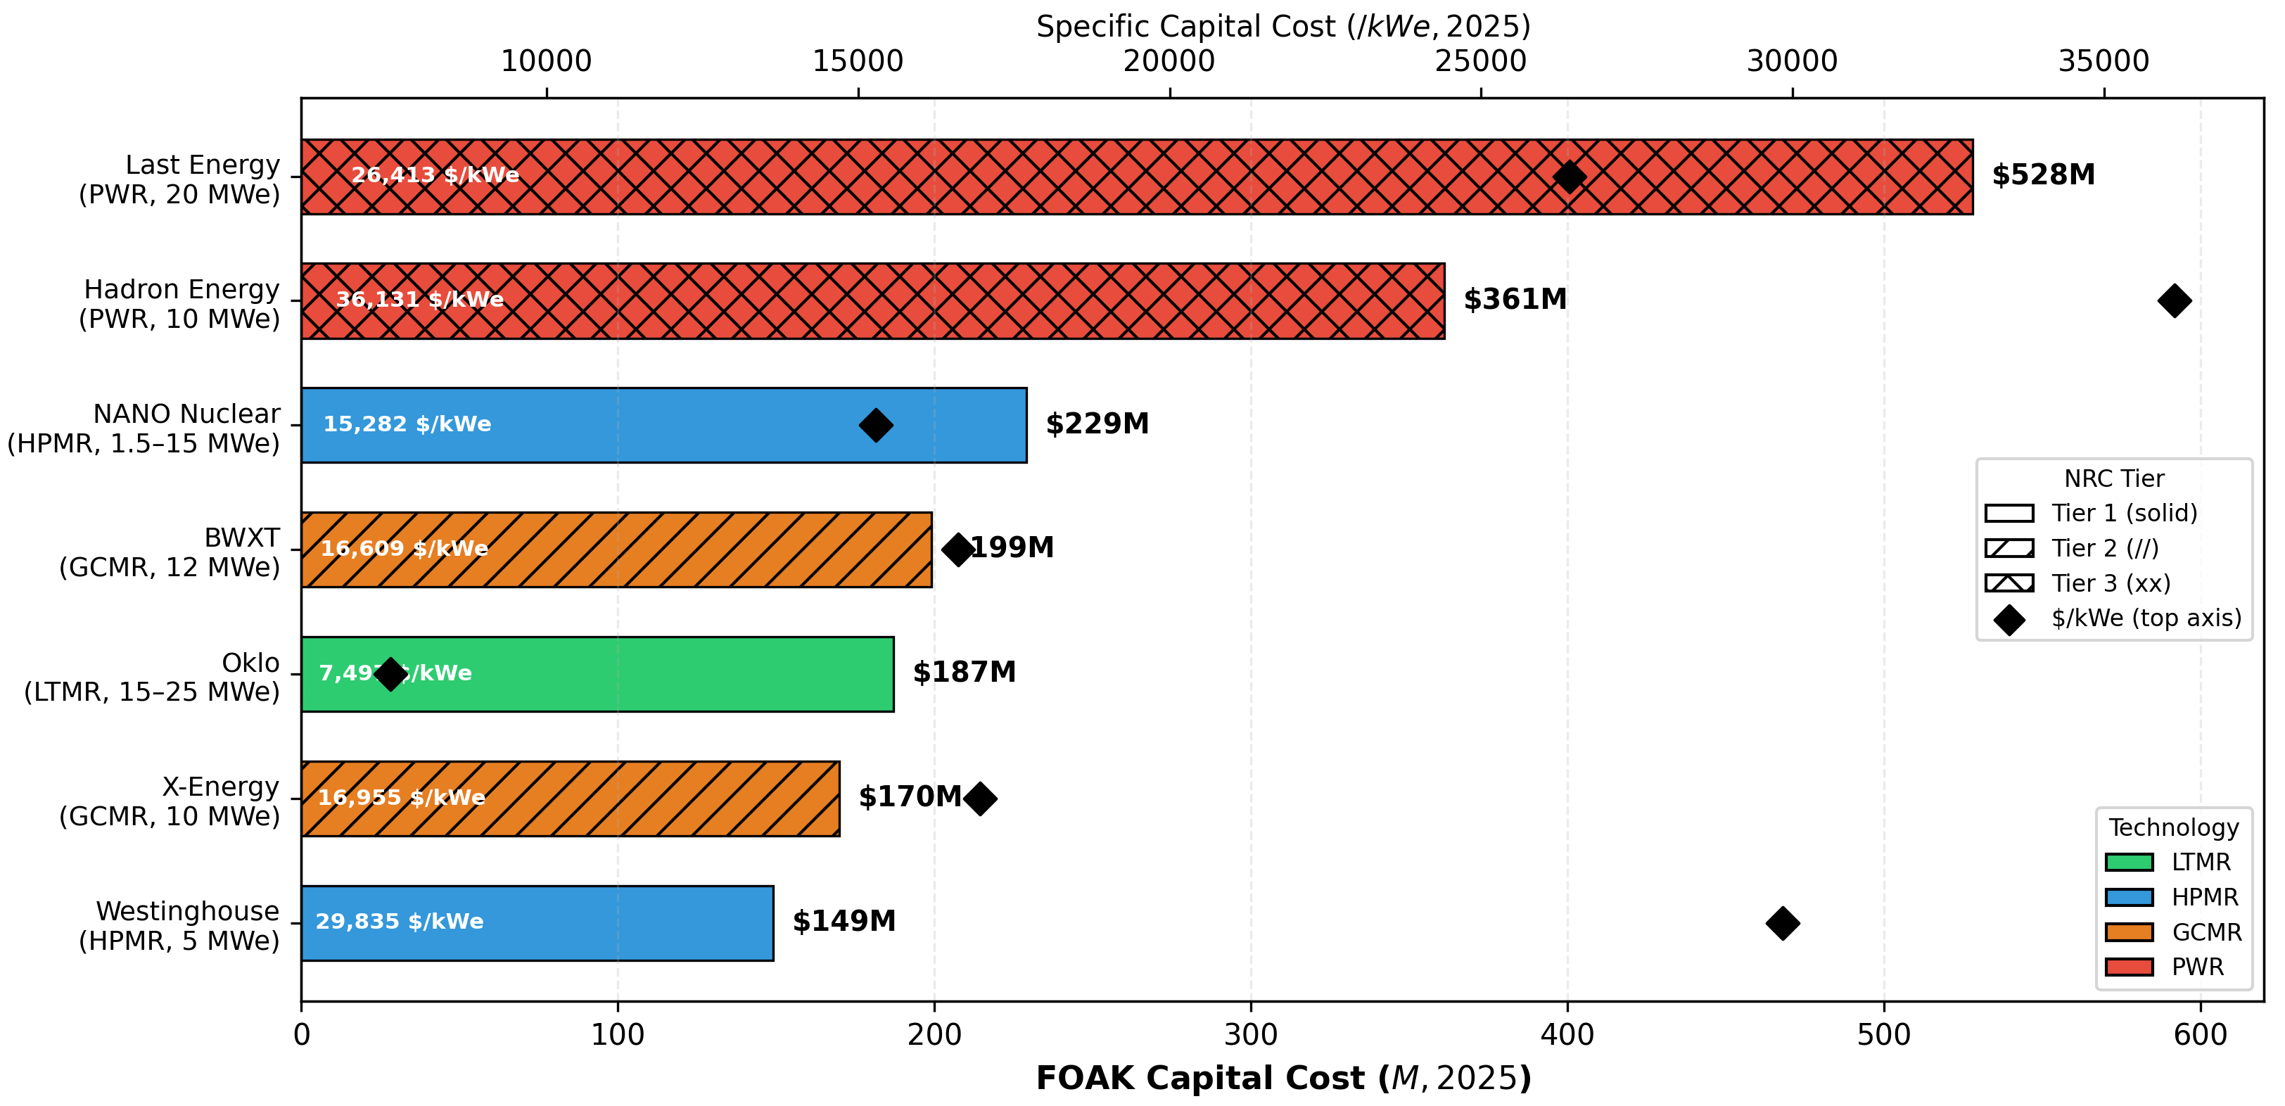
4
Non-LWR designs cost 57% less at FOAK
Technology class is the dominant cost driver (FOAK $149M–$528M)
Figure 1
FOAK capital cost by vendor,
colored by technology family
3.5× spread: $149M (Westinghouse) → $528M (Last Energy)
Non-LWR $187M vs PWR $445M — a 57% gap
Per-kWe 4.8×: Oklo $7,497 → Hadron $36,131
Driver: factory fabrication + simpler balance-of-plant
FOAK capital cost estimates (Table 3 / Fig. 1)
Notes:
~1.5 min. First result. FOAK capital costs span 3.5× — from $149M for the Westinghouse eVinci to $528M for the Last Energy PWR20. Technology class is the dominant driver: the non-LWR families (LMFR, HPMR, GCMR) average $187M versus $445M for PWR-based designs — a 57% gap driven by higher factory-fabrication fraction and simpler balance-of-plant. Per-kilowatt the spread is 4.8×, Oklo cheapest at $7,497/kWe. PWR maturity at gigawatt scale does not transfer to 10–20 MWe. [Figure 1 to be pasted from the paper.]

Slide 5
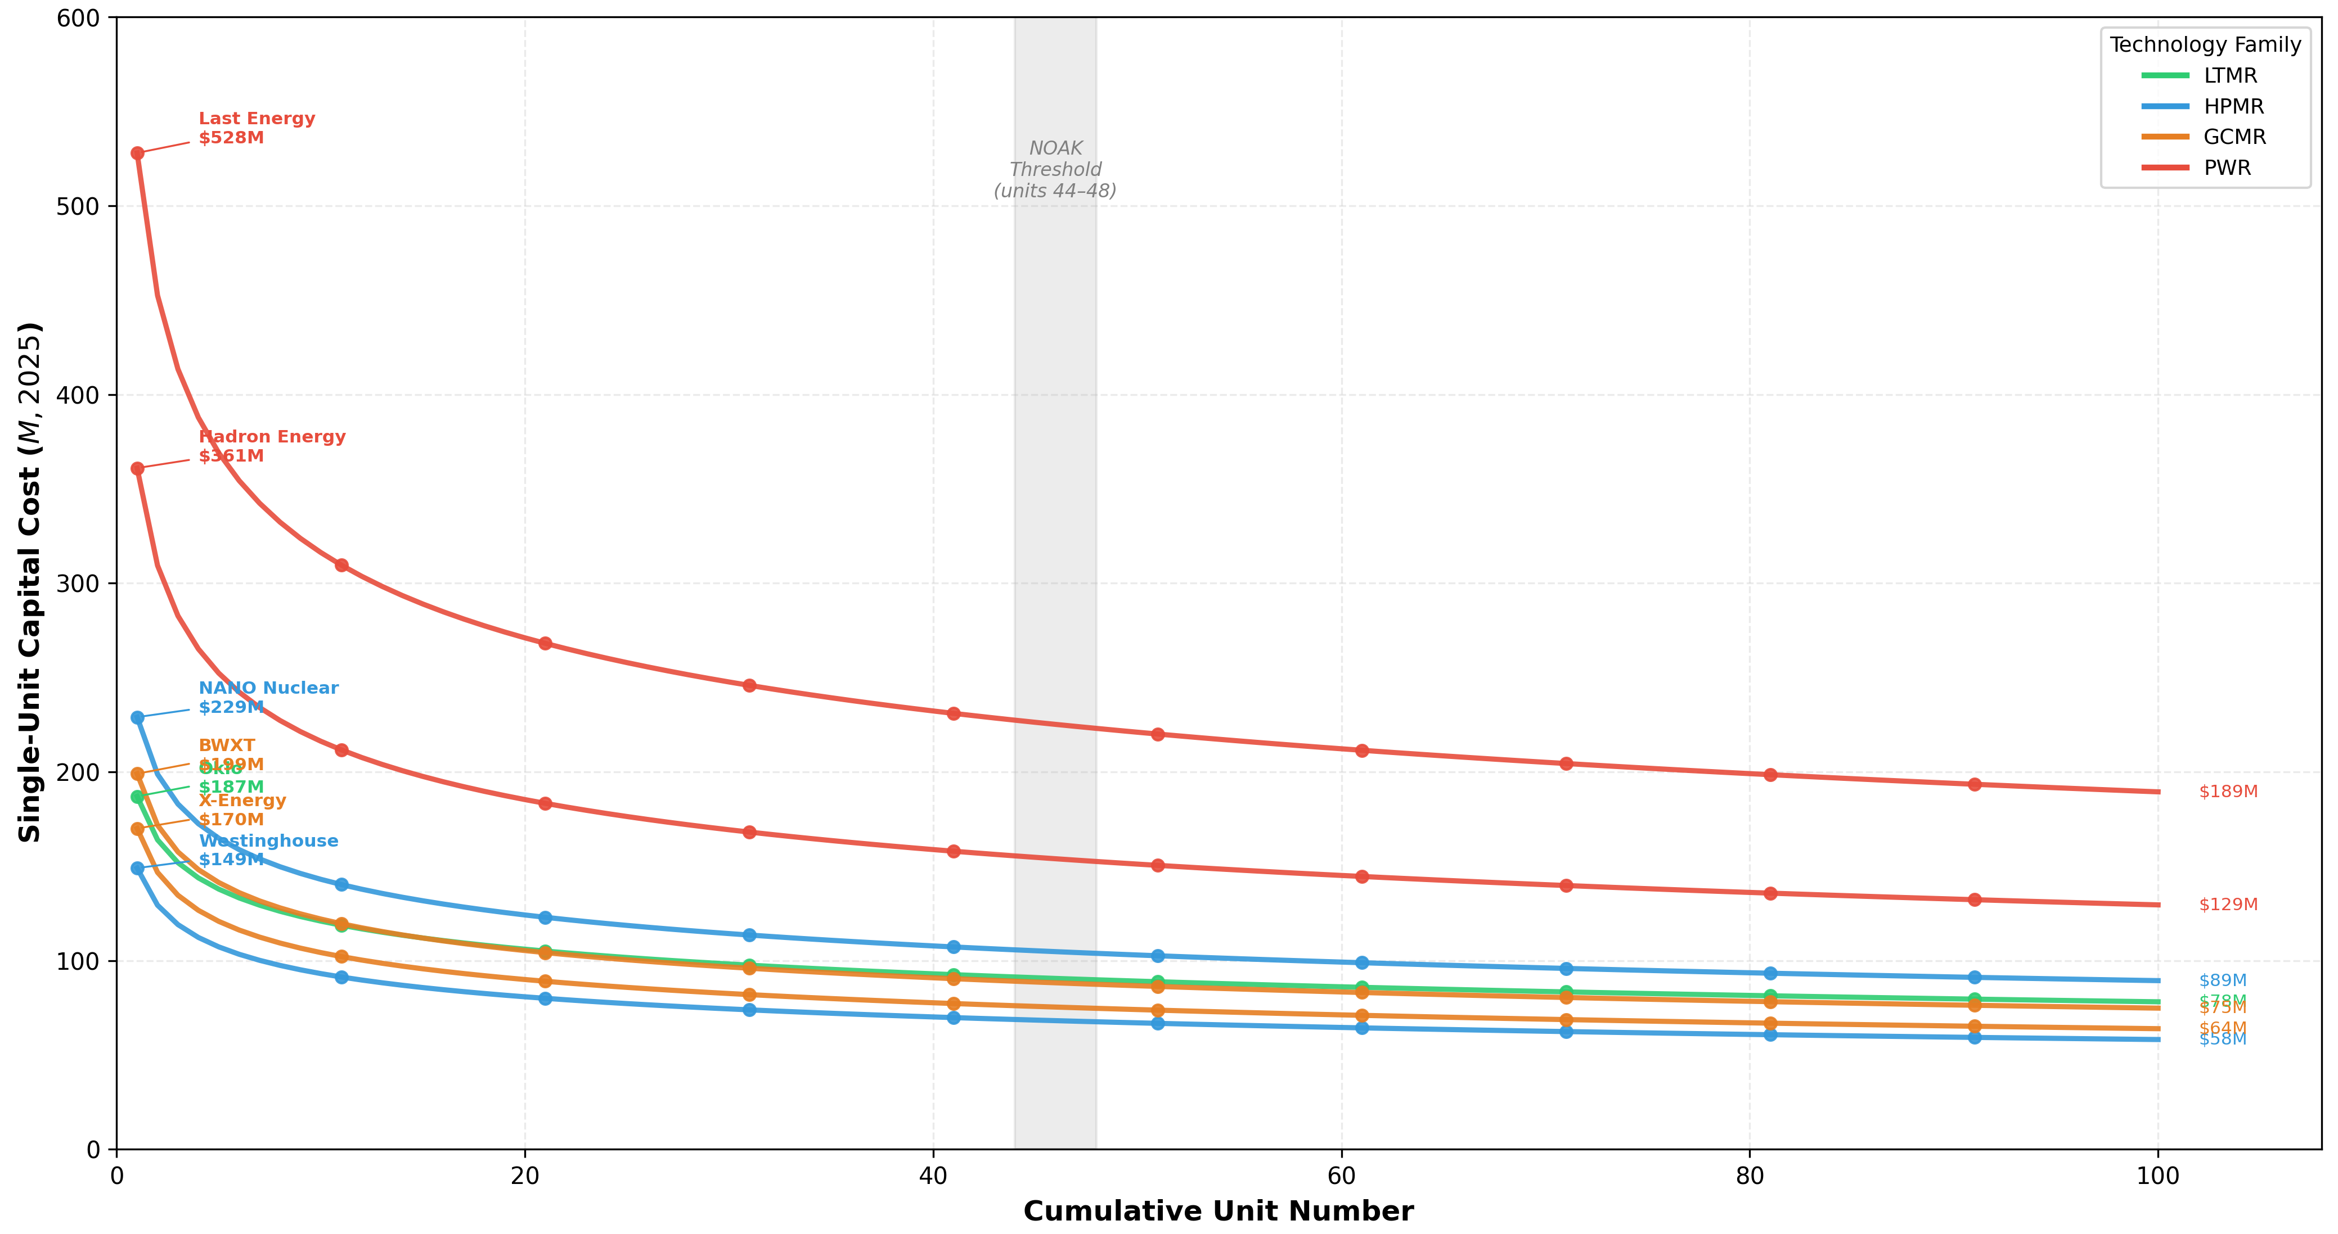
5
Learning cuts unit costs up to 64%
Regulatory Tier-1 adds $235M in fleet savings — as important as tech class
Figure 2
Learning-curve cost trajectories
(units 1–100; NOAK band 44–48)
Wright's Law: unit 100 = $58–189M (44–64% below FOAK)
NOAK threshold at units 44–48; 50-unit fleet saves $4.8B
Tier 1 saves $4.7M/unit → $235M across 50 units
Early units lose money but de-risk the whole fleet
NOAK trajectories and NRC tier impact (Fig. 2 / Table 4)
Notes:
~1.5 min. Two levers cut the FOAK cost. First, manufacturing learning: component-level Wright's Law brings costs down 44–64% by the 100th unit; the NOAK maturity point (90% of the asymptotic reduction) lands at units 44–48, and a 50-unit fleet generates $4.8B in aggregate savings. Second — and this surprised us — regulatory maturity: Tier-1 vendors (Oklo, Westinghouse, NANO) save $4.7M per unit versus Tier 3, which compounds to $235M over 50 units, making NRC engagement depth a cost lever comparable to technology choice. Every early unit loses money individually but drives learning for all that follow — the economic rationale for government FOAK support. [Figure 2 from the paper.]

Slide 6
6
Centrus's ACP is a ready-made co-siting testbed
Only domestic enrichment facility · sole U.S. HALEU source
Only U.S.-owned enrichment facility: NRC SNM-2011
Sole domestic HALEU source: outages carry supply-chain risk
Continuous centrifuge load: restart magnifies losses (2011 precedent)
Brownfield edge: perimeter, licensed area, workforce, emergency plans
Scenario A
21.7 MWe
3.8M SWU/yr
$81k/hr outage*
Scenario B
37.1 MWe
7.6M SWU/yr
$163k/hr outage*
~11 outage-hours/yr → $0.9M–$1.8M/yr in lost production
*assuming that no extra actions are/were taken
Centrus American Centrifuge Plant, Piketon OH (Section 2.2)
Notes:
~1.5 min. Now the case study — the heart of the applied contribution. Centrus's American Centrifuge Plant in Piketon, Ohio is the only U.S.-owned enrichment facility and the sole domestic source of HALEU, so an outage is a national supply-chain issue, not just lost revenue. Its centrifuge cascades draw a continuous, uninterruptible load; a power loss without active damping can cause irreversible cascade failure, as happened in 2011. Two well-characterized demand scenarios bracket the analysis: A at 21.7 MWe (3.8M SWU/yr) and B at 37.1 MWe (7.6M SWU/yr), with outage costs of $81k and $163k per hour and ~11 outage-hours/year. And it's a brownfield site — perimeter, licensed area, qualified workforce, and emergency planning already exist, cutting the regulatory burden. Both scenarios sit squarely in MMR output range, so the ACP is a direct co-siting candidate. The next two slides put real dollars on it.

Slide 7
7
A 30% ITC brings MMR power to grid parity
50-year LCOE vs the $86.3/MWh grid baseline, by ITC level
$137.5
$105.6
$84.4
$86.3
No ITC (59% above grid)
30% ITC → grid parity
50% ITC (below grid)
Grid baseline
All values in $/MWh.
Grid escalates 3%/yr → $151 (Yr 20), $367 (Yr 50); the no-ITC MMR LCOE falls below grid by Year 20.
Financing quirk: Unit 5 LCOE > Unit 1 (7% commercial vs 4% DOE); Unit 10 = $122.6 at 6%.
Notes:
~1.25 min. First financial result — levelized cost. Without any ITC, MMR power is $137.5/MWh, 59% above the $86.3 grid baseline. A 30% ITC (IRA Section 48C) brings it to $105.6 and effectively to parity once grid escalation is considered; a 50% ITC drops it to $84.4, just below grid. And the grid keeps rising 3%/yr — $151/MWh by year 20, $367 by year 50 — so even the no-ITC MMR falls below the grid price by year 20. One counterintuitive detail: Unit 5's LCOE is actually higher than Unit 1's, because Unit 1 gets 4% DOE-backed financing while Unit 5 pays 7% commercial rates before settling to 6% by Unit 10. Note: the abstract's '32% below grid' phrasing is inconsistent with §4.3's near-parity figure; I used the §4.3 numbers — flag this.

Slide 8
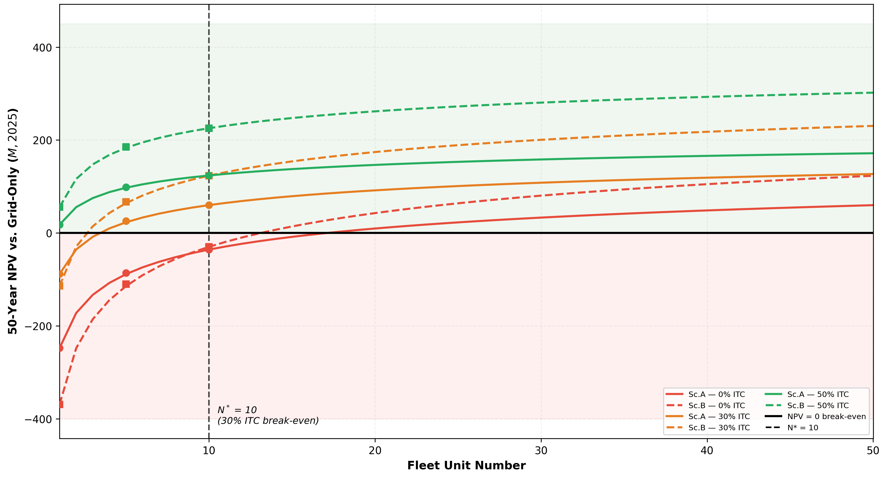
8
NPV turns positive at Unit 10
Commercial break-even within a decade — N* = 10 at a 30% ITC
Figure 3
Government-to-private transition:
50-yr NPV vs fleet unit, ITC bands
Unit 1 needs ≥50% ITC (Sc. B); Unit 5 positive at 30%
Unit 10 = commercial break-even (N* = 10, 30% ITC)
50-yr advantage $1.75B → $2.65B (Sc. A → B)
$1 ITC at Unit 1 → $3–5 saved; capex + grid escalation dominate
50-year NPV and sensitivity, 8% discount (Fig. 3 / Tables 5–6)
Notes:
~2 min, the payoff. The 50-year NPV reveals a clean government-to-private transition. At Unit 1 the project needs at least a 50% ITC to break even (Scenario B); by Unit 5 a 30% ITC suffices; and at Unit 10 — the commercial break-even, N* = 10 — private capital can sustain the program without ITC. That's the key policy message: ITC support is needed mainly at the FOAK stage, roughly the first decade of deployment. The lifetime advantage over grid-only supply is $1.75B (Scenario A) to $2.65B (Scenario B), and it doesn't depend on favorable tax policy long-run. Every ITC dollar at Unit 1 returns $3–5 in reduced lifecycle costs. Sensitivity: capital cost and grid escalation dominate; IRR is 5.3–5.4%, which is why the 30% ITC is needed to clear the 8% hurdle early on. Caveat: Wright's Law on pre-commercial MMRs is extrapolative — read NOAK as model-based bounds. [Figure 3 from the paper.]

Slide 9
9
Conclusions
MMR co-siting is commercially viable within a decade (under the assumption of 1 deployment per year)
1. First reproducible account-level FOAK→NOAK framework — 7 vendors, MOUSE + Wright's Law
2. 57% non-LWR cost gap; Tier-1 maturity worth $235M — as important as technology class
N* = 10 at 30% ITC → government-to-private transition — $1.75B–$2.65B 50-yr advantage
Next:
  other NFC stages + a couple with the co-siting risk PSA (companion paper)
  other coupling scenarios (e.g., NFC stages + datacenters + MMRs)
  perform uncertainty analysis on the parameters of the economic model
  use of real economic data as soon as they become publicly available
Notes:
~1 min, stays up for Q&A. Four takeaways: (1) the first reproducible, account-level FOAK-to-NOAK cost framework for the U.S. MMR field; (2) a 57% non-LWR cost advantage, with NRC Tier-1 regulatory maturity worth $235M at fleet scale — as important as technology choice; (3) the commercial break-even at Unit 10 under a 30% ITC, a $1.75–2.65B 50-year advantage that doesn't hinge on tax policy; and (4) the road ahead — extend to other fuel-cycle stages and couple this economics with our companion co-siting risk PSA for joint cost-risk evaluation. Invite questions: 'Are there any questions or feedback?'

Slide 10

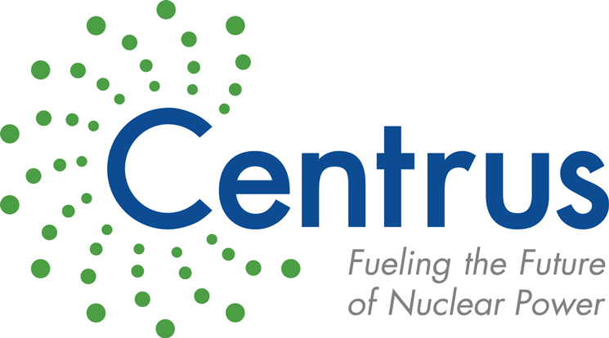

10
Acknowledgments
We extend our gratitude to Centrus Energy Corp. and Mr. Dan Watts for their valuable feedback and contributions. This research was supported by The Ohio State University’s Sustainability Institute. The first author also acknowledges and thanks the financial support provided by the OSU College of Engineering, the OSU Nuclear Program, and the OSU Council of Graduate Students.
Vinicius Zanardo Rodrigues · zanardorodrigues.1@osu.edu · Questions & Discussion Welcome

Slide 11
11
Key References
B. N. Hanna, K. Al-Dawood, P. R. Seurin, R. Abdelnasser, A. Abou-Jaoude, A Bottom-Up Cost Estimation Tool for Nuclear Microreactors, Tech. Rep. INL/RPT-25-87273-Rev. 0, Idaho National Laboratory (2025).
G. Black, D. Shropshire, K. Araújo, A. van Heek, Prospects for Nuclear Microreactors: A Review of the Technology, Economics, and Regulatory Considerations, Nuclear Technology 209 (2022).
E. Worsham, C. Bolisetti, W.-C. Cheng, G. Griffith, C. Otani, H. Byran, K. Vedros, R. Saeed, Site Integration and Regulatory Considerations for a Nuclear Power Plant Colocated with Industrial Facilities, Tech. Rep. INL RPT-24-77936, Idaho National Laboratory (2024).
O. Erdem, K. Daley, G. Hoelzle, M. I. Radaideh, Multi-objective combinatorial methodology for nuclear reactor site assessment: A case study for the United States, Energy Conversion and Management: X 26 (2025).
E. G. R. Germonpre, J. Buongiorno, A Preliminary Study on the Feasibility of Nuclear Batteries for Offshore Power Generation, Tech. Rep. MIT-ANP-TR-202, Massachusetts Institute of Technology (2024).
R. Testoni, A. Bersano, S. Segantin, Review of nuclear microreactors: Status, potentialities and challenges, Progress in Nuclear Energy 138 (2021).
U.S. Nuclear Regulatory Commission (U.S. NRC), Oklo Inc. Doc. Pack., Docket No.: 99902095 (2025).
U.S. Nuclear Regulatory Commission (U.S. NRC), Westinghouse Electric Company Doc. Pack., Docket No.: 99902079 (2025).
U.S. Nuclear Regulatory Commission (U.S. NRC), ADAMS (Agencywide Documents Access and Management System) (2025).
United States of America, 10 CFR Part 170 - Fees For Facilities, Materials, Import And Export Licenses, And Other Regulatory Services Under The Atomic Energy Act Of 1954, As Amended (June 2021).
U.S. Nuclear Regulatory Commission (U.S. NRC), Materials License, Docket No. 70-7003; NRC-2021-0058 (June 2021).
United States of America, Inflation Reduction Act of 2022 (P.L. 117-169) (January 2023).
U.S. Department of Energy (U.S. DOE), Loan Program Office (2024).
Notes:
Backup for Q&A; not shown during the timed talk. Conclusions (slide 9) stays on screen. Remove if you want a leaner file. Full reference list is in the paper.

