Slide 1


Risk Assessment of Co-Siting Small Modular and Microreactors with Nuclear Fuel Cycle Facilities
Establishing the first empirical NFC risk baseline for co-siting decisions
Vinicius Zanardo Rodrigues¹ · Taiyang Zhang¹ · Brian Capobianco² · Jeffrey Jacquet² · Carol Smidts¹
¹ Dept. of Mechanical & Aerospace Engineering ² School of Environment & Natural Resources — The Ohio State University
PSAM 18 · July 19–24, 2026 · Pittsburgh, Pennsylvania, USA
Notes:
Title + ~30s. Greet, state name/affiliation. One-liner: SMRs/MMRs are about to be deployed beside fuel-cycle facilities; before we can do a co-siting PSA we need to know the facilities' own risk. That baseline didn't exist — so we built it. Talk runs ~11 min, leaving time for questions.

Slide 2
2
Co-siting is imminent — but its risk baseline is missing
SMRs / MMRs nearing deployment
NuScale, Oklo, Kairos, Westinghouse, and others
NFC facilities are prime hosts
Electricity-intensive; already inside a licensed perimeter
Co-siting PSA needs the facility's risk profile first
Yet no systematic global NFC risk database exists
This work builds that baseline
A precursor to a bidirectional reactor–facility PSA
Single licensed security perimeter
SMR / MMR
2–300 MWe
NFC facility
(4 different fuel-cycle stages)
Electricity /
Heat
Captive industrial load — no grid (or minimum) export
Precedents: Bruce, Tricastin, Paducah
Notes:
~1.5 min. The push: SMRs/MMRs are licensed and near deployment, and fuel-cycle facilities are natural first customers — huge electrical loads, already on a licensed nuclear site. Co-siting (diagram): reactor inside the SAME security perimeter feeding captive heat/power, not the grid. The catch: any credible co-siting PSA needs the facility's own risk profile first — and no systematic global NFC risk database exists. Note the diagram is an original schematic, not a paper figure.

Slide 3
3
We built the first global NFC risk database
184 facilities · 16 countries · 80+ years of operating history
Sources: IAEA INFCIS, U.S. NRC, OECD/NEA, general literature
35 accidents · 101 fatalities (1940s–2020s)
Two exposure metrics: 3,881 status-based FY; 25,836 capacity-weighted FY
Monte Carlo UQ (1,000 iter.) absorbs 58.7% missing end-dates → 90% CIs
Database summary, 2024 reference year (Table 1)
Notes:
~2 min. What we built: 184 facilities across all four stages — fuel fabrication is the largest population (86), then conversion, reprocessing, enrichment. Compiled from IAEA INFCIS, NRC event reports, OECD/NEA and the literature; 35 accidents and 101 fatalities. Methods point: exposure measured two ways — status-based (3,881 facility-years) and capacity-weighted (25,836). The biggest data problem — 58.7% of non-operational facilities have no end date — is handled with a 1,000-iteration Monte Carlo giving the 90% CIs. Primary metric = fatality rate per 1,000 facility-years.

Slide 4
4
Reprocessing dominates NFC risk
~148 fatalities per 1,000 facility-years — 10.7× any other stage
Other three stages statistically equivalent (~13 / 1,000 FY)
Driver: PUREX chemistry + high-level liquid waste (Cs / Sr source term)
Mayak 1957 dominates the reprocessing aggregate
Accident ↔ fatality r = 0.9958 → frequency drives risk
Risk metrics by stage, 2024 reference year (Table 2)
Notes:
~2 min. The single most important result for co-siting. Reprocessing sits at 148 fatalities per 1,000 facility-years — about 10.7× the next stage and 3.3× the industry average; severity index (4.8) also highest. The other three stages are statistically indistinguishable at ~13. Why: PUREX aqueous chemistry plus high-level liquid waste with Cs/Sr — the largest combined radiological+chemical source term, and Mayak 1957 anchors the aggregate. Across the rest of the dataset accidents and fatalities track almost perfectly (r=0.996), so accident frequency is a reliable risk proxy — reprocessing is the severity exception.

Slide 5
5
NFC safety has matured 99.9% since the 1950s
99.9% reduction, 1950s → 2010s
Two 1957 events (UK Windscale and Mayak) = 87.1% of all fatalities
Risk tracks regulatory maturity
U.S. 14.56 / 1,000 FY (upper bound); post-1990 zero fatal accidents
Japan 7.98 / 1,000 FY
France 4.56 / 1,000 FY
Others 1.39 /1,000 FY — modern regimes lowest
Decade & regional fatality rates, 2024 ref. year (Figs. 2–3).
Notes:
~2 min. The reassuring half. Fatality rate fell from a 1950s peak of 995 per 1,000 FY to ~1.25 in the 2010s — 99.9% reduction — with zero fatalities in the 1970s and the 2020s to date. Two 1957 events (Windscale, Mayak) account for 87% of ALL recorded fatalities but only a third of exposure, so the aggregate is dominated by one decade. Regionally risk tracks regulatory maturity: legacy Soviet/UK rates high; U.S. 14.6 is an upper bound (decommissioned-plant methodology) and post-1990 the U.S. has zero fatal NFC accidents; France and the modern base lowest. Takeaway: modern, well-regulated sites are a suitable co-siting environment. The 1980s decade rate isn't reported in the paper text, so it's omitted.

Slide 6
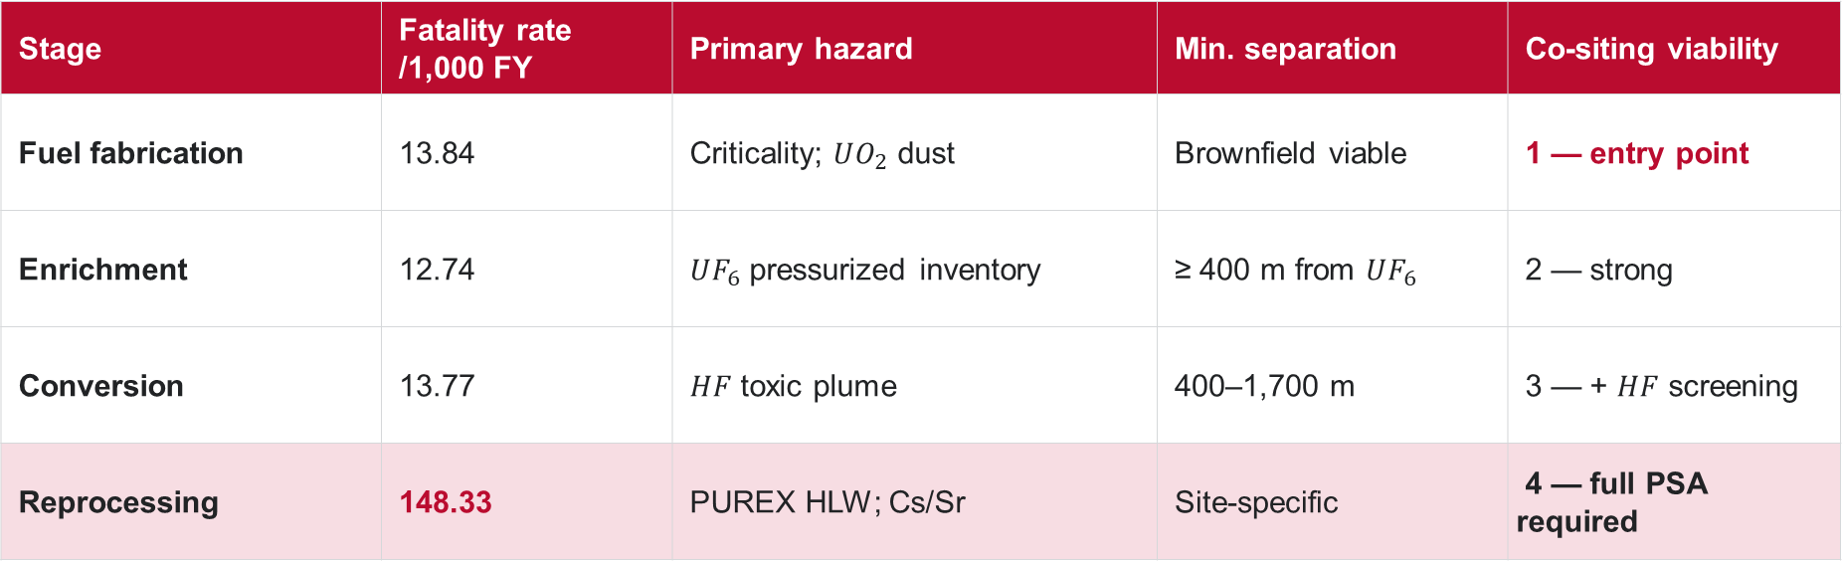
6
A risk matrix ranks the four stages for co-siting
Stage | Fatality rate /1,000 FY | Primary hazard | Min. separation | Co-siting viability
Fuel fabrication | 13.84 | Criticality; $UO_{2}$ dust | Brownfield viable | 1 — entry point
Enrichment | 12.74 | $UF_{6}$ pressurized inventory | ≥ 400 m from $UF_{6}$ | 2 — strong
Conversion | 13.77 | $HF$ toxic plume | 400–1,700 m | 3 — + $HF$ screening
Reprocessing | 148.33 | PUREX HLW; Cs/Sr | Site-specific | 4 — full PSA required
Fuel fabrication = the entry point; reprocessing requires a full site-specific PSA before co-siting.
Notes:
Synthesis of Table 2 risk + Section 2.1 hazards + Section 3.5 separation criteria (Table 3)
~1.5 min. The deliverable — the matrix that turns the empirical hierarchy into a co-siting ranking. Top to bottom = best to worst entry point. Fuel fabrication is the entry point: lowest practical risk, highest facility count, brownfield-viable. Enrichment strong (mostly electrical load). Conversion workable but adds an HF toxic-plume screen. Reprocessing is the outlier — highlighted row — site-specific, full PSA required. Separation distances come from NRC/IAEA screening. Next slide: what each regulatory action actually is.

Slide 7
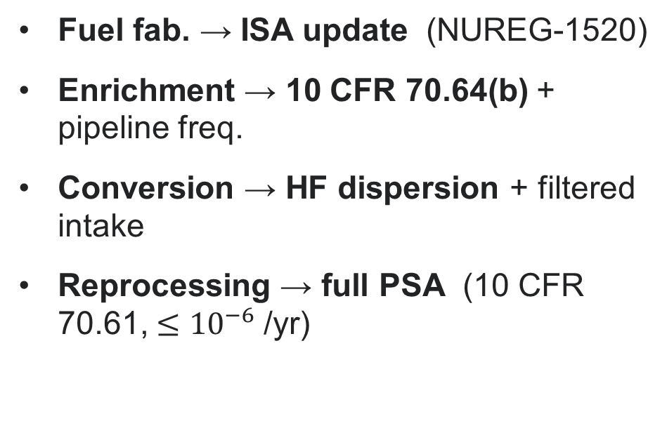
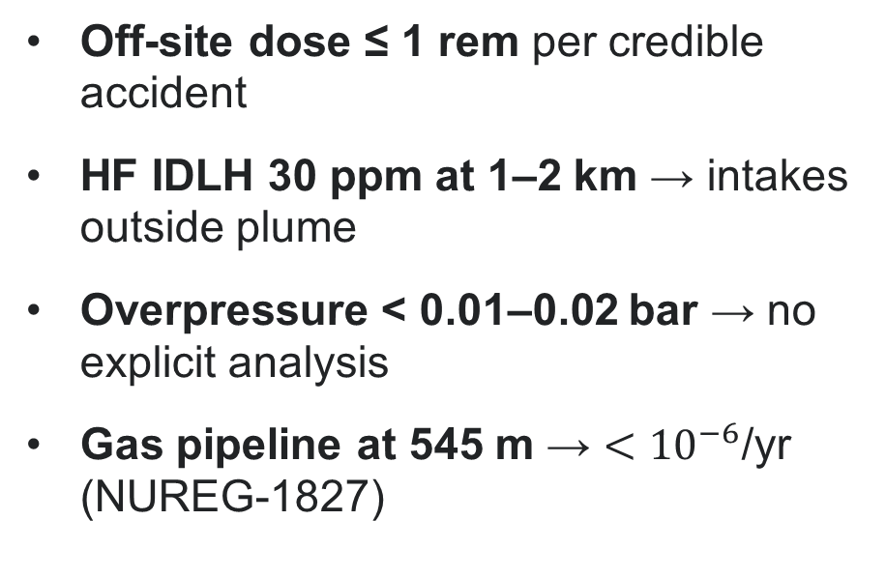
7
Each stage maps to a defined regulatory pathway
Regulatory action by stage
Quantitative screening
Fuel fab. → ISA update (NUREG-1520)
Enrichment → 10 CFR 70.64(b) + pipeline freq.
Conversion → HF dispersion + filtered intake
Reprocessing → full PSA (10 CFR 70.61, $≤{10}^{−6}$/yr)
Off-site dose ≤ 1 rem per credible accident
HF IDLH 30 ppm at 1–2 km → intakes outside plume
Overpressure < 0.01–0.02 bar → no explicit analysis
Gas pipeline at 545 m → $<{10}^{−6}$/yr (NUREG-1827)
10 CFR 70.22(i) / 70.61; NUREG-1520 / 1827; IAEA SSR-4, SSG-35
Notes:
~1.5 min. Regulatory translation. Crucially, brownfield co-siting at a licensed NFC site does NOT trigger a new-site safety evaluation — mechanism is an updated Integrated Safety Analysis (ISA) under NUREG-1520 for fuel fab; enrichment adds a 10 CFR 70.64(b) common-cause/utility analysis plus pipeline frequency; conversion adds HF dispersion modeling with filtered control-room intake; reprocessing requires a full site-specific PSA demonstrating high-consequence events at or below 1e-6 per year under 10 CFR 70.61. Right column = quantitative screens: 1-rem off-site dose limit, HF IDLH 30 ppm at 1–2 km, an overpressure no-analysis threshold, and the NUREG-1827 precedent (gas pipeline at 545 m shown < 1e-6/yr). 70.61 tiers: high >25 rem ≤1e-5–1e-6/yr; intermediate 5–25 rem ~1e-4/yr; beyond-design-basis <1e-7/yr.

Slide 8
8
Conclusions
Modern NFC sites are co-siting-ready — reprocessing excepted
1. First global NFC risk baseline — 184 facilities; the missing precursor to co-siting PSA
2. Reprocessing is the singular high-risk stage — 10.7× the others (historical data)
3. 99.9% maturation; risk tracks regulatory maturity — modern sites suitable
Co-siting risk matrix + regulatory pathways — next: bidirectional reactor–NFC PSA
Next: Account for demonstrated industry learning and estimate current NFC risk from recent operating experience and plant-specific safety assessments (PSA/ISA)
Notes:
~1 min, stays on screen for Q&A. Four takeaways in order: (1) first systematic global NFC risk baseline — the precursor co-siting PSA needs; (2) reprocessing is the one stage that dominates risk; (3) 99.9% maturation and risk tracks regulatory maturity, so modern sites are suitable; (4) the result is an actionable co-siting risk matrix with regulatory pathways, next step the bidirectional reactor–facility PSA. Invite questions: 'Are there questions or feedback?' Backup reference slide follows if needed.

Slide 9

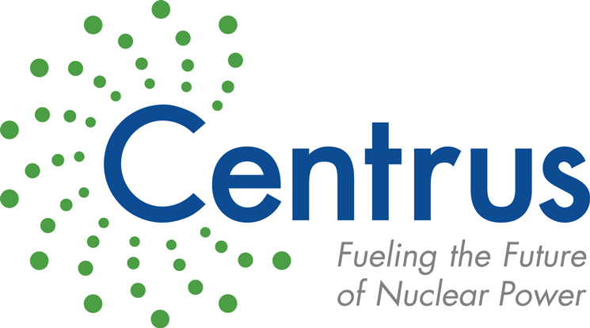
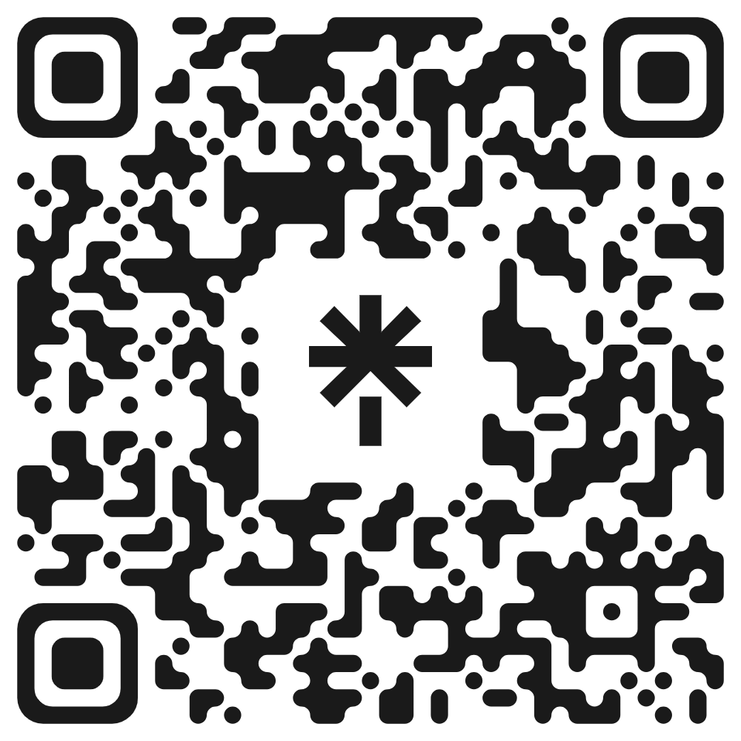
9
Acknowledgments
We extend our gratitude to Centrus Energy Corp. and Mr. Dan Watts for their valuable feedback and contributions. This research was supported by The Ohio State University’s Sustainability Institute. The first author also acknowledges and thanks the financial support provided by the OSU College of Engineering, the OSU Nuclear Program, and the OSU Council of Graduate Students.
Vinicius Zanardo Rodrigues · zanardorodrigues.1@osu.edu · Questions & Discussion Welcome

Slide 10
10
Key References
U.S. Nuclear Regulatory Commission (U.S. NRC), Nuclear fuel cycle facility accident analysis handbook, Tech. Rep. NUREG/CR-6410, Science Applications International Corporation (SAIC), Washington, DC (March 1998).
U.S. Nuclear Regulatory Commission (U.S. NRC), Release of UF6 from a ruptured model 48y cylinder at Sequoyah Fuels Corporation, Tech. Rep. NUREG-1198, U.S. Nuclear Regulatory Commission (1986).
U.S. Nuclear Regulatory Commission (U.S. NRC), Safety evaluation report for the national enrichment facility, Lea County, NM, Tech. Rep. NUREG-1827, U.S. Nuclear Regulatory Commission (June 2005). U.S. NRC, Regulatory Guide 1.233, Rev. 0 (from DG-1353) (2020).
U.S. Nuclear Regulatory Commission (U.S. NRC), NuScale Small Modular Reactor Design Certification, Federal Register Doc. 2023-00729 (March 2 2023). U.S. NRC, Standard Review Plan for a Fuel Cycle Facility License, NUREG-1520, Rev. 2 (2015).
B. V. Nikipelov, G. N. Romanov, L. A. Buldakov, N. Babaev, Y. B. Kholina, E. I. Mikerin, A radiation accident in the southern Urals in 1957, At Energy 67 (1989) 569–576.
T. P. McLaughlin, S. P. Monahan, N. L. Pruvost, V. V. Frolov, B. G. Ryazanov, V. I. Sviridov, A review of criticality accidents: 2000 revision, Tech. Rep. LA-13638, Los Alamos National Laboratory (LANL) (May 2000).
International Atomic Energy Agency (IAEA), Safety of nuclear fuel cycle facilities, Tech. Rep. SSR-4, IAEA, Vienna (2017).IAEA, Nuclear Fuel Cycle Facilities Database (NFCFDB), INFCIS (accessed 2025).
U.S. Nuclear Regulatory Commission (U.S. NRC), Event Notification Reports, https://www.nrc.gov/reading-rm/doc-collections/event-status/event/index, accessed: November 10, 2025 (2026).
Code of Federal Regulations, 10 CFR 70.22(i) and 10 CFR 70.61, U.S. Government Publishing Office (2016).
Y. Shen, W. Zhou, A comparison of onshore oil and gas transmission pipeline incident statistics in Canada and the United States, International Journal of Critical Infrastructure Protection 45 (2024).
Notes:
Backup slide for Q&A and academic completeness. Not shown during the timed talk — Conclusions (slide 8) stays on screen. Remove if you want exactly 8 files. In-slide citations on each content slide point to these full references.

