Slide 1
A Timely Imperative for Advanced Reactor Designs: Reliability Data Need
July 20, 2026| Pittsburgh
Askin Guler Yigitoglu
Pavan Kumar Vaddi
Oak Ridge National Laboratory

Slide 2
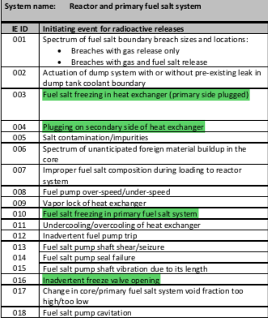
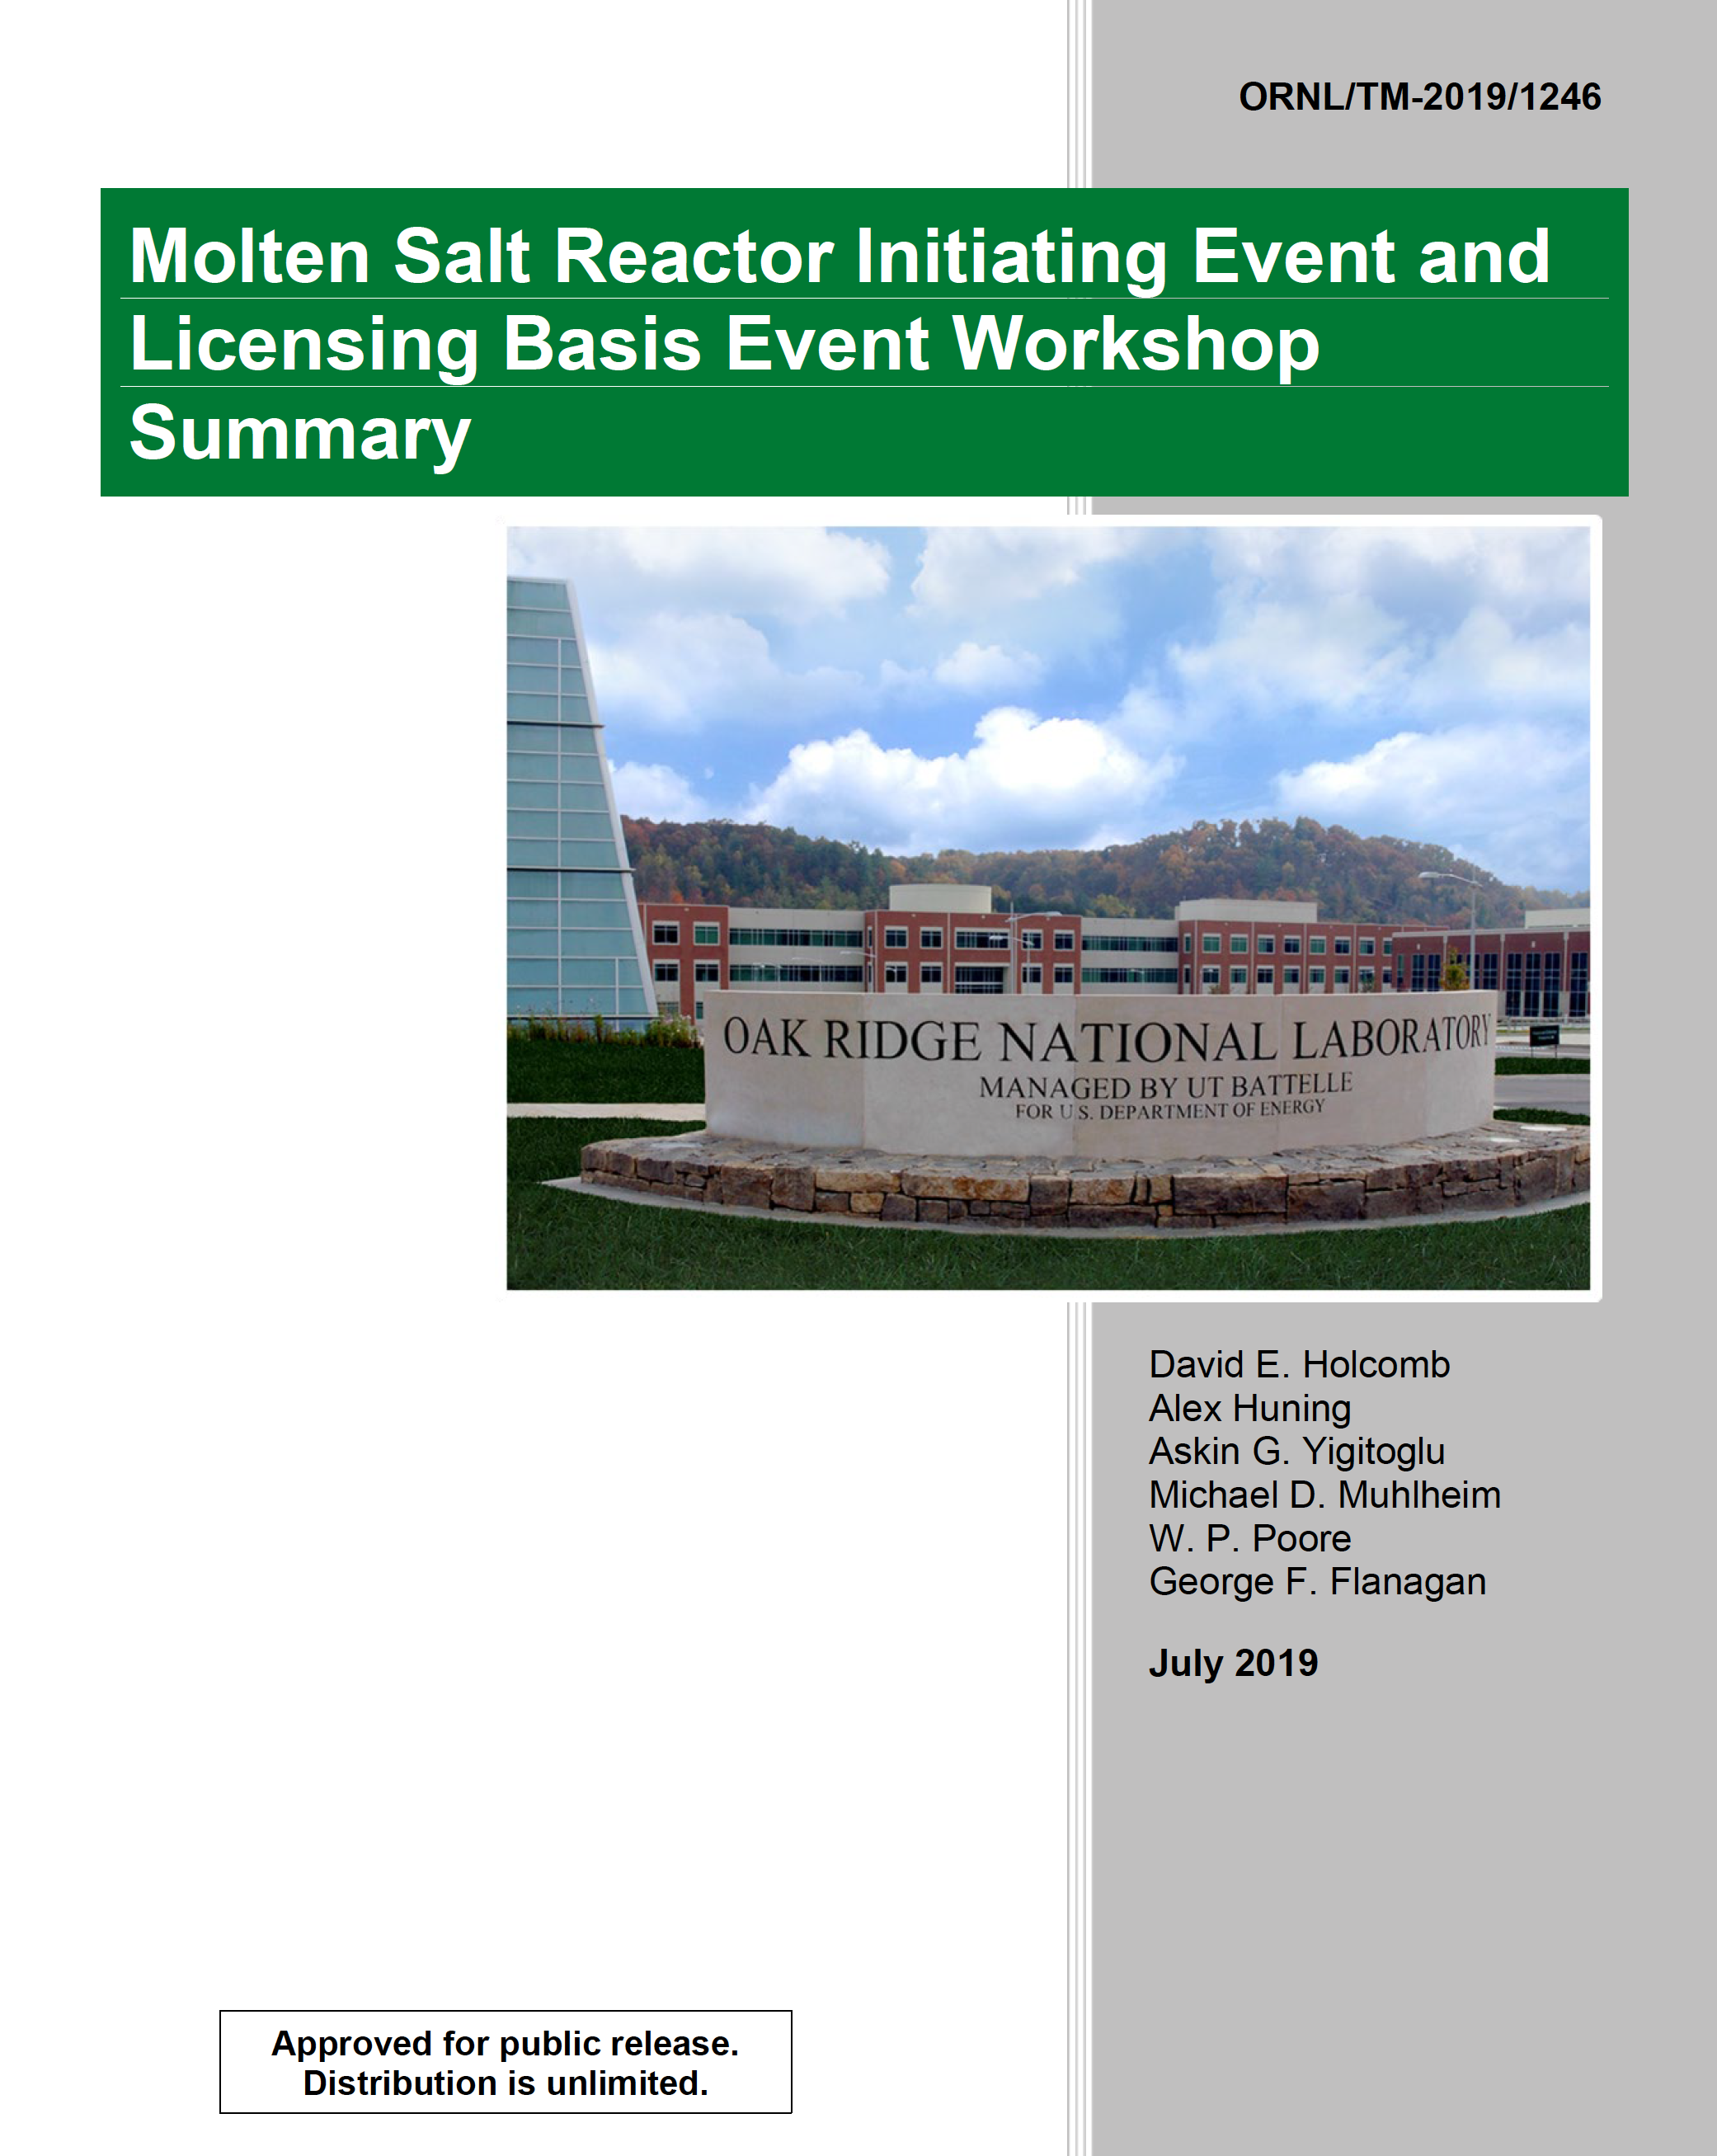

Licensing and Oversight of Advanced Reactors
10 CFR Part 53 – Risk-informed, performance-based and technology-inclusive regulatory framework for Advanced Reactors
Most of the non-LWR operational experience relies on legacy data
Data is needed to estimate LBE frequencies
New accident hazard scenarios for advanced non-LWR reactor:
  Passive safety systems
  Chemistry control
  Digital I&C
Integrating AI methods and tools to risk assessment for advanced reactors designs at different stages of the risk analysis
  pre-assessment
  post-processing

Slide 3
Input Data Required for the LBE Evaluations
Re-evaluation of the LBE frequencies will impact design basis accident analyses and SSC categorization. Input data required for the LBE selection:
Plant design definition
system descriptions, P&IDs, logic diagrams, control/protection system design, passive features, functional containment/barriers, operating states/modes. IE list: internal transients, reactivity events, heat removal failures, shutdown events, abnormal operations; design‑specific events (e.g., salt freeze plug behavior, sodium leaks/fire, HTGR water ingress).
Reliability data for SSCs credited in prevention and mitigation
failure rates, demand failure probabilities, common-cause failure parameters,
repair/restoration times, test/maintenance unavailability, human error probabilities (HEP).
Event progression and success criteria:
thermal-hydraulic and neutronic response, reactivity feedback, decay heat curves, heat removal pathways, barrier performance.

Slide 4
Reliability Data is a Critical Input
Reliable component failure data is a critical input to quantify PRA. Non-LWR (NLWR) designs, there is a gap in the operational failure data required to robustly quantify risk.
The ANSI/ASME/ANS RA-S-1.4-2021 standard, which is the consensus PRA standard for NLWR plants, outlines requirements for 18 technical elements covering all hazards, operating states, and radiological sources covering design, construction and operation.
The NRC endorsed this standard via Trial Regulatory Guide (RG) 1.247 on March 21, 2022, to evaluate the technical sufficiency of non-LWR PRAs. RG 1.232 is an acknowledgment of the benefits that can be obtained by risk-informing the non-LWR design criteria to the extent practicable given the available design information and data.
The component failure rates are also essential to support design validation activities, operational reliability and availability assessments, and broader reliability integrity management applications.
Reliability-Availability-Maintainability-Inspectability (RAMI) assessments and Reliability growth, the structured process of finding root causes for reliability problems and predicting and monitoring the increase of the system’s reliability through successive phases.

Slide 5
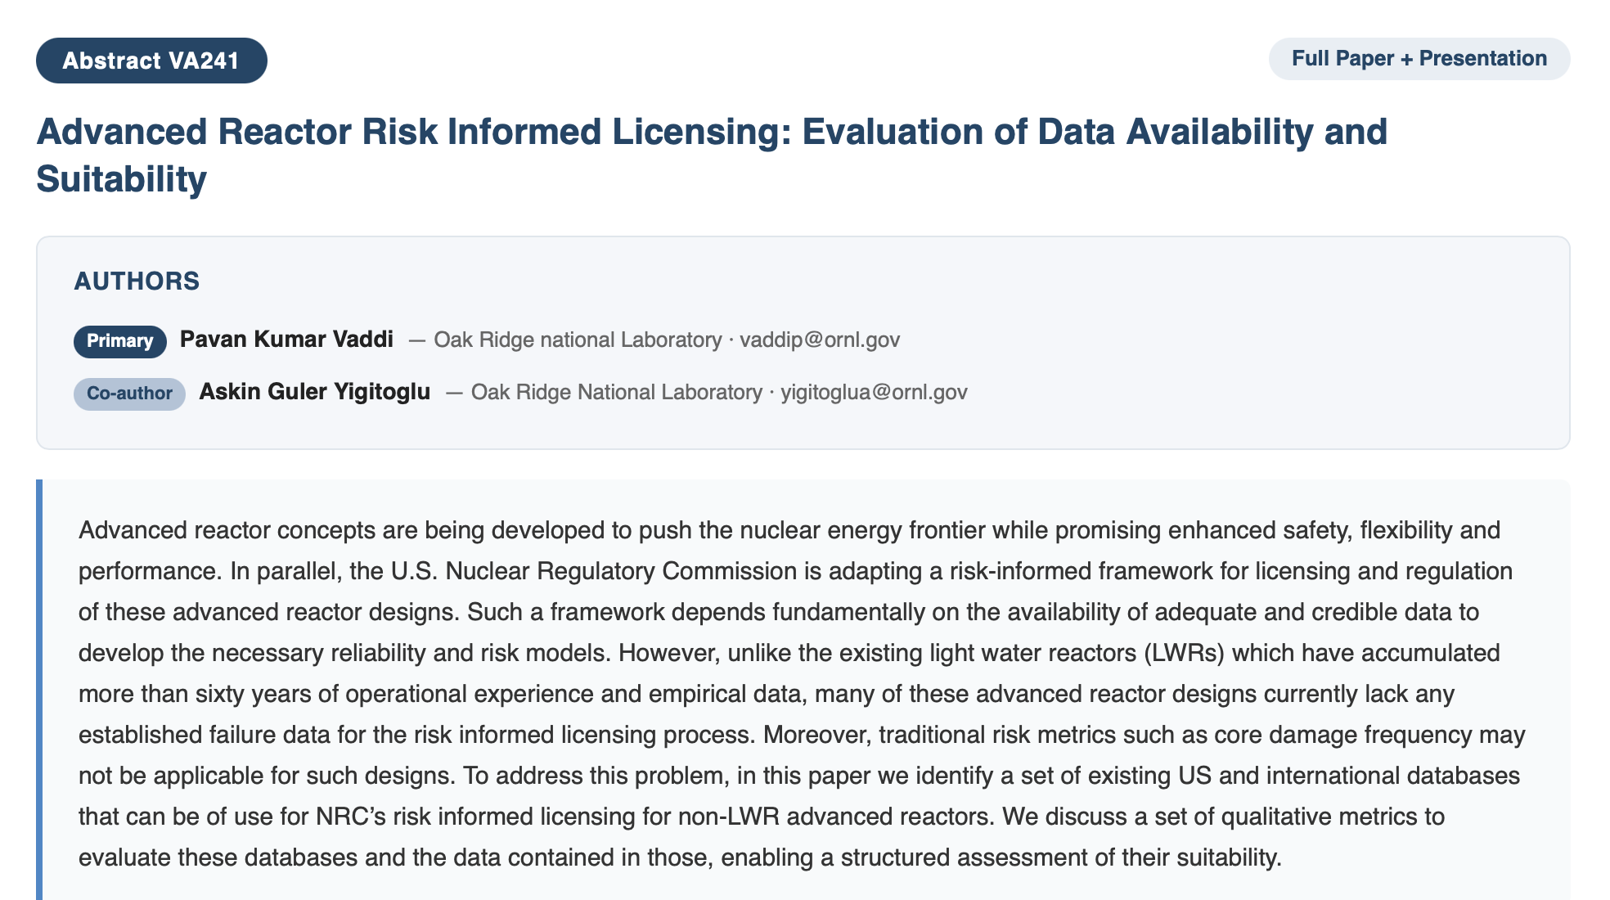
Data Availability and Fit
Operating experience data, expert elicitation, and advanced simulation methods for data augmentation can form the basis for the risk assessment models required for advanced reactors.
The main limitations of the available data are categorized using 12 characteristics—spanning age, reporting standards, representativeness, and scalability—is defined, and available data sources and databases were evaluated according to those characteristics.

Slide 6
PRA Input Coverage by Reactor Design
The absence of comprehensive reliability data for diverse operational conditions, coolants, and design configurations exacerbates the data gap.
Operational experience data source of advanced non-LWRs, mainly not from a single database like historic CREDO effort but a collection from historical reports, the design specific coverage is listed below:
  SFR: Best historical data exist (EBR‑II/FFTF and international prototypes); much is in reports, NaSCoRD database is the most horizontal database for non-LWRs, it is access controlled.
  MSR: Meaningful legacy data exist (MSRE), mostly report-based; missing maintenance data.
  HTGR: Some experience exists (historical plants and prototypes internationally) such as, MHTGR and PMBR and significant test experience; reliability parameters are not public.
  LFR: Most data are from test loops mainly materials and component tests such as mechanisms engineering test loop at ANL.
  Shared subsystems (e.g., off-gas systems in SFRs and MSRs) offer an opportunity to pool available information and improve the statistical basis for reliability estimates and operational insights.

Slide 7
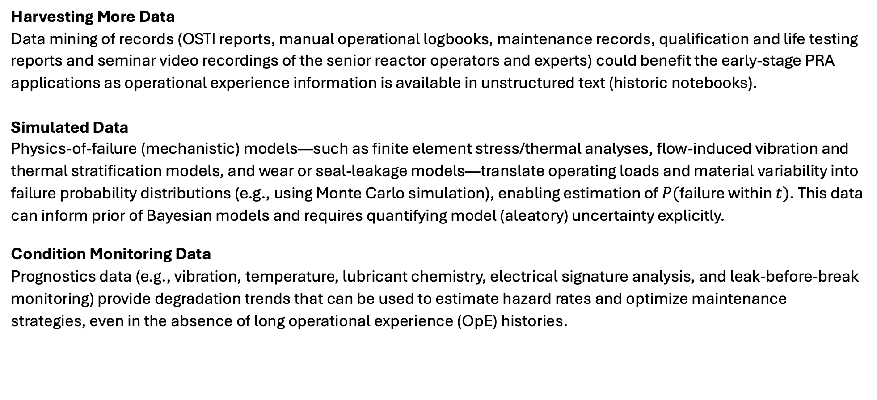
Data Augmentation Using Advanced Methods
  Harvesting More Data
  Data mining of records (OSTI reports, manual operational logbooks, maintenance records, qualification and life testing reports and seminar video recordings of the senior reactor operators and experts) could benefit the early-stage PRA applications as operational experience information is available in unstructured text (historic notebooks).
  Simulated Data
  Physics-of-failure (mechanistic) models—such as finite element stress/thermal analyses, flow-induced vibration and thermal stratification models, and wear or seal-leakage models—translate operating loads and material variability into failure probability distributions (e.g., using Monte Carlo simulation), enabling estimation of $P(\text{failure} \text{within} t)$. This data can inform prior of Bayesian models and requires quantifying model (aleatory) uncertainty explicitly.
  Condition Monitoring Data
  Prognostics data (e.g., vibration, temperature, lubricant chemistry, electrical signature analysis, and leak-before-break monitoring) provide degradation trends that can be used to estimate hazard rates and optimize maintenance strategies, even in the absence of long operational experience (OpE) histories.
Notes:
Reliability calculations and PRA insights with insufficient data, and inadequate approximations, leading to inaccurate conclusions.
Deep learning, automatic text and image indexing, generative Artificial Intelligence (AI), and other data/text mining tools can convert maintenance logs into structured event types (demand, failure, degraded, repair). LLMs can assist classification, experts needed for QA and clear taxonomy.

Slide 8
Conclusions
Advanced NLWR PRA and other risk evaluations are currently limited by sparse, fragmented, and inconsistently reported reliability and operational experience data.
  Based on the review of the legacy and operational test loops data in U.S. and internationally, SFR designs have the highest data coverage and then MSRs and other designs.
  Most of the available reliability data search are manual efforts than a curated reliability database.
  Legacy data for non-LWRs are aged (50-60 plus years) and provide retrospective data and lessons learned. The approach is to use these data until new facilities generate enough experience data to perform a Bayesian update to these existing values.
  Expert elicitation process should be included and utilizing advanced simulation methods in closing gaps.

Slide 9
Future Work
Immediate actions (0–12 months). Advanced NLWR stakeholders should establish mechanism for operating-experience (OE) sharing.
  Prioritizing data mining of records and access agreements, adopting a standardized metadata template to improve traceability and usability, and identifying high-value data suitable for targeted testing to improve reliability inputs.
Mid-term actions (1–2 years). Efforts should transition from initial guidance to durable processes for consistent high-quality reliability reporting. This includes defining approaches for handling proprietary and sensitive information, piloting simulation-augmented parameter estimation to strengthen sparse-data inferences
Long-term actions (2+ years). Priorities should include completing and verifying previously incomplete data records; evaluating and, building a curated database tailored to advanced reactors; and establishing ongoing international data-sharing mechanisms.
  Digital-twin frameworks should be matured using validated datasets to enable higher-confidence inference and forecasting.

Slide 10
Acknowledgements
This research has been performed by UT‑Battelle, LLC, under Contract No. DE‑AC05‑00OR22725 with the U.S. Department of Energy.
This work was supported by the U.S. Nuclear Regulatory Commission, Office of Nuclear Regulatory Research, under Interagency Agreement (IAA) No. 31310025S0001.
The views expressed in this paper are those of the authors and do not necessarily represent the views of the NRC or the U.S. Government.

Slide 11
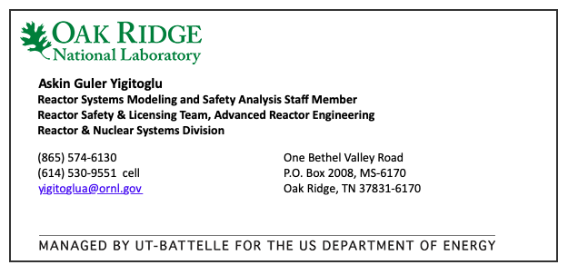
Thank you!
yigitoglua@ornl.gov

