Slide 1
Human Reliability Analysis for Human-Induced Common-Cause Failures
Probabilistic Safety Assessment and Management PSAM 18,
July 19-July 24, 2026, Pittsburgh, Pennsylvania
2026.07.22
○Yuta Yanada, Kanoko Nishiono, Tingting Cheng, Ali Mosleh
The contents of this document represent the opinions of the authors and do not represent the opinions of the Nuclear Regulation Authority.

Slide 2
Table of Contents
Background and Objective
Methodology
Analytical Conditions
Result
Conclusion

Slide 3
Background and Objective
Scope of PRA
Human-induced Common Cause Failures (CCFs) can significantly degrade plant reliability.
It is needed to model the causal relationship between Human Failure Events (HFEs) and common causes in HRA.
Initiating Event
Eq1
Eq2
Eq3
In this study, we proposed a method to consider causal relationship.
Using proposed method, evaluate the human-induced initiating events.
Human-induced CCF
Human Failure Event (HFE)1
Proceed next HFE
HFE2
maintenance, inspection
common cause
procedure, skill, training, work plan, safety culture, design
Root Cause
Scope of HRA

Slide 4
Adopted Phoenix HRA modeling framework
IE
Critical Task 1
Success
IE
Critical Task 2
Success
CF 1
Failure
CF 2
Failure
Critical Task 1
Critical Task 2
Information
Decision
Action
I
D
A
Crew Failure Mode
(CFM) 1
CFM 2
…
…
CFM 3
CFM 4
…
…
Bayesian Belief Network (BBN)
Performance Influencing Factor (PIF) 1
PIF 2
PIF 3
Without dependency
PIF 3
PIF 4
independent
independent
When the dependency is not considered, each PIFs is independent

Slide 5
Methodology for considering common cause
IE
Critical Task 1
Success
IE
Critical Task 2
Success
Failure
CF 2
Failure
CF 1
Critical Task 1
Critical Task 2
Information
Decision
Action
I
D
A
Crew Failure Mode
(CFM) 1
CFM 2
…
…
CFM 3
CFM 4
…
…
Dependency methodology of Phoenix
Bayesian Belief Network (BBN)
PIF 1
PIF 2
PIF 3
PIF 3
PIF 3
PIF 4
Common Cause
By treating the common causes of HFEs as performance influencing factors (PIFs) and applying the dependency analysis method of Phoenix, an HRA was conducted that accounts for the common causes underlying human-induced CCFs.

Slide 6
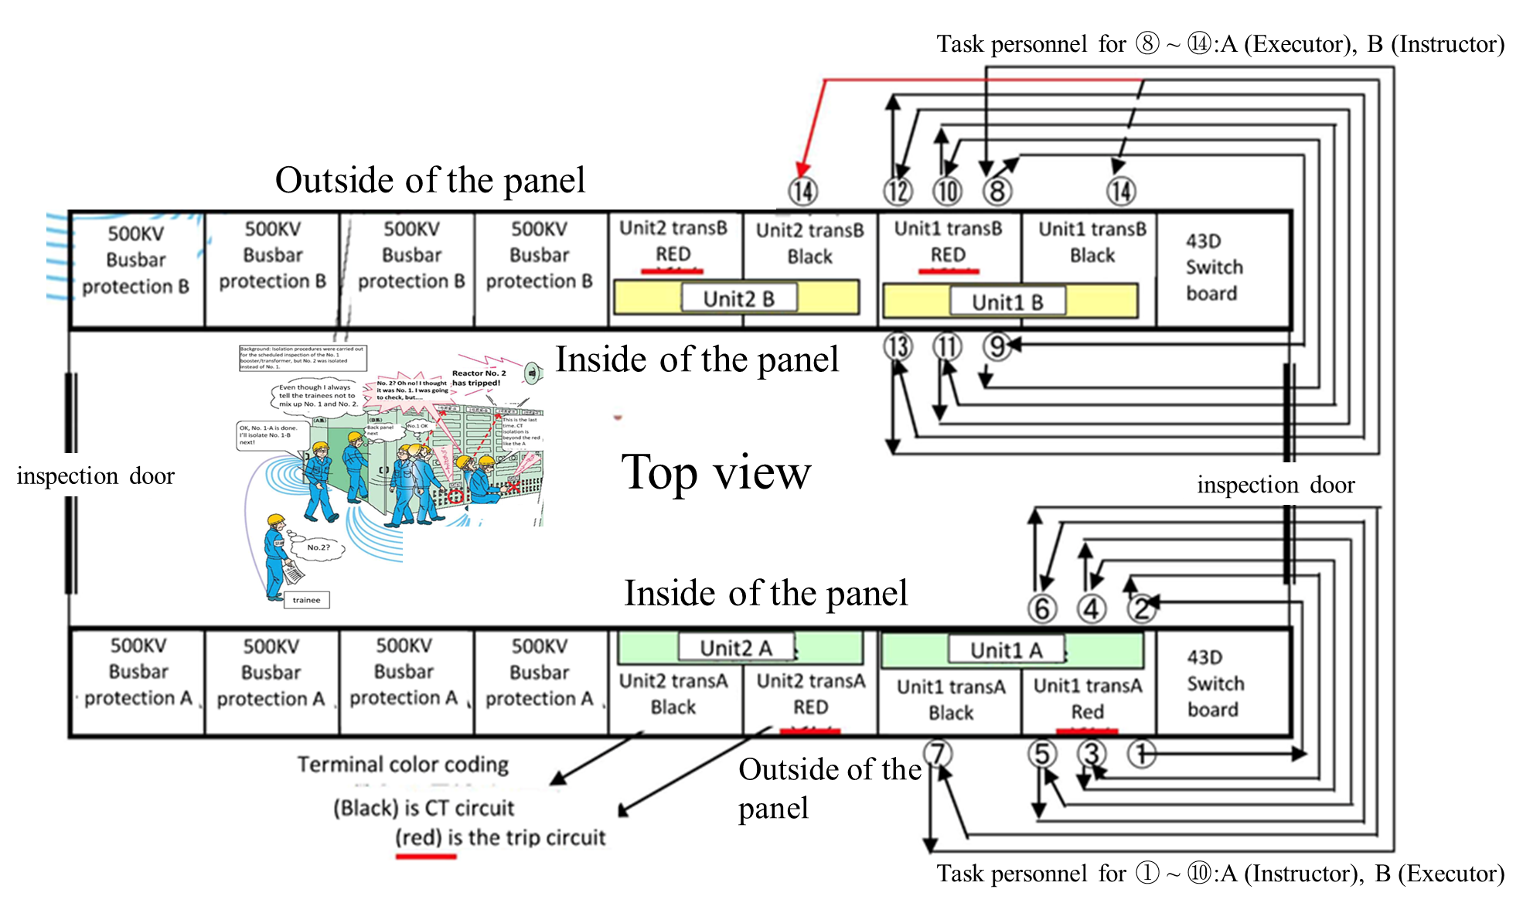
Analytical scenario for trial calculation
This scenario is based on an actual incident that occurred in a nuclear power plant in Japan.
At unit 1, an inspection of step-up transformer protection relay was occurred. While unit 2 was at the rated power.
This task includes isolation operation of the current transformer (CT) circuits at the step-up transformer protection relay panel.
The task was configured in operations for two train (Unit1 A and Unit1 B).
After the operation for Unit1 A was performed, the operation for Unit1 B was performed.
Reactor trip
 | Instructor | Executor
Unit1 A operation (step1~step7) | Highly experienced crew | Unexperienced crew
Unit1 B operation (step8~step14) | Unexperienced crew | Highly experienced crew

Slide 7
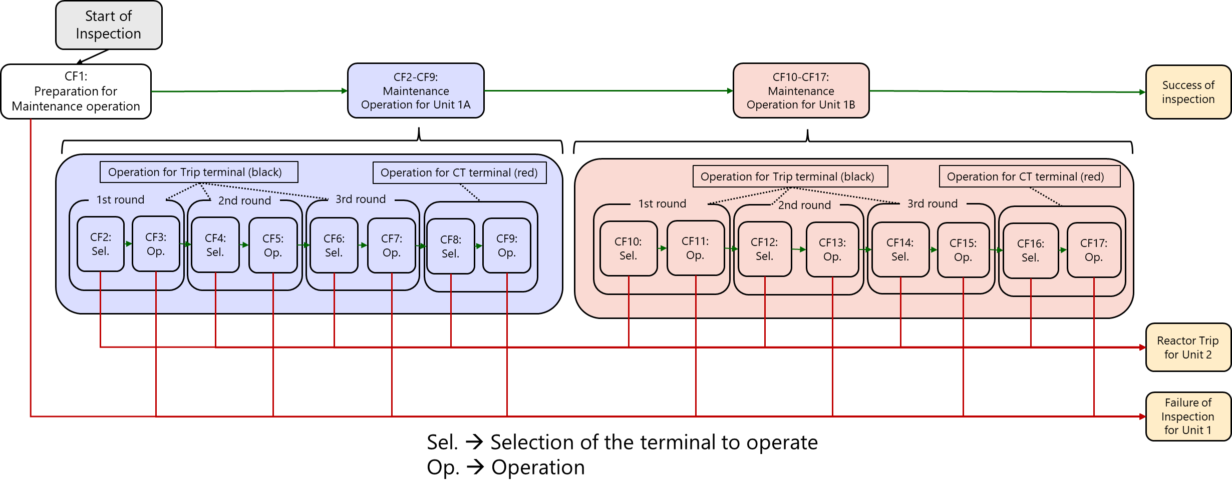
Overview of analytical model for trial calculation
Unit1A maintenance
Unit1B maintenance

Slide 8
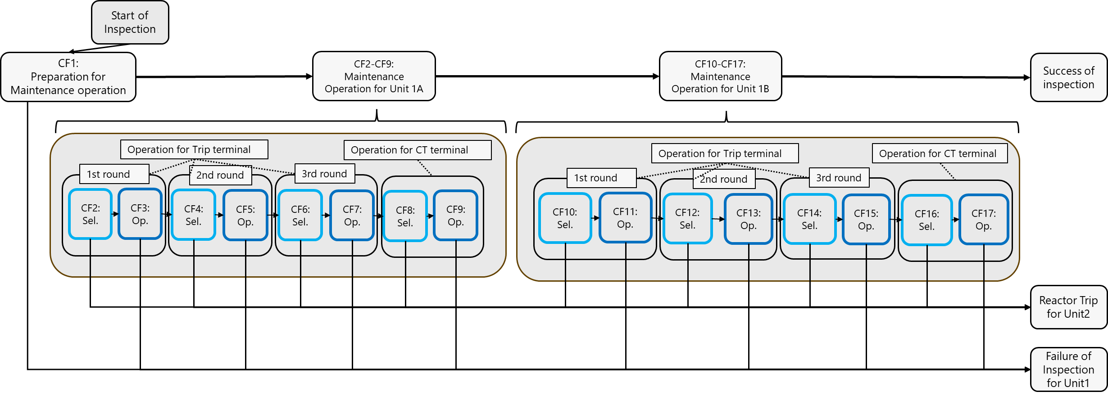
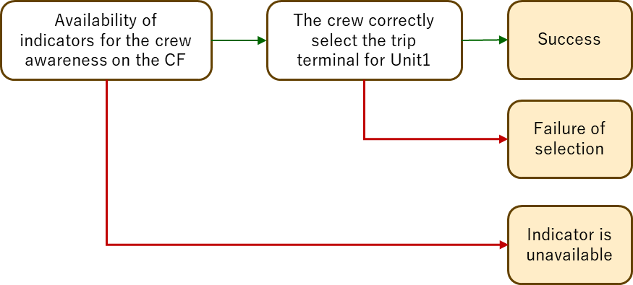
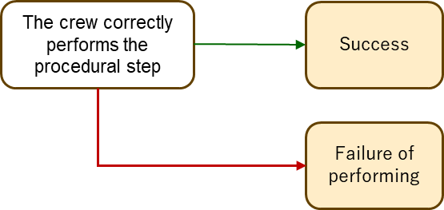
Branching of each selection and operation
CF 2,4,6,8,10,12,14,16
CF 3,5,7,9,11,13,15,17
Critical Task 1
Critical Task 2

Slide 9
Example for Determination of PIFs related to each CFMs
Critical Task 1
Critical Task 2
Critical Task 2
Critical Task 1
I
D
A
Information
Decision
Action
CFM
Incorrect operation of component
CFM
Action on wrong component
PIF
Task load for continuation of repetitive tasks and
the large number of procedural steps
PIF
The unit identification marking is positioned outside the operator’s field of view during work.
Task Load
Human System Interface

Slide 10
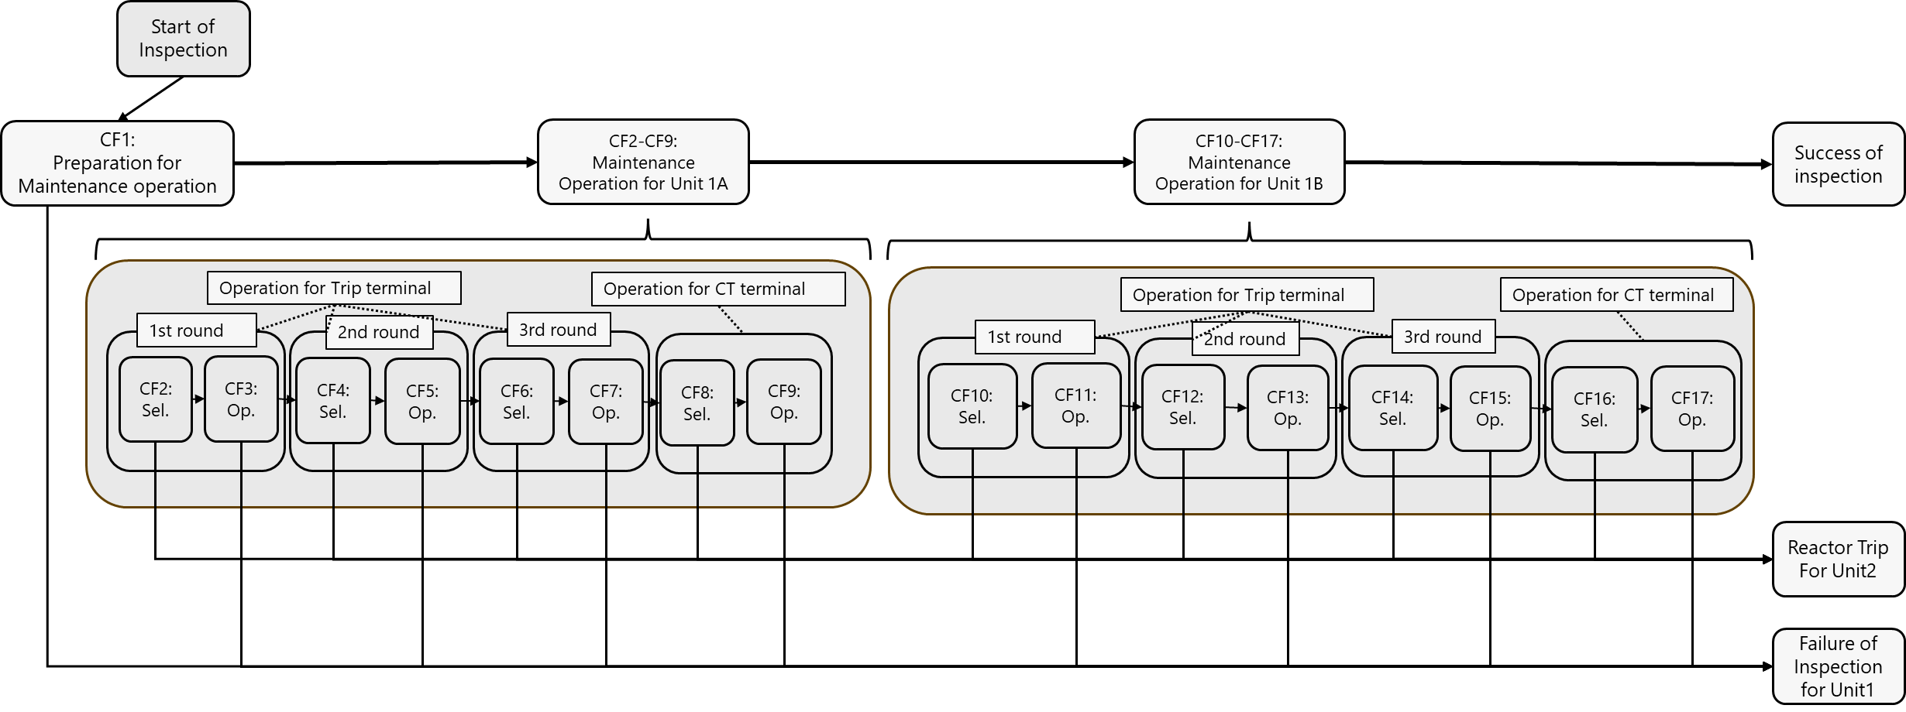
Without dependencies as common causes of different HFEs
Knowledge and Abilities-Crew A
Team Effectiveness
Knowledge and Abilities-Crew A
Team Effectiveness
Human System Interface
Procedure
Human System Interface
Procedure
・・・
A
A

Slide 11
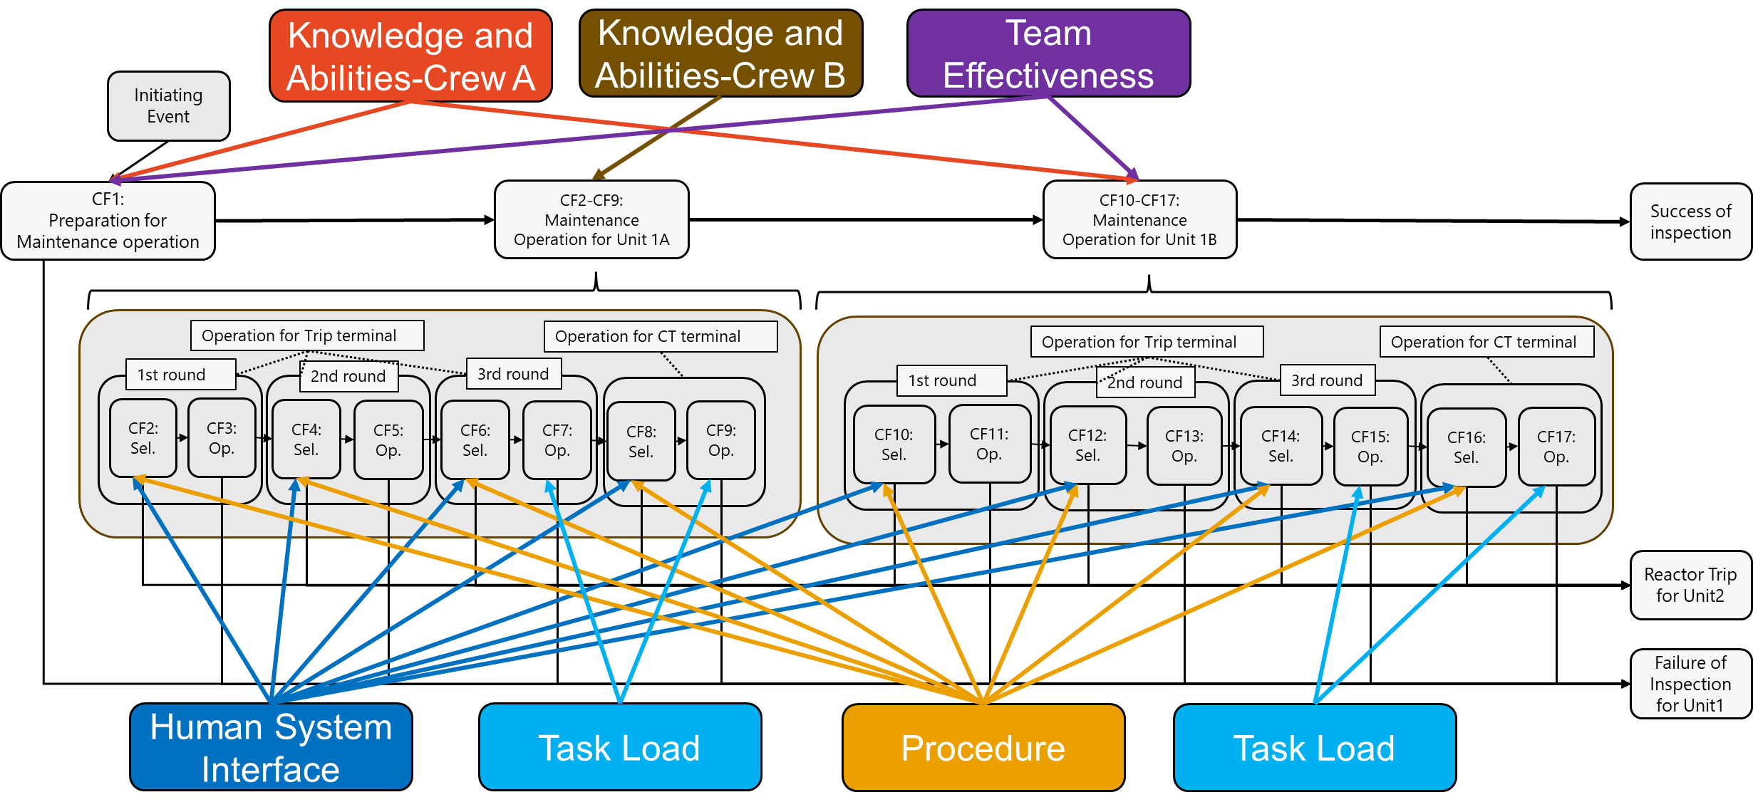
With dependencies as common causes of different HFEs
Using BBN, the dependency is considered

Slide 12
Quantification Process
The occurrence probability of a CFM is assigned to each combination of degraded and non-degraded PIF states.
Since Phoenix HRA defines eight primary PIFs, the table contains 2⁸=256 possible combinations of PIF states.
Example for conditional probabilities table (CPT) of CFM, “action on wrong component”
Human System Interface (HSI) | Degradation (D) |  |  |  | Nominal (N)
Procedure | D |  | N |  | D |  | N
Knowledge and Abilities | D | N | D | N | D | N | D | N
Probability of action on wrong component | 0.001995 | 0.001390 | 0.001459 | 0.000853 | 0.001228 | 0.000622 | 0.000691 | 0.000085
The degradation probability of a PIF is obtained by the PIF values implemented in the Phoenix tool.
When dependencies are taken into account, the degradation probability is updated using a Bayesian Belief Network (BBN).

Slide 13
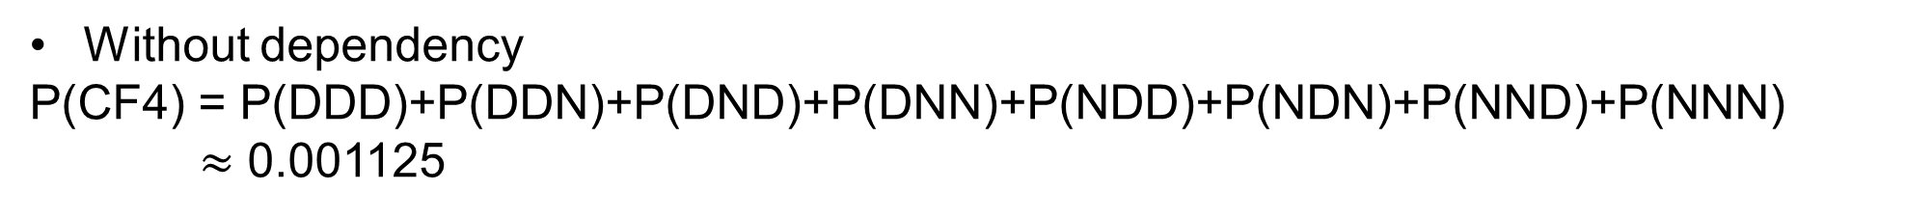
Example for quantification of CF4 “selection of trip terminal for unit1 A”
Example for CPT table of CFM, “action on wrong component”
HSI | Degradation (D) |  |  |  | Nominal (N)
Procedure | D |  | N |  | D |  | N
Knowledge and Abilities | D | N | D | N | D | N | D | N
Probability of action on wrong component | 0.001995 | 0.001390 | 0.001459 | 0.000853 | 0.001228 | 0.000622 | 0.000691 | 0.000085
PIF degradation probability
 | HSI | Procedure | Knowledge and Abilities
Degradation probability | 0.667 | 0.7 | 0.25
Without dependency
P(CF4) = P(DDD)+P(DDN)+P(DND)+P(DNN)+P(NDD)+P(NDN)+P(NND)+P(NNN)
$≈$ 0.001125
When dependency is considered, HSI and Procedure degradation probability is updated due to success for CF2 and Knowledge and Abilities degradation probability is updated due to success for CF3.

Slide 14
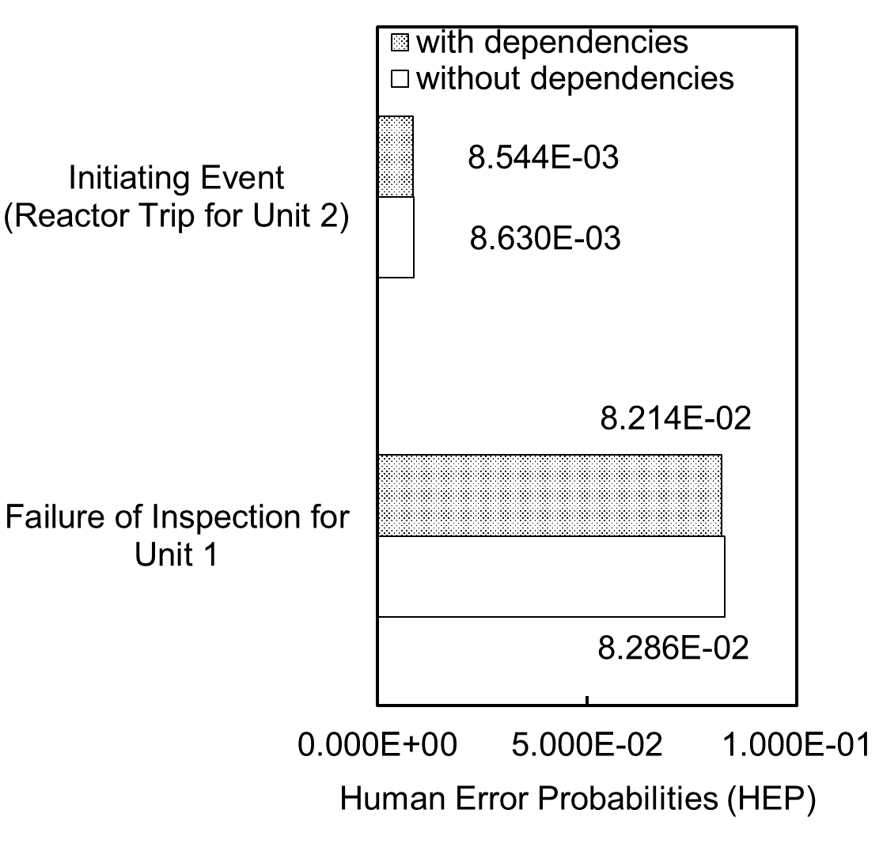
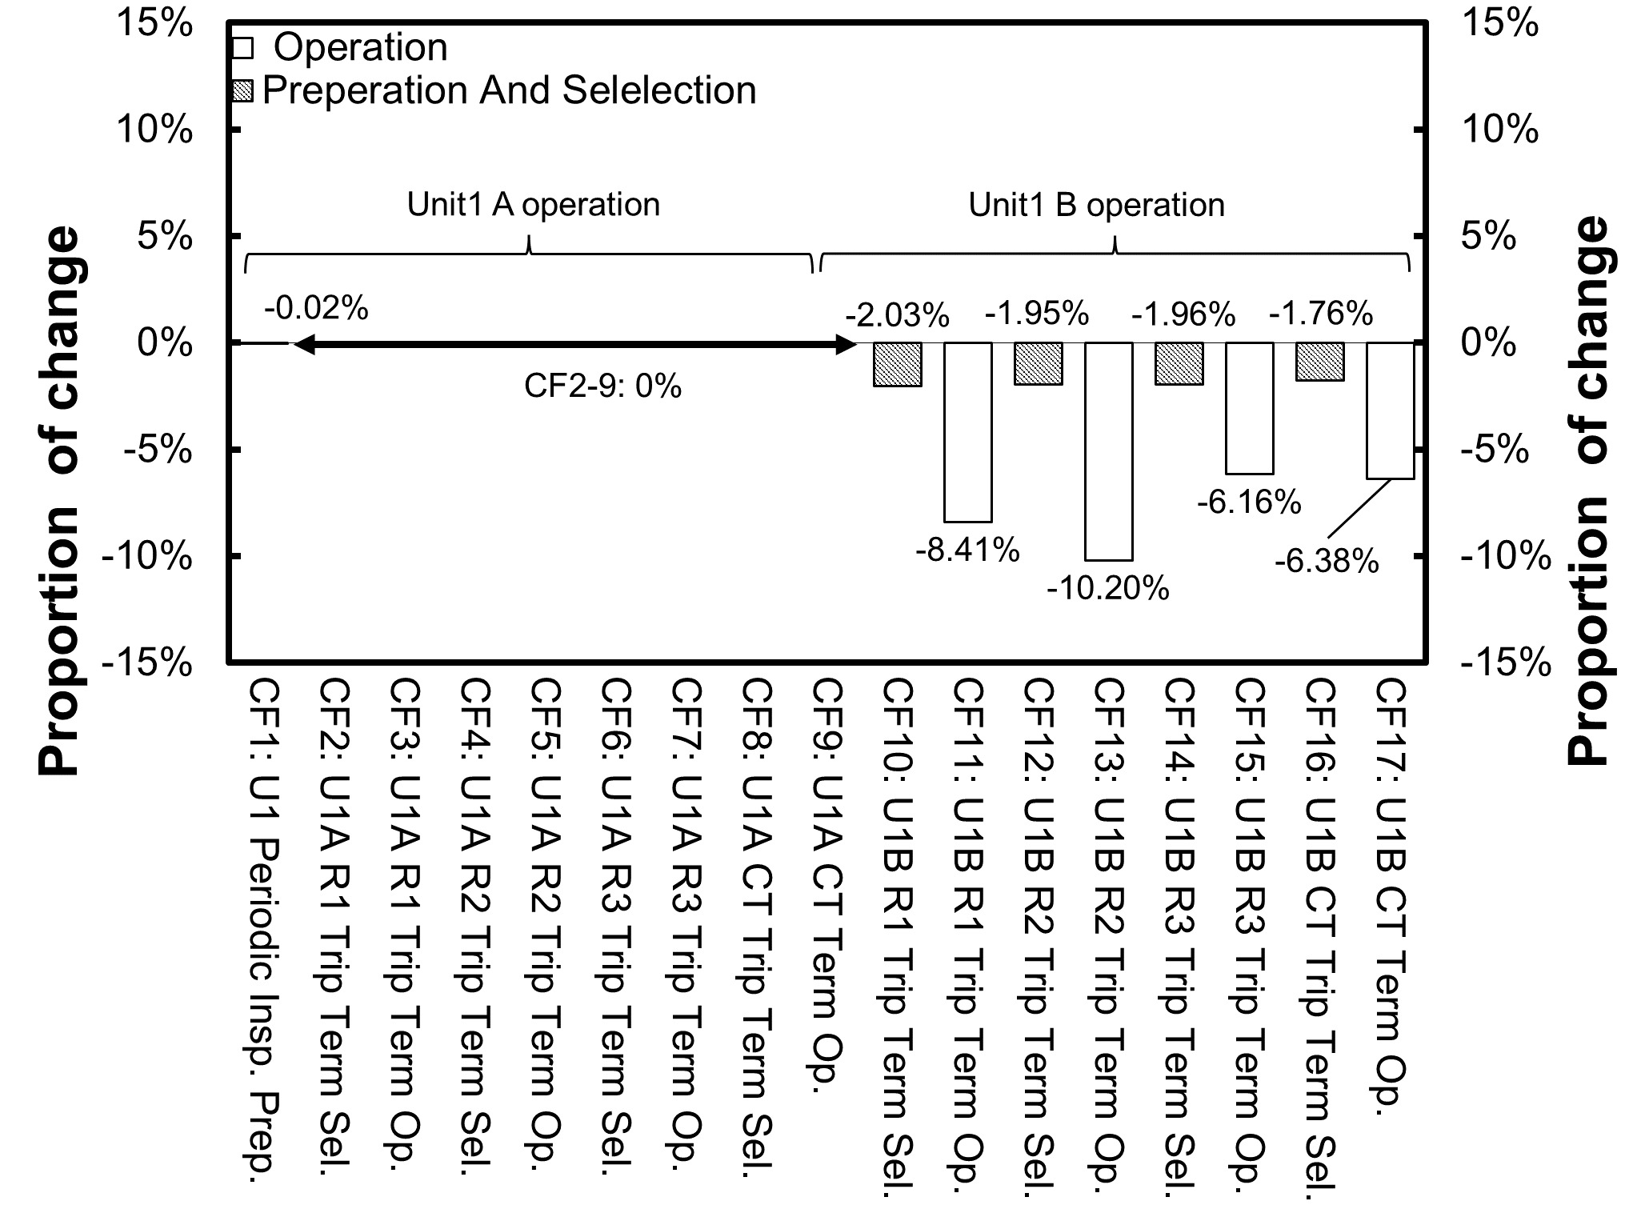
Comparison of results with and without dependency consideration
Considering common cause of multiple HFEs slightly reduced the End-State HEP compared with the case without considering of common cause.
→The scenario proceeds to the next CF only when the preceding CF is successful, and no subsequent CF remains once any CF fails. Therefore, the dependency effect is limited to the impact of preceding CF success.
When common cause of HFEs are considered, HEP does not change for CF2–CF9, but decreases for CF10–CF17.
→Among the common cause PIF, “Knowledge and Abilities - crew A” and “Team Effectiveness” are the main contributors. The other PIFs show no noticeable impact.

Slide 15
Conclusion
In this study, HRA was conducted that accounts for common causes of multiple HFEs, and the probability of initiating events resulting from these HFEs was estimated.
As an approach to incorporating the relationship between common causes and HFEs, a method using the dependency analysis technique of Phoenix HRA was proposed.
A trial HRA analysis was conducted using Phoenix, focusing on an accident that occurred during past maintenance work.
The trial analysis showed that, when common causes of human-induced CCF are taken into account, the HEP of a task following the successful completion of a preceding task tends to decrease.
Additional trial analyses are required using human event scenarios that include recovery actions following the failure of a task.

Slide 16
Appendix: Determination PIFs related to each CFMs (1)
PIF/PIF level | CFM | Critical Task | Relevant CFs | Description
Human System Interface (HSI) /0.667 | Action on Wrong component | The crew correctly select the trip terminal for Unit1 | CF2, CF4, CF6, CF8, CF10, CF12, CF14, CF16 | Because the unit identification markings on the panels were common across all panels, the CFs related to panel selection share a common PIFs.
Resource /0.333 | Action on Wrong component | The crew correctly select the trip terminal for Unit1 | CF16 | The layout structure was such that it was prone to inducing errors in panel selection in CF16.
Knowledge and Abilities for Crew A /0.25 | Action on Wrong component | The crew correctly select the trip terminal for Unit1 | CF1, CF10, CF11, CF12, CF13, CF14, CF15, CF16, CF17 | In the series of operations for the B train, a potential lack of attention by Crew A, attributable to their high level of task familiarity, was considered.
 | Incorrect Operation of component | The crew correctly performs the procedural step

Slide 17
Appendix: Determination PIFs related to each CFMs (2)
PIF/PIF level | CFM | Critical Task | Relevant CFs | Description
Knowledge and Abilities for Crew B /0.25 | Action on Wrong component | The crew correctly select the trip terminal for Unit1 | CF2, CF3, CF4, CF5, CF6, CF7, CF8, CF9 | In the series of operations for the A train, insufficient task experience of Crew B was considered.
 | Incorrect Operation of component | The crew correctly performs the procedural step
Task Load /0.375 | Incorrect Operation of component | The crew correctly performs the procedural step | CF7, CF9, CF15, CF17 | Increased task load due to the continuation of repetitive tasks and the large number of procedural steps was considered.
Bias /0.333 | Action on Wrong component | The crew correctly select the trip terminal for Unit1 | CF16 | It was considered that an assumption existed that “performing the same actions as in the A‑train work would be sufficient.”

Slide 18
Appendix: Determination PIFs related to each CFMs (3)
PIF/PIF level | CFM | Critical Task | Relevant CFs | Description
Team Effectiveness /0.214 (3/14) | Action on Wrong component | The crew correctly select the trip terminal for Unit1 | CF1, CF10, CF11, CF12, CF13, CF14, CF15, CF16, CF17 | In the series of operations for the B train, the work was not sufficiently supervised due to an inappropriate team composition.
 | Incorrect Operation of component | The crew correctly performs the procedural step
Procedure /0.7 | Action on Wrong component | The crew correctly select the trip terminal for Unit1 | CF2, CF4, CF6, CF8, CF10, CF12, CF14, CF16 | When selecting the panel, the procedure did not include a step requiring confirmation of the target unit.

Slide 19
Appendix: Critical Function of Master Event Sequence Diagram(ESD)

Slide 20
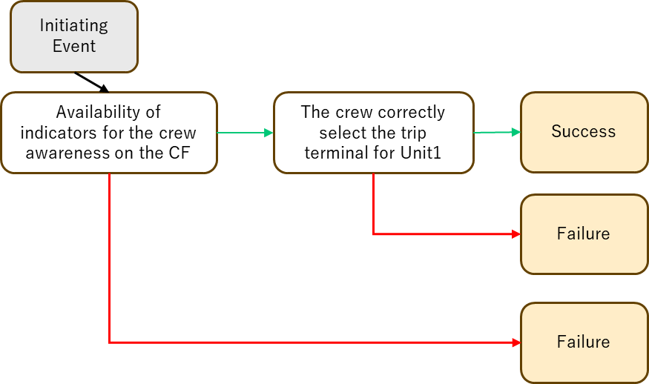
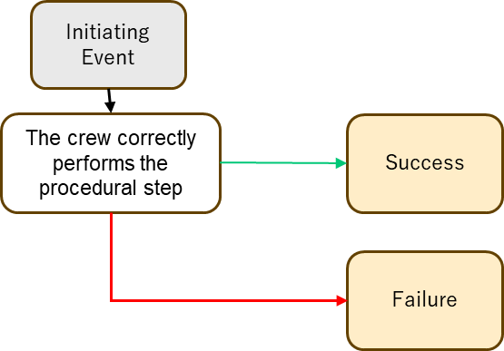
Appendix: Analytical model for trial analysis
Critical Task 1
Critical Task 2
Critical Task 1
Critical Task 2
Information
Decision
Action
I
D
A
CFM 1
CFM 2
…
…
CFM 3
CFM 4
…
…
BBN
Without dependency
PIF 1
PIF 2
PIF 3
PIF 3
PIF 4

Slide 21
Appendix: Analytical model for trial analysis
Critical Task 1
Critical Task 2
Critical Task 1
Critical Task 2
Information
Decision
Action
I
D
A
CFM 1
CFM 2
…
…
CFM 3
CFM 4
…
…
BBN
With dependency
PIF 1
PIF 2
PIF 3
PIF 4

