Slide 1

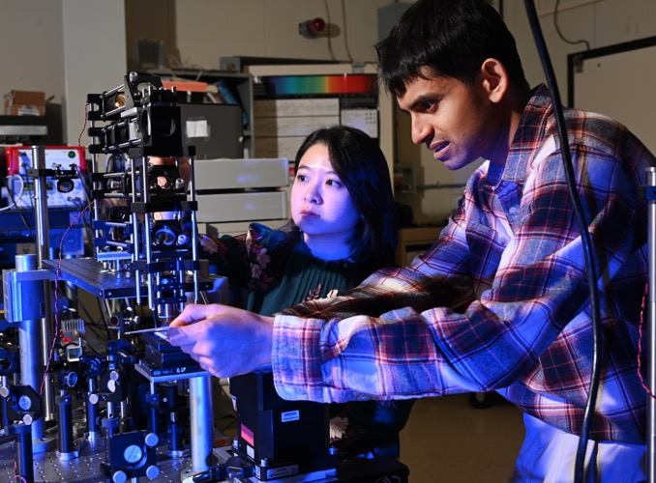

INL/CON-26-93385
Wen-Chi Cheng, PhD
Nuclear Computational Scientists (INL)
Fazlur Rahman Bin Karim (INL, UT Dallas)
Gang Li, PhD
Assistant Professor (MSU)
Mucun Sun, PhD
Power Systems Engineer (INL)
An FMEA-Informed Reliability Framework for Infinitely Variable
Transmissions in Tidal Energy Systems
Paper presented in Probabilistic Safety Assessment and Management PSAM 18, July 19-July 24, 2026, Pittsburgh, Pennsylvania

Slide 2
Acknowledgement
INL research has been supported by DOE Hydropower and Hydrokinetics (H2O) Office’s Testing Expertise and Access for Marine Energy Research (TEAMER) program.
We appreciated the valuable feedback by American Bureau of Shipping (ABS) who support the New Technology Qualification (NTQ) process in Marine Energy Applications.
Fazlur Karim is the recipient of the Marine Energy Fellowship Program, sponsored by the U.S. Department of Energy (DOE), Office of Critical Minerals and Energy Innovation (CMEI), and Hydropower and Hydrokinetics Office (H2O) and now the intern here in INL.
Dr. Gang Li is the recipient of the National Science Foundation (NSF) under Grant No. 2329791.

Slide 3
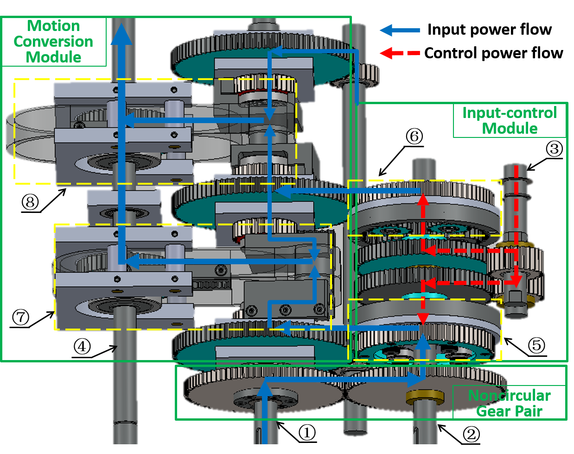
Research Objective and Tasks
Objective: Perform the following tasks to support New Technology Qualification (NTQ) process for infinitely variable transmission (IVT) design in tidal energy converter.
  Task 1: Failure modes and effects analysis (FMEA) on the gear box
    both the root bending fatigue in non-circular gear pair and planet gear sets were identified as the dominant failure mechanisms (WE336)
  Task 2: Probabilistic Physics-of-Failure (PPoF) based reliability assessment-stress-strength analysis (WE206)

Slide 4
Task-1: Failure Mode and Effect Analysis-Driven Reliability and Reliability Assessment for IVT
Methodological Steps developed for Failure Mode and Effect Analysis (FMEA)
Different failure modes were identified and characterized for different gear types in IVT based on the publicly available gear failure database.
As part of the FMEA, failure modes are ranked based on the Risk Priority Number (RPN).
The most important failure modes is loss of toque transmission, mainly caused by root bending fatigue
A reliability assessment equation is developed for the IVT gearbox
Literature-based failure rate were obtained by relevant fields including wind turbine gears to support the reliability assessment
Sensitivity study was performed to analyze the uncertain parameters

Slide 5
Failure Mode and Effect Analysis (FMEA)

Slide 6
FMEA-Step 1: Target system: IVT Gearbox in Tidal Current Energy Converter (TCEC)
A. Noncircular gear pair
B. Planetary gear sets *2 (ICM)
C. Rack–pinion sets (MCM)
D. Output gears (MCM)
E. Gearbox seal

Slide 7
FMEA-Step 2: Process Function Defintions
Gear/System Type | Process Functions
A. Noncircular gear pair | Transmit input torque and create modulated Speed
B. Planetary gear sets | Combine control speed & modulated speed
C. Rack–pinion sets | Convert translation to rotation
D. Output gears | Provide rotational outputs
E. Gearbox seal | Isolate sea water from equipment

Slide 8
FMEA-Step 3: Failure Modes Identification
Gear/System Type | Process Functions | Failure Mode
A. Noncircular gear pair | Transmit input torque and create modulated Speed | Loss of torque Transmission; Excessive vibration/noise; Loss of modulation Accuracy
B. Planetary gear sets | Combine control speed & modulated speed | Loss of combined speed Accuracy; Loss of torque Transmission; Excessive vibration/noise; Overheating; Locked rotation
C. Rack–pinion sets | Convert translation (yoke) to rotation | Excess backlash; Fail-to-run; Tooth chipping; Overheating; Corrosion-driven degradation
D. Output gears | Provide rotational outputs | Loss of output torque contribution; Excessive vibration/noise; Efficiency loss
E. Gearbox seal | Isolate sea water from equipment | Water ingress beyond limit

Slide 9
FMEA-Step 4: Root Case Analysis (Part 1)
Category | Failure Mode | Failure Mechanism (Root Causes)
A.1 | Loss of torque Transmission | Root bending fatigue
A.2 | Excessive vibration/noise | Micro-pitting causing increased surface roughness and transmission error
A.3 | Loss of modulation accuracy | Fretting wear at hub-shaft interface
B.1 | Loss of combined speed accuracy | Sun gear tooth deflection under load
B.2 | Loss of combined speed accuracy | Abrasive flank wear
B.3 | Loss of torque Transmission | Excessive vibration/noise; Overheating; Locked rotation
B.4 | Loss of torque Transmission | Ring gear rim/web cracking
B.5 | Excessive vibration/noise | Subsurface fatigue leading to macro-pitting and debris formation
B.6 | Excessive vibration/noise | Micropitting leading to macropitting progression
B.7 | Overheating | Edge loading leading to localized heating
B.8 | Overheating | Micropitting/scuffing increasing friction Coefficient
B.9 | Locked rotation | Scuffing due to film collapse
B.10 | Locked rotation | Debris-induced scuffing event

Slide 10
FMEA-Step 4: Root Case Analysis (Part 2)
Fail ID | Failure Mode | Failure Mechanism (Root Causes)
C.1 | Excess backlash | Abrasive wear of rack and pinion teeth
C.2 | Fail-to-run | Debris wedging in engagement
C.3 | Tooth chipping | Impact loading at reversal leading to stress Concentration
C.4 | Overheating | Boundary lubrication loss
C.5 | Corrosion-driven degradation | Corrosive wear
D.1 | Loss of output torque contribution | Root bending fatigue of output gear Teeth
D.2 | Excessive vibration/noise | Subsurface fatigue leading to spall formation
D.3 | Efficiency loss | Profile wear increasing sliding losses
E.1 | Water ingress beyond limit | Seal degradation (lip wear, elastomer aging, extrusion, pressure differential)

Slide 11
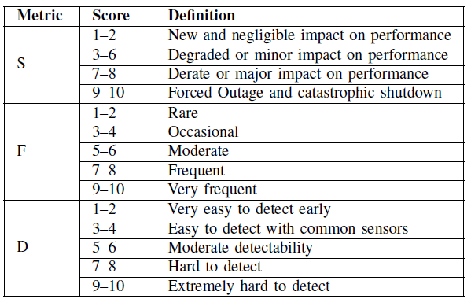
FMEA-Step 5: Evaluate severity, frequency, and detectability

Slide 12
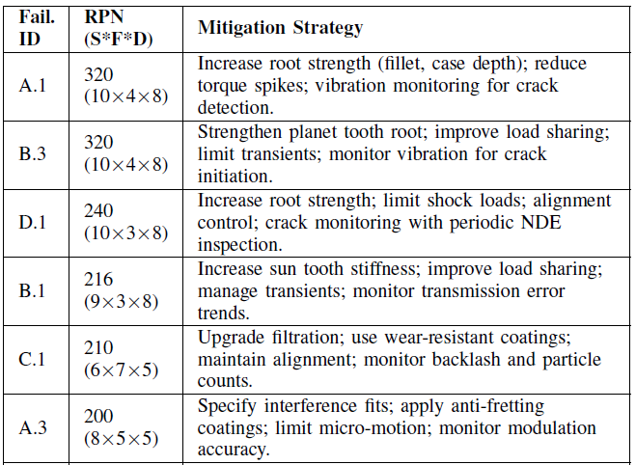
FMEA-Step 6 and 7: RPN and mitigation strategies

Slide 13
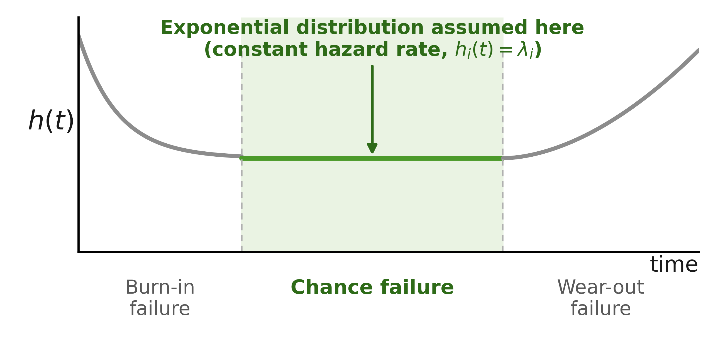
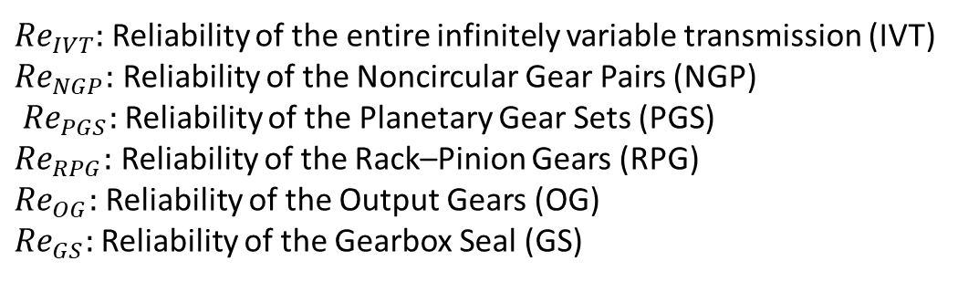
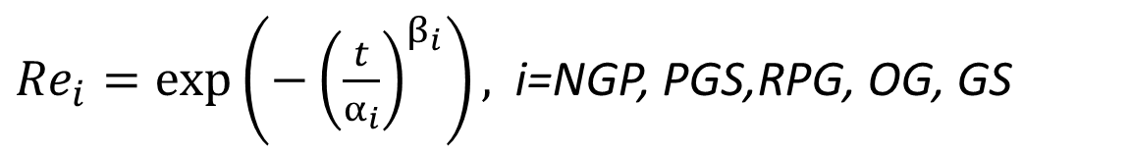
Reliability Assessment (for non-repairable system)
$${Re}_{IVT}={Re}_{NGP}∗{Re}_{PGS}∗{Re}_{RPG}∗{Re}_{OG}∗{Re}_{GS}$$
${Re}_{i}=\exp\left(−{\left(\frac{t}{α_{i}}\right)}^{β_{i}}\right),$ i=NGP, PGS,RPG, OG, GS
${Re}_{IVT}$: Reliability of the entire infinitely variable transmission (IVT)
${Re}_{NGP}:$ Reliability of the Noncircular Gear Pairs (NGP)
${Re}_{PGS}:$ Reliability of the Planetary Gear Sets (PGS)
${Re}_{RPG}:$ Reliability of the Rack–Pinion Gears (RPG)
${Re}_{OG}:$ Reliability of the Output Gears (OG)
${Re}_{GS}:$ Reliability of the Gearbox Seal (GS)
Note: Exponential is the special case of Weibull with shape parameter β = 1 → constant hazard rate, no shape parameter.
Modarres, Mohammad, Mark P. Kaminskiy, and Vasiliy Krivtsov. Reliability engineering and risk analysis: a practical guide. CRC press, 2016.

Slide 14
Component Failure-Rate & Reliability Estimation
Point estimates enable a first-pass model, with the baseline set using midpoint values
Provides uncertainty bounds for sensitivity analysis
Component | λ Lower | λ Mid | λ Upper | R Upper (%) | R Mid (%) | R Lower (%)
Planetary Gear | 0.000189 | 0.0500 | 0.1500 | 99.98 | 95.23 | 86.07
Non-Circular Gear | 0.0200 | 0.0500 | 0.1452 | 97.15 | 92.88 | 86.49
Rack-Pinion Gear | 0.0040 | 0.0080 | 0.0200 | 99.60 | 99.20 | 98.00
Output Gear | 0.0020 | 0.0600 | 0.1000 | 98.00 | 94.18 | 90.50
Gearbox Seal | 0.0300 | 0.0739 | 0.1892 | 97.00 | 92.88 | 82.76
Data provenance: Planetary, rack-pinion, output-gear and seal λ drawn from offshore wind-turbine gearbox / drivetrain reliability literature; the non-circular gear λ comes from a dedicated probabilistic physics-of-failure model (next presentation) for its bending-fatigue behavior.

Slide 15
Baseline One-Year System Reliability
Even with high individual-component reliability, the series configuration compounds risk — motivating the sensitivity analysis that follows.
76.75%
BASELINE R(t=1 yr)
Product of the five component midpoint reliabilities under the series-system assumption
R_IVT = R_PG × R_NCG × R_RPG × R_OG × R_GS
= 0.9523 × 0.9288 × 0.9920 × 0.9418 × 0.9288

Slide 16
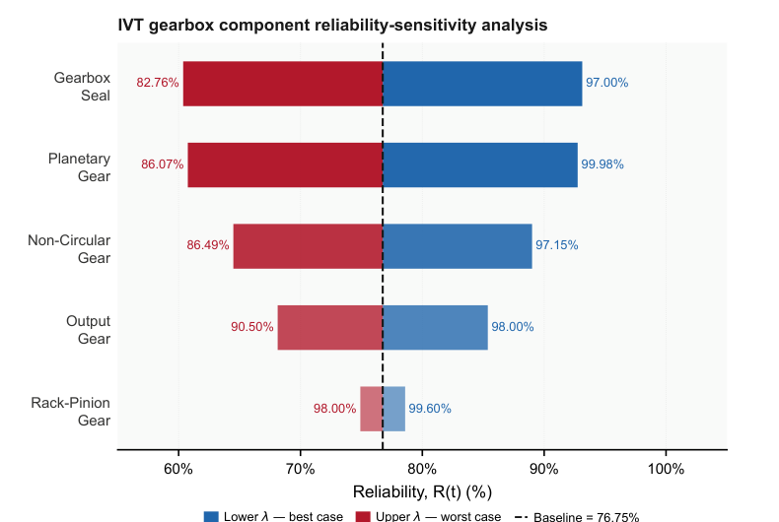
Sensitivity Analysis: What Moves the Reliability Result?
One-at-a-time sensitivity analysis over a one-year mission period
OAT variation reveals which component uncertainties matter most
Gearbox seal
1
Largest uncertainty range; governs water ingress, lubricant loss and contamination pathway.
Planetary gear
2
Second-largest lever; load sharing and tooth-root fatigue affect the system-level confidence.
Non-circular gear
3
Design-critical custom element; physics-of-failure data reduce uncertainty directly.

Slide 17
Conclusion & Future Work
CONCLUSIONS
FUTURE WORK
A qualified reliability baseline
→
Experimental IVT testing
✓
Physical testing is needed to reduce uncertainty in component failure-rate estimates used in the reliability model.
The IVT gearbox, modeled as a five-component non-repairable series system, has a baseline one-year reliability of 76.75%.
→
Incorporate field failure data
✓
Root bending fatigue is design-critical
Fit lifetime distributions from operational data in place of today's point-estimate failure rates.
FMEA identified this as the dominant failure mechanism, driving the highest RPNs in the non-circular gear and planetary gear sets.
→
Rigorous uncertainty quantification
✓
Three components dominate uncertainty
Develop confidence intervals for failure rates, time-to-failure behavior, and reliability estimates.
The gearbox seal, planetary gear, and non-circular gear are the leading contributors to reliability uncertainty.
→
Extend physics-of-failure modeling
✓
A structured basis for qualification
Apply the non-circular-gear approach to other high-RPN components flagged by the FMEA.
Together, the FMEA and reliability model support technology qualification ahead of TCEC commercialization.

