Slide 1

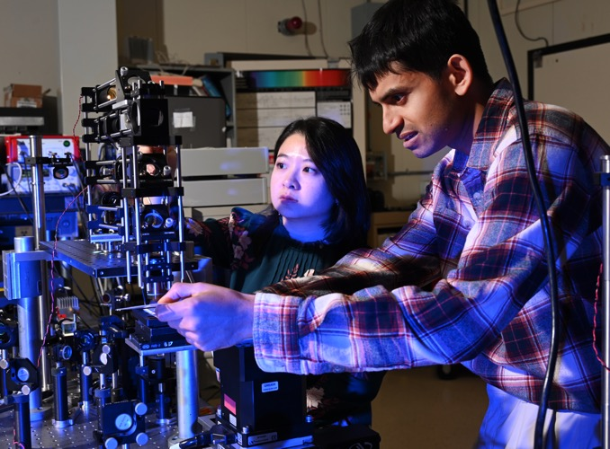
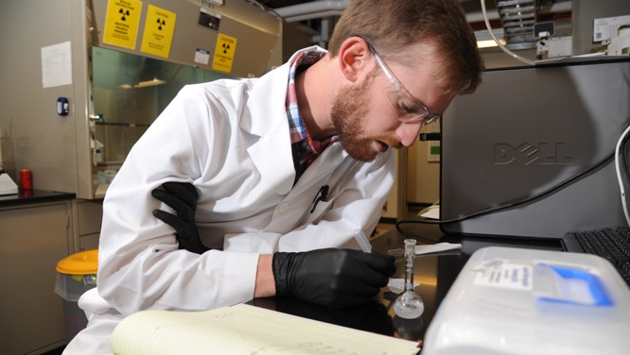
INL/CON 26-90723
Wen-Chi Cheng, PhD
Nuclear Computational Scientists (INL)
Gang Li, PhD
Assistant Professor (MSU)
Mucun Sun, PhD
Power Systems Engineer (INL)
Probabilistic Physics-of-Failure based Reliability Assessment for an Infinitely Variable Transmission
Paper presented in Probabilistic Safety Assessment and Management PSAM 18, July 19-July 24, 2026, Pittsburgh, Pennsylvania

Slide 2
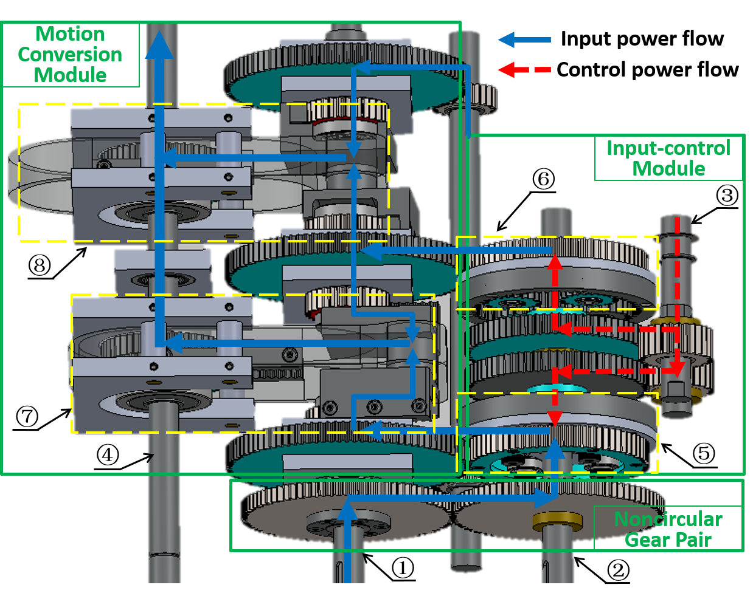
Research Objective and Tasks
Objective: Perform the following tasks to support New Technology Qualification (NTQ) process for infinitely variable transmission (IVT) design in tidal energy converter.
  Task 1: Failure modes and effects analysis (FMEA) on the gear box
    both the root bending fatigue in non-circular gear pair and planet gear sets were identified as the dominant failure mechanisms (WE336)
  Task 2: Probabilistic Physics-of-Failure (PPoF) based reliability assessment-stress-strength analysis (WE206)

Slide 3
Research Overview
Pick the most dominant failure modes from FMEA (loss of torque transmission )
  Stress overload (failure mechanism-1)
  Tooth bending fatigue (failure mechanism-2)
Perform stress/load estimation for gear box as a function of tide current velocity
Evaluate the strength of the gear for multiple materials
Quantitative analysis for stress-strength analysis (for overloaded conditions)
Quantitative analysis for high-cycle fatigue analysis (low stress condition)
Reliability analysis by combining the over-loaded and high-cycle fatigue analysis

Slide 4
2.1 Pick the most dominant failure modes from FMEA
IV Gear Systems | Category | Failure Mode | Failure Mechanism (Root Causes) | RPN (Severity*Frequency*Detection)
Noncircular gear pair | A.1 | Loss of torque Transmission | Root bending fatigue | 320 (10*4*8)
Planetary gear sets | B.3 | Loss of torque Transmission | Excessive vibration/noise; Overheating; Locked rotation | 320 (10*4*8)
Output gears | D.1 | Loss of output torque contribution | Root bending fatigue of output gear Teeth | 240 (10*3*8)
Planetary gear sets | B.1 | Loss of combined speed accuracy | Sun gear tooth deflection under load | 216 (9*3*8)
Rack–pinion sets | C.1 | Excess backlash | Abrasive wear of rack and pinion teeth | 210 (6*7*5)
Noncircular gear pair | A.3 | Loss of modulation accuracy | Fretting wear at hub-shaft interface | 200 (8*5*5)

Slide 5
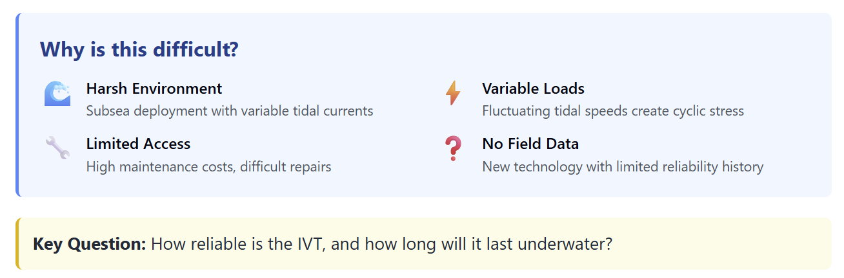
The challenge: Subsea Energy Harvesting
The Probabilistic-Physics of Failure (PPoF) Approach is proposed

Slide 6
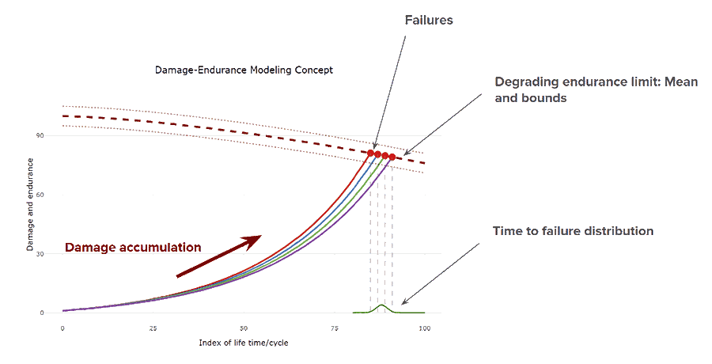
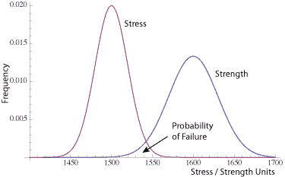
Probabilistic Physics-of-Failure Methodology
Stress-strength Analysis
Damage-Endurance
Good for overloaded condition analysis
Good for wear, corrosion, erosion, and fatigue analysis
M. Modarres, M. P. Kaminskiy, and V. Krivtsov, Reliability engineering and risk analysis: a practical guide. CRC press, 2016

Slide 7

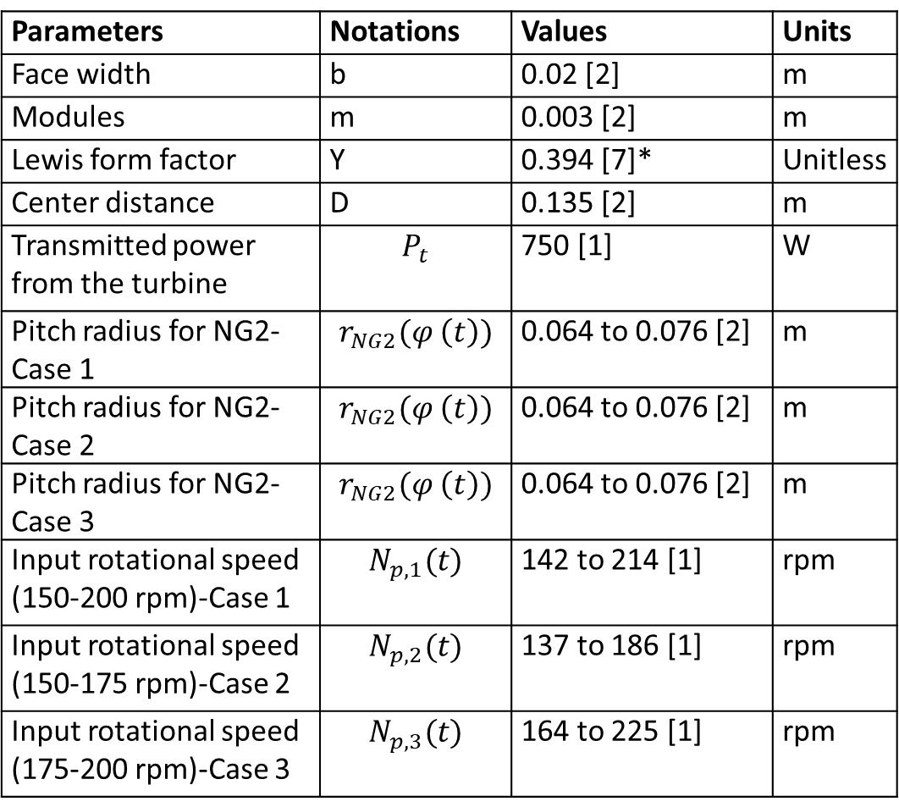


Stress Characterization
(Inputs and model)
Parameters | Notations | Values | Units
Face width | b | 0.02 [2] | m
Modules | m | 0.003 [2] | m
Lewis form factor | Y | 0.394 [7]* | Unitless
Center distance | D | 0.135 [2] | m
Transmitted power from the turbine | $$P_{t}$$ | 750 [1] | W
Pitch radius for NG2-Case 1 | $$r_{NG2}(φ \left(t\right))$$ | 0.064 to 0.076 [2] | m
Pitch radius for NG2-Case 2 | $$r_{NG2}(φ \left(t\right))$$ | 0.064 to 0.076 [2] | m
Pitch radius for NG2-Case 3 | $$r_{NG2}(φ \left(t\right))$$ | 0.064 to 0.076 [2] | m
Input rotational speed (150-200 rpm)-Case 1 | $$N_{p,1}(t)$$ | 142 to 214 [1] | rpm
Input rotational speed (150-175 rpm)-Case 2 | $$N_{p,2}(t)$$ | 137 to 186 [1] | rpm
Input rotational speed (175-200 rpm)-Case 3 | $$N_{p,3}(t)$$ | 164 to 225 [1] | rpm
$$σ_{b}=\frac{T_{in}\left(t\right)}{bmYr_{NG2}\left(t\right)}$$
$$r_{NG2}\left(t\right)=\frac{D}{1+i_{n}\left(θ\left(t\right)\right)}$$
$i_{n}(θ(t))=\frac{π}{2\sqrt{2}}max⁡\left[sinθ_{n},\sin\left(θ_{n}−\frac{π}{2}\right),\sin\left(θ_{n}−π\right),sin⁡(θ_{n}−\frac{3π}{2})\right]$,
$θ_{n}\left(t=0\right)=0$; $θ_{n} \left(t+1\right)=θ_{n} \left(t\right)+\frac{2πN_{p}(t)}{60{ i}_{n}(θ(t))}$,
$T_{in}(t)=\frac{60P_{t}}{2πN_{p}(t)}$,
[1] G. Li and W. Zhu, "Control and flume flow experiments of a tidal current energy converter with an infinitely variable transmission," IEEE/ASME Transactions on Mechatronics, vol. 29, no. 4, pp. 2803-2811,(2024).
[2] G. Li and W. Zhu, "Design and power loss evaluation of a noncircular gear pair for an infinitely variable transmission," Mechanism and Machine Theory, vol. 156, p. 104137,(2021).
[7] RoyMech. "Spur Gears: Design, Formula, Terminology and Calculations." https://www.roymech.co.uk/Useful_Tables/Drive/Gears.html (accessed May 21, 2026).
*Assume that it is applicable for 42-tooth with 20 degrees of pressure angle

Slide 8
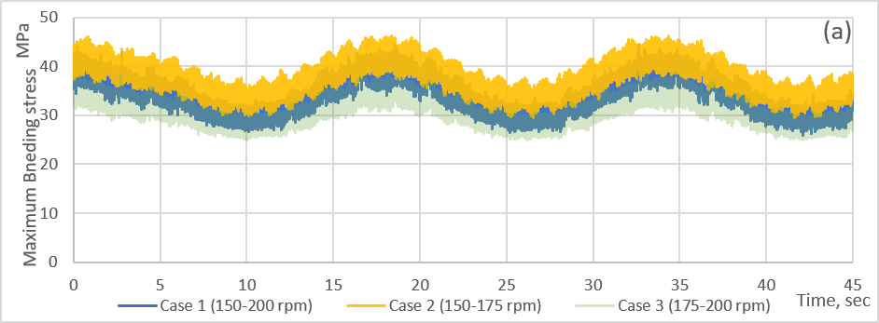
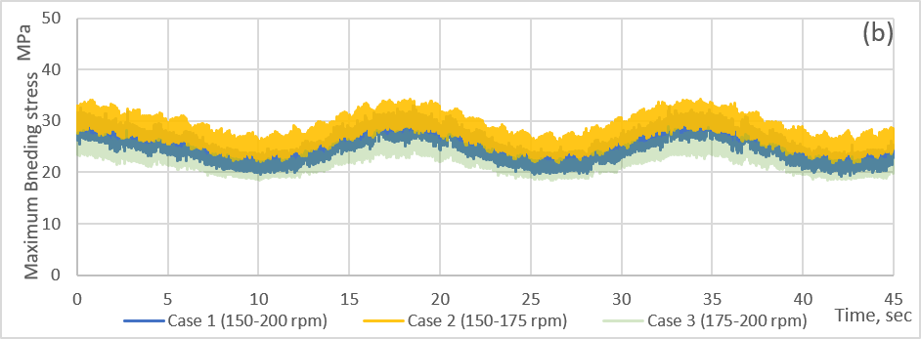
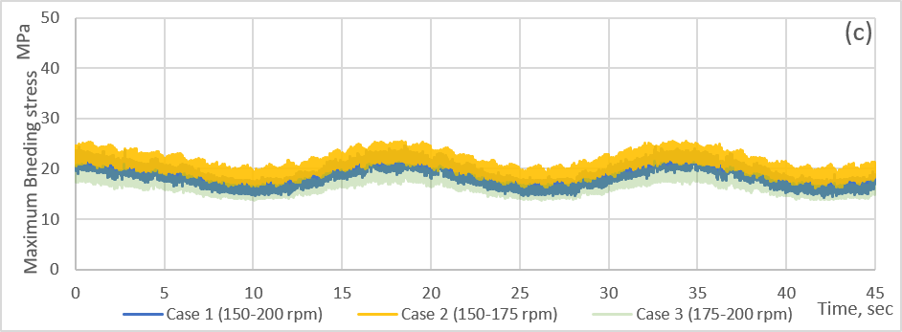
Stress Characterization (Results)
All bending stresses are all less than 50 MPa (limited concern if material is selected properly)
The stress ranges between the maximum and minimum stresses are less than 17 MPa (high cycle fatigue problem)

Slide 9
Phase I: Stress-Strength Analysis
Types of Material | Yield strength (MPa)
M1: Nylon-12 | Normal (µ=55, σ=4)
M2: 6061-T6/T651 aluminum | Lognormal (mean=276, std=23.6)
M3: AISI 4140 low-alloy steel | Lognormal (mean=415, std=33)

Slide 10
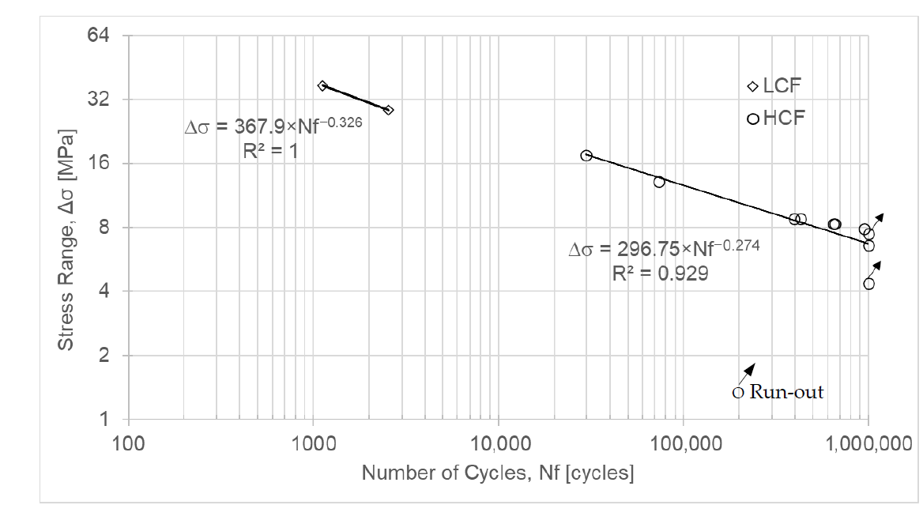
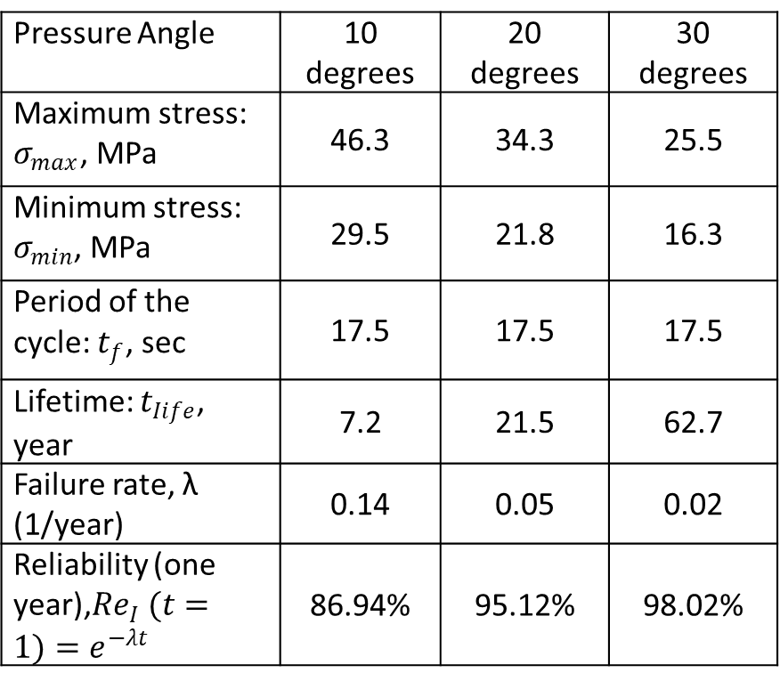
Phase II: Damage-endurance (S-N curves)
Pressure Angle | 10 degrees | 20 degrees | 30 degrees
Maximum stress: $σ_{max}$, MPa | 46.3 | 34.3 | 25.5
Minimum stress: $σ_{min}$, MPa | 29.5 | 21.8 | 16.3
Period of the cycle: $t_{f}$, sec | 17.5 | 17.5 | 17.5
Lifetime: $t_{Iife}$, year | 7.2 | 21.5 | 62.7
Failure rate, λ (1/year) | 0.14 | 0.05 | 0.02
Reliability (one year),${Re}_{I} (t=1)=e^{−λt}$ | 86.94% | 95.12% | 98.02%
Â. Rodrigues, R. Branco, M. Franco, R. Silva, C. Malça, and R. F. Martins, "Mechanical, Fatigue, and Thermal Characterization of ASA, Nylon 12, PC, and PC-ABS Manufactured by Fused Filament Fabrication (FFF)," Polymers, vol. 18, no. 2, p. 302,(2026).

Slide 11
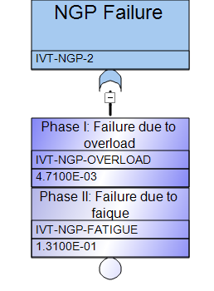
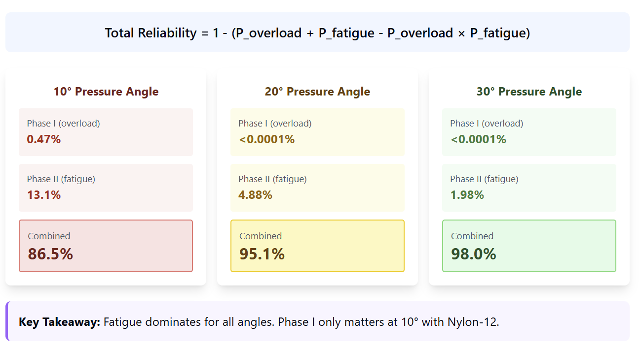
Combined Reliability Estimation

Slide 12
Conclusions and Future works
Failure Mode and Effect Analysis (FMEA) indicates that tooth bending fatigue is a critical issue for non-circular gear pair in infinitely variable transmission (IVT) of tidal current energy converters for marine energy applications.
Both stress-strength and damage-endurance from probabilistic physics-of-failure analysis was performed and concluded that damage-endurance analysis contributes more in the reliability assessment.
Reliability ranges from 86% to 98% depending on the design pressure angle if a Nylon-12 is used.
For the real tidal energy environment, it is expected that the power conversion is larger, leading to larger stress variation, which needs validation and verification using real testing data. (Paper #3)

Slide 13
Research Team
Wen-Chi Cheng, PhD, wenchi.cheng@inl.gov
Mucun Sun, PhD, Mucun.Sun@inl.gov
Fazlur Rahman Bin Karim, PhD student, fazlurrahmanbin.karim@inl.gov
Gang Li, Assistant professor at MSU, gli@me.msstate.edu
ABS (American Bureau of Shipping)

Slide 15
