Slide 1
Advanced Reactor Risk-Informed Licensing: Evaluation of Data Availability and Suitability
July 2026 | Pittsburgh
Pavan Kumar Vaddi, Askin Guler Yigitoglu
Modern Nuclear I&C Group, ORNL.

Slide 2
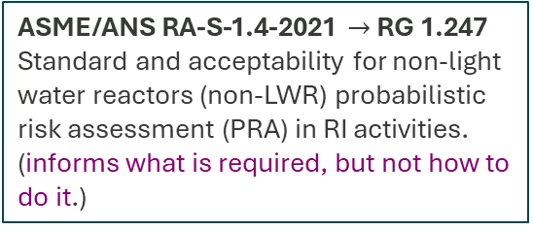
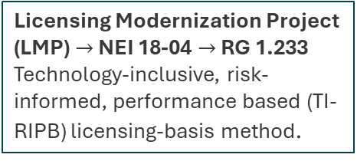
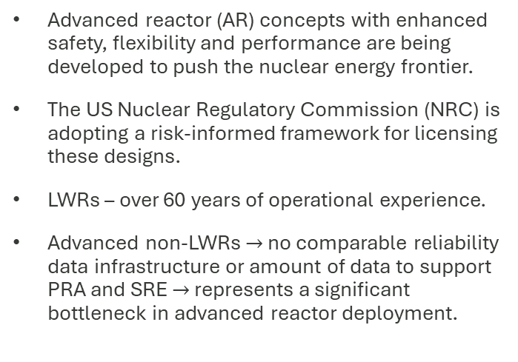
The Problem – Advanced Reactor Licensing is in Critical Need of Reliability Data
Licensing Modernization Project (LMP) $→$ NEI 18-04 $→$ RG 1.233
Technology-inclusive, risk-informed, performance based (TI-RIPB) licensing-basis method.
ASME/ANS RA-S-1.4-2021 $→$ RG 1.247
Standard and acceptability for non-light water reactors (non-LWR) probabilistic risk assessment (PRA) in RI activities. (informs what is required, but not how to do it.)
10 CFR Part 53
Promotes the use of PRA and other Systematic Risk Evaluations (SRE) in TI-RIPB licensing
Advanced reactor (AR) concepts with enhanced safety, flexibility and performance are being developed to push the nuclear energy frontier.
The US Nuclear Regulatory Commission (NRC) is adopting a risk-informed framework for licensing these designs.
LWRs – over 60 years of operational experience.
Advanced non-LWRs $→$ no comparable reliability data infrastructure or amount of data to support PRA and SRE $→$ represents a significant bottleneck in advanced reactor deployment.
Example: Pebble Bed Fluoride Salt Cooled High Temperature Reactor (PB-FHR) PRA.
Reactivity control elements can be inserted directly into the pebble bed [1].
What initiating events should be considered?
How could a control element fail to insert?
What is the failure probability per demand?
What success criteria and uncertainties are justified?
There is no commercial PB-FHR fleet.
LWR fleet has no comparable experience to capture such control element insertion.
1. Buster, G., Sawadichai, R., Laufer, M. and Peterson, P., 2015. Control Blade Insertion Dynamics in Pebble-Bed Fluoride-Salt-Cooled High-Temperature Reactors. Department of Nuclear Engineering, University of California, Berkeley.

Slide 3
Reliability Data – What is needed?
Type -2: Quantitative Data
How often? What is the likelihood?
Failure rates/Frequencies per unit time or per demand.
Human error probability values
Distribution parameters (shape, scale, mean)
Uncertainty bounds
Population data
CCF parameters
Example Source: EIReDA, NUREG/CR-6928
Context Data
Under what conditions?
Informs/Adds depth to Type 1 and Type 2 data
Mission type – standby or in operation
Operating conditions – temperature, pressure etc.
Materials
Component lifecycle stage
Example Source: NRC LER database – context is recorded.
Type -1: Qualitative Event Data
What can go wrong?
Definitions and descriptions of:
Failures and failure modes
Root causes
Degradation mechanisms
Event sequences
End consequences
Example Source: NRC LER database
PB-FHR example:
Control element blade jamming/failure to insert.
Broken pebbles.
Blade geometry, Insertion angle, Buoyancy/Forces due to pebbles floating in molten salt coolant.
Failure probability per demand.
This information is not new, but we are stating it here to establish our problem statement.*
Notes:
Broadly establish what data is needed – This information is not new, but we are stating it here to establish our work.

Slide 4
Reliability Data Sources – Where can we find the data?
Data source: Any report, document, or recorded experience containing reliability information.
Database: Organized repository that aggregates records from various facilities, components, or periods for querying. All databases are data sources.
Experimental/Report level
Curated reliability databases
Type -1 Data - phenomenological and context rich
Generated by small loops, experiments, testbeds as well.
Often-technology specific
Usually from limited operation,
May reveal relevant failure modes but rarely contain fleet level data.
Ex: Molten Salt Reactor Experiment (MSRE) reports
Structured, queryable, statistical
Type 2 rich
Potentially large populations
Possibly from multiple facilities
May cover long operation duration
Purpose built (usually for PRA)
Requires multi-institute collaboration, sustained funding
Ex: NROD, RADS, MoSARD
Reliability data source spectrum
Data from both ends are needed*
Buster, G., Sawadichai, R., Laufer, M. and Peterson, P., 2015. Control Blade Insertion Dynamics in Pebble-Bed Fluoride-Salt-Cooled High-Temperature Reactors. Department of Nuclear Engineering, University of California, Berkeley.
Rubin, S., 2001. Briefing on Visit of the NRC Delegation to Germany on Safety Aspects of HTR Technology. Nuclear Regulatory Commission. https://www.nrc.gov/docs/ML0219/ML021960035.pdf.
Publicly available fleet scale parameters do not exist.
Control Blade Insertion Experiment (CoBIE) at UC Berkeley [1].
Operating experience from Thorium High Temperature Reactor (THTR), Germany [2]
What data are present?
Blade tip jamming behavior, Insertion force variability, Effects of blade geometry, Descriptions of failure-to-insert mechanisms.
What data are absent?
Long-term and fleet scale quantitative parameters.

Slide 5
Challenges in the Landscape of Non-LWR Reliability Data Sources
Challenges
Questions to address
Sources are scattered across documents, databases, organizations and countries.
1. Where are the candidate sources?
Each source contains different data: descriptions, rates, context, uncertainty etc.
2. What data do those contain?
Sources are generated under different objectives, quality assurance (QA) practices, operators etc.
3. What is the pedigree/quality of those sources?
Sources rarely match target advanced reactor designs – coolants, materials, operating regimes etc.
4. How applicable are the data in those sources?
Find relevant sources, evaluate their content and quality, and assess their usefulness.
Can I use (type 1) data from CoBIE – operated by students in a research setting, directly in PB-FHR PRA? How about PB gas cooled reactor PRA (blade jamming behavior)?
We are primarily addressing question 2-4.

Slide 6
The 12 Characteristic Framework
# | Characteristic | Evaluation question (for the data source under evaluation) | Supporting requirements from ASME/ANS RA-S-1.4-2021
1 | Objective | Why were these data collected? What was the intended purpose and scope? | HLR-DA-A, DA-B2
2 | System design | From which system were the data collected? Specific to this effort - are there any data from non-LWR systems? | DA-A2, HLR-DA-B, DA-C1
3 | Operational regime context | Under which conditions were the reliability data collected (power ranges, life cycle stage, in operation or standby, etc.)? | DA-B1, DA-C8
4 | Component populations | How many different types, designs, and number of components were considered? | DA-B1, DA-B2
5 | Data collection duration | How long were the data collection efforts? | DA-C11, DA-E1(e)
6 | Age of the data source | How old is the data source (i.e., when was the data collected)? | DA-D10
7 | Data source accessibility | Is the data source publicly available? Or is access restricted? | No direct requirement
8 | Reliability data type | Which reliability data are collected and stored (Type 1, Type 2, or both)? | DA-C5
9 | Data quality assurance and validation | Which standards were followed in collecting and storing the data? Are the data verified across sources? Are the data sufficient? | DA-C1, DA-E1
10 | Uncertainty characterization | Does the data source include parameters/mechanisms for uncertainty quantification? | HLR-DA-D, DA-D3
11 | Data use | How were these data used and who are the expected users of the data? | DA-E1
12 | Data extrapolatability | Can the data be extrapolated to similar components in systems with “similar” design parameters or “similar” operating conditions? | DA-C1, DA-C2, DA-D2
Expanded from the work in [3, 4, 5].
3. K. M. Groth, A. Al-Douri, M. West, K. Hartmann, G. Saur, and W. Buttner, “Design and requirements of a hydrogen component reliability database (HyCReD),” International Journal of Hydrogen Energy, vol. 51, pp. 1023–1037, Jan. 2024, doi: 10.1016/j.ijhydene.2023.07.165.
4. International Atomic Energy Agency, Development and Application of Level 1 Probabilistic Safety Assessment for Nuclear Power Plants, 2024. doi: 10.61092/iaea.3ezv-lp49.
5. R. Gitzel, S. Turring, and S. Maczey, “A Data Quality Dashboard for Reliability Data,” in 2015 IEEE 17th Conference on Business Informatics, Jul. 2015, pp. 90–97. doi: 10.1109/CBI.2015.24.

Slide 7
12 Characteristics of Data Sources
1. Objective
Why the data was collected influences what was recorded.
Determines the scope, structure, definitions and what the data can/cannot support.
Helps identify any gaps and biases (ex: emphasis on certain phenomena).
2. System Design
Which systems are covered in the data source
Databases without relevant reactor data are limited to generic components – ex: electric components.
Design features explicitly considered:
  Coolant family
  Neutron spectrum
  Materials of construction
  Instrumentation and control.
  Physical scale
  System and facility configuration
 | CoBIE report [1] | LWR and Liquid Sodium generic component reliability database [2]
Objective | Study control blade insertion in a pebble bed. | Provide PRA-ready generic component reliability parameters.
What is recorded | Records on insertion forces and hysteresis, blade tip jamming, analysis of pebble failure, control blade buckling and deflection results. | Failure counts, operating time, demands, parameter estimates
What it supports | Defining success criteria and failure modes of control blade insertion. | Type – 2 data for PRA, generic priors
Buster, G., Sawadichai, R., Laufer, M. and Peterson, P., 2015. Control Blade Insertion Dynamics in Pebble-Bed Fluoride-Salt-Cooled High-Temperature Reactors. Department of Nuclear Engineering, University of California, Berkeley.
Eide, S A, et al. "GENERIC, COMPONENT FAILURE DATA BASE FOR LIGHT WATER AND LIQUID SODIUM REACTOR PRAs." , Feb. 1990. https://doi.org/10.2172/975488

Slide 8
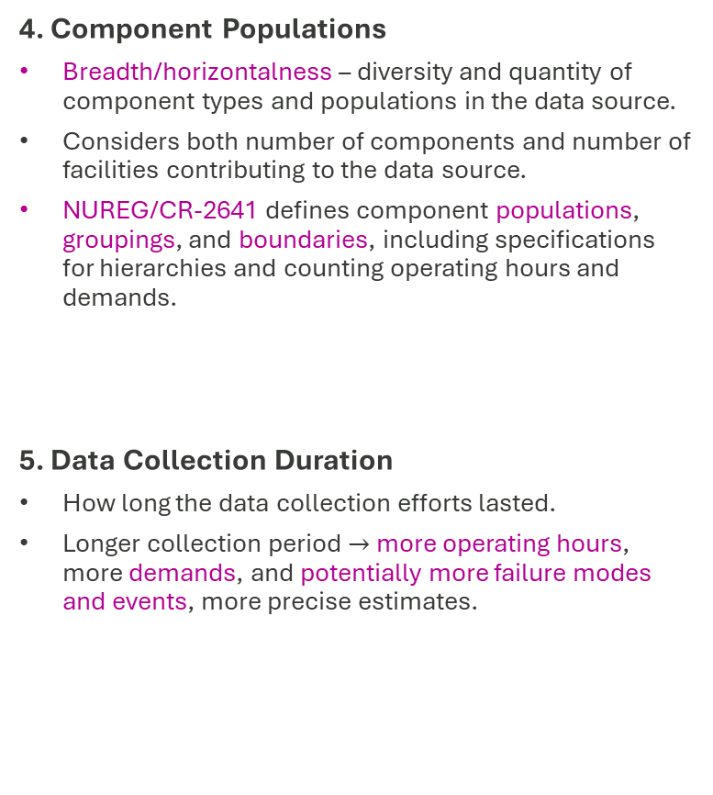
12 Characteristics of Data Sources
3. Operating Regime Context
Conditions under which the data were collected.
Example: NUREG/CR-6928 excludes startup and shutdown-related events.
ASME/ANS RA-S-1.4-2021 requires PRA for advanced reactors to consider multiple plant operating states beyond full power.
Include:
  Operating mode and mission profile: Operating, standby, intermittent.
  Physical conditions: The operating physics range over which the data were generated. Example: MSRs: ~600–750 °C and low pressure (< 1 MPa); HTGRs: ~700–950 °C and high-pressure (~7 MPa).
  Chemistry control practice: Corrosion and material degradation depend on chemistry, impurity levels (moisture, oxygen), and control measures.
  Life cycle stage: Whether the data cover burn-in, useful life, or wear-out periods of the components.
  Operational context during data generation and collection: Data collected are influenced by the environment and personnel involved.
    Test loops and commercial reactors follow different protocols, interventions etc.
    Failures linked to support systems or human factors unique to test environments should be filtered. (Ex: Salt leak due to incorrect salt loading or insufficient tightening of pipes)
4. Component Populations
Breadth/horizontalness – diversity and quantity of component types and populations in the data source.
Considers both number of components and number of facilities contributing to the data source.
NUREG/CR-2641 defines component populations, groupings, and boundaries, including specifications for hierarchies and counting operating hours and demands.
5. Data Collection Duration
How long the data collection efforts lasted.
Longer collection period $→$more operating hours, more demands, and potentially more failure modes and events, more precise estimates.

Slide 9
12 Characteristics of Data Sources
6. Age of the Data
When was the data collected.
Is the MSRE data from 1960s relevant to AR designs in 2020s? - informative but potentially conservative priors.
Characteristic 2 - source specifications align with the target system vs Characteristic 6 - assesses whether the era matches.
  Ex: 316H pipe from 1980 may have different defect distributions than one from 2025
4 sub aspects:
  Calendar age: The time gap between the source’s data window and the target system’s design period.
  Manufacturing-era practices: Standards in effect when components were made,. Ex: ASME Boiler and Pressure Vessel Code (BPVC)
  QA program “era”: Regulatory QA requirements vary over time; data generated from previous regimes may need special justification for current use.
  Record keeping practices: Data drawn from historical operation records (e.g., MSRE 1960s) depend on what was documented, which may differ from actual events due to varying event definitions and I&C capabilities.
7. Accessibility
ASME/ANS RA-S-1.4-2021 - reliability estimates be documented, traceable and reviewable. Accessibility does not make a data source and the data contained within it good/credible, but makes traceability and the PRA review process easier.
Two types:
  Publicly available data (PAD): Information approved for unlimited public release (e.g., published reports).
  Access controlled:
    Applied technology (AT) data: nonpublic technical information developed under DOE programs. Not classified but controlled.
    Export controlled (EC) data: Information needs formal review, restricted access, and sharing controls. NaSCoRD contains both AT and EC data.

Slide 10
12 Characteristics of Data Sources
8. Reliability Data Content
Which reliability data are in the data sources
3 types of sources:
  Type 1 sources – ex: NRC’s LER database, MSRE reports.
  Type 2 sources – ex: NUREG/CR-6928
  Mixed sources – ex: , NaSCoRD.
9. Data Quality Assurance and Validation
focus is the data itself (i.e., the records of failure rates, distributional parameters, event narratives, and context fields).
Quality is inherent to the data. Validation reflects the analyst's or user's assessment.
6 sub aspects [4,5]:
  Level of detail: granularity of recorded information (i.e., does the data source contains detailed descriptions of failure events and modes or aggregate counts).
  Data collectors: human factors element of (and not in) reliability data. Quality of the data is impacted by who collects it. NUREG/CR-6928 - from the operating commercial LWR fleet, CoBIE type -1 data - from a test loop operated by students.
  Standards and codes: Adherence to reliability standards like ISO 14224:2016.
  Consistency: Reviews if uniform definitions, formats, and coding were applied over time and across locations
  Quantity and significance: Are collected data sufficient to estimate failure parameters and establish uncertainty bounds of those parameters.
  Cross validation: Type 1 data are verified across facilities for matching failure modes and Type 2 data are benchmarked with comparable sources.
4. International Atomic Energy Agency, Development and Application of Level 1 Probabilistic Safety Assessment for Nuclear Power Plants, 2024. doi: 10.61092/iaea.3ezv-lp49.
5. R. Gitzel, S. Turring, and S. Maczey, “A Data Quality Dashboard for Reliability Data,” in 2015 IEEE 17th Conference on Business Informatics, Jul. 2015, pp. 90–97. doi: 10.1109/CBI.2015.24
Notes:
Characteristic 4 establishes the population (numbers) from which the data are reported, and this sub metric determines whether what is reported is adequate.

Slide 11

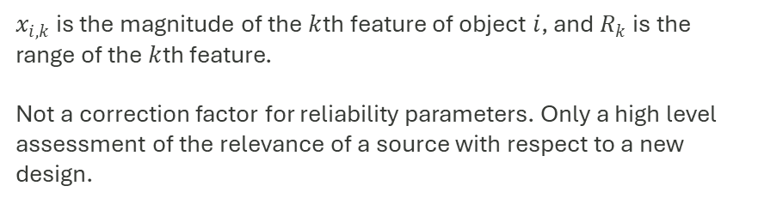

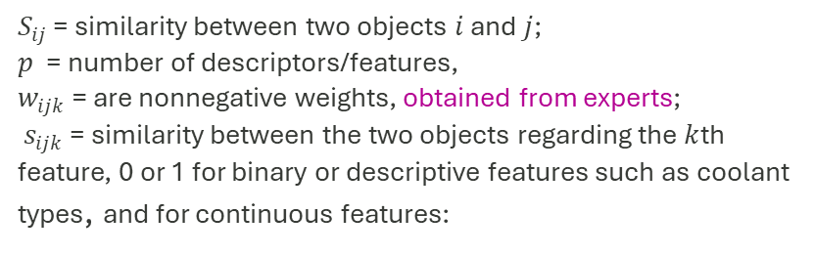
12 Characteristics of Data Sources
12. Extrapolatability
Relational with respect to a target design. Can reliability data from one source can credibly apply to a new reactor design PRA with similar but different design conditions.
Uses system design, operational regime, age (Characteristics 2, 3, and 6), and expert opinion to calculate Gower’s distance
10. Uncertainty Characterization
Does the data source include support for UQ?
Non-LWR sources lack clear support for UQ - requiring analysts to assess uncertainty through expert judgment or sensitivity analysis.
3 levels:
  Explicit: Source provides distributional parameters and the analyst transcribes them.
  Implicit: Source does not provide distributional parameters but gives sufficient statistics (e.g., failure count) to compute distributional parameters.
  Absent: Source only offers point estimates and analyst assigns a default uncertainty distribution based on assumptions.
11: Data Use
Usage history - indirect evidence of quality, acceptance, and regulatory suitability.
Characteristic 1 - why the data was collected, characteristic 11 - how the data was used after collection
$$S_{ij} = \frac{\sum_{k = 1}^{p}{w_{ijk}s_{ijk}}}{\sum_{k = 1}^{p}{w_{ijk}}}$$
$S_{ij}$ = similarity between two objects $i$ and $j$;
$p$ = number of descriptors/features,
$w_{ijk}$ = are nonnegative weights, obtained from experts;
$s_{ijk}$ = similarity between the two objects regarding the $k$th feature, 0 or 1 for binary or descriptive features such as coolant types, and for continuous features:
$$s_{ijk} = 1 − \frac{\left|x_{i,k} − x_{j,k}\right|}{R_{k}}$$
$x_{i,k}$ is the magnitude of the $k$th feature of object $i$, and $R_{k}$ is the range of the $k$th feature.
Not a correction factor for reliability parameters. Only a high level assessment of the relevance of a source with respect to a new design.
Notes:
Characteristics 1-11: Source assessment on its own.
Ch12: how good of a match is a source
- High level assessment of the source itself. Not correction factors for actual reliability parameters.

Slide 12
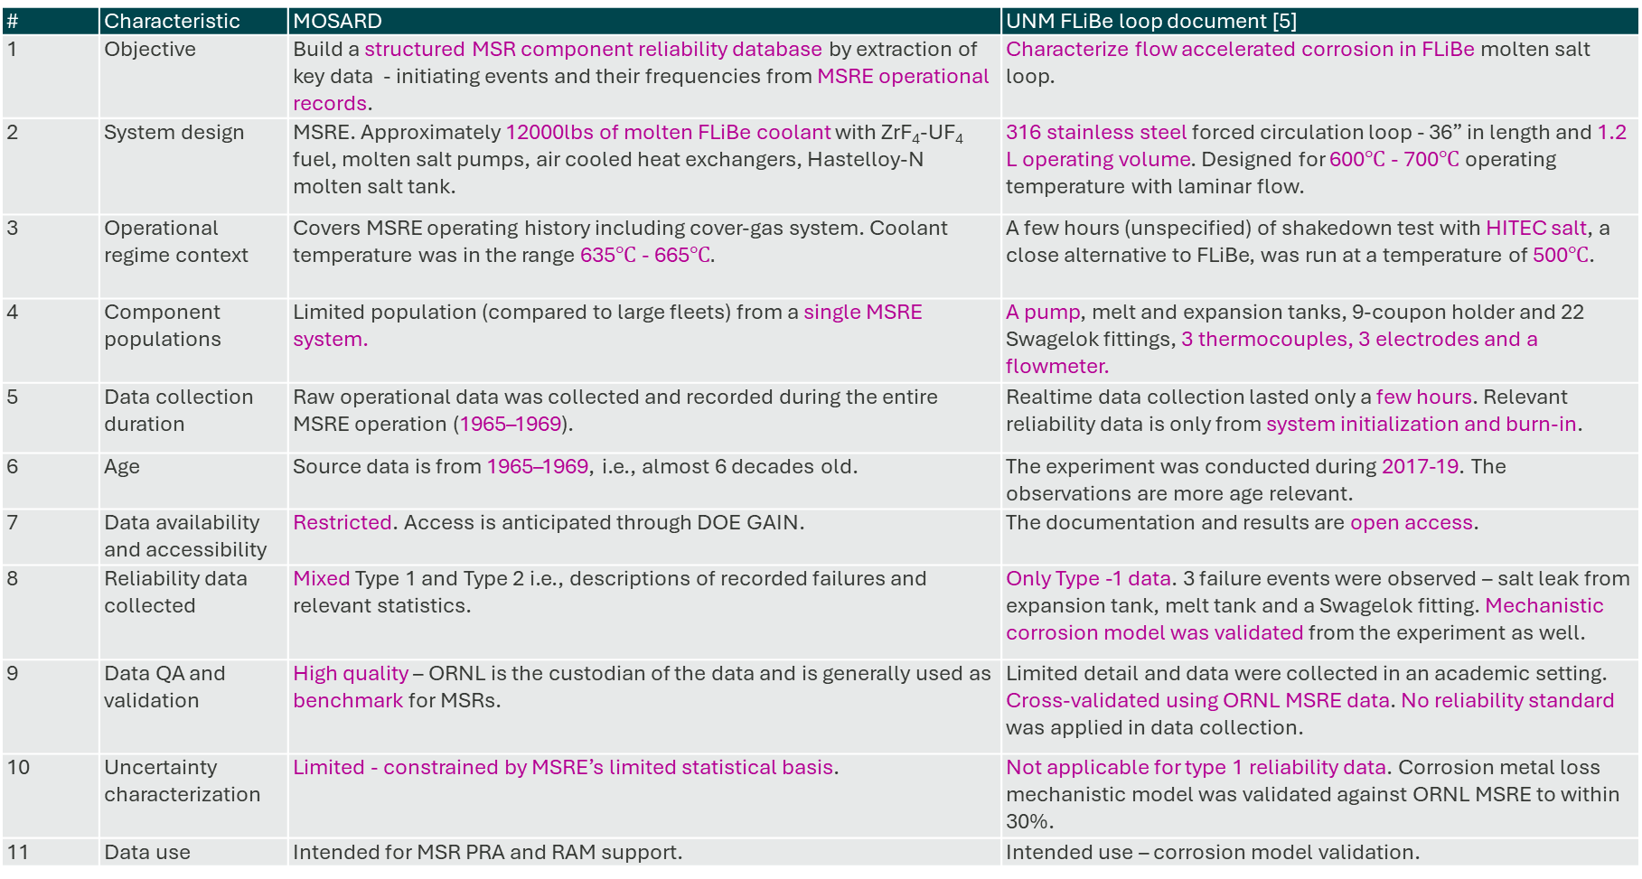
Example demonstration of the framework
# | Characteristic | MOSARD | UNM FLiBe loop document [5]
1 | Objective | Build a structured MSR component reliability database by extraction of key data - initiating events and their frequencies from MSRE operational records. | Characterize flow accelerated corrosion in FLiBe molten salt loop.
2 | System design | MSRE. Approximately 12000lbs of molten FLiBe coolant with ZrF₄-UF₄ fuel, molten salt pumps, air cooled heat exchangers, Hastelloy-N molten salt tank. | 316 stainless steel forced circulation loop - 36” in length and 1.2 L operating volume. Designed for 600$℃$ - 700$℃$ operating temperature with laminar flow.
3 | Operational regime context | Covers MSRE operating history including cover-gas system. Coolant temperature was in the range 635$℃$ - 665$℃.$ | A few hours (unspecified) of shakedown test with HITEC salt, a close alternative to FLiBe, was run at a temperature of 500$℃$.
4 | Component populations | Limited population (compared to large fleets) from a single MSRE system. | A pump, melt and expansion tanks, 9-coupon holder and 22 Swagelok fittings, 3 thermocouples, 3 electrodes and a flowmeter.
5 | Data collection duration | Raw operational data was collected and recorded during the entire MSRE operation (1965–1969). | Realtime data collection lasted only a few hours. Relevant reliability data is only from system initialization and burn-in.
6 | Age | Source data is from 1965–1969, i.e., almost 6 decades old. | The experiment was conducted during 2017-19. The observations are more age relevant.
7 | Data availability and accessibility | Restricted. Access is anticipated through DOE GAIN. | The documentation and results are open access.
8 | Reliability data collected | Mixed Type 1 and Type 2 i.e., descriptions of recorded failures and relevant statistics. | Only Type -1 data. 3 failure events were observed – salt leak from expansion tank, melt tank and a Swagelok fitting. Mechanistic corrosion model was validated from the experiment as well.
9 | Data QA and validation | High quality – ORNL is the custodian of the data and is generally used as benchmark for MSRs. | Limited detail and data were collected in an academic setting. Cross-validated using ORNL MSRE data. No reliability standard was applied in data collection.
10 | Uncertainty characterization | Limited - constrained by MSRE’s limited statistical basis. | Not applicable for type 1 reliability data. Corrosion metal loss mechanistic model was validated against ORNL MSRE to within 30%.
11 | Data use | Intended for MSR PRA and RAM support. | Intended use – corrosion model validation.
5. D. Weitzel, “An Experimental and Numerical Investigation of Flow Accelerated FLiBe Corrosion,” University of New Mexico, 2019. [Online]. Available: https://digitalrepository.unm.edu/ne_etds/82

Slide 13
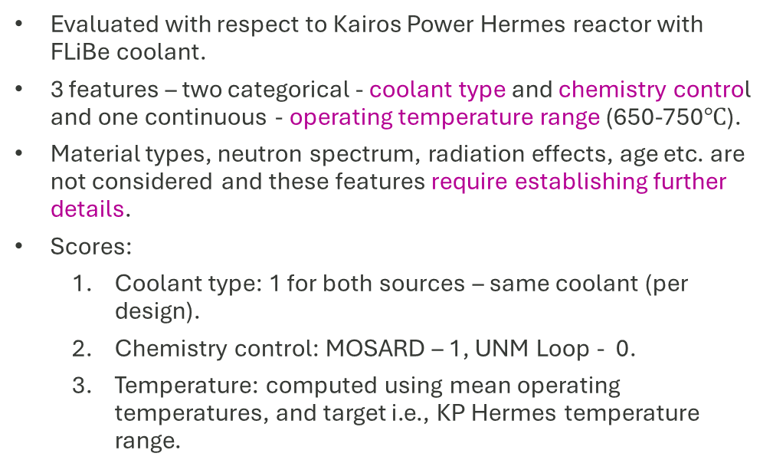
Extrapolatability
Weights | MOSARD | UNM Loop
Baseline - Equal weights (0.33, 0.33, 0.33) | 0.833 | 0.50
Coolant type dominant (0.6, 0.2, 0.2) | 0.9 | 0.7
Chemistry dominant (0.2, 0.6, 0.2) | 0.9 | 0.3
Temperature dominant (0.2, 0.2, 0.6) | 0.7 | 0.5
Evaluated with respect to Kairos Power Hermes reactor with FLiBe coolant.
3 features – two categorical - coolant type and chemistry control and one continuous - operating temperature range (650-750$℃$).
Material types, neutron spectrum, radiation effects, age etc. are not considered and these features require establishing further details.
Scores:
  Coolant type: 1 for both sources – same coolant (per design).
  Chemistry control: MOSARD – 1, UNM Loop - 0.
  Temperature: computed using mean operating temperatures, and target i.e., KP Hermes temperature range.
Quality
ranks
Extrapolatability
higher
0.833
MOSARD
0.50
UNM loop
lower

Slide 14
Conclusions and Future Work
Real sources are rarely uniformly good or bad: A source may be excellent on quality but weak on extrapolatability.
Some sources exhibit specific strengths (e.g., phenomenological insight and failure mode identification) and limitations for PRA use (e.g., incomplete exposure statistics, limited uncertainty characterization).
We provide a framework that enables analysts and reviewers to capture the strengths and weaknesses of a reliability data source.
Further work involves
  finalizing the framework with expert opinions
  assessment of weights for the extrapolatability metric.
  translating these descriptive characteristics into graded, design-specific assessment process,
  Providing guidance for consistent application across analysts and reactor concepts.

Slide 15
Acknowledgments
This research has been performed by UT‑Battelle, LLC, under Contract No. DE‑AC05‑00OR22725 with the U.S. Department of Energy.
This work was supported by the U.S. Nuclear Regulatory Commission, Office of Nuclear Regulatory Research, under Interagency Agreement (IAA) No. 31310025S0001.
The views expressed in this paper are those of the authors and do not necessarily represent the views of the NRC or the U.S. Government.
Thank You

Slide 16
Reliability Data Sources – Where can we find the data?
Data source: Any report, document, or recorded experience containing reliability information.
  Examples: NUREG/CR-6928, EIReDA.
Database: Organized repository that aggregates records from various facilities, components, or periods for querying.
  Examples: NaSCoRD, MOSARD.
Data generation
Data sources
Databases
Structured
Use consistent taxonomies
Queryable
(Can be) Collected from multiple facilities with large component populations.
Small scale test loops and experiments
Research and commercial reactors
Reports and publications
Synthesize
Datasets
Buster, G., Sawadichai, R., Laufer, M. and Peterson, P., 2015. Control Blade Insertion Dynamics in Pebble-Bed Fluoride-Salt-Cooled High-Temperature Reactors. Department of Nuclear Engineering, University of California, Berkeley.
Rubin, S., 2001. Briefing on Visit of the NRC Delegation to Germany on Safety Aspects of HTR Technology. Nuclear Regulatory Commission. https://www.nrc.gov/docs/ML0219/ML021960035.pdf.
Publicly available databases do not exist.
Control Blade Insertion Experiment (CoBIE) at UC Berkeley [1].
Operating experience from Thorium High Temperature Reactor (THTR), Germany [2]
What data are present?
Blade tip jamming behavior, Insertion force variability, Effects of blade geometry, Descriptions of failure-to-insert mechanisms.
What data are absent?
Long-term and fleet scale quantitative parameters.

Slide 17
12 Characteristics of Data Sources
9. Data Quality Assurance and Validation
focus is the data itself (i.e., the records of failure rates, distributional parameters, event narratives, and context fields).
Quality is inherent to the data. Validation reflects the analyst's or user's assessment.
6 sub aspects [3,4]:
  Level of detail: granularity of recorded information (i.e., does the data source contains detailed descriptions of failure events and modes or aggregate counts).
  Data collectors: human factors element of (and not in) reliability data. Quality of the data is impacted by who collects it. NUREG/CR-6928 - from the operating commercial LWR fleet, CoBIE type -1 data - from a test loop operated by students.
  Standards and codes: Adherence to reliability standards like ISO 14224:2016.
  Consistency: Reviews if uniform definitions, formats, and coding were applied over time and across locations
  Quantity and significance: Are collected data sufficient to estimate failure parameters and establish uncertainty bounds of those parameters.
  Cross validation: Type 1 data are verified across facilities for matching failure modes and Type 2 data are benchmarked with comparable sources.
 |  | Sub metrics
 |  | 1 | 2 | 3 | 4 | 5 | 6
Type 1 data (definitions and description) | Failures and failure modes
 | Root causes of failures (initiators)
 | Event sequences
 | Hazards
 | Consequences |  |  |  |  |  | System-dependent
Type 2 data (failure/ reliability/ statistics) | Failure rates/frequencies per unit time or per demand.
 | Human error probability values
 | Distributional parameters
 | Uncertainty bounds
 | Population data
 | Number of maintenance activities, time durations of repair and unavailability
 | CCF parameters |  |  |  |  | Limited availability
3. International Atomic Energy Agency, Development and Application of Level 1 Probabilistic Safety Assessment for Nuclear Power Plants, 2024. doi: 10.61092/iaea.3ezv-lp49.
4. R. Gitzel, S. Turring, and S. Maczey, “A Data Quality Dashboard for Reliability Data,” in 2015 IEEE 17th Conference on Business Informatics, Jul. 2015, pp. 90–97. doi: 10.1109/CBI.2015.24
Notes:
Characteristic 4 establishes the population (numbers) from which the data are reported, and this sub metric determines whether what is reported is adequate.

