Slide 1

PSAM 18, Pittsburgh, PA, USA, July 2026
Advancing Probabilistic Risk Assessment in Critical Systems Using Python and Time Simulation: The SURE Methodology
Todd Paulos, Ph.D.
William Tirone
Andrew Ho
Joshua Bendig

Slide 2
Acknowledgement
Pittsburgh, PA, USA
This research was carried out at the Jet Propulsion Laboratory, California Institute of Technology, under a contract with the National Aeronautics and Space Administration.
“Be quick, be quiet, and be on time”
KELLY JOHNSON
Notes:
ANIMATED:
Click three times to show each quote.

Slide 3
Acknowledgement
This research was carried out at the Jet Propulsion Laboratory, California Institute of Technology, under a contract with the National Aeronautics and Space Administration.
“Be quick, be quiet, and be on time”
KELLY JOHNSON
“I believe in the golden rule:
he who has the gold makes the rules”
BEN RICH
Notes:
ANIMATED:
Click three times to show each quote.

Slide 4
Acknowledgement
This research was carried out at the Jet Propulsion Laboratory, California Institute of Technology, under a contract with the National Aeronautics and Space Administration.
“Be quick, be quiet, and be on time”
KELLY JOHNSON
“I believe in the golden rule:
he who has the gold makes the rules”
BEN RICH
“Do not go where the path may lead,
go instead where there is no path
and leave a trail”
EMERSON
Notes:
ANIMATED:
Click three times to show each quote.

Slide 5
Topics
💡 Inspirations
⚠️ Limitations of Current Modeling
⚙️ SURE Methodology
🧪 Example Problem (2 Phases)
📊 Results
✅ Conclusions

Slide 6
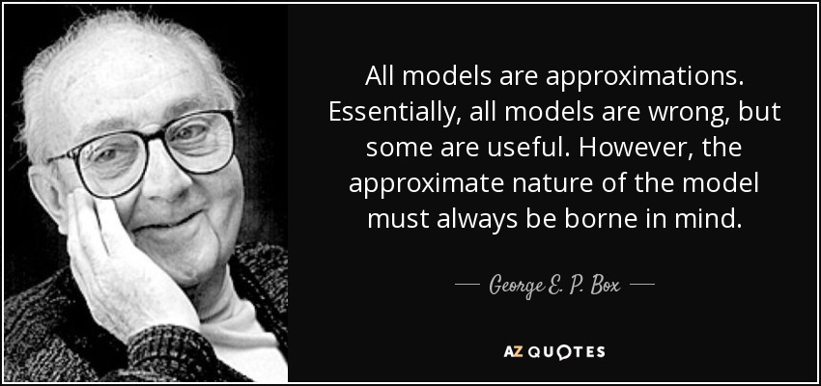
Models of the World

Slide 7
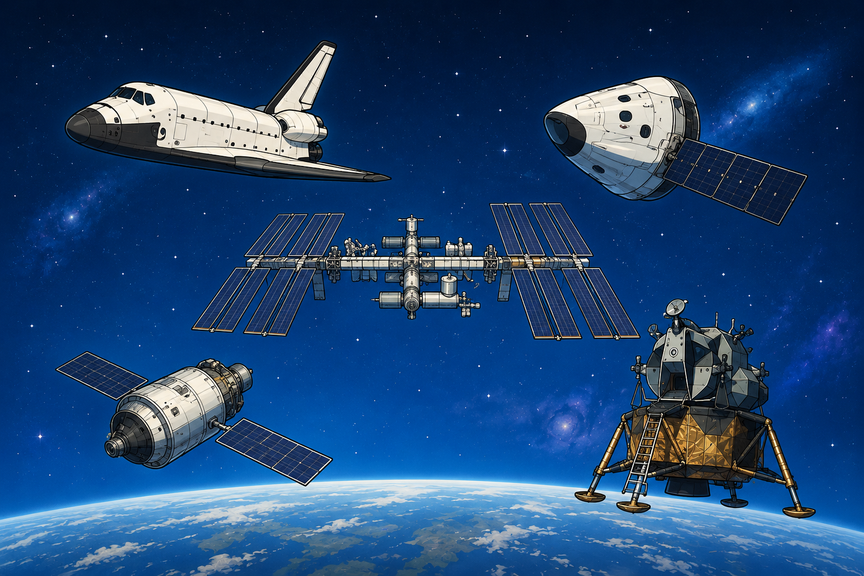

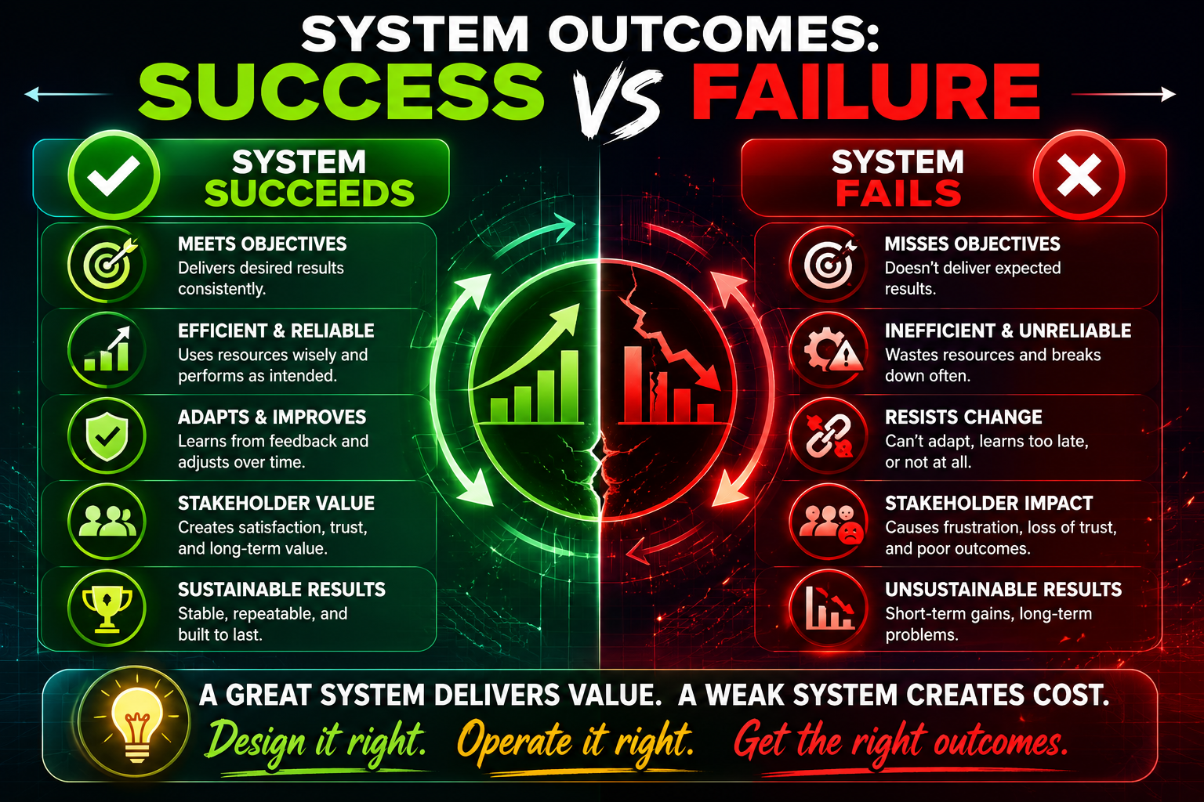
Inspirations
PRAs of long duration missions tend to be overly conservative and predict high probabilities of failure; predictions do not match actual performance
Failure rates are not constant (e.g., wear out) in long duration missions; use of exponential distributions are problematic
Discussions that the PRA process and prioritization of risk drivers is the important outcome are difficult with such high failure predictions
A new methodology was needed to assess long-term missions where rare event approximations and exponential assumptions fail, thus…

Slide 8
Simulated Uncertainty and Reliability Estimation (SURE) Methodology
System life models simulated in time
No rare event approximations
No exponential random variables
Think of a spacecraft, shiny and new
Designed to work with inputs from SAPHIRE 8 for simplicity and consistency
Notes:
ANIMATED:
Click three times to show each quote.

Slide 9
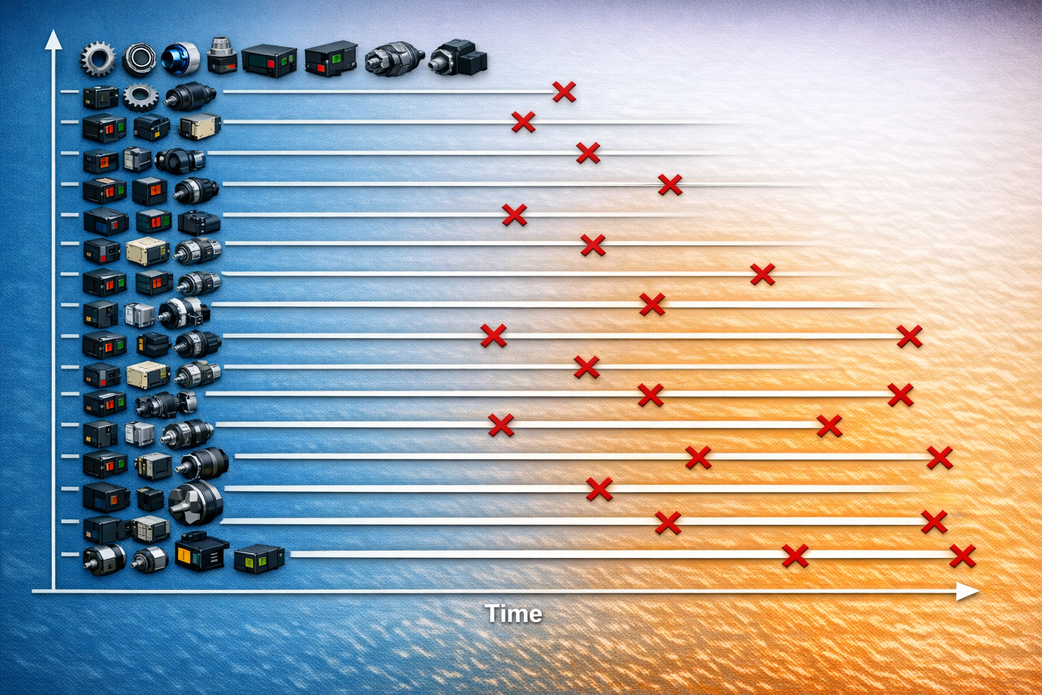
The Model of the World
Consider the system a state machine
System survives until specific components fail
Unlike typical models, many components can fail before the system fails

Slide 10
Pseudo Code
Import Minimal Cut Set (MCS) and basic event uncertainty information from SAPHIRE 8
Process the MCS and basic event information into the simulation
Identify components with multiple failure modes and phases and mark them for additional handling
Convert basic event rate and uncertainty information for each basic event into a failure time model
Run simulation
Compute summary statistics of mission times to failure and drivers

Slide 11
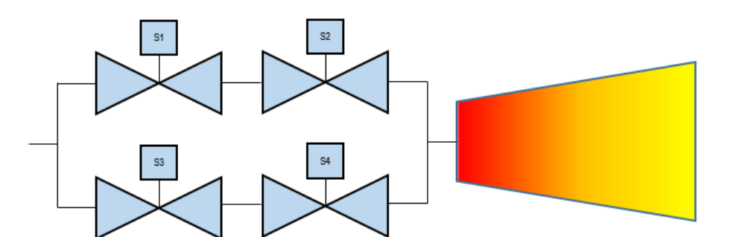
Thruster Problem
T. Paulos, C. Smith and A. Ho. “Reliability Modeling of Complex Components Using Simulation,” Proceedings of the 16th International Conference on Probabilistic Safety Assessment and Management (PSAM 16), (2022). Available at https://psam16.org/.
Initially done in one phase as a proof-of-concept
This work continues into two phases; can be extended into many phases
Two competing failure scenarios: paths open and paths closed

Slide 12
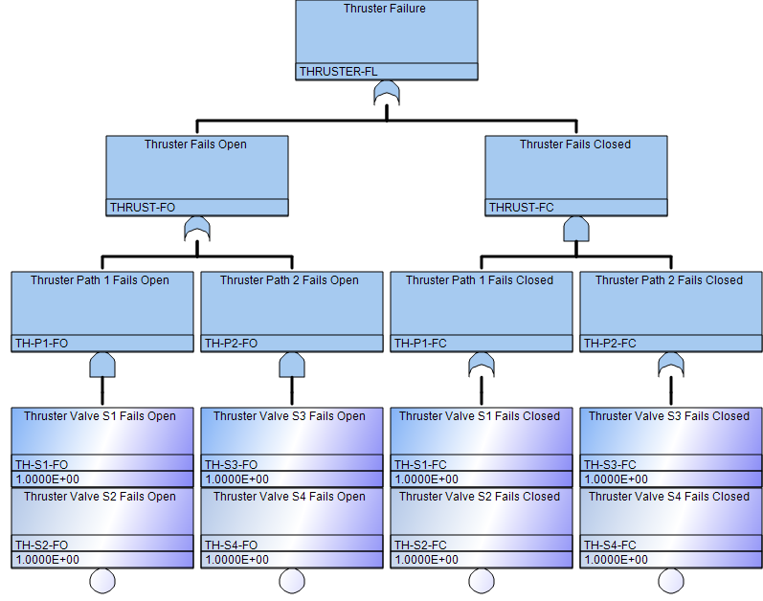
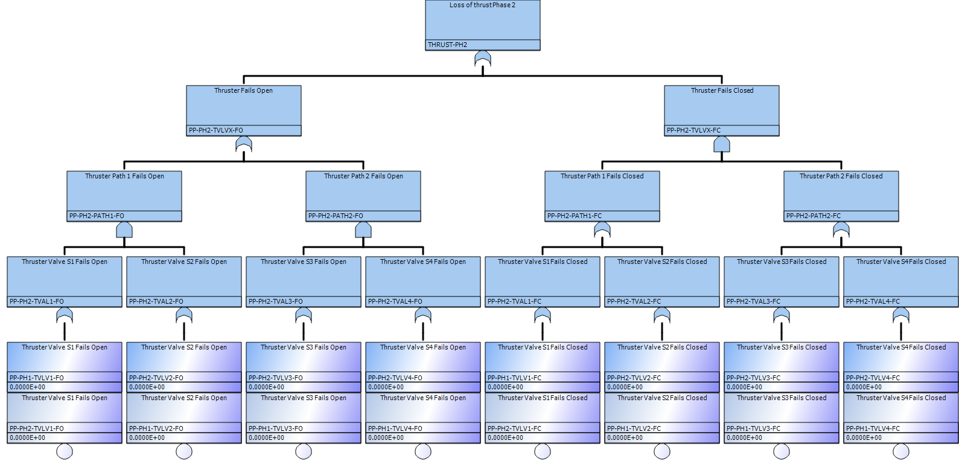
Fault Tree and MCS for 1 and 2 Mission Phases
Consistent naming convention for simulation understanding
PP-PH?-TVLV?-F?
where,
PP = Propulsion Subsystem,
PH? = PH1 or PH2 for Phase 1 or Phase 2,
TVLV? = Thruster Valve number 1 through 4, and
F? = Fail Open or Fail Closed.
1 Phase
2 Phases
Difference in MCS between 1 and 2 phases
PH1 has 6
PH2 has 24
Mission time =
Phase 1 time +
Phase 2 time

Slide 13
Simulation Results for 100k Trials
 | Basic Events | Gamma(2,100000) |  | Gamma(2,200000) |  | Gamma(2.5,100000)
Mission Time | Method | 1-Phase | 2-Phases | 1-Phase | 2-Phases | 1-Phase | 2-Phases
3 years | Excel | 6.1E-02 | 6.2E-02 | 8.0E-05 | 5.0E-05 | 1.6E-01 | 1.6E-01
 | MATLAB sim | 5.7E-02 |  | 7.0E-05 |  | 1.4E-01
 | Python sim | 5.5E-02 | 5.7E-02 | 9.1E-05 | 9.9E-05 | 4.2E-01 | 1.4E-01
 | SAPHIRE | 6.7E-01 | 7.3E-01 | 2.8E-01 | 3.1E-01 | 8.0E-01 | 8.6E-01
5 years | Excel | 4.6E-01 | 4.6E-01 | 1.9E-02 | 1.9E-02 | 7.1E-01 | 7.1E-01
 | MATLAB sim | 3.9E-01 |  | 1.8E-02 |  | 6.0E-01
 | Python sim | 3.8E-01 | 3.8E-01 | 1.8E-02 | 1.8E-02 | 3.8E-01 | 3.8E-01
 | SAPHIRE | 9.2E-01 | 9.6E-01 | 5.5E-01 | 6.1E-01 | 9.7E-01 | 1.0E+00
10 years | Excel | 9.4E-01 | 9.5E-01 | 4.6E-01 | 4.6E-01 | 9.2E-01 | 9.9E-01
 | MATLAB sim | 8.5E-01 |  | 3.8E-01 |  | 9.5E-01
 | Python sim | 8.5E-01 | 8.5E-01 | 3.8E-01 | 3.8E-01 | 9.5E-01 | 8.9E-01
 | SAPHIRE | 1.0E+00 | 1.0E+00 | 9.2E-01 | 9.6E-01 | 1.0E+00 | 1.0E+00
Probabilities of failure are shown, comparing a typical MCS solution vs various simulation solutions
Typical MCS solutions have much higher failure probabilities

Slide 14
MCS for a Single Simulation of `100k Trials
# | Minimal Cut Set | Fail Count in Mission | Fail Count Regardless of Mission | Proportion in Mission | Proportion Regardless of Mission Time
1 | PP-PH2-TVLV3-FO/PP-PH2-TVLV4-FO | 949 | 21469 | 0.164699757 | 0.21469
2 | PP-PH2-TVLV1-FO/PP-PH2-TVLV2-FO | 943 | 21425 | 0.163658452 | 0.21425
3 | PP-PH2-TVLV2-FC/PP-PH2-TVLV3-FC | 839 | 16343 | 0.145609163 | 0.16343
4 | PP-PH2-TVLV1-FC/PP-PH2-TVLV3-FC | 854 | 13799 | 0.148212426 | 0.13799
5 | PP-PH2-TVLV2-FC/PP-PH2-TVLV4-FC | 820 | 13645 | 0.142311697 | 0.13645
6 | PP-PH2-TVLV1-FC/PP-PH2-TVLV4-FC | 805 | 11220 | 0.139708435 | 0.1122
7 | PP-PH1-TVLV2-FO/PP-PH2-TVLV1-FO | 51 | 233 | 0.008851093 | 0.00233
8 | PP-PH1-TVLV1-FC/PP-PH2-TVLV4-FC | 62 | 206 | 0.010760153 | 0.00206
9 | PP-PH1-TVLV4-FO/PP-PH2-TVLV3-FO | 45 | 206 | 0.007809788 | 0.00206
10 | PP-PH1-TVLV1-FO/PP-PH2-TVLV2-FO | 48 | 205 | 0.008330441 | 0.00205
11 | PP-PH1-TVLV1-FC/PP-PH2-TVLV3-FC | 43 | 198 | 0.007462687 | 0.00198
12 | PP-PH1-TVLV3-FO/PP-PH2-TVLV4-FO | 43 | 195 | 0.007462687 | 0.00195
13 | PP-PH1-TVLV3-FC/PP-PH2-TVLV2-FC | 51 | 175 | 0.008851093 | 0.00175
14 | PP-PH1-TVLV3-FC/PP-PH2-TVLV1-FC | 45 | 156 | 0.007809788 | 0.00156
15 | PP-PH1-TVLV4-FC/PP-PH2-TVLV2-FC | 47 | 136 | 0.00815689 | 0.00136
16 | PP-PH1-TVLV2-FC/PP-PH2-TVLV4-FC | 38 | 128 | 0.006594932 | 0.00128
17 | PP-PH1-TVLV4-FC/PP-PH2-TVLV1-FC | 30 | 125 | 0.005206526 | 0.00125
18 | PP-PH1-TVLV2-FC/PP-PH2-TVLV3-FC | 32 | 119 | 0.005553627 | 0.00119
19 | PP-PH1-TVLV1-FC/PP-PH1-TVLV4-FC | 5 | 5 | 0.000867754 | 0.00005
20 | PP-PH1-TVLV1-FC/PP-PH1-TVLV3-FC | 4 | 4 | 0.000694203 | 0.00004
21 | PP-PH1-TVLV2-FC/PP-PH1-TVLV3-FC | 3 | 3 | 0.000520653 | 0.00003
22 | PP-PH1-TVLV2-FC/PP-PH1-TVLV4-FC | 2 | 2 | 0.000347102 | 0.00002
23 | PP-PH1-TVLV3-FO/PP-PH1-TVLV4-FO | 2 | 2 | 0.000347102 | 0.00002
24 | PP-PH1-TVLV1-FO/PP-PH1-TVLV2-FO | 1 | 1 | 0.000173551 | 0.00001
In a MCS solution, all MCS would have all the same probability of failure
Simulation results are not as intuitive; risk drivers are different

Slide 15
Exponential vs Gamma Distributions
λt = 1E-3
Failure Rate (λ) Per Time | Time t | Number of Failures in Time t | Minimum Time to Failure (10⁶ Trials)
1.00E-04 | 10 | 0 | 349.2782
1.00E-05 | 100 | 0 | 4,802.795
1.00E-06 | 1000 | 0 | 40,266.53
1.00E-07 | 10000 | 0 | 472,746.8
Exponential
P_{f} = 0.001
Gamma
P_{f} < 10-6
Exponential distributions will have much higher failure probabilities than gamma distributions in typical mission times
λt = 1E-4
Failure Rate (λ) Per Time | Time t | Number of Failures in Time t | Minimum Time to Failure (10⁶ Trials)
1.00E-05 | 10 | 0 | 4,201.016
1.00E-06 | 100 | 0 | 43,236.67
1.00E-07 | 1000 | 0 | 381,401.3
1.00E-08 | 10000 | 0 | 4,306,800
Exponential
P_{f} = 0.0001
Gamma
P_{f} < 10-6
λt = 1E-5
Failure Rate (λ) Per Time | Time t | Number of Failures in Time t | Minimum Time to Failure (10⁶ Trials)
1.00E-06 | 10 | 0 | 37,135.85
1.00E-07 | 100 | 0 | 365,918.1
1.00E-08 | 1000 | 0 | 3,938,313
Exponential
P_{f} = 0.00001
Gamma
P_{f} < 10-6

Slide 16
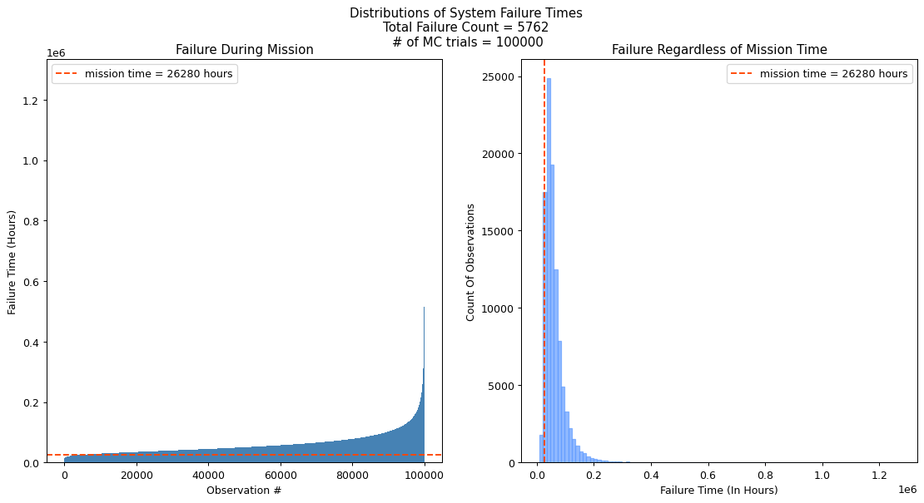
Distribution of Failure Times
Simulation in time space helps answer questions of time to failure of a complex system, or when do assets need to be replaced

Slide 17
Conclusions
The SURE methodology holds promise in analyzing systems where rare event approximations and exponential distributions are no longer hold valid, e.g., systems that are run until failure
Methodology can be used with the inputs and results of a variety of models (PRA, FT, RBD, etc.)
Time to failure is a common question that can be more reasonably answered
No need to use methods that are based in the computing power of the 1970s; avoid the definition of insanity
Just another methodology for analysts to consider before deciding what is best for their application

Slide 18
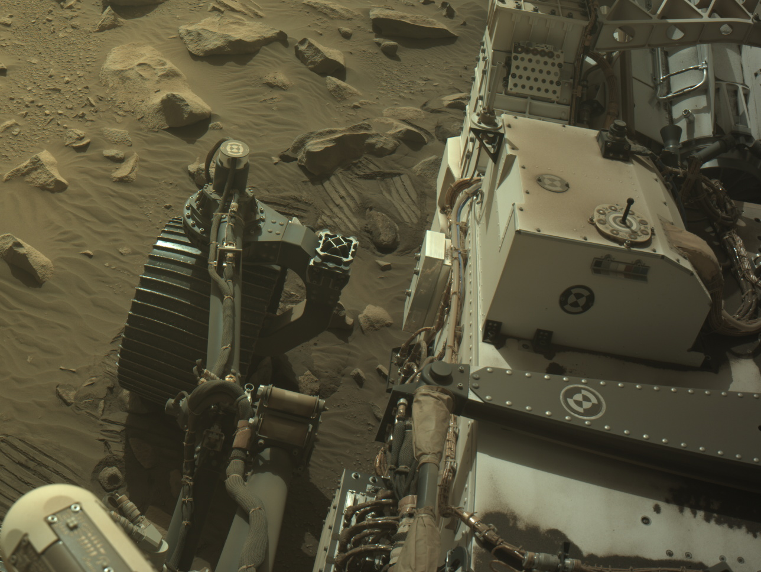
Questions?
Mars Perseverance Sol 1893
https://mars.nasa.gov/mars2020/multimedia/raw-images/NLF_1893_0834998400_925ECM_N0884292NCAM03893_10_195J

