Slide 1

UCLA
LLM-Based Extraction of
Causal Relationships among
Organizational Factors for
Extending Human Reliability
Analysis
Dr. Tingting Cheng (Presenter), David Doberstein
Prof. Ali Mosleh
PSAM 18 Conference
Pittsburgh, Pennsylvania, July 21, 2026

Slide 2
Overview
Presentation roadmap
From the HRA data gap to an Large Language Model (LLM)-assisted evidence base for causal modeling
Why organizational factor causality matters for HRA
266
1
Motivation and problem definition of the whole project and this study
publications in corpus
What the extraction pipeline does
2
Corpus, text processing, prompt, model, outputs
19
How prompt engineering and model selection were handled
organizational factors
3
Constrained schema rather than free-form generation
38
What the extracted results show
4
Coverage, target matching, and frequency profile
predefined target links
What needs validation before BBN use
1,538
5
Limitations, state-level evidence, and next steps
candidate causal instances
2

Slide 3



1 Motivation and Problem Definition
Why organizational factor (OF) causality matters for HRA
Motivation and problem definition of the whole project
Major accidents show OF importance
High-risk industries depend on people, teams, procedures, management controls, and organizations, not only technical components.
Current HRA & OF studies remain incomplete
OFs’ definitions are unclear and inconsistent across fields; most HRAs incorporate OFs by listing separate OFs without clear and traceable causal relationships.
Existing causal models need broader and traceable evidence
Existing causal models are usually based on expert judgment and experience, with limited evidence synthesized across wide industries.
Project motivation:
Identify organizational factors from miscellaneous fields;
Construct knowledge- and data-driven causal and probabilistic OF model for extending HRA.
3

Slide 4
1 Motivation and Problem Definition
Why organizational factor (OF) causality matters for HRA
Motivation and problem definition of this study
Indirect pathways
Scalable evidence discovery
OFs influence operator performance through intermediate mechanisms, such as training, climate, information exchange, or decision framing.
Find causal evidence in existing literature without manually reading hundreds of documents.
Context dependence
Structured dataset
A link may be strong in one domain, weak in another, or conditional on operating context and organizational level.
Need to be
Store relationship labels, direct excerpts, and justifications in a machine-readable format.
Opaque evidence basis
Reproducible workflow
Many causal structures are encoded from expert judgment without a traceable literature inventory.
Support validation, audit, corpus updates, and future BBN development.
4

Slide 5

2 OF Causal Modeling Framework and Extraction Scope
Predefined ontology bounds the extraction task
The Large Language Model (LLM) is used as an evidence-extraction mechanism within expert-defined conceptual boundaries.
1 Literature base reviewed by the whole project
2 OF inventory
Nuclear
power
Aviation &
aerospace
Healthcare
266
19
46
200+
Oil & gas
Maritime &
offshore
Transportation
main OF groups
sub-factors
attributes
publications
reviewed
Energy
Chemical
processing
Others
19
38
266
3
organizational factors
directed causal links
publications
LLM model candidates
Examples of target relationships
Design choice
1
Leadership -> Group climate
Policy design -> Employee training and development
Information exchange and coordination -> Decision framing and execution
Employee training and development -> Knowledge/abilities
The model is not asked to identify any relationship it considers plausible. It is instructed to return passages supporting one or more of the 38 predefined relationships.
selected model
Purpose: reduce unconstrained causal generation, standardize labels, and compare evidence distribution across the target structure.
5

Slide 6
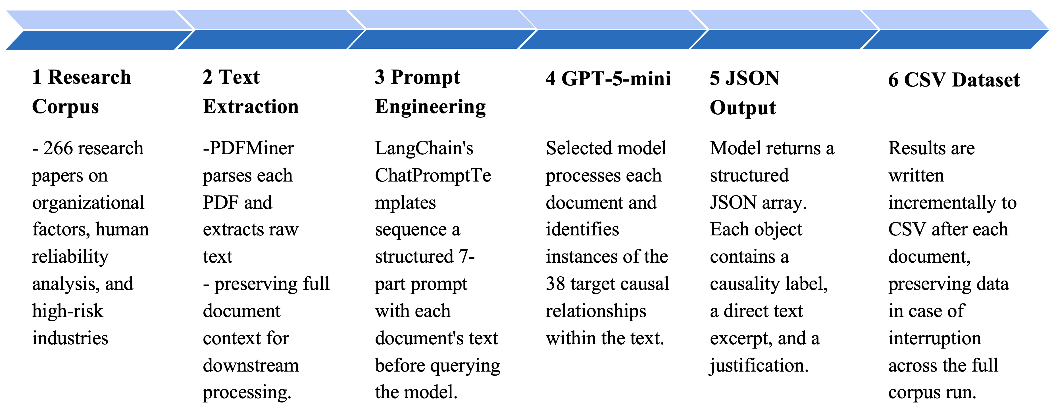
3 Method
LLM-based causal-evidence extraction pipeline
Output
A structured evidence dataset that can be summarized, validated, and used as empirical input for reviewing organizational-factor causal models and supporting later HRA Bayesian-network development.
6

Slide 7
3 Method
Prompt engineering: structured prompt and causal-language constraints
7-part structured prompt
Causal-language constraints
Linguistic causality markers were specified as necessary but not sufficient indicators of causation. Examples include but do not limited to:
1
Task definition
5
Sample output
Positive direction
leads to, results in, contributes to, drives, enables, etc.
2
JSON output
schema
6
19 OF definitions
Negative direction
hinders, prevents, undermines, reduces, weakens, etc.
3
Formatting rules
7
38 target links
Dependency / conditional
because of, due to, as a result of, depends on, influenced by, determined by, etc.
4
Causal terminology
Exclude statements with no unambiguous directionality, including general importance, mutual relevance, or parallel influence only.
Example OF definition: Leadership
Definition: leaders’ culture, style, engagement, and skills through which leaders influence employees’ motivation, safety attitudes, and team performance. Leadership includes setting direction, communicating expectations, allocating resources, and modeling desired behaviors.
Synonyms: leadership culture/style/engagement/skills, safety leadership, supervisory leadership, supervision, managerial leadership, management, oversight, leader influence, leader behavior.
The prompt constrains the task, output format, causal definition, OF definitions, and target relationship list.
Key instruction: distinguish directional causal evidence from simple co-occurrence or association.
7

Slide 8
3 Method
Pilot model comparison and selection
GPT-5-mini was selected because it matched observed extraction quality at lower cost for the full corpus run.
Identified results
Model
Excerpt quality
Justification
Selected
Selection rationale
Grok-4
3
Short and implicit
Limited
No
Comparable extraction quality
lower full-corpus cost
GPT-5
7
Long and implicit
High
No
GPT-5-mini
8
Long and explicit
High
Yes
Important caveat
This pilot supported an engineering selection decision in this study, but it was not a formal benchmark. The models were tested on a limited common task and no independently labeled gold standard was used.
8

Slide 9
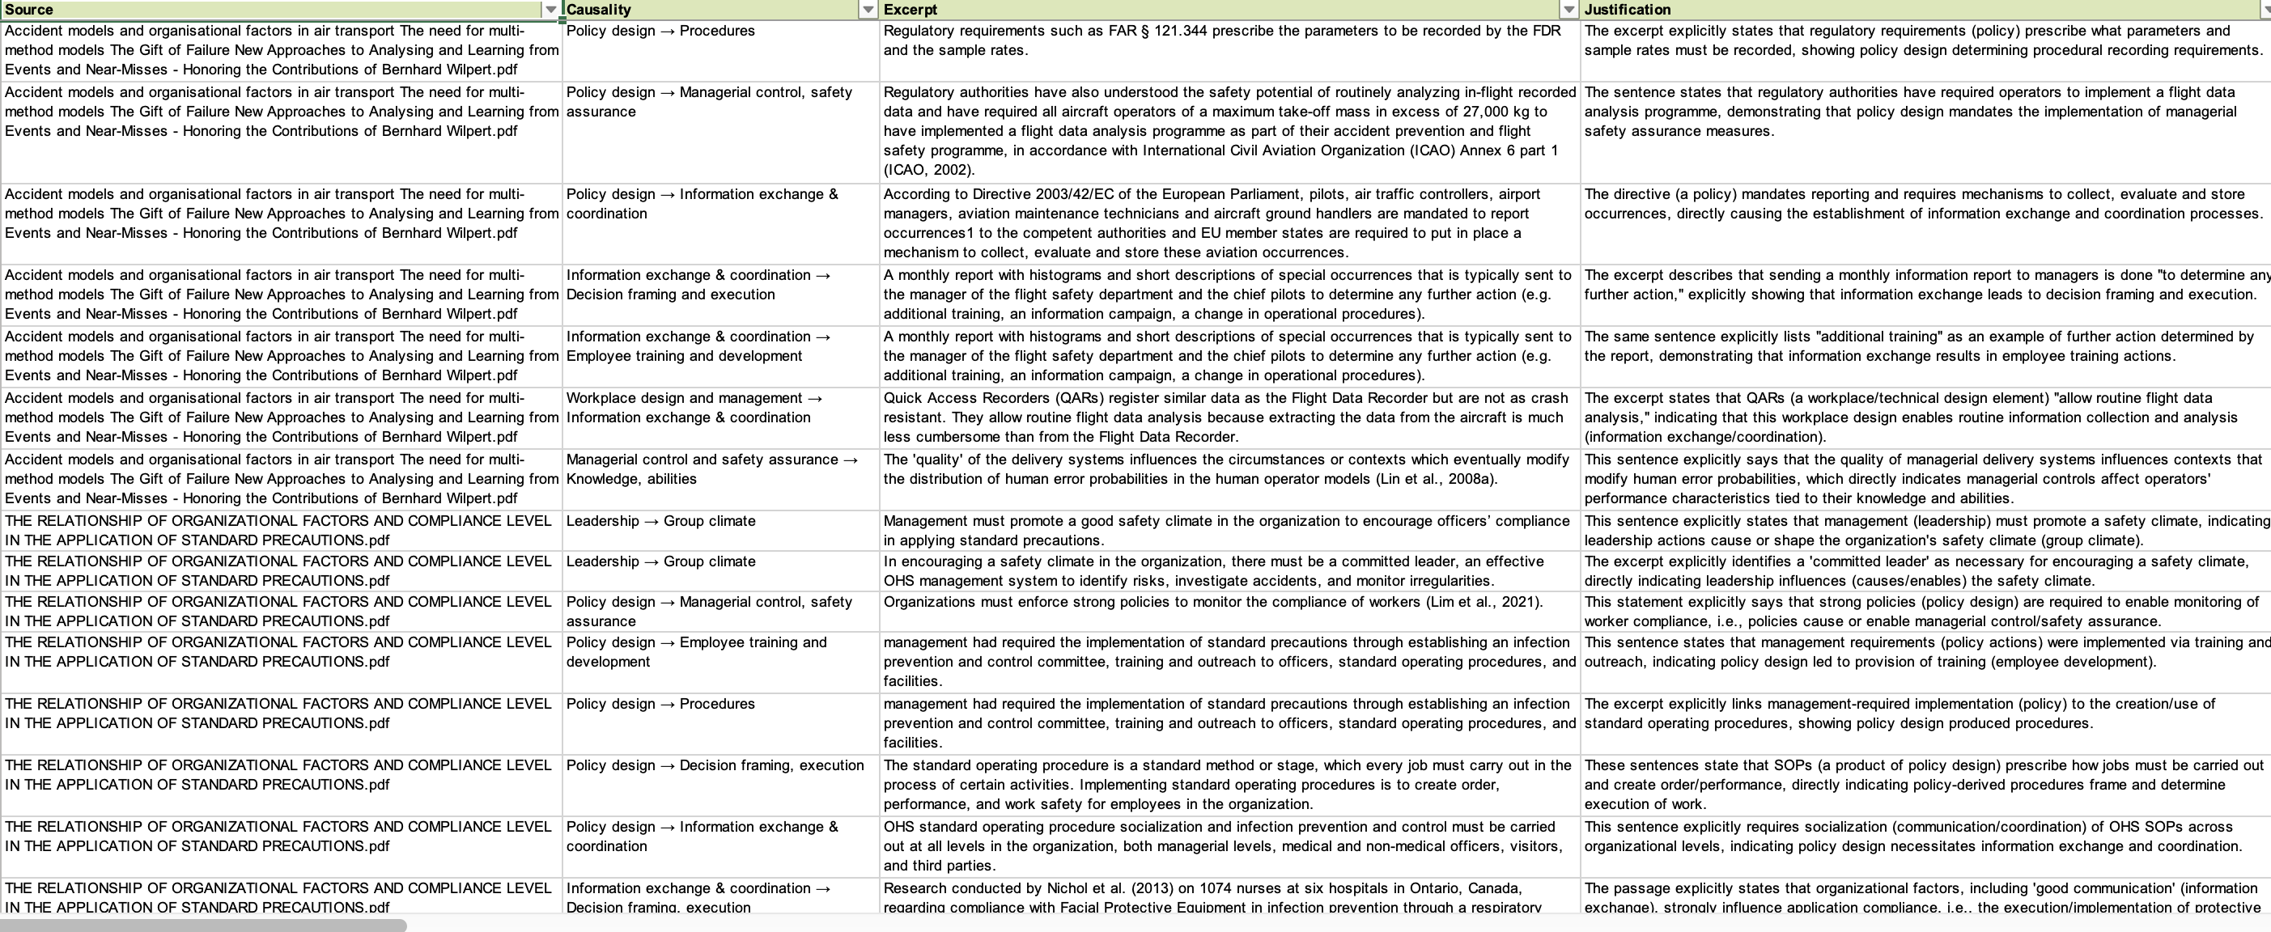
4 Results
Corpus-level extraction results
The full-corpus pipeline generated a traceable candidate evidence dataset.
1,538
1,482
38/38
candidate causal instances
matched target links
target links with evidence
What this means
The structured prompt and predefined ontology strongly constrained relationship labels.
The identified excerpts are verbatim from the original corpus reflecting causal relationships of the target links.
What this does not mean
This does not mean extraction accuracy because evidence assigned to a valid target link may vary in causal explicitness from clear, direct statements to weak or implicit indications.
9

Slide 10
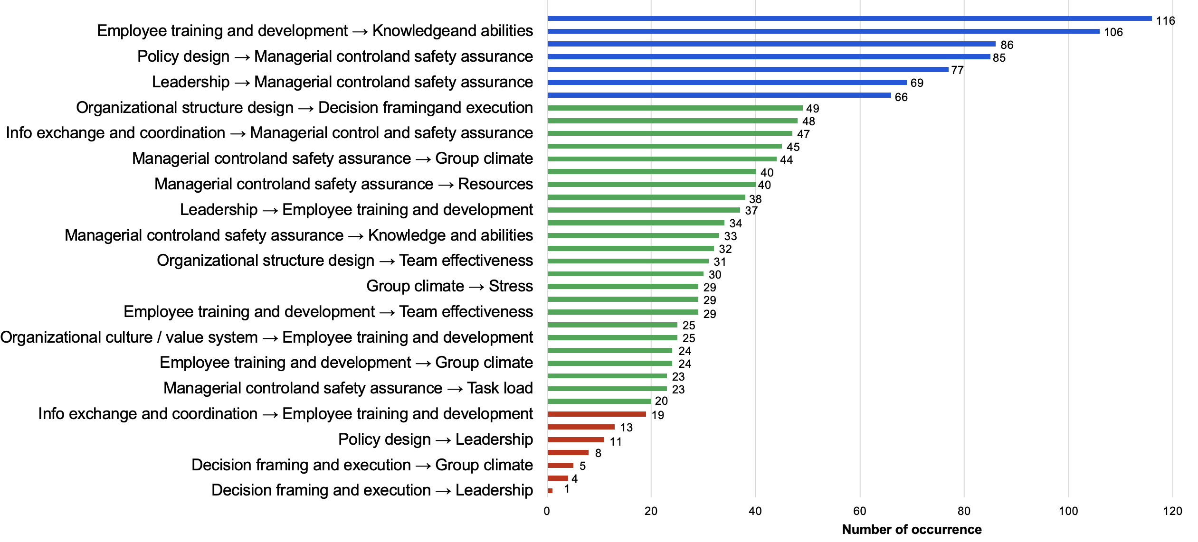
4 Results
Frequency distribution across target relationships
The extraction results provide an empirical frequency profile of the predefined OF causal relationships.
Info exchange and coordination → Decision framing and execution
Interpretation: high frequency indicates repeated textual support in this corpus and greater research attention to particular causal links. It may provide a preliminary signal of causal strength, but needs to be supplemented by evidence on effect size, study quality and independence, and expert validation.
10

Slide 11
4 Results
From extracted records to reviewable evidence objects
Each instance preserves a causal label, direct source excerpt, LLM justification, and validation status.
Target relationship
Original source excerpt
LLM justification
Human review
Employee training ->
Team effectiveness
Inclusive training could increase mutual understanding and improve transparency of the work system.
The sentence links training to mutual understanding and system transparency, aspects of team effectiveness.
Accept
Information-seeking ties are shaped by both formal organizational structure, such as the position of supervisory or administrative divisions, and informal, tacit dynamics.
Organizational structure design->
Info exchange and coordination
This sentence explicitly states that formal organizational structure contributes to the formation of information-seeking ties, which correspond to information exchange and coordination.
Accept
Policy design ->
Decision framing and execution
Reject
An expedited process can enable HOF research to align with technical developments.
This sentence indicates that adopting an expedited policy/ process would enable HOF research to align (i.e., influence how research is planned and executed) .
The expedited process does not necessarily represents policy design.
11

Slide 12
5 Discussion
How the extracted evidence supports HRA and BBN development
The contribution is an evidence foundation, not an automated causal model or quantified HRA.
1
2
3
4
Extracted evidence
Human review
OF causal structure
BBN development
Targeted causal links, excerpt, justification
causal direction and sufficiency
candidate edges in BBN
priors and CPT support
Useful for BBN structure
Not directly usable as CPTs
Evidence records can support candidate directed links, evidence inventories, model revision, and screening for weakly supported relationships.
Publication frequency is not conditional probability. Quantification requires state coding, context coding, contradiction handling, and expert review.
12

Slide 13
5 Discussion
Extension from relationship-level to state-level evidence
Relationship-level evidence establishes that one OF may influence another; BBN quantification needs how factor states change probabilities.
Relationship-level evidence
needs refinement into
State-level propositions
Employee training and development -> Knowledge/abilities
Inadequate training increases the likelihood of insufficient task knowledge.
Parent-factor state (e.g.)
Child-factor state (e.g.)
Employee training and development: inadequate / complete / recurrent / effective
Group climate: positive / supportive / cohesive / negative / distrustful
Effect polarity (e.g.)
Effect strength (e.g.)
degrading or improving
weak, moderate, strong evidence
13

Slide 14
5 Discussion
Extraction challenges and limitations
The dataset is usable for frequency analysis and review, but quality control is essential before probabilistic modeling.
Out-of-scope relationships
Naming inconsistencies
Weak evidence
Abbreviations and symbols changed, such as “&” to “and” or “info” to “information.”, causing equivalent relationships to be treated as different labels, reducing automated matching.
56 records combined valid OFs but did not match the 38 target links.
Some excerpts or justifications did not implicitly support the claimed causal relationship.
Corpus coverage
Parsing and layout
Evidence independence
Corpus composition and selection bias need additional characterization.
Full-document prompting may be affected by PDF parsing errors and context-window constraints.
Multiple publications may repeat the same theory or cite the same primary study.
14

Slide 15
6 Future Work
Next steps toward validated and reusable HRA evidence
1
Causality-specific prompting
Run one prompt per target link to reduce drift and improve relationship-specific evidence retrieval.
2
Retrieval Augmented Generation (RAG) framework
Use semantic chunking, embeddings, and retrieval for repeatable querying and source localization.
3
Governed evidence objects
Store relationship ID, source, location, prompt version, validation status, and reviewer disposition.
4
BBN integration
Use validated evidence and state-level propositions to support priors and CPT development.
15

Slide 16
Conclusion
A disciplined role for LLMs in safety analysis
Structured LLM extraction can transform dispersed qualitative evidence into a traceable review dataset.
Scalable
Traceable
Useful for HRA
Processed 266 publications and extracted 1,538 candidate causal instances.
Stored relationship labels, direct excerpts, and justifications for review.
Supports review of OF causal structure and later BBN development.
Takeaway
LLMs should extract and organize evidence within a constrained schema, while acceptance and quantification remain with qualified analysts.
Thank you
16

