Slide 1
Bayesian Belief Network-based HRA Dependency Analysis: Methodology and Case Study
Dr. Tingting Cheng (Presenter)
Dr. Marilia Ramos, Prof. Ali Mosleh
PSAM 18 Conference
Pittsburgh, Pennsylvania
July 20, 2026

Slide 2
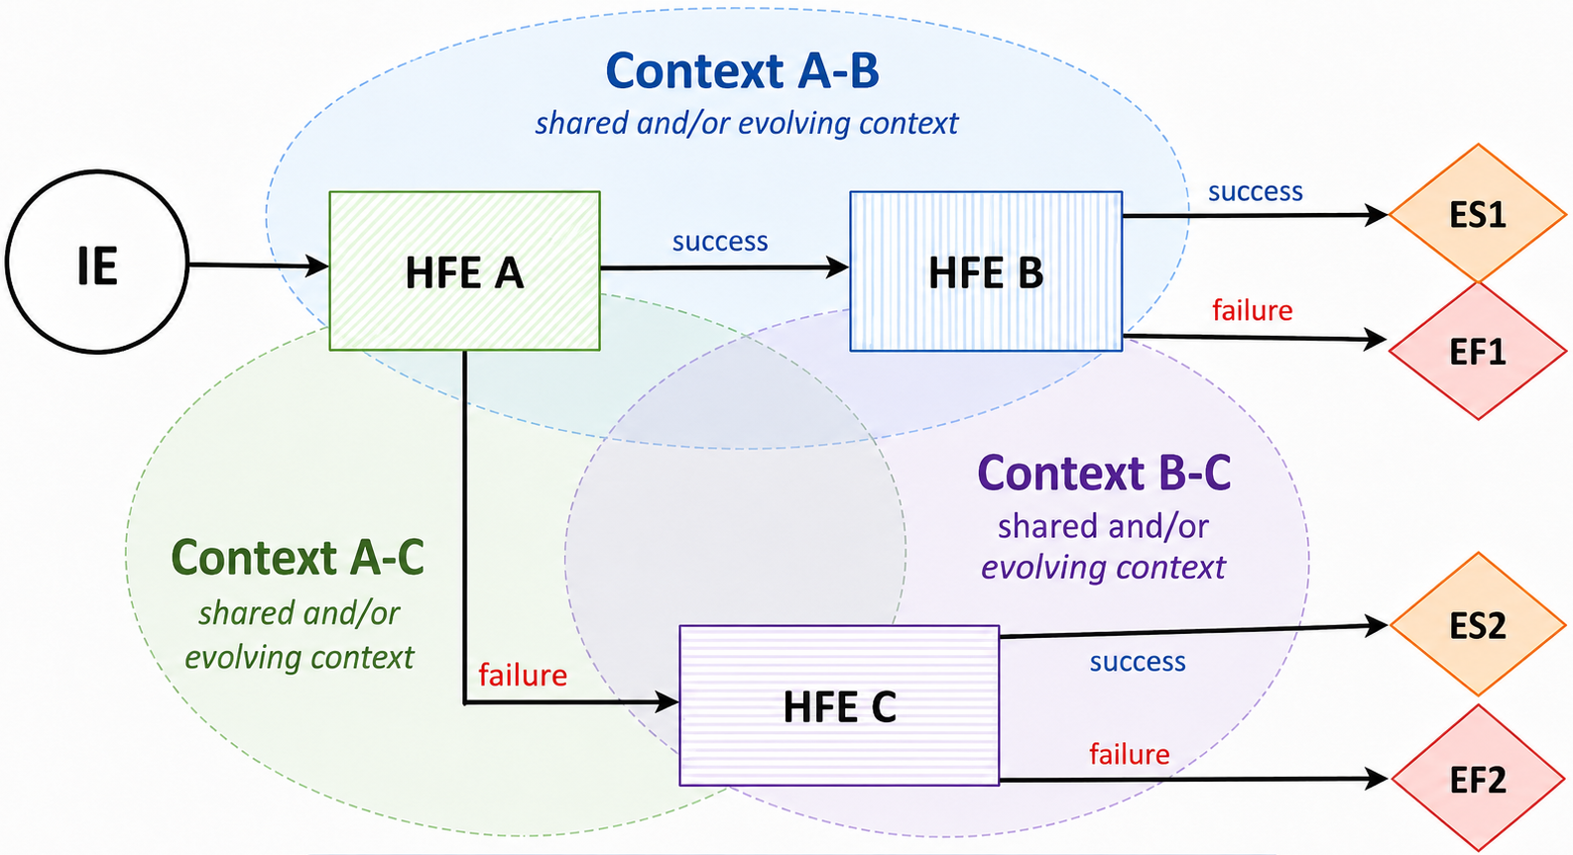
1 MOTIVATION
Why dependency matters in HRA
• Accident recovery often requires multiple time-ordered instead of isolated operator actions.
• HFEs may share procedures, cues, interfaces, crew resources, or cognitive demands.
• Upstream human action success or failure can change stress, workload, time pressure, or situation awareness.
Shared context
procedure ·
team effectiveness ·
resources
Evolving context
stress · fatigue ·
workload ·
time pressure
• If dependency is treated only after base HEPs are estimated by using a multiplier, the causal basis can be hard to justify.
Dependency is not just a correlation between HFEs; it can be a propagation of evidence through PIFs.
HFE: human failure event
2

Slide 3
2 METHODOLOGY: OVERVIEW
Core idea: replace a fixed adjustment with evidence propagation
Observed upstream
HFE or CFM outcome
BBN inference
Updated PIF
posterior probabilities
Downstream
CFM/HFE update
Dependency-aware
HEP
• The BBN explicitly represents causal or influential links among HFEs, CFMs, and PIFs.
• Evidence from upstream outcomes updates beliefs about shared or future PIF states.
• The downstream HEP becomes a reproducible result of explicit causal assumptions.
CFM: cognitive failure mode
PIF: performance influencing factor
HEP: human error probability
3

Slide 4

2 METHODOLOGY: DEPENDENCY TAXONOMY
Three dependency types are separated before quantification
The downstream action is reached only under a particular outcome of the upstream action
1. Sequential
HFEs are influenced by the same PIF instance or common causal source.
2. Static causal
An upstream outcome changes the downstream context, such as stress or time pressure.
3. Dynamic causal
Figure from paper: overview of independence, sequential, static causal, and dynamic causal dependency.
Sequential dependency is handled by PRA logic; causal dependency is handled by the BBN layer.
4

Slide 5
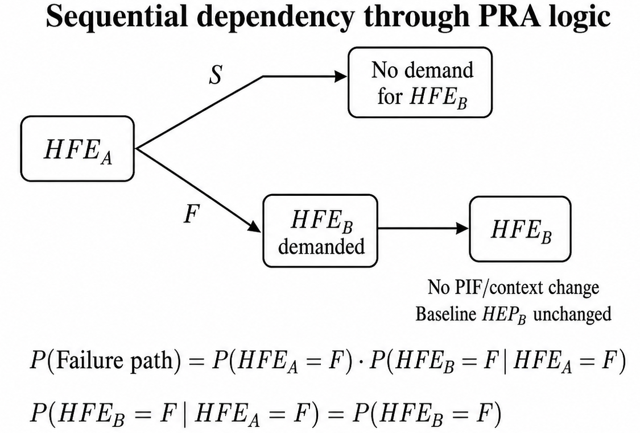
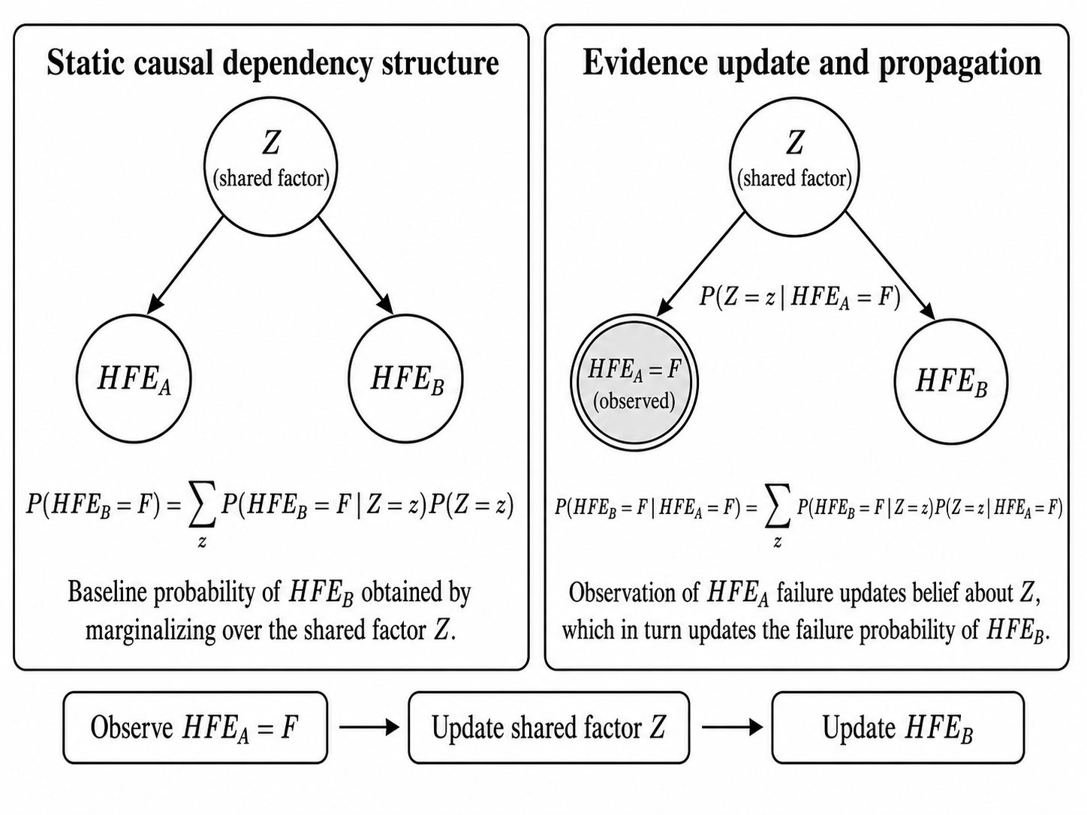
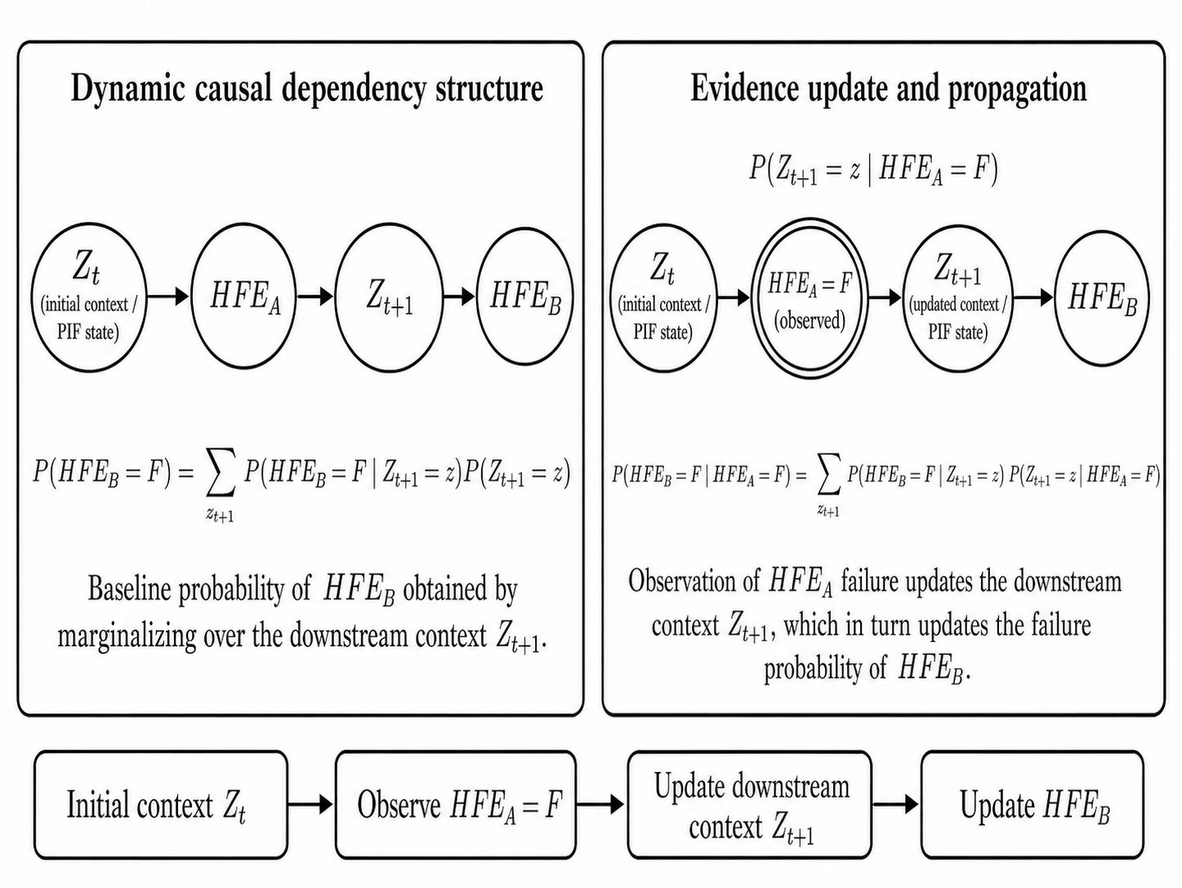
2 METHODOLOGY: QUANTIFICATION PROCESS
Quantification: one PRA logic path plus two BBN updating paths
5

Slide 6
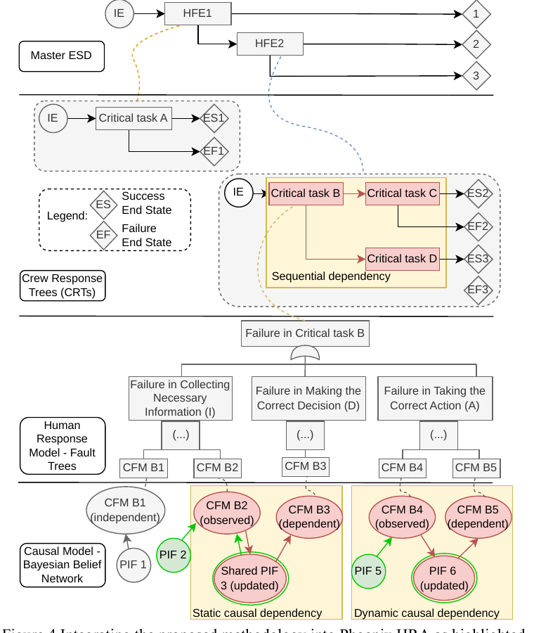

3 INTEGRATION OF THE PROPOSED METHOD INTO PHOENIX HRA
Integration within Phoenix HRA
• Master ESD (event sequence diagram) models the accident sequence and HFEs.
• CRTs decompose each HFE into critical tasks and end states.
• Fault trees represent task failures by using CFMs (crew failure modes).
• BBNs link CFMs to PIF states and propagate dependency evidence.
The highlighted dependency layer shows where sequential, static causal, and dynamic causal mechanisms enter the Phoenix quantification process.
Phoenix layers: Master ESD, CRTs, fault trees, and BBN causal model.
6

Slide 7
4 APPLICATION
Case study: Manual Opening of PORV during station blackout
Loss of all
AC power
~10 min
Open main
steam relief valves
Adjust valve
opening degree
~1.5 h
Station blackout initiating context
Operators D, E, F move onsite
Cooldown and depressurization
Maintain temperature and pressure
Operator E adjusts AFW control valve
• The case evaluates onsite manual operation of three main relief valves.
• Operators are assumed trained and proficient; surrounding conditions are normal.
• Possible noise from nearby safety valve operation is addressed by carrying earplugs.
7

Slide 8
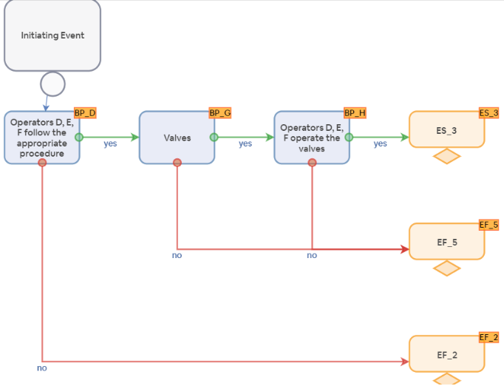
4 APPLICATION: PHOENIX MODEL
HFE, CFM, and PIF modeling for the case
HFE_1
Operators follow procedure
HFE_2
Operators operate valve
• Reading error
• Action on wrong component
• Procedure misinterpreted
• Information miscommunicated
Shared PIFs used for dependency modeling
Stress
P(D)=0.333
Team effectiveness
P(D)=0.438
Procedures
P=0.111
CRT: HFE_2 is reached only after HFE_1 succeeds.
D- marks common PIFs across HFEs. Stress and team effectiveness are shared by both HFEs.
8

Slide 9
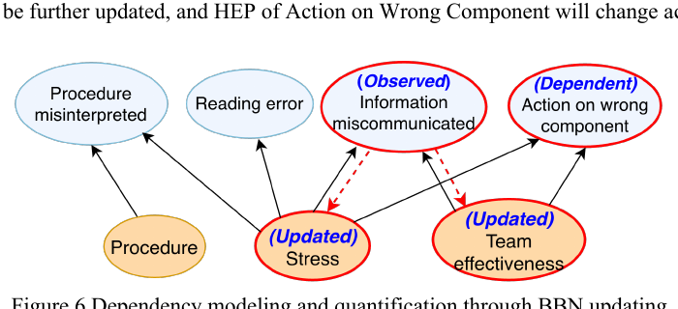

4 APPLICATION: CASE QUANTIFICATION
Dependency evidence path in the case BBN
Evidence entered
CFM 3: Information Miscommunicated = Success
PIFs updated
Posterior P(Stress degraded) and P(Team degraded)
Partial BBN link from observed Information Miscommunicated to updated PIFs and dependent CFM.
Partial BBN Conditional probability table (CPT) of CFM “Information Miscommunicated” with PIF Team effectiveness and Stress
Dependent CFM updated
CFM 4: Action on Wrong Component
Team Effectiveness | Nominal |  | Degraded
Stress | Nominal | Degraded | Nominal | Degraded
Information Miscommunicated = Failure | 0.000198 | 0.026893 | 0.008806 | 0.035271
Information Miscommunicated = Success | 0.999802 | 0.973107 | 0.991194 | 0.964729
Downstream HEP
HEP is recalculated using updated PIF probabilities.
9

Slide 10
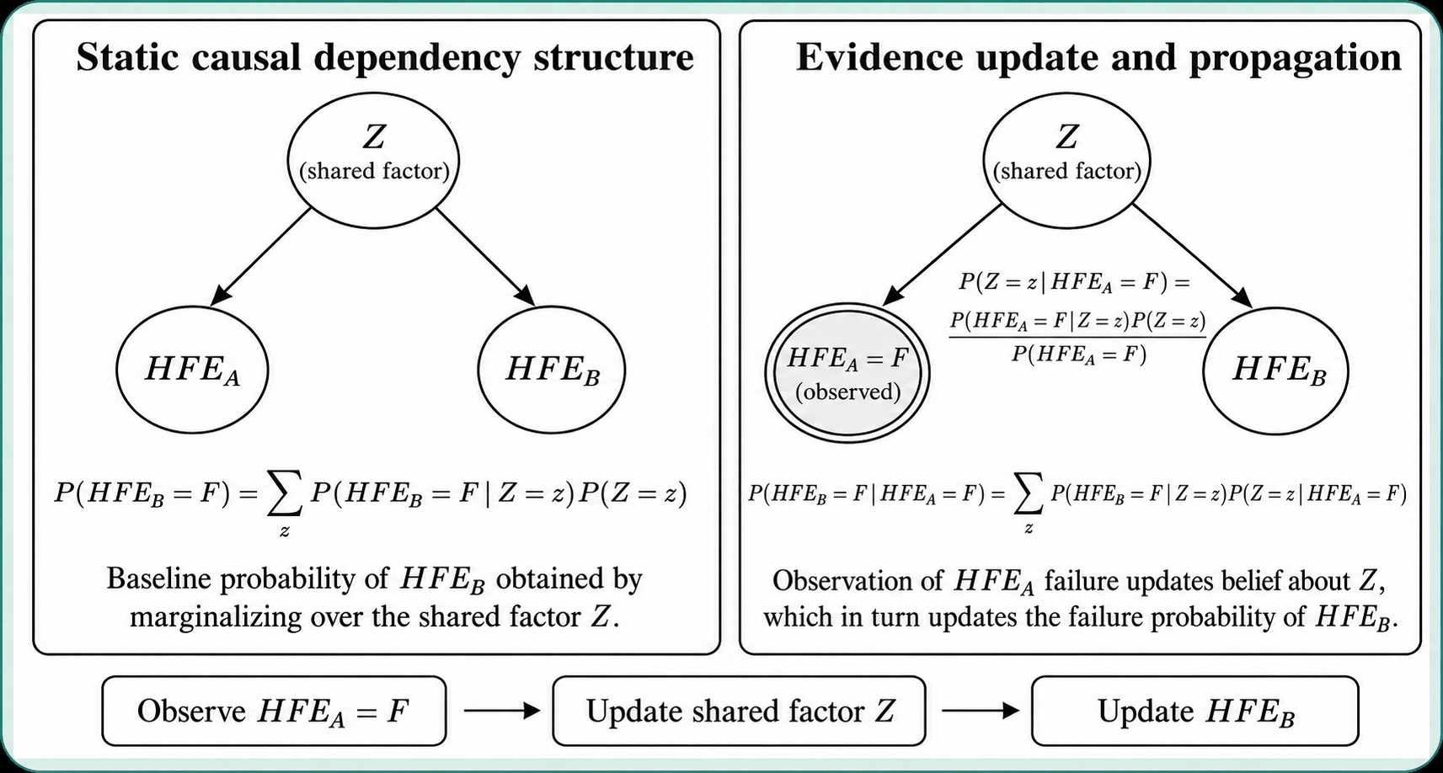
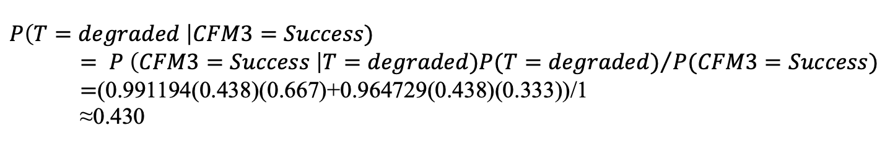
4 APPLICATION: CASE QUANTIFICATION
Dependency-aware HEP calculation using BBN
$$P\left(T=degraded \right|CFM3=Success)$$
$$= {P \left(CFM3=Success \right|T=degraded)P(T=degraded)}/{P(CFM3=Success)}$$
$=$(0.991194(0.438)(0.667)+0.964729(0.438)(0.333))/1
≈0.430
5

Slide 11
4 APPLICATION: QUANTITATIVE OUTCOME
Results: upstream success slightly reduces the downstream HEP
Metric
No dependency
Dependency-aware
Change
Team effectiveness degraded PIF
0.438
0.430
↓ 1.8%
Stress degraded PIF
0.333
0.323
↓ 3.0%
HEP: Action on wrong component
4.566E-04
4.468E-04
↓ 2.1%
Downstream HEP comparison
In this path, dependency does not increase HEP; successful upstream performance provides positive evidence about downstream conditions.
4.566E-04
No dependency
4.468E-04
Dependency-aware
10

Slide 12

5 DISCUSSION
What this changes for PRA implementation
1
Evidence
2
Updated PIFs
3
Dependent HEP
4
PRA quantification
• Traceability: analysts can causally and probabilistically trace the upstream evidence, updated PIFs, and final HEP change.
• Extensibility: the BBN can include richer causal structures and upstream organizational factors and models [1-2].
• Portability: this dependency analysis method can be used with other HRA methods if analysts identify the HFEs, relevant task outcomes, and PIFs influencing the downstream action.
[1] Cheng, T., Mosleh, A., Tabibzadeh, M., Jafary, H., Gill, H., Doberstein, D. 2026. Incorporating Organizational Factors into Human Reliability Analysis, Part I: Knowledge- and Data-Driven Causal and Probabilistic Model Development. Reliability Engineering & System Safety. (under review)
[2] Cheng, T., Mosleh, A., Tabibzadeh, M., Jafary, H. 2026. Incorporating Organizational Factors into Human Reliability Analysis, Part II: Integration of Organizational Factor Model into Phoenix HRA and Case Studies. Reliability Engineering & System Safety. (under review)
11

Slide 13
6 CONCLUSION
Closing message
BBN-based dependency analysis turns dependency from an unexplained adjustment into a causal, probabilistic, and path-specific update.
• Sequential dependency is handled through PRA logic.
Future work
• Static causal dependency is represented through shared PIFs or common causal sources in BBN.
Develop a modular dependency analysis tool that can interface with Phoenix and other HRA and PRA methods and tools
Benchmark the method against other dependency approaches
Integrate the organizational factors model into the BBN
• Dynamic causal dependency is represented through evolving downstream PIF states in BBN.
• The PORV case shows how upstream success updates shared PIFs and reduces the downstream HEP.
Thank you
Questions?
12

