Slide 1
July 22, 2026
Grid-aware Online and Realtime Deep Reinforcement Learning-based Control and Optimization of Tightly Coupled Nuclear-Hydrogen System
Dr. Elvan Sahin
Postdoctoral Researcher
Idaho National Laboratory | Hydrogen & Electrochemistry
• PSAM18 • Pittsburgh, PA

Slide 2




The Problem: Control and Optimization of Complex Systems
Nuclear–HTSE Synergy
Grid Transformation
Rising penetration of intermittent energy resources creates volatility. Flexible multi-energy systems needed for real-time grid stability.
HTSE (750–850°C) leverages nuclear heat to reduce electrical consumption. Ideal for co-production of electricity + hydrogen.
Control and optimization Challenge
Flexible Electrolyzer Load
Tightly coupled electro-thermal dynamics, ramp constraints, and stochastic markets make conventional optimization insufficient.
HTSE power demand can dynamically respond to grid signals — absorbing surplus generation or relieving peak demand.
Goal: Develop a scalable, grid-aware, real-time DRL framework for integrated nuclear–hydrogen systems

Slide 3
DRL Framework: TD3-Based Optimization
Twin-Delayed Deep Deterministic Policy Gradient (TD3) — Continuous action space, actor–critic, twin Q-networks, delayed policy updates
State Space s(t)
Action Space u(t)
Reward Function r(t)
Time index
Bus voltages & frequency
Uncertain PV output
Uncertain load demand
Stochastic H₂ price
Electricity price πte
Battery SOC(t)
NPP dynamic states
Previous control action
HTSE-1 electrical power demand.
HTSE-2 electrical power demand.
Allowable solar PV dispatch.
Continuous-valued control within equipment limits
Maximize electricity revenue + H₂ revenue
Penalize constraint violations (grid & NPP)
Penalize abrupt control-action changes
r(t) = Revenue − λviol Vt − λΔu ‖Δu‖²

Slide 4







Uncertainty Modeling & Physics-Informed Environment
PV Generation
Load Demand
Hydrogen Price
$$\begin{aligned}&P_{t,u}^{PV}=\max\left(0,P_{t}^{PV}\left(1+ϵ_{t}^{PV}\right)\right)\#\end{aligned}$$
$$\begin{aligned}&P_{t,u}^{L}=\max\left(0,P_{t}^{L}\left(1+ϵ_{t}^{L}\right)\right)\#\end{aligned}$$
$$\begin{aligned}&π_{t,u}^{H2}∼U\left(π_{max}^{H2},π_{min}^{H2}\right)\#\end{aligned}$$
where,
where,
$$ϵ_{t}^{PV}∼𝒩\left(0,σ_{PV}^{2}\right)$$
$$ε_{t}^{PV}∼𝒩\left(0,σ_{PV}^{2}\right)$$
Physics-Informed Simulation Environment
Captures nuclear thermal dynamics (fuel, coolant, steam temperatures) and HTSE electro-thermal behavior
Incorporates inverter-based PV generation and battery SOC dynamics
Enforces nonlinear AC power flow constraints (bus voltages, line flows, frequency limits)
Enables realistic closed-loop training with stochastic generation and market conditions
Validated on real-time digital simulator (RSCAD) for high-fidelity operational assessment

Slide 5


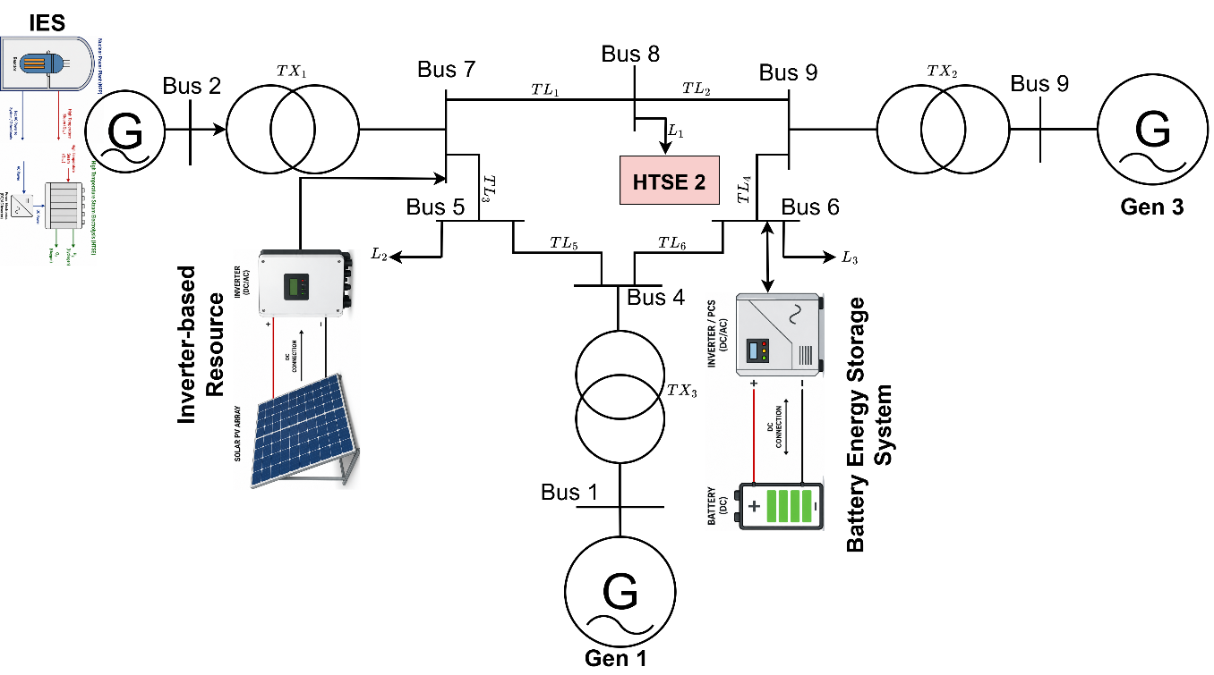



System Architecture — Modified IEEE 9-Bus
1000 MW NPP
HTSE-1: 500 MW
Bus 2 — coupled to HTSE-1
Coupled with NPP at Bus 2
HTSE-2: 200 MW
PV: 100 MW
Standalone at Bus 8
Inverter-based at Bus 5
BESS: 50 MWh
Grid Loads
Storage at Bus 6
Stochastic demand profile

Slide 6
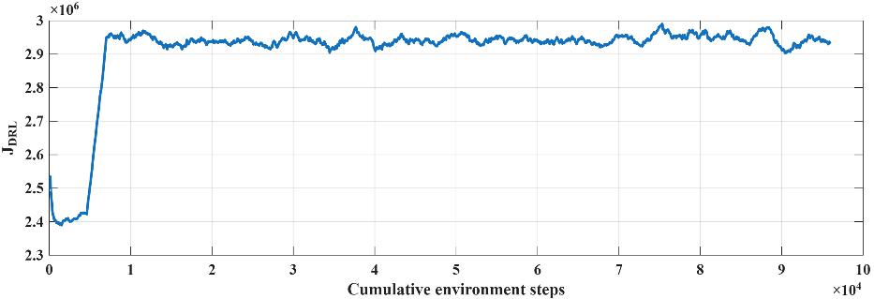
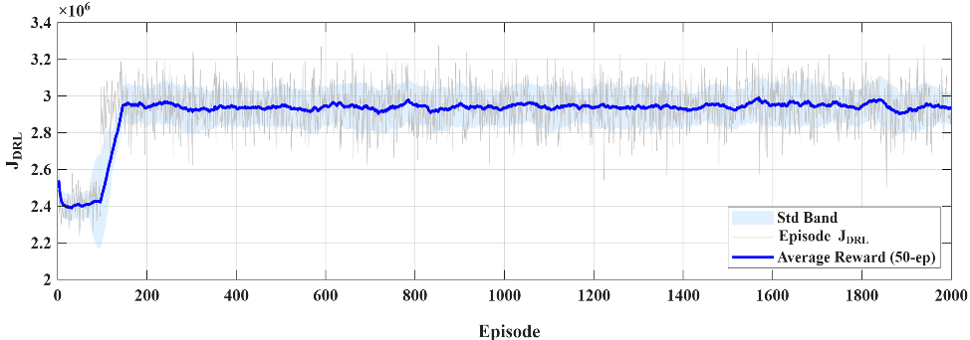
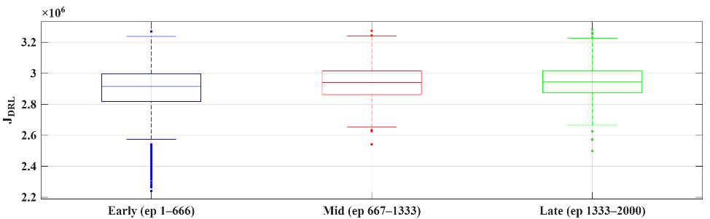
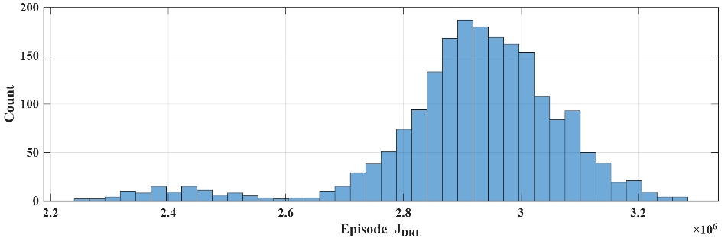
Results - TD3 Training Performance Analysis
episode reward evolution with moving-average smoothing and variance band
episode reward versus cumulative environment steps
reward distribution across training stages
histogram of converged episodic rewards.

Slide 7
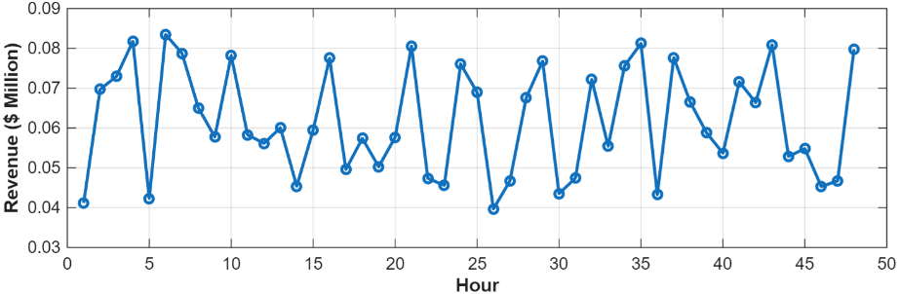
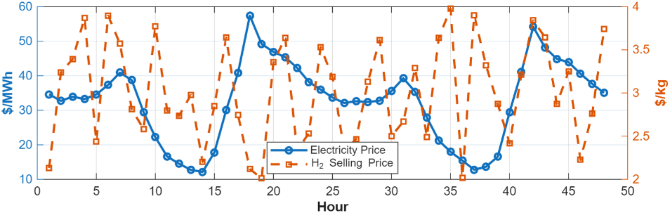
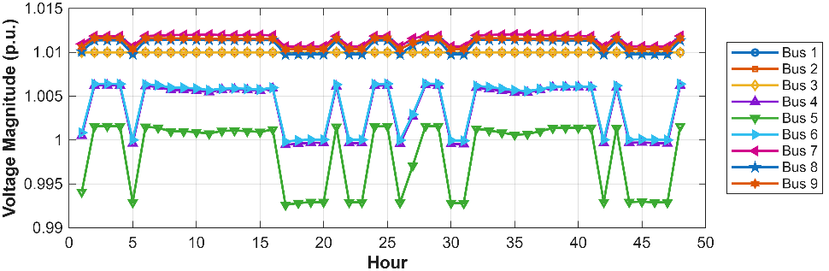
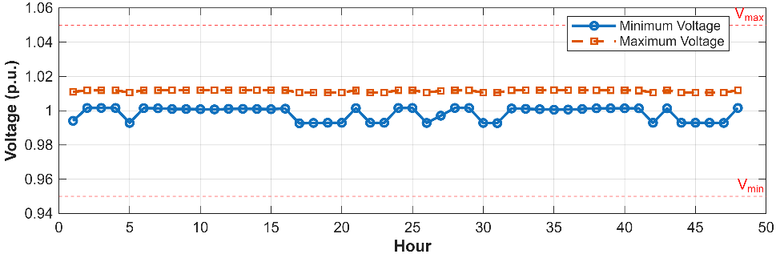
Results – Testing Analysis
Hourly generated revenue
Electricity and HTSE price variation
Timeseries grid bus voltages
Bus maximum and minimum voltage

Slide 8
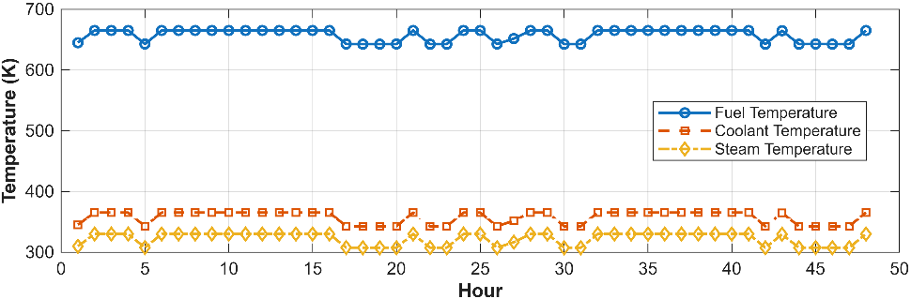
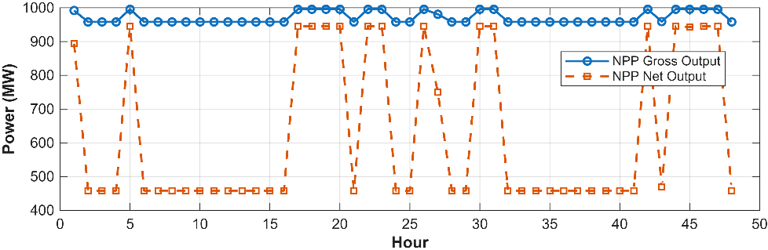
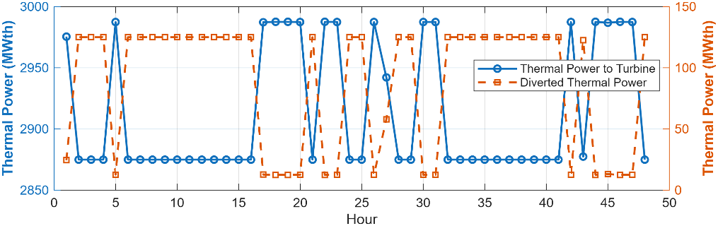
Results – Testing Analysis
Fuel, coolant, and steam temperature responses of the NPP
NPP electrical dispatch
(a)
(b)
Thermal power delivered to the turbine and thermal power diverted for hydrogen production
(c)

Slide 9
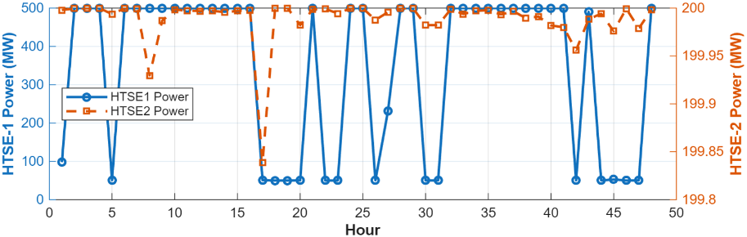
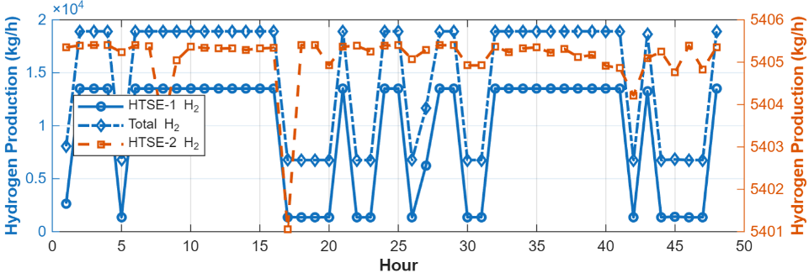
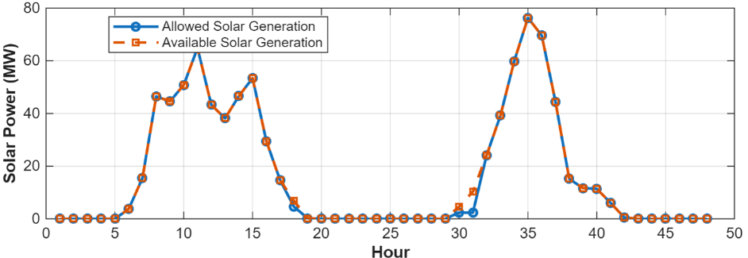
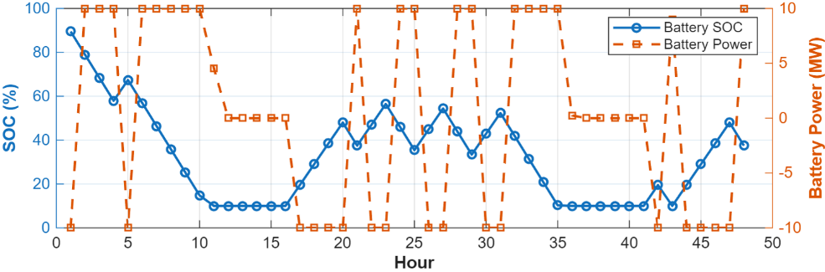
Results – Testing Analysis
Optimal HTSEs Power Demand
Hourly hydrogen production rates for HTSEs 1 & 2
Optimal solar power dispatch and available power
Optimal BESS power and SOC

Slide 10





Conclusions and future work
Conclusions
Future Work
Grid-aware TD3 framework successfully learns stable, economically optimal dispatch policies
Dynamic coordination of electricity generation and hydrogen production across varying price conditions
Thermal and electrical diversion managed without introducing NPP thermal instability
Physics-informed constraints ensure safe operation under stochastic system conditions
All grid bus voltages maintained within 0.95–1.05 pu throughout the scheduling horizon
Scalable architecture suitable for next-generation integrated energy systems with high levels of variable generation and flexible loads
Extend to larger transmission systems
Electrochemical degradation models for HTSE
Cybersecurity-resilient control mechanisms
Hardware-in-the-loop validation
Experimental test-bed deployment

Slide 11
Q & A and Acknowledgements
Thanks for listening to me and for your great questions☺
• Temitayo Olowu • Nick Kane • Jeremy Hartvigsen • Micah Casteel • Jan Lambrechtsen • Joseph Barton • Korey Robert Cook
U.S. Department of Energy, Office of Nuclear Energy under DOE Idaho Operations Office Contract DE-AC07-05ID14517.

