Slide 1

Availability Evaluation of a Nuclear-Enabled Microgrid for a Data Center
INL/CON-26-94211
July 22, 2026
Authors: Tate Shorthill, Iza Lantgios, Wen-Chi Cheng
Presenter: Wen-Chi Cheng

Slide 2
Background
Data center growth share of total U.S. electric demand is expected to increase to 10-20% by 2035 [1]
Data centers face long interconnection timelines [2]. Some online sources suggest locations like Virginia have nearly 14-year delays [3].
Behind the meter electrical power, such as microgrids, are gaining traction for those working to bypass interconnection challenges [4].
Nuclear power is targeted as a potential power source to meet the rapid growth. Once such option is through co-located facilities [5].
This work examines availability metrics for a nuclear-enabled microgrid.

Slide 3
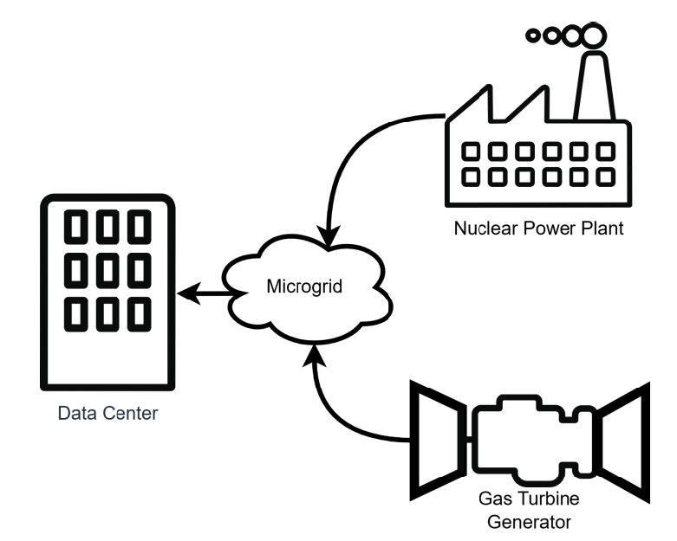
Background
“A microgrid is a group of interconnected loads and distributed energy resources within clearly defined electrical boundaries that acts as a single controllable entity with respect to the grid. A microgrid can operate in either grid-connected or in island mode, including entirely off-grid applications.” [6]
There are no predefined maximums or minimums for the size of microgrids [7].

Slide 4
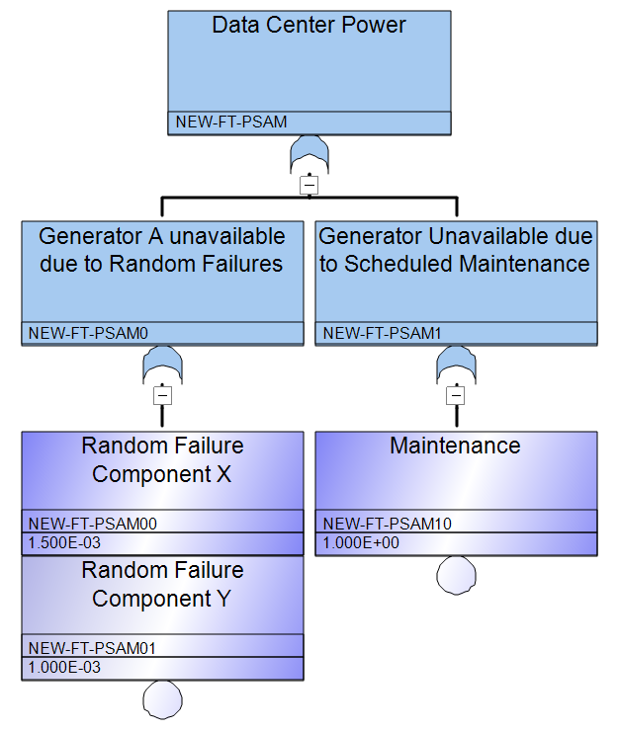
Methodology
Objective: evaluate data center availability in terms of available power.
Approach: Employ static, high-level assessment for convenience in planning and evaluating microgrid generator configurations.
Method: Fault Tree
Concepts [8]:
  Probability that a system is up = availability
  Probability that a system is down = unavailability

Slide 5
Methodology-continued
Procedure:
1. Identify the power requirements of the data center
2. Select generators for the microgrid
3. Determine the failure frequency of the power generator
4. Determine the maintenance frequency of the power generator
5. Construct the fault tree
6. Evaluate the minimal cut sets and top event probability

Slide 6
Case Study – Setup
This work examines power source availability for a 300 MWe data center. The power supply for the data center is from an islanded local microgrid powered by a nuclear power plant (NPP) and natural gas turbine generators (NGT)
Generator A: 1000 MWe pressurized water reactor.
Generator B: 52 MWe aeroderivative turbine generator.
All other equipment (transformers, breakers, distribution, etc. are not included in the analysis)
Excess power from the NPP is supplied elsewhere, not considered in this model

Slide 7
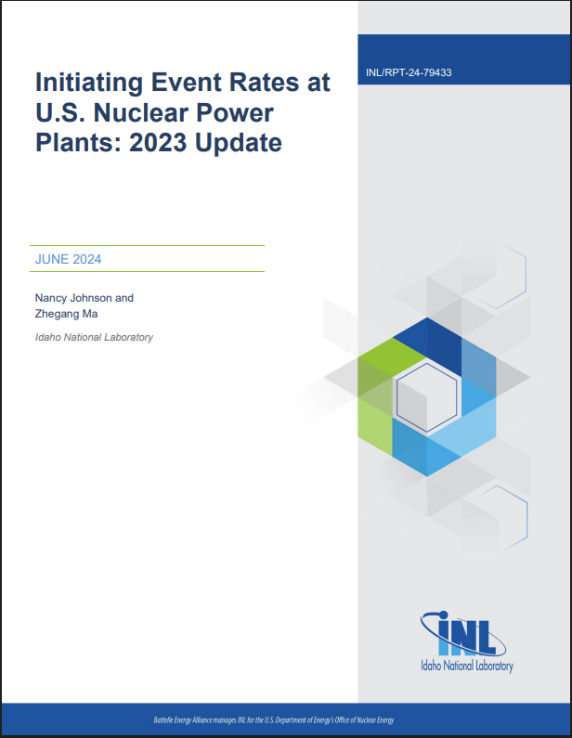

Case Study – Data
Evaluate the conditions for which generators are unavailable:
  NPP is unavailable during tripped conditions and scheduled outages
  NGT is unavailable during random downtimes and scheduled outages
Estimate frequency and duration of downtime events. (operational history, publications, etc.)
  NPP initiating event frequency (INL publication) [9]
  NGT event frequency (IEEE gold book) [10]

Slide 8
Data Reference - NGT
NGT Data [10] | Unit-years | Failures | Failure rate (failures/year) | MTBF | MTTR | MTTM | MDT
750 kW-7 MW | 167.9 | 290 | 1.7276 | 5070.6 | 27.39 | 1 | 1.225
NGT maintenance *[11] **[12] | interval (hours) | Mean time to perform* |  | hours/year
Borescope Inspection | 4000* | 12 |  | 26.28
Hot Section Combustor Rotator Exchange | 25000** | 72 |  | 25.23
Major overhaul Core Exchange | 50000** | 48 |  | 8.41
Total mean hours/year |  |  | 59.92
Maintenance probability |  |  | 6.840E-03
Schedule maintenance of the NGT based on recommended major and minor maintenance times and online reported durations.
NGT data assumed appropriate for case study demonstration, despite not exact match for size.
MTTT: mean time to repair, MTBF: mean time between failures, MTTM mean time to maintain, MDT: mean down time

Slide 9
Data Reference – NPP
Initiating Event *[9],**[13] |  | Mean event Frequency * (per year) | Mean Duration (hours)** | Mean downtime (hours)
Loss of vital AC bus (LOAC) |  | 5.29E-03 | 192.00 | 1.02
Loss of vital DC bus (LODC) |  | 6.23E-04 | 120.00 | 0.07
Partial loss of component cooling water (LCFW) |  | 1.56E-03 | 348.00 | 0.54
Loss of feedwater (LFW) |  | 6.98E-02 | 188.16 | 13.13
Partial loss of service water (LSW) |  | 1.25E-03 | 408.00 | 0.51
PWR loss of instrument air (LOIA) |  | 8.44E-03 | 59.04 | 0.50
PWR loss of heat sink (LOHS) |  | 5.81E-02 | 340.80 | 19.80
PWR General Transient (GT) |  | 9.43E-01 | 137.52 | 129.68
Loss of coolant accident (LOCA) |  | 1.56E-03 | 1200.00 | 1.87
Loss of offsite power (LOOP) |  | 2.36E-02 | 18.11 | 0.46
Total events/year | 1.1132
Total Event down time per year (hours) | 167.56
NPP initiating event data was combined with estimates of event durations given by Doyle et al. in 2020 [13].

Slide 10
Model Inputs
Model inputs | Values | Notes
Failure rate of the NPP (per hour) | 1.271E-04 | Drives unavailability due to random failures (calculated from reference data)
Maintenance probability of the NPP | 6.895E-02 | Drives unavailability due to scheduled maintenance. Maintenance was calculated from 18 months refueling outage interval and duration of 37.75 days [14]
Repair time for the NPP (hours) | 167.59 | Influences unavailability due to random failures. Also, the time required for backup load coverage by NGTs.
Failure rate of the NGTs (per hour) | 1.972E-04 | Drives unavailability due to random failures (based on reference data slide)
NGT failure to start (per demand) | 1.4E-02 | Failure to start based on “starting reliability” given in [15]
Maintenance probability of the NGTs | 6.840E-03 | Drives unavailability due to scheduled maintenance (value from reference slide)
Repair time for the NGTs (hours) | 27.39 | Influences unavailability due to random failures. Also, the time required for backup load coverage by additional NGTs, if available.

Slide 11
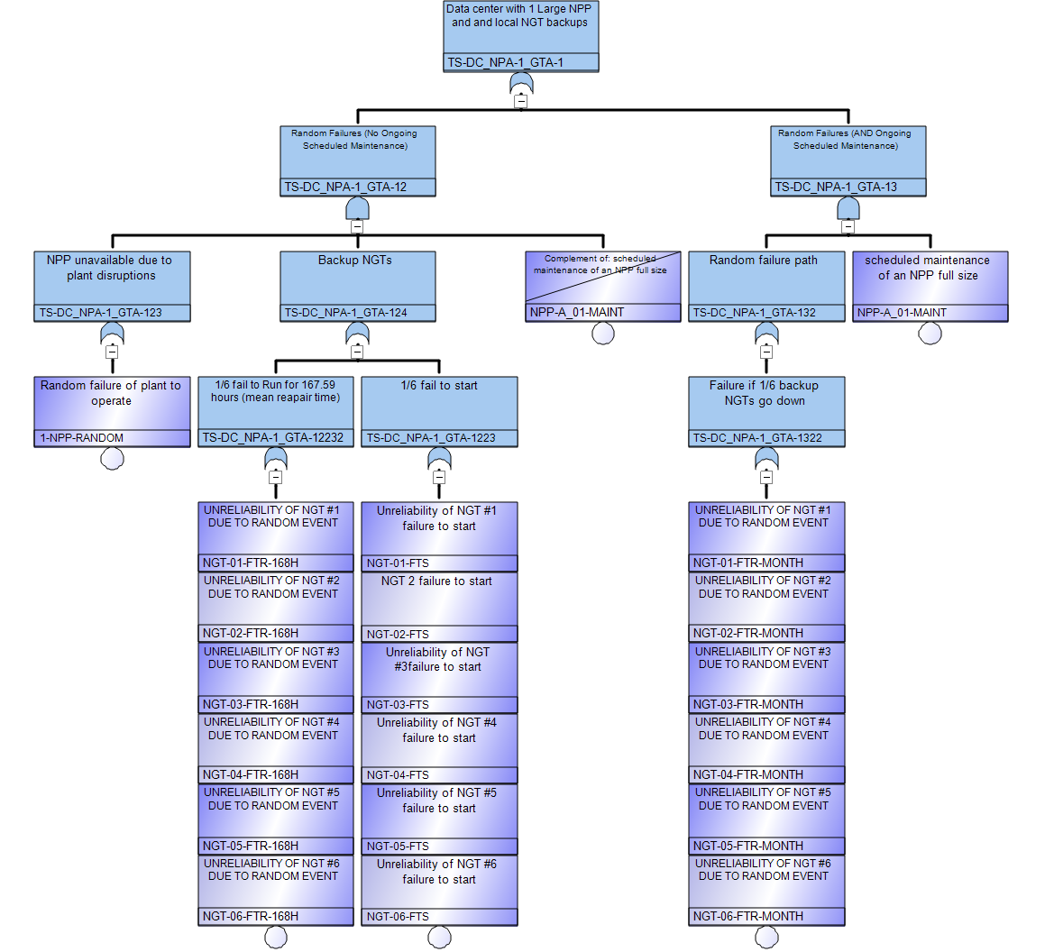
Case Study – Fault Tree
Two main branches
  Normal
  Maintenance
Backup NGTs with different operational periods
Effectively N+1 power generation.
Top event availability = 99.53%

Slide 12
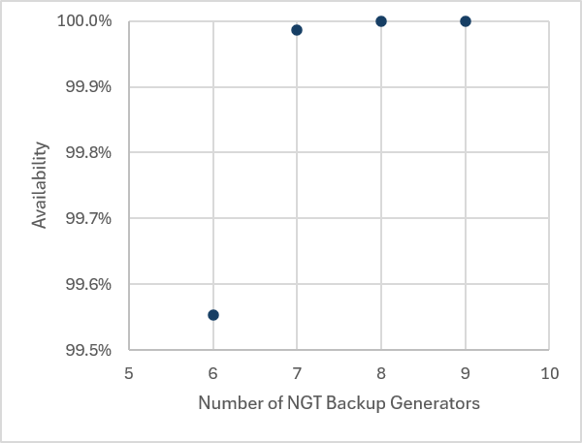
Results
Reliability improves fastest with the first few backup generators, then tapers off.
Case | Microgrid Configuration | Availability
1 | Nuclear solo | 91.297000%
2 | Nuclear + 6 NGTs | 99.553100%
3 | Nuclear + 7 NGTs | 99.986660%
4 | Nuclear + 8 NGTs | 99.999625%
5 | Nuclear + 9 NGTs | 99.999990%

Slide 13
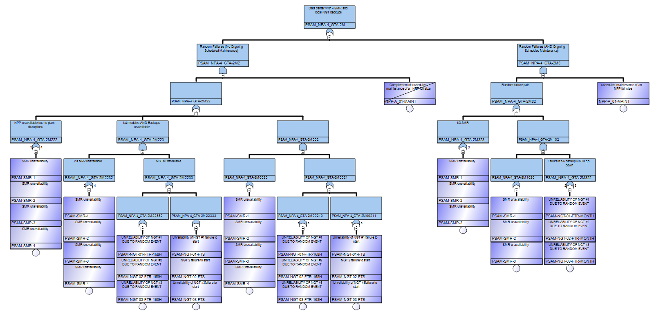
Discussion
The large NPP configuration may be costly. During outages backup generators must support the entire 300 MWe data center.
In contrast, a modular plant (4x77 MWe modular reactor) can achieve better availability with half as many backup generators.
  Assumption other model metrics remain unchanged
  1/4 SMRs units maintained at a time
NPP+6NGTs = 99.5%
4SMR+3NGTs = 99.9%

Slide 14
Discussion continued
Model results are based on limited data. More detailed results could be obtained by leveraging the North American Electric Reliability Corporation (NERC) [16] or other data collection agencies.
Model results are point estimates; future work will expand the results to capture uncertainties.
The inclusion of distribution systems, transformers, controllers, breakers, etc. would reduce the availability results.
The evaluation of advanced/next generation nuclear power will require detailed analysis but ultimately is limited until such systems are deployed.
Results allow discussion with data center availability targets (e.g., Tier V or 99.999%) from a power-availability and planning perspective.

Slide 15
Conclusion
GRA with fault-tree analysis provides a quantitative pathway for sizing microgrid backup capacity against specific availability targets.
Large NPPs can reach availability targets, but the data centers will need 100% power backup during NPP outages if they wish to remain online.
Next-generation reactors with online refueling, modular design, shorter outages could reduce the required backup capacity needed to hit high availability targets.
Future work: extend this work into availability and risk informed technoeconomic assessments for data centers.

Slide 16
References
[1] | Electric Power Research Institute, "Powering Intelligence 2026 white paper," 3002034696, EPRI, 2026.
[2] | Electric Power Research Institute, "Reconciling the Value of Grid Interconnection and Speed to Power: Strategies for Powering Data Centers in the AI Era," 3002034260, 2025.
[3] | A. Broughel, "Will AI Break The Grid? It Depends On How We Use Every Electron," Forbes, 31 May 2026. [Online]. Available: https://www.forbes.com/sites/annabroughel/2026/05/31/will-ai-break-the-grid-it-depends-on-how-we-use-every-electron/. [Accessed 2026 17 July].
[4] | A. Good, "Data center developers turn to distributed behind-the-meter power," S&P Global, 23 October 2025. [Online]. Available: https://www.spglobal.com/market-intelligence/en/news-insights/articles/2025/10/data-center-developers-turn-to-distributed-behind-the-meter-power-94174247. [Accessed 17 July 2026].
[5] | L. Kearney, "Talen Energy mulls options to supply data centers after Amazon setback," Reuters, 8 May 2025. [Online]. Available: https://www.reuters.com/business/energy/talen-energy-considers-alternative-data-center-power-deals-after-regulator-push-2025-05-08/. [Accessed 09 June 2026].
[6] | U.S. Department of Energy, "Microgrid Overview," U.S. DOE, 2024.
[7] | R. Broderick, B. M. Garcia, S. E. Horn and M. S. Lave, "Microgrid Conceptual Design Guidebook," Sandia National Laboratories, 2022.
[8] | M. Modarres, M. P. Kaminskiy and V. Krivtsov, Reliability Engineering and Risk Analysis: A Practical Guide, 3rd ed., New York: Marcel Dekker, Inc., 1999.

Slide 17
References
[9] | Z. M. Nancy Johnson, "Initiating Event Rates at U.S. Nuclear Power Plants: 2023 Update," INL/RPT-24-79433, Idaho National Laboratory, Idaho Falls, ID, 2024.
[10] | IEEE, "Design of Reliable Industrial and Commercial Power Systems," Institute of Electrical and Electronics Engineers, Inc., New York, NY, IEEE Std 493-2007, "IEEE Gold Book", 2007.
[11] | J. M. Ingham and S. Sawant, "How aeroderivatives support renewable energy," Gas Turbine World, 1 April 2023. [Online]. Available: https://gasturbineworld.com/aeroderivatives-and-renewable-energy/#:~:text=Figure%202.%20Typical%205%2Dminute%20start,cold%20condition%20to%20full%20load.. [Accessed 6 June 2026].
[12] | Baker Hughes, "LM6000PF+ aeroderivative gas turbine (53.8 MW, 50/60 Hz)," Baker Hughes, [Online]. Available: https://www.bakerhughes.com/gas-turbines/aeroderivative-technology/lm6000pf. [Accessed July 2026].
[13] | J. Doyle, B. Haley, B. Galyean and D. T. Ingersoll, "Highly Available Nuclear Power for Mission-Critical Applications," Nuclear Technology, vol. 206 (7), pp. 1059-1074, 2020.
[14] | EIA, "U.S. summer nuclear outages rose in 2023, returning to 2021 levels," U.S. Energy Information Administration, 17 October 2023. [Online]. Available: https://www.eia.gov/todayinenergy/detail.php?id=60682. [Accessed 9 June 2026].
[15] | Turbomachinery International, "AERODERIVATIVE USERS SHARE MAINTENANCE TIPS," Turbomachinery International, 1 May 2013. [Online]. Available: https://www.turbomachinerymag.com/view/aeroderivative-users-share-maintenance-tips. [Accessed July 2026].
[16] | NERC, "Generating Availability Data System," [Online]. Available: https://www.nerc.com/programs/reliability-assessment--performance-analysis/generating-availability-data-system. [Accessed 2026].

