Slide 1
Quantitative Assessment of Human Error Probabilities and PSF Multipliers for Railway:
An Expert Elicitation Study
July 20, 2026
Taewon Yangª, Seong Keun Kang^{b}, and Jonghyun Kim^{a*}
ªKorea Advanced Institute of Science and Technology
^{b}Korea Railroad Research Institute
Notes:
Thank you for being here. My name is Taewon Yang, from the Korea Advanced Institute of Science and Technology.
Today, I will present our study titled "Quantitative Assessment of Human Error Probabilities and PSF Multipliers for Railway: An Expert Elicitation Study."

Slide 2
Contents
1. Introduction
  Background and necessity of research on railway human error
2. Quantification of NHEP and PSF Multipliers
  Data collection method and Cooke’s classical model
3. Elicitation of Expert Opinion
  Seed variables, target questions, and survey execution
4. Results and Discussion
  Nominal HEP and PSF multipliers derived from 16 experts
5. Conclusion
Notes:
Here is the outline of my talk. I will begin with the background and motivation of our research on railway human error.
Then, I will introduce the Classical Model, which is the expert-judgment framework we used to collect and aggregate data.
After that, I will explain how we designed and conducted the expert elicitation — including the seed variables, the target questions, and the survey itself.
Finally, I will present the results — the nominal human error probabilities and PSF multipliers — and close with our conclusions and future work.

Slide 3

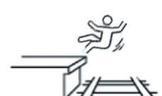
1. Introduction
What is Railroad Accident?
  Republic of Korea Railroad Safety Act Ch1. Article 2.11
    …an accident prescribed by Decree of the Ministry of Land, Infrastructure and Transport, which causes casualties or damage to goods in connection to railroad operation or railroad infrastructure management
  Railway Vehicle Operations
  Railway Facility Management
Train Collision
Train Fire
Train Derailment
Track Damage
Passenger Fall-from-Platform/Train
Notes:
Let me start with a brief definition. Under the Republic of Korea Railroad Safety Act, a railroad accident is defined as an accident that causes casualties or damage to goods in connection with railroad operation or railroad infrastructure management.
These accidents fall into two broad categories. The first is railway vehicle operations — for example, train collisions, train fires, and derailments, as shown in the upper part of the slide. The second is railway facility management — such as track damage, or passengers falling from a platform or a train.
In this study, our primary concern is the first category — accidents related to railway vehicle operations, which have the potential for large-scale casualties.

Slide 4
1. Introduction
Contribution of Human Factors to Railway Accidents
  In South Korea, about 50% of incidents are attributed to human errors by railway employees, including drivers and controllers
  Nevertheless, safety investment remains heavily concentrated on facilities and rolling-stock management
    The contribution of human error to railway accidents remains significant and insufficiently addressed
    Foundational research on factors influencing human error of railway employees remains insufficient
  Therefore, methods to reduce human errors of railway employees are needed
Notes:
Now, why do we focus on human error? The chart on this slide shows the trend of railway accidents in South Korea from 2010 to 2024, based on statistics from the Ministry of Land, Infrastructure and Transport. As you can see, train accidents have increased noticeably since 2020. More importantly, about fifty percent of these incidents are attributed to human errors by railway employees — including drivers and controllers.
Nevertheless, safety investment in Korea remains heavily concentrated on facilities and rolling-stock management. As a result, the contribution of human error remains significant and insufficiently addressed. In addition, foundational research on the factors that influence human error of railway employees is still lacking.
Therefore, systematic methods to reduce human errors of railway employees are clearly needed — and that is the motivation of this study.

Slide 5
1. Introduction
Objective of This Study
  Development of an HRA method for railway employees to reduce human errors
    Quantify the nominal human error probability (NHEP) and PSF multipliers required for a railway-specific HRA method
    Establish foundational data for the quantitative assessment of HEP
Contents of Today’s Presentation
  Data collection method for quantifying Nominal HEP and PSF multipliers
    Classical Model: a method for eliciting and aggregating expert opinions
    Expert survey based on the Classical Model
  Results of Nominal HEP and PSF multipliers
Notes:
The ultimate goal of our research is to develop a Human Reliability Analysis method for railway employees, in order to reduce human errors.
To support that goal, this study has two specific objectives. First, to quantify the nominal human error probability — the NHEP — and the PSF multipliers that a railway-specific HRA method requires. Second, to establish foundational data for the quantitative assessment of HEP.
In today's presentation, I will cover four things: the data collection method we chose; the Classical Model, which is our framework for eliciting and aggregating expert opinions; the expert survey we conducted based on this model; and finally, the resulting NHEP and PSF multiplier values.

Slide 6
2. Classical Model
Data Collection
  Four general methods are used to evaluate human error
    Human error modeling, simulation experiments, literature analysis, and expert opinion elicitation
  This study adopts the expert opinion elicitation method
    Collect opinions from multiple experts to evaluate human performance and error probabilities
    Can derive results with relatively little data, Generally easier to apply to real environments
Expert Opinion Elicitation Method - Classical model
  Developed by Cooke in 1991
  Systematic framework for deriving rational consensus estimates when empirical field data are lacking
  Premise: an expert’s proficiency in quantifying uncertainty can be inferred from demonstrated accuracy on variables with known outcomes
Notes:
Let me move to Chapter 2, the Classical Model.
In general, there are four ways to collect the data needed to evaluate human error: human error modeling, simulation experiments, analysis of existing literature, and expert opinion elicitation.
In this study, we adopted the expert opinion elicitation method. This approach collects the judgments of multiple experts to evaluate human performance and error probabilities. It has two practical advantages: it can derive results with relatively little empirical data, and it is generally easier to apply to real operational environments. This matters because, in the railway domain, empirical field data are very scarce.
Specifically, we used the Classical Model, developed by Cooke in 1991. It is a systematic framework for deriving rational consensus estimates when empirical data are lacking. Its key premise is simple: an expert's ability to quantify uncertainty can be inferred from how accurately they assess variables whose true values are already known.

Slide 7
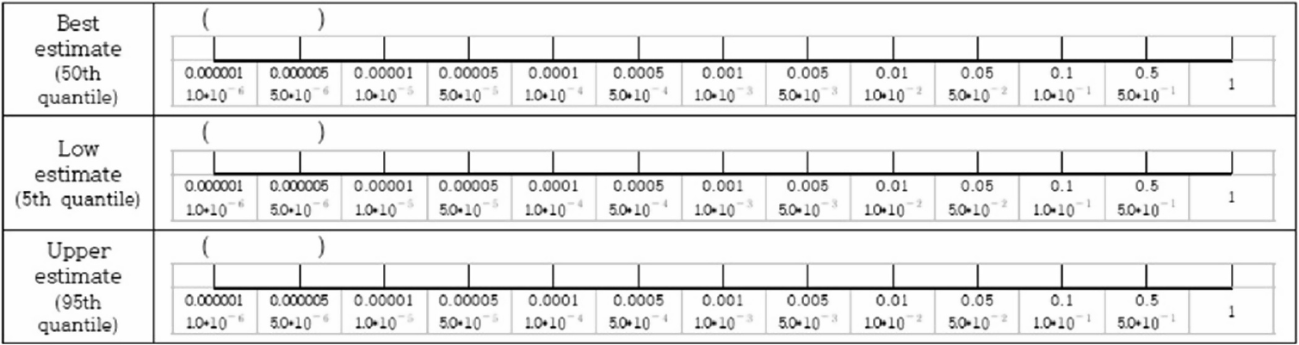
2. Classical Model
Structure of the Classical Model
  Expert opinions are collected using a structured questionnaire
  The questionnaire comprises two types of questions
    Seed variables: true values known to the analyst but undisclosed to experts
      Quantify expert performance and enable performance-optimized aggregation
    Target questions: quantities requiring novel evaluation
      Collect opinions about NHEP and PSF multipliers of railway employees
Notes:
This slide shows the structure of the Classical Model. Expert opinions are collected through a structured questionnaire, and the questionnaire comprises two types of questions.
The first type is the seed variable. These are questions whose true values are known to the analyst, but not disclosed to the experts. Seed variables allow us to quantify each expert's performance, and they enable performance-optimized aggregation of the opinions.
The second type is the target question. These are the quantities we actually want to evaluate — in our case, the nominal HEPs and PSF multipliers of railway employees.
So, in short: seed variables tell us how much to trust each expert, and target questions tell us what the experts believe about the quantities of interest.

Slide 8
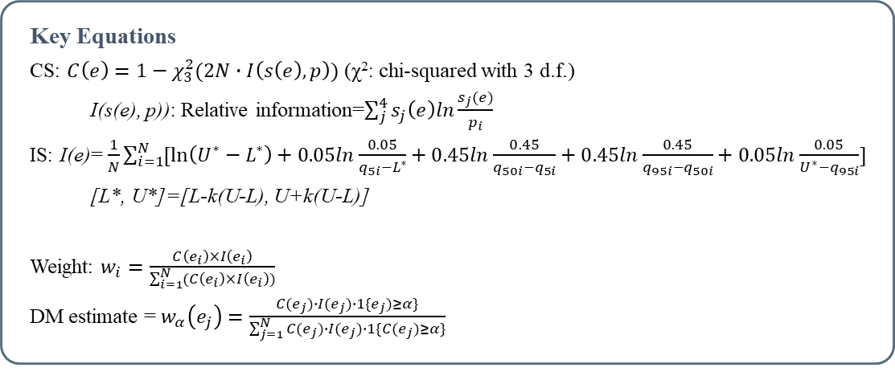
2. Classical Model
Classical Model Process — from Expert Survey to Aggregated Estimates
1. Expert Weighting
Experts answer seed variables with 5th / 50th / 95th percentile estimates
Calibration Score (CS) × Information Score (IS)
2. Decision Maker (DM)
Virtual expert integrating all opinions with performance-based weights
3. DM Optimization
Exclude experts whose CS falls below significance level α
→ maximize the DM’s combined CS × IS
Key Equations
CS: $C\left(e\right)=1−χ_{3}^{2}(2N∙I\left(s\left(e\right),p\right))$ (χ²: chi-squared with 3 d.f.)
I(s(e), p)): Relative information=$\sum_{j}^{4}{s_{j}\left(e\right)ln\frac{s_{j}(e)}{p_{i}}}$
IS: I(e)= $\frac{1}{N}\sum_{i=1}^{N}{[\ln\left(U^{∗}−L^{∗}\right)+0.05ln\frac{0.05}{q_{5i}−L^{∗}}+0.45ln\frac{0.45}{q_{50i}−q_{5i}}+0.45ln\frac{0.45}{q_{95i}−q_{50i}}+0.05ln\frac{0.05}{U^{∗}−q_{95i}}]}$
[L*, U*]=[L-k(U-L), U+k(U-L)]
Weight: $w_{i}=\frac{C\left(e_{i}\right)×I\left(e_{i}\right)}{\sum_{i=1}^{N}{(C\left(e_{i}\right)×I\left(e_{i}\right))}}$
DM estimate = $w_{α}\left(e_{j}\right)=\frac{C(e_{j})∙I(e_{j})∙1\{e_{j})≥α\}}{\sum_{j=1}^{N}{C(e_{j})∙I(e_{j})∙1\{C(e_{j})≥α\}}}$
Scoring an expert’s answer (per seed question)
5%
45%
45%
5%
m
x_{5%}
x_{50%}
x_{95%}
M
CS: how often the true value falls in each interval
- empirical distribution s(e) vs. theoretical p = (0.05, 0.45, 0.45, 0.05)
IS: narrower [x_{5%}, x_{95%}] range → more informative expert
Notes:
This slide summarizes the whole process of the Classical Model on a single page. It consists of three steps.
Step one is expert weighting. Each expert answers the seed variables by giving three estimates — the 5th, 50th, and 95th percentiles. As the diagram at the bottom left shows, these three values divide the expert's answer range into four intervals. If the expert is well calibrated, the true value should fall in each interval with the theoretical probabilities of 5, 45, 45, and 5 percent. The Calibration Score measures how closely the expert's empirical distribution matches this theoretical distribution — using the relative information and a chi-squared statistic with three degrees of freedom, as shown in the equations on the right. The Information Score, on the other hand, measures how narrow the expert's ranges are — a narrower range means a more informative expert.
Step two is constructing the Decision Maker, or DM. The DM is a virtual expert that integrates all opinions, where each expert's weight is the product of their Calibration Score and Information Score, normalized across the panel.
Step three is DM optimization. Experts whose calibration falls below a significance level alpha are excluded, so that the DM's combined performance — calibration times information — is maximized. The final aggregated estimate for each target question is the DM's performance-weighted distribution.

Slide 9
3. Elicitation of Expert Opinion
Seed Variables — 9 questions in each questionnaire
  Nominal HEP survey
    6 on situation-specific HEPs of train operators from Railway Action Reliability Assessment (RARA)
    3 questions on execution/omission error probabilities from Technique for Human Error Rate Prediction (THERP)
    E.g., “Probability of human error when performing a familiar task that is repeated on a regular basis”
  PSF multiplier survey
    9 PSFs selected from RARA
      Experts estimate how much the HEP changes when each PSF is in effect
    E.g., “Effect on HEP when available time margin becomes insufficient due to delays, breakdowns, or construction”
Notes:
Now let me explain how we designed the elicitation. We developed two questionnaires — one for the nominal HEP and one for the PSF multipliers — and each contains nine seed variables.
For the nominal HEP survey, six seed questions were based on situation-specific HEPs of train operators from RARA — the Railway Action Reliability Assessment — and three were based on execution and omission error probabilities from THERP. For example: "the probability of human error when performing a familiar task that is repeated on a regular basis.”
For the PSF multiplier survey, nine PSFs were selected from RARA, and experts were asked to estimate how much the HEP changes when each PSF is in effect. For example: "the effect on HEP when the available time margin becomes insufficient due to delays, breakdowns, or construction."

Slide 10
3. Elicitation of Expert Opinion
Target Questions — Nominal HEP (8 items)
  Diagnosis and action error probabilities for four representative employee types
    Train operators, traffic controllers, maintenance workers, and track workers
  Illustrative examples provided alongside each question
Target Questions — PSF Multiplier (14 items)
  Eight PSFs
    Workload, Equipment/HMI, Procedures/Guidelines, Experience/Training, Work Process, Complexity, Communication, Environment
  Six PSFs with three qualitative levels; Communication and Environment with two levels
  Multiplier at the nominal level assumed to be 1
    Experts assess the magnitude of change as the level varies
Notes:
Next, the target questions.
The nominal HEP questionnaire contains eight items. We asked for the diagnosis error probability and the action error probability for each of four representative employee types: train operators, traffic controllers, maintenance workers, and track workers. Illustrative examples were provided alongside each question to help the experts.
The PSF multiplier questionnaire contains fourteen items, covering eight PSFs: Workload, Equipment and HMI, Procedures and Guidelines, Experience and Training, Work Process, Complexity, Communication, and Environment. Six of these PSFs have three qualitative levels, while Communication and Environment have two. The multiplier at the nominal level is assumed to be one, and experts assessed how much the multiplier changes as the level.

Slide 11
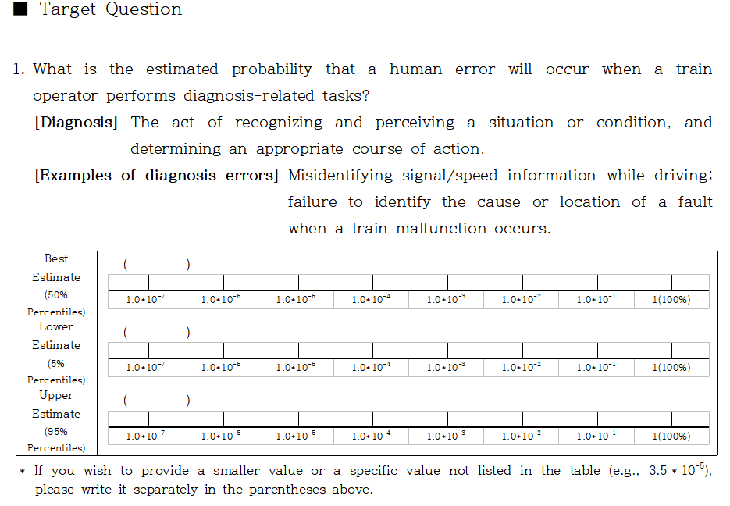
3. Elicitation of Expert Opinion
Example of Questionnaire
Notes:
This slide shows an actual example of the questionnaire. For each question, the expert provides three responses: the best estimate; the lower estimate, and the upper estimate.
This format allows each expert to express not only their best judgment, but also their uncertainty around it

Slide 12
3. Elicitation of Expert Opinion
Expert Panel — 16 Railway Domain Experts
  Diverse backgrounds: academia, research institutions, training agencies, and field operations
  Experience ranging from 3 to 43 years (average 29 years)
Conducting the Survey
  In-person, individual or group interviews
    Heightened responsibility and immediate clarification of uncertainties
  Briefing prior to elicitation
    Study overview, research ethics, classical model, percentile-based responses, and cognitive biases
  Prescribed sequence
    Seed variables first, then Target questions
Notes:
For the survey, we recruited a panel of sixteen railway domain experts. They came from diverse backgrounds — academia, research institutions, training agencies, and field operations — with experience ranging from three to forty-three years, and an average of twenty-nine years.
The survey was administered through in-person interviews, either individually or in small groups.
Before the elicitation, each respondent received a briefing covering the study overview, research ethics, the Classical Model itself, how to express uncertainty using percentiles, and the cognitive biases that could influence their answers. Respondents then proceeded in a prescribed sequence — seed variables first, followed by the target questions.

Slide 13
4. Results and Discussion
Results of Expert Elicitation — Nominal HEP
  Mean: probability-weighted average produced by the DM using performance-based weights from the seed variables
Question | Mean | 5% | 50% | 95%
Train operator – Diagnosis | 1.23 × 10⁻² | 1.00 × 10⁻³ | 1.00 × 10⁻² | 2.00 × 10⁻²
Train operator – Action | 6.15 × 10⁻³ | 1.00 × 10⁻³ | 2.00 × 10⁻³ | 1.00 × 10⁻²
Traffic controller – Diagnosis | 5.50 × 10⁻³ | 2.00 × 10⁻⁴ | 1.00 × 10⁻³ | 1.00 × 10⁻²
Traffic controller – Action | 3.52 × 10⁻³ | 3.00 × 10⁻⁴ | 1.00 × 10⁻³ | 2.00 × 10⁻³
Maintenance worker – Diagnosis | 2.79 × 10⁻³ | 1.00 × 10⁻⁵ | 1.00 × 10⁻⁴ | 1.00 × 10⁻³
Maintenance worker – Action | 3.47 × 10⁻³ | 1.00 × 10⁻⁴ | 1.00 × 10⁻³ | 2.00 × 10⁻³
Track worker – Diagnosis | 1.23 × 10⁻² | 1.00 × 10⁻³ | 1.00 × 10⁻² | 2.00 × 10⁻²
Track worker – Action | 3.50 × 10⁻³ | 2.00 × 10⁻⁴ | 1.00 × 10⁻³ | 2.00 × 10⁻³
Notes:
Now, the results. This table shows the nominal HEP values derived from the expert elicitation. The mean is the probability-weighted average produced by the Decision Maker, using the performance-based weights from the seed variables, and the percentile columns show the DM's overall distribution.
Let me highlight a few numbers. The highest nominal HEPs were obtained for the diagnosis tasks of train operators and track workers. The lowest was for the diagnosis tasks of maintenance workers.
I will discuss the patterns behind these numbers in a moment, but the key point is that the elicited values differ across employee types and task types.

Slide 14
4. Results and Discussion
Results of Expert Elicitation — PSF Multiplier
  Multiplier = factor by which the HEP changes at a given qualitative level (nominal level = 1)
Question | Mean | 5% | 50% | 95%
Workload – Poor | 14.450 | 2 | 6.441 | 36.105
Workload – Very Poor | 23.424 | 4 | 14.068 | 56.273
Equipment/HMI – Poor | 5.654 | 1.593 | 3.186 | 9.186
Equipment/HMI – Good | 0.492 | 0.186 | 0.444 | 0.881
Procedures/Guidelines – Poor | 8.559 | 2 | 5.593 | 14.068
Procedures/Guidelines – Good | 0.292 | 0.036 | 0.280 | 0.525
Experience/Training – Poor | 7.229 | 2 | 4.407 | 12.882
Experience/Training – Good | 0.421 | 0.048 | 0.363 | 0.881
Work Process – Poor | 12.110 | 2 | 6.780 | 28.137
Work Process – Good | 0.322 | 0.0319 | 0.263 | 0.681
Complexity – High | 4.654 | 1.593 | 3.186 | 9.186
Complexity – Very High | 11.873 | 3.186 | 5.593 | 28.137
Communication – Poor | 9.559 | 2 | 4.407 | 22.205
Environment – Poor | 11.576 | 2 | 5.593 | 28.137
Notes:
This table shows the PSF multiplier results. Again, the multiplier is the factor by which the HEP changes at a given qualitative level, with the nominal level fixed at one.
Looking at the negative levels Workload stands out with the largest multipliers: about twenty-three at the Very Poor level, and about fourteen at the Poor level. At the positive levels, Procedures and Guidelines at the Good level gave the strongest reduction, with a multiplier of about zero point two nine.
Notice also that within each PSF, the multipliers change monotonically with the qualitative level

Slide 15
4. Results and Discussion
Nominal HEP
  Ranged from 2.79 × 10⁻³ (maintenance worker – diagnosis) to 1.23 × 10⁻² (train operator and track worker – diagnosis)
  Diagnosis tasks more error-prone than action tasks for train operators, traffic controllers, and track workers; the reverse for maintenance workers
  Mean HEP in ascending order:
    maintenance workers < traffic controllers < track workers < train operators
PSF Multipliers
  Workload showed the largest negative-level multipliers: ×23.4 (Very Poor) and ×14.5 (Poor)
  Procedures/Guidelines – Good yielded the greatest reduction (×0.29), followed by Work Process (×0.32)
  Asymmetric influence: deterioration of a PSF impacts the HEP far more than its enhancement
Notes:
Let me summarize the main observations.
For the nominal HEP: the values ranged from two point seven nine times ten to the minus three, for maintenance-worker diagnosis, up to one point two three times ten to the minus two, for train-operator and track-worker diagnosis. For train operators, traffic controllers, and track workers, diagnosis tasks were judged more error-prone than action tasks — On the other hands, the reverse was true for maintenance workers. This reflects the different cognitive and physical demands of each job. Ordering the mean HEP across both task types, maintenance workers were lowest, followed by traffic controllers, track workers, and train operators.
For the PSF multipliers: Workload showed by far the largest negative influence, while good procedures and a good work process provided the largest reductions. And one clear pattern emerged — the influence is asymmetric. The deterioration of a PSF increases the HEP far more than its enhancement decreases it. In other words, preventing bad conditions matters more than perfecting good ones.

Slide 16
5. Conclusion
Summary
  Nominal HEP and PSF multipliers for railway employees quantified through structured expert elicitation with Cooke’s classical model
  Judgments of 16 experts systematically weighted and aggregated into performance-weighted estimates
  Findings provide foundational quantitative data for a railway-specific HRA method
Future Work
  Refine classification into four occupational categories (train operators, traffic controllers, train attendants, field workers) with 10 experts per category
  Develop a dedicated HRA method for quantitative HEP assessment of railway employees based on the refined estimates
Notes:
To conclude. In this study, we quantified the nominal HEPs and PSF multipliers for railway employees through a structured expert elicitation based on Cooke's Classical Model. The judgments of sixteen experts were systematically weighted and aggregated into performance-weighted estimates, and the findings provide foundational quantitative data for a railway-specific HRA method.
As future work, we plan to proceed in two directions. First, we will refine the employee classification into four categories — train operators, traffic controllers, train attendants, and field workers — and recruit ten experts per category to derive more detailed estimates. Second, building on these refined estimates, we will develop a dedicated HRA method for the quantitative assessment of HEP among railway employees.

Slide 17
Thank You
Taewon Yang | taewon.yang@kaist.ac.kr | Korea Advanced Institute of Science and Technology
Notes:
That concludes my presentation. Thank you very much for your attention
Before q&a, if you can’t solve your questions because my communication skill, please send your question to my email.
Thank you

