Slide 1

Toward a Generic PRA Framework for Sodium Fast Reactors
A Comparative Review of Four Pool-Type SFR Designs
Tao Liu, Jisuk Kim, Wen-Chi Cheng, and Svetlana Lawrence
Idaho National Laboratory

Slide 2



Motivation
Nuclear-Industrial
Park Optimization
Supporting New
Licensing Frameworks
Enabling NRC
Independent Verification
SFRs are candidate energy sources for co-located industrial facilities
Quantitative risk characterization is a prerequisite for integrated safety and configuration optimization
Generic SFR PRA provides the risk foundation for the broader systems engineering framework
PRA plays a central role in LMP-based and Part 53 non-LWR licensing.
Many SFR vendors lack a mature PRA model — a validated generic model provides a credible starting point
Reduces barriers to PRA development and accelerates the licensing process for emerging designs
NRC needs independent PRA capability to review and verify vendor-submitted models
Generic SFR PRA benchmark gives NRC a reference model for comparison and regulatory auditing
Supports regulatory confidence in advanced reactor safety claims
Notes:
three motivations

Slide 3
Goals & Objectives
Goal: Develop a generic Level 1 PRA model for sodium-cooled fast reactors by systematically synthesizing PRA knowledge across representative SFR designs — supporting nuclear-industrial park optimization, advanced reactor licensing, and NRC independent verification.
Objectives
1
Assess and compare PRA elements across four reference designs (EBR-II, PRISM, ARC-100, Natrium) — covering IEs, ET/FT structures, success criteria, and safety systems
2
Synthesize findings into unified generic IE and ET/FT lists with documented modeling rules and bounding assumptions
3
Develop a complete generic SFR Level 1 PRA model package
3

Slide 4
Scope and method
Reference designs
Review flow
• EBR-II: experimental reactor with operating experience and a published Level 1 PRA
• PRISM: modular commercial SFR with public PRA and safety documentation
• ARC-100: current small modular pool-type SFR concept
• Natrium: current pool-type SFR with a molten-salt energy-storage interface
1
Design features
2
Safety functions
3
Initiating-event families
4
Event sequence groups
5
Assumptions and data
Paper focus: comparative design review and generic PRA structure. Detailed quantification and complete PRA model development are outside the present paper scope.

Slide 5
Standards and licensing context
Element | EBR-II | PRISM (legacy and LMP) | ARC-100 | Natrium
PRA context | DOE guidance; predates the non-LWR PRA standard | NRC preapplication review; updated PRA used the trial-use ASME/ANS non-LWR standard | Early conceptual Level 1 PSA cited trial-use RA-S-1.4-2013 and NEI 18-04 | LMP-based PRA supporting the Part 50 application
Regulatory context | DOE-owned and regulated experimental reactor | NRC preapplication review documented in NUREG-1368 (1994); LMP pilot completed in 2018 | NRC preapplication engagement | NRC Part 50 construction-permit application using NEI 18-04/RG 1.233
LBE Categorization | Pre-LMP; DOE safety analysis categories | LMP-style AOO (Anticipated Operational Occurrence), DBE (Design Basis Event), BDBE (Beyond Design Basis Event) | AOO, DBE, BDBE | AOO, DBE, BDBE; design-specific sodium–salt interface events.
ASME/ANS RA-S-1.4-2021, Probabilistic Risk Assessment Standard for Advanced Non-Light Water Reactor Nuclear Power Plants (NRC endorsed for trial use via RG 1.247, March 2022)
NEI 18-04 Rev. 1, Risk-Informed Performance-Based Technology Inclusive Guidance for Non-Light Water Reactor Licensing Basis Development (NRC endorsed via RG 1.233, June 2020)
Notes:
this table shows how each reference design actually sits in the regulatory landscape

Slide 6
Reference-design comparison (selected)
Feature | EBR-II | PRISM | ARC-100 | Natrium
Power | 62.5 MWt | 471 MWt | 286 MWt | 840 MWt
Fuel | U-Zr / U-Pu-Zr | U-Pu-Zr | U-10Zr | U-10Zr HALEU
Heat sink interface | Primary Na → IHX → intermediate Na → Na-water SG | Primary Na → IHX → intermediate Na → Na-water SG | Primary Na → IHX → intermediate Na → Na-water SG | Primary Na → IHX → intermediate Na → Na-salt HX → salt storage → steam system
Primary pump | Mechanical Centrifugal | Electromagnetic | Electromagnetic | Mechanical centrifugal
Decay heat removal | Natural circulation of primary sodium cools the core; the NaK shutdown-cooling circuit rejects heat to air. | RVACS uses natural circulation of outside air around the vessel. ACS can remove heat through naturally circulating sodium loops when that path is available. | DRACS and RVACS provide passive heat removal using natural circulation and natural-draft air cooling. | RAC uses passive natural circulation of air around the guard vessel. IAC also has a passive natural-draft operating mode.
Containment | Plant-specific containment and release barriers | Containment vessel (guard vessel) with top dome and PRISM-specific radionuclide barrier treatment | Guard vessel and design-specific features | Functional containment
IHX = Intermediate Heat Exchanger; DRACS = Direct Reactor Auxiliary Cooling System; RVACS = Reactor Vessel Auxiliary Cooling System; ACS = Auxiliary Cooling System; RAC = Reactor Air Cooling; IAC = Intermediate Air Cooling; DHR = Decay Heat Removal.

Slide 7
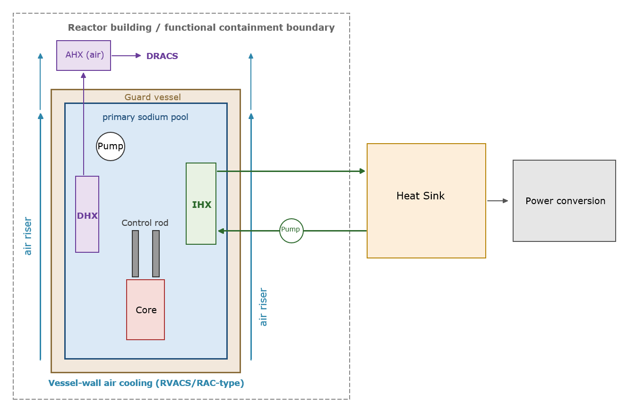
Generic pool-type SFR architecture
IHX = Intermediate Heat Exchanger; DRACS = Direct Reactor Auxiliary Cooling System; RVACS = Reactor Vessel Auxiliary Cooling System; ACS = Auxiliary Cooling System; RAC = Reactor Air Cooling; IAC = Intermediate Air Cooling; DHR = Decay Heat Removal.
Notes:
This figure abstracts those four designs into one generic architecture, and it is the picture behind everything that follows.
In the center: the primary sodium pool inside the reactor vessel, with the core, the primary pump, and the IHX all in-vessel
. Around the vessel: the guard vessel, with vessel-wall air cooling of the RVACS or RAC type rising past it. Inside the pool, a DHX connecting to an air heat exchanger represents the DRACS-type path. Everything sits inside the reactor building or functional containment boundary.
To the right, the IHX hands heat to the heat sink and power conversion

Slide 8
Safety functions
Safety function | Representative systems or phenomena
1. Control heat generation and achieve shutdown | Reactor protection system, primary and diverse shutdown systems, inherent reactivity response
2. Maintain core cooling | Primary pumps, pump coastdown, natural circulation, core flow paths
3. Remove decay heat to the ultimate heat sink | Design-specific active and passive decay-heat-removal paths
4. Maintain sodium inventory and primary-boundary integrity (SFR-specific) | Reactor vessel, guard vessel, level instrumentation, leak detection
5. Limit sodium chemical-reaction consequences (SFR-specific) | Leak detection, isolation, inerting, drainage, fire mitigation
6. Retain radionuclides and control release paths | Fuel, sodium pool, cover gas, vessel, containment or functional containment

Slide 9
Generic initiating-event families
Physical challenge | Generic IE families | Representative initiators
Core and primary-system response | IE-LOF: loss of forced primary flow IE-TOP: transient overpower IE-TRANS: general transient IE-PFB/LFF: local fault | Pump trip, coastdown failure, reactivity insertion, overcooling, local blockage
Heat rejection and support systems | IE-LOHS: loss of normal heat sink IE-IHTS: intermediate heat-transport failure IE-LOOP/SBO: power-support challenge | Loss of downstream heat rejection, intermediate-loop leak or isolation, loss of electrical or control power
Sodium boundary and interfaces | IE-SODIUM: sodium leak, inventory loss, or fire IE-INTERFACE: interface leak or reaction | Primary or intermediate sodium leak; sodium-water, sodium-salt, or salt-steam interface failure
Internal and external hazards | IE-INT: internal hazards IE-EXT: external hazards | Internal fire or flood, seismic event, external flood, high wind

Slide 10
Three functional groups for event-sequence modeling
Functional group | Questions represented | Generic endstate / transfer
Protected response | Did the reactor trip? Are core cooling and decay-heat removal adequate? | OK; transfer to unprotected response; or provisional PDS
Unprotected response | Are inherent feedback, sodium inventory, cooling, and DHR adequate? | Stable / OK or provisional PDS
Barrier response, when needed | How do fuel, sodium, vessel, guard vessel, and confinement perform? | No or limited release; release category
These are functional groups. A design may use separate event trees, transfer logic, or branches within one tree.
PDS: Plant damage state

Slide 11
Representative loss-of-flow application
Core flow and DHR
adequate?
OK or
provisional PDS
YES
Trip and rod
insertion?
IE-LOF
NO
Inherent feedback
adequate?
Cooling and DHR
adequate?
Stable / OK or
provisional PDS
if barriers are challenged
Future barrier response
→ release category
11

Slide 12
Limitations
1
The framework is based on four pool-type SFR designs, and available design information varies in detail and maturity.
2
It defines a generic PRA structure rather than a complete plant-specific event-tree and fault-tree model.
3
Success criteria, initiating-event frequencies, reliability data, HRA, CCF, and passive-system uncertainties require plant-specific development.
4
Mechanistic source term, release categories, and consequence analysis remain outside the current scope.

Slide 13
Conclusions
1
This paper reviews four pool-type SFR designs and identifies their common PRA-relevant characteristics.
2
The comparison supports a generic PRA framework that can be adapted to different pool-type SFR designs.
3
Plant-specific information, success criteria, and reliability data are needed to develop and quantify an application-specific PRA model.
4
The proposed framework provides a starting point for future Level 1 PRA model development and downstream risk analysis.

Slide 14
Questions
This work was supported by the U.S. Department of Energy through the Integrated Energy Systems program at Idaho National Laboratory, operated by Battelle Energy Alliance, LLC, under DOE contract DE-AC07-05ID14517.
Tao Liu | Tao.Liu@inl.gov
Jisuk Kim | Jisuk.Kim@inl.gov
Wen-Chi Cheng | Wen-Chi.Cheng@inl.gov
Svetlana Lawrence | Svetlana.Lawrence@inl.gov

