Slide 1

PSAM 18 | July 19–24, 2026 | Pittsburgh, Pennsylvania
Reliability Study of Digital Instrumentation and Control Systems in Nuclear Power Plants
Insights from operating experience data
Tao Liu¹, Zhegang Ma¹, and John Lane²
¹ Idaho National Laboratory ² U.S. Nuclear Regulatory Commission

Slide 2
Introduction: Problem, Objective, and Scope
• DI&C systems increasingly support monitoring, control, actuation, diagnostics, and operator information in nuclear power plants.
• Software, configuration, digital communications, hardware-software coupling, and common-cause failures are not fully represented by conventional hardware-centered reliability models.
• The NRC-sponsored INL study examined whether existing U.S. operating experiences can support DI&C reliability and CCF estimation for PRA.
Research question
What can current operating-experience data support now, and what additional data is required for DI&C reliability quantification?
PSAM 18 | Pittsburgh, Pennsylvania
2

Slide 3
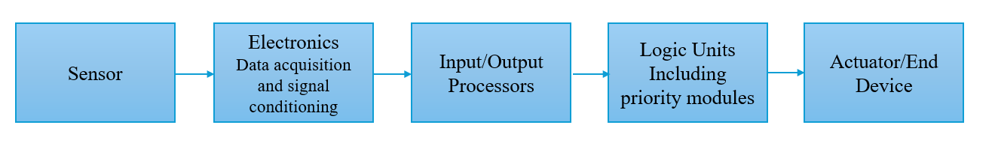
DI&C components and information flow
Sensors
Data acquisition
and signal conditioning
Input/output
processors
Logic units
Actuators and
end devices
Measure plant parameters such as temperature, pressure, flow, and neutron flux.
Check, condition, and convert raw sensor signals for digital processing.
Move data between acquisition electronics and computational logic.
Execute programmed algorithms and determine required control actions.
Valves, motors, and other equipment implement the control commands.
Communication buses connect the modules and provide information to actuators and control-room displays.
PSAM 18 | Pittsburgh, Pennsylvania
3

Slide 4
What previous studies established
PRA methods and modeling
Operating experience and CCF
• NUREG/CR-6962 — Identified limitations of hardware-centered PRA for software reliability, digital CCF, and component interdependencies; sparse failure data remained a central barrier.
• BNL LER study (2005–2016) — Screened 618 LERs, confirmed 97 DI&C events, and identified 18 potential or confirmed CCF events.
• NUREG/CR-6997 — Applied FMEA and Markov models to digital feedwater control. State-based models captured software and interaction effects but were difficult to scale and parameterize.
• EPRI CCF studies — Found common defects in safety and non-safety systems, while noting failure-reporting bias and insufficient demand data for statistical estimates.
• NUREG/CR-6942 — Used dynamic methods to represent timing, sequence, and cascading behavior that static fault and event trees may miss; empirical parameters were still needed.
• European Clearinghouse (2013–2018) — Linked events to smart devices, configuration management, and digital communications across design, operation, maintenance, and modification.
PSAM 18 | Pittsburgh, Pennsylvania
4

Slide 5
Operating-experience databases and screening methodology
LER
IRIS
Reporting basis
Regulatory, safety-significant events
Broader industry operating experience
Period
2016–2023
1997–2023
Initial screen
1,580 reports → 206 keyword candidates
2,104 cause-category records
Retained set
43 DI&C-related events
636 potential DI&C-related events
Screening and coding sequence
1
Database screen
2
Manual review
3
System / component
4
Mode / cause / impact
5
PRA relevance
PSAM 18 | Pittsburgh, Pennsylvania
5

Slide 6
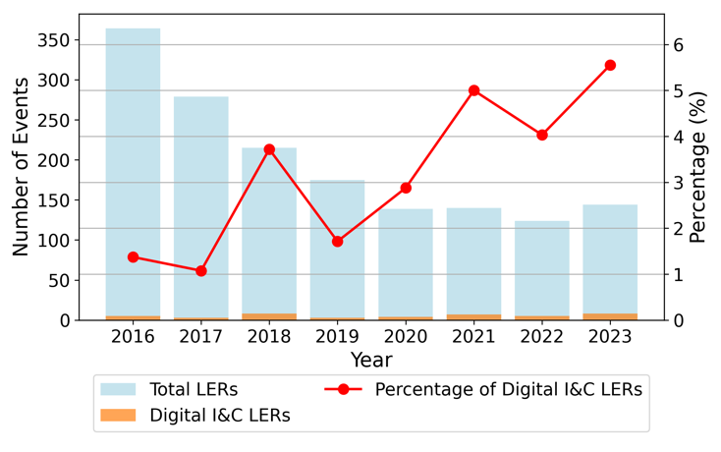
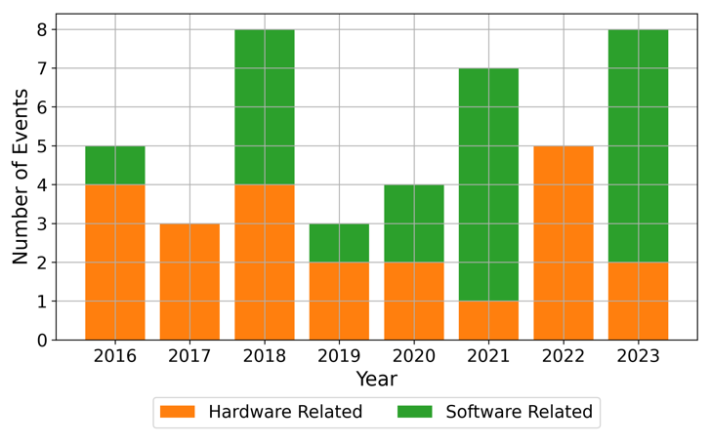
LER results: event trend and hardware/software classification
Event trend
Hardware- and software-related events
43
23
20
DI&C-related LERs
hardware-related events
software-related events
PSAM 18 | Pittsburgh, Pennsylvania
6
Notes:
• 43 DI&C-related LERs were identified from 2016 through 2023 out of 1,580 total LERs.
• The 43 events included 23 hardware-related and 20 software-related events.

Slide 7
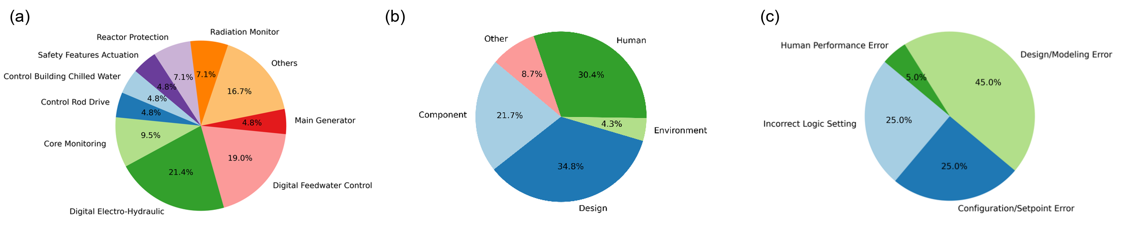
LER results: affected systems, causes, and consequences
Affected systems
Hardware-related causes
Software-related causes
Digital electrohydraulic control: 21.4%
Digital feedwater control: 19.0%
Core monitoring: 9.5%
Design and human causes were prominent.
Design/modeling, configuration, and logic errors were prominent.
19 unexpected reactor trips were attributed to DI&C failures, approximately 5.6% of unexpected trips during the period.
PSAM 18 | Pittsburgh, Pennsylvania
7

Slide 8
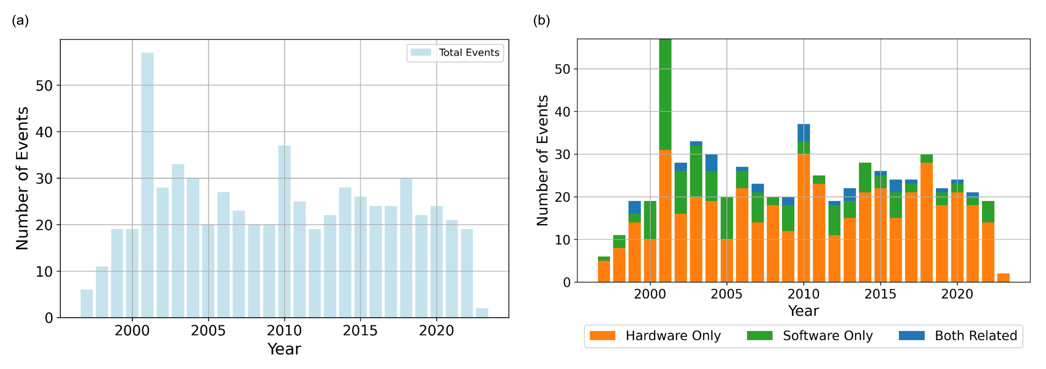
IRIS results: event trend and hardware/software classification
636
489
178
31
potential DI&C-related events
hardware-related events
software-related events
events in both groups
PSAM 18 | Pittsburgh, Pennsylvania
8
Notes:
• 636 potential DI&C-related IRIS events were identified for 1997–2023.
• Annual counts increased from 1997 to 2001, peaked at 57 events in 2001, and then generally stabilized, often between 19 and 37 events per year.
• Hardware-related failures accounted for 489 events (76.9%). Software-related failures accounted for 178 events (28.0%).
• The categories overlap: 31 events involved both hardware and software and are counted in both totals.

Slide 9
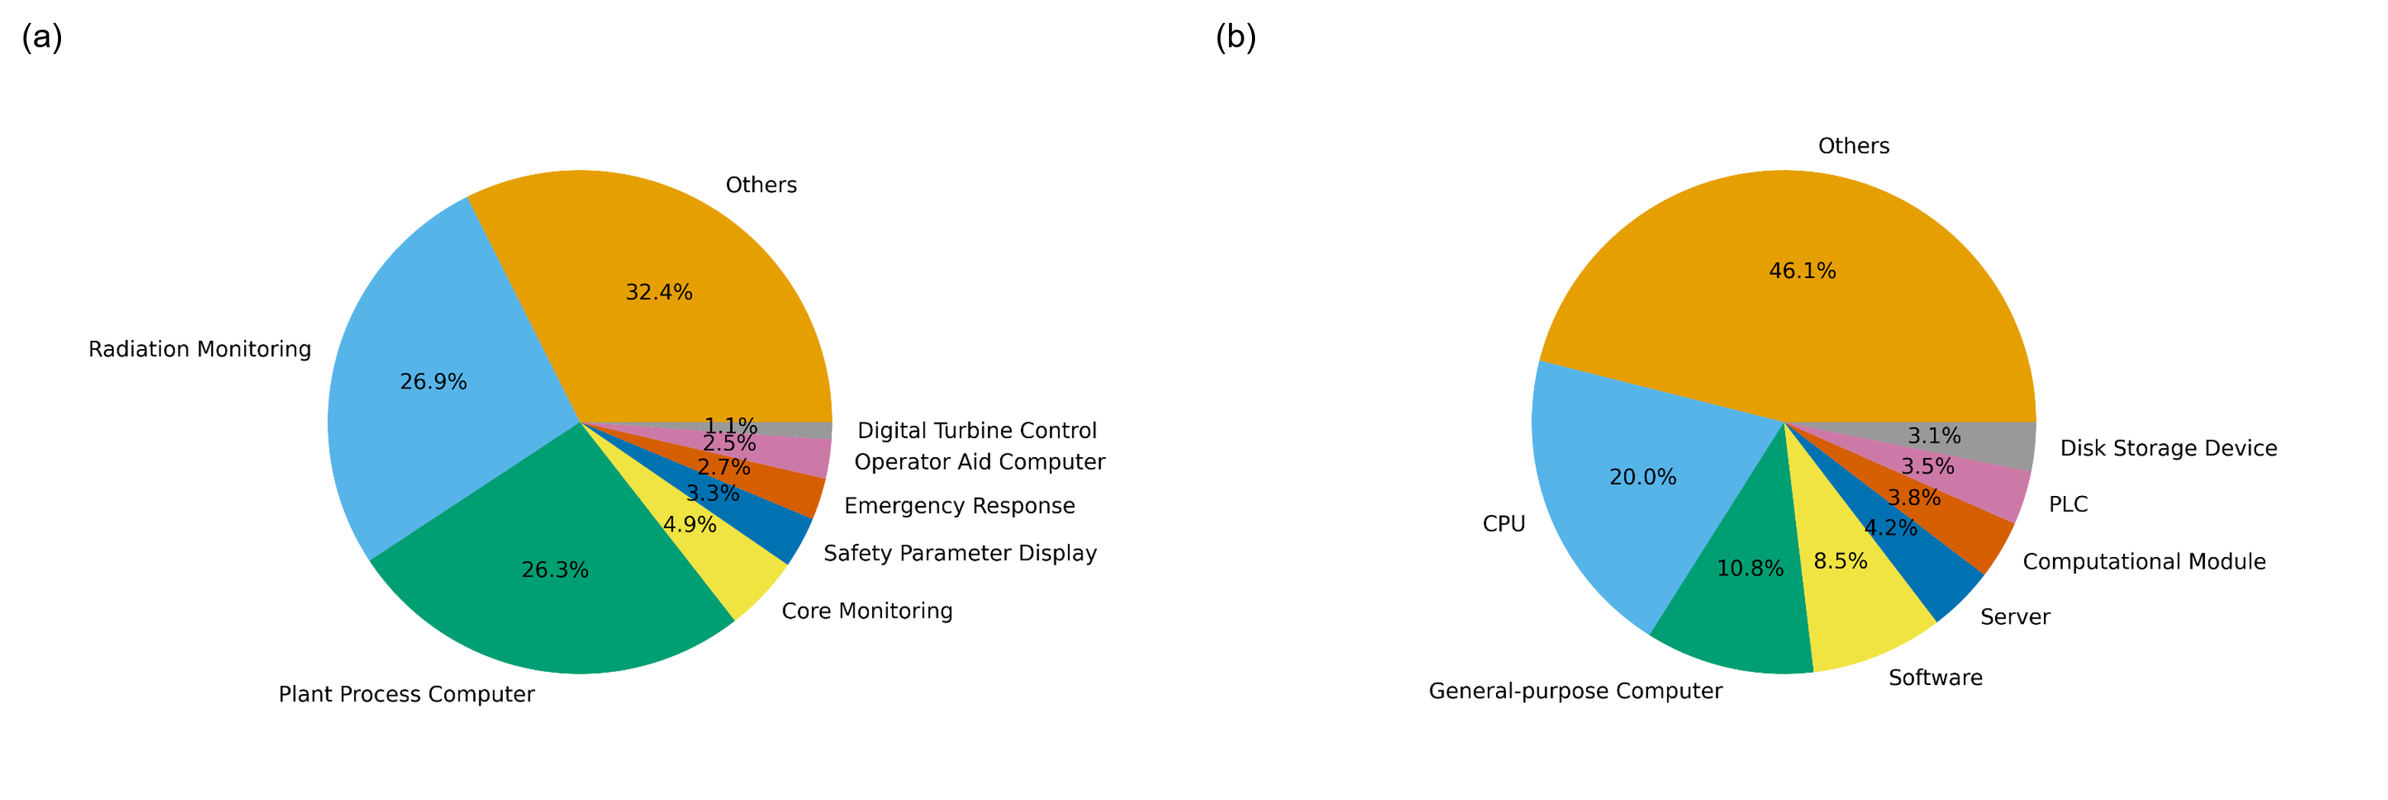
IRIS results: affected systems and identified components
• Radiation monitoring: 171 (26.89%)
• Plant process computer: 167 (26.26%)
• Core monitoring: 31 (4.87%)
• Safety parameter display: 21 (3.30%)
• Emergency response: 17 (2.67%)
• Operator aid computer: 16 (2.52%)
• Digital turbine control: 7 (1.10%)
• CPU: 127 (19.97%)
• General-purpose computer: 69 (10.85%)
• Software: 54 (8.49%)
• Server: 27 (4.25%)
• Computational module: 24 (3.77%)
• PLC: 22 (3.46%)
• Disk storage device: 20 (3.14%)
PSAM 18 | Pittsburgh, Pennsylvania
9

Slide 10
Recurring failure modes across key DI&C components
Component / item
Fail to
operate
Loss of
communication
Lockup
Incorrect /
failed output
Spurious
operation
CPU
●
●
●
●
●
General-purpose computer
●
●
●
●
○
Software
●
●
●
●
○
Server
●
●
○
○
●
PLC
●
●
●
●
○
Communication module
●
●
○
○
○
• Dominant modes across the review include fail to operate, loss of communication, lockup, incorrect output, output failure, spurious operation, and loss of network.
PSAM 18 | Pittsburgh, Pennsylvania
10

Slide 11
Why DI&C reliability quantification remains difficult
Cause information is often incomplete
88.5%
61.2%
IRIS events with an unknown reported cause
hardware-related events
software-related events
1
Limited event detail
2
Missing denominator data
3
Inconsistent coding and dependencies
• Failed device, failure mechanism, and root cause may be unclear.
• Hardware/software attribution can be ambiguous.
• Device identifiers and component populations are not consistently reported.
• Demand counts and operating hours are usually unavailable.
• Failure-mode and cause taxonomies are not applied consistently.
• Software, configuration, and CCF dependencies need separate treatment.
Current data still support
Structured screening, affected-system and component identification, recurring failure modes, and candidate PRA dependencies.
PSAM 18 | Pittsburgh, Pennsylvania
11

Slide 12
Implications for PRA modeling
• DI&C failures should not be treated only as independent hardware component failures.
• Software-related events involve configuration, setpoint, logic, programming, and design issues that do not map directly to classical hardware failure rates.
• Events involving both hardware and software indicate dependencies where a CPU, communication module, interface, or other digital device can affect software execution, operator information, or credited control functions.
• Where a digital function affects accident sequence progression, operator response, or common-cause screening, the PRA should represent the functional dependency explicitly when practical.
• The current data can support event screening and model scoping, but they are not sufficient for routine DI&C component reliability estimation.
PSAM 18 | Pittsburgh, Pennsylvania
12

Slide 13
Internal and external DI&C CCF treatment
Internal DI&C CCF
External DI&C CCF
Redundant trains or components
Functional dependency across the DI&C boundary
Within DI&C | same credited function
Across DI&C boundary | same or different functions
Definition
Definition
A shared cause disables redundant DI&C trains or components performing the same credited function.
One DI&C failure affects multiple plant components, systems, functions, or operator actions.
Typical mechanisms
Typical effects
• Shared software or configuration error
• Common hardware or environmental cause
• Multiple plant components or systems affected
• Operator information or actions impaired
PRA treatment
PRA treatment
Use CCF grouping and parameterization when data support it; otherwise use bounded sensitivity cases.
Model the dependency explicitly; use surrogate events or bounding cases when data are sparse.
PSAM 18 | Pittsburgh, Pennsylvania
13

Slide 14
Data needs and next steps
1
Capture events
2
Code in IDCCS
3
Estimate in RADS
4
Implement in PRA
LER and IRIS narratives
system, component, mode, cause, function
population, demands/hours, failures, uncertainty
rates, CCF, dependencies, human actions
Implementation requirements
• A DI&C-specific event-coding guideline and pilot population of historical events in IDCCS.
• RADS updates to accommodate DI&C component families, denominator data, uncertainty, and CCF treatment.
• Coordination with INPO and industry to improve device identification, demand or run-hour data, and reporting of software and configuration causes.
• A graded modeling approach based on the risk significance and functional integration of the DI&C application.
PSAM 18 | Pittsburgh, Pennsylvania
14

Slide 15
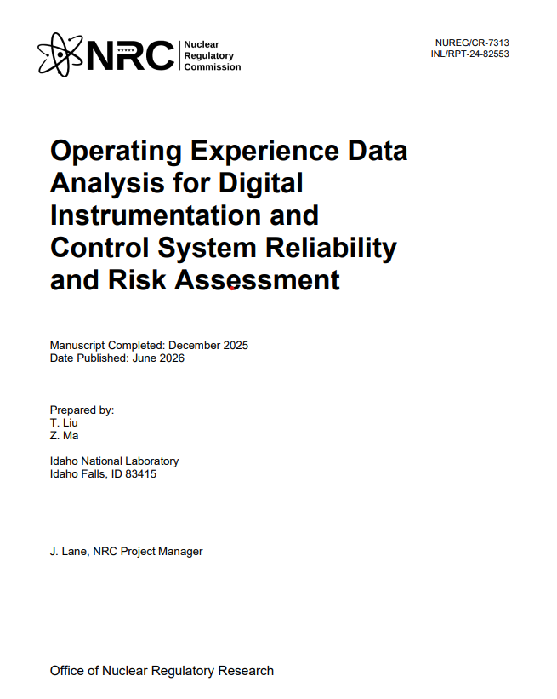
More detailed information
Operating Experience Data Analysis for Digital Instrumentation and Control System Reliability and Risk Assessment
PSAM 18 | Pittsburgh, Pennsylvania
15

Slide 16
Conclusions
• Existing operating experience supports DI&C event screening, taxonomy development, and identification of affected systems, components, failure modes, and causes.
• LERs provide a smaller set of safety-significant and better documented events: 43 DI&C-related LERs from 2016 through 2023, including 19 unexpected reactor trips attributed to DI&C failures.
• IRIS provides a broader view: 636 potential DI&C-related events from 1997 through 2023, with hardware-related events more frequent than software-related events and 31 events involving both categories.
• Current data do not support routine component reliability or CCF estimation without improved identifiers, populations, demands or run hours, and cause documentation.
• Internal DI&C CCF and external functional dependencies should be represented separately in PRA.
PSAM 18 | Pittsburgh, Pennsylvania
16

Slide 17
Acknowledgment
This paper was authored by Battelle Energy Alliance, LLC, under Contract No. DE-AC07-05ID14517 with the U.S. Department of Energy (DOE), and Agreement Number 31310019N0006, Task Order Number 31310019F0022 with the NRC. References herein to any specific commercial product, process, or service by trade name, trademark, manufacturer, or otherwise do not necessarily constitute or imply endorsement, recommendation, or favoring by the U.S. Government or any agency thereof. The views and opinions of the authors expressed herein do not necessarily state or reflect those of the U.S. Government or any agency thereof.
PSAM 18 | Pittsburgh, Pennsylvania
16

