Slide 1


Simulation-Based Probabilistic Reliability Techniques for Complex Nuclear Safety Systems
Taha ABDELNAEEM, I&C Solution Lead

Slide 2
X
Check the boxes corresponding to the document’s confidentiality level and indicate the applicable export control markings.
EU EC country code = XX marking code = N | US EC marking code = N | OTH EC country code = XX marking code= N
Goods marked EU EC different to “N” are subject to export authorization of the States members of the European Union (EU) in case of export outside EU, and also for certain sensitive goods (e. g. goods marked “EU EC”: “0E001”) in case of transfer within UE ; they cannot be reexported nor transferred back without a prior agreement from the State of the first export. Goods marked US EC different to “N” are subject to export, re-export or transfer authorization of the United States of America. Goods marked OTH EC (country code(s)) different to “N” are subject to export, re-export or transfer authorization of the mentioned county(ies). Even for goods marked “EU EC: N” and “US EC: N” and “OTH EC: N”, an export authorization may be required depending on their final destination or end-use.
X
AL = N | ECCN = N
Goods labeled with “AL not equal to N” are subject to European or German export authorization when being exported within or out of the EU. Goods labeled with “ECCN not equal to N or EAR99” are subject to U.S. reexport authorization. Even without a label, or with label: “AL: N” or “ECCN: N” or “ECCN: EAR99,” authorization may be required due to the final whereabouts and purpose for which the goods are to be used.

Slide 3

Content
1.
The Need for Dynamic PRA
4.
Reactor Trip Signals
2.
Basic Features of Discrete Dynamic Event Tree Analysis
3.
RPS Components

Slide 4
The Need for Dynamic PRA
1.

Slide 5
The Need for Dynamic PRA
Probabilistic Risk Assessment (PRA): Lessons from NUREG-1150
PRA integrates Fault Trees (FTs) and Event Trees (ETs) to systematically model initiating events, system failures, accident progression, and their associated risk for nuclear power plants.
NUREG-1150 represented one of the first comprehensive Level 1–3 PRA studies, evaluating severe accident risks for five U.S. commercial nuclear power plants and establishing many of the methodologies still used in modern PRA.
Due to the large number of initiating events and accident sequences, NUREG-1150 organized accident scenarios into representative Plant Damage States (PDSs), Accident Progression Bins (APBs), and Source Term Groups (STGs), significantly reducing computational complexity while preserving essential accident characteristics.
Key takeaway:
Today's highly integrated digital I&C systems introduce dynamic interactions, software behavior, diagnostics, communication networks, and time-dependent dependencies that motivate the use of simulation-based probabilistic reliability techniques to complement traditional PRA approaches.
We will discuss techniques that accurately represent, under a dynamic event tree (DET) structure, detailed evolutions of transient events without restrictions placed on preselected groups of events.

Slide 6
Basic Features of Discrete Dynamic Event Tree Analysis
2.

Slide 7
Basic Features of Discrete Dynamic Event Tree Analysis
Why Was Dynamic PRA Needed?
Traditional PRA (FT/ET) provides a structured and efficient framework for nuclear risk assessment.
NUREG-1150 demonstrated the effectiveness of PRA for evaluating severe accident risk using representative Event Trees and probabilistic sampling.
Modern digital safety systems introduce dynamic interactions that are difficult to capture using static analytical models.
Classical PRA
Fault Trees
Fixed Branches
Success / Failure
Event Trees
Risk Metrics
Dynamic PRA
Dynamic Simulation
Dynamic Branching
Time-Dependent States
Plant Simulation
Realistic Accident Evolution
Limitations of Classical PRA
Static event tree structure
Binary success/failure modeling
Fixed branching times
Limited representation of operator actions
Simplified treatment of dynamic system behavior
Dynamic simulation complements traditional PRA by capturing time-dependent interactions, equipment degradation, operator actions, and complex dependencies that are difficult to represent using conventional Fault Tree and Event Tree methods.

Slide 8
Basic Features of Discrete Dynamic Event Tree Analysis
Dynamic Event Tree (DET) Advantages
Dynamic Event Tree methods enhance traditional PRA by replacing fixed accident sequences with simulation-driven accident evolution, providing a more realistic representation of complex nuclear safety systems.
Dynamic branching
Event Tree branches are generated during the simulation based on the evolving plant conditions, rather than at predefined branch points.
Realistic system behavior
Realistic system behavior: DET explicitly models operator actions, equipment degradation, safety system actuation, and recovery actions as the accident progresses.
Improved modeling fidelity
By simulating individual accident scenarios, DET captures time-dependent interactions, dependent failures, and dynamic relationships between component states and overall system behavior more accurately than traditional Event Trees.

Slide 9
Basic Features of Discrete Dynamic Event Tree Analysis
Dynamic Event Tree Analysis (DETAM): Modeling Operator Actions
1. Accident Initiation
The simulation begins with the Start node.
Two possible initiating conditions are considered:
SGTR diagnosis state
SLOCA (Small Loss-of-Coolant Accident) diagnosis state
At this point, the operator has not yet correctly diagnosed the event.
The first challenge is:
Can the operator correctly identify what accident is occurring?
Incorrect diagnosis immediately changes the accident evolution.

Slide 10
Strategic Objectives
I&C Requirements Validation
I&C Design Verification
I&C Design Validation
(Simulation)
I&C Design Validation
(Stimulation)
Site Acceptance Test (SAT)
Training
&
HFE Validation
Customer-Centric Execution
De-risk FAT
Optimize I&C Design effort
Improve HFE
Intelligent HSI Advancement with Proven Automation Integrity

Slide 11
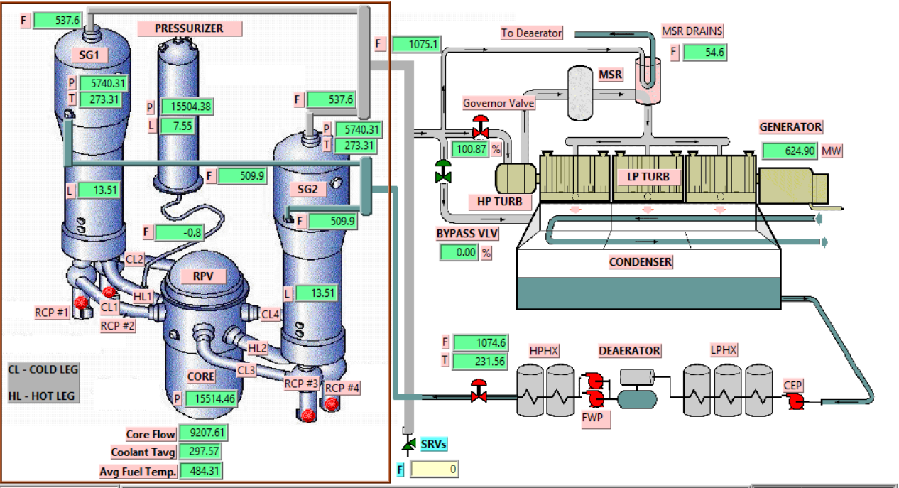



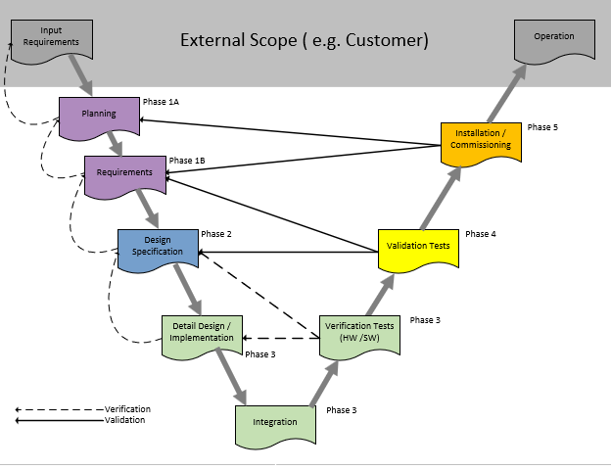
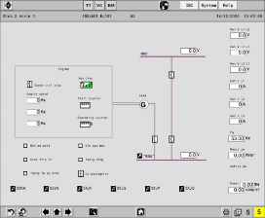


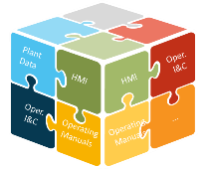
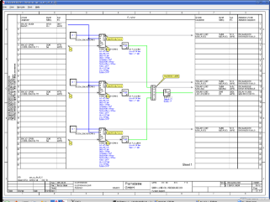

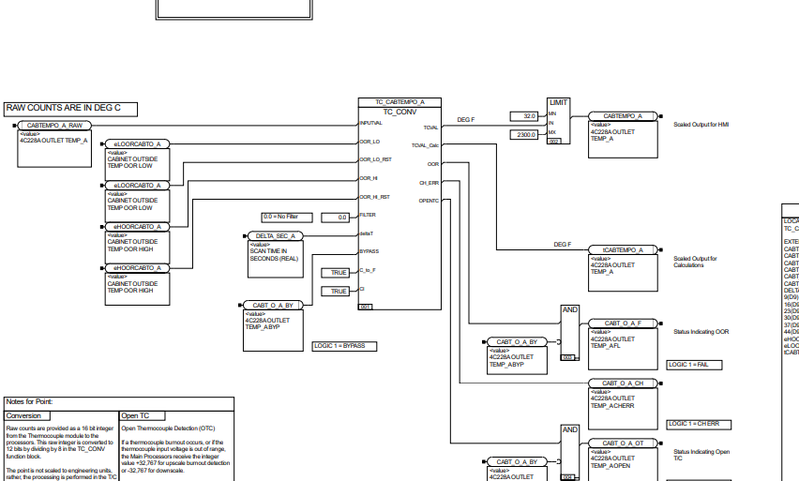


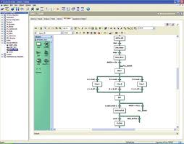
Requirements Validation
I&C Model Checking
Project Execution Framework with Simulation
I&C Model Tunning
I&C Validation
Plant Design and License Bases
Operator Displays
Operating
Manuals
I&C Diagrams
CRADLE
Specification
  HMI (Operator Screen, .oz files)
COMMISSIONING
Graphics files
TriSim
TREX
THOR
  Safety I&C diagrams
  (TELEPERM XS)
CS2 and SimFD
De-risk Commissioning
Simulator Database and Tools
  Operational I&C diagrams
  (TRICON)
  TS1131
TS1131 PT2 files
TriSim and FSIM
  Operational I&C diagrams
  (Foxboro I/A)
  Saveall
Saveall files
Operational I&C Tests
HFE analysis
Interface consistency
Operating Manuals Testing

Slide 12
References
3.

Slide 13
References
1- NUREG- 1150 Vol. 2 Severe Accident Risks: An Assessment for Five U.S. Nuclear Power Plants
2- Risk and Safety Analysis of Nuclear Systems (RSANS) John C. Lee, Norman J. McCormick

Slide 14
Thank you
Contacts
    Taha ABDELNAEEM
  taha-ibrahim.abdelnaeem@framatome.com

