Slide 1

NRC-RES’ Sitewide, All Hazards Level 3 PRA Project: Integrated Site Risk for a Two-Unit Site
Susan E. Cooper, Brian Wagner, Erick Ball, Keith Compton, Trey Hathaway, Alan Kuritzky
18th Probabilistic Safety Assessment and Management (PSAM) Conference
Pittsburgh, Pennsylvania
July 20 - 24, 2026

Slide 2
Background
Integrated site risk (ISR) is included in the scope of the NRC’s Level 3 PRA project.
  Staff requirements memorandum (SRM-SECY-11-0089), dated 9/21/2011, directed the staff to conduct a full-scope, comprehensive site Level 3 PRA.
  In September 2012, staff provided the Commission with its plans to apply the Level 3 PRA project results to the NRC’s regulatory framework (SECY-12-0123).
Previous NRC PRA efforts have not addressed ISR.
The following definition has been adopted:
    Integrated site risk is the total combined risk of a release from one or more radiological sources on site (i.e., reactors, spent fuel pools (SFPs), and dry cask storage (DCS)), considering all hazards and all plant operating states.

Slide 3
How is ISR calculated?
Simplistically, we could add all of the results from each radiological source.
But…
  This overlooks that there are dependencies between radiological sources (e.g., there are common initiating events that can cause all reactors on site to trip).
  This over-estimates severe accident frequency (because the area of overlap is “counted” two or three times – see figures in next slides).
  This overlooks that timing of radiological releases from different sources could change the consequences.
  This approach does not provide any useful PRA insights beyond what the single source PRAs have already provided.

Slide 4
Venn Diagram Showing Single Unit (SU), Single Unit Only (SO), and Multi-Unit CDF for Two Units with Dependencies

Slide 5
ISR Terminology
From the Venn diagram:
  SUCDF: Single-unit CDF that is calculated by traditional PRAs
  MUCDF: Multi-unit (MU) CDF (area of overlap - both units experiencing core damage simultaneously)
  SOCDF: Single-unit only CDF representing only one unit experiencing core damage
  SCDF: Sitewide CDF
Key terms for L3PRA project’s ISR task:
  MU risk: Risk from concurrent or simultaneous accidents for multiple reactors (i.e., both reactors on the two-unit reference site).
  Multi-source risk: Risk from concurrent or simultaneous accidents for multiple reactors (i.e., both reactors on the reference site) and another radiological source (i.e., either the SFPs or the DCS on the reference site).

Slide 6
ISR Technical Approach
High-level approach:
  Sitewide dependency assessment
  Calculate multi-unit (MU) core damage frequency (MUCDF)
  Calculate MU Level 2 and Level 3 results
  Identify/define an illustrative multi-source scenario
  Aggregate MU release category frequencies (MURCFs) with spent fuel pool RCFs
  Calculate multi-source consequences (using MACCS)
MU risk is addressed first; then multi-source risk.
ISR was not calculated; “multi-source” risk for an illustrative scenario was calculated.

Slide 7
ISR – High-Level Results for Sitewide Dependency Assessment
The two reactors on the reference site are mostly independent (i.e., “loosely coupled”).
A subset of the initiating events addressed in the single unit PRAs are relevant to MU risk.
Seismic events are the only initiating events that are important to both the reactors and the SFPs.
There are very few cross-unit dependencies involving operator actions, except for operator actions in the reactor Level 2 PRA model.
There is some resource sharing between the SFPs and the reactors for seismic events.
There were no dependencies identified between the DCS facility and the two reactors and the SFPs.
The sitewide dependencies that have been identified provide important insights by themselves.

Slide 8
ISR – Scope and Limitations
Because of scope and state-of-the-art limitations, the ISR task is intended to be a “proof of concept,” e.g.,
  Only at-power conditions addressed
    Only internal events low power and shutdown for reactors was addressed by L3PRA project; this limitation could be significant
  Due to computational challenges for NRC’s SAPHIRE PRA code, a simplified approach to develop MU core damage frequencies (MUCDFs) was used
MU Level 2, MU Level 3, and ISR limitations:
  Due to well-known computational challenges for MU Level 2 PRA, MU Level 2 and Level 3 results addressed only:
    Two scenarios: weather-related LOOPs and seismic bin 6 events
    A limited number of MU release category combinations
  Only “base case” addressed because the “FLEX sensitivity” case was not performed for SFPs
ISR was not calculated; “multi-source” risk for an illustrative scenario was calculated.

Slide 9
Illustrative Multi-Source Scenario
ISR team identified and defined the ISR scenario using reactor and SFP PRA results, MU PRA results, and sitewide dependency assessment results.
Focused on scenarios with maximum amount of dependencies between reactors and SFPs.
Inputs:
  Phase 1 (sitewide IEs) sitewide dependency assessment: seismic event.
  At-power, MU Level 1 PRA assessment:
    Combined MUCDF result for seismic events:> 50% of total MUCDF.
    Of the seismic events: Bins 3 through 6 are the largest contributors to total MUCDF.
  SFP Level 1 and 2 PRA results:
    Seismic bins 5 through 7 are most important
    Mitigation is not credited for seismic bins 7 and 8
    A simplified MELCOR model was used to calculate available times for operator actions for the SFP Level 1 and 2 PRAs, including the amount of time available to align makeup (depending on the size of the leak), the amount of sloshing (affected by the seismic bin), and the operating cycle phase (OCP) (which affects decay heat).

Slide 10
Illustrative Multi-Source Scenario (continued)
Because only at-power conditions were addressed, only two operating cycle phases needed to be considered for the SFPs (i.e., AAN1 and AAN5).
Also, only three release categories (RCs) for the reactors were selected for the illustrative scenario:
  containment isolation failure (CIF)
  late containment failure (LCF)
  intermediate containment failure due to burn (ICF-BURN)
MU Level 2 PRA is computationally challenging due to the potential number of RC combinations for two or more reactors. Consequently, a few of the more risk-important RCs were selected for the illustrative ISR scenario.
Notes:
AAN1 and AAN5 involve both reactors at power and the SFPs in nominal conditions (i.e., no fuel handling activities). They differ only in the time since one of the reactors was shut down for refueling.

Slide 11
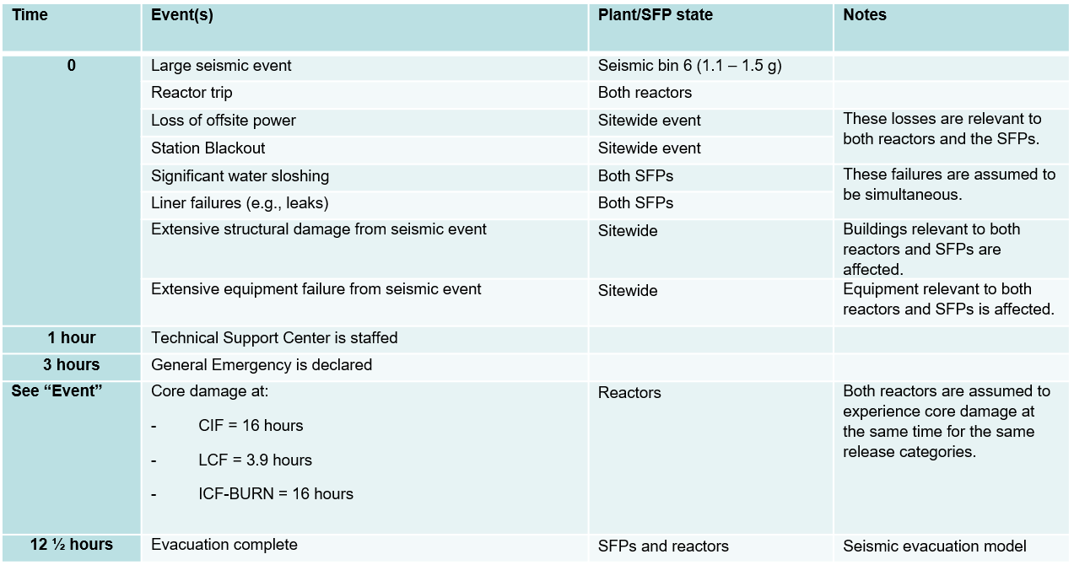
Multi-Source Timeline (Part 1)

Slide 12
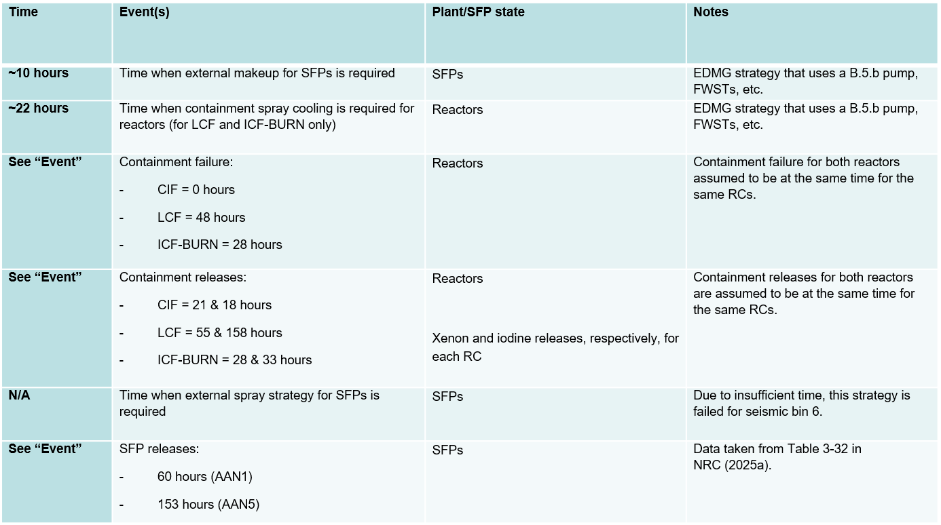
Multi-Source Timeline (Part 2)

Slide 13
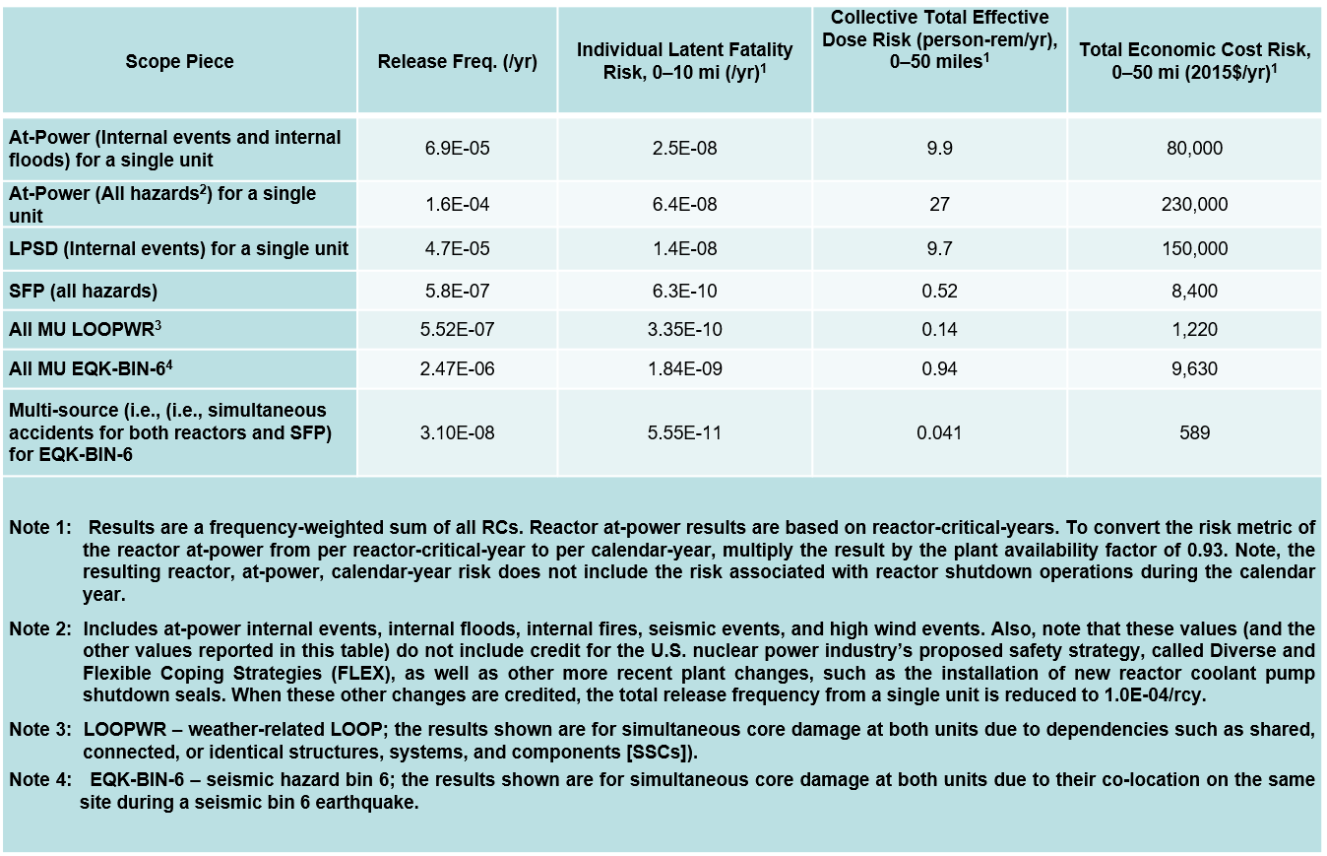
Single Unit, Multi-Unit, and Multi-Source Risk Measures

Slide 14
Takeaways for ISR Results
The multi-source (i.e., combined MU and SFP) consequence results cannot be directly compared with the single source results.
However, it can be generally concluded that the results for the combined reactor and SFP risk (i.e., multi-source risk) are substantially less than that for either the reactor at-power, reactor LPSD, or SFPs.
ISR was not calculated for two reasons:
  multi-source risk results provide new insights while ISR would not, and
  scope limitations prevented calculation of all of the inputs needed to make a calculation of ISR (e.g., risk associated with accident scenarios involving only one reactor and both SFPs).

Slide 15
QUESTIONS?

Slide 16
Background
USNRC has completed technical work for its sitewide, all hazards Level 3 PRA Project.
In addition to Level 1, 2, and 3 PRAs, the L3PRA project includes an integrated site risk (ISR) task that considers all radiological sources
Integrated site risk (ISR) is defined as the aggregation of risk from all relevant radiological sources
  Two, nearly identical reactors (PWRs)
  Two, hydraulically connected spent fuel pools (SFPs)
  A dry cask storage (DCS) facility
Most experience is for multi-unit (i.e., multiple reactor) PRA
Most relevant guidance addresses multi-unit (MU) PRA:
    IAEA MU PSA guidance (2019, 2023)
    EPRI, “Framework for Assessing MU Risk…” (2021)
Following the 2011 Great Japan Earthquake (and events at the Fukushima Daiichi), there has been increased interest in MU risk - both in U.S. and internationally.

Slide 17
Sitewide dependency contributions to MUCDF for grid-related LOOPs

