Slide 1

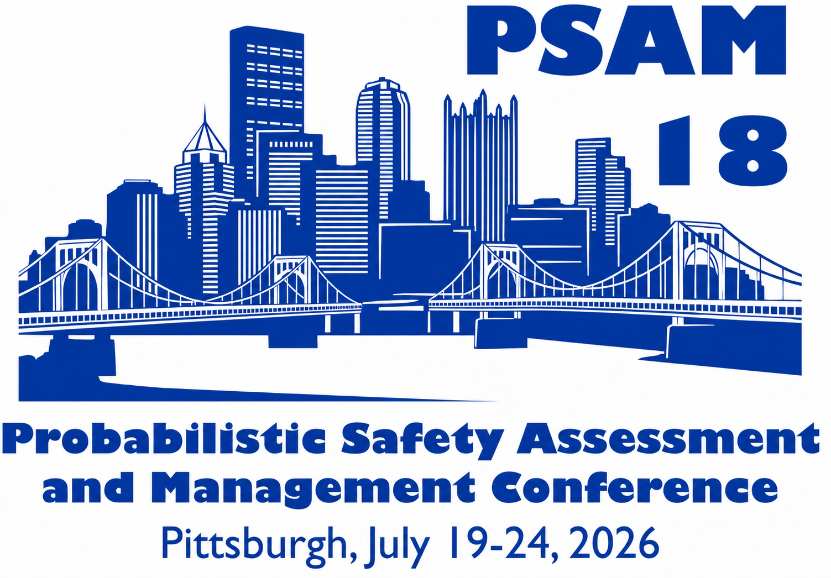
July 2026
Sonali Sinha Roy
Applied AI Engineer
Idaho National Laboratory
Autonomous Design Optimization for Nuclear Energy (AutoDONE)
An Agentic App for Nuclear Power Plant Design

Slide 2
Agentic AI 101
Request
State, Context,
Memory
Orchestrator
[A2A]
Agent 1
Agent 2
Agent 3
Specialized Agents
[MCP]
[MCP]
[MCP]
Web Seach API
Database
Simulation Tool

Slide 3
AutoDONE Overview
What is it?
An AI application for selecting lifecycle-optimized commercial-grade equipment for nuclear power plant systems.
How does it work?
System specifications
Individual Component Identification
Optimal Combination Ranking
User Selection
Behavioral Model Generation
System-level Monte Carlo Simulation
Operational Statistics
Product / data constraints
Iterate

Slide 4
AutoDONE Architecture
System Requirements
Design Constraints
UI (Web or CLI)
Orchestrator
A2A
Component 1 Search Agent
Component 1 Behavior Modeling Agent
MCP
Search Tool (database / web)
MCP
EMRALD (Dynamic PRA Tool)
Human in the Loop: Design Selection
Component Behavior Models
Component 2 Search Agent
Candidate components
Optimization Agent
Top-ranked designs
Component 2 Behavior Modeling Agent
System Simulation Agent
MCP
Search Tool (database / web)
MCP
EMRALD (Dynamic PRA Tool)
Operational Statistics
…
…
Component n Search Agent
Component n Behavior Modeling Agent
(Results Package)
MCP
Search Tool (database / web)
MCP
EMRALD (Dynamic PRA Tool)

Slide 5
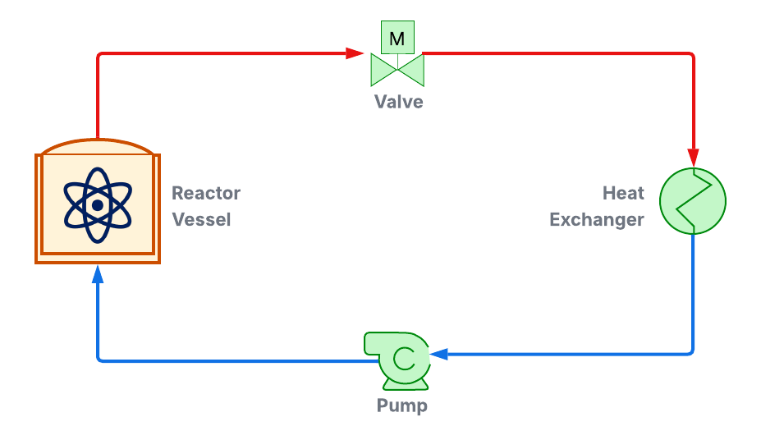
Demonstration of Current Status
Goal: Select pump, valve, heat exchanger for a simplified cooling loop.

Slide 6
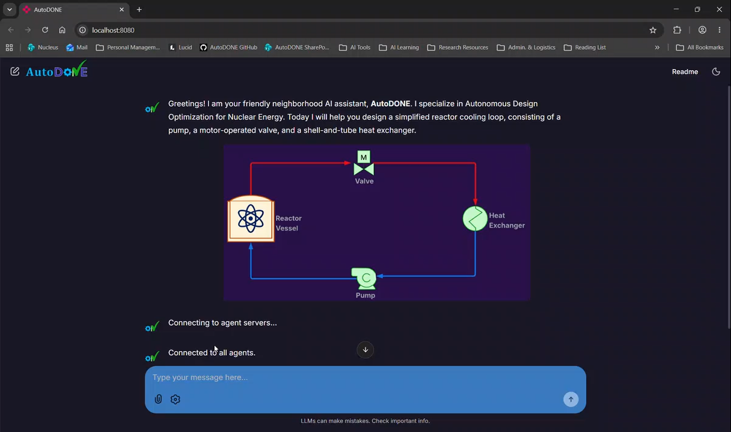

Slide 7
Next Steps
Addition of verification agent
  Independently verifies outputs at every step of the workflow.
Generalization for dynamic system architectures
  Users upload requirement of system design definition, AutoDONE identifies necessary equipment, configuration, specifications.
Benchmarking against real systems
  Compare quality and efficiency metrics for traditional design process vs. AutoDONE-assisted design.
  How much time does AutoDONE actually save?
  Are the output designs as good as (or better than) status quo?

Slide 8
Thank You!
Questions?
Contact:
Sonali.SinhaRoy@inl.gov

