Slide 1
No.SO199
Tsunami PRA and Its Protective Measures at the Kashiwazaki-Kariwa Nuclear Power Plant Unit 6/7
July 20, 2026
Nuclear Reactor Safety Engineering Group,
Nuclear Asset Management Department
Tokyo Electric Power Company Holdings,Inc.
Yohei SOUMA
Notes:
Im yohei souma from tepco ,department of Nuclear Asset Management,Nuclear Safety Engineering Group
I am responsible for external PRA, primarily involved in tsunami PRA and internal flood PRA.

Slide 2
Table of Contents
Introduction
Tsunami PRA
Enhancement of Fragility Assessment
Accident Sequence Evaluation
Protective Measures identified through Tsunami PRA
Recent Initiatives in Risk-Informed Decision Making
Conclusion

Slide 3
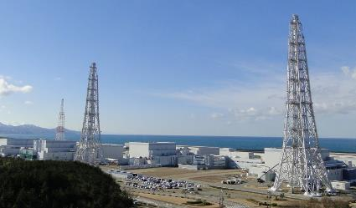
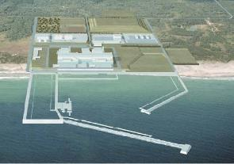
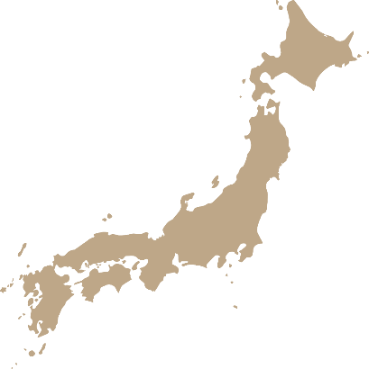
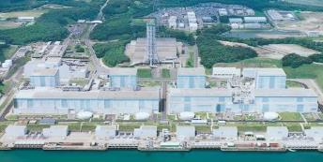
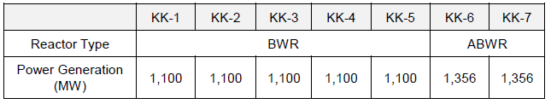
1. Introduction: TEPCO Overview
Kashiwazaki-Kariwa NPS
（Under Construction)
(Unit 6 is restarted)
7units
1unit
Fukushima Daiichi NPS
KK-7: Restart Preparation
KK-6:Restart
KK-1~KK-5: in a state of long-term shutdown.
(Decommissioning)
Aomori
6Units
Fukushima
Niigata
Fukushima Daini NPS
Tokyo
(Decommissioning)
4Units
Notes:
At first I would like show about Tepco Overview in Nuclear devition
We have 3 NPS in japan, Higashidoori NPS at AOMORI Under construction,
Kashiwaaki kariwa NPS,NIGATA～
Fukushima Daiiti NPS and Fukusima daini NPS in Fukushima is in Decommissioning/
In this presentation I focus to show about Kashiwazaki kariwa NPS
The Kashiwazaki-Kariwa(KK) Nuclear Power Station is located in Niigata, Japan.
In KK 6/7, from the lessons learned from the Fukushima Daiichi Nuclear Power Station accident, we have implemented safety measures.
KK-7: 特重トライアル定検開始、再稼働のための準備
KK-6: Ready to restart
KK-1~KK-5: These plants are in a state of long-term shutdown.

Slide 4
Overview of the Fukushima Daiichi NPS accident
Progression of the Accident and Lessons Learned
Progression
Tsunami impact
Approximately 50 minutes after the earthquake, the plant was directly hit by a large tsunami.
Nuclear power plant was flooded, and the power supply facilities were rendered inoperable, resulting in the loss of important safety functions such as those for injecting water into the reactor and monitoring its condition.
Units 1 through 3, which were in operation, failed to cool the reactor cores after shutdown, leading to severe accident.
A major factor in the failure to cool the reactor was the loss of power, which made it impossible to operate and control the “cooling” system.
Lessons
(1) Protection against tsunami was weak.
(2) There were insufficient means for restoring power, injecting water into reactors, etc., and cooling them in the event that all power sources were lost.
(3) There were insufficient measures in place to prevent hydrogen explosions after core damage or to reduce the release of radioactive materials.
Notes:
In this slide, I would like explain Overview of the Fukushima Daiichi NPS accident
Progression of the Accident and Lessons Learned
---------------------------------------------------------------------------------------------------------------------
In addition, based on the lessons learned from the Fukushima Daiichi Nuclear Power Plant accident, it was decided to consider voluntary safety measures aimed at further enhancing safety
As one of these voluntary safety enhancement initiatives, Probabilistic Risk Assessment (PRA) began to be implemented.

Slide 5
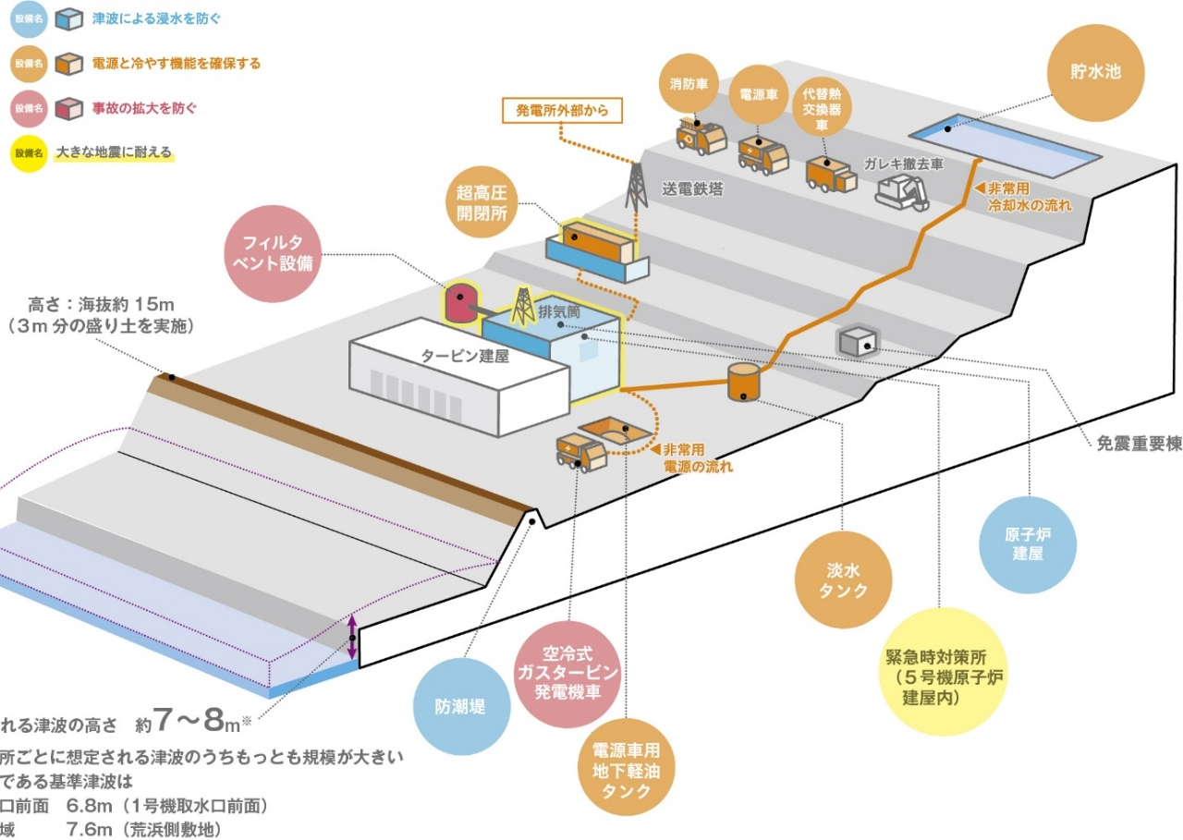
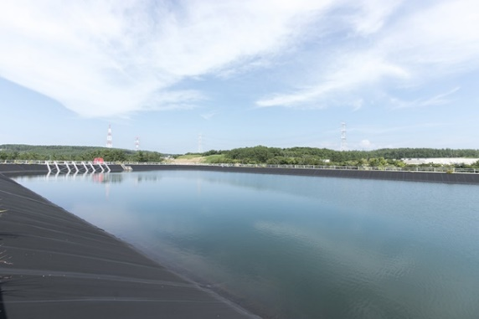
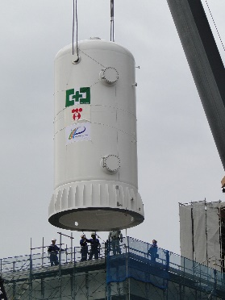
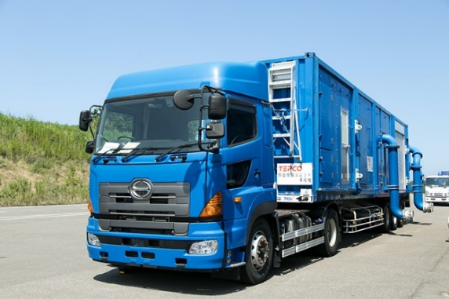
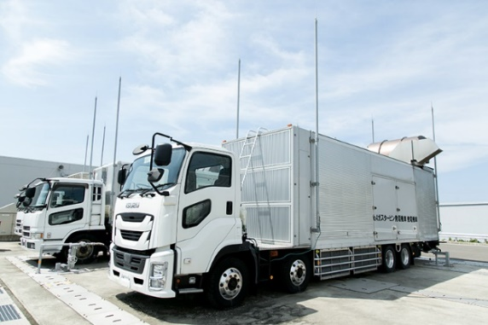
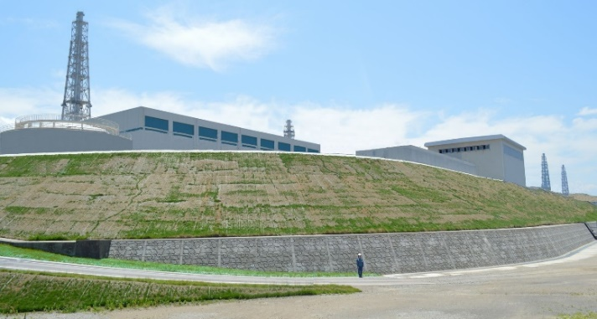
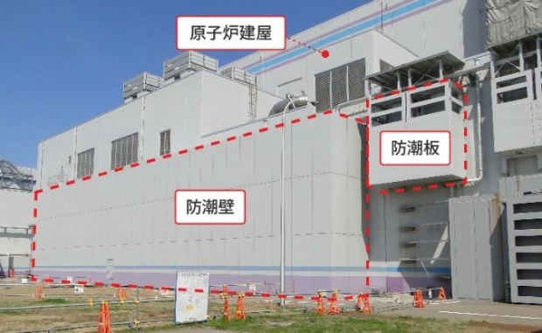
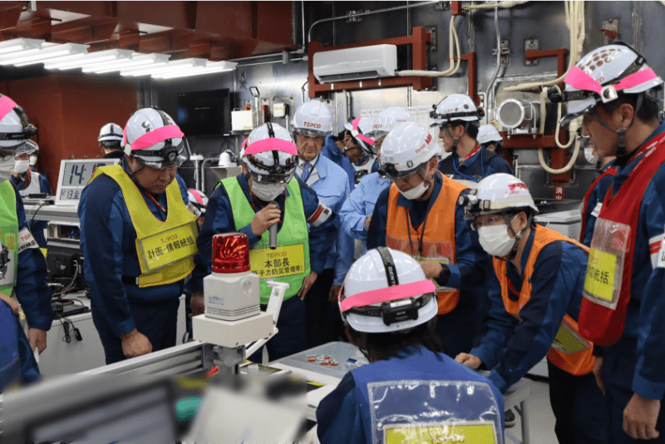
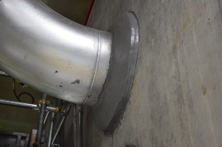
Overview of the Fukushima Daiichi NPS accident
Progression of the Accident and Lessons Learned
(3) Measures in anticipation
of serious accidents
(2) Multiplexing and diversification
of power and cooling functions
Freshwater Reservoir
Filter Vent
Reactor
Building
Turbine
Building
Alternative Heat Exchanger
Trucks
Air-Cooled Gas Turbine
Generator Trucks (GTGs)
(4) Comprehensive treatment of
various kinds of external hazards
(1) Tsunami inundation measures
Seawalls
Reactor Building
Flood Barrier
Flood Barrier
Comprehensive Protocols
Regular Training and Drills
Watertight treatment
of pipe penetrations
Notes:
Kashiwazaki Kariwa NPS is taking various safety measures based on the lessons I’ve mentioned.
(1) Implementing tsunami inundation(i-nan-dei-tion) measures such as the installation of seawalls and flood barriers.
(2) Multiplexing and diversification(di-ver-si-fi-cation) of power and cooling functions in case of loss of function of power and cooling facilities.
(3) Measures to prevent damage to the containment vessel and control the diffusion of radioactive materials into the environment in the event of a severe accident.
(4) Comprehensive treatment of various kinds of external hazards.

Slide 6
State-of-Art PRA model
Evaluation scope
・Internal L1,L2
・seismic L1（,L2）
・tunami L1（,L2）
・internal floodL1（,L2）
・fire L1（,L2） etc.
Enhancement of PRA model
z
EP model
（PRA at U.S）
State of practice
State-of-the-Art
PRA model
Schedule
Update |  |  |  | Futher enhancement
SAR safety reveiw
Following 1F accident, the new regulatory requirements mandated PRA for internal events, Seismic, and tsunamis, and Establishment Permission (EP) models were developed accordingly.
Subsequently, these models have been enhanced to support the development of more sophisticated safety measures and additional risk reduction strategies.
This presentation introduces our advanced tsunami PRA model as an example of the PRA models that have undergone such enhancements.
Notes:
震災後の新規制基準において、内的、地震、津波PRAの評価が求められ、EPモデルを作成している。
その後、より精緻な安全対策、追加措置を策定をするために、それらのモデルの高度化図っている。
本発表では、高度化が図られたPRAモデルのうち、当社の津波PRAモデルについて紹介する。

Slide 7
Safety measures and PRA at KK NPS
Tsunami PRA
Tsunami is recognized as a natural phenomenon with large uncertainties.
Tsunami PRA is a technique that can evaluate such uncertain events and quantify the risk.
Quantified risks play a role in providing knowledge that can be used to make decisions on countermeasures in risk management of nuclear power plants.
The main considerations for the tsunami PRA are (1) tsunami hazard assessment, (2) fragility assessment, and (3) accident sequence assessment.
Plant walkdown
（Plant walkdown on actual plant）
General analysis and establishment of accident scenarios（Extensive analysis and selection of accident scenarios and screening of accident scenarios）
(1) Tsunami hazard assessment：
Quantify the height and frequency (probability) of future tsunamis reaching nuclear power plants.
(2) Fragility assessment：
Quantify damage probabilities due to effects (flooding, submersion, wave pressure, wave force, etc.) based on tsunami height for SSC(Structure, System and Component)s where maintenance/loss of functionality affects accident scenarios.
(3) Accident sequence assessment：
Quantify the frequency of core damage (CDF) caused by loss of safety function (reactor cooling, depressurization, power supply etc.).
Frequency of occurrence
Hazard curve
Fragility curve
Core damage frequency
Core damage frequency curve
Damage probability
Core damage
frequency curve
Tsunami height
Tsunami height
Tsunami height
Notes:
Tsunami is recognized as a natural phenomenon with large uncertainties.
Tsunami PRA is a technique that can evaluate such uncertain events and quantify the risk.
The main considerations for the tsunami PRA are (1) tsunami hazard assessment, (2) fragility assessment, and (3) accident sequence assessment.
The enhanced areas are (2) Fragility Assessment and (3) Accident Sequence Assessment, and this presentation focuses specifically on these topics.
津波は不確実性の大きい自然現象と認識されている。
津波PRAは，このような不確実さがある事象を評価し，リスクを定量化することができる技術である。
津波PRAの検討事項は主に，①津波ハザード評価，②フラジリティ評価及び③事故シーケンス評価である。
高度化を行った部分は②フラジリティ評価、③事故シーケンス評価であり、今回はこれに特化して説明する。

Slide 8
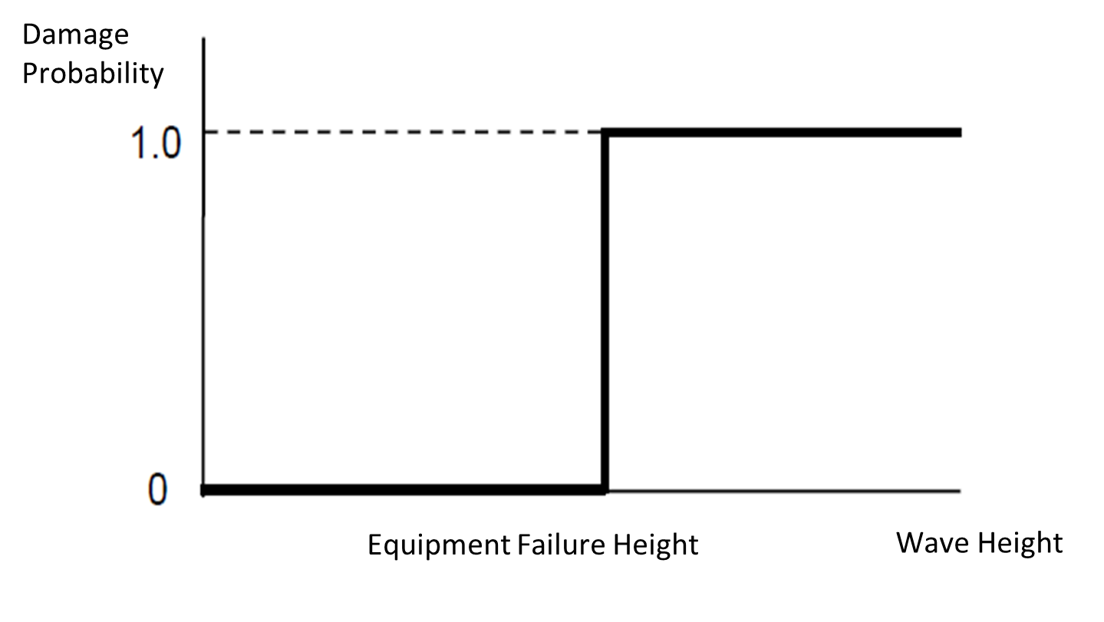
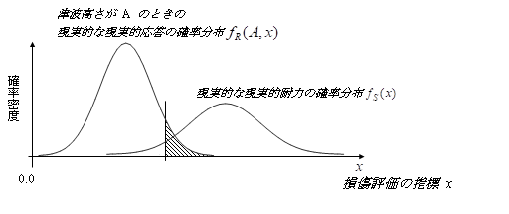
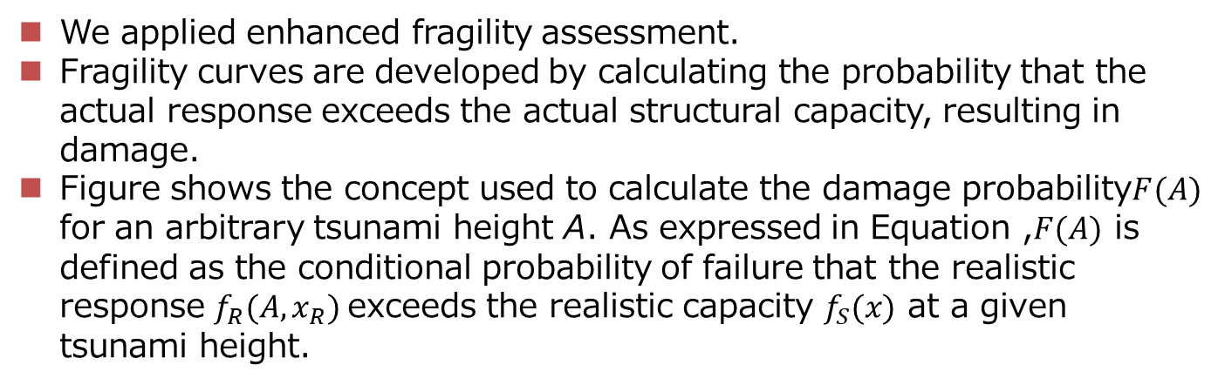

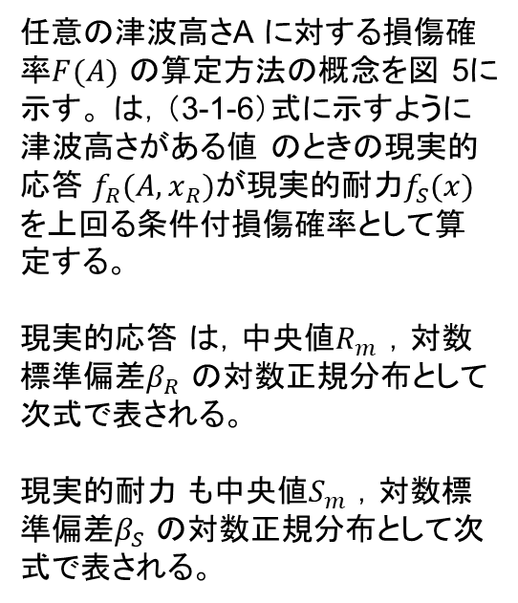
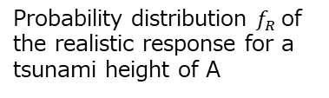
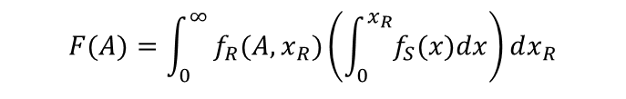
Enhancement of Fragility Assessment
We applied enhanced fragility assessment.
Fragility curves are developed by calculating the probability that the actual response exceeds the actual structural capacity, resulting in damage.
Figure shows the concept used to calculate the damage probability$F(A)$ for an arbitrary tsunami height A. As expressed in Equation ,$F(A)$ is defined as the conditional probability of failure that the realistic response $f_{R}(A,x_{R})$exceeds the realistic capacity $f_{S}(x)$ at a given tsunami height.
任意の津波高さA に対する損傷確率$F(A)$ の算定方法の概念を図 5に示す。 は，（3-1-6）式に示すように津波高さがある値 のときの現実的応答 $f_{R}(A,x_{R})$が現実的耐力$f_{S}(x)$ を上回る条件付損傷確率として算定する。
現実的応答 は，中央値$R_{m}$ ，対数標準偏差$β_{R}$ の対数正規分布として次式で表される。
現実的耐力 も中央値$S_{m}$ ，対数標準偏差$β_{S}$ の対数正規分布として次式で表される。
Probability distribution $f_{R}$of the realistic response for a tsunami height of A
Probability distribution of the realistic capacity $f_{S}(x)$
Probability
Density
Conventional Equipment Fragility
Advanced Equipment Fragility
$$F(A)=\int_{0}^{∞}{f_{R}(A,x_{R})\left(\int_{0}^{x_{R}}{f_{S}(x)dx}\right)}dx_{R}$$
Notes:
Previously, the evaluation assumed a loss of function once a certain elevation was reached.
However, with advances in the methodology, the probability of damage is now calculated based on cases
where the actual response curve exceeds the actual capacity curve, and building and equipment fragility curves are subsequently derived.
EP時にはある高さに到達した時点で機能喪失するという評価を実施していたが、
高度化により、現実的応答曲線が現実的耐力曲線を上回る損傷確率を算定し、建屋・機器フラジリティ曲線を求めている。

Slide 9
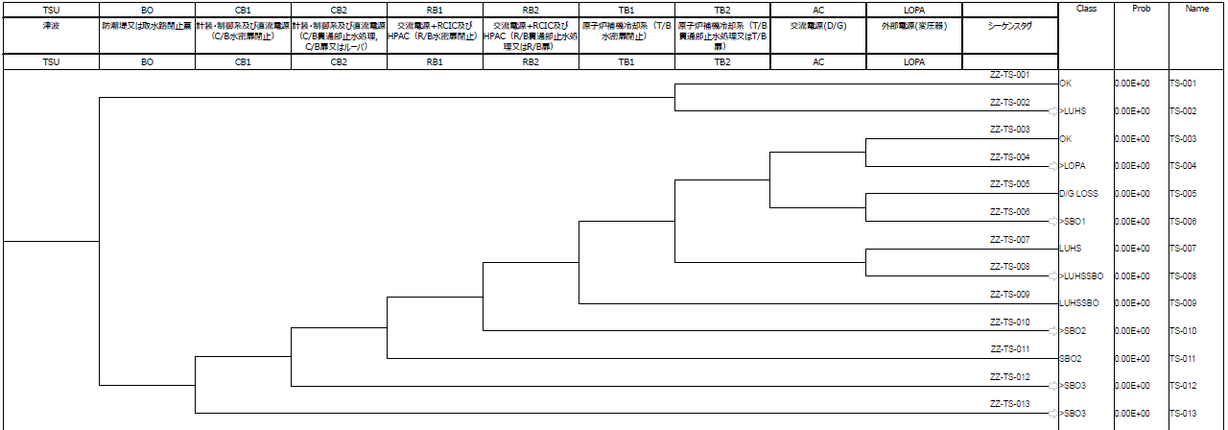
Accident Sequence Evaluation
After conducting the hazard assessment and fragility assessment, initiating events and the SSCs that lead to these events were identified based on damage to SSCs caused by the Tsunami.
A hierarchical Event Tree was developed to represent tsunami event progression, with emphasis on the severity of the impact on the plant for the defined initiating event.
Reproduction of tsunami-induced event progression using a hierarchical Event Tree (ET).
tunami
Sea wall
C/B flooding 1
C/B flooding 2
R/B flooding 1
R/B flooding 2
T/B flooding 1
T/B flooding 2
D/G
LOPA
Tag
Notes:
文章～
this fig shows hierarchical Event. This is big point of enhancement.
We make hierachcal event tree reproduction of tsunami induced event progression
The initiating events induced by Tsunami-related facility damage are as follows:
Loss of offsite power: LOPA
Loss of ultimate heat sink: LUHS
Station blackout (RCW: intact): SBO1
Station blackout (RCW: failed): LUHSSBO
Station blackout + loss of RCIC and HPAC functions: SBO2
Loss of DC power and loss of instrumentation and control functions: SBO3

Slide 10
Protective Measures identified through Tsunami PRA
Based on the FV importance evaluation results, additional measures to enhance safety were examined.
Failure to close the watertight doors between buildings and the watertight door leading to the process computer room was identified as one of the dominant contributors in the ranking.
  Physical Countermeasures:
  ・installing an alarm/buzzer that sounds when the door is opened
  ・implementing physical barriers that prevent access while the door remains open.
  Training: Provide training for operators and field personnel
Results of FV Importance Analysis for Total CDF
Rank | Event | FV Importance | Factor
1 | Seawall damage due to Tsunami | We will keep FV Importance confidential. | Tsunami Damage
1 | 6 unit startup transformers (6SA, 6SB) damaged by Tsunami |  | Tsunami Damage
2 | Watertight door left open (S/B-C/B), failure in closing operation |  | Human Error
3 | Watertight door left open (No.22) |  | Human Error
3 | Watertight door left open (No.66)
3 | Watertight door left open (No.66) |  | Human Error
4 | C/B flooding due to Tsunami |  | Tsunami Damage
5 | SPC system configuration error (excess) |  | Human Error

Slide 11
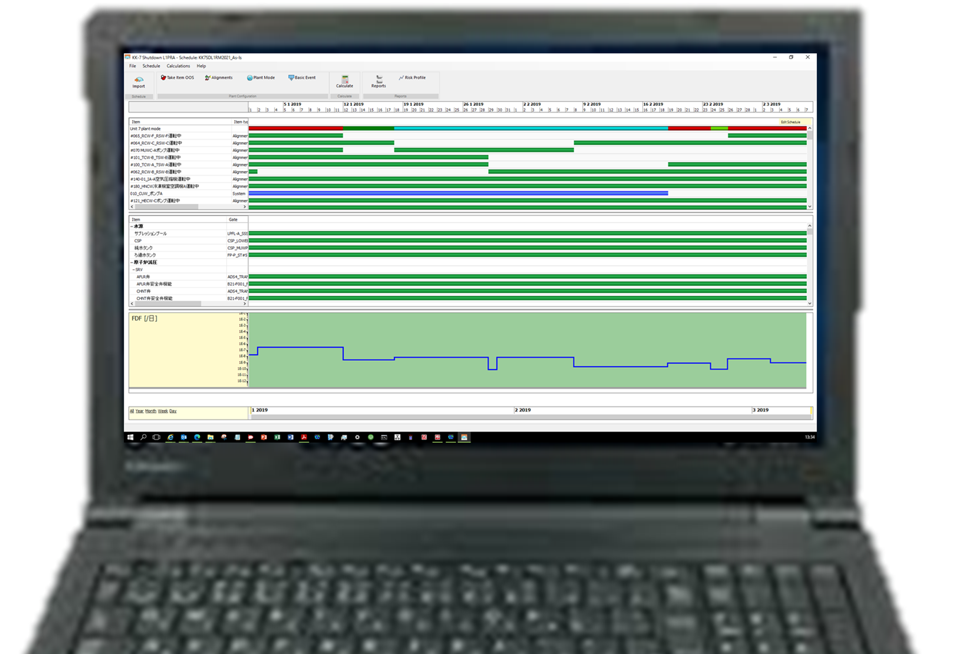
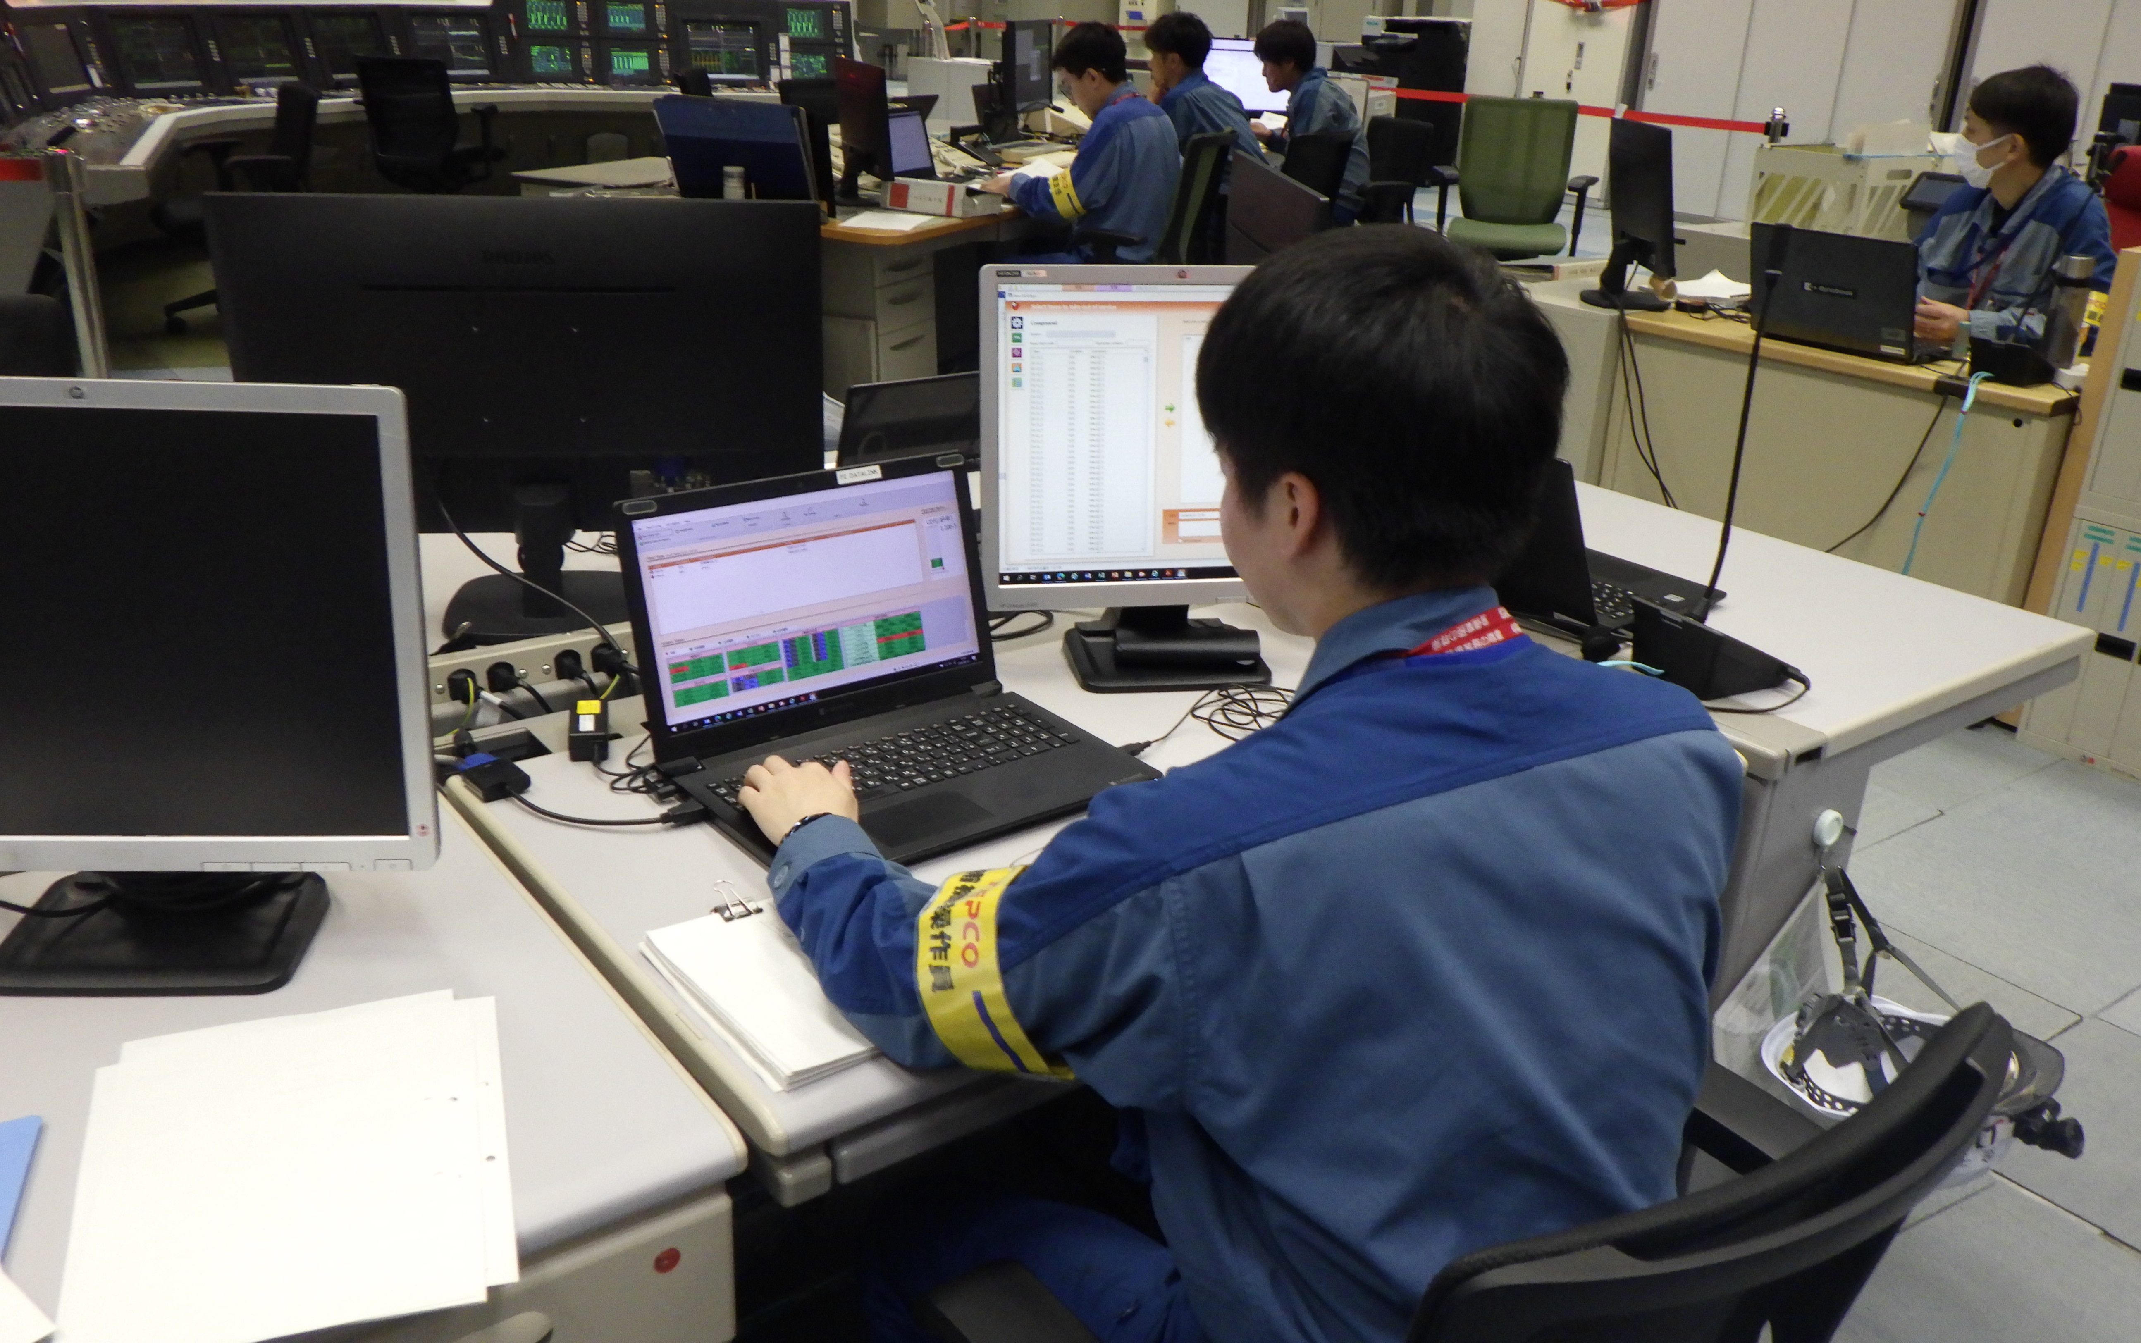

Recent Initiatives in Risk-Informed Decision Making
Since 2026, a risk monitor has been installed in the Main Control Room.
In preparation for the implementation of online maintenance (OLM), efforts are underway to enable operators to perform risk assessments themselves
in order to better understand and manage risks during planning. By allowing operators to conduct evaluations on their own, it becomes possible to achieve assessments that more closely reflect actual on-site conditions.
Currently, the risk monitor is limited to internal PRA; however, the aim is to implement a full-scope PRA that also includes external events. Furthermore, efforts are being made not only to develop models but also to ensure that these models are designed with practical on-site application in mind.
CDF
Risk Monitor Installed in the Main Control Room
Phoenix Risk Monitor

Slide 12
Conclusion
We showed the significance of Tsunami PRA and its implementation status. In light of 1F accident, it is essential to appropriately evaluate Tsunami-induced risks and to identify plant vulnerabilities going forward. Through Tsunami PRA, clarifying accident scenarios enables the formulation of effective protective measures.
Moving forward, it is important to utilize the knowledge gained to further enhance safety and to implement measures that rationally reduce Tsunami-related risks.

Slide 13
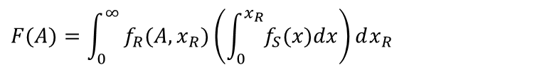
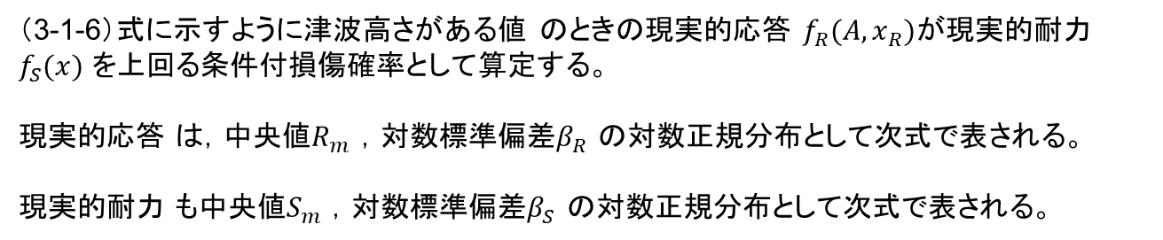
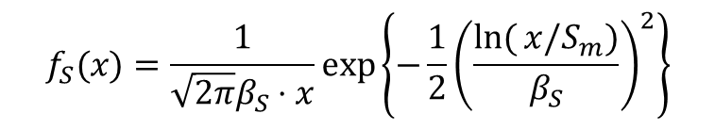
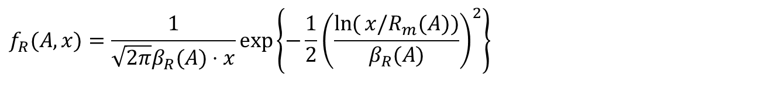
参考：Enhancement of Fragility Assessment
（3-1-6）式に示すように津波高さがある値 のときの現実的応答 $f_{R}(A,x_{R})$が現実的耐力$f_{S}(x)$ を上回る条件付損傷確率として算定する。
現実的応答 は，中央値$R_{m}$ ，対数標準偏差$β_{R}$ の対数正規分布として次式で表される。
現実的耐力 も中央値$S_{m}$ ，対数標準偏差$β_{S}$ の対数正規分布として次式で表される。
$$F(A)=\int_{0}^{∞}{f_{R}(A,x_{R})\left(\int_{0}^{x_{R}}{f_{S}(x)dx}\right)}dx_{R}$$
$$f_{R}(A,x)=\frac{1}{\sqrt{2π}β_{R}(A)⋅x}\exp\left\{−\frac{1}{2}{\left(\frac{\ln{(}x/R_{m}(A))}{β_{R}(A)}\right)}^{2}\right\}$$
$$f_{S}(x)=\frac{1}{\sqrt{2π}β_{S}⋅x}\exp\left\{−\frac{1}{2}{\left(\frac{\ln{(}x/S_{m})}{β_{S}}\right)}^{2}\right\}$$
Notes:
KK７ではフラジリティ評価の高度化を行っている。
現実的応答が現実的耐力を上回る損傷確率を算定し、建屋・機器フラジリティ曲線を求めている
以前はある高さに到達した時点で機能喪失するという評価を実施していたが、
高度化により、現実的応答曲線が現実的耐力曲線を上回る損傷確率を算定し、建屋・機器フラジリティ曲線を求めている。

