Slide 1


INTEGRATED SAFETY MARGIN QUANTIFICATION–LEVERAGING PROBABILISTIC CONSIDERATIONS IN SAFETY DEMONSTRATION
PSAM18 – Pittsburgh, July 2026
Shizhen Yu, Jinzhao Zhang, Pierre-Etienne Labeau

Slide 2
content
Introduction
Integrated Safety Margin Quantification (ISMQ)
Comparison with Best-Estimate Plus Uncertainty (BEPU)
Conclusion and perspectives

Slide 3
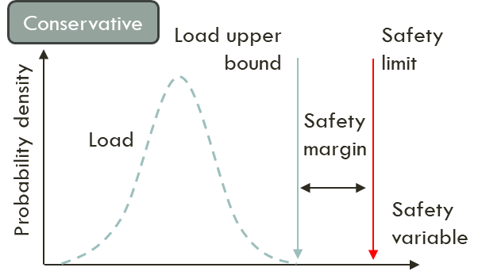
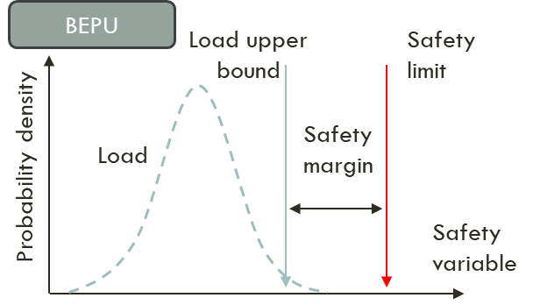
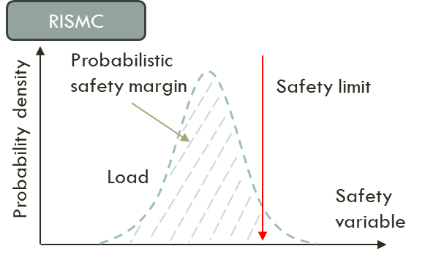
Introduction
Dynamic
PSA
Risk-Informed Safety Margin Characterization
Extended
BEPU
Deterministic safety analysis – conservative approach
Best Estimate Plus Uncertainty (BEPU) approach
IDPSA
Probabilistic Safety Assessment (PSA)
Integrated Safety Margin Quantification (ISMQ) methodology incorporating probabilistic approaches to account for all relevant uncertainties:
  Credible scenarios
  Realistic estimation of safety margin
  Machine-learning-based sensitivity analysis to identify most penalizing conditions

Slide 4
Integrated Safety Margin Quantification
Step 1: define scenario
Step 3: identify uncertainties related to physical/modeling parameters
Step 6: uncertainty selection
Step 2: identify safety limit(s)
Step 7: run calculations
Uncertainty handling in two loops: inner loop for uncertainties related to dynamic evolutions, and outer loop for the others
Step 4: identify uncertainties related to safety system availabilities
Step 8: quantify safety margin
Step 5: identify uncertainties related to dynamic evolution
1. Physical process |  | 2. Safety system |  |  | 3. Operator action
a) initial and boundary conditions | b) modelling parameters | a) configuration | b) actuation | c) performance | a) action timing

Slide 5
Integrated Safety Margin Quantification
  Step 1: Define scenario
    Scenario definition can be deterministic or risk-informed (PSA-based)
    3 to 8" Small Break Loss Of Coolant Accident (SBLOCA) of a Gen-II 1000 MWe Pressurized Water Reactor
    Reactor trip, RCP trip and main FW trip ➔ actuation of AFW, accumulators and SI
  Step 2: Identify safety limit
    Peak Cladding Temperature (PCT) of 600°C (instead of ~1200°C), due to lumped code and coarse core nodalization
  Step 3: Identify uncertainties related to physical/modeling parameters
    41 parameters identified with variation ranges and distributions

Slide 6
Integrated Safety Margin Quantification
  Step 4: Identify uncertainties related to safety system availabilities
    Safety injection system as main uncertainty
    Train on broken loop is ignored (lost through break)
    3 cases to be considered as uncertainties
  Step 5: Identify uncertainties related to dynamic evolution
    5 potential uncertainty parameters with variation ranges and distributions
# | No. | Configuration | Probability
1 | 1&2 | 2 HPSI trains | 95.84%
2 | 1&2 | 1 HPSI train | 4.04%
3 | 4 | 2 LPSI trains | 0.12%
4 | 4 | 1 LPSI train | 0.00%
(H/LP)SI: (High / Low Pressure) Safety Injection

Slide 7
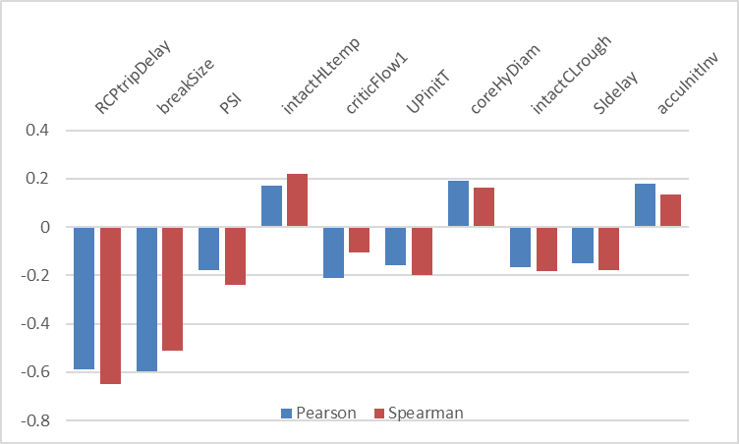
Integrated Safety Margin Quantification
  Step 6: Uncertainty selection
    Sensitivity analysis repeated n = 3 times (SI configurations), by considering each time m = 59 samples (Wilks' one-sided first-order 95/95 formula combined with Latin Hypercube Sampling)
    Minimum collapsed core level as the commensurate Figure of Merit (FoM), as PCT could remain below its nominal value in calculations with significant margins
    Pearson (linearity) and Spearman (monotony) coefficients calculated to measure sensitivity
Case | Physical/modeling uncertainties |  | Dynamic evolution related uncertainties
 | threshold | number | threshold | number
2LPSI | > 0.2 | 3: breakSize, criticFlow, intactHLtemp | > 0.2 | 2: PSI, RCPtripDelay

Slide 8
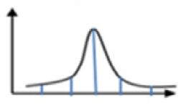
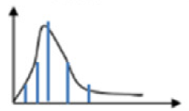
Integrated Safety Margin Quantification
  Step 7: Run calculations
    Complete set of calculations for representative safety margin measurements
Distribution of outer loop parameters
Outer loop samples
Distribution of inner loop parameters
Margin in each calculation
Overall margin with uncertainty quantification
Inner loop samples: dynamic evolution
Margin in branch #1 of DET₁
OLS₁
OLS₂
·
·
·
OLS_{m × n}
DET₁
Deterministic sampling:
3 parameter, 6 samples,
each at 1/6 = 16.7% probability
DET₂
Physical/modelling ➔ m samples
parameters
Overall margin
RCPtripDelay: 4 samples, at 0.05, 0.35, 0.65 and 1 cumulatively
PSI: 3 samples, at 0.05, 0.5 and 1 cumulatively
·
·
·
·
·
·
2LPSI case: 6 x (4 x 3) = 72 integral calculations, with probabilities estimated based on sample probabilities
3 samples, at 95.84%, 4.04% and 0.12% probabilities
DET_{m × n}
Safety system ➔ n samples
availabilities

Slide 9
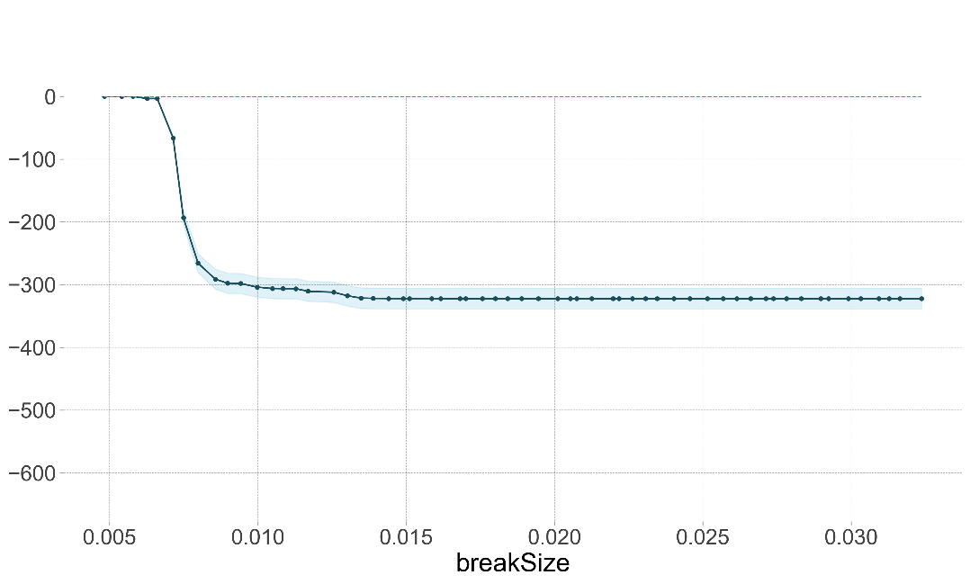
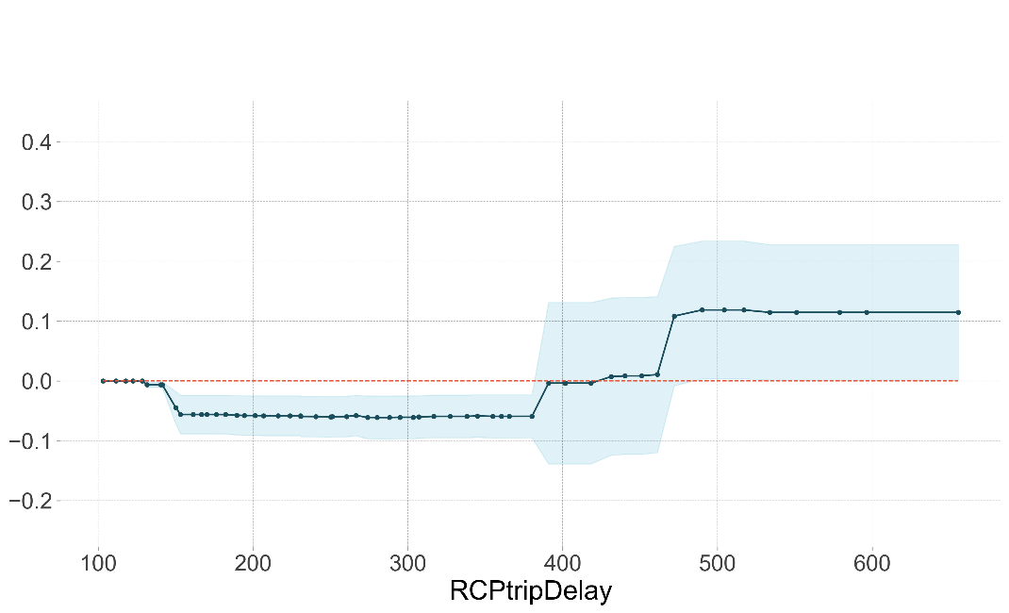
Integrated Safety Margin Quantification
  Step 7: Run calculations (cont’)
    Exploring the most penalizing case
      Partial Dependency Plot (PDP) technic combing the random forest machine learning method: for delineation of relationships between the inputs and the output
      By isolating the effect of a single variable, PDPs predict how changes in one input variable influence the output
      Applied to the 59 sensitivity analysis calculations of 2LPSI case (5 inputs analysed, 2 shown below), with PCT as output
695 s, at 9/59 probability
0.00456 m², at 5/59 probability

Slide 10
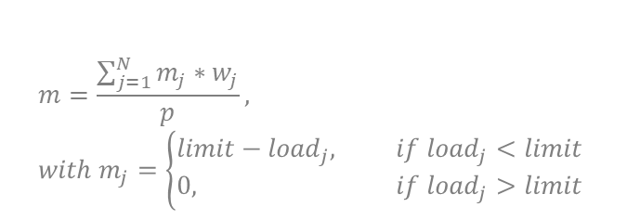
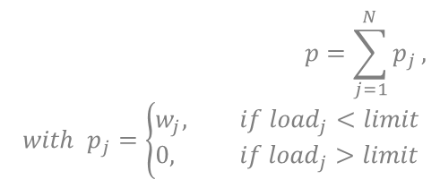
Integrated Safety Margin Quantification
  Step 8: Safety margin quantification
$$m=\frac{\sum_{j=1}^{N}{m_{j}∗w_{j}}}{p}, with m_{j}=\left\{\begin{aligned}&limit−{load}_{j}, if {load}_{j}<limit \\ &0, if {load}_{j}>limit\end{aligned}\right.$$
Probability-weighted margin
Safety limit
No trespassing calculations being far from the safety limit
$$p=\sum_{j=1}^{N}{p_{j}}, with p_{j}=\left\{\begin{aligned}&w_{j}, if {load}_{j}<limit \\ &0, if {load}_{j}>limit\end{aligned}\right.$$
Probability density
Load
Penalizing case
Predicted worst case at a negligible probability
x
Probabilistic safety margin
Safety variable
Probability of respecting a safety limit

Slide 11
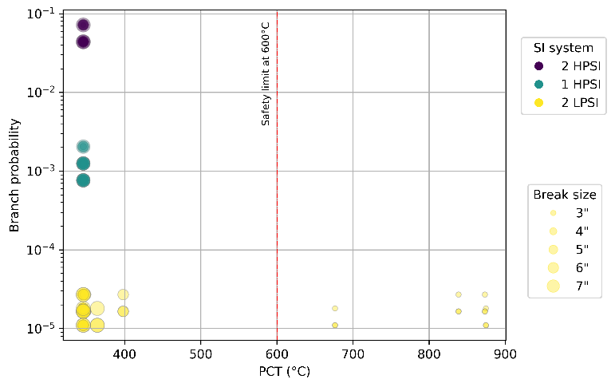
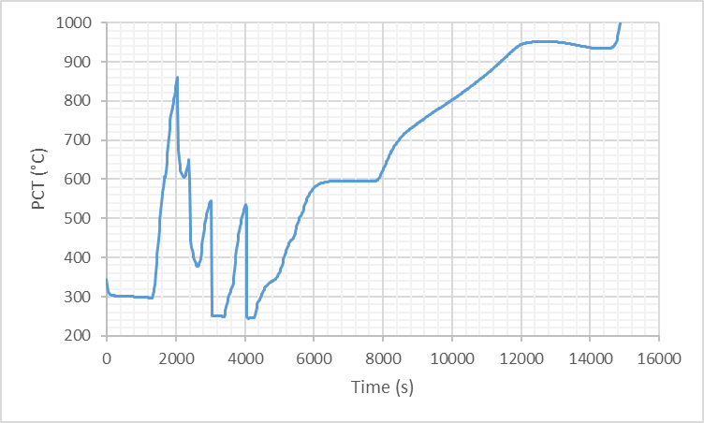
Integrated Safety Margin Quantification
  Step 8: Safety margin quantification (cont’)
Penalizing case
Case | Probabilistic safety margin | Probability-weighted margin (K)
2HPSI (95.84%) | 1 | 254.3
1HPSI (4.04%) | 1 | 254.3
2LPSI (0.12%) | 0.8333 | 208.4
All | 0.9998 | 254.2
Probability of 4E-05 among 2LPSI case; 5E-08 among all cases
Distance between PCT at nominal conditions and safety limit: 256.6 K
Overall margin of 254.2K = ~99% of 256.6K

Slide 12
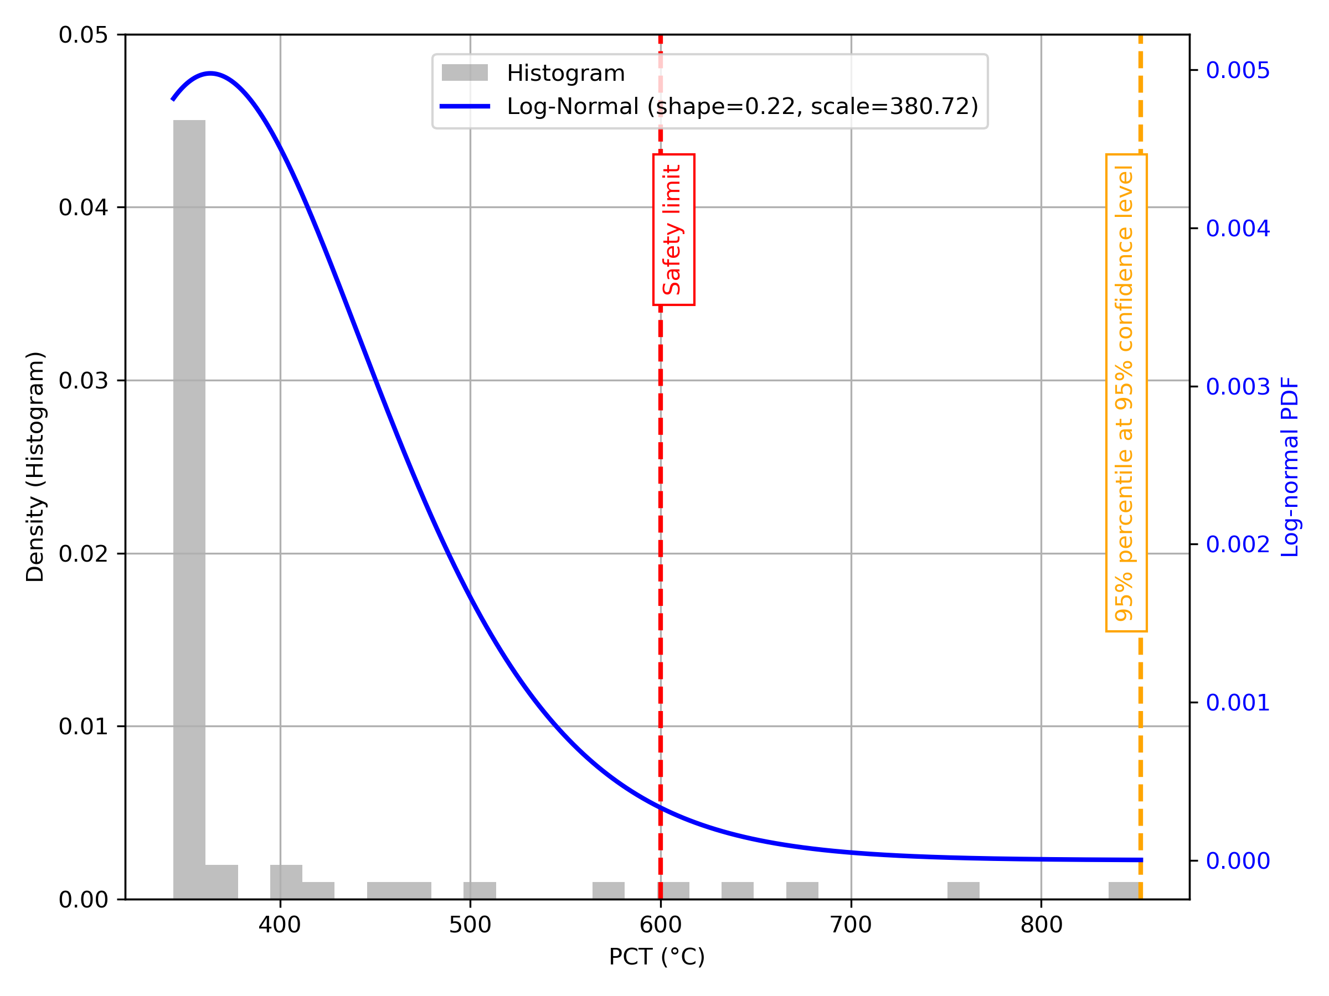
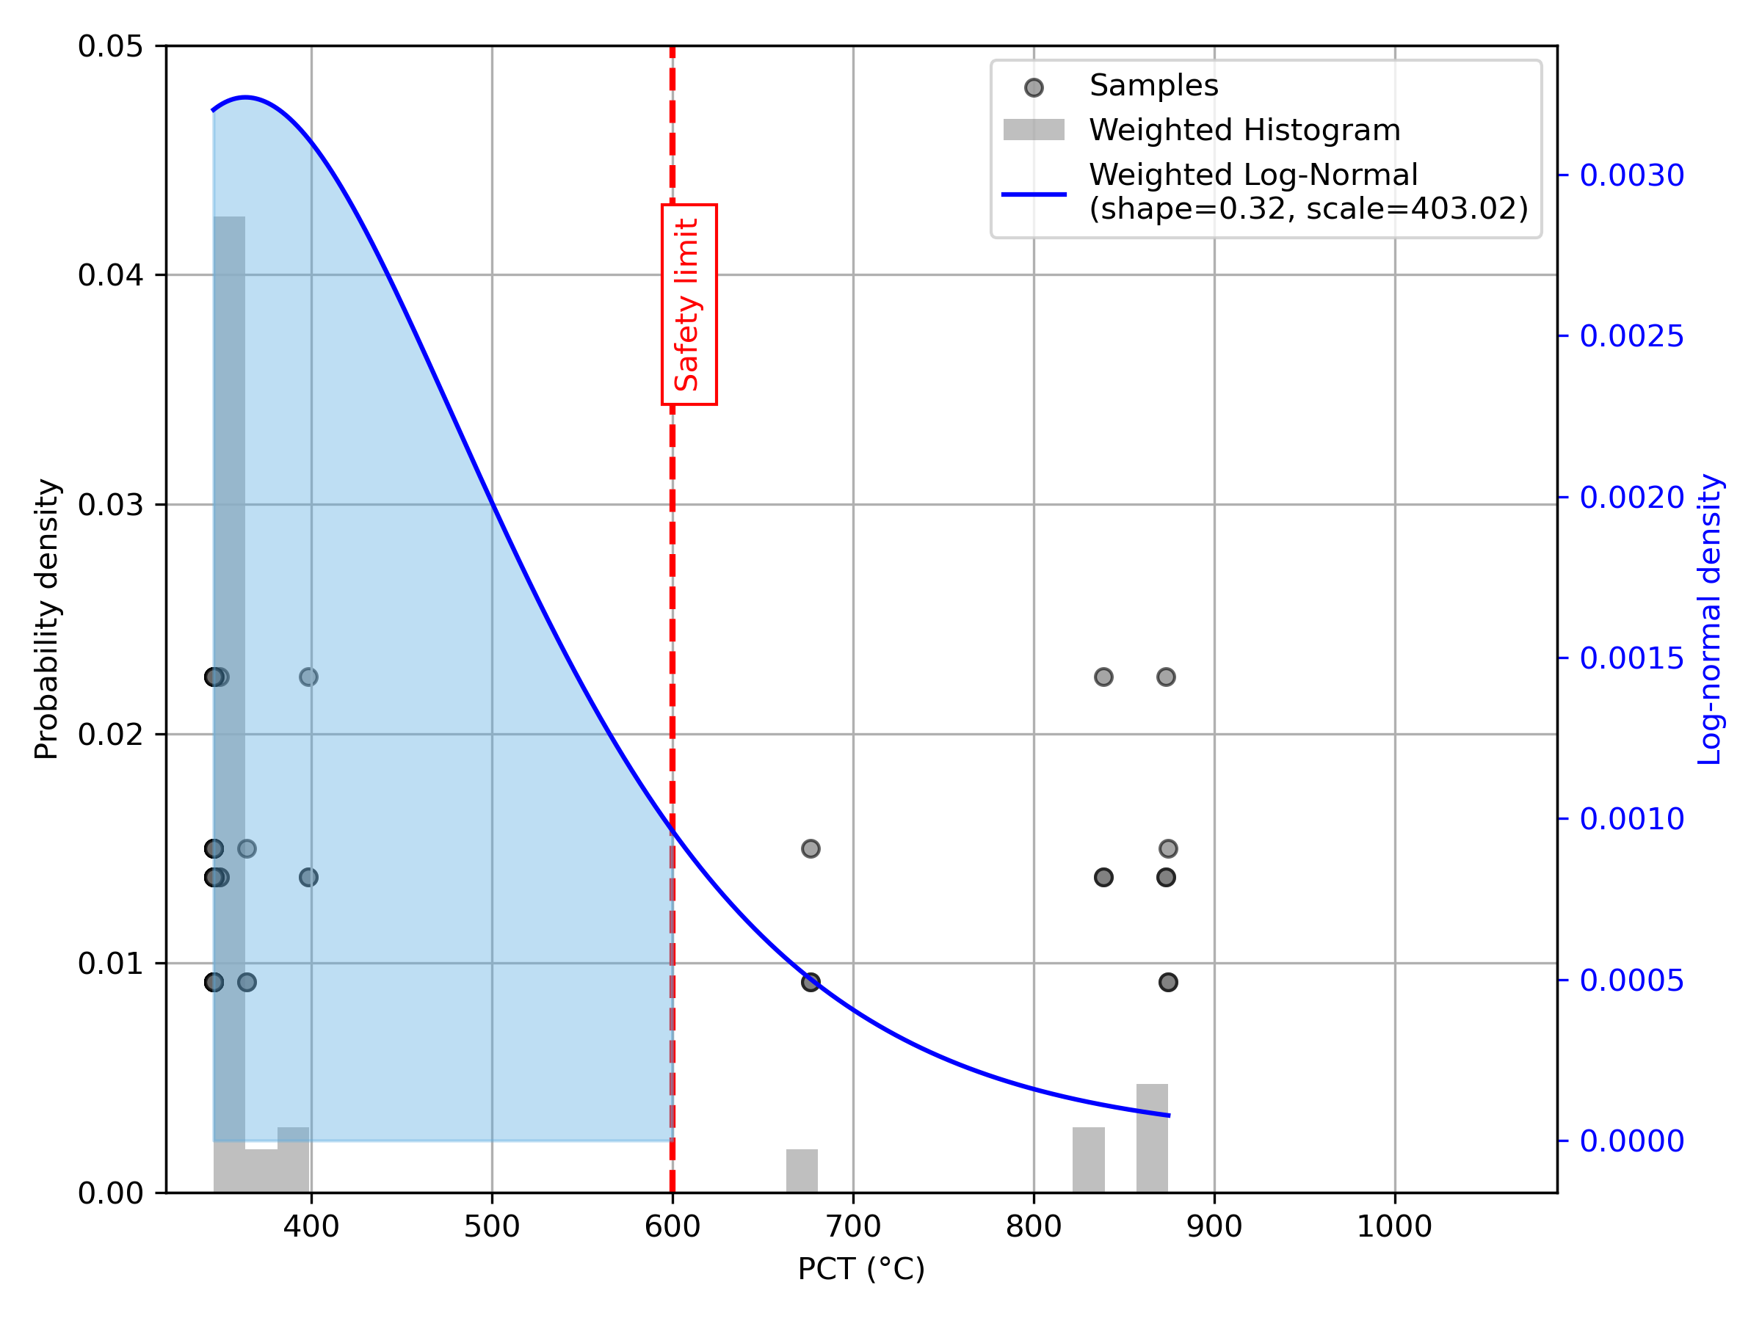
Comparison with BEPU (2LPSI)
BEPU
ISMQ
Probability-weighted margin = 208K
Probabilistic safety margin = 0.83
Penalizing case at 4E-05 probability
BEPU emphasizes a conservative upper bound; ISMQ provides richer insights

Slide 13
Conclusion and perspectives
  ISMQ extends existing IDPSA methodologies by integrating BEPU, EBEPU, DET, and RISMC concepts into a unified framework that quantifies both probabilistic and deterministic safety margins, characterizes residual risk, and introduces novel uncertainty treatment and machine-learning-based exploration of limiting situations.
  It embeds probabilistic considerations into safety demonstration by accounting for system availability, dynamic accident evolution uncertainties, probabilistic safety margins, and the residual risk associated with the most penalizing situation.
  It is a flexible methodology applicable to both research and industry, particularly for passive systems, highly uncertain phenomena and operator actions. It also supports risk-informed reactor design optimization by balancing safety performance and economic objectives.

Slide 14
Thank you for your attention!
shizhen.yu@tractebel.engie.com

