Slide 1


A convex multi-objective optimization method for reliability allocation in fault tree analysis
In collaboration with

Slide 2

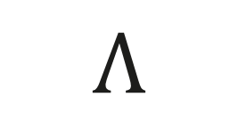
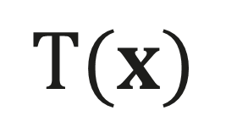
A nuclear powerplant from the perspective of PSA
Reliabilities of barriers
$$T(x)$$
$$Λ$$
$$C$$
Initiating events
Consequences

Slide 3

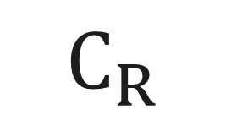
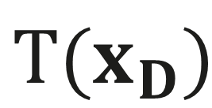
A nuclear powerplant from the perspective of PSA
Designers role is to adjust these
$$T(x_{D})$$
$$I$$
$$C$$
$$C_{R}$$
Acceptable consequences
Initiating events
Consequences

Slide 4
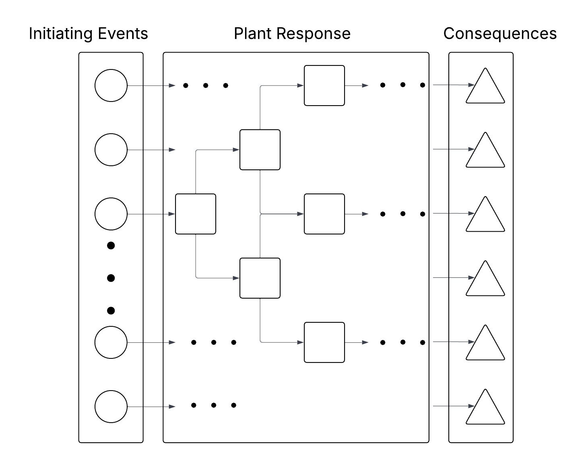




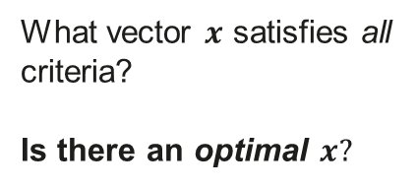




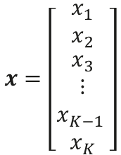




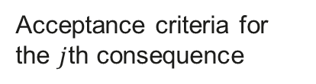






A nuclear powerplant from the perspective of PSA
Acceptance criteria for the $j$th consequence
$$λ_{1}$$
$$x_{1}$$
$$F_{1}$$
$$F_{j}\left(x\right)≤c_{j}$$
$$λ_{2}$$
$$x_{2}$$
$$F_{2}$$
$$x=\left[\begin{matrix}x_{1} \\ x_{2} \\ \begin{aligned}x_{3} \\ ⋮ \\ x_{K−1 } \\ x_{K}\end{aligned}\end{matrix}\right]$$
$$λ_{3}$$
$$x_{3}$$
$$x_{4}$$
$$F_{3}$$
$$x_{5}$$
$$F_{4}$$
What vector $x$ satisfies all criteria?
Is there an optimal $x?$
$$λ_{n−1}$$
$$x_{6}$$
$$F_{5}$$
$$λ_{n}$$
$$F_{6}$$

Slide 5
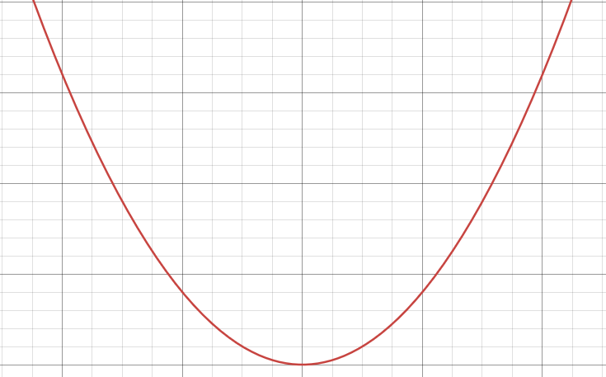

Convex optimization
Convex function
Convex optimization minimizes convex functions over convex sets.
Decision variable
$$\begin{matrix}\text{m}\text{inimize} \\ x\end{matrix} f\left(x\right) s.t. g\left(x\right)≤0$$
Objective function
Constraint function
Minimum
In plain English, the goal is to find the value of $x$ that produces the smallest value for $f\left(x\right)$ while still satisfying some constraint $g\left(x\right)≤0. If they are convex, that minimum is guaranteed to be a global minimum.$
Can the results of a PSA model be made convex?

Slide 6
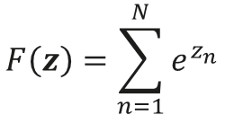


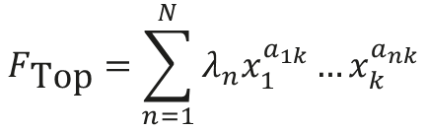
Logarithmic representation
Sums of cutsets are posynomials, neither convex nor concave
$$F_{\text{Top}}=\sum_{n=1}^{N}{λ_{n}x_{1}^{a_{1k}}…x_{k}^{a_{nk}}}$$
$$F_{\text{Top}}=λ_{1}x_{1}x_{2}+λ_{2}x_{1}x_{3}+λ_{3}x_{1}x_{2}x_{4}+…$$
Solution: we perform a logarithmic transformation!
$$x=e^{y}$$
Each cutset can, through the exponential product rule, be turned into a sum, so the cutset list can be represented by
Log of initiator frequences
Matrix to select which barriers belong to each cutset
$$z=Λ+Ay$$
Log of barrier failure probabilities
$$F\left(z\right)=\sum_{n=1}^{N}{e^{z_{n}}}$$
$$LSE\left(z\right)=log\left(\sum_{n=1}^{N}{e^{z_{n}}}\right)$$
The sum of cutsets is then
The logarithm of this is called LogSumExp (LSE) function and is convex!

Slide 7
Potential uses
A convex representation of the results of a PSA model allows for efficient convex optimization in general. Risk can be efficiently framed as a geometric problem!
The general class of questions of the form:
What is the optimal way of changing some set of systems to satisfy some constraints?
can be systematised with this framework, such as risk-informed trade-off studies, lifecycle optimization and design optimization.
Here we present one example of how it could be used, specifically:
  Produce risk-informed reliability targets for barrier systems based on selected objectives while satisfying core damage frequency acceptance criteria.

Slide 8
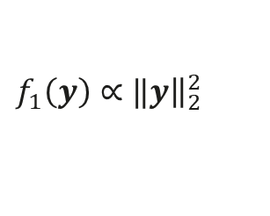
Cost criterion
The more reliable a system $↔$ The more the system costs
What is the largest $x$ (the lowest reliability/cheapest systems) we can accept to satisfy all criteria?
In the log-representation larger $x$ means a smaller $y$.
Naïve solution: Find the smallest vector $y$ that satisfies all criteria
The problem? Trivial solutions where $x_{i}=0$ or $1 →$ infinitely reliable or unreliable systems. Some sequences carry disproportionate risk.
Reliability minimizing objective function:
$$f_{1}\left(y\right)∝‖y{\left.​\right\|}_{2}^{2}$$

Slide 9

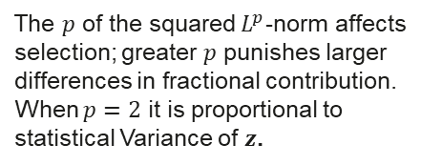

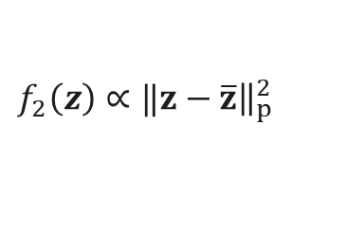
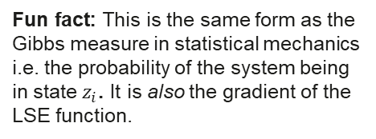
Risk-spread criterion
Balanced Risk Profile: High-probability events must have negligible consequences; serious events must have very low probability.
$${\text{FC}}_{i}=\frac{F_{i}}{F_{Top}}$$
Fractional contribution: The contribution of a cutset (sequence) frequency to the total frequency
Criterion: there should be no “extreme” contributions from cutsets, risk should be “evenly” spread out across cutsets
Fun fact: This is the same form as the Gibbs measure in statistical mechanics i.e. the probability of the system being in state $z_{i}$. It is also the gradient of the LSE function.
${\text{FC}}_{i}=\frac{e^{z_{i}}}{F(z)}$
Fractional contribution in logarithmic representation:
Minimizing the difference between each $z_{i} ↔$spreading out fractional contribution across cutsets
The $p$ of the squared $L^{p}$-norm affects selection; greater $p$ punishes larger differences in fractional contribution. When $p=2$ it is proportional to statistical Variance of $z$.
Risk-spreading objective function:
$$f_{2}\left(z\right)∝‖z−\overline{z}{\left.​\right\|}_{p}^{2}$$

Slide 10
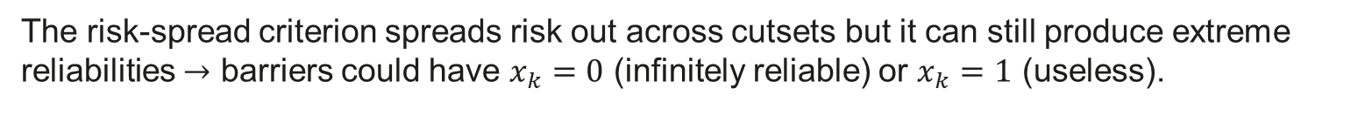
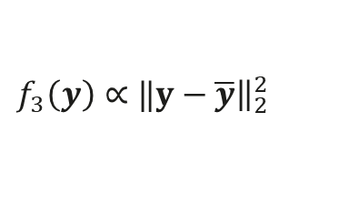
Reliability-spread criterion
The risk-spread criterion spreads risk out across cutsets but it can still produce extreme reliabilities $→$ barriers could have $x_{k}=0$ (infinitely reliable) or $x_{k}=1$ (useless).
Criterion: there should be no “extreme” reliabilities i.e. reliability should be “evenly” spread out amongst the barriers.
Minimizing the difference between each $y_{i} ↔$spreading out reliability across barriers
Reliability-spreading objective function:
$$f_{3}\left(y\right)∝‖y−\overline{y}{\left.​\right\|}_{2}^{2}$$

Slide 11
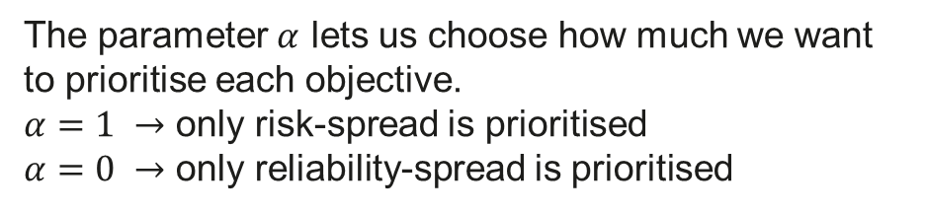



Multi-objective optimization
We want to find a reasonable trade-off between spreading out risk across cutsets and spreading out reliability across barriers.
Risk-spread objective
Reliability-spread objective
$f_{1}$ is used to select the solution with lowest reliability!
The final objective function
$$f=αf_{2}+\left(1−α\right)f_{3}$$
$$\begin{matrix}\text{m}\text{inimize} \\ y\end{matrix}{f\left(y\right)} s.t. F\left(y\right)≤c$$
“Maximize the objective such that the frequency is less than the acceptance criteria”
The parameter $α$ lets us choose how much we want to prioritise each objective.
$α=1 →$ only risk-spread is prioritised
$α=0 →$ only reliability-spread is prioritised

Slide 12
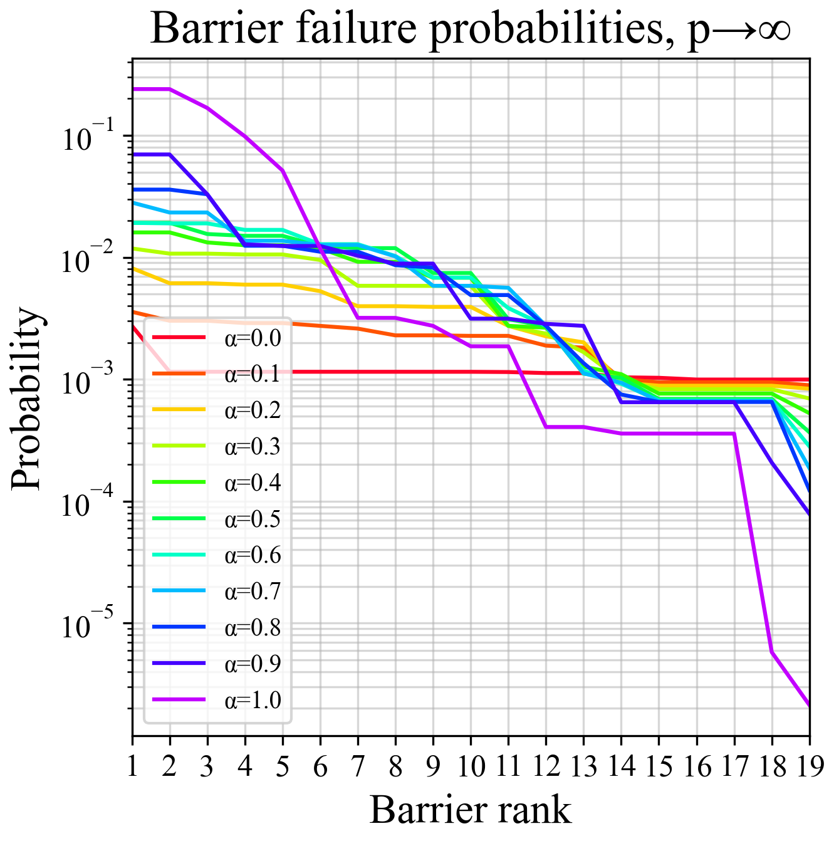
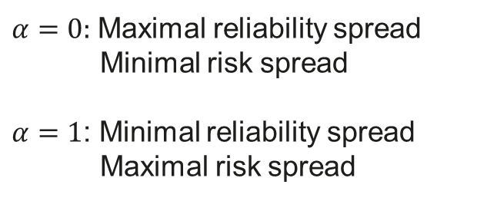
Example of optimization – Barrier failure probability distributions
$α=0:$Maximal reliability spread
Minimal risk spread
$α=1$: Minimal reliability spread
Maximal risk spread
Each barrier is assigned a rank for least reliable (1) and most reliable (19)

Slide 13
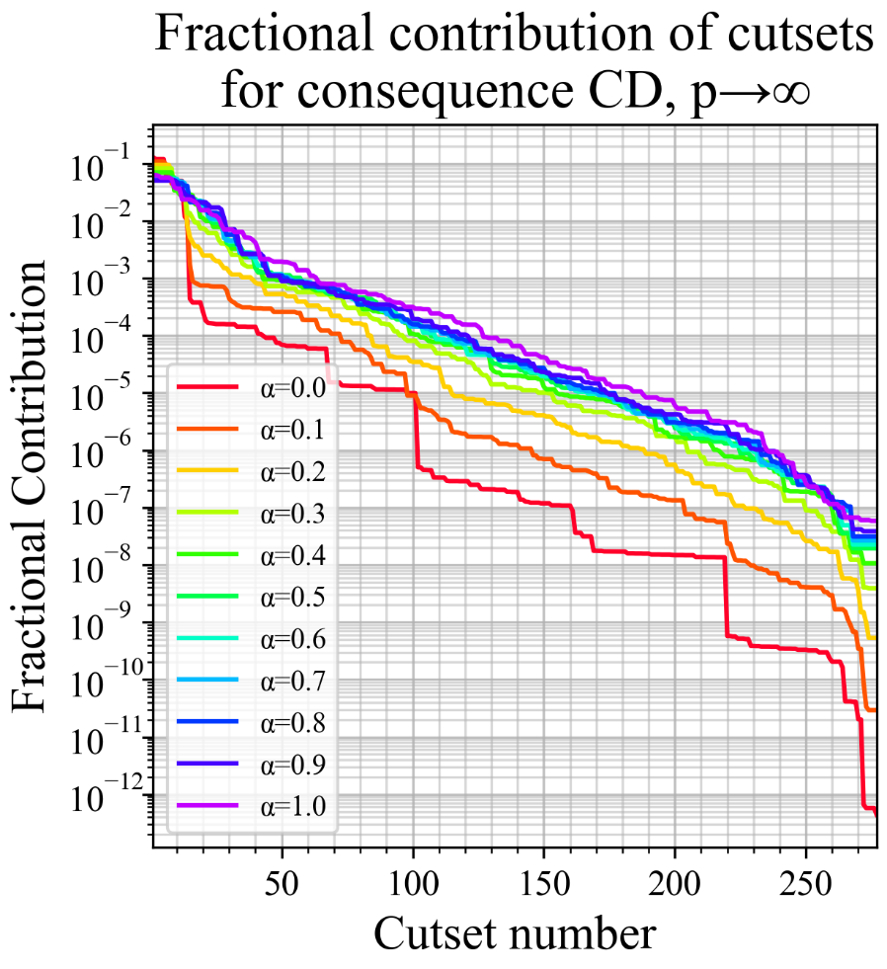
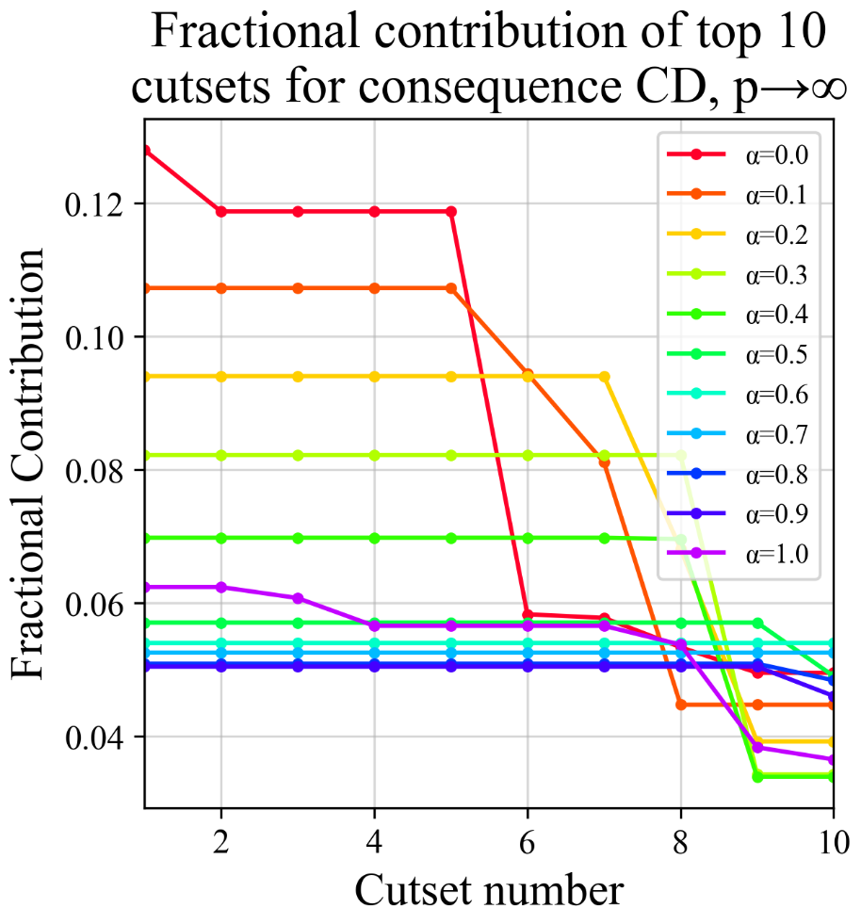
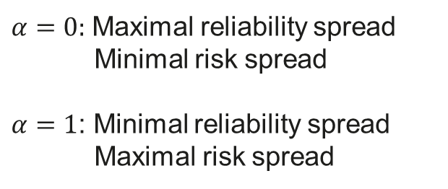
$α=0:$Maximal reliability spread
Minimal risk spread
$α=1$: Minimal reliability spread
Maximal risk spread
Example of optimization – Fractional contribution distributions

Slide 14

Summary
We have shown that the results of PSA fault tree model admit a convex representation through a logarithmic transformation.
PSA fault tree models can be optimised using convex optimization
As a proof of concept, we have formulated and solved a convex optimization problem to derive reliability targets for system barriers that minimize overall reliability requirements while satisfying acceptance criteria and balancing both risk across cutsets and reliability across barriers.

Slide 15
Sebastian Jovancic
Consultant
+46 70 05 800 31
Sebastian.Jovancic@vysusgroup.com

