Slide 1
PSAM 2026 Conference
A Levels-of-Automation Framework for Computerized Procedure Systems in Small Modular Reactors
Korea Advanced Institute of Science & Technologies
Nuclear I&C and Autonomous operation Lab
Choi Soohyeon, Kim Jonghyun*
Notes:
Good afternoon, everyone. I hope you had nice lunch. My name is Soohyeon Choi, from the Nuclear I&C and Autonomous Operation Lab at KAIST. Today I'll be presenting our work, "A Levels-of-Automation Framework for Computerized Procedure Systems in Small Modular Reactors," co-authored with Professor Jonghyun Kim.

Slide 2
Contents
Introduction
Related work
Identification of CPS functions relevant to SMRs
Proposal of CPS LOA framework
Discussion & Conclusion
Notes:
The talk is organized into five parts. I'll start with the motivation behind this study, then review related work on CPS and LOA. After that, I'll walk through how we identified CPS(Computerzied Procedure System) functions relevant to SMRs, present our proposed LOA(Level of AUtomation) framework, and close with discussion and conclusions.

Slide 3
1. Introduction
Notes:
Let's begin with the introduction.

Slide 4
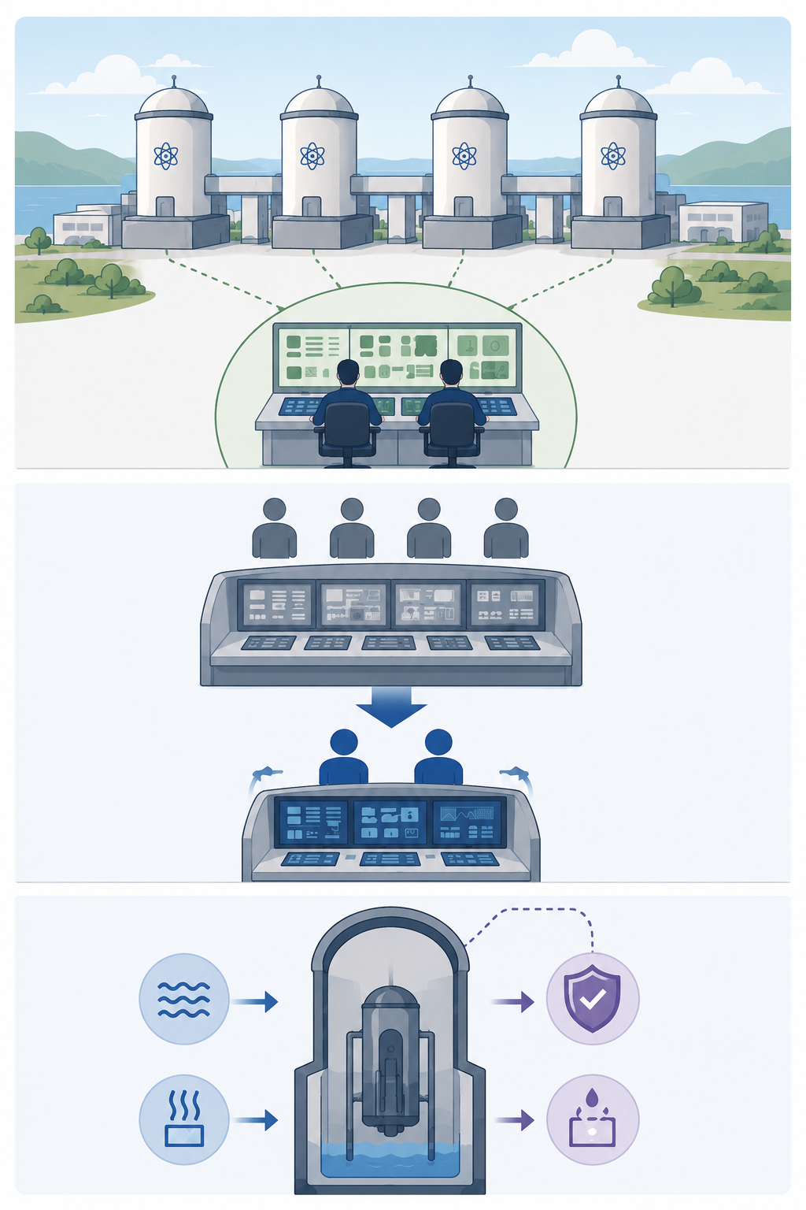
1. Introduction
Background of Small Modular Reactors(SMRs) Developments
  A New Operational Paradigm for SMRs
    Small Modular Reactors are being developed with operational concepts that differ from those of large light-water reactors
    combining modular multi-unit deployment, reduced operating-crew sizes, and substantially enhanced passive safety.
  SMR characteristics
    Multi-module operation
      Two or more reactor modules are installed and operated together at a single site, often monitored and controlled from a shared control room
    Reduced operating crew
      Fewer operators are required to monitor and control the plant, enabled by increased automation and simplified system designs.
    Long passive-safety grace
      The reactor can maintain safety without operator action or external power for an extended period, relying on passive systems
Notes:
Small Modular Reactors are being developed around an operational paradigm that's quite different from large light-water reactors. Three characteristics define this new paradigm: multi-module operation, where two or more reactor modules are installed and operated together — often from a single shared control room; reduced operating crew, made possible by increased automation and simplified system designs; and long passive-safety grace periods, where the reactor can maintain safety without operator action or external power for an extended time. These three characteristics together are what motivate the rest of this study.

Slide 5

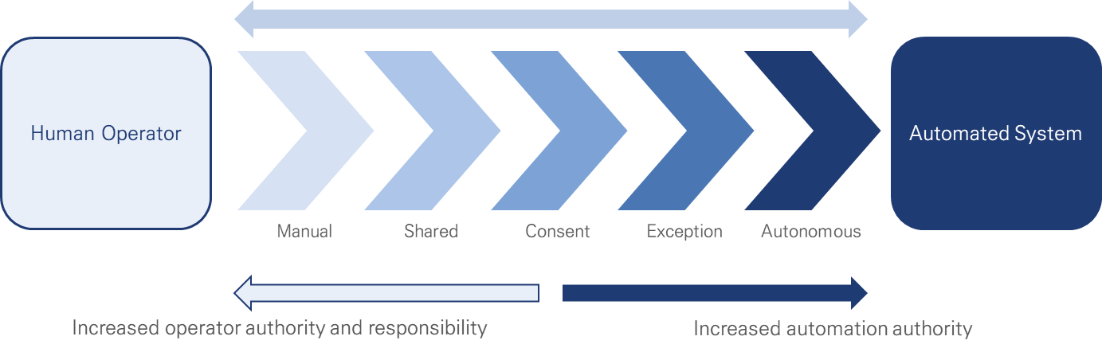
1. Introduction
Envisioned Computerized Procedure System & Level of Automation Role in SMRs
  Why Computerized Procedure System(CPS) matters in SMRs
    In the digital Main Control Rooms on SMRs, the CPS is the medium through which operators monitor plant state, assess situations, plan responses, and execute control actions.
  Level of Automation(LOA) Role in SMRs
    With the increasing importance of CPSs in operating SMRs, the selected Level of Automation (LOA) for each CPS function directly affects operational efficiency, operator cognitive workload, situation awareness, and the complexity of regulatory review.
STAGE 1
Monitor plant state
STAGE 3
Plan responses
CPS
the medium
STAGE 2
Assess situations
STAGE 4
Execute control actions
Notes:
Why does the Computerized Procedure System matter here? In the digital main control rooms envisioned for SMRs, the CPS is the medium through which operators monitor plant state, assess situations, plan responses, and execute control actions — these four stages you see on this diagram. And because CPS sits at the center of nearly everything the operator does, the level of automation selected for each CPS function directly affects operational efficiency, operator cognitive workload, situation awareness, and even the complexity of regulatory review. So what I want to say, is that LOA isn't a secondary design choice — it's central to how well the CPS can support operators in this new SMR paradigm.

Slide 6
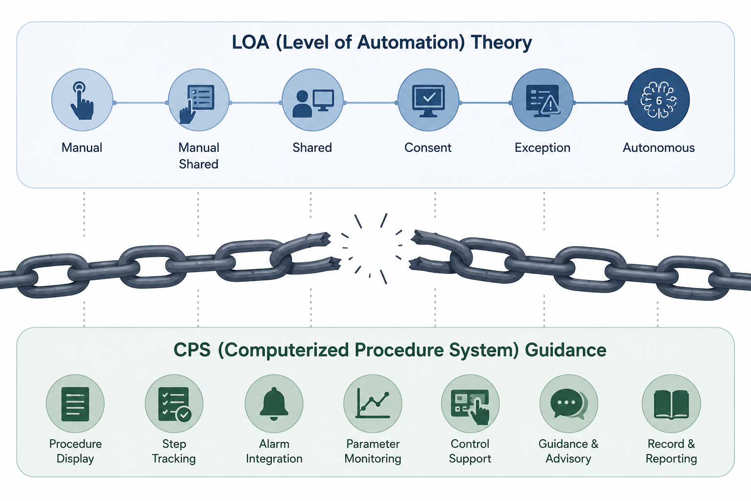
1. Introduction
Limitations of previous research
  LOA(Level of Automation) theory and CPS(Computerized Procedure System) guidance have developed separately
    LOA classification and CPS functional guidance have been developed independently, with little systematic framework linking CPS functions to automation levels
  Existing LOA theories don't specify which CPS function they apply to
    Existing LOA frameworks define how to grade automation, but not what CPS function each level apply to.
  System-level LOA statements are too broad for design
    describing a CPS as overall Level gives no clear guidance on which specific functions to automate
Notes:
Now, here's the problem. LOA theory and CPS guidance have developed as two separate bodies of knowledge. Existing LOA classifications and CPS functional guidance were built independently, with little systematic framework connecting the two. This creates two concrete limitations. First, existing LOA theories tell us *how* to grade automation, but not *what specific CPS function* each level should apply to. Second, system-level LOA statements are too broad for actual design. for example, saying a CPS is "overall Level 3" gives a designer no guidance on which specific functions to automate and which to leave manual. What's missing is a bridge that states which CPS function belongs at which level of automation.

Slide 7
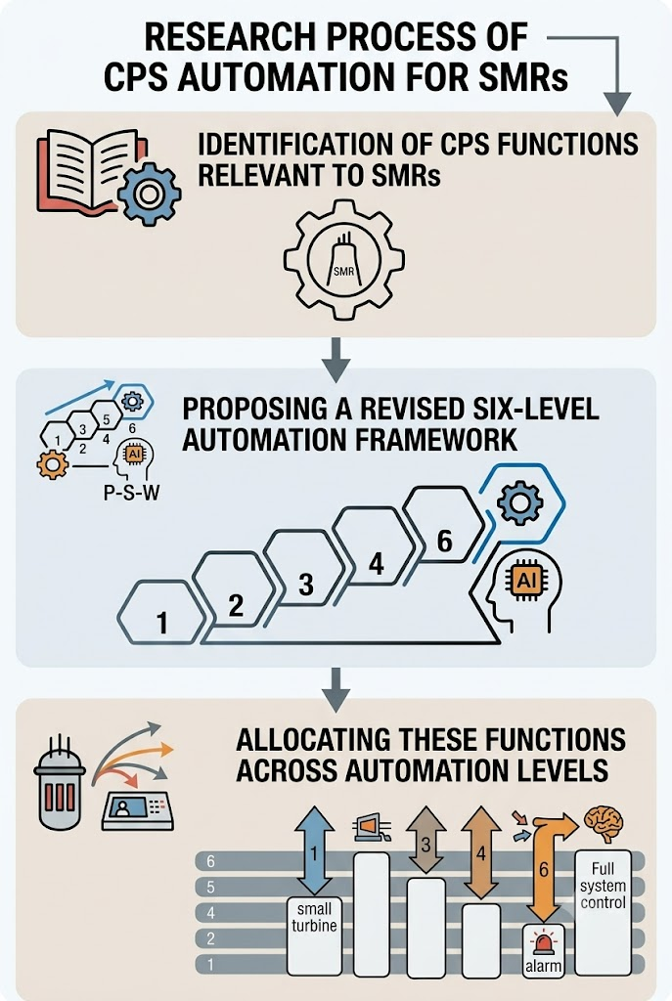
1. Introduction
Study Goal: Bridging LOA theory and CPS function design for SMRs
  Object of the study
    Identification of CPS functions relevant to SMRs
      Conduct a structured literature review on CPS and SMR characteristics to extract 22 functions relevant to SMR operation
    Proposing a revised six-level automation framework
      Define three automation dimensions based on the P-S-W cognitive model and combined them into six LOA levels
    Allocating these functions across automation levels
      Allocate the 22 identified CPS functions across the six LOA levels to build a function-to-LOA matrix
6
5
Notes:
So our study goal is to bridge LOA theory and CPS function design, specifically for SMRs. We approach this in three steps. First, we identify CPS functions relevant to SMRs, through a structured literature review of CPS and SMR characteristics — this gave us 22 functions. Second, we propose a revised six-level automation framework, defining three automation dimensions based on the P-S-W cognitive model and combining them into six LOA levels. Third, we allocate all 22 identified functions across these six levels, building a function-to-LOA allocation matrix.

Slide 8
2. Related Work
Notes:
Moving on to related work.

Slide 9
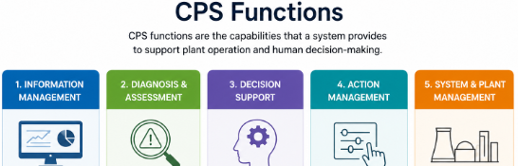
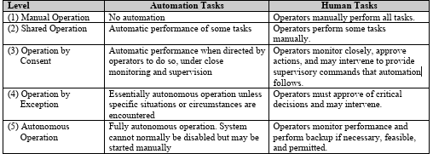
2. Related Work
Two Foundational Concepts: CPS and LOA
  Object of the Related work:
    achieving the study goal requires knowing not only what a CPS needs to do, but also how automation level is conventionally graded
    So each is reviewed separately before being brought together in this framework
  CPS (Computerized Procedure System)
    the digital medium through which operators monitor plant state, assess situations, plan responses, and execute control actions in a digital MCR — replacing paper-based procedures
  LOA (Level of Automation)
    a framework describing how much of a task is carried out by the system versus the operator, ranging from fully manual to fully autonomous
Notes:
Before diving into the literature, it's worth pausing on why we reviewed two separate bodies of work here. Achieving our study goal requires understanding not just what a CPS needs to do, but also how automation level is conventionally graded — so each concept is reviewed on its own terms before we bring them together in our framework. TO explain about each concept Briefly: CPS is the digital medium through which operators monitor, assess, plan, and act in a digital main control room, replacing paper-based procedures. LOA is a framework describing how much of a task is carried out by the system versus the operator, ranging from fully manual to fully autonomous.

Slide 10
2. Related Work
CPS Function Taxonomies
  CPS Function Lineage
    CPS guidance began by defining what operators actually do when following a procedure, and used this operator task structure as the basis for what a computerized procedure system should support. (NUREG/CR-6634, 2000)
    Later guidance addressed procedure integration with soft control.(EPRI 1015313, 2007)
    Eventually consolidated into a practical standard for computerized procedure systems.(IEEE Std 1786-2011)
    More recently, this lineage has continued into experimental territory, with efforts to build a working CBP platform where different levels of automation can actually be implemented and tested. (Boring et al., 2025)
CPS Function Taxonomies | Contents
Computer-Based Procedure Systems: Technical Basis and Human Factors Review Guidance (NUREG/CR-6634, 2000) | Characterizes plant procedures as guiding operator monitoring, decision-making, and control; frames 4 operator tasks
Computerized Procedures: Design and Implementation Guidance (EPRI 1015313, 2007) | Describes progression from paper to electronic/computer-based procedures (CBP) to procedure-based automation (PBA); basis for soft-control integration and hold points
IEEE Guide for Human Factors Applications of COPS (IEEE Std 1786-2011) | Classifies computerized procedures into 3 types by degree of automated support; corresponds to lower/middle levels of the proposed framework
A Level-of-Automation Testbed for Nuclear Power Plants (Boring et al., 2025) | Implements a COPS-style CBP as a working research platform for experimentally validating different LOAs
Notes:
Looking at the CPS function lineage: guidance began by defining what operators actually do when following a procedure, and used that operator task structure as the basis for what a computerized procedure system should support — that's NUREG/CR-6634 from 2000. Later guidance, EPRI report of CPS guidance, addressed how procedures should integrate with soft control. This was eventually consolidated into a practical implementation standard, IEEE Std 1786. And more recently, this lineage has continued into experimental territory by Boring et al., in 2025, building a working computer-based procedure platform where different levels of automation can actually be implemented and tested.

Slide 11
2. Related Work
Levels of Automation Taxonomies
  LOA Lineage
    Automation-level thinking began as a single overall scale describing how much of a task is handed to automation. (Sheridan & Verplank's 10-point scale, 1978)
    This was later broken down stage-by-stage, separating perception, analysis, decision, and action into distinct levels. (Parasuraman, Sheridan & Wickens' four-stage model, 2000)
    The stage-wise approach was then adapted across industries in autonomous driving. (SAE J3016, 2021)
    These approaches were separately brought into the nuclear domain, where it was reframed around operator trust and regulatory review rather than general task automation. (Alberti et al., 2023)
LOA Taxonomies | Contents
Human and Computer Control of Undersea Teleoperators (Sheridan & Verplank, 1978) | Earliest quantified LOA scale; arranges automation along a single dimension of human–computer authority
A Model for Types and Levels of Human Interaction with Automation (Parasuraman, Sheridan & Wickens, 2000) | Decomposes automation into 4 stages of human information processing (acquisition, analysis, decision/action selection, action implementation), each independently gradable
Taxonomy and Definitions for Terms Related to Driving Automation Systems (SAE J3016, 2021) | Defines 6 levels of driving automation; introduces the "tipping point” concept where fallback responsibility shifts from human to system
Automation Levels for Nuclear Reactor Operations: A Revised Perspective (Alberti et al., 2023) | Adapts cross-industry constructs into a 6-level nuclear scale; locates the tipping point at Level 3–4; places CPS at a relatively low automation level
Notes:
On the LOA side: automation-level thinking began with Sheridan and Verplank's ten-point scale in 1978, a single overall scale of how much of a task is handed to automation. This was later broken down stage by stage by Parasuraman, Sheridan, and Wickens in 2000, separating perception, analysis, decision, and action into distinct, independently-gradable levels. This stage-wise approach was then adapted across industries — most notably in autonomous driving, through SAE J3016. And separately, it was brought into the nuclear domain by Alberti et al. in 2023, and it was reframed around operator trust and regulatory review rather than general task automation — notably placing CPS at a relatively low automation level overall, which is part of what motivates our finer-grained, function-level analysis.

Slide 12
3. Identification of CPS functions
Notes:
Now let's move to how we identified CPS functions.

Slide 13

3. Identification of CPS Functions
CPS function Identification
  Method
    CPS functions were organized into five categories, from which twenty-two specific functions were derived.
      The four-category structure is directly grounded in NUREG/CR-6634 and the P-S-W model
      Manage & Support category is introduced to explicitly represent functions that either support the operator's task or manage the CPS itself
      Management & Support: Captures cross-cutting functions running in parallel with the cognitive sequence, rather than belonging to a single stage
    The specific items within each category were synthesized from a broader review of the CPS and SMR literature.
    This function set is presented as an early-stage design reference, not a formally validated taxonomy. Validating this function set is explicitly identified as future work, through operator-in-the-loop simulator experiments.
1.Monitoring & Detection
2. Situation Awareness
3. Response Planning
4. Response Implementation
5. Management & support
Notes:
We organized CPS functions into five categories, from which we derived twenty-two specific functions. The first four categories — Monitoring and Detection, Situation Assessment, Response Planning, and Response Implementation — are directly grounded in NUREG/CR-6634 and the P-S-W cognitive model.
The fifth category, Management and Support, is one we introduced ourselves. Unlike the first four, it isn't tied to a single stage of the cognitive sequence — it captures general-purpose functions that operate alongside the entire process in parallel. We introduced this category to explicitly represent functions that either support the operator's task while using the CPS, or that are needed to manage the CPS itself — things like logging or version control, which don't belong to four categories,, but are still essential to how a CPS actually operates in practice.
Within each category, the specific functions were synthesized from a broader review of the CPS and SMR literature. I want to be upfront that this function set is presented as an early-stage design reference, not a formally validated taxonomy — validating it is explicitly future work, through operator-in-the-loop simulator experiments.

Slide 14
3. Identification of CPS Functions
Five categories | Contents
Monitoring & Detection | F1.1 real-time parameter display & navigation F1.2 trend graphs F1.3 monitoring/recording of operator actions
Situation Assessment | F2.1 entry-condition determination & notification F2.2 step-state distinction & updating F2.3 caution/warning display F2.4 execution-history retrieval F2.5 procedure-state sharing among operators
Response Planning | F3.1 procedure prioritization & presentation F3.2 procedure-list browsing & search F3.3 previous/next procedure transition F3.4 cross-procedure hyperlinking
Response Implementation | F4.1 sequential step display F4.2 active-step emphasis F4.3 textual-instruction display F4.4 completed-step check marking F4.5 correction/override F4.6 hold-point/break-point setting F4.7 procedure-linked soft control
Management & Support | F5.1 note-taking F5.2 automatic logging F5.3 version control F5.4 paper-backup transition support
Notes:
Here you can see all 22 functions organized under the five categories. I won't read through every line, but a few worth noting:: under Monitoring and Detection, real-time parameter display and trend graphs; under Situation Assessment(second row of this table), functions like entry-condition determination and procedure-state sharing among operators are defined, as we'll see later; under Response Implementation, procedure-linked soft control, which is one of the more automation-heavy functions; and under Management and Support, things like automatic logging and version control.

Slide 15
4. Proposal of CPS LOA framework
Notes:
Now to the core of this work — our proposed LOA framework.

Slide 16
4. Proposal of CPS LOA framework
Classification Dimensions and Six Levels
  Method
    The three dimension: from the same grounded structure of the function taxonomy
      The three dimensions D1, D2, and D3 were derived from NUREG/CR-6634, itself grounded in P-S-W.
      D1: Information (P-S-W Stages 1+2, consolidated since automated monitoring and assessment are typically deployed together): None → Display-only → Embedded-data → Diagnostic
      D2: Decision Support (Stage 3): None → Alert → Advisory → Recommendation
      D3: Action Implementation (Stage 4): Manual → Consent → Exception → Autonomous
    Each dimension's graduated values are drawn from existing regulatory/industry terminology
      D3's Manual/Consent/Exception/Autonomous terms come directly from NUREG-0700 Rev.3's five-level scale
      The Consent/Exception distinction and the notion of procedure-based automation (PBA) come from EPRI 1015313
    The six levels are the qualitatively distinct combinations of these three grounded dimensions
      Six levels were derived from the combinations of these three dimensions, with each LOA level corresponding to a specific combination of D1, D2, and D3 values.
Notes:
To build the six levels, we first needed dimensions to classify automation along. These three dimensions — D1, D2, and D3 — were derived from the same grounded structure as our function taxonomy: NUREG/CR-6634, itself grounded in P-S-W. D1 is Information, corresponding to P-S-W stages 1 and 2 consolidated together, ranges from None to Display-only to Embedded-data to Diagnostic. D2 is Decision Support, corresponding to stage 3 in P-S-W models, range from None, Alert, Advisory, Recommendation. D3 is Action Implementation, corresponding to stage 4 — Manual, Consent, Exception, Autonomous.
Importantly, each dimension's graduated values aren't invented labels — they're drawn from existing regulatory and industry terminology. D3's Manual, Consent, Exception, and Autonomous terms come directly from NUREG-0700 Rev. 3's five-level scale. And the Consent/Exception distinction, along with the notion of procedure-based automation concept comes from EPRI report. So the vocabulary inside each dimension already carries regulatory precedent — we're not redefining terms, we're reusing them.
From there, the six levels are simply the qualitatively distinct combinations of these three dimensions — each LOA level corresponds to a specific combination of D1, D2, and D3 values.

Slide 17
4. Proposal of CPS LOA framework
Classification Dimensions and Six Levels
  Six Levels of LOA
    Level 1 – Digital procedure display only (operator performs all decisions and actions)
    Level 2 – Procedure guidance & plant information support (tracking, highlighting, process variables)
    Level 3 – Automated condition evaluation & decision support (branch recommendation, error checking)
    Level 4 – Operator-approved automation (system executes actions only after explicit approval)
    Level 5 – Automatic execution with operator veto (actions proceed unless rejected)
    Level 6 – Fully autonomous procedure execution (operator monitors and intervenes only when necessary)
1
2
3
4
5
6
Digitized Paper Procedure
Cognitive-Aiding Procedure
Decision-Aiding Procedure
PBA - Consent
PBA - Exception
Autonomous Execution
Information D1
Display-only
Embedded-data
Embedded-data
Diagnostic
Diagnostic
Diagnostic
Decision D2
None
Alert
Recommendation
Recommendation
Recommendation
(internalized)
Action D3
Manual
Manual
Manual
Consent
Exception
Autonomous
From Levels 1-3 : operator keeps action authority (Operator is in-the-loop, mitigates out-of-the-loop risk)
TIPPING POINT
From Levels 4-6 : procedure-based automation, system gains action authority
Notes:
Here are the six levels. Level 1 is digital procedure display only — the operator performs all decisions and actions. Level 2 adds procedure guidance and plant information support. Level 3 introduces automated condition evaluation and decision support — branch recommendations, error checking. Level 4 is operator-approved automation, where the system executes actions only after explicit approval. Level 5 is automatic execution with operator veto — actions proceed unless rejected. And Level 6 is fully autonomous procedure execution, where the operator only monitors and intervenes when necessary.
Looking at the dimension values across these levels: from Level 1 to 3, the operator keeps action authority entirely — the system progressively aids cognition at Level 2 and decision-making at Level 3, which helps mitigate the well-known out-of-the-loop performance problem. But the Level 3-to-4 transition is what we call the tipping point. D1 and D3 change simultaneously here, and the system gains action-implementation authority for the first time — shifting the operator's role from controller to approver. From Levels 4 through 6, we're in procedure-based automation territory, where the system holds increasing action authority.

Slide 18
4. Proposal of CPS LOA framework
ALLOCATION OF CPS FUNCTIONS ACROSS LOAs
  Allocation Logic
    Allocation is tied directly to the three dimensions already defined
      Because each function belongs to one of the five categories, and each category maps onto a specific stage of the P-S-W model, a function's LOA range is determined by tracking when its governing dimension (D1, D2, or D3) actually changes value
    Three criteria applied to every function
      The LOA at which it first becomes meaningful
      The LOAs at which its implementation qualitatively differs
      The highest LOA at which it remains applicable
    These criteria are expressed in the matrix using three symbols
      ✗ (not applicable): the function has no meaningful role at this LOA
      ◐ (partial): the function is present but only partially realized
      ● (full realization): the function is fully implemented at this LOA
Function | L1 | L2 | L3 | L4 | L5 | L6
F1.1 Parameter display & navigation | ✗ | ◐ | ● | ● | ● | ●
F1.2 Trend graphs | ✗ | ◐ | ● | ● | ● | ●
F1.3 Action monitoring/recording | ✗ | ● | ● | ● | ● | ●
F2.1 Entry-condition determination | ✗ | ◐ | ◐ | ● | ● | ●
F2.2 Step-state distinction/updating | ◐ | ● | ● | ● | ● | ●
F2.3 Caution/warning display | ◐ | ● | ● | ● | ● | ●
F2.4 Execution-history retrieval | ● | ● | ● | ● | ● | ●
F2.5 Procedure-state sharing | ✗ | ◐ | ● | ● | ● | ●
F3.1 Procedure prioritization | ✗ | ◐ | ● | ● | ● | ●
F3.2 Procedure-list browsing/search | ● | ● | ● | ● | ● | ●
F3.3 Previous/next transition | ◐ | ◐ | ● | ● | ● | ●
F3.4 Cross-procedure hyperlinking | ● | ● | ● | ● | ● | ●
F4.1 Sequential step display | ● | ● | ● | ● | ● | ●
F4.2 Active-step emphasis | ● | ● | ● | ● | ● | ●
F4.3 Textual-instruction display | ● | ● | ● | ● | ● | ●
F4.4 Completed-step check marking | ◐ | ◐ | ● | ● | ● | ●
F4.5 Correction/override | ● | ● | ● | ● | ● | ◐
F4.6 Hold-point/break-point setting | ◐ | ◐ | ◐ | ● | ● | ●
F4.7 Procedure-linked soft control | ✗ | ✗ | ✗ | ● | ● | ●
F5.1 Note-taking | ● | ● | ● | ● | ● | ●
F5.2 Automatic logging | ✗ | ● | ● | ● | ● | ●
F5.3 Version control | ● | ● | ● | ● | ● | ●
F5.4 Paper-backup transition | ● | ● | ● | ● | ● | ●
Notes:
Now, this slide shows how did we allocated each of the 22 functions across these six levels. The allocation is tied directly to the three dimensions we just defined. Because each function belongs to one of the five categories, and each category maps onto a specific stage of the P-S-W model, a function's LOA range is determined by tracking when its governing dimension — D1, D2, or D3 — actually changes value.
We applied three criteria to every function: the LOA at which it first becomes meaningful, the LOAs at which its implementation qualitatively differs, and the highest LOA at which it remains applicable. These are expressed in the matrix using three symbols: an X mark for not applicable, meaning the function has no meaningful role at that LOA; a half-filled circle for partial, meaning the function is present but only partially realized; and a filled circle for full realization, meaning the function is fully implemented at that LOA.
You can see the full matrix here across all 22 functions and six levels. Rather than walking through every row, I'll highlight three representative patterns on the next slide.

Slide 19
4. Proposal of CPS LOA framework
ALLOCATION OF CPS FUNCTIONS ACROSS LOAs
  Illustrative Patterns
    F1.1 (Parameter display & navigation)
      Escalates through a four-step policy: navigation-only (L1) → display-only (L2) → display& navigation (L3) → display & control (L4–6), integrating with soft control above the tipping point
    F2.5 (procedure-state sharing)
      No sharing (L1) → progress-only visibility (L2) → real-time state sharing (L3) onward, a near-functional requirement given SMR’s Multi-module MCR characteristics
    F4.7 (procedure-linked soft control)
      Empty below Level 4, since D3 is Manual there, and becomes non-empty exactly at the tipping point — appearing at Level 4 with per-action consent, becoming automatic-with-veto at Level 5, and autonomous at Level 6
Function | L1 | L2 | L3 | L4 | L5 | L6
F1.1 Parameter display & navigation | ✗ | ◐ | ● | ● | ● | ●
F2.5 Procedure-state sharing | ✗ | ◐ | ● | ● | ● | ●
F4.7 Procedure-linked soft control | ✗ | ✗ | ✗ | ● | ● | ●
Notes:
Let's look at three functions that illustrate different allocation patterns. F1.1, parameter display and navigation, escalates through a four-step policy: navigation-only at Level 1, display-only at Level 2, display plus navigation at Level 3, and display plus control from Level 4 onward — integrating with soft control once we cross the tipping point.
F2.5, procedure-state sharing, is especially important for SMRs: no sharing at Level 1, progress-only visibility at Level 2, and real-time state sharing from Level 3 onward — this becomes close to a functional requirement given the multi-module, shared-control-room characteristics of SMRs we discussed earlier.
And F4.7, procedure-linked soft control, is empty below Level 4 — because D3 is still Manual there — and becomes non-empty exactly at the tipping point: appearing at Level 4 with per-action consent, becoming automatic-with-veto at Level 5, and fully autonomous at Level 6. This function is a clean illustration of how the tipping point concept plays out at the individual function level.

Slide 20
5. Discussion & Conclusion
Notes:
Let's move to discussion and conclusion.

Slide 21
5. Discussion & Conclusion
Discussion: Target LOA depends on procedure type
  The allocation matrix assigns a single LOA progression per function. However, we note that the target LOA should be considered case by case across normal operating procedures (NOP), abnormal operating procedures (AOP), and emergency operating procedures (EOP).
EOP lower LOA
AOP mid LOA
NOP higher LOA
← preserve operator authority reduce cognitive load →
EOP - Emergency
NOP - Normal
Rapid, high-stakes decisions → a lower LOA preserves operator authority and avoids out-of-the-loop problems.
Extended routine monitoring degrades sustained attention → a higher LOA reduces cognitive load.
Schreck et al. (2025): consent outperformed exception in a simulated emergency.[1]
Multi-unit operation pushes NOP functions toward higher automation.
[1] J. Schreck et al., "Levels of Automation for a Computer-Based Procedure for Simulated Nuclear Power Plant Operation: Impacts on Workload and Trust," Safety, vol. 11, no. 1, article 22, 2025.
Notes:
One important nuance: the allocation matrix we just showed assigns a single LOA progression per function, in general terms. But in practice, the appropriate target LOA should be considered case by case, across normal operating procedures, abnormal operating procedures, and emergency operating procedures.
For emergency procedures, rapid, high-stakes decisions call for a lower LOA — this preserves operator authority and avoids out-of-the-loop problems. Schreck et al., in 2025, found that consent-based automation outperformed exception-based automation in a simulated emergency, which supports this. On the other hand, for normal operating procedures, extended routine monitoring degrades sustained operator attention, so a higher LOA helps reduce cognitive load — and multi-unit operation in SMRs pushes these NOP functions further toward higher automation. So the direction of travel would be: lower LOA for EOPs to preserve operator authority, higher LOA for NOPs to reduce cognitive load, with AOPs falling in between.

Slide 22
5. Discussion & Conclusion
Conclusion and Future Work
  Summary
    A levels-of-automation framework for CPS in SMRs was suggested, built on 22 functions across five categories and allocated across six LOA levels.
  Contribution of the study
    It offers a CPS function taxonomy that is grounded in regulatory guidance.
    It introduces a six-level LOA structure with an explicit tipping point at the transition from decision-aiding to procedure-based automation
    It provides a function-to-LOA allocation matrix that can serve as an early-stage design reference for CPS development.
  Future work
    simulator-based validation with operators in the loop
    detailed HSI requirements per function-LOA cell
    extension to AI-enabled CPS at higher levels
Notes:
To summarize: we proposed a levels-of-automation framework for CPS in SMRs, built on 22 functions across five categories and allocated across six LOA levels.
This work makes three contributions. First, it offers a CPS function taxonomy that is grounded in regulatory guidance, rather than defined independently. Second, it introduces a six-level LOA structure with an explicit tipping point at the transition from decision-aiding to procedure-based automation. Third, it provides a function-to-LOA allocation matrix that can serve as an early-stage design reference for CPS development.
For future work, we plan to pursue simulator-based validation with operators in the loop, develop detailed human-system-interface requirements per function-LOA cell, and extend this framework to AI-enabled CPS capabilities at the higher levels of automation.

Slide 23
Thank you for listening
Soohyeon Choi, science326@kaist.ac.kr
Notes:
Thank you for listening. If you have any questions I would be happy to answer it.

