Slide 1
Probabilistic Multi-Hazard Performance Assessment of Irradiated Concrete Biological Shields and Reactor Vessel Supports
July 20, 2026 | PSAM 18 | Pittsburgh, PA
Samantha Sabatino
Oak Ridge National Laboratory

Slide 2
Outline
Motivation
Reliability model
Key results
Conclusions

Slide 3
Motivation
RPV shoe support
Extended reactor operation increases fast-neutron exposure near the cavity
Irradiation can reduce concrete strength and stiffness near the surface
Accident loads may transfer differently as degradation grows
Deterministic checks show margin, but not the likelihood of failure
Concrete damage depth δ
CBS
CBS
LOCA
SSE
Goal
Quantify reliability of the concrete biological shield (CBS) and reactor pressure vessel (RPV) support load path under:
  Loss-of-coolant accident (LOCA) only
  Safe-shutdown earthquake (SSE) only
  LOCA + SSE combined (conservative peak-sum)

Slide 4
Study Overview
Use mesoscale simulation results to represent structural capacity - Lattice Discrete Particle Model (LDPM)
Use plant-generic LOCA loads and simplified seismic demand at the support level
Represent key uncertainties with statistical distributions
Define strength limit states using a standard reliability formulation
Estimate failure probability P_{f} and reliability index β using Monte Carlo simulation (MCS) with Latin hypercube sampling (LHS)
LDPM Capacity R
LOCA and SSE demand L
Uncertainty model
MCS + LHS
Limit State Evaluation g = R – L
Failure Probability P_{f} and Reliability Index β

Slide 5
Outline
Motivation
Reliability model
Key results
Conclusions

Slide 6



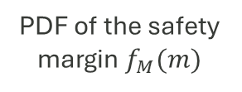
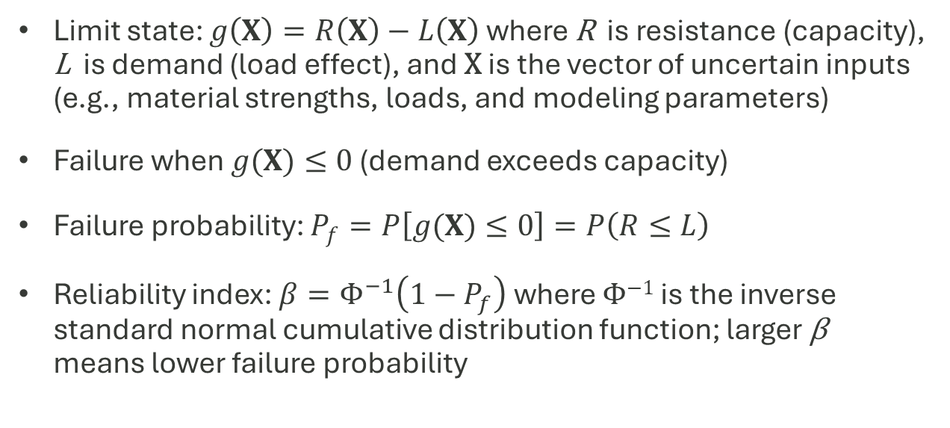
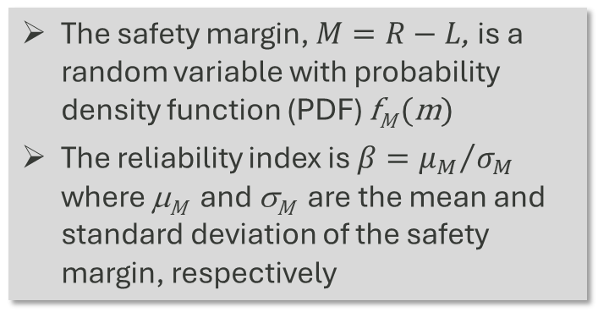
Reliability Analysis
Limit state: $g\left(X\right)=R\left(X\right)−L\left(X\right)$ where R is resistance (capacity), L is demand (load effect), and X is the vector of uncertain inputs (e.g., material strengths, loads, and modeling parameters)
Failure when $g(X)≤0$ (demand exceeds capacity)
Failure probability: $P_{f}=P\left[g(X)≤0\right]=P\left(R≤L\right)$
Reliability index: $β=Φ^{−1}\left(1−P_{f}\right)$ where Φ⁻¹ is the inverse standard normal cumulative distribution function; larger β means lower failure probability
The safety margin, $M=R−L$, is a random variable with probability density function (PDF) f_{M} (m)
The reliability index is $β={μ_{M}}/{σ_{M}}$ where μ_{M} and σ_{M} are the mean and standard deviation of the safety margin, respectively
PDF of the safety margin $f_{M}(m)$
$$μ_{m}=βσ_{m}$$
PDF of L
PDF of R
Probability density function (PDF)
Area = Probability of failure P_{f}
$$μ_{m}$$
$$m$$
Capacity R and demand L
0

Slide 7
Structural Capacity Model
Capacity taken from nonlinear push-over simulations using mesoscale modeling (LDPM)
Two reinforcement ratios ρ_{s} evaluated:
  ρ_{s} = 0.8% (lightly reinforced)
  ρ_{s} = 1.6% (representative level)
Irradiation damage depth δ = 0, 5, 10, 15, 20 cm
Resistance uncertainty modeled with 20% coefficient of variation (COV) (lognormal)
ρ_{s} = 1.6%
ρ_{s} = 0.8%

Slide 8
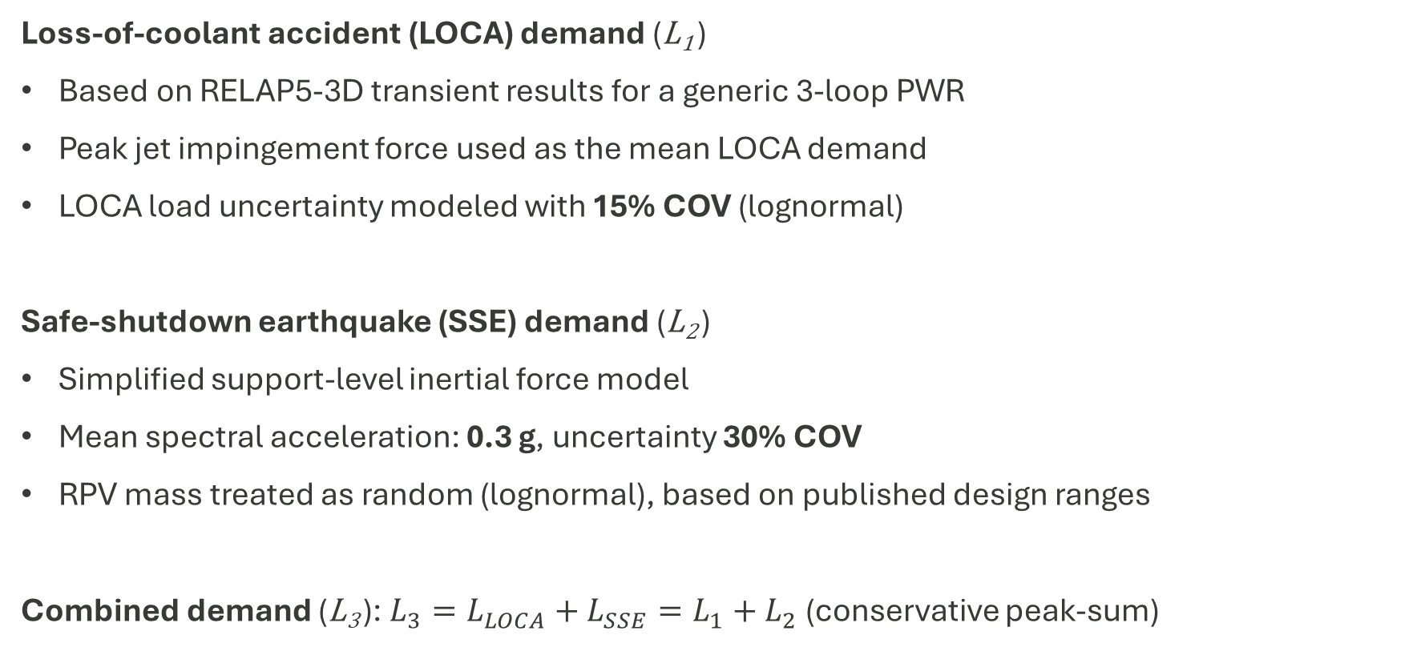
Accident Demand Models (Plant-Generic)
Loss-of-coolant accident (LOCA) demand (L₁ )
Based on RELAP5-3D transient results for a generic 3-loop PWR
Peak jet impingement force used as the mean LOCA demand
LOCA load uncertainty modeled with 15% COV (lognormal)
Safe-shutdown earthquake (SSE) demand (L₂ )
Simplified support-level inertial force model
Mean spectral acceleration: 0.3 g, uncertainty 30% COV
RPV mass treated as random (lognormal), based on published design ranges
Combined demand (L₃ ): $L_{3}=L_{LOCA}+L_{SSE}=L_{1}+L_{2}$ (conservative peak-sum)

Slide 9
Uncertainty Treatment and Sampling
Key inputs modeled as lognormal random variables
  Mean resistance R (from LDPM)
  LOCA demand L₁
  SSE acceleration a_{s}
  RPV mass m_{RPV}
Monte Carlo simulation with Latin hypercube sampling
N = 10⁶ samples per case
Output metrics: P_{f} and β for each δ, reinforcement ratio ρ_{s} , and load case
Random variable | Mean | COV (%)
Mean resistance R | From simulations | 20
Maximum jet impingement force L_{LOCA} | 6.03 MN | 15
SSE acceleration a_{s} | 0.3 g | 30
RPV mass m_{RPV} | 451.2 metric tons | 21.5

Slide 10
Outline
Motivation
Reliability model
Key results
Conclusions

Slide 11
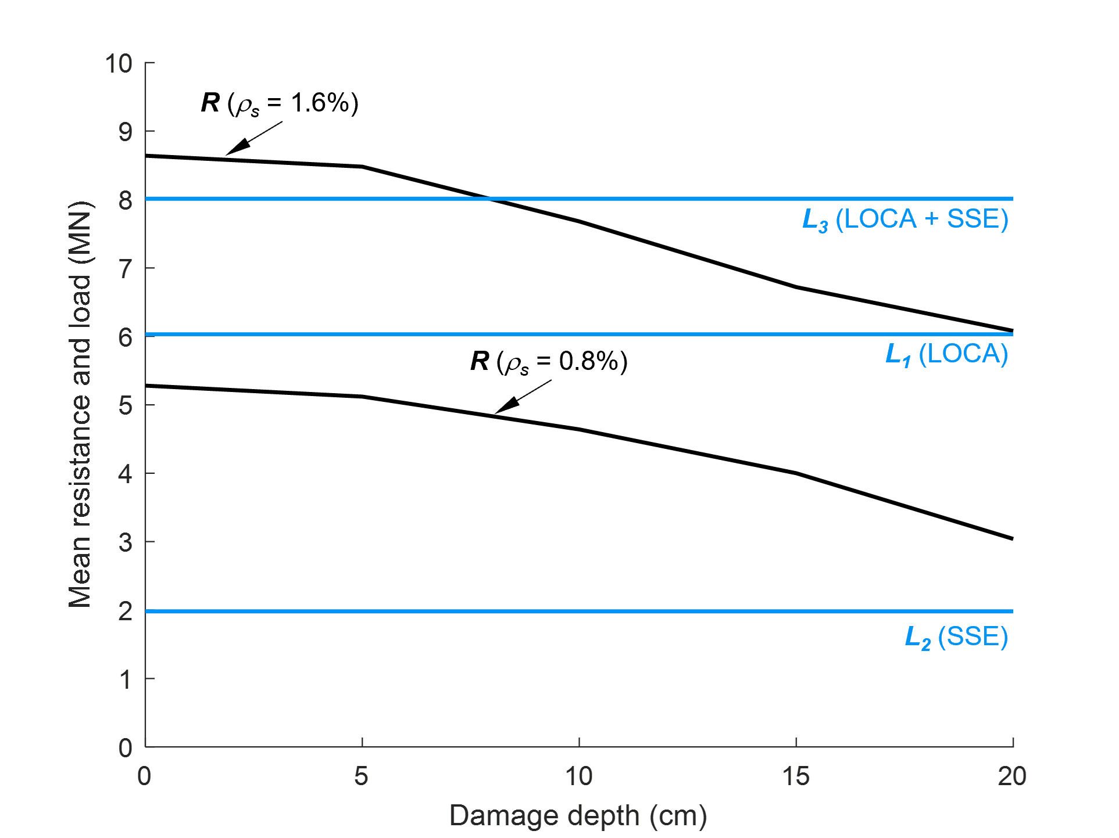
Capacity vs Demand
Resistance decreases steadily as δ increases for both reinforcement cases
SSE-only demand stays relatively low compared to capacity
LOCA-only reduces margin
LOCA + SSE peak-sum demand approaches or exceeds mean capacity at modest damage depths
Capacity drops with damage depth, combined loading becomes critical

Slide 12
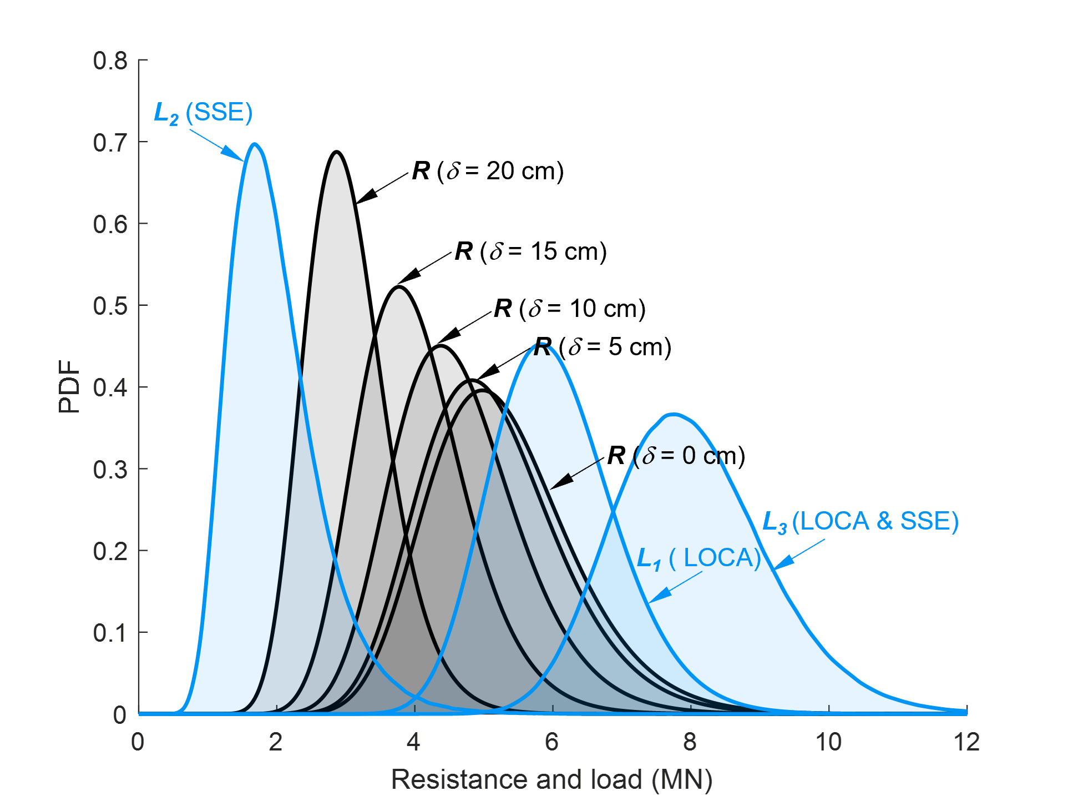
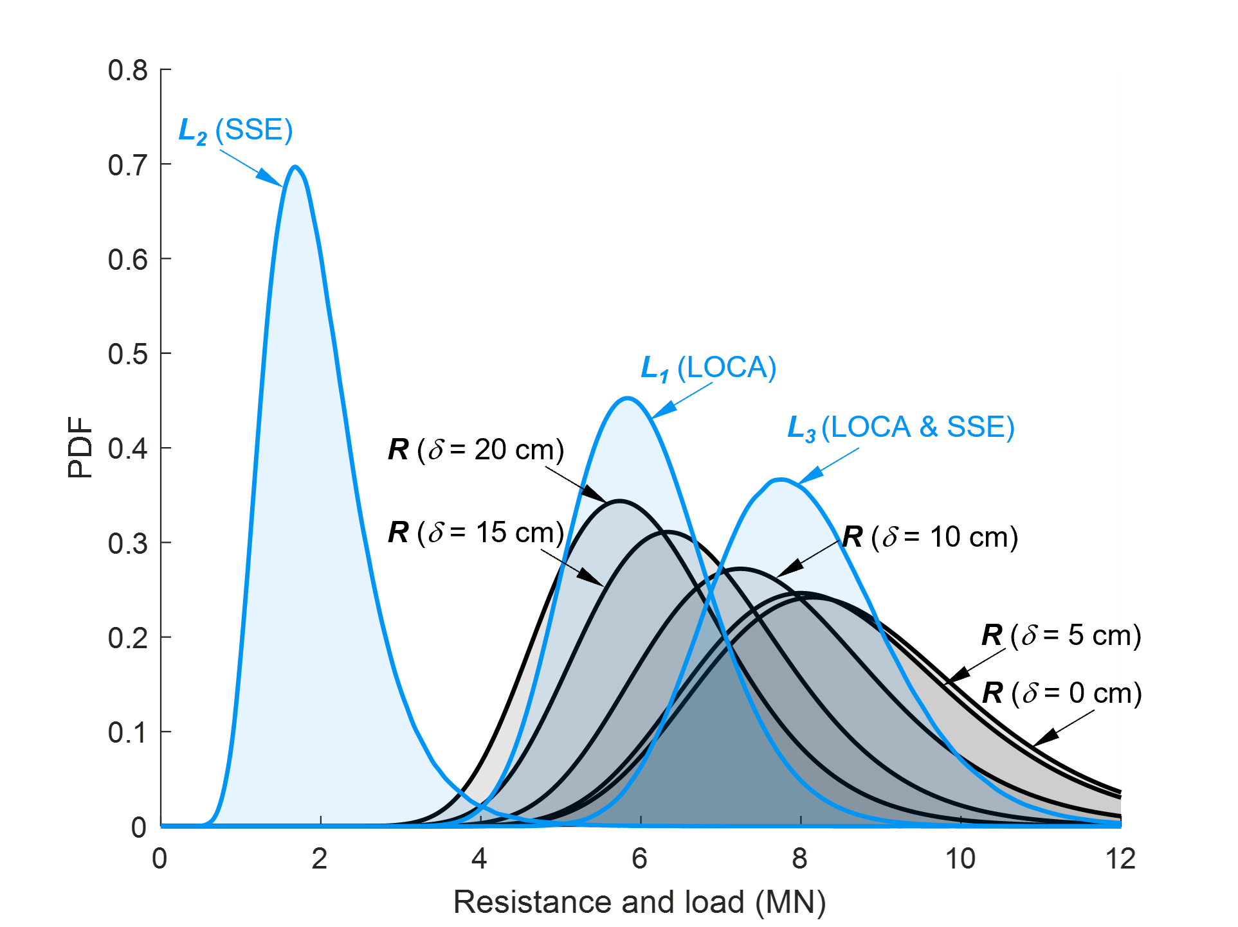
Distribution View: Overlap Drives Failures
ρ_{s} = 0.8%
ρ_{s} = 1.6%
Why P_{f} increases
As δ increases, the resistance distribution shifts lower
Loads stay the same, so overlap between R and L grows
Higher reinforcement shifts resistance higher and reduces overlap, especially for SSE-only

Slide 13
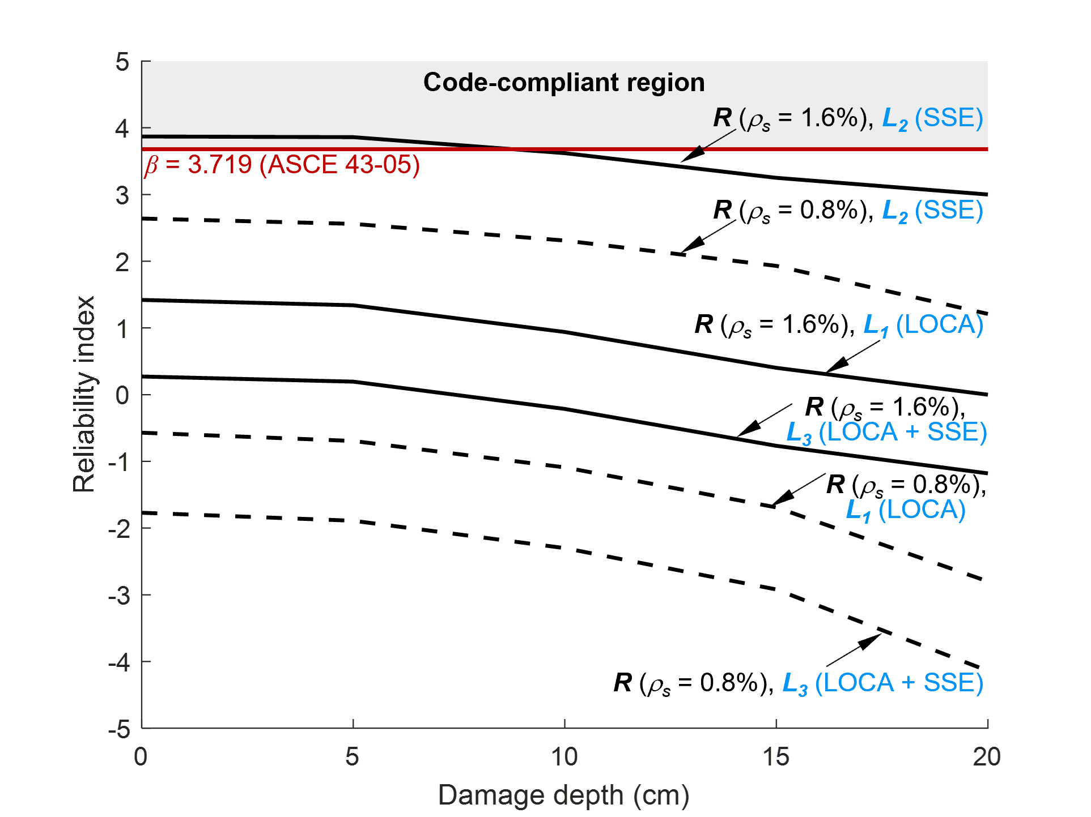
Reliability Index
Reliability decreases with damage depth, combined case governs
β decreases with increasing δ for all load cases
ρ_{s} = 0.8% shows low reliability across scenarios
ρ_{s} = 1.6% improves reliability, but:
  SSE-only meets the ASCE 43-05 target only at small δ
  LOCA-only and LOCA + SSE remain well below the target for most δ
LOCA + SSE (peak-sum) is the governing screening case

Slide 14
Outline
Motivation
Reliability model
Key results
Conclusions

Slide 15
Takeaways and Practical Meaning
Main conclusions
Irradiation damage depth is a strong driver of reduced accident reliability
Combined LOCA and SSE loading controls performance in this screening study
Increasing reinforcement improves reliability, but does not fully offset degradation under severe loading
Practical implications
Track and update damage depth estimates using plant-specific fluence profiles
Prioritize evaluations that include severe accident demand combinations
Use reliability metrics to support surveillance planning and life-extension decisions

