Slide 1
July 22, 2026
Robby Christian, PhD
Probabilistic Risk Analyst
INL/CON-26-94056 Rev. 1
Dynamic Generation Risk Assessment of Modular HTGR for Integrated Energy Systems

Slide 2
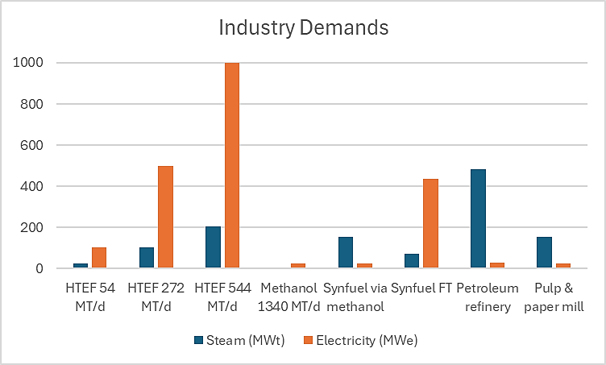
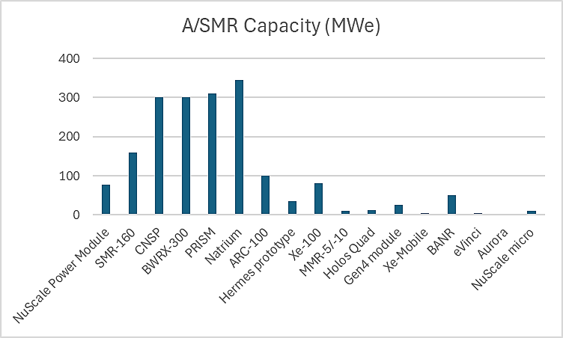
Question
How many advanced small modular reactors (A/SMR) should be built to support industry operation reliably?
References:
IES FY24 report
World Nuclear Association

Slide 3
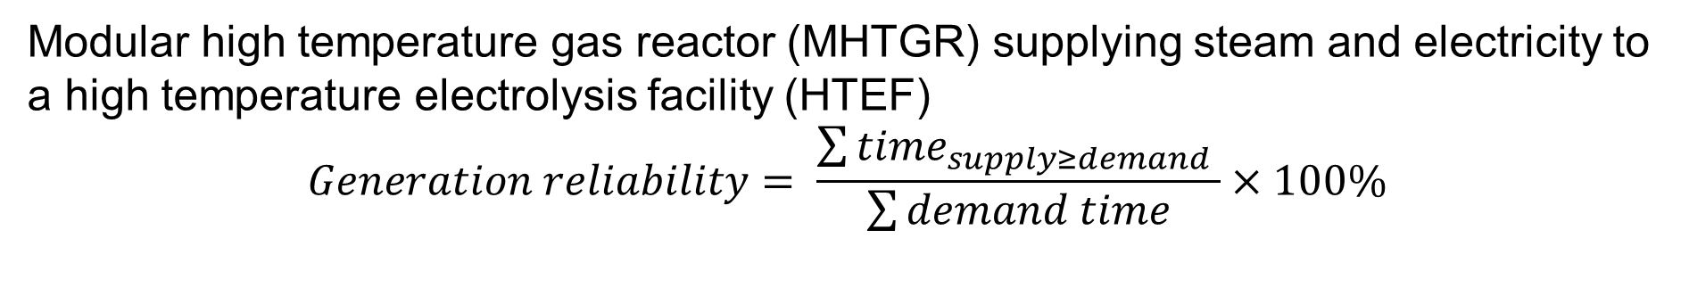
Methodology: Generation Risk Assessment (GRA)
Modular high temperature gas reactor (MHTGR) supplying steam and electricity to a high temperature electrolysis facility (HTEF)
$$Generation reliability= \frac{\sum{{time}_{supply≥demand} }}{\sum{demand time}}×100\%$$
1st 4-pack (1400 MWt / 540 MWe)
2nd 4-pack (1400 MWt / 540 MWe)
Rx 1
Rx 1
Rx 2
TG 1
TG 1
Rx 2
HTEF
105 MWt
500 MWe
Rx 3
TG 2
TG 2
Rx 3
Rx 4
Rx 4
Note: Rx = reactor, TG = turbine generator

Slide 4
MHTGR Systems
System groups | Systems | Model Name | Affects | Derates | Quantity per 4-pack
Reactor Service Group | Helium Purification System (HPS) | HPS | 1 Rx | 100% | 4
 | Gaseous Radioactive Waste System | GRWS | 1 Rx | 100% | 4
 | Liquid Nitrogen System | LNS | 2 Rx | 100% | 2
 | Reactor Plant Cooling Water System | RPCWS | 4 Rx | 100% | 1
Heat Transport System | Main Circulator Subsystem | MCS | 1 Rx | 100% | 4
 | Steam Generator Subsystem | SGS | 1 Rx | 100% | 4
Reactor System | Neutron Control Subsystem | NCS | 1 Rx | 100% | 4
 | Reactor Core Subsystem | RCS | 1 Rx | 100% | 4
 | Reactor Internals Subsystem | RIS | 1 Rx | 100% | 4
Vessel System | Vessel System | VS | 1 Rx | 100% | 4
Shutdown Cooling System | Shutdown Cooling Water Subsystem | SCWS | 4 Rx | 100% | 1
 | Other Shutdown Cooling Subsystems | OSS | 1 Rx | 100% | 4
Plant Protection and Instrumentation System | Safety Protection Subsystem | SPS | 1 Rx | 100% | 4
 | Investment Protection Subsystem | IPS | 1 Rx | 100% | 4
 | Special Nuclear Area Instrumentation Subsystem | SNAIS | 1 Rx | 100% | 4
Plant Control Data and Instrumentation System | Supervisory Control/Data Management Subsystems | SCDMS | 4 Rx | 100% | 1
 | NSSS Control Subsystem | NSSSCS | 1 Rx | 100% | 4
 | ECA Control (all controlled ECA systems) | ECAC | 2 TG | 100% | 1
Miscellaneous Control and Instrumentation Group | NSSS Analytical Instrumentation System | NSSSAIS | 1 Rx | 100% | 4
Operator and Maintenance Errors | Operator and Maintenance Errors | OME | 1 Rx | 100% | 4
System groups | Systems | Model Name | Affects | Derates | Quantity per 4-pack
Power Conversion Group | Turbine-Generator and Auxiliaries System | TG | 1 TG | 10%, 100% | 2
 | Main and Bypass Steam System | MBSS | 1 TG | 25%, 100% | 2
 | Feedwater and Condensate System | FCS | 1 TG | 50%, 100% | 2
 | Condenser | C | 1 TG | 20%, 100% | 2
 | Extraction and Auxiliary Steam System | EASS | 1 TG | 100% | 2
 | Heater Drains and Condensate Returns System | HDCRS | 1 TG | 100% | 2
 | Condensate Polishing System | CPS | 1 TG | 100% | 2
Power Conversion Group Support Systems | Chemical Feed System | CFS | 1 TG | 10%, 100% | 2
 | Steam Vents and Drains System | SVDS | 1 TG | 100% | 2
Heat Rejection Group | Circulating Water System | CWS | 1 TG | 100% | 2
 | Service Water System | SWS | 1 TG | 30% | 2
Plant service group | Instrument and Service Air System | ISAS | 2 TG | 100% | 1
 | Nuclear Island HVAC System | NIHVACS | 1 Rx | 100% | 4
 | Other Mechanical Service Systems | OMSS | 1 TG | 10%, 100% | 2
Electrical Group | Overall Station Electrical Distribution | OSED | 1 TG | 20%, 100% | 2
 | Unit Transformers | UT | 1 TG | 25%, 100% | 2
 | DC Power Systems | DCPS | 1 TG | 100% | 2
 | AC Power System | ACPS | 1 TG | 100% | 2
 | Unit Auxiliary Transformers | UAT | 1 TG | 100% | 2
Notes:
Rx = reactor, TG = turbine generator
Turbine generator and Electrical Group systems affect electrical output but not steam output.

Slide 5
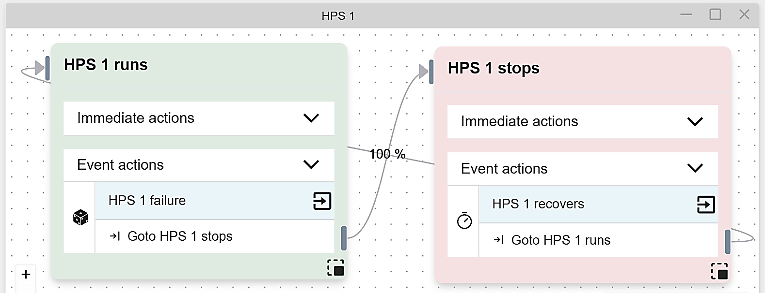
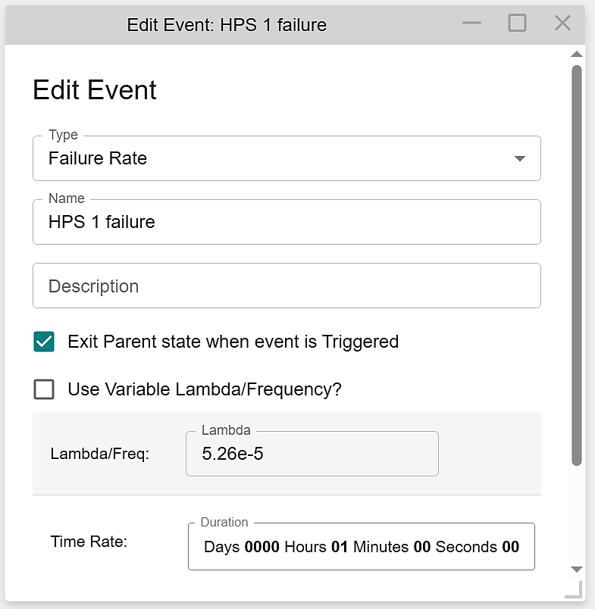
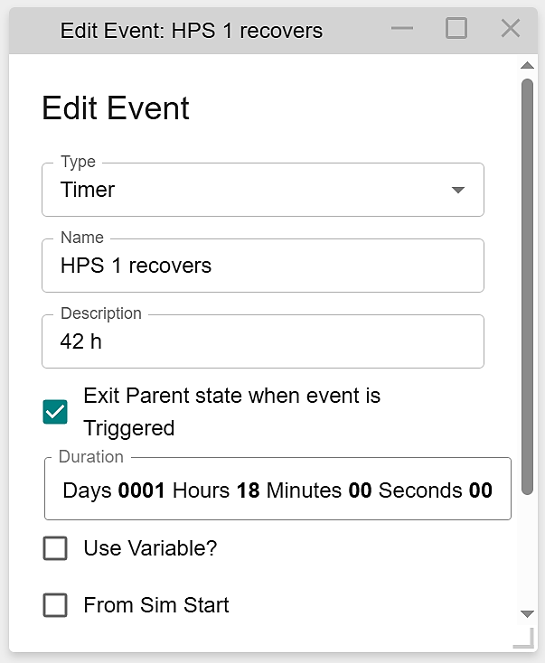
Dynamic GRA Model
MHTGR systems’ failures and repairs are modeled in EMRALD. Example:
  Simple “on or off” model for Helium Purification System (HPS)
    When HPS 1 runs:
      When HPS 1 fails stochastically, go to the “HPS 1 stops” state
    When HPS 1 stops:
      After some time (42 hours), go to “HPS 1 runs” state
  Green state(s) mean system is functional, red state(s) mean system fails

Slide 6
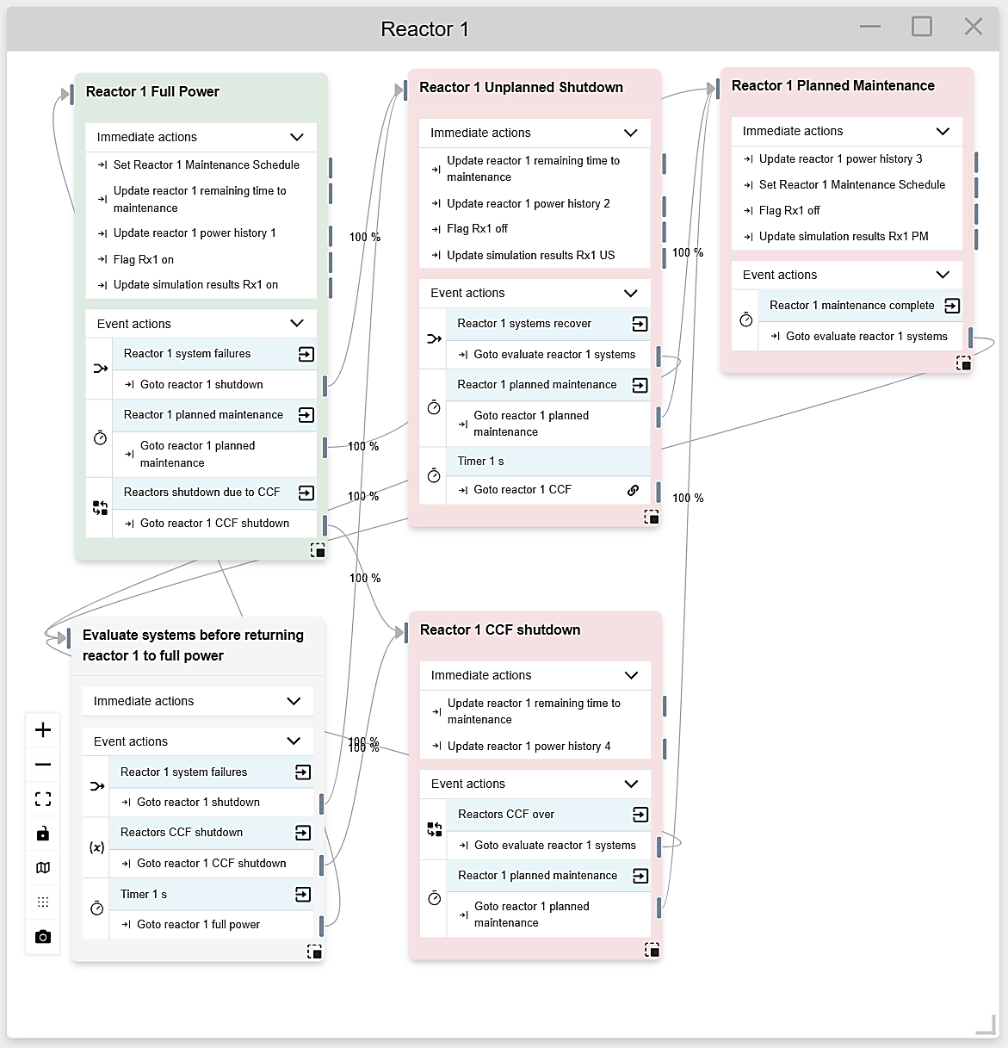
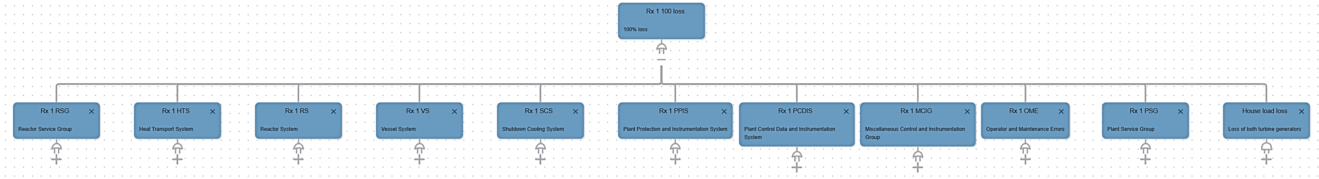
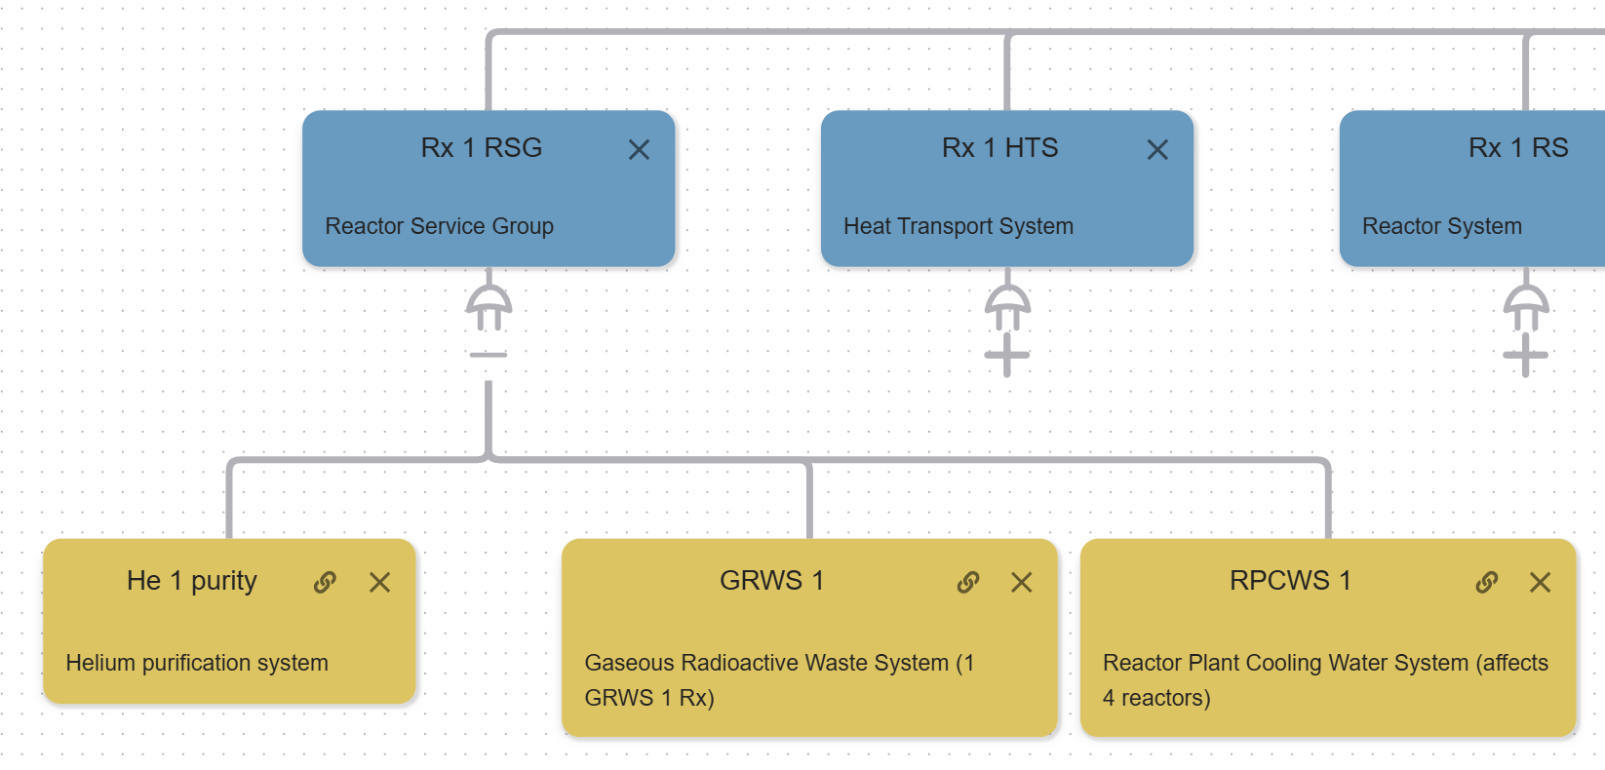
Bottom-up Modeling in EMRALD (1)
Helium impure

Slide 7
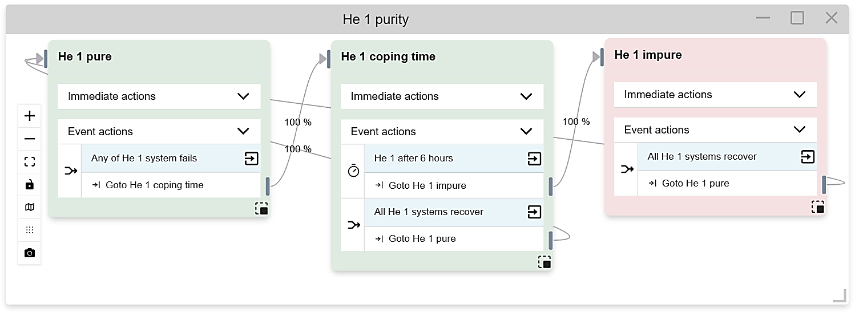
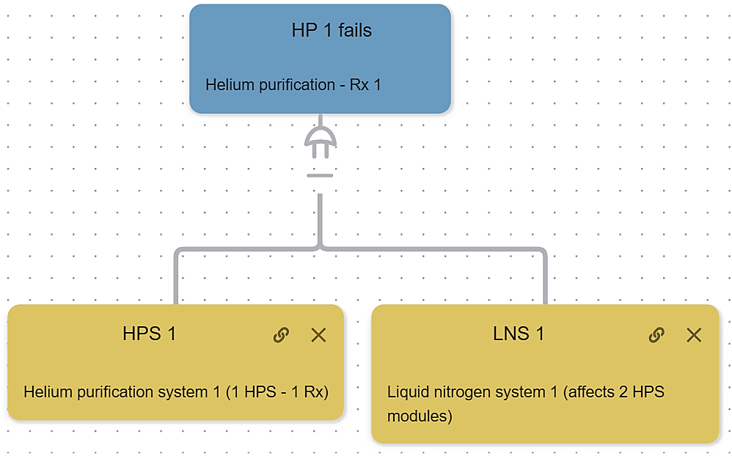
Bottom-up Modeling in EMRALD (2)
Failure & repair statistics

Slide 8
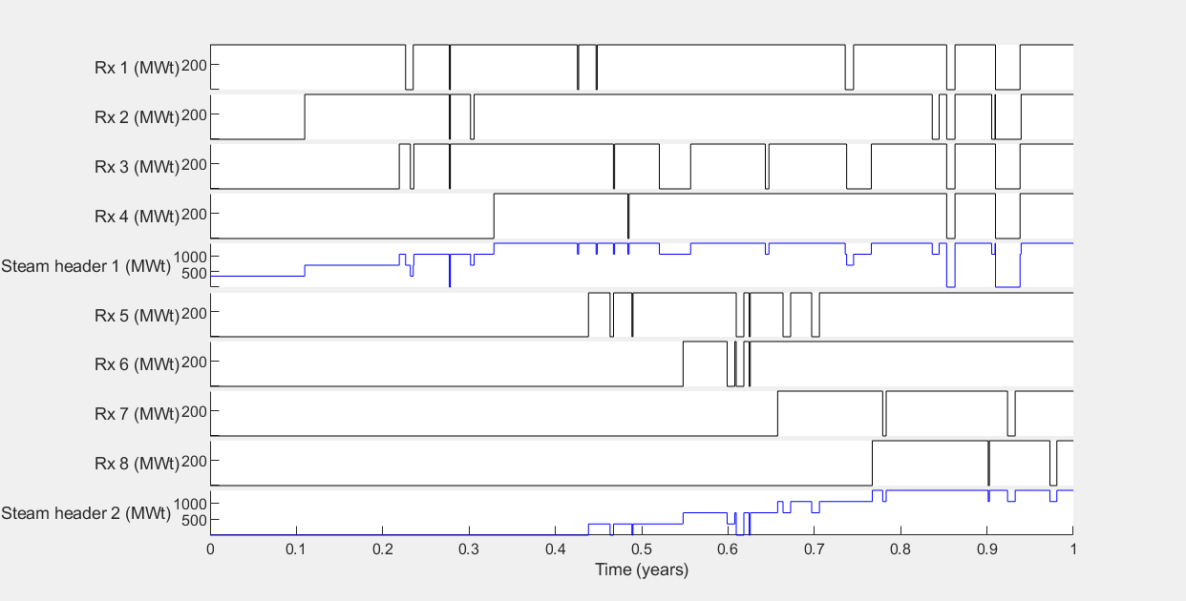
Results: Reactors #1-8

Slide 9
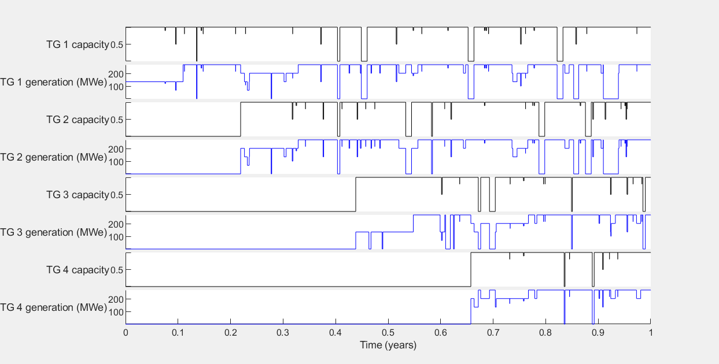
Results: Turbine Generators #1-4

Slide 10
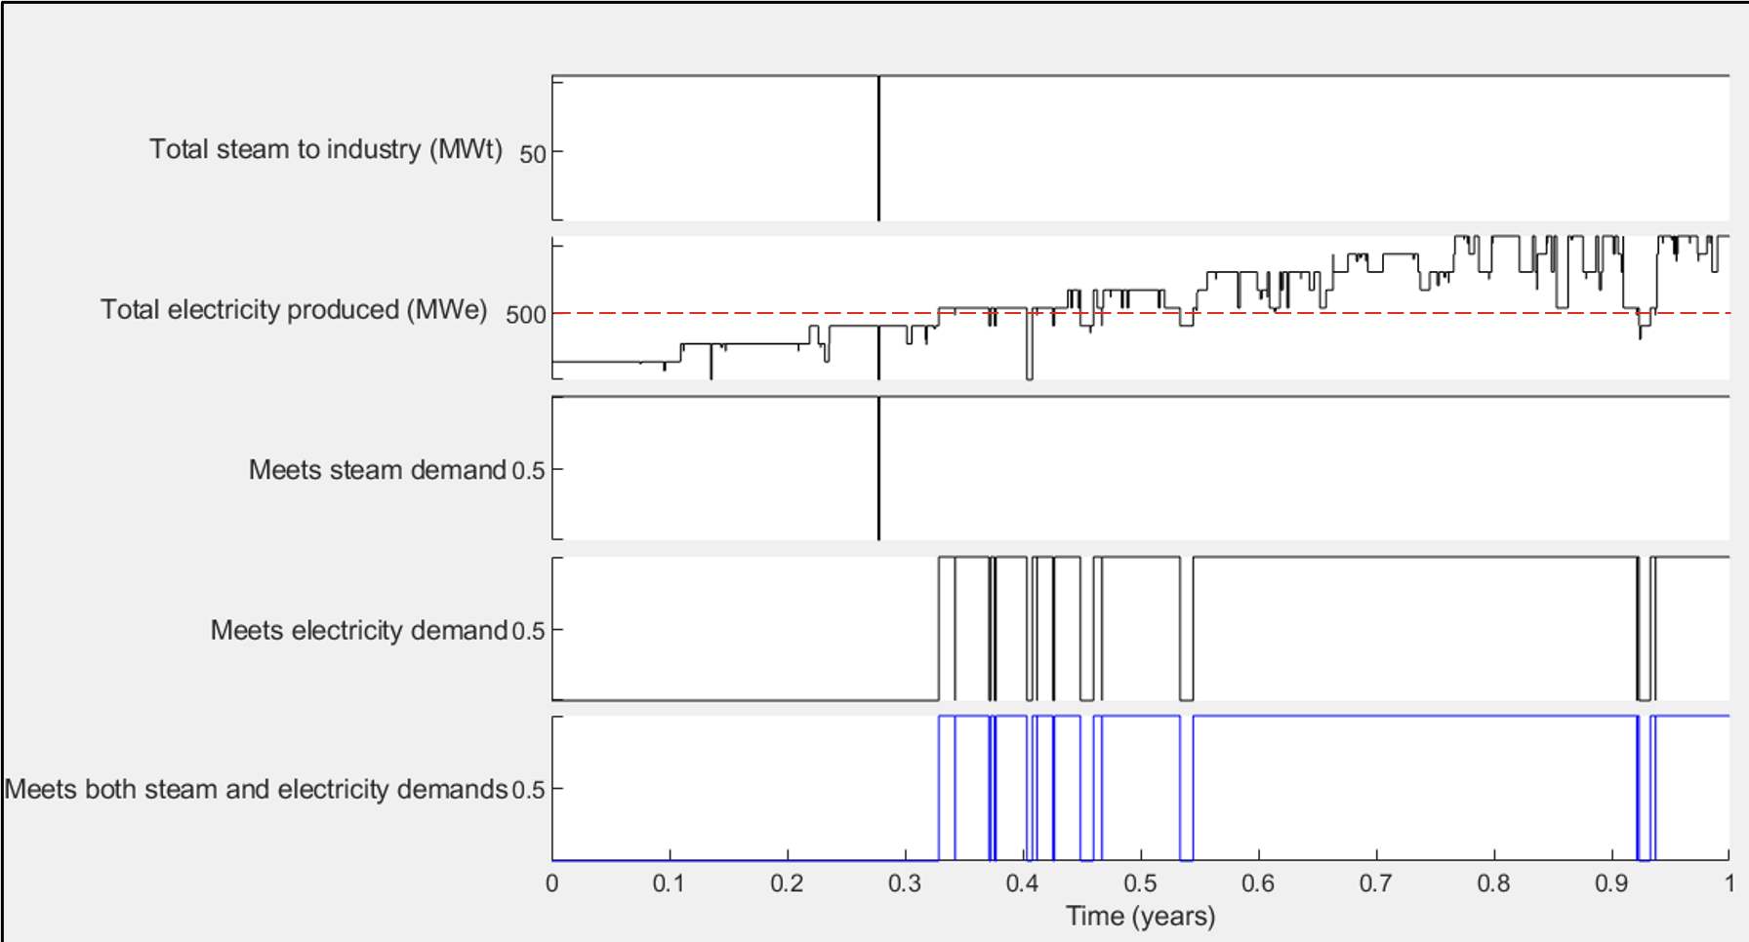
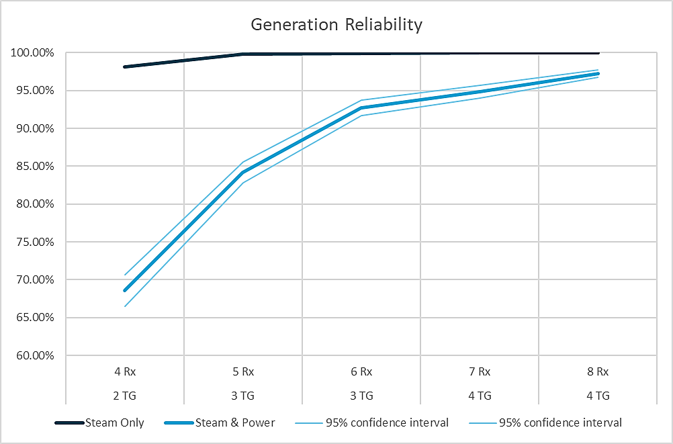
Results (1)
Results from two 4-packs Reliability from varying numbers of reactors
Notes:
1. Energy supply from nuclear plant only without grid backup
2. Simulated for 40 years (whole MHTGR lifetime), 250 times

Slide 11
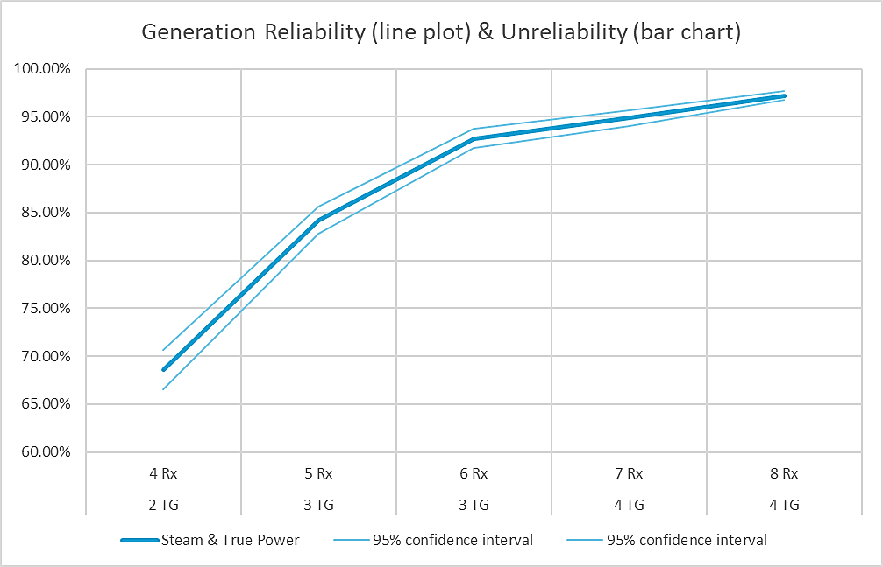
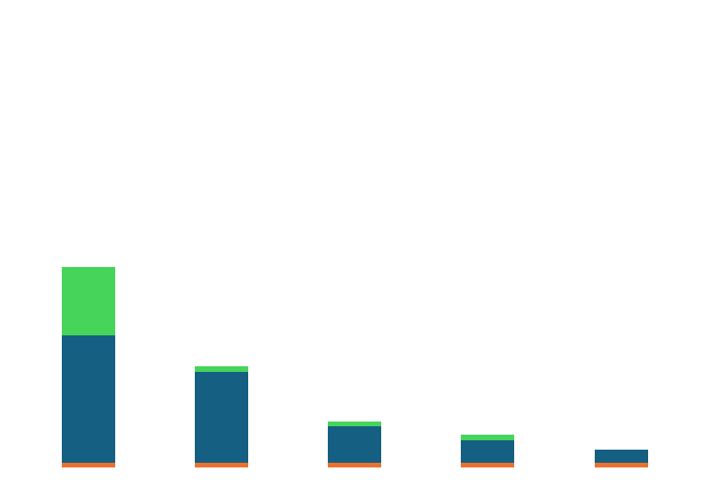
Contributing Factors to Unreliability
Notes:
Planned maintenance schedule:
  For reactor units: 40 days every 5 years per reactor
  For turbine generator units: 16 days every 5 years per turbine. Reactors can still operate to provide process steam while turbines are offline, provided that house-load power is available.
Periodic maintenance has a high unreliability contribution at the baseline (4 Rx, 2 TG) because generation fails to meet demand anytime any reactor or turbine is offline. This effect is reduced with an increasing number of reactors & turbines. Periodic maintenance does not affect reliability with a minimum of 8 Rxs and 4 TGs.
Random failures has a high unreliability contribution at the baseline for the same reason. This effect reduces with increasing redundancies, but it cannot be completely eliminated.

Slide 12
MHTGR Systems’ Reliability
100%
99.5%
99%
98.5%
98%
97.5%
More reliable
Higher failure consequence
More reliable
Lower failure consequence
Less reliable
Lower failure consequence
Less reliable
Higher failure consequence
(Analogous to the F-C curve)

Slide 13
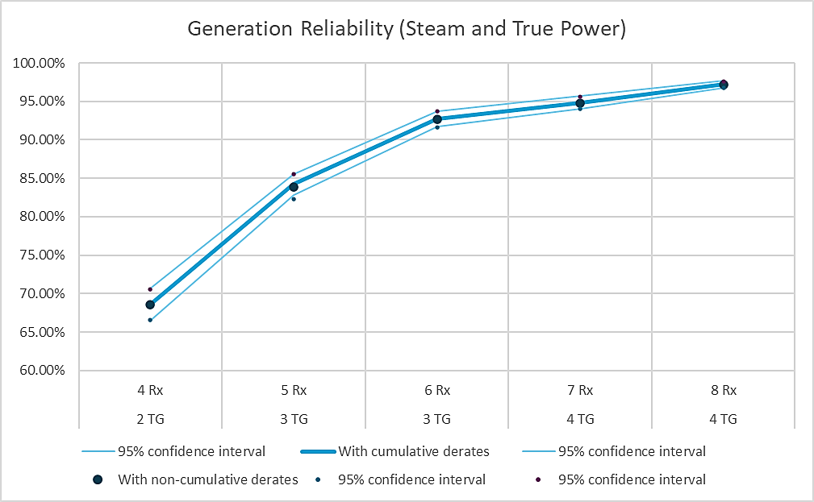
Sensitivity Study
Derates are assumed cumulative, caused by the loss of generation capability. Example:
  Condenser fault leads to a 20% derate
  Main steam system fault leads to a 25% derate
  If both condenser and main steam system are faulty, turbine is derated 45%
What if derates are non-cumulative? Example: turbine is derated to 25% when both condenser and main steam system are faulty. This derate is not due to a loss of generation capability, but an intentional derate to prevent safety incidents caused by operating at full power. The 25% maximum derate in this example satisfies safety criteria for both systems.
Generation reliability is insensitive to the derate mechanism assumption. This is likely because the probability of several derate events happening at the same time is low.

Slide 14
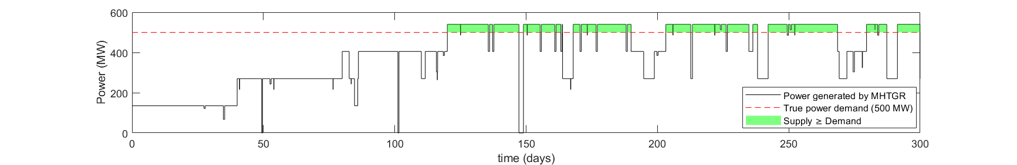
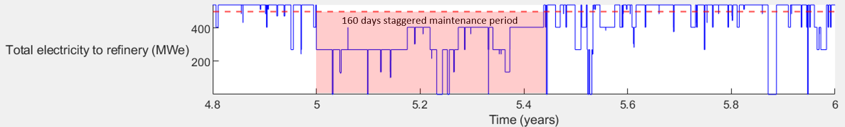
Options to Improve Generation Reliability (1)
Use electricity storage: Store surplus electricity to complement supply during plant derates
Use peaking plants: To complement supply during extended outages (e.g. scheduled maintenance)

Slide 15
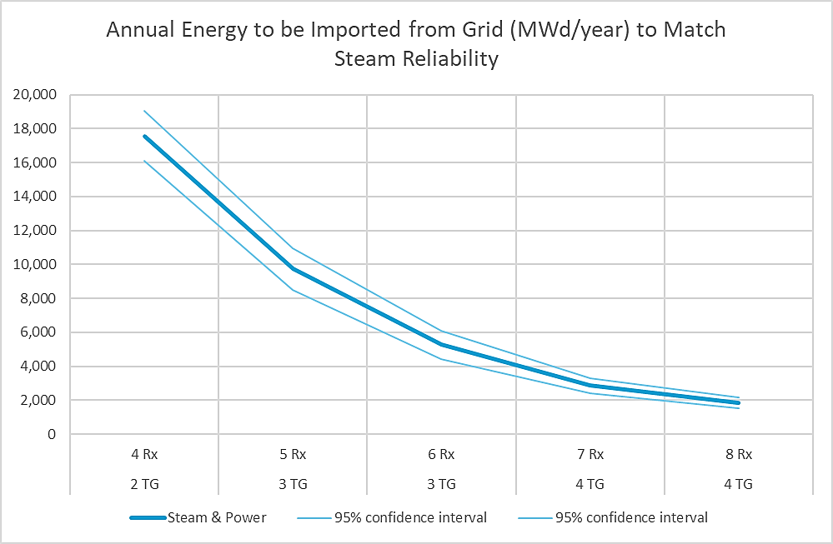
Options to Improve Generation Reliability (2)
Use grid backup to keep HTEF operational when steam supply meets demand but electrical supply does not

Slide 16
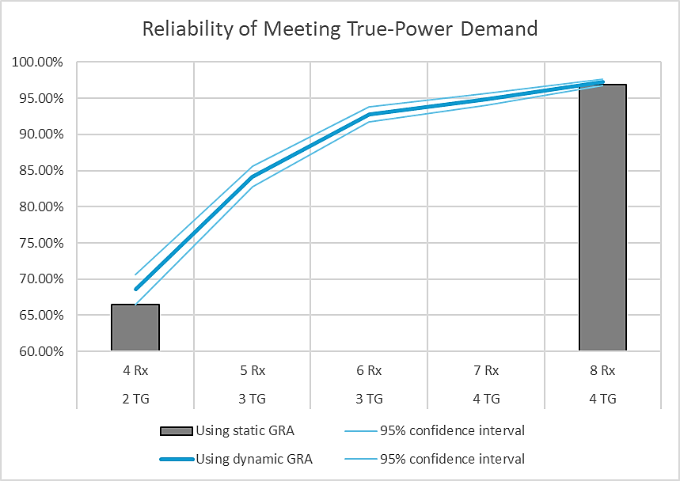
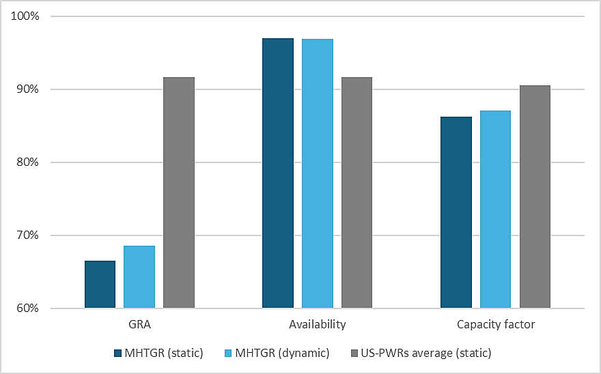
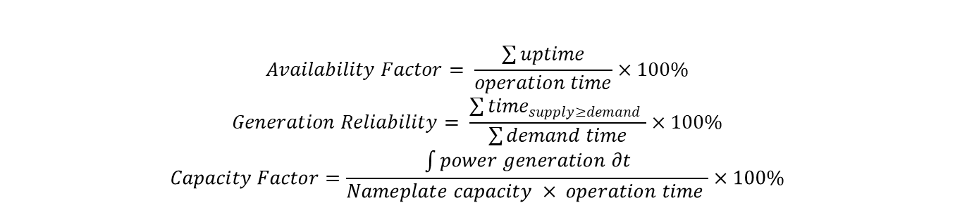
Comparison with Static GRA
$$Availability Factor= \frac{\sum{uptime}}{operation time}×100\%$$
$$Generation Reliability= \frac{\sum{{time}_{supply≥demand} }}{\sum{demand time}}×100\%$$
$$Capacity Factor=\frac{\int{power generation ∂t}}{Nameplate capacity × operation time }×100\%$$

Slide 17
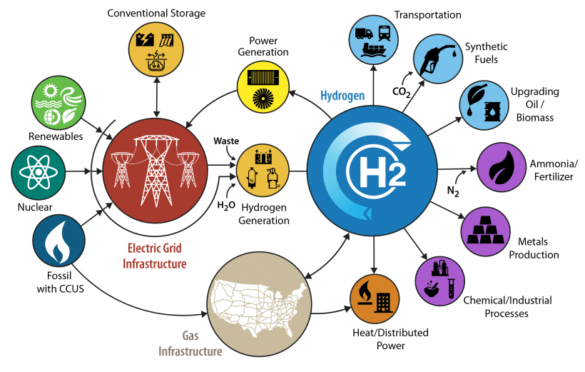
Future Work
GRA for the whole IES:
  Power generators
  Steam and electricity transmission lines
  H2 electrolyzers
  H2 transmissions
GRA for technoeconomic analysis
Lost generation
Industry process model
Lost production
Lost revenue
Market model

Slide 19
Backup Slides

Slide 20
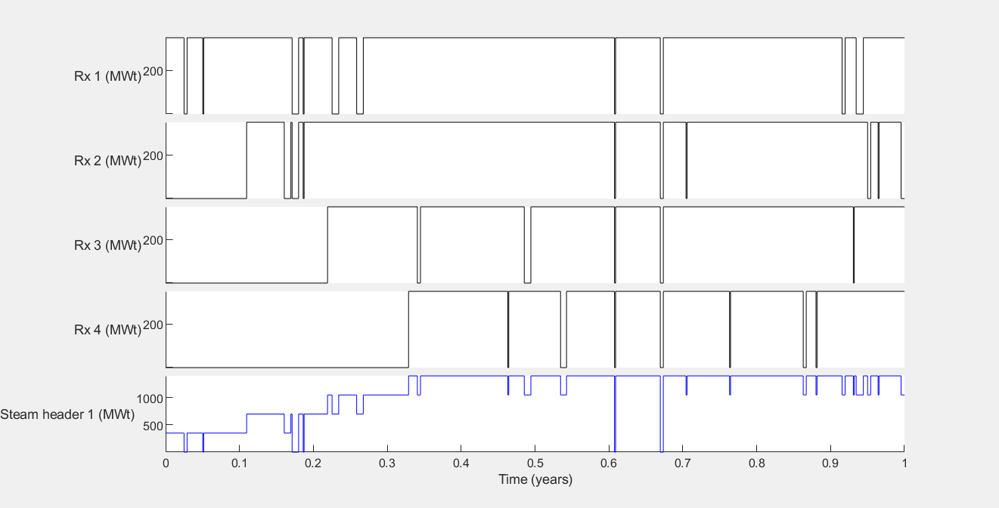
Reactors # 1-4
40 d
80 d
120 d

Slide 21
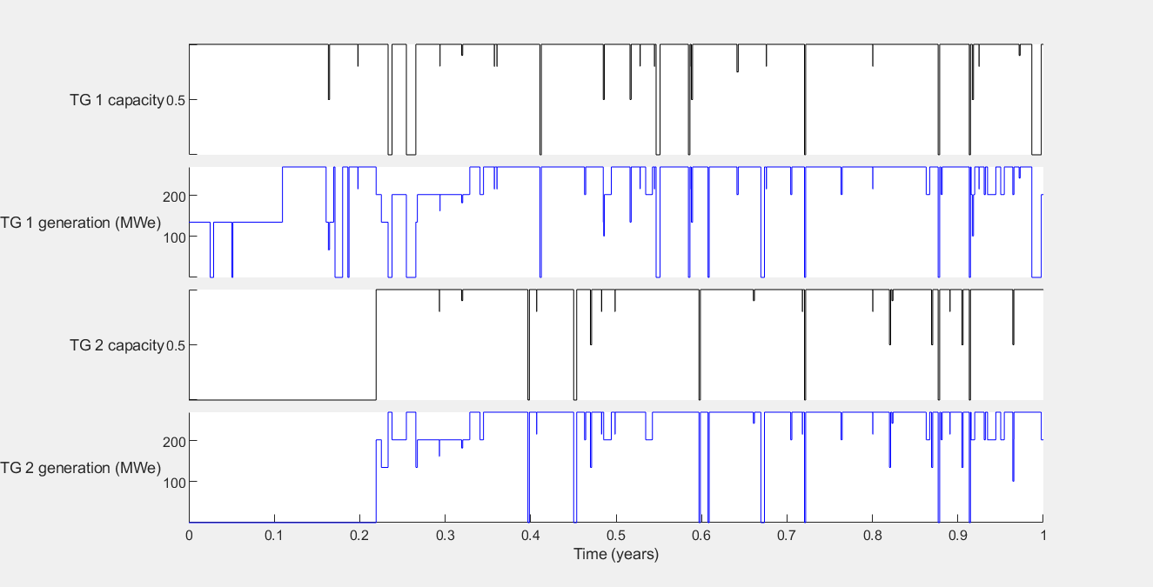
Turbine generators #1-2
80 d

Slide 22
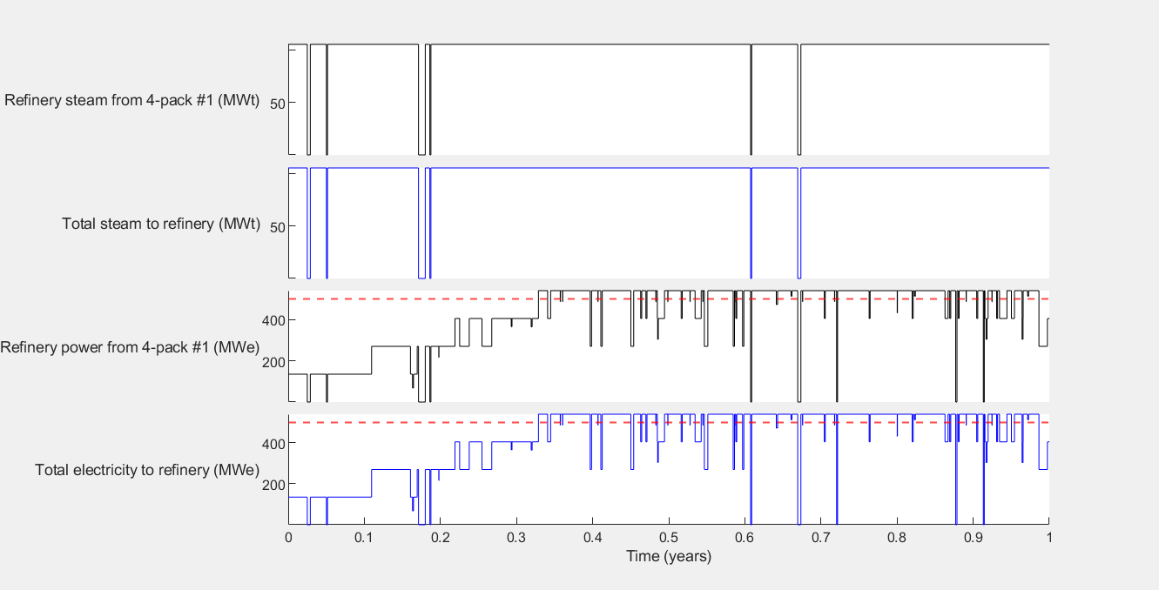
Supply of steam and electricity
Industry steam from 4-pack #1 (MWt)
Total steam to industry (MWt)
Industry power from 4-pack #1 (MWe)
500
540 MWe max
Total electricity to industry (MWe)

Slide 23
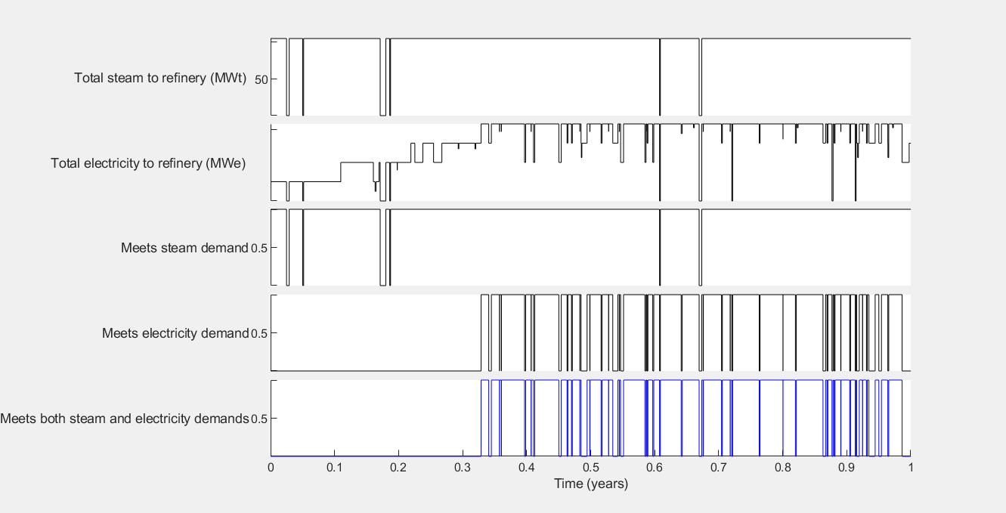
Generation reliability. Supply Meets Demand After 120 days.
Total steam to industry (MWt)
500
Total electricity to industry (MWe)

Slide 24
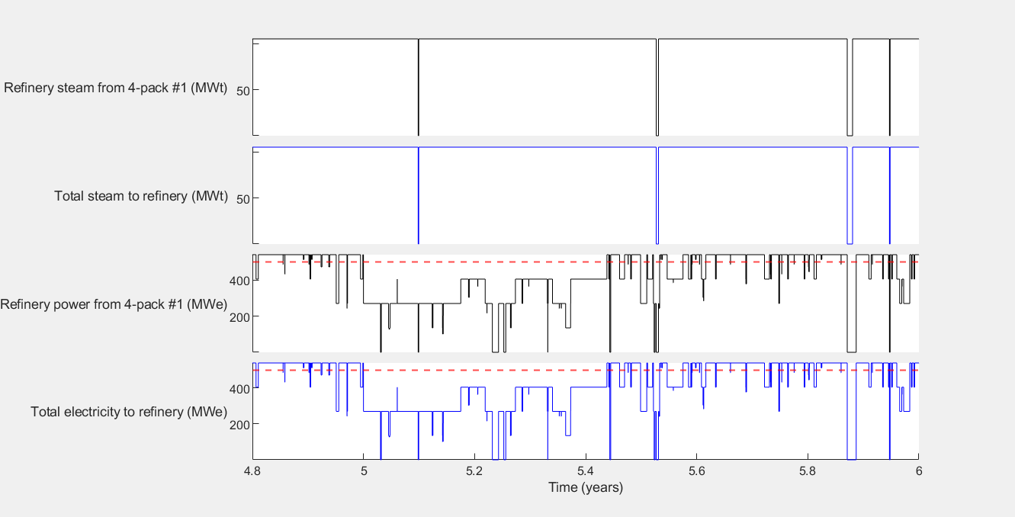
Reliability During Reactor Planned Maintenance (every 5 years)
Industry steam from 4-pack #1 (MWt)
Total steam to industry (MWt)
Industry power from 4-pack #1 (MWe)
160 days staggered maintenance period
Total electricity produced (MWe)

