Slide 1
July 24, 2026
Robby Christian, PhD
Probabilistic Risk Analyst
INL/CON-26-94102 Rev 1
Dynamic Coupling of TMAP8 and EMRALD for Risk‑Informed Fusion Fuel‑Cycle Analysis

Slide 2
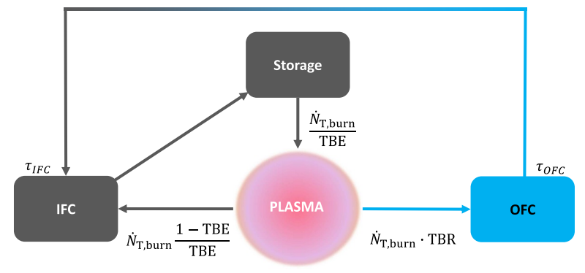
Introduction: Fusion Fuel Cycle
Two loops:
  Outer: heat transfer & tritium breeding (6 systems)
  Inner: fuel processing and injection (5 systems)
Retention Time Method (RTM): Set of ordinary differential equations
Abbreviations:
  OFC: Outer Fuel Cycle
  IFC: Inner Fuel Cycle
  TBE: Tritium Breeding Efficiency
  TBR: Tritium Breeding Ratio
  N_{T,burn}: Tritium breeding rate

Slide 3
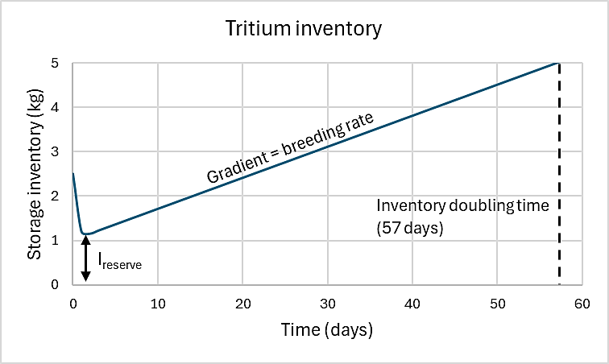
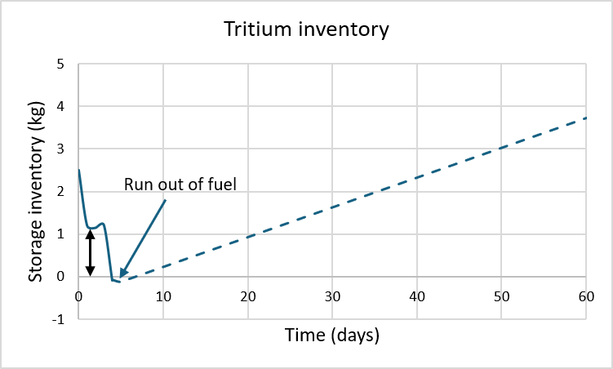
Introduction: Tritium Self-Sufficiency
Unlike fission, fusion requires external power to maintain chain reaction → interruptions cease fusion reaction
Fusion maturity < fission’s → low availability factor
Tritium self-sufficiency: Bred tritium ≥ consumed tritium
Research needs: tritium self-sufficiency considering reliability, availability, maintainability, inspectability (RAMI)

Slide 4
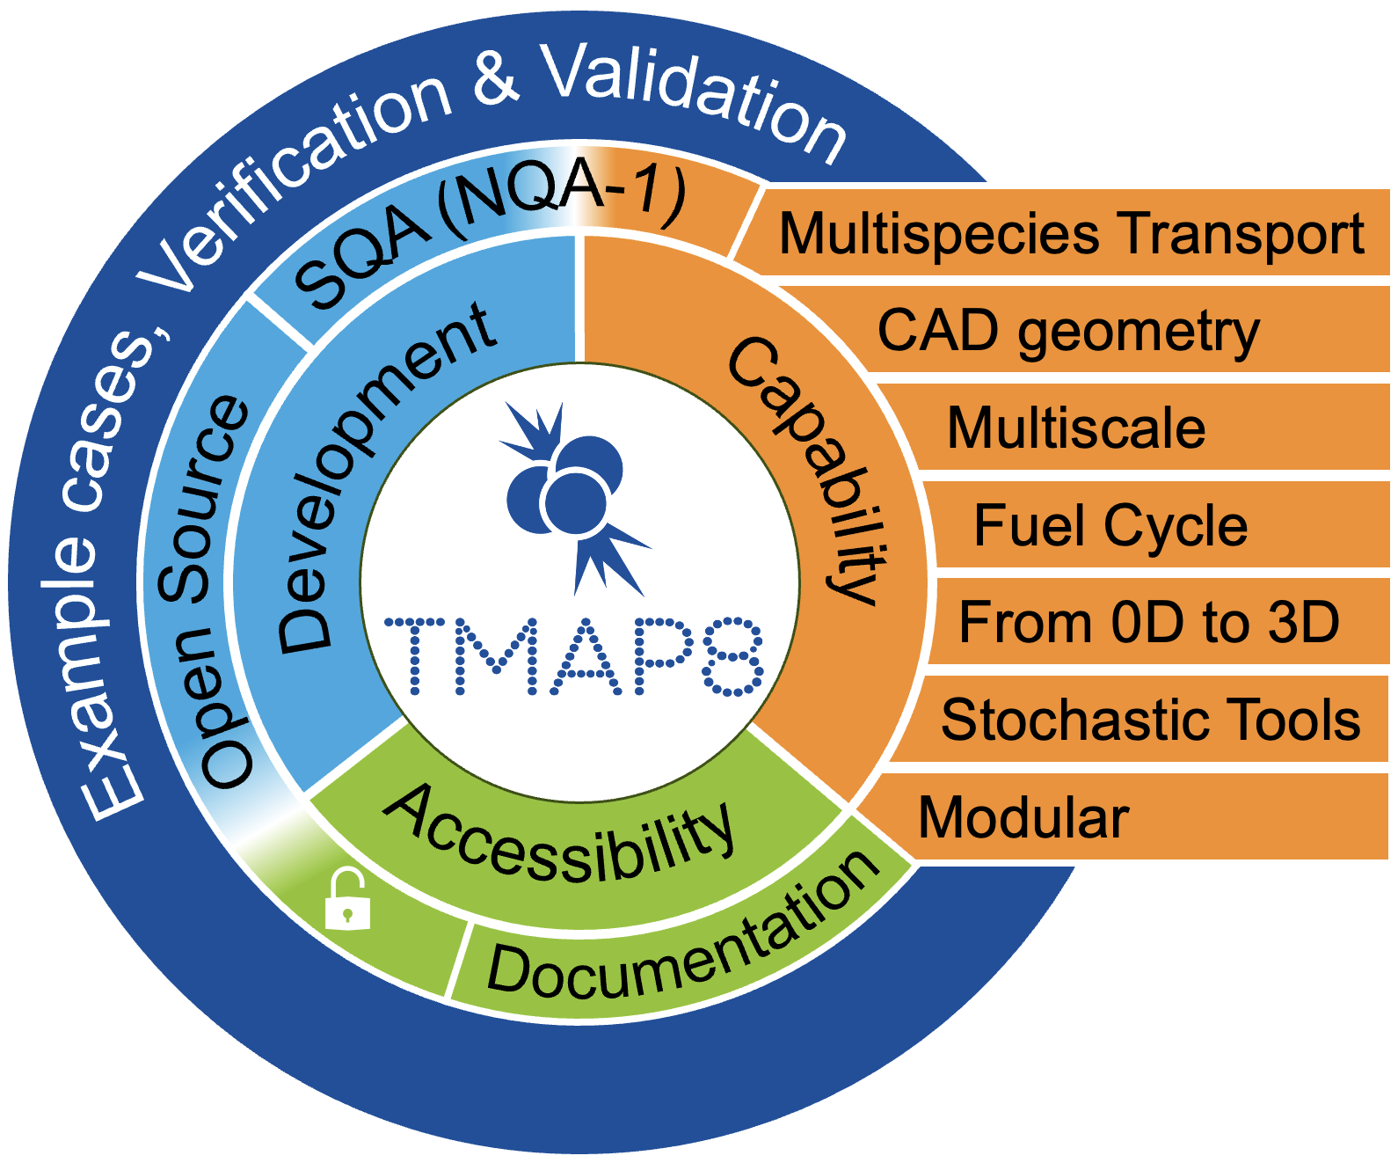
Introduction: Tritium Migration Analysis Program v8 (TMAP8)
Built on and inherited features of Multiphysics Object-Oriented Simulation Environment (MOOSE)
Nuclear Quality Assurance level 1 (NQA-1) compliant
Enables low-fidelity (system-level) to high fidelity, multi-scale, 0D to 3D, multispecies, multiphysics simulations of tritium transport, and offers massively parallel capabilities
Uses time steps
Open source and available on GitHub
Fuel cycle models have been benchmarked against reference publications

Slide 5
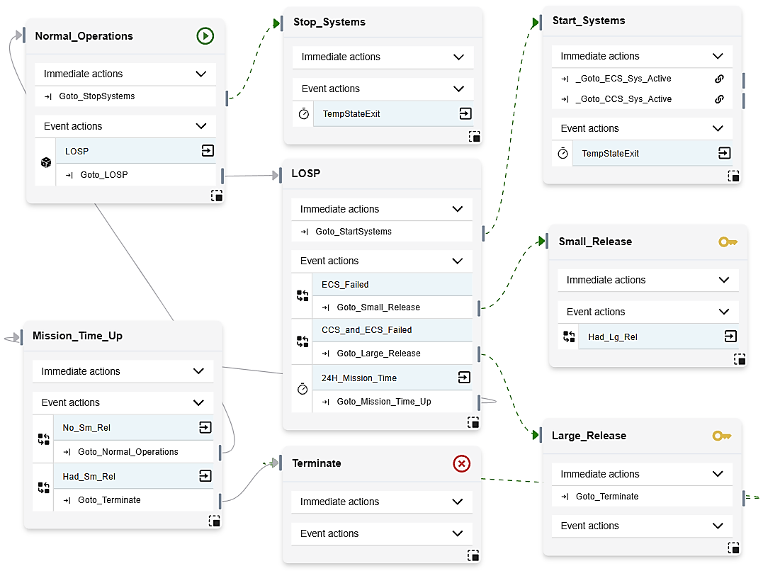
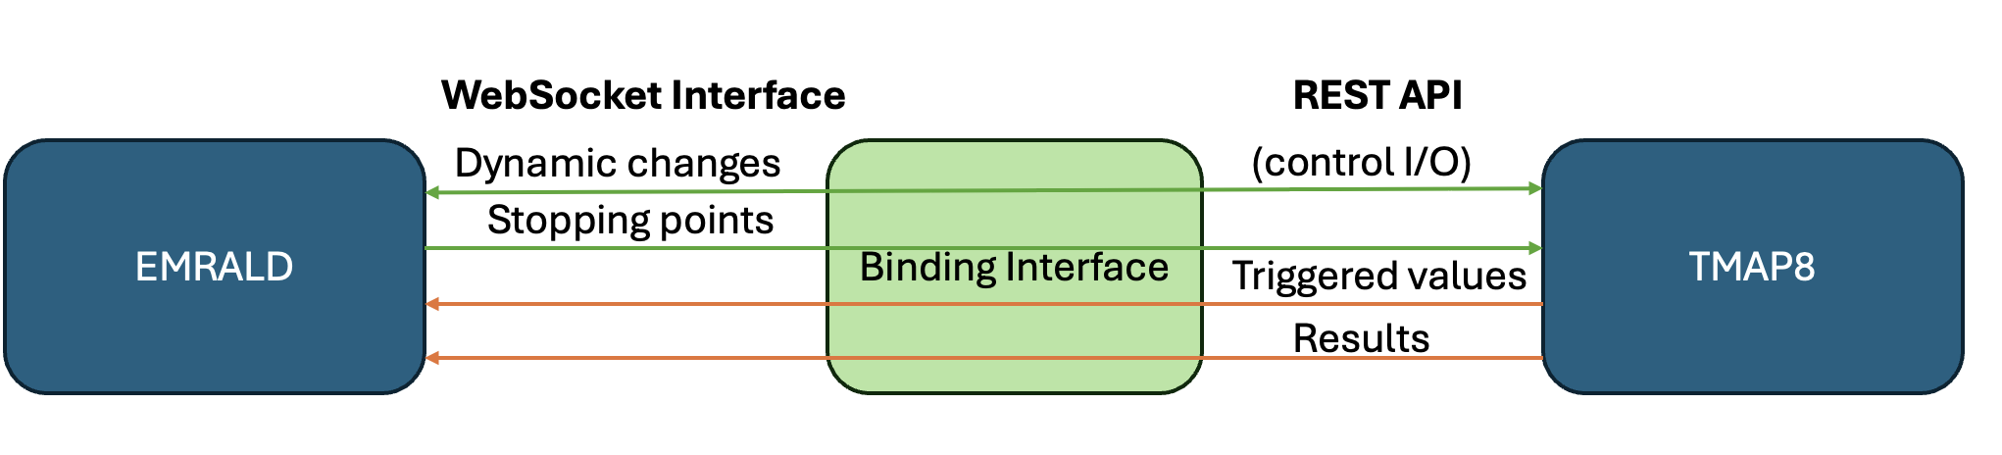
Introduction: Event Modeling Risk Assessment using Linked Diagrams (EMRALD)
Dynamic PRA modeling tool
State-based, no time steps
Jumps to next thing that happens in time
Open-source and available on GitHub
EMRALD-TMAP8 coupling to analyze tritium self-sufficiency considering RAMI
  EMRALD issues actions: start, stop, modify variables
  TMAP8 replies with events: variable updates, simulation complete, etc.
  EMRALD processes TMAP8 events
Executes on High Performance Computers (HPCs) or MacOS environments.

Slide 6
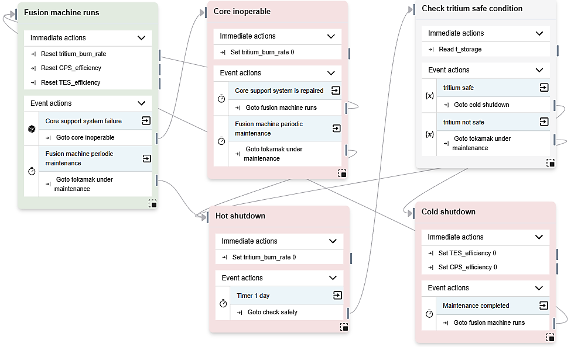
EMRALD RAMI Modeling Example (1)
Models graceful failures & maintenance of tokamak
Models maintenance safety:
  Hot shutdown
  Cold shutdown
Set & Reset actions → EMRALD sends values to TMAP8
Read actions → EMRALD reads variables from TMAP8

Slide 7
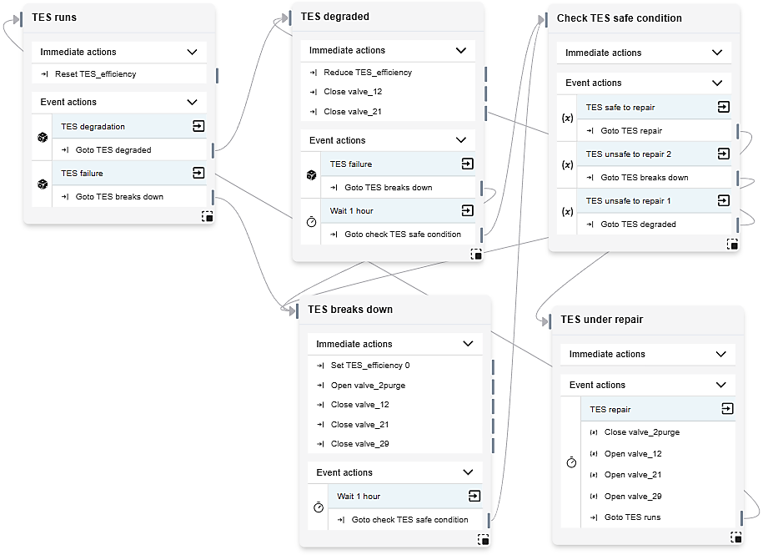
EMRALD RAMI Modeling Example (2)
Models graceful degradation, failure & replacement of tritium extraction system (TES)
At degraded state:
  Message TMAP8 to disconnect TES from blanket & reduce TES efficiency
  TES still connected to Isotope Separation System (ISS)
  Listen from TMAP8 for when TES inventory is safe for workers
At failure state:
  Message TMAP8 to disconnect TES from blanket and ISS, set TES efficiency to 0, and purge TES inventory
  Listen from TMAP8 for when TES inventory is safe for workers
At TES under repair state: message TMAP8 to reconnect TES to the fuel cycle and reset its efficiency value.

Slide 8
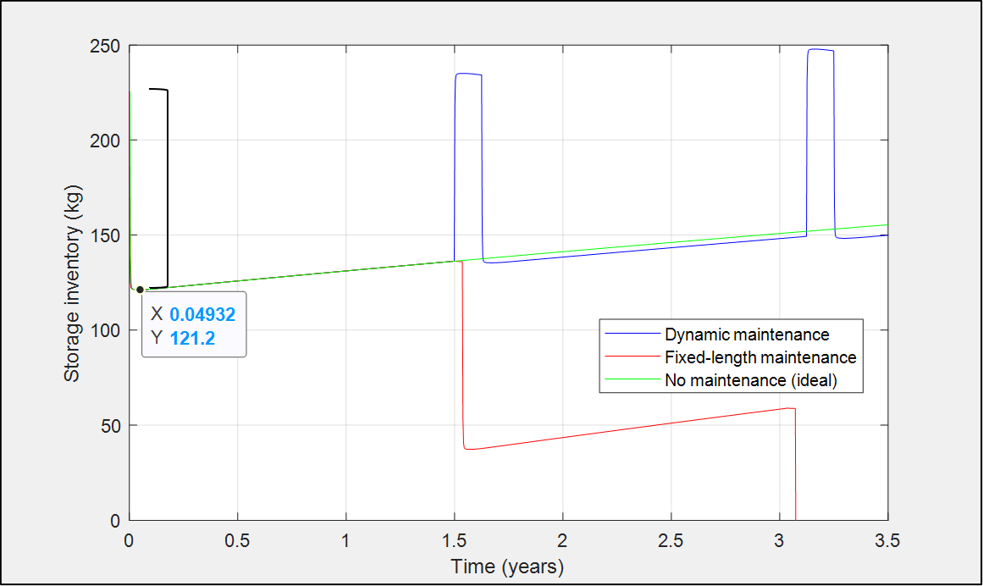
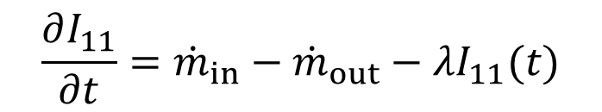
Results: Storage Inventory
Hot shutdown
Cold shutdown
$$\frac{∂I_{11}}{∂t}={\dot{m}}_{in}−{\dot{m}}_{out}−λI_{11}(t)$$
134.2

Slide 9
Results: Variables Exchanged between EMRALD & TMAP8
Hot shutdown
Cold shutdown

Slide 10
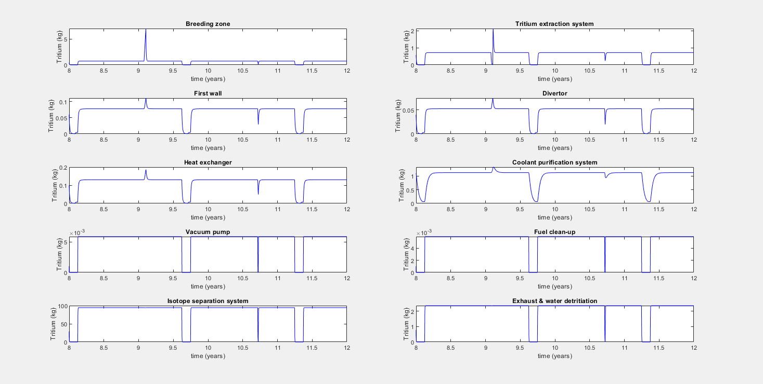
Results: Inventory in Other Systems

Slide 11
Summary & Future Work
Developed coupling between EMRALD & TMAP8 to analyze tritium self-sufficiency considering RAMI aspects
Developed case study to evaluate periodic maintenance strategies and assess fuel cycle coping-time capability during tokamak/TES random failures.
Two maintenance strategies investigated:
  Fixed-length maintenance: Purge tritium inventory to ensure workers can perform maintenance immediately → higher availability factor, but not sustainable
  Dynamic-length maintenance: Extract tritium from all systems to storage until inventory is low enough for workers to perform maintenance → lower availability factor, but sustainable
Future works: Expand RAMI modeling to other fuel-cycle systems

Slide 13
Backup Slides: Fuel Cycle Model

Slide 14
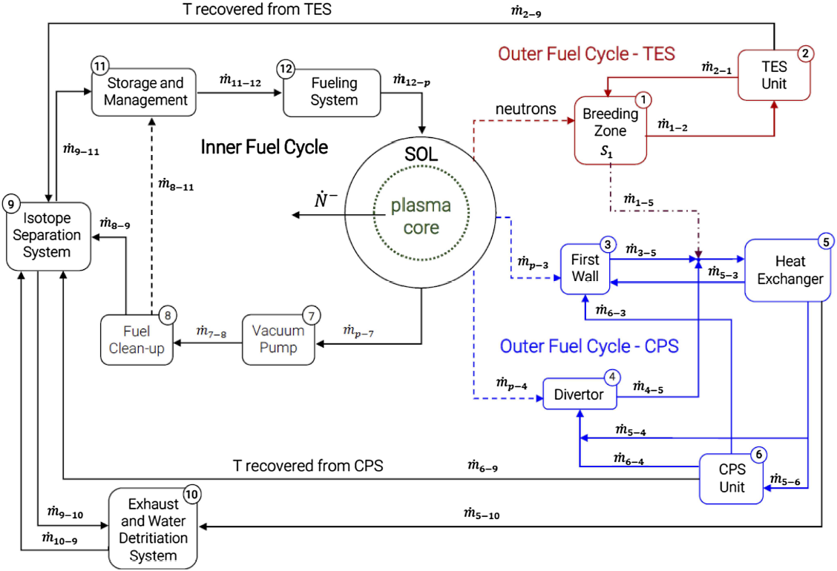


Modified System for PSAM Conference
TES: Tritium extraction system
SOL: Scrape-off layer
CPS: Coolant purification system
Notes:
https://www.sciencedirect.com/science/article/pii/S092037961930167X: According to present assumptions, the total legal limit within any given calendar-year period is 9.9 g of T (gaseous and liquid forms)

Slide 15

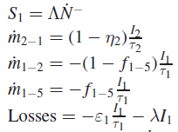
1: Breeding Zone
Parameters:
  TBR (A)
  Burn rate (Ndot-)
  Tritium extraction efficiency in the Tritium Extraction System (n2)
  Residence times (t1 and t2)
  Non-rad losses (e1)
  Decay rate (lamda)
  OFC leak fraction (f1-5)
expression = '-(tritium_burn_rate * TBR + (1 - TES_efficiency)*T_02_TES/residence2*valve_21
- BZ_HX_leak_fraction*T_01_BZ/residence1 - (1 - BZ_HX_leak_fraction)*T_01_BZ/residence1*valve_12 - T_01_BZ*epsilon1/residence1 - T_01_BZ*tdecay)'

Slide 16

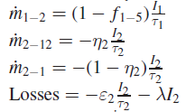
2: Tritium Extraction System
Parameters:
  OFC Leak fraction (f1-5)
  Tritium extraction efficiency in the Tritium Extraction System (n2)
  Non rad losses (e2)
  Decay rate (lamda)
expression = '-((1 - BZ_HX_leak_fraction)*T_01_BZ/residence1*valve_12 - TES_efficiency*T_02_TES/residence2*valve_29 - (1 - TES_efficiency)*T_02_TES/residence2*valve_21 - T_02_TES*epsilon2/residence2 - T_02_TES*tdecay - T_02_TES*valve_2purge)'

Slide 17
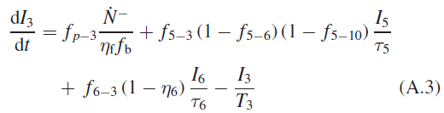
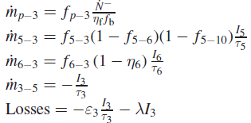
3: First Wall
Parameters:
  Leak fraction (fp-3, f5-3, f6-3)
  Burn rate (Ndot-)
  Fueling efficiency (nf)
  Burn fraction (fb)
  Tritium extraction efficiency in the Coolant Purification System (n6)
  Non rad losses (e)
  Decay rate (lamda)
  Residence times (t)
expression = '-(P_FW_leak_fraction*tritium_burn_rate /tritium_burn_fraction / tritium_fueling_efficiency + HX_FW_leak_fraction * (1 - HX_CPS_leak_fraction) * (1 - HX_EXO_leak_fraction) * T_05_HX/residence5 + CPS_FW_leak_fraction * (1 - CPS_efficiency) * T_06_CPS/residence6 - T_03_FW/residence3 - T_03_FW*epsilon3/residence3 - T_03_FW*tdecay)'

Slide 18
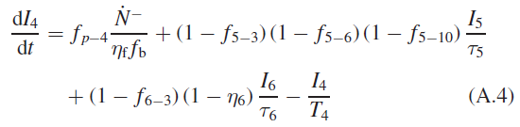
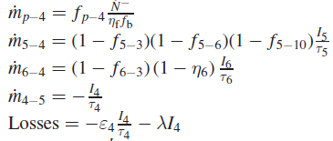
4: Divertor
Parameters:
  Leak fraction (f)
  Burn rate (Ndot-)
  Fueling efficiency (nf)
  Burn fraction (fb)
  Residence times (t)
  Tritium extraction efficiency in the Coolant Purification System (n6)
  Non rad losses (e)
  Decay rate (lamda)
expression = '-(P_DIV_leak_fraction * tritium_burn_rate/tritium_burn_fraction / tritium_fueling_efficiency + (1-HX_FW_leak_fraction)* (1-HX_CPS_leak_fraction)*(1-HX_EXO_leak_fraction) * T_05_HX/residence5 + (1-CPS_FW_leak_fraction)*(1 - CPS_efficiency) * T_06_CPS/residence6 - T_04_DIV*epsilon4/residence4 - T_04_DIV/residence4 - T_04_DIV*tdecay)'

Slide 19

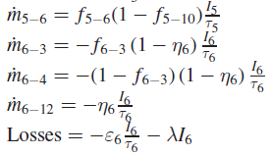
5: Heat Exchanger
Parameters:
  Leak fraction (f)
  Burn rate (Ndot-)
  Fueling efficiency (nf)
  Burn fraction (fb)
  Residence times (t)
  Tritium extraction efficiency in the Coolant Purification System (n6)
  Non rad losses (e)
  Decay rate (lamda)
expression = '-(BZ_HX_leak_fraction * T_01_BZ/residence1 + T_03_FW/residence3 + T_04_DIV/residence4 - T_05_HX/residence5 - T_05_HX*epsilon5/residence5 -T_05_HX*tdecay)'

Slide 20

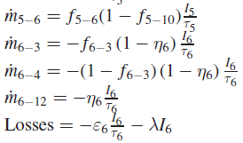
6: Coolant Purification System
Parameters:
  Leak fraction (f)
  Residence times (t)
  Tritium extraction efficiency in the Coolant Purification System (n6)
  Non rad losses (e)
  Decay rate (lamda)
expression = '-(HX_CPS_leak_fraction * (1 - HX_EXO_leak_fraction)*T_05_HX/residence5 - T_06_CPS/residence6 - T_06_CPS*epsilon6/residence6 - T_06_CPS*tdecay)'

Slide 21

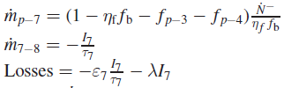
7: Vacuum Pump
Parameters:
  Leak fraction (f)
  Burn rate (Ndot-)
  Fueling efficiency (nf)
  Burn fraction (fb)
  Residence times (t)
  Non rad losses (e)
  Decay rate (lamda)
expression = '-((1-tritium_burn_fraction*tritium_fueling_efficiency - P_FW_leak_fraction
- P_DIV_leak_fraction)* tritium_burn_rate/(tritium_burn_fraction
* tritium_fueling_efficiency) - T_07_vacuum/residence7
- T_07_vacuum*epsilon7/residence7 - T_07_vacuum*tdecay)'

Slide 22

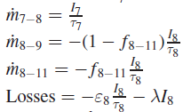
8: Fuel Clean-Up
Parameters:
  Leak fraction (f)
  Residence times (t)
  Non rad losses (e)
  Decay rate (lamda)
expression = '-(T_07_vacuum/residence7 - T_08_FCU/residence8 - T_08_FCU*epsilon8/residence8 - T_08_FCU*tdecay)'

Slide 23

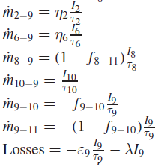
9: Isotope Separation System
Parameters:
  Leak fraction (f)
  Residence times (t) → t9 is 4 hours → slow transfer to storage
  Tritium extraction efficiency in the Tritium Extraction System (n2)
  Tritium extraction efficiency in the Coolant Purification System (n6)
  Non rad losses (e)
  Decay rate (lamda)
expression = '-((1-FCU_STO_fraction)*T_08_FCU/residence8 + T_10_exhaust/residence10
+ TES_efficiency*T_02_TES/residence2 + CPS_efficiency*T_06_CPS/residence6
- T_09_ISS/residence9 - T_09_ISS*epsilon9/residence9 - T_09_ISS*tdecay)'

Slide 24

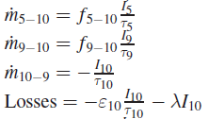
10: Exhaust and Water Detritiation System
Parameters:
  Leak fraction (f)
  Residence times (t)
  Non rad losses (e)
  Decay rate (lamda)
expression = '-(HX_EXO_leak_fraction * T_05_HX/residence5 + ISS_EXO_leak_fraction * T_09_ISS/residence9 - T_10_exhaust/residence10 - T_10_exhaust*epsilon10/residence10 - T_10_exhaust*tdecay)'

Slide 25
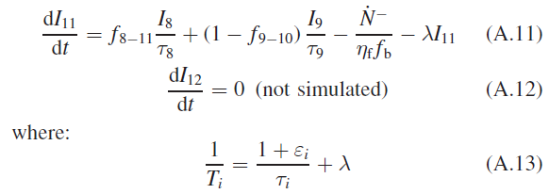
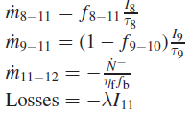
11: Storage and Management
Parameters:
  Leak fraction (f)
  Burn rate (Ndot-)
  Fueling efficiency (nf)
  Burn fraction (fb)
  Residence times (t)
  Non rad losses (e)
  Decay rate (lamda)
expression = '-(FCU_STO_fraction * T_08_FCU/residence8 + (1-ISS_EXO_leak_fraction) * T_09_ISS/residence9 - tritium_burn_rate/tritium_burn_fraction/tritium_fueling_efficiency - T_11_storage*tdecay)'

