Slide 1
Discrete Probability Distributions for Machine Learning
Assessing the Uncertainty in Aging Aircraft Maintenance and Inspection Strategies
Robert (Bob) Kurth
RKZ Associates
July 23rd, 2026

Slide 2
Presentation Content
Discrete Probability Distribution Methodology
  Fundamentals
  Importance Sampling
  Calculation of the Joint Probability Distribution for Machine Learning
Aging Aircraft Probabilistic Damage Tolerant Analysis (DTA)
  Mechanics Model
  Inspection Methods
  Simulation training data
Machine Learning
  Using the training data assess
    Inspection Methods
    Inspection Schedules
Summary and Conclusions

Slide 3
Motivation
Data Sources Overlap and, potentially, are contradictory
Allowance for a selection of methodology to characterize data
  Introduces additional uncertainty
  This uncertainty, in many cases is unquantifiable
Using an agreed upon criterion to separate the data removes such uncertainty and provides consistency
Of course, such consistency must be understood or a situation where we are consistently wrong could arise

Slide 4
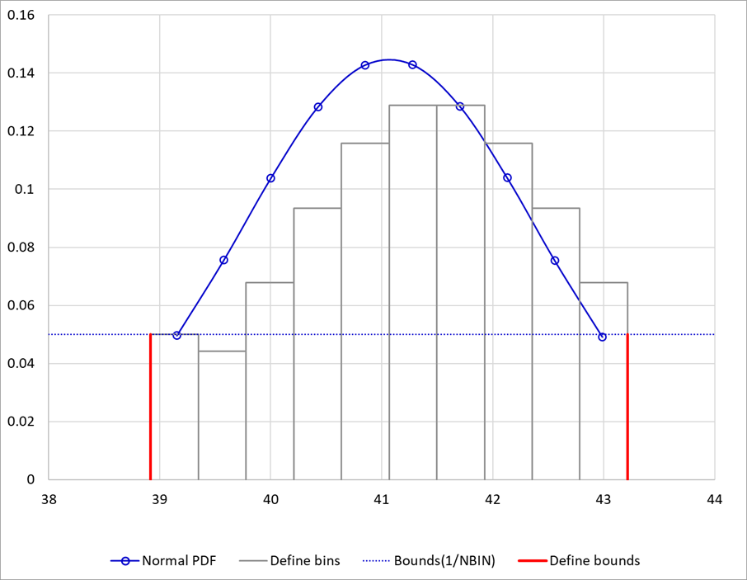
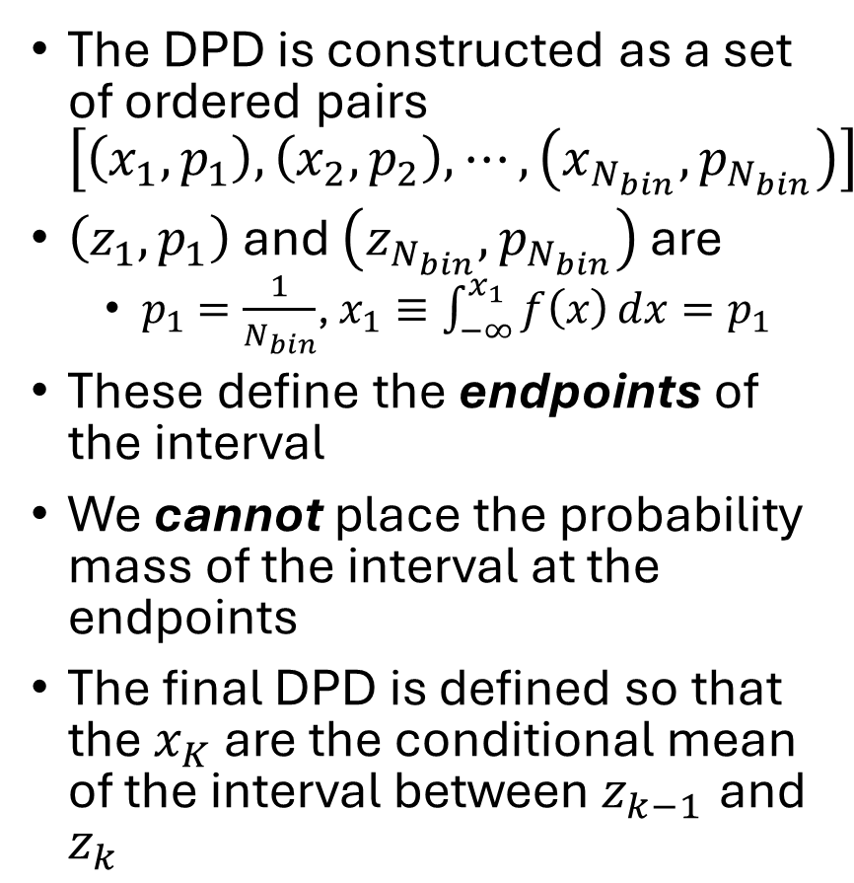
Discrete Probability Distributions (DPD)
The DPD is constructed as a set of ordered pairs $\left[\left(x_{1},p_{1}\right),\left(x_{2},p_{2}\right),⋯,\left(x_{N_{bin}},p_{N_{bin}}\right)\right]$
$\left(z_{1},p_{1}\right)$ and $\left(z_{N_{bin}},p_{N_{bin}}\right)$ are
  $p_{1}=\frac{1}{N_{bin}}$, $x_{1}≡\int_{−∞}^{x_{1}}{f\left(x\right)}dx=p_{1}$
These define the endpoints of the interval
We cannot place the probability mass of the interval at the endpoints
The final DPD is defined so that the $x_{K}$ are the conditional mean of the interval between${ z}_{k−1}$ and $z_{k}$

Slide 5
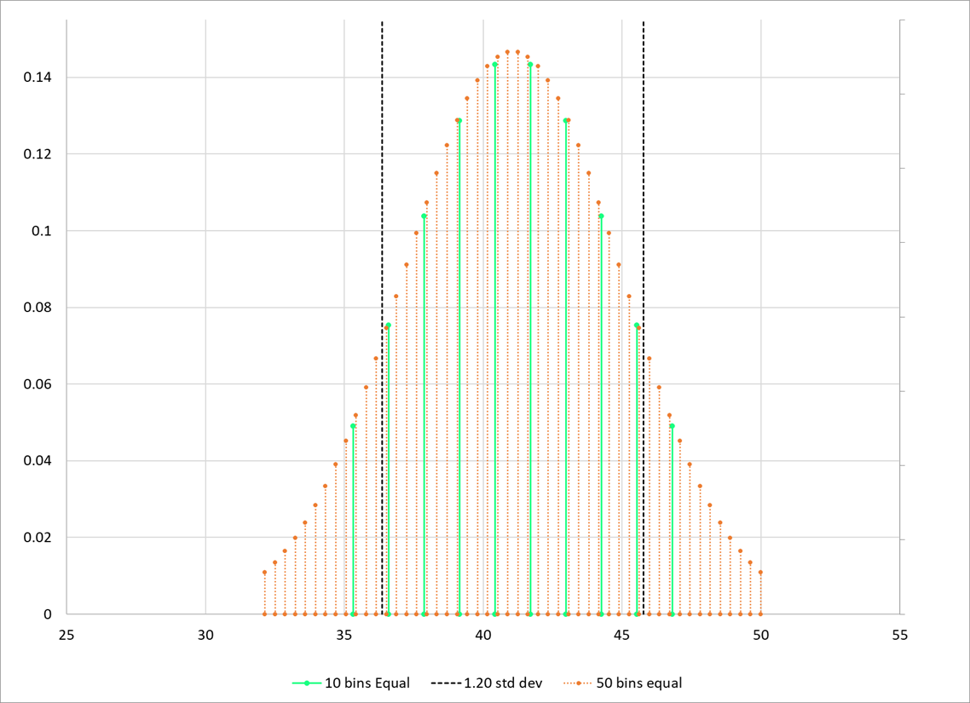
Discrete Probability Distribution (DPD) (continued)
10 discrete intervals is not enough, 1,000,000 too many
Recall that if we use the number of bins as the endpoint definition then there is a zero probability that any value will be sampled outside this bound
The difference between 10 and 50 bins is shown to the left

Slide 6
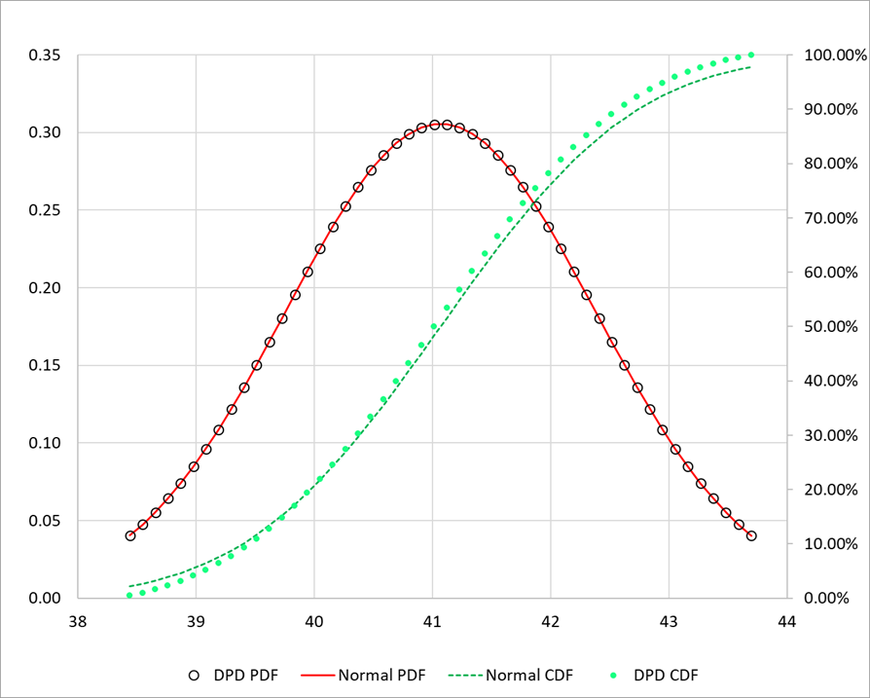
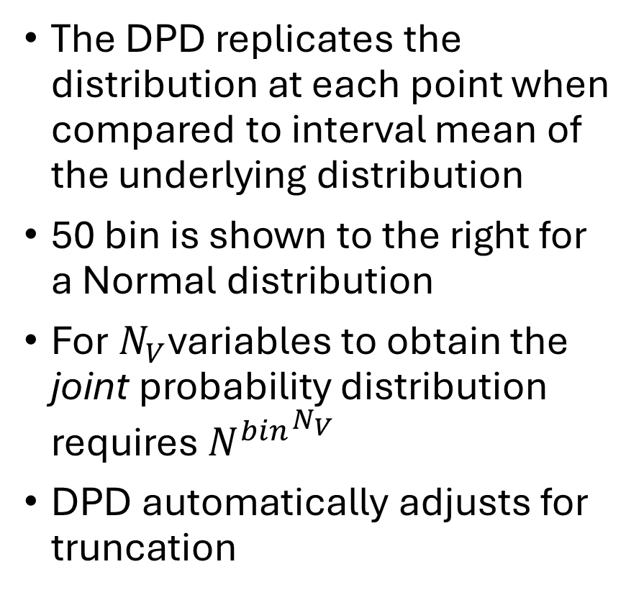
Discrete Probability Distribution (DPD) (continued)
The DPD replicates the distribution at each point when compared to interval mean of the underlying distribution
50 bin is shown to the right for a Normal distribution
For $N_{V}$variables to obtain the joint probability distribution requires ${N^{bin}}^{N_{V}}$
DPD automatically adjusts for truncation

Slide 7
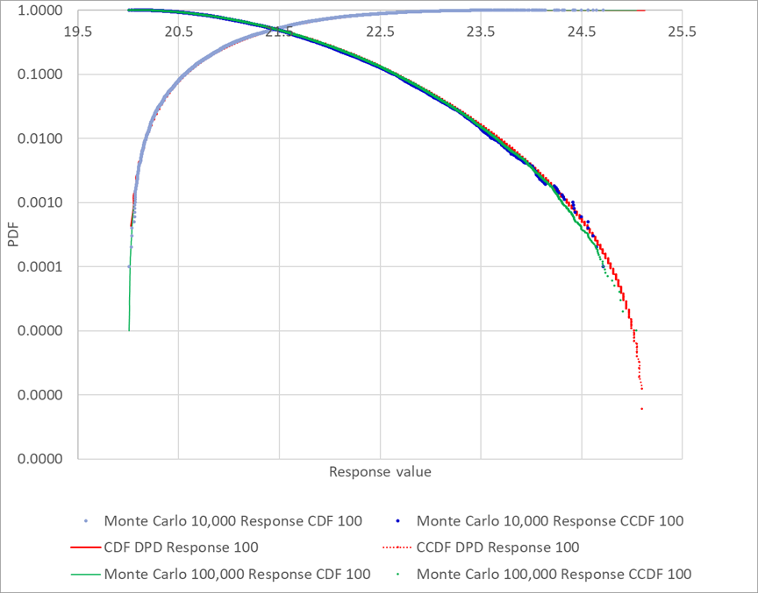
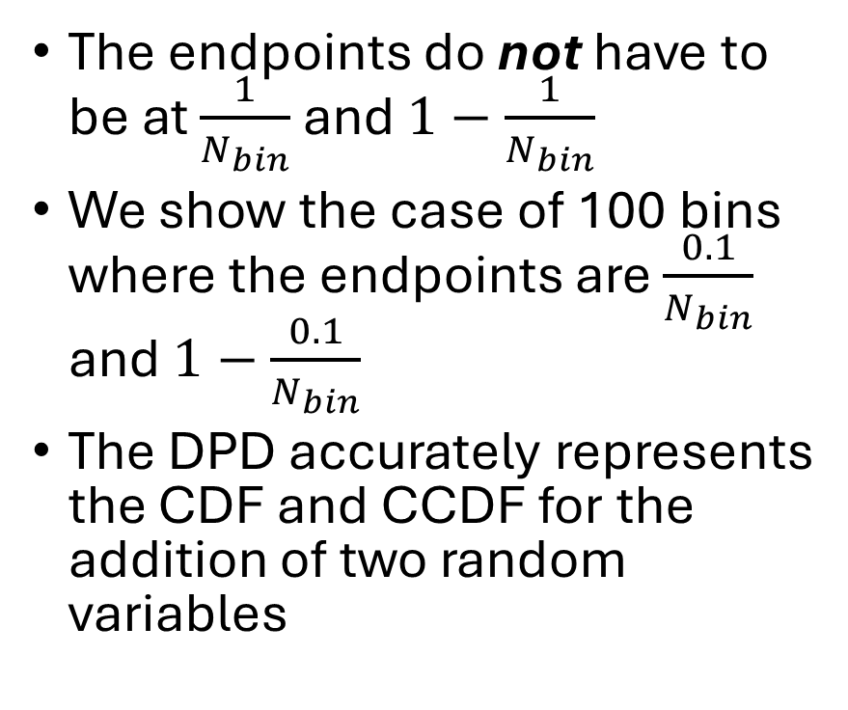
Discrete Probability Distribution (DPD) (continued)
The endpoints do not have to be at $\frac{1}{N_{bin}}$ and $1−\frac{1}{N_{bin}}$
We show the case of 100 bins where the endpoints are $\frac{0.1}{N_{bin}}$ and $1−\frac{0.1}{N_{bin}}$
The DPD accurately represents the CDF and CCDF for the addition of two random variables
Notes:
Sum of two normal random variables

Slide 8
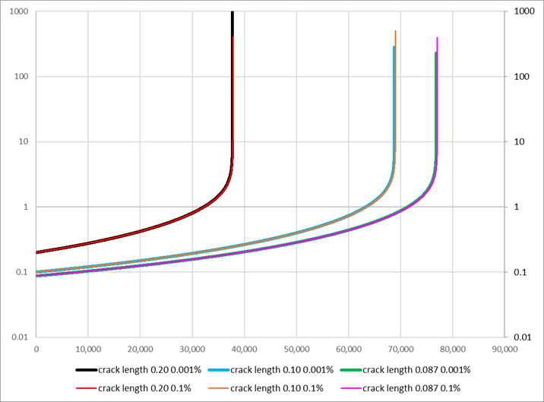
Aging Aircraft Damage Modeling for Inspections
We simplify the calculations by using damage tolerance
No initiation of cracks damage is assumed to exists at time zero
Commercial aircraft and Paris law is assumed
As the plot to the right indicates assuming a larger initial crack simply reduces the calculations

Slide 9
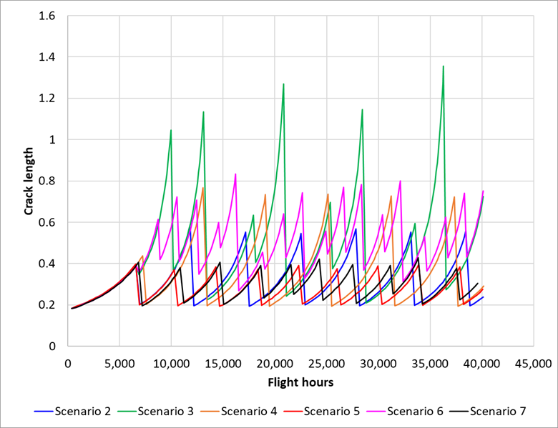
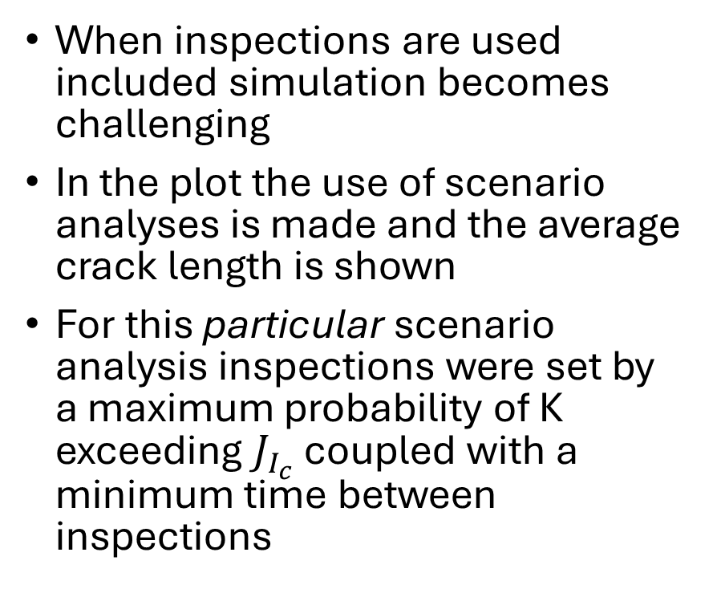
Aging Aircraft Damage Modeling for Inspections
When inspections are used included simulation becomes challenging
In the plot the use of scenario analyses is made and the average crack length is shown
For this particular scenario analysis inspections were set by a maximum probability of K exceeding $J_{I_{c}}$ coupled with a minimum time between inspections

Slide 10
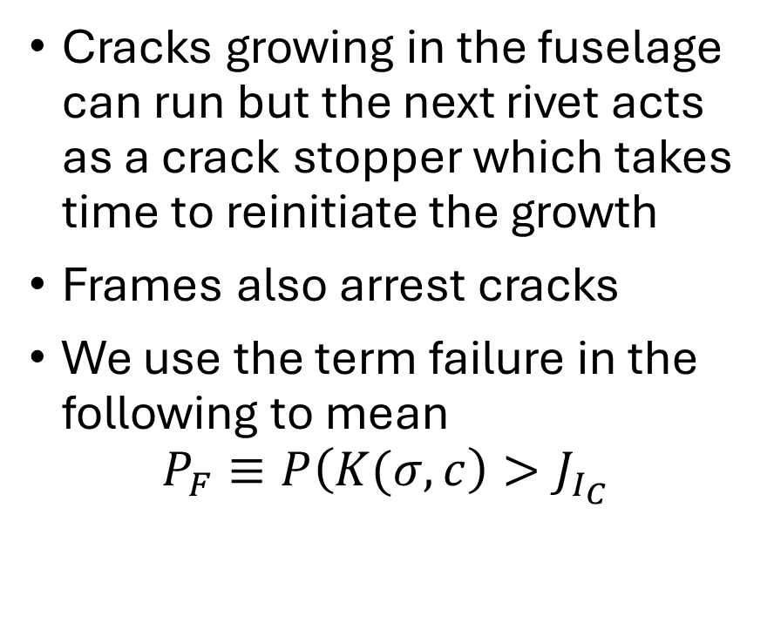
Aging Aircraft Damage Modeling for Inspections
Cracks growing in the fuselage can run but the next rivet acts as a crack stopper which takes time to reinitiate the growth
Frames also arrest cracks
We use the term failure in the following to mean
$$P_{F}≡P\left(K(σ,c\right)>J_{I_{C}}$$

Slide 11
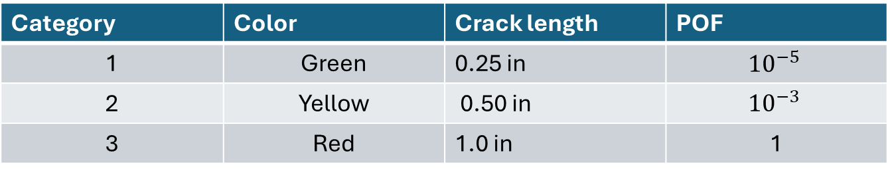
Machine Learning Application
There are twelve inputs to the PFM model, eight of which were sent to the machine learning module
The Principal Component Analyses (PCA) based on the eigenvalue solutions of the largest eigenvalues are employed
We use a color scheme to classify the risk of failure. For the full study we have a 3, 6, and 16 color scheme
For this presentation we show the 3 color results
Category | Color | Crack length | POF
1 | Green | 0.25 in | $${10}^{−5}$$
2 | Yellow | 0.50 in | $${10}^{−3}$$
3 | Red | 1.0 in | 1

Slide 12
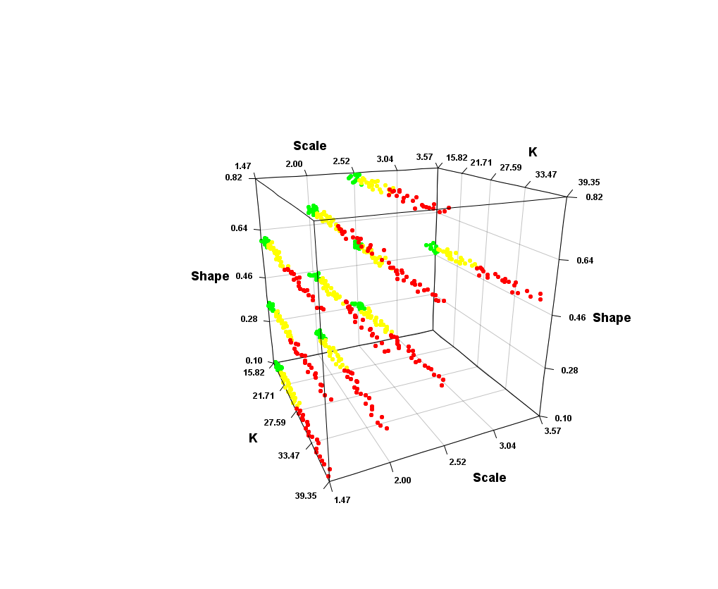
Machine Learning Application
The Probability of Detection (PoD) curve was modeled as a Weibull CDF
This allowed two parameters, the scale and shape to be used to characterize the PoD
9 different scenarios were used

Slide 13
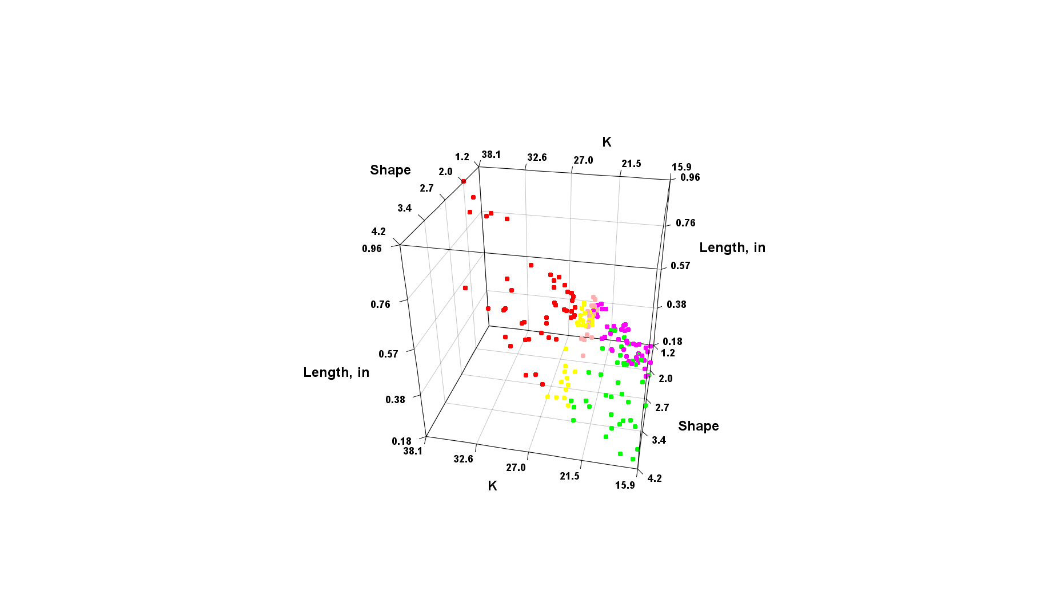
Machine Learning Application
Three variables
  Stress intensity, K
  Weibull shape parameter
  Time of inspection
The PCA method shows a good classification of the green, yellow, red
The pink and magenta data is the classification given by the training data to new analyses
There were no red classifications for the new data and the training data predicted zero red classes

Slide 14
Conclusions of the Analysis
Many more analyses were performed which will not fit into an 18 minute presentation
Important results include
  Using machine learning allowed the impact of inspections to be more easily assessed from the simulations than standard Monte Carlo simulations
  The DPD method has been integrated into past PFM analyses
    xLPR simulation
    PDTA of shuttle training aircraft
  Comparison of the MC DPD analyses to the ML DPD analyses demonstrates an advantage of machine learning for assessing inspection methods and schedules

Slide 15
The Future
These analyses focused on PCA methods which reduce higher dimensional results by projecting onto a lower dimensional hyperplane
The use of Kernel methods is being implemented to allow the results to be projected to a higher dimensional hyperplane
  We believe this may find better discrimination of the inspection
  It will also be needed for more complex analyses that included
    Crack retardation
    Welded structure residual stresses
    Crack arrest and re-initiation
THANK YOU for listening!!

