Slide 1

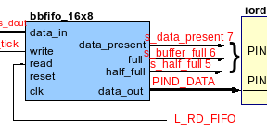

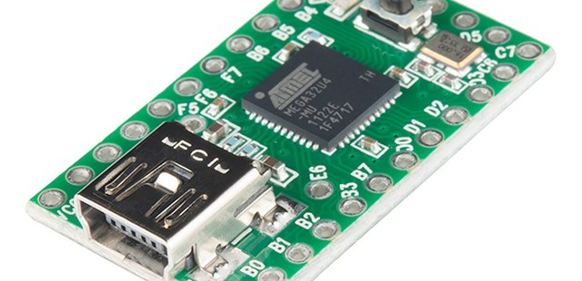
Command Interleaving
A design technique to mitigate against environment induced fault in high consequence embedded systems
For presentation at PSAM 18 Conference, July 2026
R A Williams
Sandia National Laboratories
9 June, 2026
Graphics from Wikimedia Commons
SAND2026-22497C

Slide 2
Mitigating against environment induced fault
A specialized problem in embedded systems design
The problem: increasing mission sophistication, decreasing resources
Environment induced fault
“At most once, requiring authorization”
Command interleaving as a design strategy
  Using formal logic to mitigate against environment induced faults in hardware, software, and human error
  Relationship between hardware, software (or firmware), and external commands

Slide 3

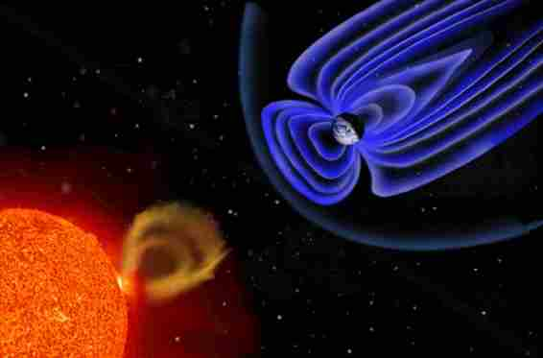
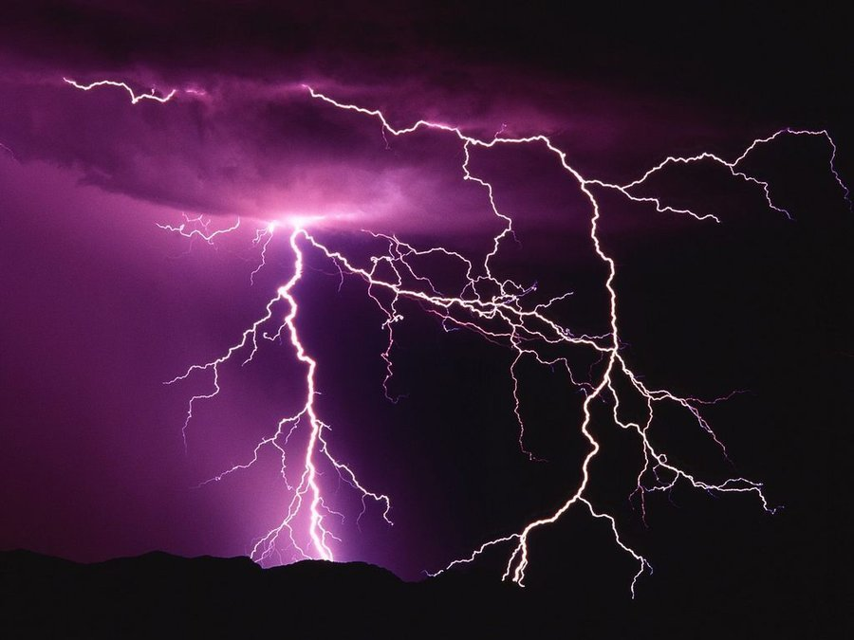
Environment Induced Fault
Electrical systems are vulnerable to induced current flow due to nearby electromagnetic energy.
A single data line to transition from a 0 to a 1 level or vice versa, creating an erroneous active high or active low signal.
Noise on a transmission line can also garble data.
Paired inputs (active-high plus active-low) and data checking can help mitigate.
  Image from Wikimedia Commons
Semiconductor based devices, particularly the CMOS7 commonly used in aerospace applications, are vulnerable to single event upset (SEU) due to collision with charged particles.
In memory or registers, a 0 may turn into a 1 or vice versa. These errors may propagate. [1]
Physical mitigations such as silicon on insulator (SoI) chip design can help mitigate [2], as well as software based methods such as scrubbing or checking operations.
  Image from Wikimedia Commons

Slide 4
At most once, Requiring Authorization (AMORA)
A specific type of high consequence operation
Operation must be executed as part of the device’s correct operation
  Examples: engage the automatic brake on a vehicle, override a human pilot’s actions, or open the outer airlock on a space station
  Can cause injury, loss of life, or significant property damage if executed prematurely or without authorization
Must not be executed autonomously or repeatedly
  Examples: transfers of money or currency between accounts
  No automatic retries
  No “music box” sequences
Vulnerable to the “jump ahead” category of software or hardware state machine faults

Slide 5
Industry Precedents
DoD requirement for “hazardous” function initiation
Origin: Joint Software Systems Safety Engineering Handbook (JSSSEH) [3]
  Computer/Human Interface (CHI) discussion: at least two independent signals, not from same interface for “hazardous function initiation”
  Operator authorization required
  Also requires various types of formal methods and risk evaluation for any product containing software [4], [5]

Slide 6
Command Interleaving
Design concept for the new era of high consequence embedded systems
Uses formal logic
Extension of the McGovney Principle
  “Hardware checks software, hardware checks hardware, software checks hardware, software checks software”
  McGovney Principle used extensively in error correcting processor design
  Space, power, and memory constraints often prevent designers from using heavily redundant hardware and software
Problem: Faulty hardware or software is still suspect when checking itself.
Solution: Add external stimulus to the list of available sources of reality checking and enablement
Each of these three sources can and should still reality-check itself when practical.
A fault or error in more than one source, or a double fault in the same source, can still be caught by one or both other resources.

Slide 7
The External Stimuli
Harden to two faults by using three external stimuli
Three different stimuli arrive from at least two independent sources
  Authorize Intent requires a human interface
  Environment Detected involves one or more sensors
  Command message could potentially be automated, on a timer, or received across a network, however it represents a situation in which the AMORA operation must be performed ASAP
Depending on system needs and time domain response requirements, these stimulus messages can be reality checked, encrypted, or firewalled. Timeouts can be designed in.
Each stimulus message contains information or data not otherwise contained in the system that must be passed on to the hardware to configure it or to cause initiation of the AMORA operation.

Slide 8
Basic Flow of Interleaved commands
Hardware (blue) states interleave with software (green) states and three external stimuli
Notes:
Note that the pairs 2, 3 and 4, 5 among the software states are music boxes. Also, states 6 and 7, if authorized, are a music box and would constitute an unauthorized self transition, which is identical to design mode operation.

Slide 9
Environment Initiated State Transition Analysis: Hardware
Initial Valid State | Jump to “Configurable But Not Configured” | Jump to “Configured” | Jump to “Initiating” | Single Fault AMORA Initiation possible?
Unconfigurable | Possible: Short | Impossible, non-trivial configuration complexity | Impossible, requires external message content | No, environment cannot cause transition beyond Configurable
Configurable But Not Configured | N/A, Self Transition | Impossible, non-trivial configuration complexity | Impossible, requires external message content | No, environment cannot cause transition beyond Configurable
Configured | N/A, Backward Transition | N/A, Self Transition | Impossible, requires external message content | No, environment cannot cause transition beyond Configurable

Slide 10
Environment Initiated State Transition Analysis: Software
Initial Valid State | Single Fault AMORA Possible After Jump To “Render Hardware Configurable, Look For Environment”? | Single Fault AMORA Possible After Jump To “Configure Hardware, Await Command”? | Single Fault AMORA Possible After Jump To “Reality Check, Final Initiation”?
Ready To Authorize | No, hardware not configurable with wrong or missing data | No, unconfigured hardware is unresponsive | No, unconfigured hardware is unresponsive
Render Hardware Configurable, Look For Environment | N/A, Self Transition | No, hardware will be configured wrong and cannot initiate AMORA operation | No, even if reality check fails wrongly configured hardware won’t initiate AMORA
Configure Hardware, Await Command | N/A, Backward Transition | N/A, Self Transition | No, even if reality check fails the hardware can’t initiate AMORA without command data
Reality Check, Final Initiation | N/A, Backward Transition | N/A, Backward Transition | N/A, Self Transition. Also identical to design mode authorized operation in correct environment with initiating command

Slide 11
Most Threatening External Faults Mitigated By Design
Initiating Command sent early due to human error?
  Hardware isn’t configured
  Reality Check also fails
Erroneous application of power due to physical short?
  Still requires intent message, environment detection, and command message
  No messages are saved within the device
Erroneous detection of environment?
  Hardware will be configured wrong or not at all
  Reality check will fail even if initiating command message received

Slide 12
Most Threatening Internal Faults Mitigated By Design
Software does not store any external messages
Software may perform firewall operations to ensure messages are handled in order
Software does keep evidence that the messages have been received
Defensive programming and inspection of Assembly instructions can prevent single-flag vulnerabilities
Software jumps ahead?
  Can’t configure or enable what’s not powered and in a configurable state
  Can’t enable what’s not configured
  Software can be stored in segments and not decoded until it is needed

Slide 13
Optimized for AMORA operations
Not optimized for high-availability operations such as security systems, communication satellites, bank servers, or life safety medical equipment
Default Behavior: Don’t Do The Thing
No recovery or redundancy for AMORA operations
  No retries
  No failover
  No parallelism
  Error correcting codes not recommended
Should be supplemented by reality-checking all messages and implementing a firewall to enforce correct message order
Suitable (and most easily verifiable) as a bare metal implementation using a single thread, polling system or at most a foreground/background design
May be supplemented with other sources of cancellation or override
  More than one source of environment detection, for reality checking and to mitigate against bad data
  Timer and unique signal dependent operations to prevent errors due to single bit operations
  The unique signal and/or command message may be used to enable hardware, either for the AMORA operation itself or for other assured safety components
  Enable exception and hardware fault handling in microcontroller(s)

Slide 14
Questions?

Slide 15
Acknowledgements
“Sandia National Laboratories is a multi-mission laboratory managed and operated by National Technology & Engineering Solutions of Sandia, LLC (NTESS), a wholly owned subsidiary of Honeywell International Inc., for the U.S. Department of Energy’s National Nuclear Security Administration (DOE/NNSA) under contract DE-NA0003525.
This written work is authored by an employee of NTESS. The employee, not NTESS, owns the right, title and interest in and to the written work and is responsible for its contents. Any subjective views or opinions that might be expressed in the written work do not necessarily represent the views of the U.S. Government. The publisher acknowledges that the U.S. Government retains a non-exclusive, paid-up, irrevocable, world-wide license to publish or reproduce the published form of this written work or allow others to do so, for U.S. Government purposes. The DOE will provide public access to results of federally sponsored research in accordance with the DOE Public Access Plan.”

Slide 16
Works Cited
[1] E. Normand. “Single-event effects in avionics”, IEEE Transactions on Nuclear Science, Volume 43, Issue 2, pp. 461-474 (April 1996).
[2] M. Barker, K. Ryden, and A. Hands. “Micro-latch and Single Event Upset phenomena observed during accelerated atmospheric neutron testing of 40-90 nm Commercial Off The Shelf Static Random Access Memories”, 22nd European Conference on Radiation and Its Effects on Components and Systems (RADECS), 03-07 October 2022, Venice, Italy.
[3] Joint Software Systems Safety Engineering Handbook, V 1.0, August 27, 2010
[4] Formal Methods and Post Hoc Binary Analysis, SAND2024-04941PE
[5] Formal Methods: Enables Increased Assurance in ND Digital Systems, SAND2024-01205PE

