Slide 1
Symptom Identification, Modeling, & Context Observation Data Mining System for Analysis of Cognitive & Decision-Making Errors in a Full-Scale Simulator
PSAM 18 Conference
3-10 Human Factors and Operator Performance
Gueorgui Petkov
Sofia University St. Kliment Ohridski
BULGARIA
Pittsburgh, Pennsylvania
July 19-24, 2026

Slide 2
SIMCO Data Mining System Aim & Scope
The aim is to create and build a prototype of a Symptom Identification, Modeling and Context Observation (SIMCO) system to analyze cognitive and decision-making errors for a NPP, based on data from the regular training of the operating crews of the full-scale simulator (FSS).
The scope of the methodology is not limited to the collection, processing and assessing HEP for HRA data mining, in a mode and format for integration into the PSA but also complements the assessment of HFE quality and HMI performance under normal and abnormal operating conditions, as well as the knowledge and abilities of operators, making the process of testing and licensing personnel in the regulatory agency more systematic and objective.

Slide 3
SIMCO’s Automated, Holistic & Contextual Approach
To prevent or minimize the impact of the introduction of SIMCO on the goals and efficiency of regular training, the extraction of data will be automated to the maximum extent using the existing capabilities of the FSS for registering operational information from the conducted exercises and archiving this data.
The context probability (CP) or contexture serves to holistic "measure" workload the processes of perception, cognition, decision-making, and execution.

Slide 4
SIMCO Methodology Purposes & Requirements
The general purpose is to collect, systematize and archive (automated, offline or online) various data related to the work of operators.
The specific purpose is to be used to improve the awareness and efficiency of operators in performing their tasks at the MCR within the existing FSS interface.
The SIMCO technique requires:
  Describing the Socio-Technical System (object and subject in each situation) by symptoms (stimuli for operator action).
  Fixing, registering and identifying symptoms with standard and non-standard (supplementary) devices.
  Obtaining a lot of different data to reliably, dynamically and statistically assess the contexts and performance of the operator’s crews.
  Monitoring (deterministically), modeling and assessing (probabilistically) the STS context.

Slide 5
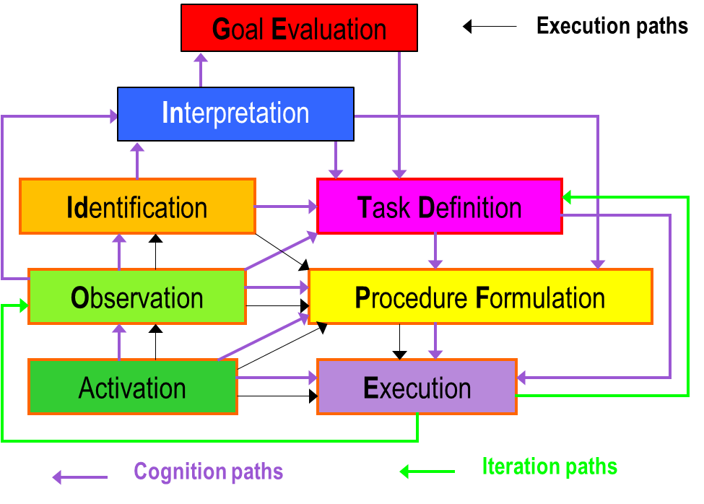
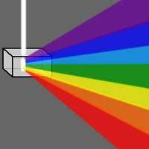

HRA Methods Used at the Kozloduy NPP
Methods, Conceptions & Points of View
PET Model for Individual Cognition
ASEP
THERP
CBDT
HCR/ORE
NARA
HDT PSFs
PET Symptoms
CONTEXT
Performance Evaluation of Teamwork Model
PET Model for Group Communication
Parameters
Functions
Automation Control System Operator
PRESENT
Object
Senior Reactor Operator
Turbine Operator
Events
Goals
Situation
CONTEXT
FUTURE
Nuclear Power Plant
Supervisor
Decision
Resources
Subject
PAST
Reactor Operator
Operator of Feed Water Pumps
Actions
Group Decision-making
Transitions
Individual Cognition
Mutual Communication
Possible communication

Slide 6
Models for Obtaining HEP for Use in HRA
A model for 'measuring' individual execution context through symptoms
Pilot model for fixing, automatically recording and archiving symptoms
A model for probabilistic assessment of individual execution
Taxonomy and criteria for identifying types of erroneous actions
A model for 'measuring' individual cognition context through symptoms
A model for assessing the subjectivity of individual judgment
A model for “measuring” group communication through mutual individual contexts
A model for probabilistic assessment of individual cognition
A model for probabilistic assessment of leader decision-making
A model for probabilistic assessment of group cognition & decision-making

Slide 7
Definition HFE & Integration HEP in HRA
IDENTIFICATION AND
DEFINITION OF HFE
INTEGRATION IN PSA
PET QUALIFICATION & QUANTIFICATION
Identification of HFEs
Final Integration
in PSA & Quantification
Recovery Error
Definition of HFEs
-
Risk important HFE
Executive Error
+
QUALITATIVE
ANALYSIS
Task Analysis
Recovery Contexts
Decision-Making Error
Preliminary Integration in PSA & Quantification
Context Characterization
Cognitive Errors
Simplified Assessment (screening values)
Executive Contexts
Error Identification
QUANTITATIVE
ASSESSMENT
Mutual Group Communication Contexts
Recovery Error Potential
Detailed Analysis
Individual Cognitive Contexts

Slide 8
SIMCO Stages Implementation Overview
Stage 1. Identifying the need for data collection for HRA/PSA and formulating requirements
Stage 2. Identifying the types of data that can potentially be obtained on the FSS-1000
Stage 3. Recording, registering and archiving of primary output data from FSS-1000.
Stage 4. Processing of primary source data using SIMCO criteria – secondary data
Process of generating new data
Process of using existing data
Stage 9. Creating an archive with a database for HRA/PSA
Stage 8. Statistical processing of data on types of HE
Stage 7. Data processing with HRA methods
Stage 6.. Combining HRA methods for data identification and classification
Stage 5. Methods for identification, classification, modeling and evaluation of HRA data

Slide 9
Brief Description of SIMCO Methodology
Stages 1÷4 of the SIMCO methodology implementation
The process is guided by the data needs of the PSA by compiling archives with databases for the different modes of human error (HE).
When specific & new data are needed in the PSA that are not included in the archives, it is determined whether these data can be obtained from the FSS.
The collection of Primary data from the simulator with standard devices and tools is done by selecting the FSS analog and discrete parameters, which must be fixed for automatic registration, recorded and archived.
Data are processed and prepared according to criteria for correspondence between the parameters used in the symptom-based emergency operating procedures (SB EOP) and the symptoms used in the PET method, to obtain Secondary data.
Secondary data are prepared for their application in the HRA methods by identifying, classifying and counting the symptoms and violation of symptoms.

Slide 10
Brief Description of SIMCO Methodology
Stages 5÷9 of the SIMCO methodology implementation
Initial data with 7 symptom groups of the PET method
For each mode of HE, appropriate HRA methods can be proposed by combining their capabilities and criteria for classification and assessment.
The combination of different HRA methods allows the processing of data with HRA methods to obtain useful and complementary dynamic and qualitative characteristics.
Statistical processing and evaluation of samples of collected data on the modes of HE can serve as the basis for the creation of an HRA/PSA database at Kozloduy NPP.
The created HRA DB can be further improved and developed.
time, s | Goals |  |  | Transitions |  |  | Actions |  |  | Events |  |  | Functions |  |  | Resources |  |  | Parameters
 | V | O | S | V | O | S | V | O | S | V | O | S | V | O | S | V | O | S | V | O | S

Slide 11
SIMCO Algorithm and Criteria (Filters)
The presence of a given parameter/event in at least one of the documents (scenario, SB EOP and other procedures) - List of Symptoms for Registration using Criterion A
  Based on Criterion A after each scenario played, file a (*.csv format) with the recorded parameters for each scenario is archived and transmitted for further processing.
The presence of a limit value or condition in the SB EOP, the played scenario or the Technical Specification (TS), which the given parameter has passed.
  Based on Criterion B, file b with the changed parameters during the scenario, serves as the source for determining the symptoms that appear during the scenario.
A symptom is a measurable cue in nuclear engineering, accessible to operator control, and can be considered as a combination of process parameters and signals that change the state of the nuclear power unit and require active actions (automation or personnel).
  Based on Criterion C, file c represents a chronological description of the scenario in qualified symptoms, which is suitable for PET qualitative and quantitative assessment of the played scenario.

Slide 12
Methods of Operator Act Diagnosis & Measurement
Recordings and recognition of conversations
The general process of diagnosis, measurement & evaluation of the crew performance includes 3 phases.
Phase 1 includes Stages 3, 4 and 9 of the SIMCO methodology and refers to its practical part - the collection of initial data of FSS-1000.
Phase 2 and Phase 3 are theoretical in nature and are based on the described HRA methods, models, procedures and tasks.
U N D E R S T A N D I N G
In
GE
Analog operational logs
Id
TD
DETECTION
DECISION
Eye movement tracking
O
PF
Operational logs on touch displays
A
E
Discrete operational logs

Slide 13
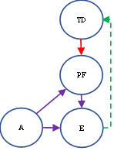
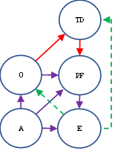
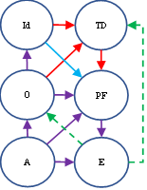
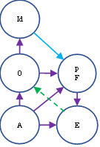
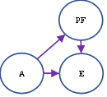
SIMCO Models & Logic for Identification and Classification of Human Error Modes (1÷5)
Human error modes, models and boundaries of HEP: 1÷5
1. P₋=P_{ca} There are no symptoms available to explore. | 2. P_{-O}=P_{cb} Symptoms for situational awareness are present but not addressed. | 3. P_{-Id}=P_{cc} Symptoms of situational awareness are misinterpreted or misrepresented. | 4. P_{-In} = P_{cd} The available symptoms for recognizing the situation are misleading! | 5. P_{-PF} = P_{ce} Steps are omitted, executed or reordered incorrectly in procedures.
CP ≥ P₋ ≥ P_{-O} | P₋ ≥ P_{-O} ≥ P_{-Id} | P_{-O} ≥ P_{-Id} ≥ P_{-In} | P_{-Id} ≥ P_{-In} ≥ P_{-PF} | P_{-In} ≥ P_{-PF} ≥ P_{-TD}

Slide 14
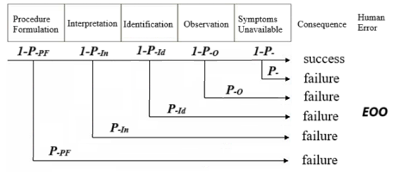
SIMCO Models & Logic for Identification and Classification of EOO Human Error Mode (6)
6. ЕОО “failure to perform an assigned action.”
ЕОО=1-(1-P_{Slips})*(1-P_{Lapses}) = 1-(1-P₋)*(1-P_{-O})*(1-P_{-Id})* (1-P_{-In})*(1-P_{-PF})

Slide 15
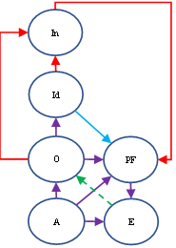
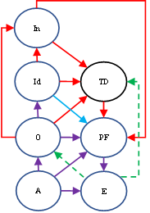
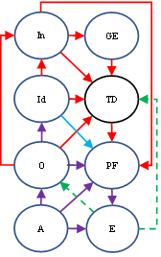
SIMCO Models & Logic for Identification and Classification of Human Error Modes (7÷9)
7. P_{-TD}=P_{cf} Errors made when interpreting instructions | 8. P_{-GE} = P_{cg} Errors made in interpreting diagnostic logic. A goal was chosen that does not lead to a resolution of the situation. | 9. P_{SLM} = P_{ch} The error is the result of an incomplete or violated cognitive process. The crew intentionally violates the procedure.
P_{-PF} ≥ P_{-TD} ≥ P_{-GE} | P_{-TD} ≥ P_{-GE} ≥ P_{SLM} | for CP < 0,5: P_{A} ≥ P_{SLM} ≥ P_{O-A} for CP ≥ 0,5: P_{A} ≥ P_{SLM} ≥ P_{TD-A}

Slide 16
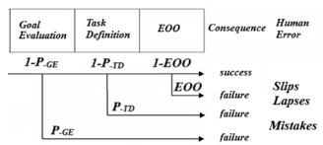
SIMCO Models & Logic for Identification and Classification of EOC Human Error Mode (10)
9. EOC “incorrect performance of an assigned task, or performance of an extraneous task that was not
assigned, which may contribute to accident progression or cause an initiating event”
1-(1-P_{Slips})*(1-P_{Lapses})*(1-P_{Mistakes})≈P_{SLM} ≥ P_{SLM}*P_{logic fallacy} ≥ЕОC

Slide 17
Identification & Classification of HE Modes
The combined criteria, models and logics for detecting the mechanism/mode of HFE and automatically identifying and classifying HE defined in PET (THERP & CBDT) are shown in Table, where based on qualitative and quantitative analysis of the context of the different HE models, interval HEPs can be obtained within the bounds for each model (inequalities).
CP≥P₋(P_{ca})≥P_{-O}(P_{cb})≥P_{-Id}(P_{cc})≥P_{-In}(P_{cd})≥P_{-PF}(P_{ce})≥ EOO ≥P_{-TD}(P_{cf})≥P_{-GE}(P_{cg})≥P_{SLM}(P_{ch})≥P_{logic fallacy}*P_{SLM}≥ EOC
However, these probability intervals may overlap depending on the current contexture of the action, the number of iterations and the recursive recovery actions.
They should also be considered in relation to the time available for the cognitive, judgmental and executive sub-processes for the respective routine or non-routine actions.

Slide 18
Conclusions
The SIMCO methodology, tasks and tools for detecting the symptoms of a given scenario gives opportunity to fix, detect and interpret the STS behavior (nuclear facility and activity) by observing, comparing and identifying the relevant trends of parameters, signals, alarms, functions, goals/tasks, procedures and actions during the scenario.
Despite the disputed reliability, feasibility and validity, FSS reproduce not only complex physical, chemical and technological processes, but also complex decision-making processes at the individual, group, mental, psychological, cognitive and organizational level and can act as natural laboratories for studying these processes, allowing us not only to observe and investigate them, but also to collect useful data for improving models of processes that cannot be reproduced by traditional methods.
he SIMCO taxonomy enables classification of HFE modes and collection of objective data for HRA/PSA & HFE, as well as crew performance assessment & improved operator training.

Slide 19
Acknowledgments
PSAM 18 2026 Conference
3-10 Human Factors and Operator Performance
This research was funded by the Ministry of Education and Science of the Republic of Bulgaria, through the National Program D01-99: ”Qualification improvement in the field of nuclear technologies and nuclear engineering.”
Pittsburgh, Pennsylvania
July 19-24, 2026

Slide 20
THANK YOU FOR YOUR ATTENTION!
Gueorgui Petkov
gipetkov@uni-sofia.bg
petkovgi@yahoo.com
Pittsburgh, Pennsylvania
July 19-24, 2026

