Slide 1

Weaving the Web of Assurance: AOPG as a Foundation for Coherent Safety Arguments
Peter Karpati (IFE), Xueli Gao (IFE), Norbert Carte (US NRC*)
* The opinions expressed are those of the author and not necessarily those of his employer.
PASM-18
July 19–24, 2026

Slide 2
NRC Mission
The NRC protects public health and safety and advances the nation’s common defense and security by enabling the safe and secure use and deployment of civilian nuclear energy technologies and radioactive materials through efficient and reliable licensing, oversight, and regulation for the benefit of society and the environment.

Slide 3
What is Safety?
Safety – “The freedom from (or avoidance of) harm or hazard”
  The NRC evaluates reasonable assurance of adequate safety
Safety is also an engineered property of the design, operation, and maintenance of a system in a particular context
Adequate safety is based on adequate engineering

Slide 4
How to Demonstrate Safety?
To demonstrate safety, one must describe:
  The context (e.g., site of the facility)
  The design, operation, and maintenance of the system (e.g., the facility)
  What could go wrong (e.g., principal safety considerations)
  Why the SSC is nonetheless safe, e.g.,
    What is done to prevent and/or mitigate the things that could go wrong,
    Why “what is done” is adequate

Slide 5
Prescriptive vs. Performance-Based Approaches
Prescriptive Approach:
  Tells the applicant what to do, rather than what outcome to achieve
  Focuses on specific steps, methods, or design features
  Limits flexibility by implying only one acceptable way to meet safety expectations
Performance-Based Approach:
  Tells the applicant what to achieve, not how to do it
  Allows flexibility in design choices, analytical tools, and safety strategies
  Requires the applicant to justify why their chosen approach is “adequate” for achieving safety

Slide 6
Structured Safety Assurance Case
One way to implement a performance-based approach
Demonstrate safety by providing Claim Arguments and Evidence
Often depicted as a tree
  There are many problems with trees

Slide 7
Motivation – specific challenges of tree-structures
Tree‑based notation oversimplifies assurance and misrepresents dependencies
  Tree‑based representations cannot capture the inherently networked nature of safety reasoning
  Converging requirements cannot be represented in tree structures
    E.g., components satisfying many requirements simultaneously (same equipment withstanding flood, seismic, fire, tornado)
    The assurance case falsely looks like many unrelated branches instead of a coherent, interacting set of obligations
  They make it difficult to express cross‑cutting concerns (e.g., CCF, cyber, human factors)
  They obscure interdependent mitigations (e.g., timing dependencies, shared assumptions, architectural constraints), leading to a false impression of completeness (“paper-assurance”)
  Existing tools often focused on manual diagramming of tree structures limiting expressiveness
Difficulty in scaling and communicating large cases
  Large SSACs diagrams become hard to present and navigate due to their size and complexity
  Stakeholders need multiple tree-based views on a more complex, multi‑dimensional safety knowledge base
Performance‑based assurance for DI&C
  To evaluate whether a design actually achieves performance‑based safety goals
  Explicit reasoning, layers of abstraction, and systematic justification might become blurred
  Trees struggle to capture behavioral dependencies, joint conditions, cross‑cutting constraints
  No unified way to connect goals → constraints → design behavior → evidence

Slide 8
Background
Aspect-Oriented Property Graphs (AOPG) paradigm and approach
Uses a typed property graph as the authoritative substrate (e.g. a database)
  A typed property graph is a property graph in which every node and directed edge belongs to an explicitly defined type that prescribes its permitted attributes (a.k.a. “properties”), connections, and multiplicities, ensuring structural consistency and enforceable semantics.
Might be not the final answer but offers a structured starting point for exploring more practical assurance approaches to improve current situation

Slide 9
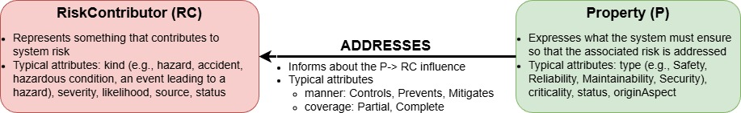
AOPG paradigm and approach
AOPG paradigm: Use a typed property graph as the single source of truth for assurance and generate stakeholder‑friendly views and governance queries from that substrate.
AOPG approach: A possible instantiation of the AOPG paradigm.
Stores assurance information structured according to a simple ontology:
  Nodes: RiskContributor, Property, Contract, DesignElement, Mechanism, Activity, Evidence…
  Edges encode semantics: REFINES_TO, ALLOCATED_TO, SATISFIED_BY, ADDRESSES, VERIFIED_BY…
  Example:
Follows a patterns-based workflow
Uses operational techniques and attributes to provide the dynamic behavior and checks

Slide 10
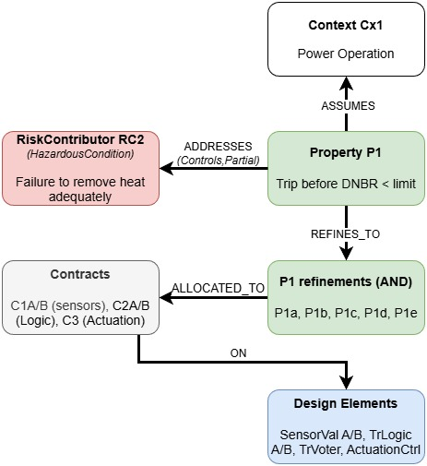
Illustrative example – AOPG application
Applying AOPG to RC2: “Failure to remove heat adequately”
Derive property: P1 – “Reactor trips before DNBR < limit.”
  DNBR: Departure from Nucleate Boiling Ratio
Decompose P1 via AND into P1a–P1e
  P1a: sensor input validation
  P1b: logic correctness and timing
  P1c: actuation latency
  P1d: mode-dependent interlocks
  P1e: single‑failure behavior
Allocate P1a–P1e to Contracts ON architecture components

Slide 11
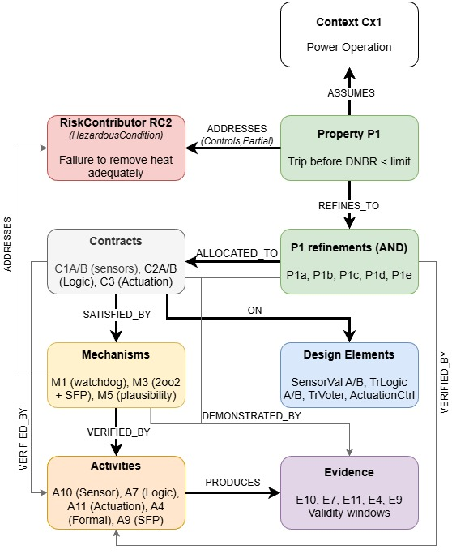
Illustrative example – AOPG application cont.
Mechanisms, Activities, Evidence
Mechanisms
  M1: watchdog
  M3: 2oo2‑SFP voting
  M5: sensor plausibility
Activities: timing tests, actuation tests, interlock proofs, SFP tests
Evidence includes time‑stamped artifacts with validity windows.
Queries check completeness, freshness, and cross‑aspect consistency.

Slide 12
Annotated references
HWR‑1149 & HWR‑1193: Structured Argumentation Case Study (APR1400); exposed that arguments built from compliance documents are not logically clean, with implicit reasoning and missing intermediate steps, indicated poor reusability
HWR‑1200: Understanding and Supporting Argumentation in Safety Demonstration; identified systemic issues: missing justification chains, poor integration of evidence, and no mechanism to check completeness or consistency
HWR‑1248: Structured Safety Argumentation (APR1400); showed the difficulty of interpreting regulatory basis, justifying claims, and dealing with cross‑cutting failure modes in tree‑only arguments
HWR‑1112 & HWR‑1259: Current State of Safety Demonstration Practice; documented high reviewer burden, lack of standardized structures, and poor scalability for complex digital systems
HWR‑1282: Structured Argumentation and Compliance; highlighted that compliance‑oriented arguments miss intent, risk context, and cross‑cutting obligations
HWR‑1283: Guidance on Structured Argumentation; pointed out the need for templates and pattern libraries, as variation leads to inconsistent arguments and repeated errors
HTOR‑027: SSAC for RPS (Assessor’s View); exposes limits of tree‑diagrams (duplication, cross‑cutting concerns), and scalability issue
HTOR‑034: Evidence for HARDENS Case (Correct‑by‑Construction); revealed the difficulty of integrating heterogeneous artefacts (formal models, proofs, code, specs) and the absence of a unified assurance substrate to keep them coherent
HTOR-078: Performance‑based SSAC for NuScale SSM slice; exposes limits of tree‑diagrams (duplication, cross‑cutting concerns), motivating multi‑view SSAC and model‑based substrate
HTOR-103 (in progress): lessons learned from SSAC & regulatory practice; deepens performance‑based structures and connects to Assurance 2.0 building blocks
HWR-1113, -1220, -1249, -1288 & HTOR-023, -033, -075: HRP and HTO activity 2 (safety demonstration and assurance) workshop proceedings

Slide 13
Thank you for your attention!
Questions or comments?
Your feedback is welcome: Peter.Karpati@ife.no

