Slide 1

Automation in PSA Development, Maintenance and Applications
PSAM18
Ola Bäckström, Pavel Krcal

Slide 2
Introduction
Generative AI is exciting – and it has created a general discussion about automation
In what way could AI, today, be relevant to use for automation within PSA modelling?
Are there other means for automation in PSA?

Slide 3
In the context of this presentation: Automation in PSA – where?
Automation in:
Building of the PSA model
  Including maintenance of PSA model
Adaptation of specific features, like seismic modelling and HRA dependencies
Reviewing of models
Generating result and data reports
Using models for applications
Model Setup
Model Update/Additions
Model Review
Result/Data Extracts
Model Usage

Slide 4
Correctness of a model
What do we expect from a PSA model?
Good correspondence to reality
  Contains relevant failure scenarios (and all of them – exhaustiveness)
  Quantitative aspects – correct ranking
Maintainability
  It is possible to extend the model or update it, without reviewing the complete model
Traceability
  Trace changes to purpose, assumptions taken, people involved (accountability)
QA
  There is a documented argument for sufficient model quality

Slide 5
A few words about Generative AI
Fantastic innovation – will make our lives easier and we must take benefit
We as community should make sure to maintain:
  Always human in the loop; accountability in risk model creation
  Quality in the first place (increase, not decrease!)
  Transparency: the models and changes must be possible to explain and defend
AI is mostly very good
  But non-deterministic behavior is a real problem
  Hallucination
  (Export control of models of nuclear stations – data must not leave country)

Slide 6
Objective of this presentation
If there are restrictions in the way we can assume we can use AI – does this mean that we cannot automate?
Can we already today automate our processes much more than most practitioners have – or do we need to wait for appropriate AI?
Model Setup
Model Update/Additions
Model Review
Result/Data Extracts
Model Usage
Read plant system information and automatically build FT/Dependability model
Use API/Macro to add and extract data
Dedicated tools for purpose
AI can support by converting plant information, and write knowledge bases
AI can write scripts to help add or extract information, or assist in reviews or generation of reports
Assisting in plant configuration and results
This presentation

Slide 7
Automation in model creation

Slide 8

The Process of Creating Fault Trees
A substantial modeling effort
P&ID
FMEA
Failures
FTs
Notes:
Can we move models closer to the design? So that as much as possible from the safety engineering will be hidden in RiskSpectrum and one will simply explain how a system works?

Slide 9
The Process of Creating Fault Trees
A substantial modeling effort – made easier
Automation in FT generation
P&ID
FMEA
Failures
FTs
Safety Engineering
Integration with plant drawings/systems
Notes:
Can we move models closer to the design? So that as much as possible from the safety engineering will be hidden in RiskSpectrum and one will simply explain how a system works?

Slide 10

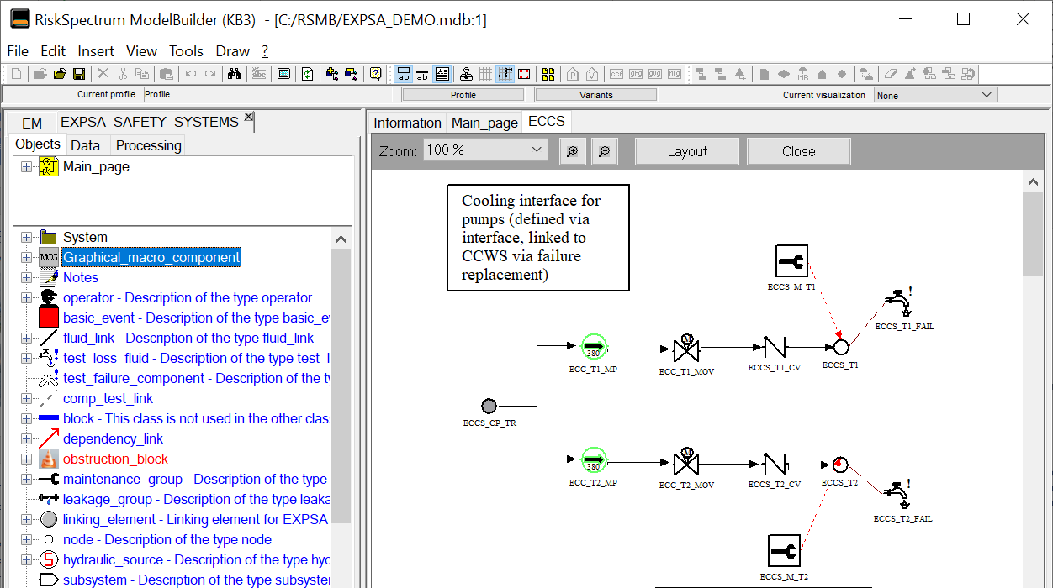
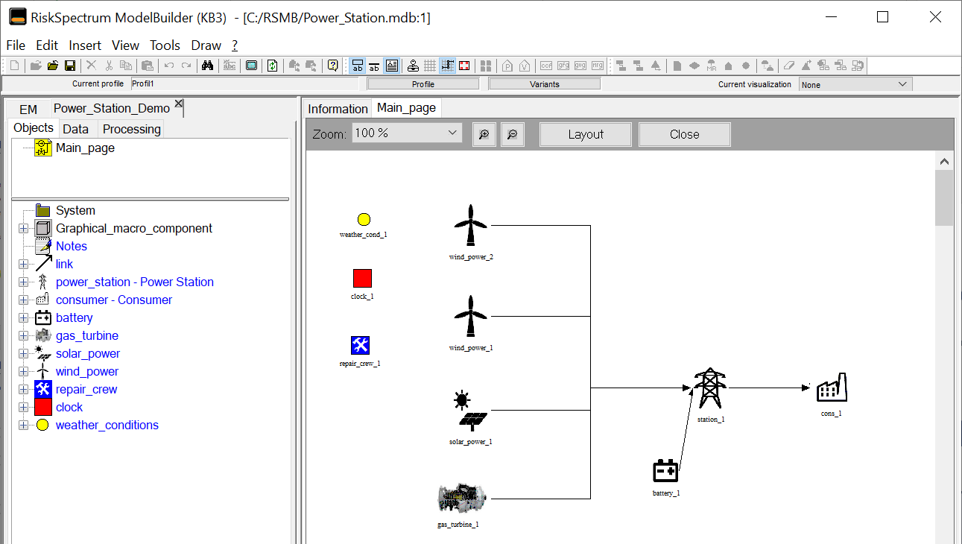

RiskSpectrum ModelBuilder (KB3)
System model
ModelBuilder – Platform
Solvers
Fault trees (RiskSpectrum PSA)
Monte Carlo simulation (YAMS)
Knowledge base (Figaro language)
Components
Behavior including failures
Interactions
Communi-cation
Propagation of failures
Low-level model
Drawing fault trees, Petri nets, Markov chains
Notes:
The tool that brings this approach to the RiskSpectrum Suite is RSMB.

Slide 11
RiskSpectrum ModelBuilder (KB3)
System model
ModelBuilder – Platform
Solvers
Fault trees (RiskSpectrum PSA)
Monte Carlo simulation (YAMS)
Library of components:
Defined by an expert
Reliability knowledge
Domain knowledge
Validated once
Knowledge base (Figaro language)
Components
Behavior including failures
Interactions
Communi-cation
Propagation of failures
Low-level model
Drawing fault trees, Petri nets, Markov chains
Notes:
The tool that brings this approach to the RiskSpectrum Suite is RSMB.

Slide 12
RiskSpectrum ModelBuilder (KB3)
System model
ModelBuilder – Platform
Graphical system model:
Can be built by system
experts with limited
reliability background
Configurable
Quick modeling
Easy evaluation of
alternatives
Knowledge base (Figaro language)
Components
Behavior including failures
Interactions
Communi-cation
Propagation of failures
Low-level model
Drawing fault trees, Petri nets, Markov chains
Notes:
The tool that brings this approach to the RiskSpectrum Suite is RSMB.

Slide 13
Enhancing automation using AI – with accountability and traceability
Platform – validation of object representation
System model
Solvers
Fault trees (RiskSpectrum PSA)
Can be imported using
“standard” import
approaches
Can be generated using AI
based on a variety of
information
Monte Carlo simulation (YAMS)
Knowledge base
Complete knowledge, validated
Can be written manually
Can be AI supported generation, with review
Notes:
The tool that brings this approach to the RiskSpectrum Suite is RSMB.

Slide 14
Model Update/Additions

Slide 15
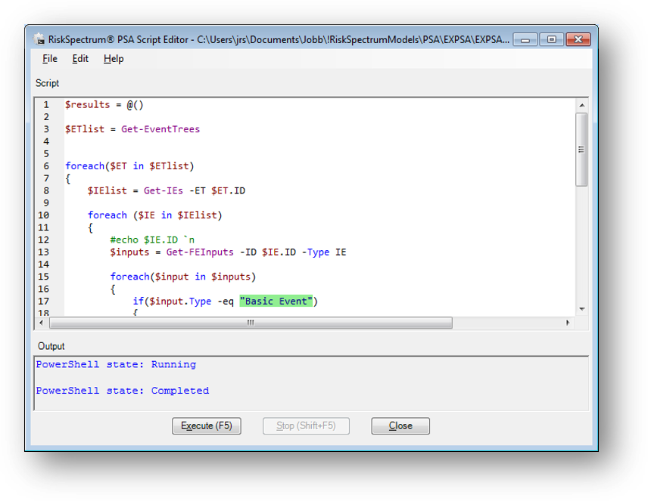
Model Update and Additions
Update model at plant modifications or with new knowledge
Should be performed with the same consistency as the
original model setup
  Same process described on model creation should be
  used by extending or modifying the input
Adding new data, where the data is to be treated
separate from the model creation phase
  An interface for automatic data adjustment is desirable
  In RiskSpectrum we have a Macro language developed for this purpose
  Manage repetitive tasks, improve quality and speed, and to assist in generation of documentation

Slide 16
An example of an API feature – using AI with accountability
RiskSpectrum PSA Macro
Collecting information that should be transferred to the PSA model
Could be generated by AI (and reviewed)
Provides a scripting interface for RiskSpectrum PSA
Simulate operations in RiskSpectrum PSA
  filtering a record list, adding/editing records
  Adding or editing relations between records, etc.
AI can efficiently be used to generate scripts (which then can be easily validated)
Inserting the information into the PSA model

Slide 17
Generation of outputs and review

Slide 18
Extracting data, generating reports and assisting in model review
Automation in data extracting activities can efficiently be achieved with scripts, to extract the relevant information
Data extraction is likely a part where AI will have a significant contribution going forward
  Depending on use case, either to write scripts to extract information – or to also process the data that you ask for
  To actually manage the data and produce information will require appropriate authorization of the AI
Review is likely also a case where AI can be very helpful. Accountability of reviewer is not removed – however AI will be a very good tool.

Slide 19
Conclusions

Slide 20
Automation in PSA Model Creation, Maintenance and Use
Model Setup
Model Update/Additions
Model Review
Result/Data Extracts
Model Usage
Automation has not widely been used in model creation – some exceptions, like EDF
Strong trend to use approaches for automation (driven by AI)
Use of AI has some challenges to solve – but there are other approaches readily available
  Model Based approaches and API/Macros
  AI is a very good supporting tool – but should be implemented with maintained accountability
Generation of output – AI will likely have a very clear use case
  Including reviewing of models

Slide 21
Thank you
Please contact:
sales@riskspectrum.com, ola.backstrom@riskspectrum.com, pavel.krcal@riskspectrum.com

