Slide 1
INL/CON-26-91187
Data-Driven Reduced-Order Models of Control Room Procedural Execution
  Niharika Karnik, Jisuk Kim, Thomas Ulrich, and Ronald Boring
Probabilistic Safety Assessment and Management (PSAM) 18

Slide 2
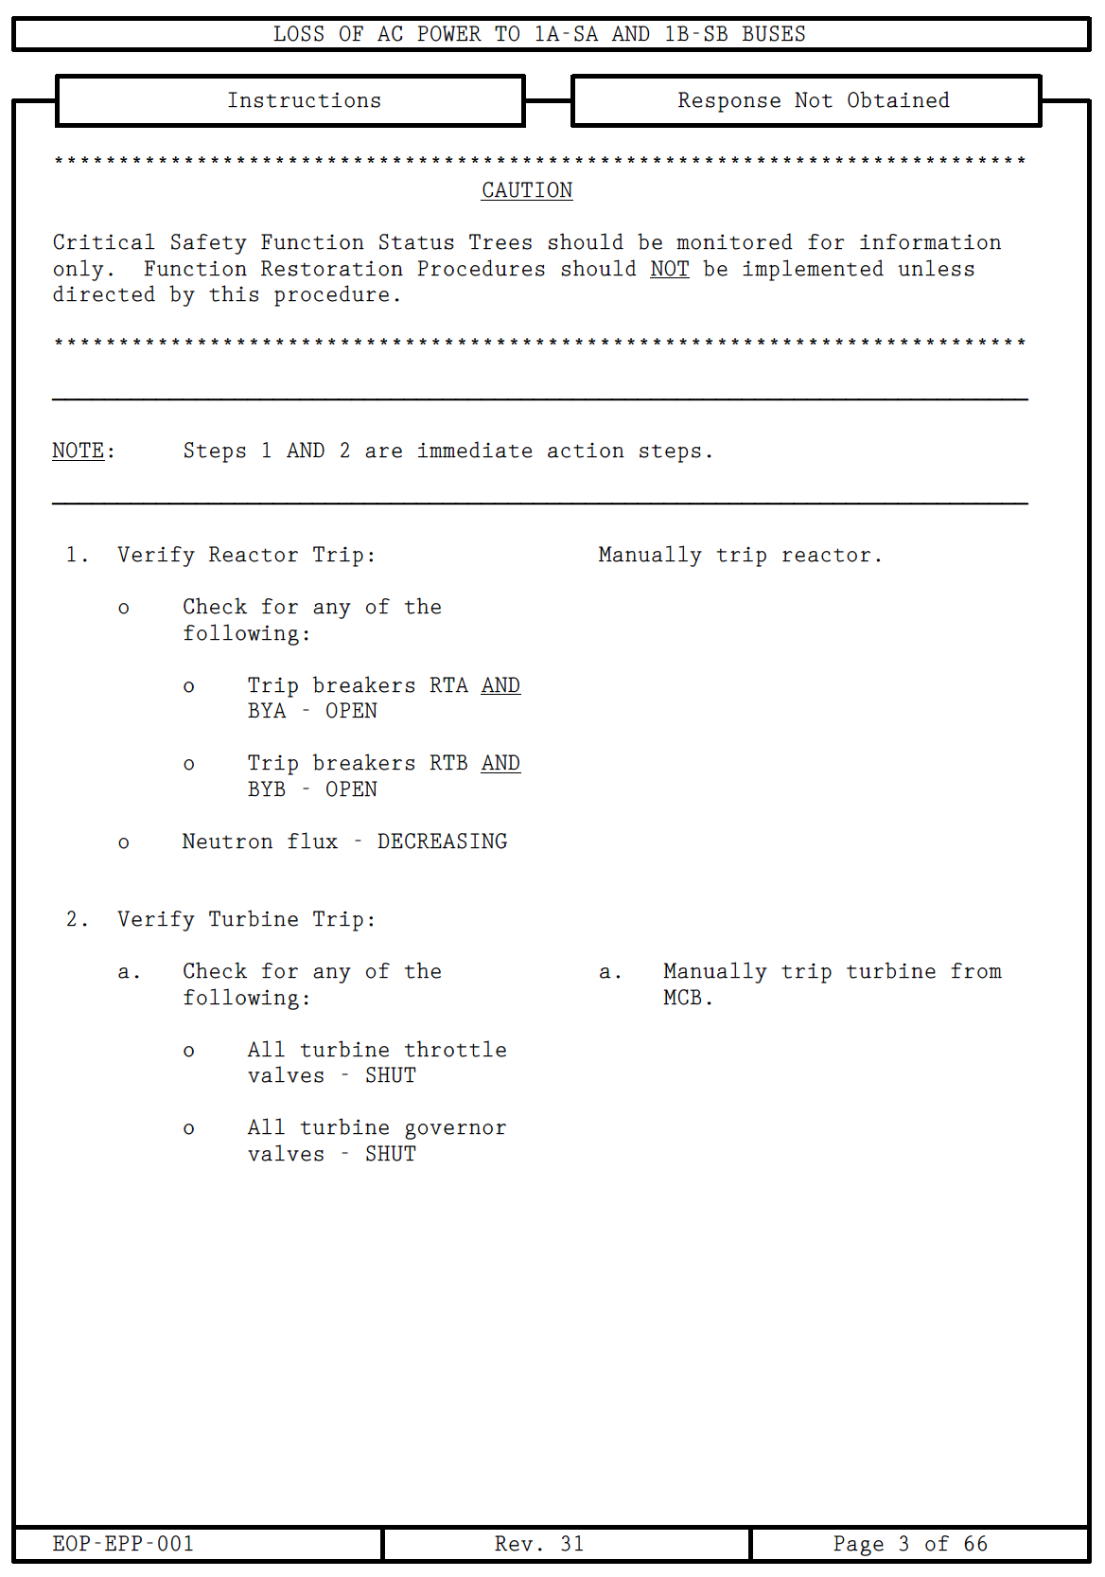
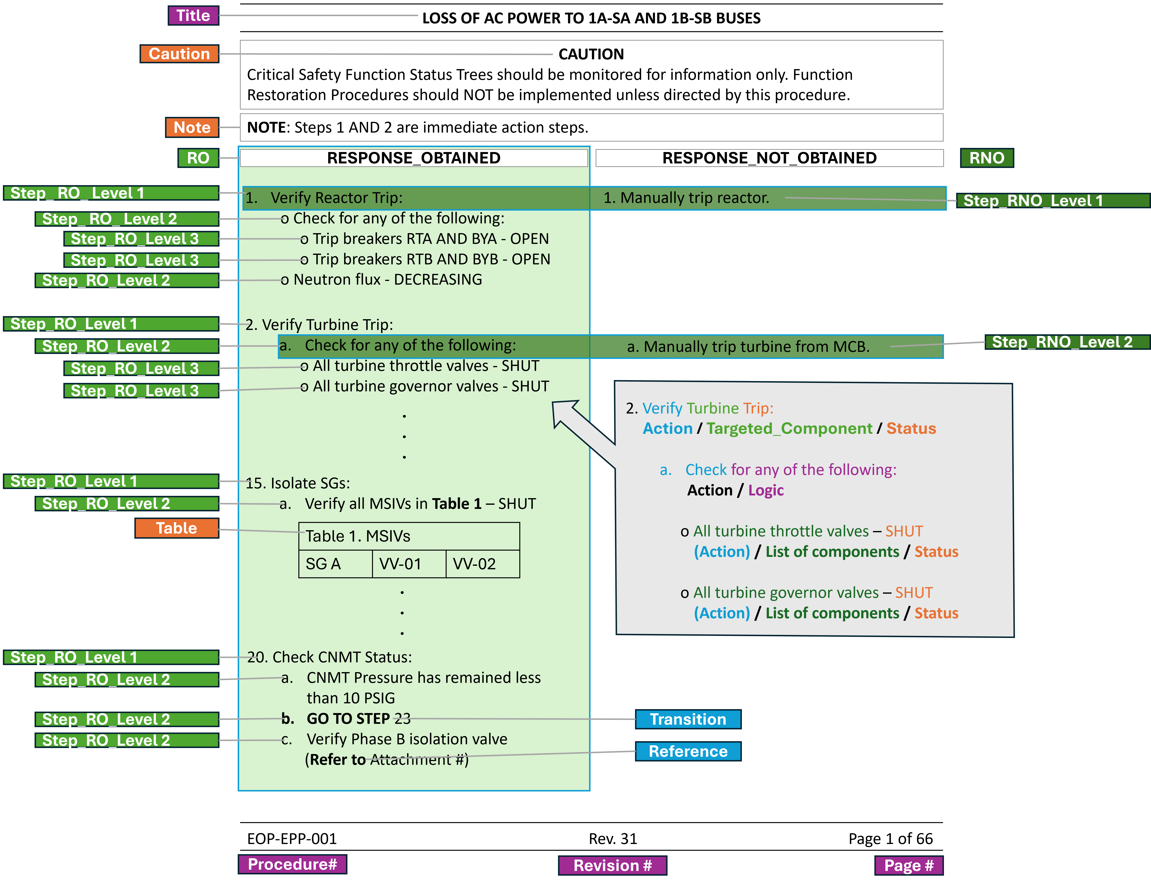
Introduction – Unstructured Paper Procedures
Nuclear power plants rely on a vast collection of paper operating procedures that are diverse and varying in their structure and codification of plant logic.
Execution of the procedures also implicitly relies on operator institutional knowledge acquired through extensive training and experience.
Translating this combined information and expertise into digital form presents a dual challenge.
Figure 1: Emergency Operating Procedure (EOP) demonstrating the complex two-column structure commonly used in nuclear operations. The diversity of layouts, notes, cautions, tables, and procedural logic across documents presents a key challenge for automated knowledge graph extraction.

Slide 3
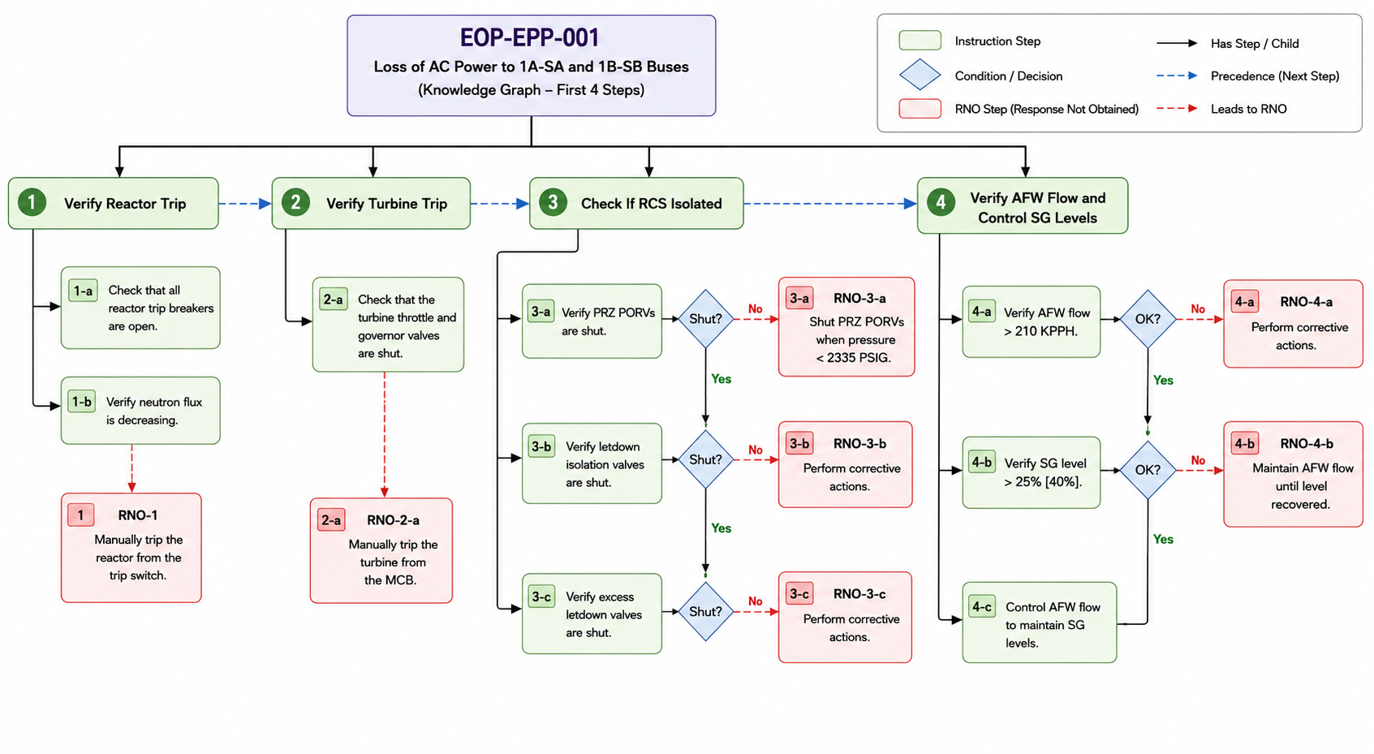
Introduction - Efforts to Digitize Procedures
AI enables the conversion of these procedures into structured, machine-readable knowledge graphs [1][2].
Structured knowledge graphs provide the foundation for:
  Simulator-based studies and operator training
  Digital control room integration
  Automated and AI-assisted plant operations
  Advanced decision support and reasoning
Figure 2: Knowledge graph representation of the first four steps of EOP-EPP-001, showing instruction flow, decision points, and RNO actions.
[1] N. Karnik, J. Kim, B. Wilcken, R. Lew, R. Boring, and T. Ulrich. 2026. “Transforming nuclear power plant procedures from unstructured paper to structured knowledge graphs using large language models.” Manuscript under review (Submitted to IEEE Transactions on Human Machine Systems).
[2] J. Kim, N. Karnik, R. Boring, B. Wilcken, R. Lew, and T. Ulrich. 2026. “LLM-based structured reconstruction framework for nuclear power plant operating procedures, with comparative evaluation and human-in-the-loop refinement." Manuscript under review (submitted to Engineering Applications of Artificial Intelligence).
Notes:
Up to this point, we've focused on converting paper-based procedures into a structured, machine-readable knowledge graph. However, simply digitizing procedures isn't the end goal. Once procedures are represented as a graph, we can begin to analyze how operators would actually traverse those procedures under different plant conditions. This opens the door to simulator-based studies, human reliability analysis, AI-assisted decision support, and ultimately digital and autonomous control room technologies.

Slide 4
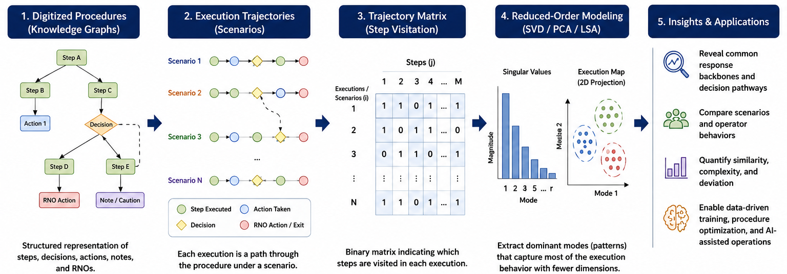
Objective - Reduced Order Modeling of Procedures
Transform digitized procedures into executable procedural trajectories.
Represent multiple execution paths as a trajectory matrix.
Discover dominant modes of procedural execution using reduced-order models (e.g., SVD/PCA/LSA).
Quantify similarities and differences between accident scenarios and operator responses.
Enable scalable analysis for operator training, procedure optimization, and autonomous control room technologies.
Figure 3: Framework for transforming procedural execution into reduced-order representations.
Notes:
One important aspect to recognize is that a procedure is not executed the same way every time. Depending on the plant conditions and the initiating event, operators may follow many different paths through the same procedure. These trajectories can be generated by coupling the digitized procedure with a full-scope plant simulator, or by analyzing procedural execution from a Probabilistic Risk Assessment (PRA) perspective using accident scenarios. As a result, each procedure does not represent a single sequence of actions, but rather a large combinatorial space of possible execution trajectories. This rapidly becomes too complex to analyze directly. Instead of examining every trajectory individually, we seek to identify the underlying patterns and dominant modes of procedural execution. This motivates the use of reduced-order modeling, which allows us to capture the latent structure and essential behavior of these trajectories in a much lower-dimensional representation.

Slide 5
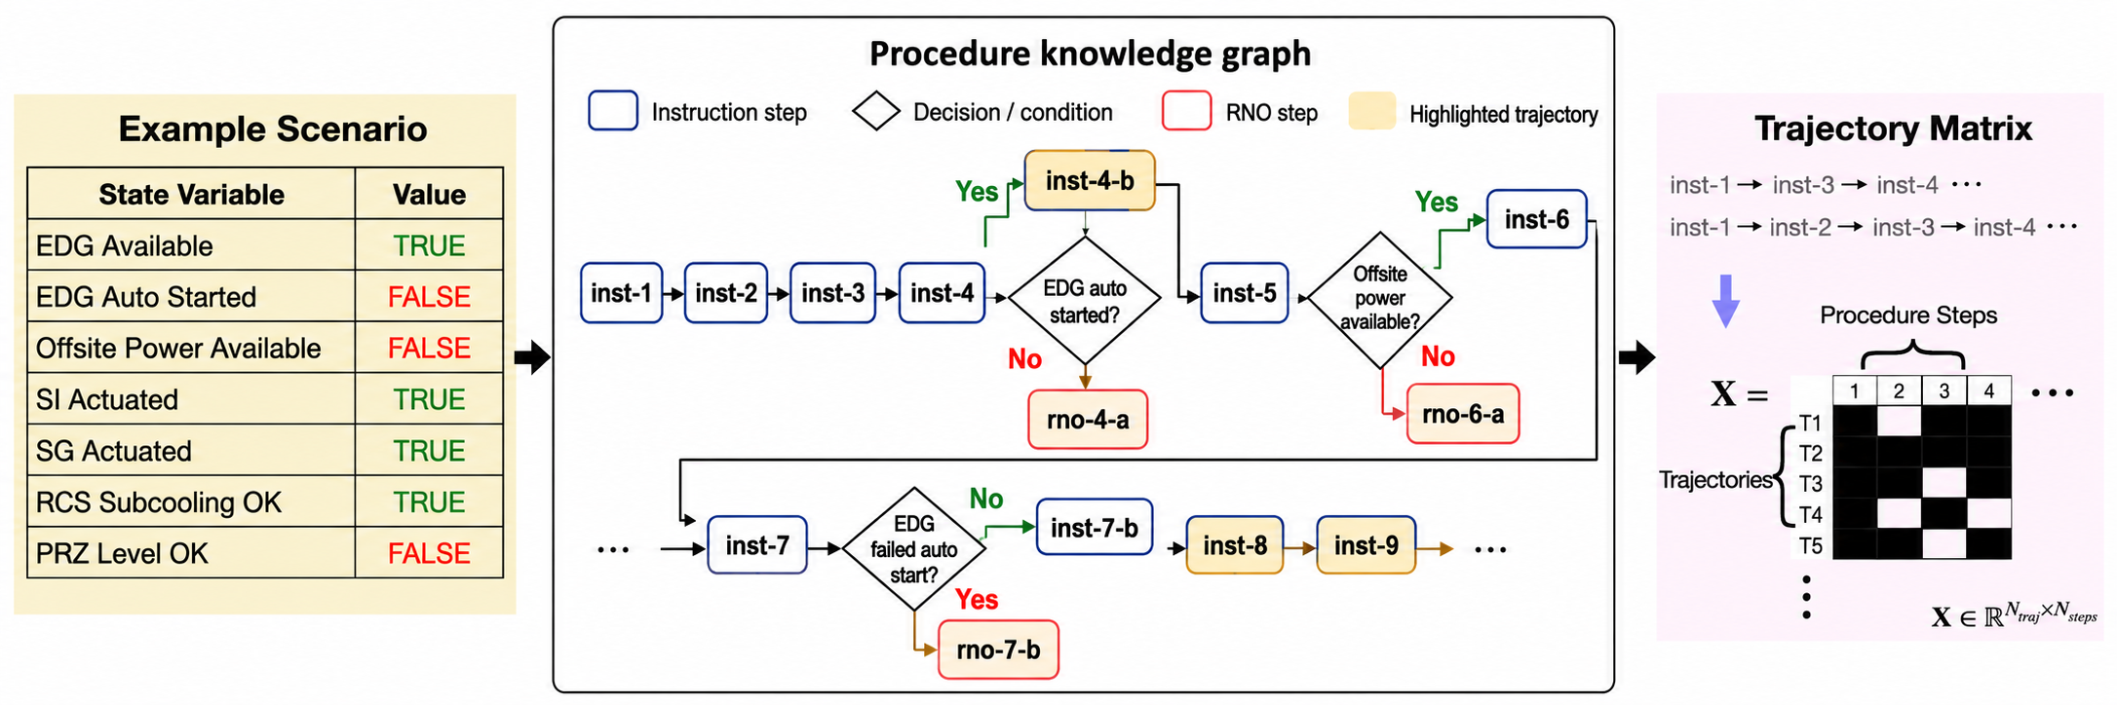
Methodology – From digitization to execution analysis
Structured procedures become executable digital workflows where different plant conditions produce different execution trajectories.
Trajectories can be first arranged into a matrix representation and then analyzed systematically across thousands of scenarios through data-driven reduced order models which supports probabilistic safety assessment and control room modernization.
Figure 4: Procedure execution represented as graph traversal trajectories and encoded into a trajectory matrix, enabling quantitative analysis of operator response pathways.
Notes:
Once we have converted the procedure into a knowledge graph, we can begin thinking about procedural execution as a collection of possible trajectories rather than a single linear sequence.
We assume different simulator scenarios where monitored plant conditions are either TRUE or FALSE. These conditions determine which decision branches are taken as the procedure is executed.
By traversing the knowledge graph under each simulated plant state, we can follow the sequence of procedural steps that an operator would execute. Each unique path through the graph represents one possible procedural trajectory.
Repeating this process across many different plant conditions allows us to generate a large collection of trajectories, which can then be organized into a trajectory matrix. This matrix becomes the foundation for applying reduced-order modeling techniques.

Slide 6
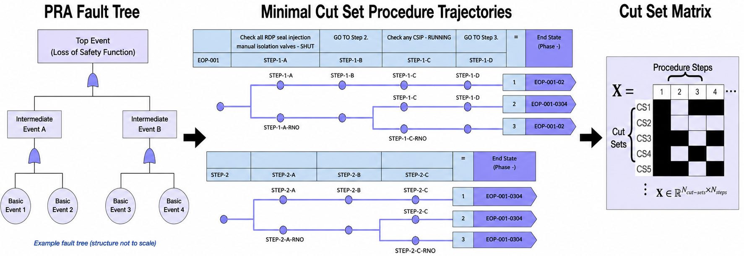
Methodology – Trajectory based representation of Cut-Sets
Structured procedures become executable digital workflows where different plant conditions produce different execution trajectories.
Trajectories can be first arranged into a matrix representation and then analyzed systematically across thousands of scenarios through data-driven reduced order models which supports probabilistic safety assessment and control room modernization.
Figure 5: Generation of a binary cut-set trajectory matrix from PRA fault tree minimal cut sets
Notes:
An alternative way to generate procedural trajectories comes from a Probabilistic Risk Assessment (PRA) perspective. Rather than simulating different plant conditions, we model the procedure as a fault tree, where each decision or action is associated with a probability of failure.
By evaluating the fault tree, we obtain minimal cut sets, which represent combinations of failures that lead to an undesired outcome. Each cut set can be viewed as a unique trajectory through the procedural logic.
These trajectories are then encoded into a trajectory matrix, with each row representing a cut set and each column corresponding to a procedural step or event. Similar to the simulator-based approach, this matrix provides a structured representation that can be analyzed using reduced-order modeling techniques

Slide 7

Methodology – Singular Value Decomposition (SVD)
Decompose the trajectory matrix using Singular Value Decomposition (SVD).
Extract the dominant modes that capture the most significant procedural behavior.
Compress thousands of possible trajectories into a low-dimensional latent representation.
Discover hidden semantic relationships between procedural steps through Latent Semantic Analysis (LSA).
Generate a latent semantic space by projecting the SVD components onto the dominant singular vectors and Use the reduced SVD representation to construct a latent semantic space that captures hidden procedural meaning.
Figure 6: Binary trajectory matrix $X$showing procedural step visitation across simulated execution scenarios.
$$X=UΣV^{T}$$
$X$ is the matrix containing all procedure execution trajectories
$U$contains the dominant execution modes (characteristic patterns)
$Σ$ ranks the importance of each mode by its singular value
$VT$ describes how each individual trajectory is composed of those modes
Notes:
The question then becomes: how do we compress thousands of possible execution trajectories into a representation that still preserves the important operational behavior? Singular Value Decomposition, or SVD, provides exactly that capability. Singular Value Decomposition (SVD) is a mathematical technique that identifies the most important patterns in a large dataset. Rather than analyzing every individual trajectory separately, SVD decomposes the trajectory matrix into a small set of dominant modes that capture the majority of the system's behavior. In other words, it compresses thousands of possible execution paths into a reduced-order representation while preserving the key dynamics. This allows us to analyze, compare, and predict procedural execution much more efficiently. These dominant modes capture the execution patterns that occur most frequently across all procedural trajectories, while less significant components often correspond to noise or rare events. By retaining only the most important modes, we obtain a compact, low-dimensional representation of the procedure.
This reduced representation forms what is known as the latent semantic space, or Latent Semantic Analysis. The key idea is that procedures or trajectories that share similar execution behavior are positioned close together in this space, even if they don't follow exactly the same sequence of steps.
Instead of comparing procedures step-by-step, we compare them based on their underlying semantic structure. This opens the door to clustering similar procedures, identifying common operational strategies, detecting unusual execution paths, and ultimately building reduced-order models that support AI-assisted reasoning and decision support.

Slide 8
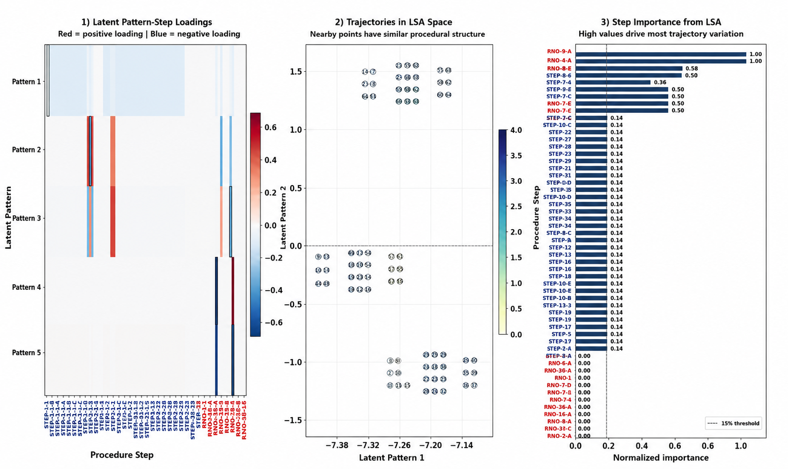
(a)
Results
96 simulated trajectories represented across 85 procedural steps.
Three latent modes capture 99.1% of the trajectory variance, indicating a highly compressible procedural space.
Compression ratio of 3/85 (≈4%), reducing procedural complexity while preserving essential execution behavior.
Latent semantic embeddings separate trajectories into groups with similar execution characteristics.
Step loadings identify the procedural actions that contribute most to variability across simulated scenarios.
(b)
Figure 7: (a) Singular Value Spectrum and Cumulative variance explained. (b) Latent Semantic Analysis
Notes:
Here we applied Singular Value Decomposition to the trajectory matrix generated from 96 simulated executions of the procedure, where each trajectory represents a unique path through the knowledge graph under different plant conditions.
The plots across the top summarize the dimensionality reduction. On the left, we see a dominant first singular value, indicating that much of the procedural behavior is explained by only a few underlying execution patterns. On the right, the cumulative variance plot shows that just three latent modes capture over 99% of the total variance, reducing an 85-step procedural representation to only three dimensions.
The lower-left figure shows the latent pattern loadings. These indicate which procedure steps contribute most strongly to each latent execution pattern. Rather than treating every step independently, SVD identifies combinations of steps that tend to occur together across many trajectories.
In the center, the trajectories are projected into the latent semantic space. Trajectories with similar procedural behavior naturally cluster together, demonstrating that the reduced representation preserves meaningful execution characteristics.
Finally, the step importance plot ranks the procedure steps according to their contribution to variation across all simulated trajectories. This helps identify the portions of the procedure that have the greatest influence on overall execution behavior.
The key takeaway is that although the procedure consists of 85 individual steps and 96 possible execution trajectories, its behavior can be represented using only three latent semantic patterns while preserving more than 99% of the information. This provides a compact reduced-order model that can support similarity analysis, anomaly detection, and future AI-assisted decision support.

Slide 9
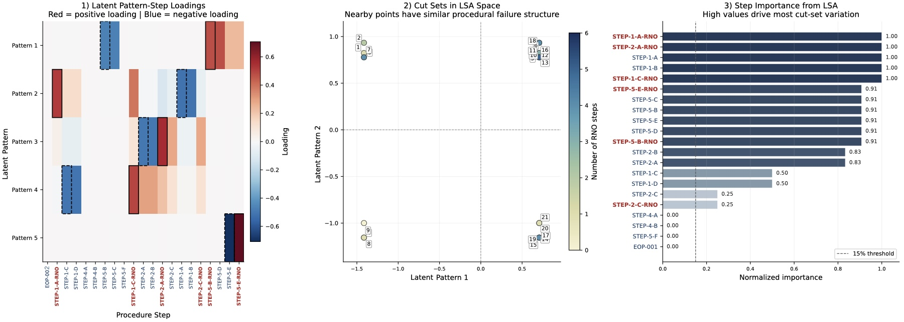
Results
(a)
21 minimal cut sets represented across 21 procedural steps.
Six latent modes capture essentially 100% of the procedural variance, yielding a 71% reduction in dimensionality.
Latent semantic embeddings group cut sets with similar procedural failure characteristics.
Dominant latent patterns identify recurring combinations of procedural steps across failure scenarios.
Step importance analysis highlights the procedural actions that contribute most to cut-set variability.
(b)
Figure 8: (a) Singular Value Spectrum and Cumulative variance explained. (b) Latent Semantic Analysis
Notes:
This analysis applies the same reduced-order modeling framework, but instead of simulator-generated trajectories, the trajectory matrix is constructed from minimal cut sets obtained through Probabilistic Risk Assessment.
Each row represents a unique failure trajectory through the procedure, while each column corresponds to a procedural step. Applying Singular Value Decomposition allows us to identify the dominant patterns that characterize these failure pathways.
Looking at the top row, the singular value spectrum and cumulative variance show that six latent modes are sufficient to capture essentially all of the variability within the cut-set matrix. Although the matrix contains 21 procedural steps, the effective dimensionality is much smaller, corresponding to a compression ratio of approximately 29%.
The lower-left figure illustrates the latent pattern loadings. These patterns identify groups of procedural steps that tend to appear together across multiple failure trajectories, providing insight into the dominant structures within the fault tree.
In the center, the cut sets are projected into the latent semantic space. Similar failure trajectories naturally cluster together, indicating that the latent representation preserves meaningful relationships between different cut sets.
Finally, the step importance plot ranks the procedural steps according to their contribution to overall variability. These rankings help identify the procedural actions that have the greatest influence on differentiating one failure pathway from another.
The key takeaway is that the same latent semantic framework applies not only to simulator execution paths but also to PRA-derived failure trajectories, providing a common reduced-order representation for procedural analysis across multiple operational perspectives.

Slide 10
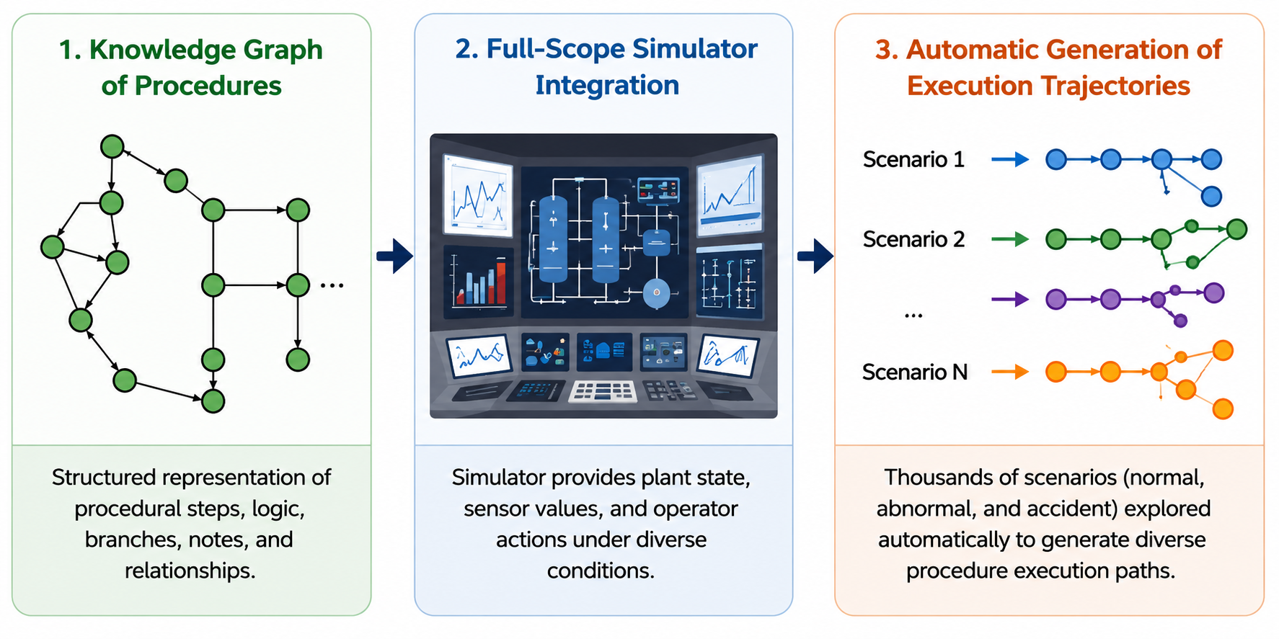
Conclusion and Outlook
Demonstrated that knowledge graph traversal can generate trajectory representations for both scenario-based and PRA minimal cut sets.
Showed that only 6 latent modes are required to represent a 21-step procedure while preserving ≈100% of the procedural variability.
Revealed hidden semantic relationships between procedural trajectories using Latent Semantic Analysis.
Identified the procedure steps that dominate variation across execution paths, improving interpretability.
Enables reduced-order procedural models for AI-assisted operations, operator decision support, and digital control room technologies.
Figure 9: Next steps would involve integration of knowledge-graph based procedures with the plant simulator to automatically generate diverse execution strategies across multiple procedures and scenarios.
Notes:
The work presented today demonstrates that procedures can be converted into knowledge graphs and represented as compact latent models. The next step is to close the loop with the plant simulator.
Instead of manually defining trajectories, the simulator will automatically execute thousands of operating scenarios under varying plant conditions. Each execution becomes another trajectory through the knowledge graph, allowing the trajectory matrix to grow continuously.
As additional operating data are incorporated, the latent semantic model becomes richer and more representative of real plant behavior. This provides a scalable reduced-order representation that can support similarity analysis, anomaly detection, procedure recommendation, and ultimately AI-assisted decision support in future digital control rooms.

Slide 11
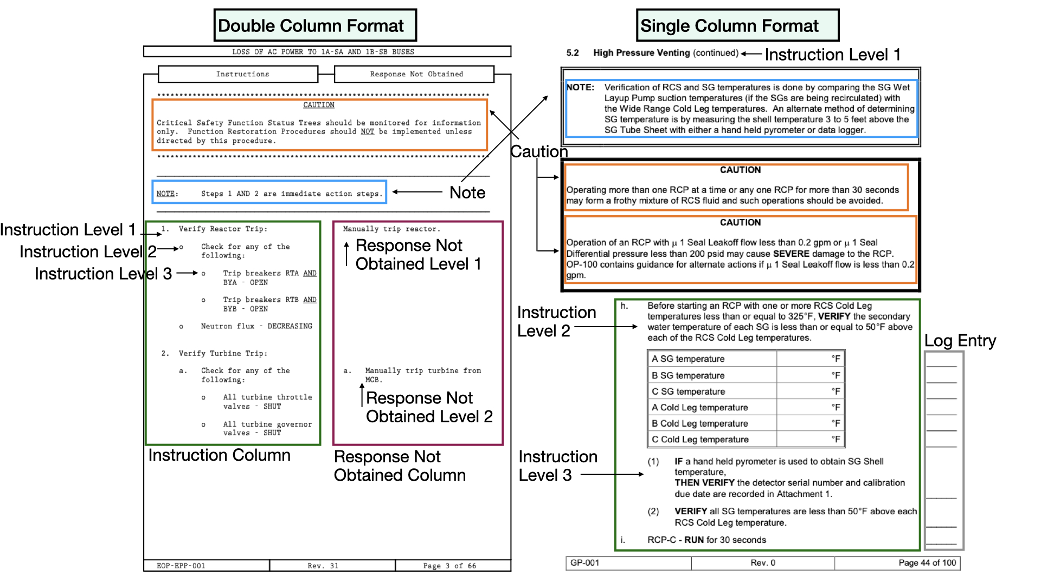
Backup 1: GP and EOP

Slide 12
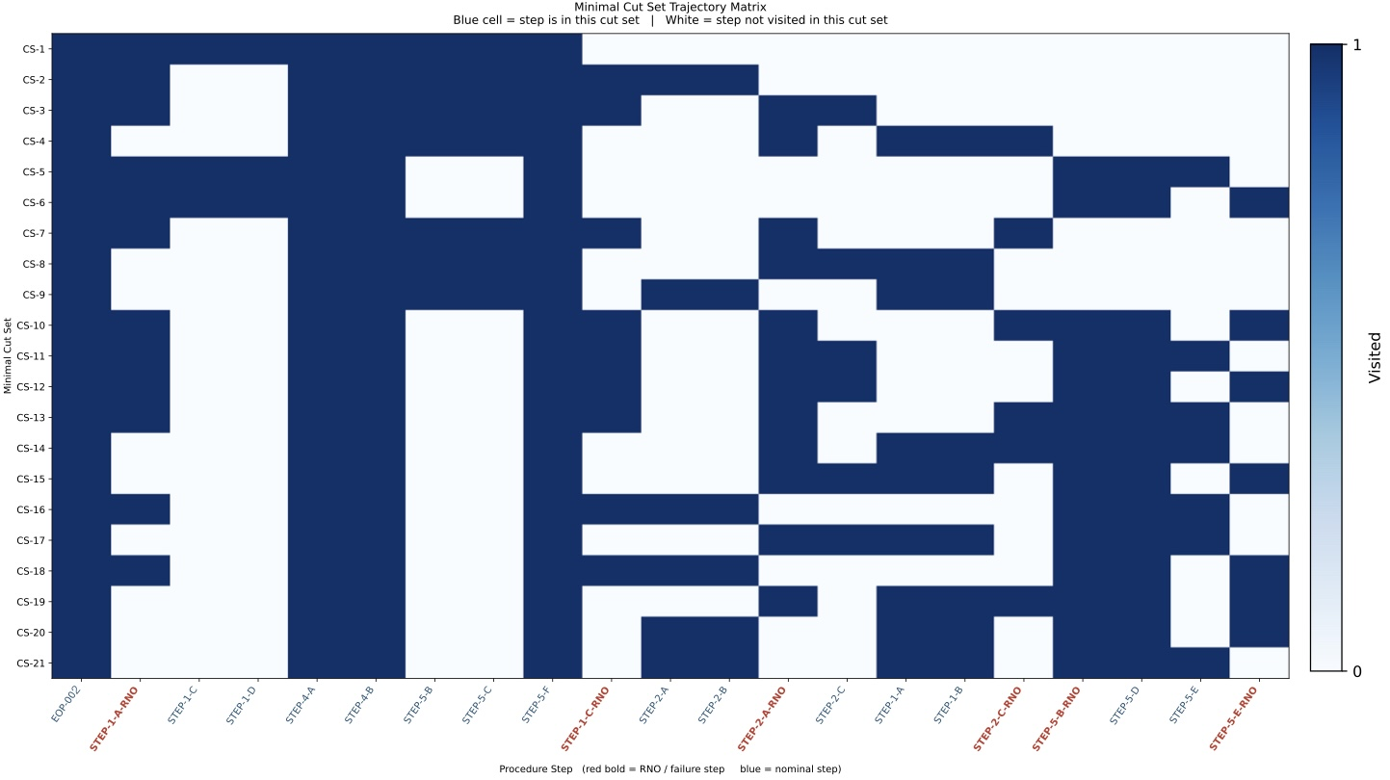
Backup 2: PRA cut-set Matrix
Figure 6: Binary trajectory matrix $X$showing procedural step visitation across PRA cut-set

