Slide 1
Specifics of PSA activities at the new build NPP project with Russian type WWER-1200 reactors
PAKS 2 (Hungary)
^{Istvan NEUBAUER}
^{Senior PSA expert}
^{Nuclear Department}
PSAM18 2026.07.21

Slide 2
Technical information
Current status of the project
Milestones & pullback factors
Project cost considerations

Slide 3
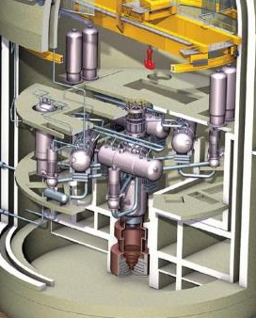
Technical information
1200 MWe, 92% LF, 18 m campaigns, 4,95% UO₂, 163 assemb /138 rods in each, 121 control rods, horizontal SG-s
Atomenergoproekt design (Russia)
Double-walled containment.
Four independent active safety systems.
Managing complex and severe accidents by passive safety systems (core-catcher, hydrogen recombiners, passive emergency cooling).
Increased earthquake resistance.
72 hours of independence from external power supply.

Slide 4
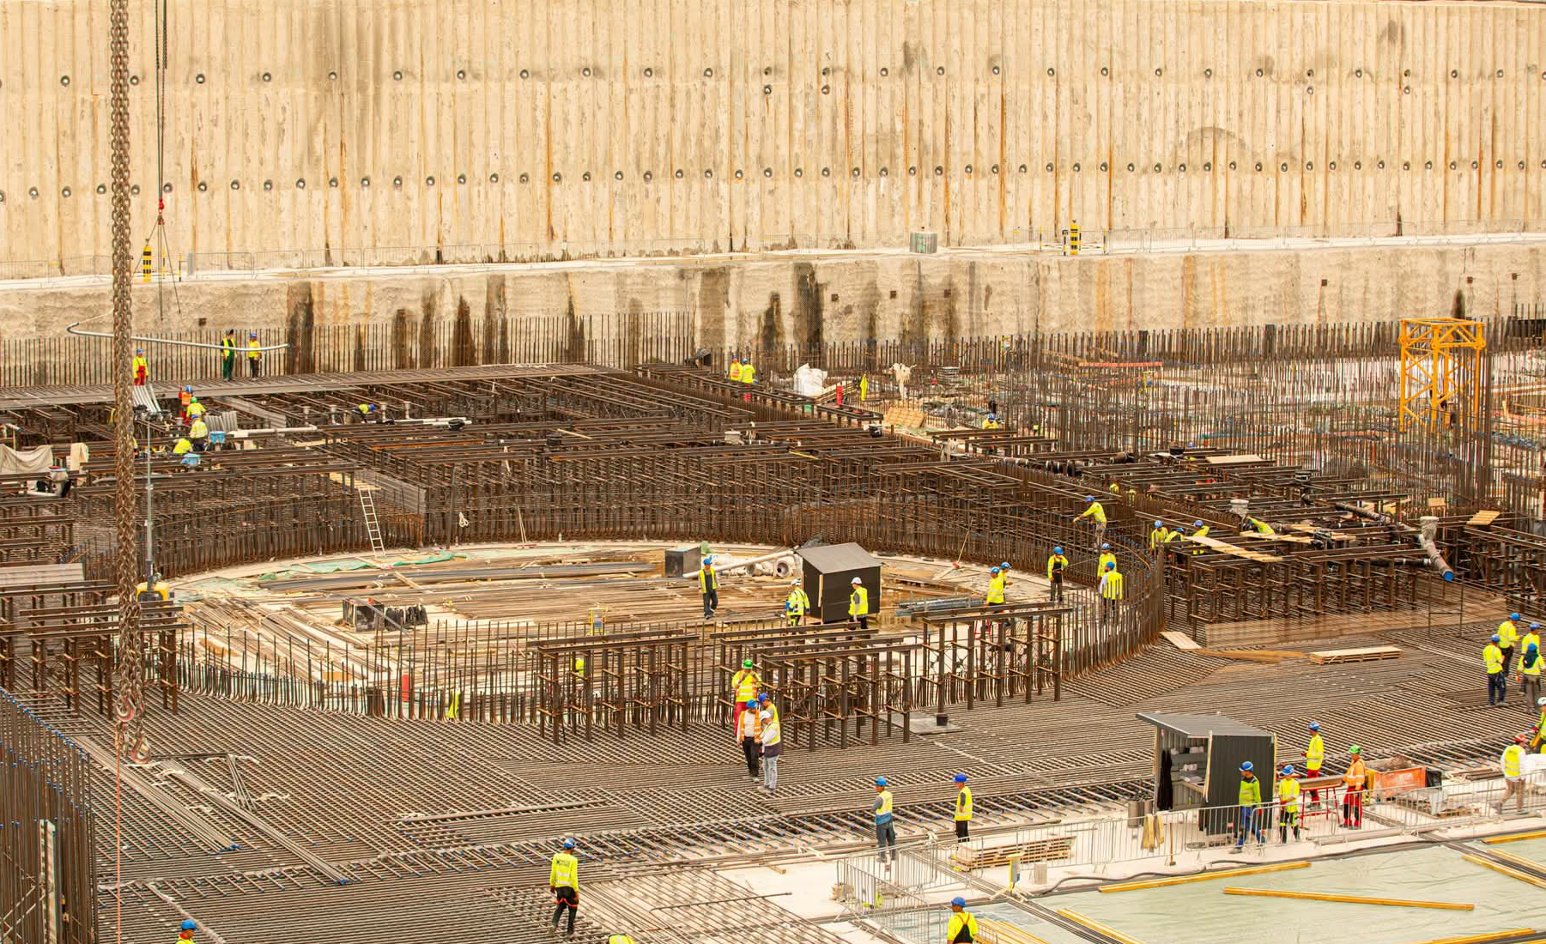
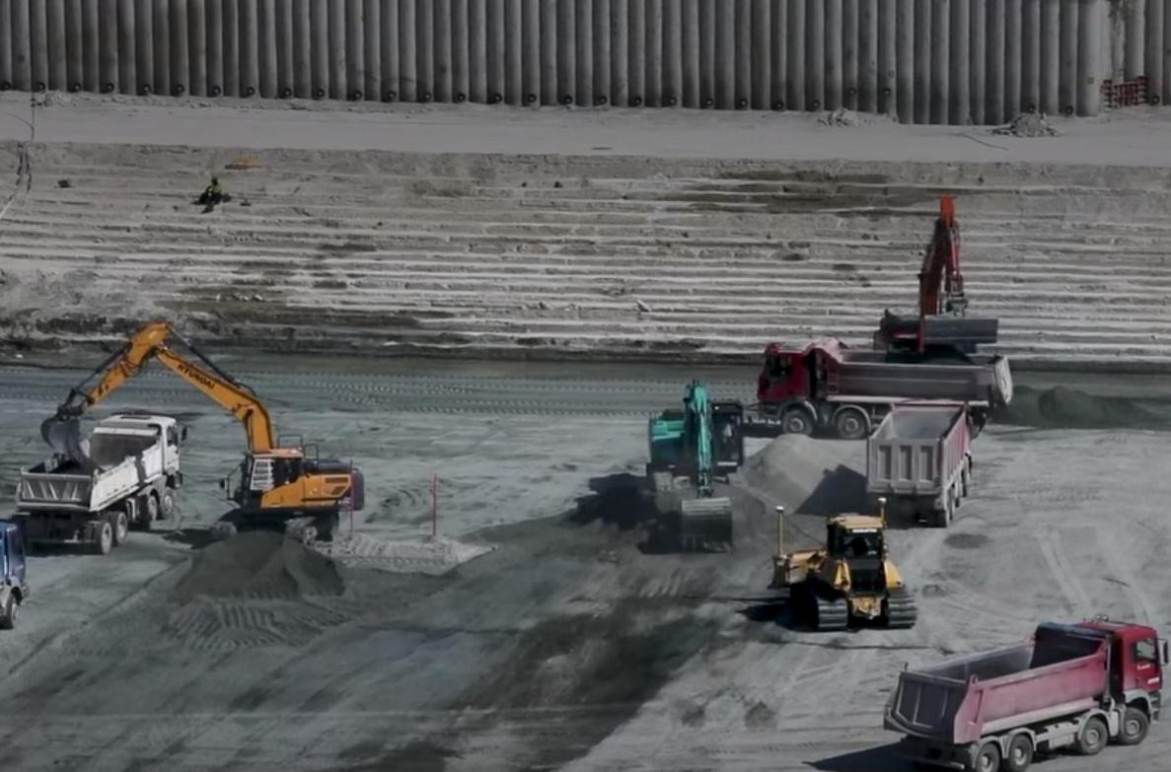
Current status of the project
Unit No 5 – excavation and soil improvement have already finished
First concrete poured: 05.02.2026
Right now: rebar mounting works go on, part of the foundation slab level is already completed
Unit No. 6: preliminary excavation is finished
Soil improvement is finished
Excavation to the levelling concrete depth is made on 75%

Slide 5
Milestones and pullback factors
2009 – 95% yes votes in the parliament for starting preliminary works of new NPP units at the Paks site.
2011 – New National Energy Strategy – Nuclear energy still in leader position
2014. January – Intergovernmental Agreement between Russia and Hungary on delivering 2 VVER NPP units
2014 Due to suspected limitation of business competition EU Commission started an investigation – almost 3 years standstill !
2019 – General Contractor delivered Basic Design intime to the Owner
2020.06 – Owner submitted to the Authority the Implementation License Application (with Preliminary Safety Review)
2022.08 – ILA has been granted
2023 – Start of excavation, soil improvement works
2024.11 – PSAR granted
2026.02 – First concrete pouring

Slide 6
Project cost considerations
As a rule: costs will increase, but Increase due to delay (fix price)
Increase due to enrichment, improvement of the technical content since specification in agreements in 2014:
Soil improvement
Increased earthquake resistance
Maneuvering
Redesigned Emergency Cooling System (JNB50)
Steam Generator & Containment passive cooling improvements
Solutions, more suitable to the state of the art (e.g. containment isolation)
More reliable Spent Fuel Pool cooling
Continuous improvement of the design
Water lubricated Main Circulation Pumps etc.

Slide 7
Generic PSA activities
Use of PSA for licensing purposes

Slide 8
Generic PSA activities
PSA – Safety Assessment
    Ruled by the Safety Code we have to justify
        All of probabilistic criteria are met summarizing them for all initiating events and all operational states (CDF, CLIEF)
        Design is balanced, so there are not initiating events, event sequences, SSC-s, hazards that determine level of the safety dominantly.
For these purposes we have to have and validate event-logic and reliability-logic model of the unit. Safety systems and components have to be modelled considering their planned and factual maintenance, tests, inspections.

Slide 9
Generic PSA activities
PSA from Designer (HAEA approved integrated model) | PSA from independent source (ongoing project, PSA1 + PSA2)
Review of the model and documentation | Review the independent model and documentation
Use PSA for evaluation of design modifications | Use PSA for partial comparison of system analyses
Use PSA for suggestion of modifications | Use for justification of modification
Use PSA as an input for PSA applications | Development of applications (methodology etc)
Probabilistic indices meet NSC criteria:
CDF = 2,21E-07 1/y < 1E-05 1/y (crit),
CLIEF = 2,29E-07 1/y < 1E-06 1/y (crit),
And the design has found balanced
Next (site-specific) designer assessment and completion of the independent assessment (including time consuming severe accident analyses) will happen in the next phase of the project (not earlier than 2029)

Slide 10
RILG – use of PSA for licensing purposes
Outlining the problem:
  Manufacturing or procurement of safety related systems, components can be started only having appropriate license.
  In Hungary there are 4 safety classes for components, SC 1,2,3 are nuclear safety related, SC4 is non safety related. NSC does not accept risk based safety classification. (not yet)
  By the preliminary assessment of the HAEA these type of licenses could have affected appr 8000-10000 components, that seemed unmanageable.
PSA team proposal: methodology, based on risk importance of components can be developed and implemented to solve the problem. Checking the assessment of the HAEA was found that SC 1,2,3 affect 25000 components per unit
Methodology was developed by Hungarian Nuclear Safety Institute (NUBIKI)

Slide 11
RILG – use of PSA for licensing purposes
Authority has changed the NSC and responded: SC1 (primary circuit components and main isolation barriers – primary circuit pipelines, containment etc) will be licensed by the previous licensing process (~1500 component), SC2 and SC3 components shall be grouped by Safety Class and their significancy:
  Significancy of PSA modelled components based on their FV risk importance and Risk Increase Factors, quantified in the PSA model;
High: FV > 0.005
Medium: FV < 0.005, RIF > 2
Low: RIF < 2
  Significancy of components not modelled in the PSA is judged by an expert group

Slide 12
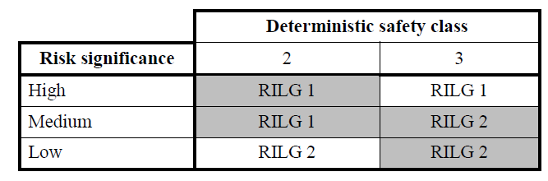
RILG – use of PSA for licensing purposes
Based on the methodology of the NUBIKI Risk Informed Licensing Group categories shall be defined by deterministic safety class and risk significance of the component.
RILG1 is licensed via „notification obligation” (Authority check-back on notification, after a given period of time – licensed),
RILG2 is licensed via „Briefing obligation”,
Both of these processes contains possibility of Authority later inspection.

Slide 13
Results
Authority: ~ 1500 components SC1
RILG1: ~ 2500 components (SC2-SC3)
RILG2: ~ 25000 components (SC2-SC3)
We are proud to solve one of the problem of licensing, and
Due to automatic processes RILG-s also gives us better planning.
Design modifications bring new components and erase old ones – the work in our RILG working group is continuous.

Slide 14
Thank you for attention!

