Slide 1
Model-Based Scenario Identification for Guided Dynamic Probabilistic Risk Assessment
Nana Yaw Amanyi Angu, Dr. Vincent Paglioni
Risk, Reliability & Resiliency Characterization Lab
nanayaw.angu@colostate.edu, vincent.paglioni@colostate.edu
PSAM 18 | July 19–24, 2026 | Pittsburgh, Pennsylvania

Slide 2
Background & Motivation
The Scalability Problem
This Work’s Approach
DPRA captures time-dependent accident progression but exploring large scenario spaces with high-fidelity codes are prohibitively expensive
Embed a low-fidelity, first-principles physics model inside a SysML (MBSE) architecture model
This is especially limiting for passive safety systems, given their novelty and limited operational data
MBSE model carries requirements, structure, function, and qualitative risk info (failure modes, fault logic)
Monte Carlo screening on the low-fidelity model identifies risk-significant regions to guide costly high-fidelity DPRA

Slide 3
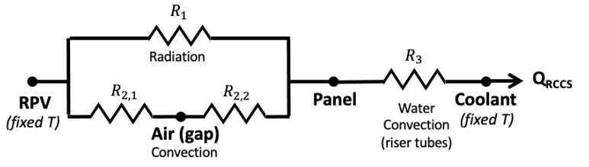
Case Study: HC-HTGR RCCS
Top Tank
The Horizontal Compact High Temperature Gas Reactor (HC-HTGR) is a prismatic gas-cooled reactor with total power of 160-230 MWt
The RCCS is a safety related system for passive decay heat removal during loss of primary and secondary cooling
high-density water
Low-density water
Heat Transfer to water
RCCS Thermal Resistance Network – (Jeong et al., 2023)
Bottom Tank
Natural Circulation Loop

Slide 4
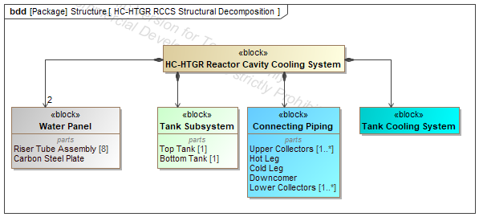
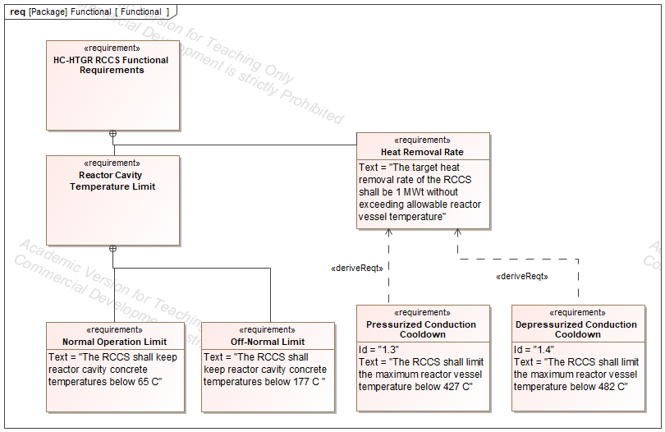
Methodology: SysML Model
Structure Diagram
The Requirements Diagram shows the required behaviors and characteristics of the system (e.g., NRC SDCs…) and links to components in the Structure Diagram
Requirements Diagram
The Structure Diagram (above) provides the logical structure of the system in terms of subsystems and components.
E.g. –Water Panel is a subsystem to RCCS, with 2 main components (Riser Tubes, Steel Plate)

Slide 5
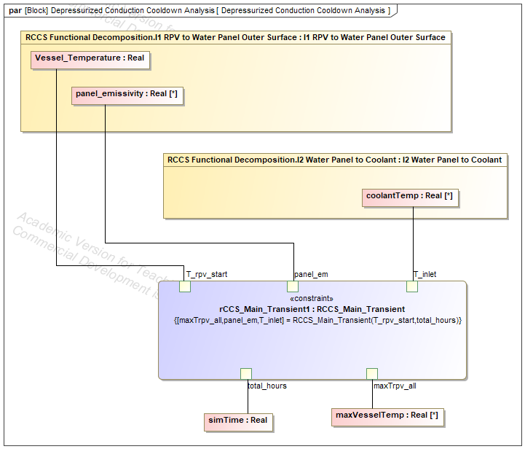
Methodology: SysML-Python
The Parametric Diagram shows how system components and parameters interconnect.
Vessel Temperature and Panel Emissivity are important to the functional connection of RPV to the Water Panel (i.e., via radiative heat transfer)
Coolant Temperature is important to the
functional connection of Water Panel to Coolant (i.e., via convective heat transfer)
Parameters from (1) and (2) are incorporated
with system constraints and passed to the low-fidelity simulation.
SysML I/O with low-fidelity model in Python.
Parametric Diagram
SysML calls low-fidelity Model

Slide 6

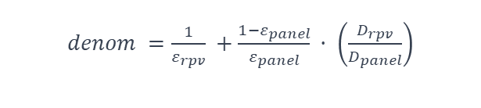
Methodology: Low-Fidelity Model
Solver 1 - Thermal Resistance Network: RPV → Panel → Coolant
RPV
Outer Wall
RCCS
Panel
Riser Tube
Coolant
T_rpv = 472 °C
ε_rpv = 0.8 (fixed)
Radiation (dominant)
T_p = unknown
ε_panel = sampled
Convection (htc)
T_in = water inlet temp
T_hot = water outlet temp
Equation 1 — Radiation (RPV → Panel)
Equation 2 — Convection (Panel → Coolant)
$$Q_{rad} = ε_{rpv} · σ · A ·\frac{\left(T_{rpv}^{4}− T_{p}^{4}\right)}{denom}$$
T_p = T_in + Q_rad / (htc · A_conv)
$denom =\frac{1}{ε_{rpv}} +\frac{1−ε_{panel}}{ε_{panel}} · \left(\frac{D_{rpv}}{D_{panel}}\right)$
htc from Dittus-Boelter: 0.023 · Re⁰·⁸ · Pr⁰·⁴ · k/D
Heat balance condition: Q_rad (Eq 1) = htc · A_conv · (T_p − T_in) (Eq 2 rearranged) — solved by successive substitution of Q_rad and T_p

Slide 7
Methodology: Low-Fidelity Model
Solver2 - Natural Circulation Loop: Momentum Balance
Collector / header
(hot side)
Pressure balance: ΔP_buoyancy = ΔP_friction + ΔP_acceleration + ΔP_minor
ΔP_buoyancy (driving force)
Density difference between cold downcomer and hot riser drives the flow. Larger ΔT → bigger ΔP_g.
(ρ_in − ρ_out) · g · H
Riser tubes
(heated, low ρ)
ΔP_friction (riser + header + downcomer)
Friction factor · (L/D) · ρ · v² / 2
Wall shear losses in all three sections. Grows with v²
Downcomer
(cold, high ρ)
ΔP_acceleration
Fluid expands as it heats
m² · (1/ρ_out − 1/ρ_in)
Lower plenum
(inlet)
ΔP_form (bends & fittings)
Entry, exit, and bend losses in headers.
K · ρ · v² / 2
Goal is to find the natural circulation flow rate where residual = ΔP_buoyancy − (ΔP_f + ΔP_acc + ΔP_minor) = 0

Slide 8
Methodology: Low-Fidelity Model
Full Coupling: How the Two Solvers Talk to Each Other
m
Re
htc
T_p
Q_rad
T_hot
ρ_out
ΔP_g
res
mass flow
(brentq guess)
Reynolds
number
convective
coefficient
panel temp
heat removed
coolant
outlet temp
hot side
density
buoyancy
force
pressure
residual
Momentum
solve (brentq)
Heat balance
iteration
Energy balance fluid properties
Back to
brentq
fzero sees residual ≠ 0 → tries new m → entire chain re-runs from scratch
brentq never sees Q_rad directly
htc changes with every m fzero tries
Both balances satisfied at m_sol
It only receives the final pressure residual. The heat balance is an invisible part needed to compute ρ_out and therefore ΔP_g.
Because Re depends on m, a different m gives a different htc, which shifts the heat balance solution, which changes Q_rad and ρ_out.
When fzero finds res = 0, the heat balance has converged for that exact m. momentum and thermal are both solved simultaneously.

Slide 9
Model Validation Against ANL’s RELAP-3D Case
At the limiting design condition (Tᵣₚᵥ = 472°C, Tᶜₒₒₗₐₙₜ = 30°C, εₚₐₙₑₗ = 0.8):
0.566 MW
0.560 MW
~1.0%
Low-Fidelity Model
ANL RELAP5-3D Reference
Error at Design Condition
At normal operation (220°C) the model underestimates ANL's total by 44%, attributable to the deliberate omission of RPV-to-panel air-gap convection — a conservative simplification for DPRA screening purposes.
The model captures the dominant radiation physics at the condition the RCCS was actually sized for. This gives confidence to proceed to Monte Carlo screening.
ε_panel

Slide 10
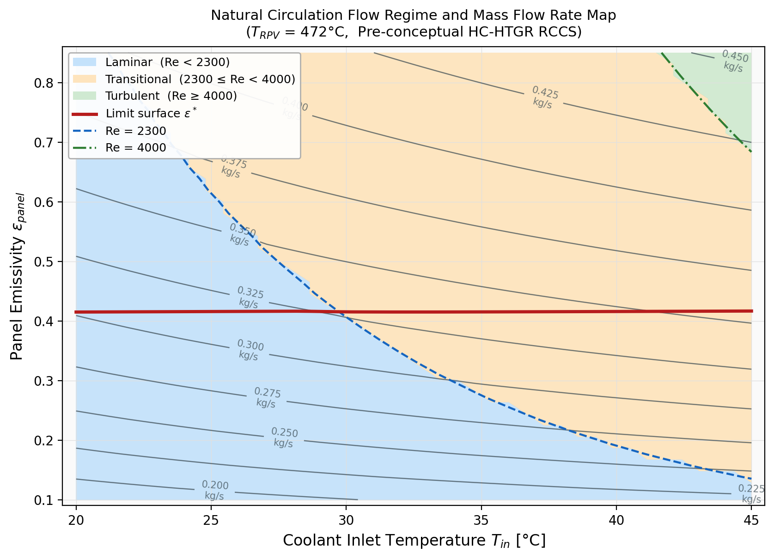
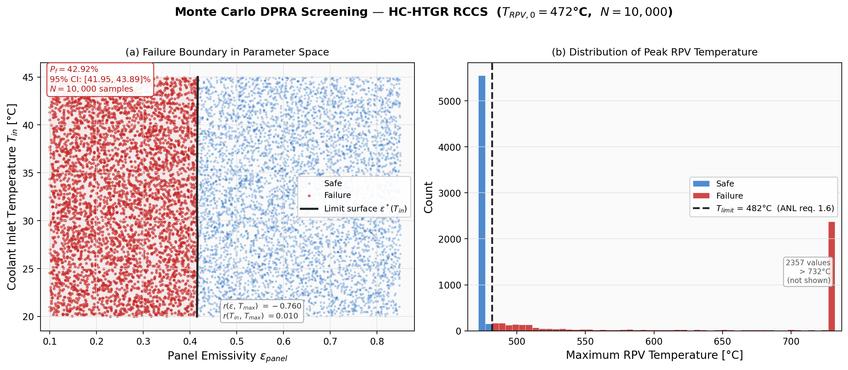
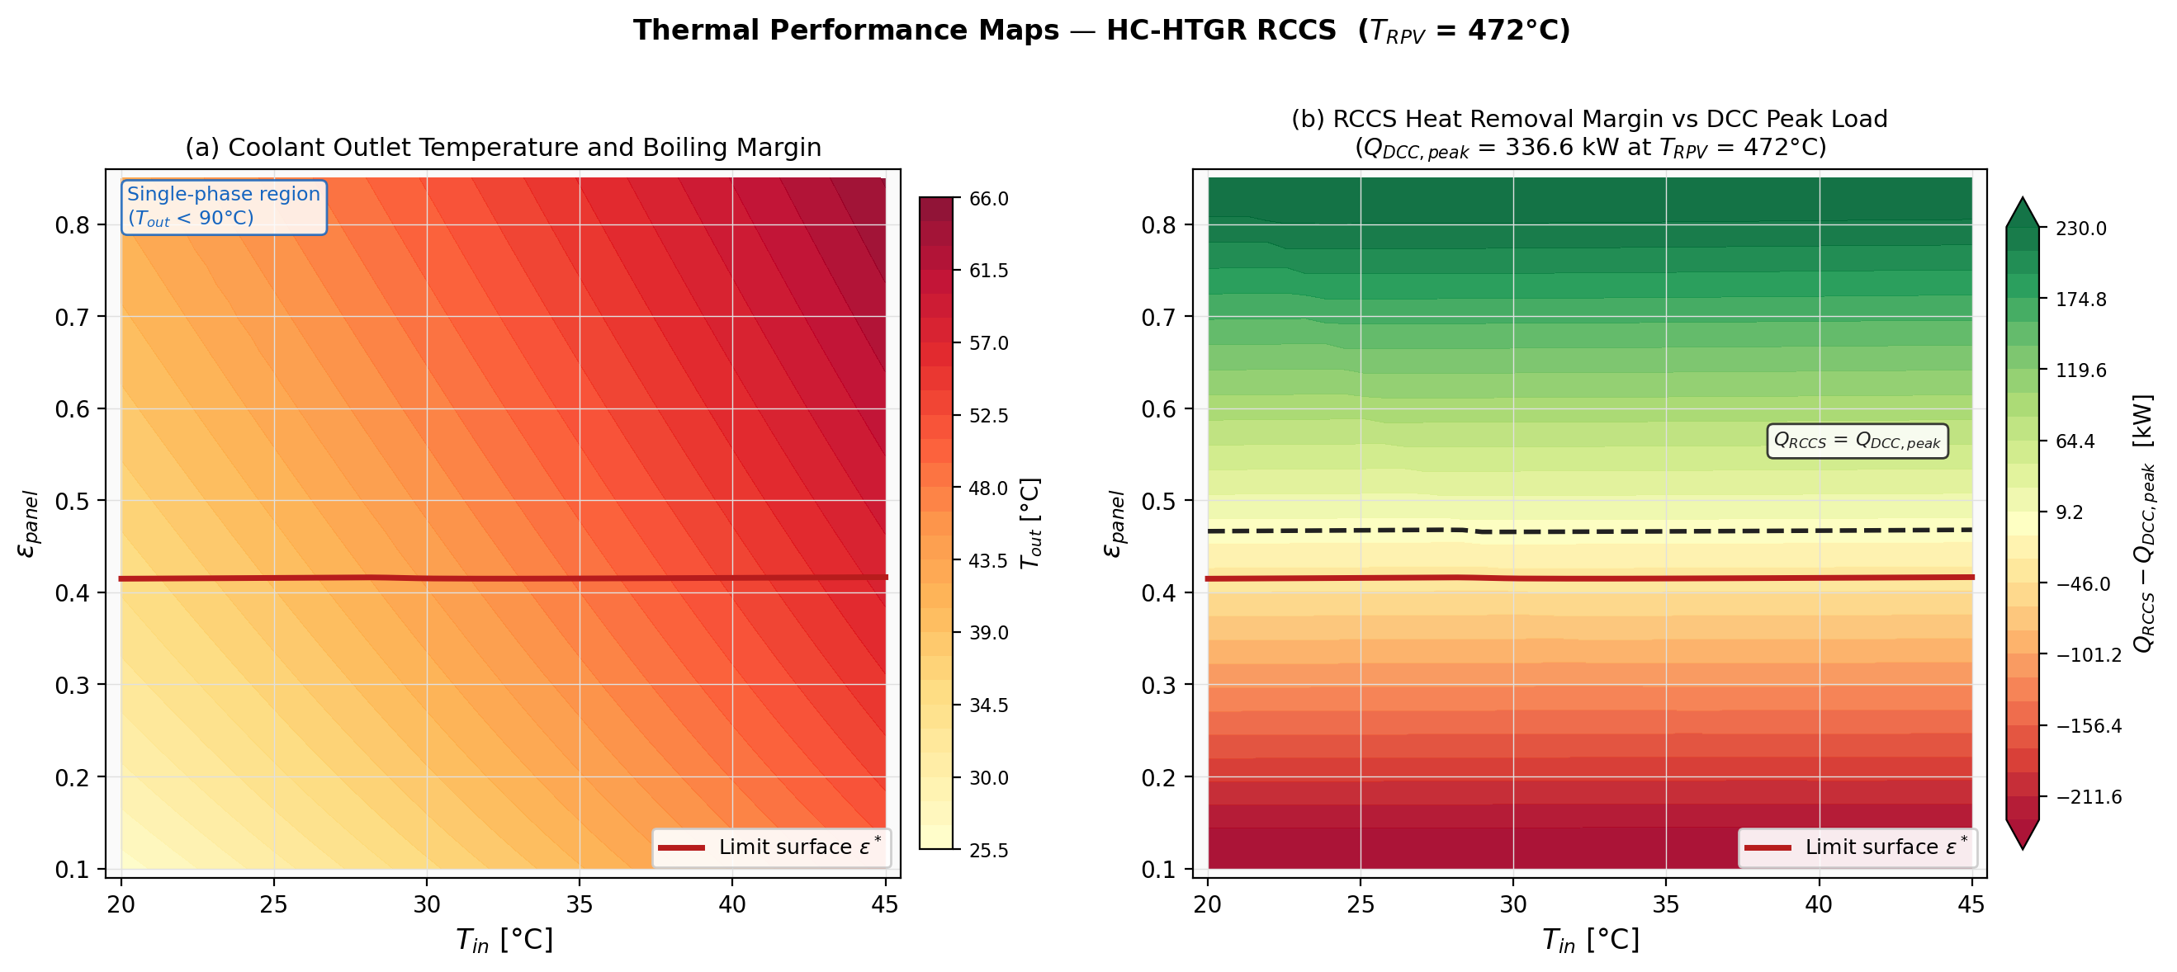
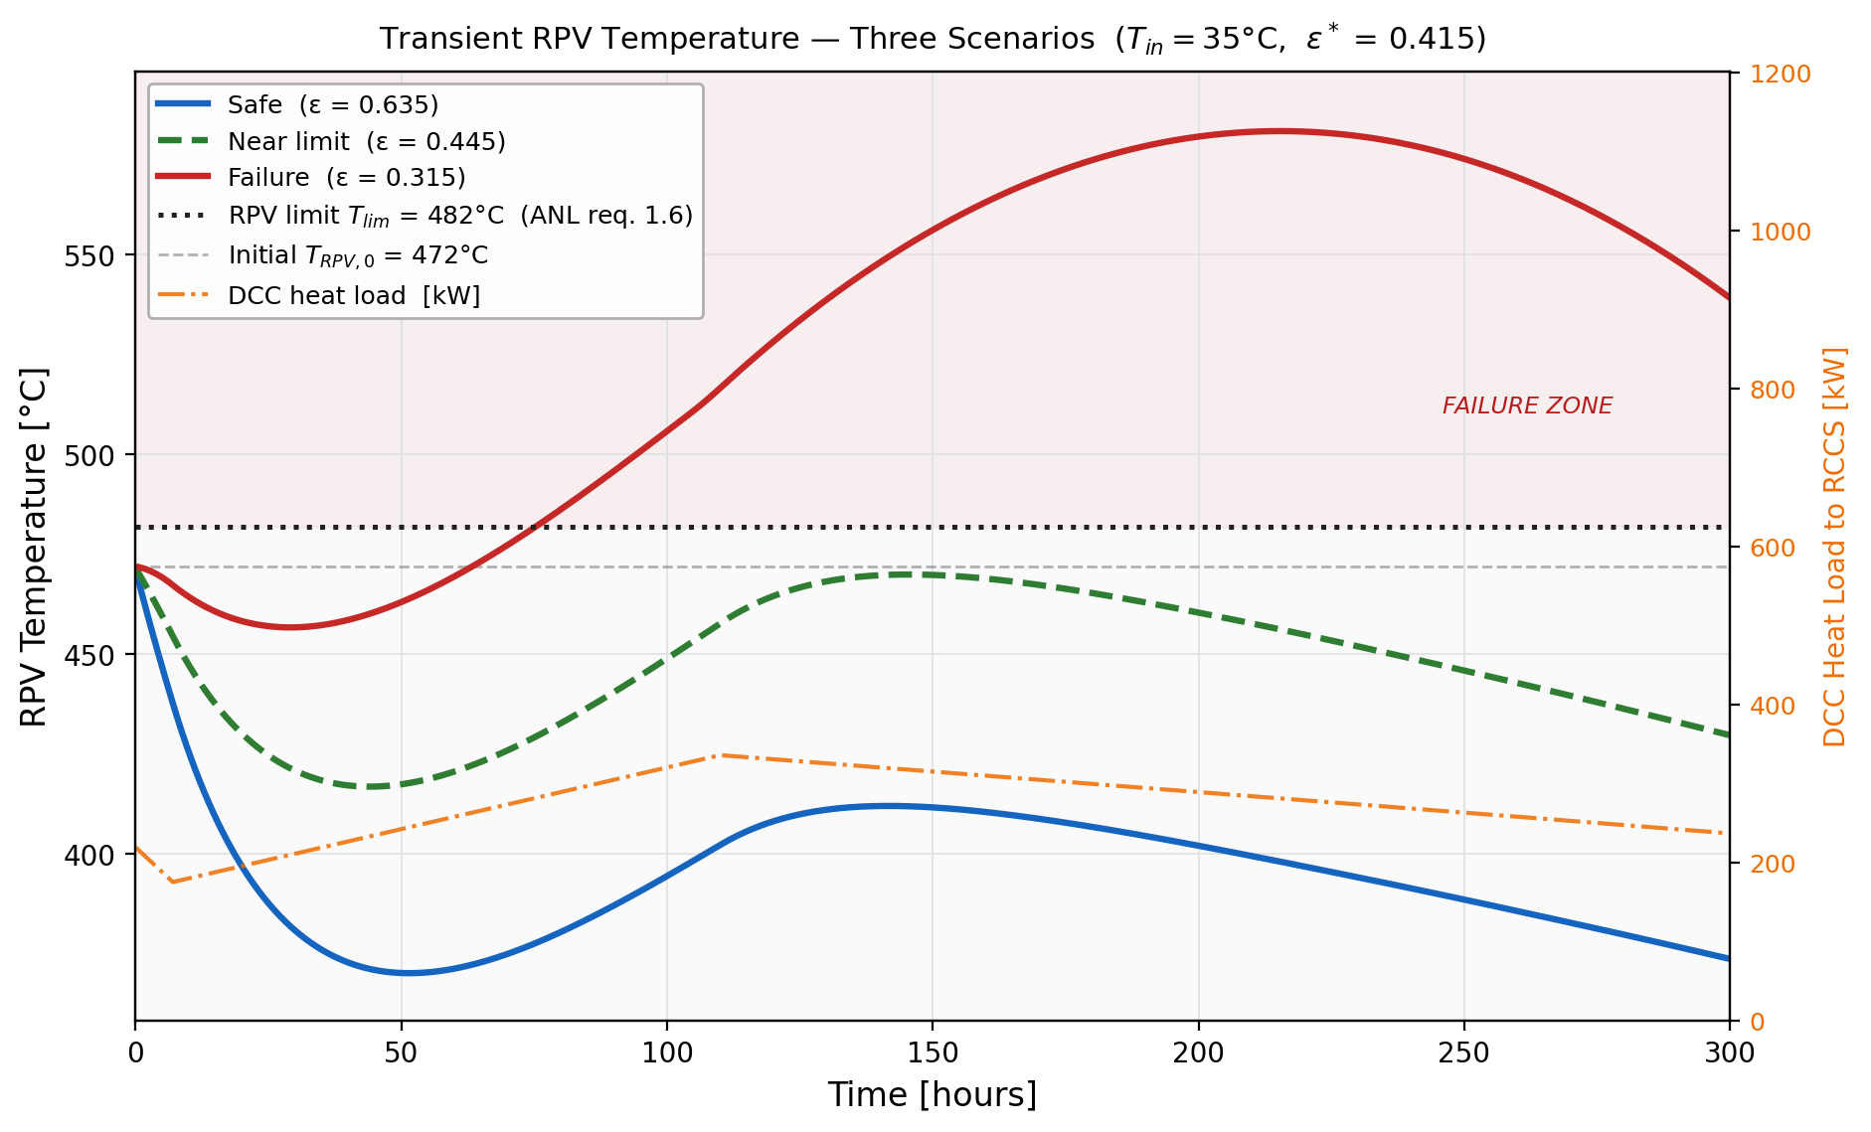
Simulation & Preliminary Results
42.92%
Failure probability across N = 10,000 samples (εₚₐₙₑₗ ∈ [0.10, 0.85], Tᶜₒₒₗ ∈ [20, 45]°C)
Monte Carlo DPRA screening results
Peak at 469.96, ~ 12°C below failure limit
Region of interest, ε ≈ 0.415–0.47

Slide 11
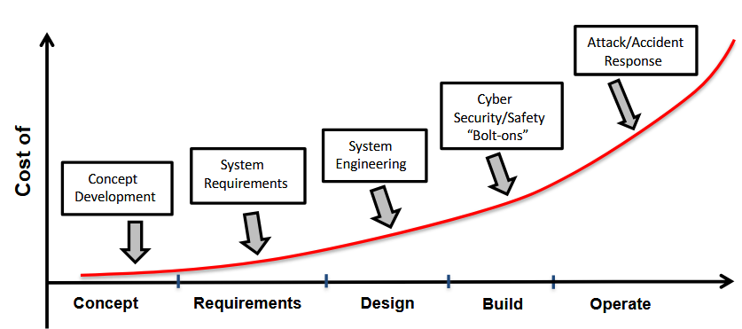
Impact
Direct Impacts
Significant time savings on simulations
Early insight into risk-significant design parameters
Safety-in-design rather than engineered (post-hoc) safety
Post-Fukushima BWR alterations
This work supports
safety-in-design and
scalable risk assessment
Gen II Reactors
Passive Safety (Gen III+/IV)
Indirect Impacts
Cost and time savings across the engineering life cycle
Better stakeholder engagement
  Model = “ground truth”
Safer, more trustworthy industry
Physics-based safety (TRIGA)

Slide 12
Limitations & Future Work
Expand uncertainty space to include other parameters
Multi-failure mode analysis
Explore Modelica + SysML integration for a more robust “intermediate fidelity” model
Close the loop with high-fidelity DPRA to demonstrate the full guided DPRA workflow
Notes:
"This paper establishes the screening half of guided DPRA — identifying where high-fidelity resources should go. Closing the loop with actual high-fidelity runs on the identified region is our next paper."

Slide 13
References
I. Ibrahim et al., “Safety Assessment of a Passive Decay Heat Removal System Using a Model-Based Systems Engineering Approach,” Nuclear Science and Engineering, pp. 1–22, Mar. 2026, doi: 10.1080/00295639.2026.2631317.
M. Tang, J. Yang, P. Zhao, and K. Wang, “Research on design requirements for passive residual heat removal system of lead cooled fast reactor via model-based system engineering,” Nuclear Engineering and Technology, vol. 56, no. 8, pp. 3286–3297, Aug. 2024, doi: 10.1016/j.net.2024.03.029.
Y. Jeong, D. Lisowski, Q. Lv, and R. Hu, “A Conceptual Design of the Reactor Cavity Cooling System for the Horizontal Compact High Temperature Gas Reactor (HC-HTGR),” ANL/NSE--23/89, 2427308, 186605, Sep. 2023. doi: 10.2172/2427308.
J. P. Abraham, E. M. Sparrow, and W. J. Minkowycz, “Internal-flow Nusselt numbers for the low-Reynolds-number end of the laminar-to-turbulent transition regime,” International Journal of Heat and Mass Transfer, vol. 54, no. 1–3, pp. 584–588, Jan. 2011, doi: 10.1016/j.ijheatmasstransfer.2010.09.012.
F. P. Incropera and F. P. Incropera, Eds., Fundamentals of heat and mass transfer, 6th ed. Hoboken, NJ: John Wiley, 2007.

Slide 14
Thank You
We welcome your questions, feedback, and ideas
nanayaw.angu@colostate.edu, vincent.paglioni@colostate.edu

