Slide 1
A Review of Ground-shine and Resuspension Weathering Parameters for Japanese Living Environment
Yuichi Naito, Ryogo Kurokawa, Masaharu Tsuzaki
Nuclear Risk Research Center (CRIEPI)
July 23, 2026

Slide 2
Outline
  Introduction
  Observed weathering data in Japan
  Sensitivity analysis against health risks
  Summary

Slide 3
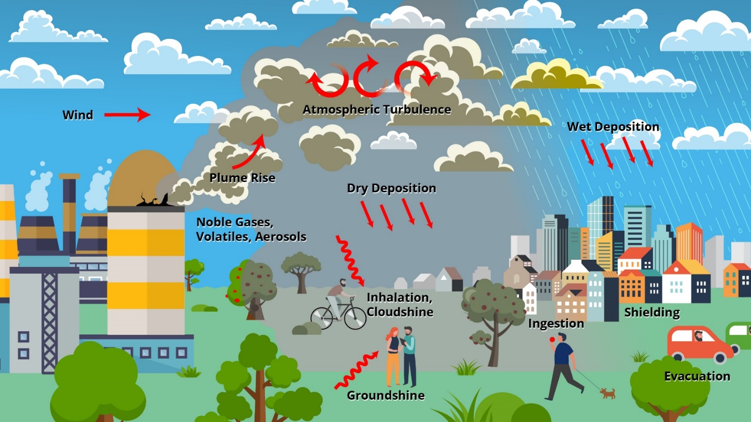
Introduction
  Level 3 PRA: a probabilistic risk assessment used to estimate hypothetical land contamination levels, individual doses, health effects and population risks resulting from a nuclear power plant accident.
  CRIEPI plans to use the WinMACCS code for Level 3 PRA applications in Japan.
https://maccs.sandia.gov/software/maccs

Slide 4
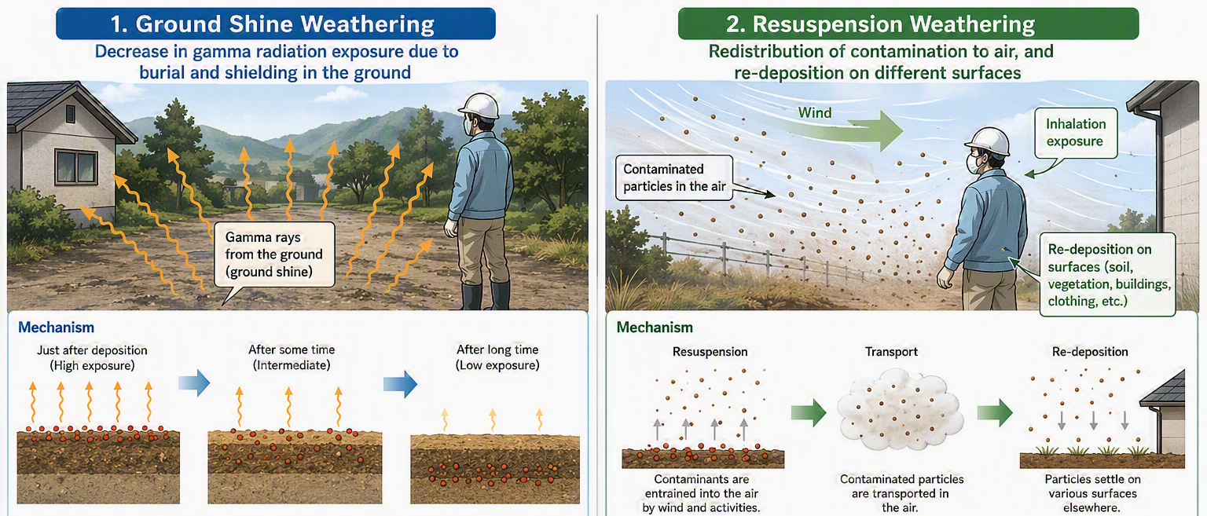
What is weathering?
地表面に沈着した放射性物質が土壌深部へ移行したり，降雨や風によって地表面から流亡して減少する現象を指し、時間の関数として表される。グラウンドシャイン、再浮遊のウェザリング等がある。
→1F事故、チェルノブイリ原発事故、その他の事例について文献調査を実施し、国内における適切なパラメータ設定値を検討。
※用語の説明
グラウンドシャイン：地表に沈着した核種から受ける外部被ばく
再浮遊：風等により核種が地表から大気中へ舞い上げられること

Slide 5
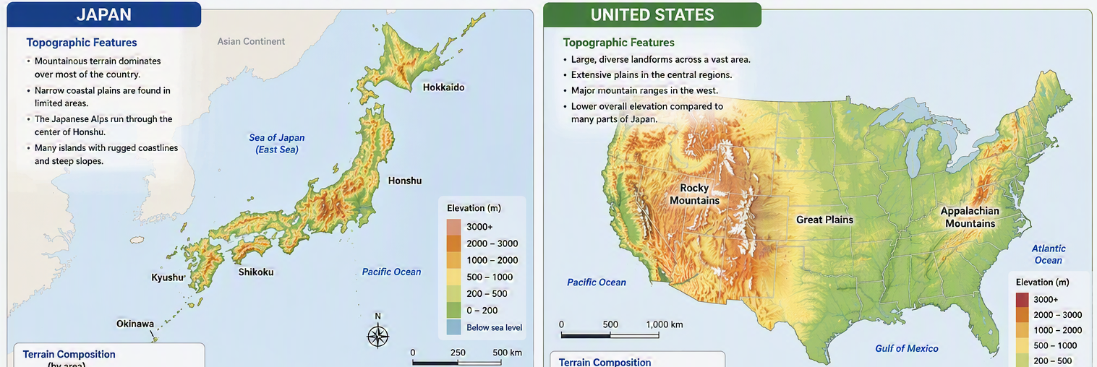
Why weathering?
  Weathering effects can directly reduce radiation exposures following the deposition of radionuclides on the ground.
  Japan is characterized by abundant precipitation, predominantly mountainous, forested landscapes and different soil property.
It is necessary to examine the importance of these effects

Slide 6
Outline of WinMACCS
WinMACCS
(ver. 5.0.0)
LHS*
making parameter sets
MACCS
ATMOS (dispersion, deposition)
EARLY (Early exposure)
CHRONC (Chronical exposure, Economical influence)
GUI
(input/output)
COMIDA2
(food chain/ingestion)
Site data
(Weather, population, land use data etc.)
Source terms
(from Level 2 PRA)
*Latin Hypercube Sampling.
2026

Slide 7
Ground-shine weathering parameters
coefficient
short-term half-life (yr)
long-term half-life
*Data for Cs-137

Slide 8
Ground-shine weathering parameters
coefficient
short-term half-life (yr)
long-term half-life
Collected data indicate shorter half-lives for Japanese environment.
T₁: 0.5 (Fukushima) vs 1.9 (Chernobyl)
T₂: 6.5 (Fukushima) vs 34.3 (Chernobyl)
Weathering half-lives were generally longer in forests and undisturbed areas than in urban environments.

Slide 9
Sensitivity analysis of ground-shine weathering parameters against population dose
Contrary to our expectations, ground-shine weathering half-lives and coefficients had only a limited impact on long-term population doses.
T₁
T₂
99.5th
Grand mean
50th

Slide 10
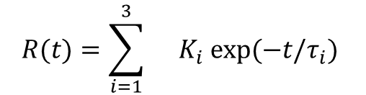
Resuspension weathering parameters
coefficient* (/m)
*air concentration/soil surface concentration
half-life (yr)
In WinMACCS, half-lives of 0.5, 5, and 50 years are set as default values.
Reported domestic values of Ki varied widely, ranging from 10⁻¹⁰ to 10⁻² (/m).
K_{i} depends on wind speeds, traffics, land uses, etc.

Slide 11
Sensitivity analysis of resuspension weathering parameters on population dose
The short-term weathering coefficient (K₁) had greater impact on population doses than the longer-term coefficients K₂ and K₃.
K₁
K₃

Slide 12
Discussion
  The results for resuspension weathering were consistent with previous model prediction (Whicker et al., 2021 J. Environ. Radioact.; K_{i} is highest at the initial stage of deposition).
  Other potentially important parameters affecting population doses (e.g., breathing rates) should be further investigated.
Lower limit for children
Upper-limit for adults

Slide 13
Summary
The sensitivity analyses revealed that the short-term resuspension coefficient was the most influential parameter affecting population dose.
However, the weathering parameters examined were not as influential as expected.
Further investigations are needed to identify other key factors: a global sensitivity analysis is ongoing.

Slide 14
Thank you for your attention!

Slide 18
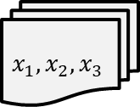



Methods: sensitivity analysis
Input parameters
Source terms
Uncertainty analyses
$$x_{1}$$
MC simulations
LHS samplings
frequency
$$x_{1},x_{2},x_{3}$$
Win
MACCS
$$x_{2}$$
Global sensitivity analysis
Societal (population) doses
$$x_{3}$$
Site data
Quantifying output uncertainties
︙
Set uncertainties for each params
Identifying params with large contributions to doses

Slide 19
The global sensitivity analysis
  Sobol’ index
e.g., In case for 3 parameters,

Slide 20
Discussions
  Contribution of food ingestion doses to total dose is minor.
~0%
~1%
production rate (kg/m²) =
consumption rate/10,000*
*recommended in the manual
production rate (kg/m²) =
consumption rate/900

