Slide 1
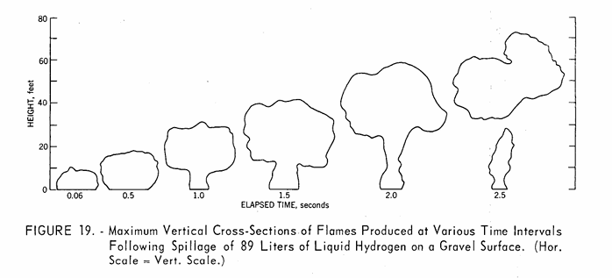
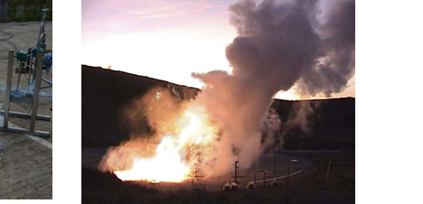
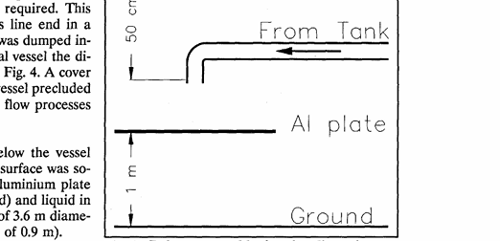
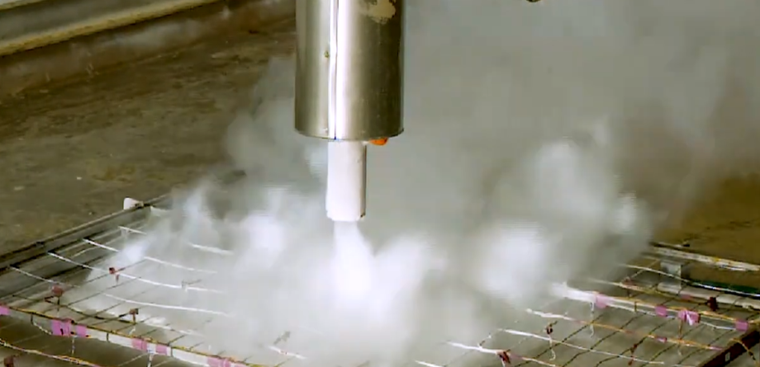
Liquid Hydrogen Pool Formation Probability: Impacts on Risk & Safety
Marina Miletic, Ethan Hecht,
and Brian Ehrhart
Sandia National Laboratories
Images:
Zabetakis & Burgess “Research on the Hazards Associated with the Production and Handling of Liquid Hydrogen”, US Bureau of Mines, 1960
Hooker et al. “Experimental Releases of Liquid Hydrogen”, HSE 2012
Schmidtchen et al., “Simulation of accidental spills of cryogenic hydrogen in a residential area”, Cryogenics, 1994.
Hecht/Sandia National Laboratories, 2024, https://www.youtube.com/watch?v=L7UmfvOwhgI
July 21, 2026
Probabilistic Safety Assessment & Management (PSAM18) Conference, Pittsburgh, PA
SAND2026-23542C
Notes:
It’s wonderful to be here at PSAM18, thank you. My name is Marina Miletic and my colleagues and I are from Sandia National Laboratories. This presentation is an overview and encapsulation of the past 66 years of research on liquid hydrogen pool formation. I will talk about what liquid hydrogen pool formation is and its impacts on risk and safety.

Slide 2
outline
Physics of Hydrogen
The history of liquid hydrogen empirical studies
Liquid Hydrogen Risks
The variables that influence liquid hydrogen pooling
Notes:
Molecular hydrogen is the lightest molecule and the lightest fuel on earth, so we will start this presentation discussing the unique physics of hydrogen and some of the historical empirical studies that have shed light onto its properties. And we will also discuss why we are interested in the risks of liquid hydrogen. There are numerous important variables that are determining factors on how liquid hydrogen accumulates in pools, so we will discuss each of those variables and their influence.

Slide 3



Hydrogen is typically stored in gaseous or liquid form with unique thermodynamic properties and volumetric energy densities
Equivalent in energy to
Equivalent in energy to
1 Gallon
Gasoline
3.7 gallons
Liquid Hydrogen
(20°C above absolute zero)
6.7 gallons
Gaseous Hydrogen
(700 bar (10,000 psi))
2.2 lbs.
6.2 lbs
2.2 lbs.
Images: openclipart.com, Wikimedia.org
Notes:
There are numerous people speaking about hydrogen at the PSAM conference this week and I wanted to present some important context about hydrogen as a gas and as a fuel. It has unique thermodynamic and thermophysical properties that make it advantageous in many ways. * If you want to compare it to 1 gallon of gasoline, * 6.7 gallons of 700 bar gaseous hydrogen represents the same energy, so hydrogen’s energy density is not the same, even at a really high pressure like 700 bar, which is the nominal storage pressure of gaseous hydrogen for a passenger fuel cell electric vehicle like a Toyota Mirai. * Now if we liquified that same amount of hydrogen, we get a great volume savings. The volume is almost halved. Unfortunately this requires storage temperatures of 20 degrees K or 20 degree above absolute zero, which can be expensive. * If we also consider the weight of all of these, the gallon of gasoline is about 6 lbs while the equivalent hydrogen is around 2 lbs. This is one of the reasons liquid hydrogen has been so attractive for transportation, storage, and space travel applications.

Slide 4
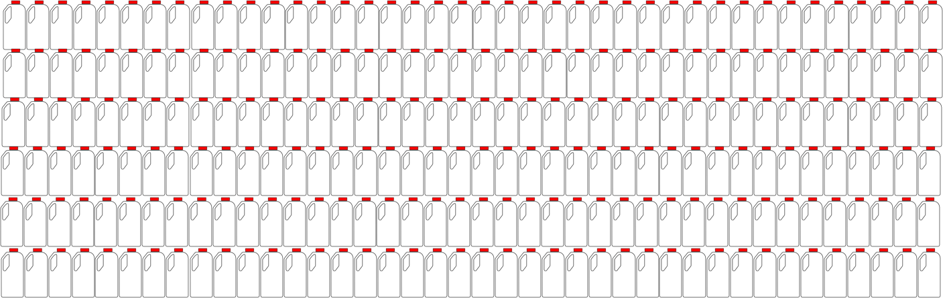
Liquid hydrogen => gaseous form at 1 atm:
1 gallon of
liquid hydrogen
can expand to
~800 gallons
of 100% gaseous hydrogen
at 1 atm
Phase change to gas
1 gallon
Liquid Hydrogen
(20°C above absolute zero)
Images: openclipart.com, Wikimedia.org
Notes:
One of the reasons we are interested in the risks associated with liquid hydrogen is when it leaks. * Let’s say one gallon of liquid hydrogen is being contained at 20 degrees Kelvin, but unfortunately a leak occurs in that container and the hydrogen rapidly heats up and changes phase to a gas. * When this occurs, that 1 gallon of liquid hydrogen can expand to form around 800 gallons of 100% gaseous hydrogen at a pressure of 1 atmosphere. This is 100% hydrogen with no air. This 1 gallon of liquid hydrogen can create a flammable volume mixture about the size of a 1 car garage, if you are at the lower flammability limit. This assumes that the hydrogen is released in some kind of containment like a room, is mixed perfectly, and doesn’t rapidly rise up into the atmosphere, but it still makes an important point. When liquid hydrogen is released, even a gallon can be a substantial amount of flammable material.

Slide 5
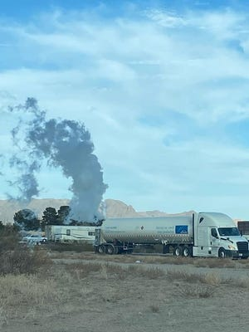

The difference between a gaseous and liquid hydrogen release
Compressed refrigerated gaseous hydrogen leak
Liquid hydrogen released on a concrete pad
Sandia National Laboratories
Images: lcsun-news.com, Sandia National Labs
Notes:
Room temperature gaseous hydrogen is much lighter than air, so when it is released, it typically rises up at around 45 mph in unconfined air. * This is a refrigerated gaseous hydrogen leak from a truck. The cloud you see is formed due to the difference in temperature between the hydrogen and the surrounding air which causes condensation of moisture in the air. * In contrast, this is a downward liquid hydrogen release a few inches above a concrete pad. The cloud is again is caused by cold gaseous hydrogen contacting the surrounding air, but if you look closely, there is liquid hydrogen pooling on the concrete pad. It looks a little like liquid nitrogen on a surface.

Slide 6

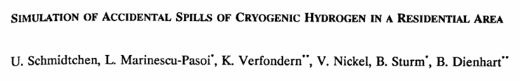
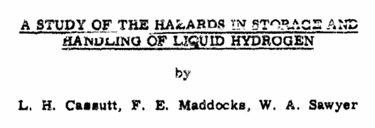

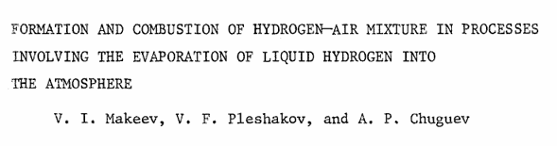
Liquid Hydrogen pooling experiments: an international effort
2024
Hecht, Sandia National Laboratories
1994, 1996
Schmidtchen & Verfondern Battelle Ingenieurtechnik (BAM)
2012
Hooker, Health and Safety Laboratory
2020
Health and Safety Laboratory (PRESLHY)
1960
Cassut / Arthur D. Little, Inc. / USAF
1981, 1984
Witcofski & Chirivella, NASA
1960
Zabetakis & Burgess, U.S. Bureau of Mines
1981
Makeev, USSR
1994
Takeno, Mitsubishi Heavy Industries
2021-2023
Friedrich, Karlsruhe Institute of Technology (KIT)
Notes:
Many groups around the world have been studying this phenomena of liquid hydrogen pooling * starting in 1960 with the US Air Force and the US Bureau of Mines, * then in the early 1980s the US resumed some experiments while the USSR also started performing some spill experiments, * then in the mid-1990s BAM in Germany and Mitsubishi Heavy Industries in Japan, * in 2012 and 2020 the HSL in England performed some vertically down, vertically up, and horizontal release experiments, * KIT in Germany in 2021 performed pooling experiments on different substrates, * and lastly in 2024 Sandia National Labs performed controlled, continuous flow liquid hydrogen experiments, also studying the effect of wind.

Slide 7
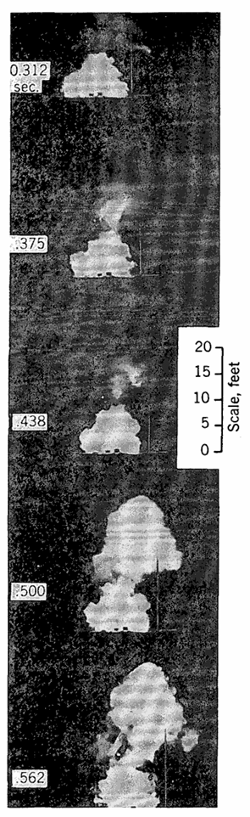
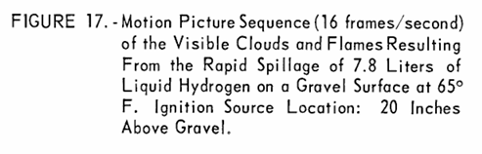
Zabetakis & Burgess /
US Dept. of Interior, US Bureau of Mines,
1961
Images: Zabetakis & Burgess, Research of the Hazards Associated with the production and Handling of Liquid Hydrogen, https://www.osti.gov/servlets/purl/5206437
Notes:
Some of the earliest experiments and photographs of liquid hydrogen spills or pooling are from the United States government. These images show a 7.8 liter instantaneous spill, this is around 2 gallons of liquid hydrogen spilled. You can see than in less than a half a second the hydrogen plume has traveled over 20 feet upward.

Slide 8
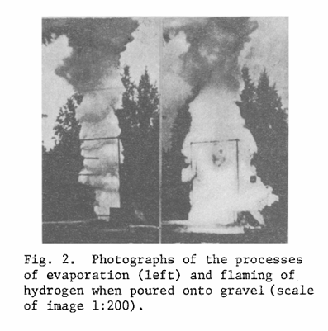
Makeev / USSR, 1981
30 L instantaneous spill
Images: Makeev, Formation and combustion of hydrogen-air mixture in processes involving the evaporation of liquid hydrogen into the atmosphere, 1981
Notes:
In 1981 Soviet researchers released a much larger spill, around 8 gallons, onto gravel and lit it. You can see it creates a large plume.

Slide 9
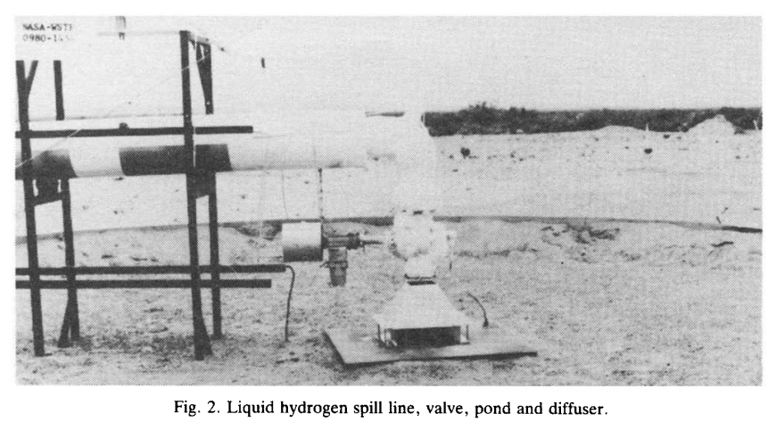
Witcofski & Chirivella / NASA, 1984
24 - 237 Liters/second
Witcofski & Chirivella, EXPERIMENTAL AND ANALYTICAL ANALYSES OF THE MECHANISMS GOVERNING THE DISPERSION OF FLAMMABLE CLOUDS FORMED BY LIQUID HYDROGEN SPILLS, 1984
Notes:
Not to be outdone, in 1984, NASA performed some of the first, very large flowrate liquid hydrogen pooling experiments at up to 237 Liters per second (that a huge 3700 gallons per minute). This was unprecedented at that time and now because no one up to that point and no one since has performed such massive flowrate liquid hydrogen experiments. This was performed at the NASA White Sands Test facility in New Mexico.

Slide 10
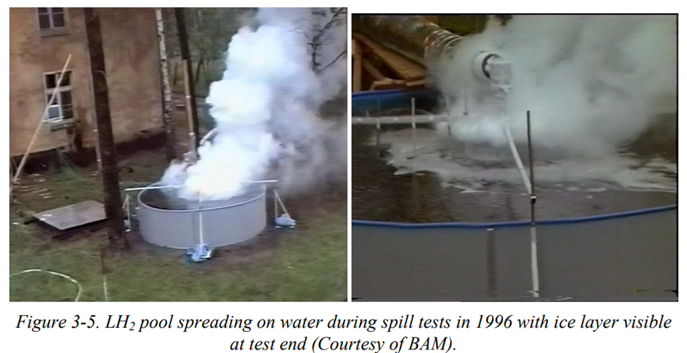
Schmidtchen & Verfondern, Research Center Juelich, Battelle Ingenieurtechnik (BAM), 1994, 1996
5-6 L/s
U. Schmidtchen, SIMULATION OF ACCIDENTAL SPILLS OF CRYOGENIC HYDROGEN IN A RESIDENTIAL AREA, Cryogenics 1994.
Notes:
In Germany in the 1990s researchers at BAM studied liquid hydrogen releases on water in an above ground swimming pool and on an aluminum plate. They wanted to study how pooling could affect the formation of ice on the surface of the water. They conducted these experiments outside an abandoned, formerly Soviet-controlled barracks.

Slide 11
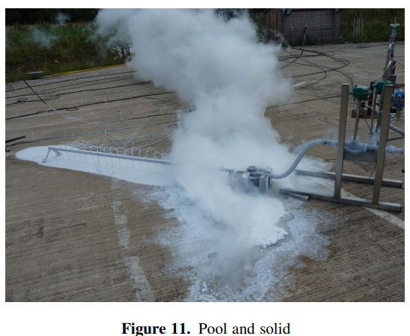
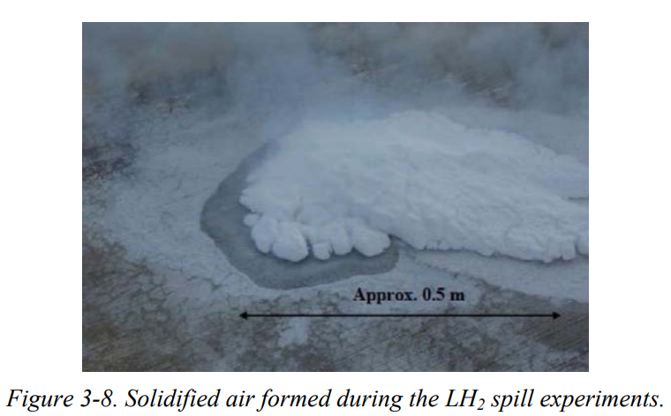
Health and Safety Laboratory, England, 2012
1 L/s
Images: Hooker et al. “Experimental Releases of Liquid Hydrogen”, HSE 2012
Notes:
In England in 2012, researchers at HSL studied liquid hydrogen releases on concrete. These were long duration 1 L/s releases. Notice that since the temperature of the liquid hydrogen is well below the freezing point of nitrogen and oxygen, they observed the solidification of the surrounding air.

Slide 12
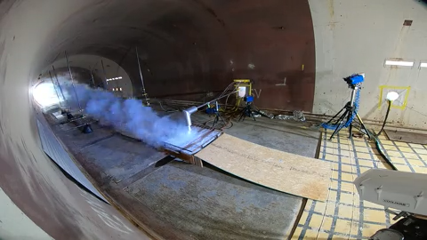
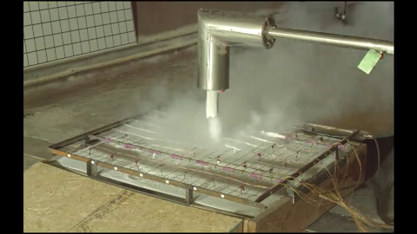
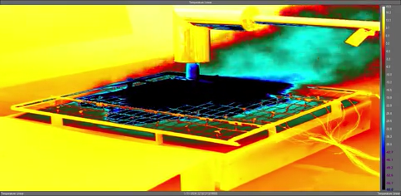
Sandia National Laboratories, 2024
https://www.youtube.com/watch?v=L7UmfvOwhgI
infrared (temperature)
Notes:
Most recently, in 2024, Sandia National Laboratories conducted very highly controlled, high fidelity liquid hydrogen pooling experiments. These experiments also produced the first publicly available videos of liquid hydrogen pooling.

Slide 13
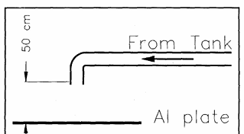

Variables that influence liquid hydrogen pooling
13
Notes:
Almost all of these experiments have the same setup: * liquid hydrogen is dispensed from a tank through a line and flows onto some surface like gravel, steel, concrete, etc. There are some important variables that determine whether the hydrogen * will just change phase and diffuse upward or * whether the liquid hydrogen will accumulate on the surface and form a pool.

Slide 14
Variables that influence liquid hydrogen pooling
Flowrate
Time
WIND SPEED
Contained?
CONTAINED OR UNOBSTRUCTED?
Distance from Surface
FLOWRATE
Direction of spill – up, horizontal, vertical?
TIME
GROUND SURFACE MATERIAL
Material Type
Wind Speed
14
Notes:
One of the most important variables is * flowrate. Minimal flowrate and the liquid hydrogen will change phase and none will accumulate on the surface. A very impactful variable is * time. If the spill is short, the surface does not cool down sufficiently. If the surface is warm, the liquid hydrogen will be conductively heated by the surface and simply vaporize. Also very influential is whether the area of the spill is * confined with walls or barriers or whether it is just a flat surface. Contained spills are far more likely to form pools. Next, * how far above the surface is the liquid hydrogen released? Too high above the surface means the liquid will be more likely to contact warm air and change phase before it lands on the surface. Also important is * the direction of the release, is it downward, horizontal, or vertically upward? Pools are far more likely to form when the release is pointed downward. Less influential but still important * is the type of ground surface such as gravel or concrete. The heat capacity, thermal conductivity, and porosity of the surface play a role in the amount of pooling. Lastly * wind speed is also important since it can aid in hydrogen diffusion away from a surface and convective warming.

Slide 15
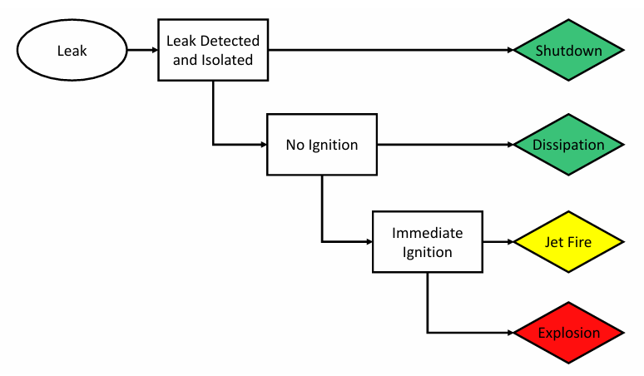
Flowrate
Time
Contained?
Distance from Surface
Direction of spill – up, horizontal, vertical?
Material Type
Wind Speed
Event Sequence Diagram: Brian D. Ehrhart, Ethan S. Hecht, Myra L. Blaylock, Erin E. Carrier, Katrina M. Groth, and John T. Reynolds. Hydrogen Risk Assessment Models (HyRAM) Version 3.0 Technical Reference Manual. Technical Report SAND2020-10600, Sandia National Laboratories, September 2020.
15
Notes:
And the reason we care about all of these factors is because they can lead to immediate or delayed ignition of hydrogen and using probit models we can correlate probabilities of these events to harm. This enables us to estimate risk metrics such as location specific individual risk, fatal accident rate, and potential loss of life.

Slide 16
Studies since the 1960s show that liquid hydrogen pooling is more likely to occur when:
Spill Flowrate and duration are sufficient
The spill occurs in a confined volume and close to the surface
The spill is vertically down and wind speed is low
Surface material has low heat capacity (sand, metal) and/or low thermal conductivity (insulators)
16
Notes:
In Conclusion, studies from the 1960s onward have shown that liquid hydrogen pooling is most likely to occur when * the spill flowrate and spill direction are sufficient to facilitate accumulation of liquid hydrogen on a surface, * the spill occurs in a confined volume and relatively close to the surface, * the spill is vertically down and wind speed is low, * and the surface material has low heat capacity and or low thermal conductivity. Thank you!

Slide 17
Thank you!
This material is based upon work supported by the U.S. Department of Energy, Office of Critical Minerals and Energy Innovation (CMEI), specifically the Alternative Fuels and Feedstocks Office (AFFO).
Notes:
We would like to acknowledge the Department of Energy, Office of Critical Minerals and Energy Innovation, Alternative Fuels and Feedstocks Office (AFFO). Thank you!

Slide 18
Thank you!
Please check out Brian Ehrhart’s upcoming talk:
“Hydrogen Contribution to Risk in Post-Crash Outcomes for Rail Locomotives”
July 23rd 10:00 – 11:30 Risk Assessment for Other Industries and Applications Session

