Slide 1
Database OECD/NEA
FIRE – Applications and Applicability Within
Fire PSA
Marina Roewekamp (GRS)
Markus Beilmann (OECD/NEA)
Andreas Werner (SAC)
PSAM18 Pittsburgh, PA, USA; July 19 – 24, 2026

Slide 2
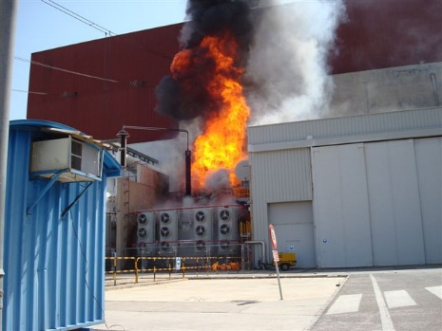
Introduction and Background
Fire – a non-negligible contributor to the risk of nuclear installations
Plant internal fires occur over entire life cycle of nuclear installations – from construction,
over the whole operational period, up to the late phase of decommissioning and dismantling
Fire safety remains an issue for the overall safety of all types of nuclear installations including new technologies under development
Only limited or no operating experience is available for nuclear reactor concepts of unique designs, prototype facilities and new generation reactors including new or advanced technologies, e.g., SMRs
OECD/NEA FIRE (Fire Incidents Records Exchange) Database Project
was established in 2003 under the auspices of OECD/NEA
The FIRE Database has been continuously advanced and extended
covering fire events in nuclear power reactors from 14 member countries
(Asia: 2, Europe:10, North America: 2) representing ~ 11,000 ry
of commercial plant operation
source: FIRE DB version 2023:03

Slide 3
Introduction and Background (contd.)
Fire risk – a permanent challenge for nuclear (reactor and non-reactor) installations
Fire hazards are addressed in all types of deterministic and probabilistic safety assessments
  In the licensing process (during design stage and commissioning)
  In the frame of Periodic Safety Reviews (PSRs)
  On a case-by-case basis
  Deterministic (fire hazard analyses, FHAs) and, mainly as a supplement, probabilistic fire
  risk analyses (Fire PSAs), are being applied for different types of assessments for different types of nuclear reactors
Various international fire risk related activities are ongoing or have been finalised

Slide 4
FIRE Database Main Objectives
FIRE is meanwhile in its Phase 8 (2026 – 2028) with the following main objectives:
Collection and analysis of fire event experience by international exchange in an appropriate format in a quality-assured and consistent database over the long-term to better understand
such events and their causes
Generation of qualitative insights into the apparent and root causes of fire events to derive approaches or mechanisms for their prevention and to mitigate their consequences
Establishing a mechanism for efficient operation feedback on
fire event experience, including developing prevention policies,
such as indicators for risk-informed and performance-based
inspections
Recording fire event characteristics to facilitate fire risk analysis
(Fire PRA), including quantification of generic fire frequencies
source: FIRE DB version 2023:03

Slide 5
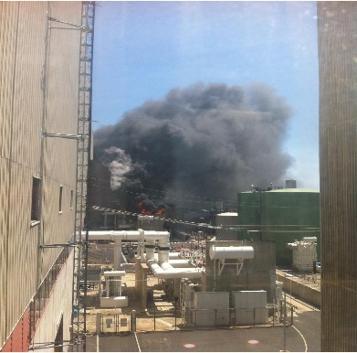
FIRE Database Overview
FIRE Database version 2023:03 (event data up to end-2023) covers 628 fire events
620 plant internal fires
590 events are included in statistics
Representing an observation period of ~ 11,007 power reactor years (ry)
8 plant external fires
Subsets of data can be generated and analyzed, e.g., for:
Full-power (FP) and low-power and shutdown (LPSD) plant operational states (POS)
Different reactor types (PWR, BWR, PHWR, GCR, ATR, FBR, HTGR, HWLWR)
Different member countries
FIRE Database version 2024:01 (event data up to end-2024) covers 648 fire events
634 plant internal fires, 14 for plants under decommissioning/dismantling
606 events are included in statistics, representing ~ 11,292 ry
source: FIRE DB version 2023:03

Slide 6
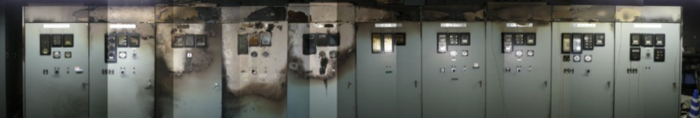
Applications of FIRE Database Within PRA (1)
High Energy Arcing Fault (HEAF) Induced Fires – a non-negligible risk contributor
68 (~ 12 %) out of 590 statistically relevant plant internal fire events were induced by HEAF
36 out of 64 statistically relevant combinations of internal fires and other internal or external hazards are combinations involving HEAF (approx. 7 % of all events, and nearly 60 % of all combinations)
  34 event combinations observed during full power operation (FP) involve HEAF and fire
  => combined HEAF and fire event occurrence frequency: 4.0 E-03 /ry
  2 event combinations observed during low-power and shutdown states (LPSD) involve
  HEAF and fire => combined HEAF and fire event occurrence frequency: 7,7 E-04 /ry
Resulting HEAF related experimental and analytical research activities with significance
for Fire PRA in different member countries and by OECD/NEA (see OECD/NEA publications)
National regulations in some countries (e.g., U.S., Japan, Germany) as well as SSG-64 and
SSG-3 (Rev. 1) consider HEAF and HEAF induced fires, particularly in PSA requirements
source: FIRE DB version 2023:03

Slide 7
FIRE Applications – Combinations of Fires and Further Hazards (1)
64 fire hazard combinations (~ 11 % of all fire events included in statistics)
A majority of these did not significantly affect plant safety, but are important precursors
95 % of all fire hazard combinations are combinations of consequential hazards with a majority
(~ 78 %) of external or internal hazards and consequential fires
6 fire events (~ 9 %) are induced by external hazards
directly or in a hazards chain (“cascading hazards”)
Combined fire hazards of all types need to be
considered in deterministic and probabilistic
fire safety assessment – guidance see e.g.
IAEA SSG-3 (Rev. 1), SSG-64, and SSG-77

Slide 8
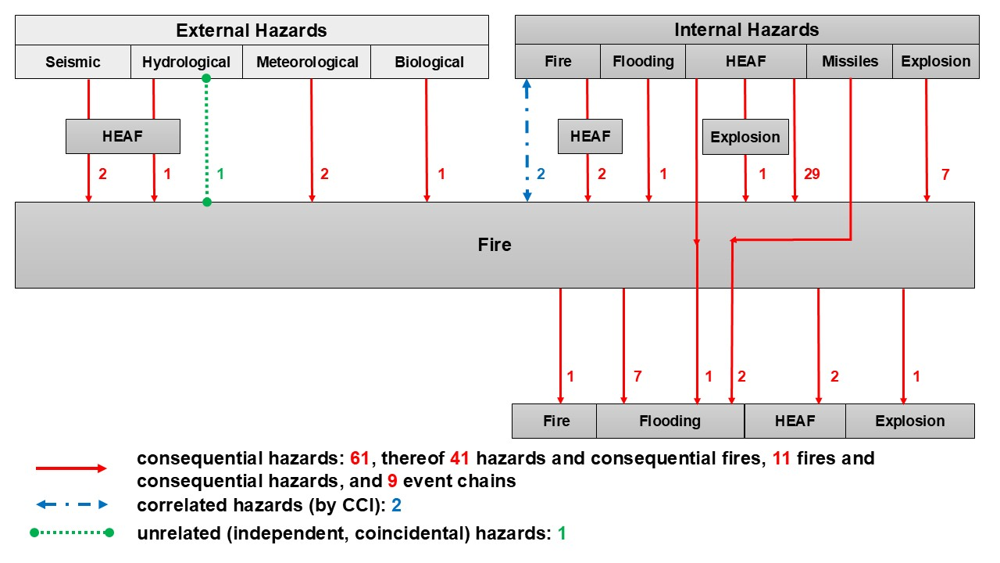
FIRE Applications – Combinations of Fires and Further Hazards (2)

Slide 9
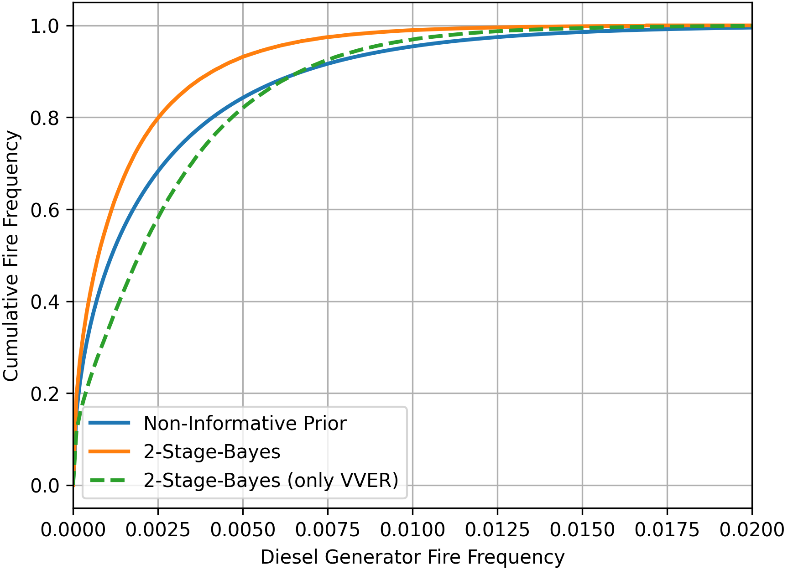
Application of Generic Data Fire from FIRE Database to Fire PSA (2)
Second example: Diesel generator fire frequency two-unit NPP site
Multi- unit NPP site with two reactor units (VVER)
During observation period of 229.90 ry no Diesel generator (DG) fires
First calculation: application of VVER reactor unit operating
operating experience in FIRE Database applied
as generic prior (1 DG fire within 814.00 doy)
Second calculation: application of generic DG
operating experience from all NPP units in FIRE
Database (17 fire events within 38,759.93 doy)
TG fire frequency distribution for plant:
5 % percentile: 1.82 E-05 /ry
50 % percentile: 1.87 E-03 /ry
95 % percentile. 1.83 E-02 /ry
Mean value: 4.50 E-03 /ry
Application of generic data will increase the level of confidence

Slide 10
Application of Generic Data Fire from FIRE Database to Fire PSA (3)
Generic Fire Frequencies for Rooms With FSSA Items – Comparison With National Data
Significance of fire in plant areas with Fire Safe Shutdown Analysis (FSSA) items
Example; comparison of fire frequencies of areas with FSSA items in power plants in Canada
and from other FIRE member countries (basis: 510 fire events of FIRE 2023:03)
  Frequencies for fires in FSSA in Canada are higher than in other countries
Need for a more detailed comparison between countries with consistent reporting criteria
 | No. of Events / Frequencies per ry, country with CANDU |  | No. of Events / Frequencies per ry, all other FIRE countries
Rooms / Plant Areas With FSSA Items | FP | LPSD | FP | LPSD
yes | 22 / 4.5 E-02 | 5 / 3.4 E-02 | 101 / 1.3 E-02 | 66 / 2.7 E-02
no | 13 / 2.7 E-02 | 8 / 5.4 E-02 | 197 / 2.5 E-02 | 62 / 2.6 E-02

Slide 11
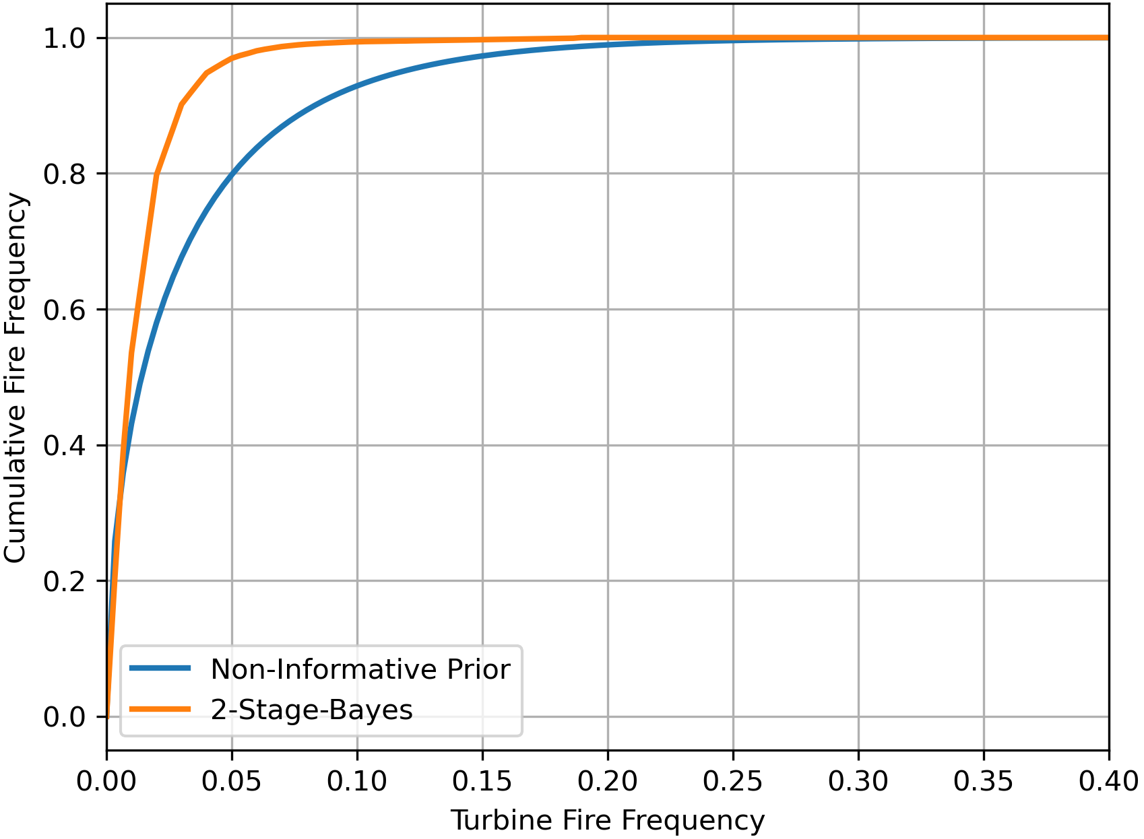
Application of Generic Data Fire from FIRE Database to Fire PSA (1)
First example: turbine generator fire frequency for full power operation
Single unit NPP with < 50 ry plant operation
During observation period of 16.28 ry
no turbine generator (TG) fires
Plant specific mean TG fire frequency:
3.07 E-02 /ry with non-informative (Jeffrey) prior
approach and high uncertainty (4.30 E-02 /ry)
Using generic operating experience from
other FIRE member countries
(38 TG fires; ~ 8.62 TG operation years)
TG fire frequency distribution for the plant:
5 % percentile: 7.93 E-04 /ry
50 % percentile: 9.10 E-03 /ry
95 % percentile: 4.10 E-02 /ry
Mean value: 1.40 E-02 /ry

Slide 12
Fire Detection and Suppression Success Analysis
Ongoing activity focusing on fire detection and suppression success data analysis including the influence of the presence of onsite plant fire
Approx. 90 % of 537 fire events in the FIRE Database with sufficient information on grace periods for successful fire detection and suppression, which were detected early – typically in
< 5 min – resulted in successful fire suppression within a short time period if firefighting was started within 15 min
In case of late detection and early start of firefighting still a small number of fires could be successfully suppressed within 15 min
Various event sequences demonstrated the benefits of a dedicated fire brigade present onsite for preventing core and/or fuel damage resulting from plant internal fires being essential for fire protection provisions success in place
In-depth analyses of fire suppression success data are ongoing; corresponding generic event trees with success probabilities are in preparation

Slide 13
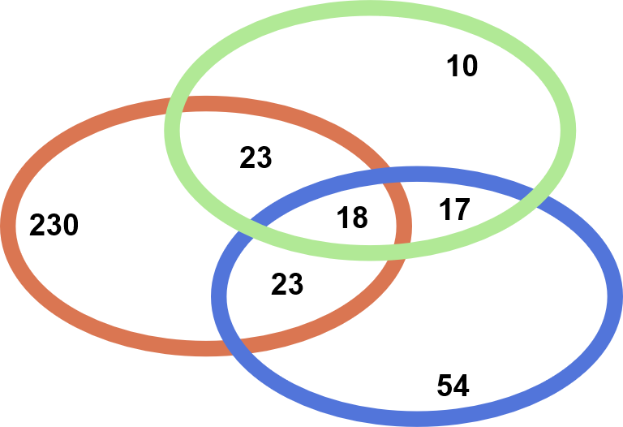
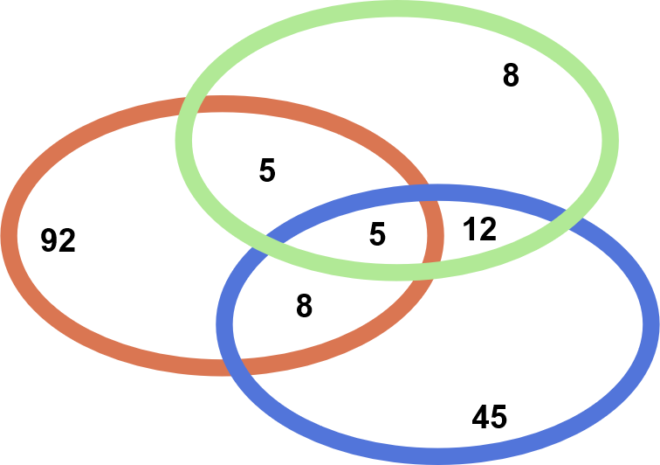
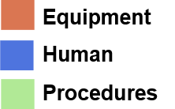
Root Cause Analysis
Ongoing activity for investigating apparent causes, based on trend analysis of ignition mechanisms, and fire event root causes
Analysis of root causes corresponds to 3 typical root cause categories (basis 550 events)
375 events at full power (8,423 ry) 175 events at low-power and shutdown (2,584 ry)
Equipment is with nearly 80% dominating root cause, underlying apparent causes are under investigation; for plants in decommissioning human and procedures show higher contributions

Slide 14
Conclusions
Insights from FIRE operating experience feedback have already been considered in further advancements of the FIRE Database already started or planned
Although the Database is available to member countries only, various publications are available
ENSREG second Topical Peer Review (TPR II) on “Fire Protection” highlighted that operating experience is key issue for safety assessments and resulting improvements in nuclear
reactor and non-reactor installations over the whole plant life cycle
This is challenging to a certain extent for countries having participated in TPR II indicating
the need for generating a corresponding fire related data repository

Slide 15
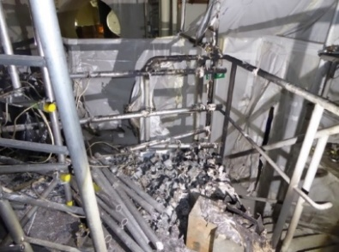
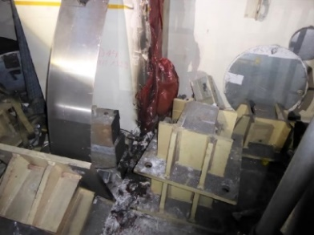
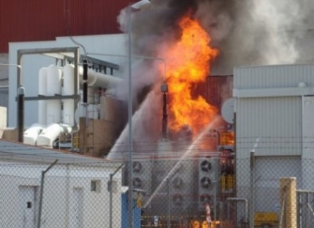
Outlook – FIRE Database Extensions Already Started
  Fire event data collection and analysis from reactor units under
  decommissioning and dismantling
  14 events so far from 4 countries in FIRE 2024:01 DB version
  Fire event data collection from research, pilot and demonstration
  reactors and corresponding modification of the Coding Guideline
  Adapted Coding Guideline is in the testing and adaptation phase
  Already 3 events from 2 countries have been coded,
  approx. 5 more events are expected to be coded in 2026
  Fire suppression success analysis (fire extinguishing systems and
  equipment, manual firefighting, incl. influence of the fire brigade
source: FIRE DB version 2023:03

Slide 16
Outlook – FIRE Database Extensions Planned
  Data collection from the operating experience of fire protection features
  Reportable events with functional failures, deteriorations or spurious operation of fire detection and suppression systems and equipment, according to FIRE member countries reporting criteria
  Findings (failure/deterioration of the required function of fire protection features from inspection and maintenance)
  Findings from inspection and maintenance of fir protection features (fire doors,
  dampers, detection features, HVAC, fire extinguishing systems and equipment
  Needing support by other OECD/NEA Databases, e.g.:
  Specific component failures (e.g. fire pumps), common cause failures (ICDE)
  Fire extinguishing water pipework (CODAP)
  Generic (technical) reliability data for fire protection features for application in Fire PSA
  Fire and fire related data exchange for SMR (small modular reactors) and other advanced nuclear technologies (ANT)
source: FIRE DB version 2023:03

Slide 17
Thank you for your attention!
The authors want to acknowledge the contributions
of all FIRE National Coordinators to this presentation
For further questions and/or requests for publicly available documents,
please contact
Dr. Markus Beilmann Markus.Beilmann@oecd-nea.org
(OECD/NEA Secretariat of the FIRE Database Project)
Dr. Marina Röwekamp Marina.Roewekamp@grs.de
(Chair of the FIRE Database Project)
Andreas Werner Andreas.Werner@safetyassess.com
(Operating Agent of the FIRE Database Project)

