Slide 1
Multi-Objective Optimization and the Value of Uncertainty in Dynamic PRA-Based Decision-Making
─ Application to Intervention Threshold Optimization ─
Shuhei Matsunaka (TEPCO SYSTEMS CORPORATION)
Takashi Takata, Takafumi Narukawa (The University of Tokyo)

Slide 2
1. Research Background & Motivation
Challenges in Safety Assessment & Emergency Planning:
  - Conventional safety assessments (Design basis and Static PRA) typically treat human action times as fixed values.
  - Under actual severe accident conditions, 'time uncertainty' (variability) is inevitable due to stress, harsh environments, and skill levels.
The Dilemma of Deterministic Margins:
  - Optimistic Bias: Ignoring variability and assuming average time leads to underestimating failure probability (Base Case).
  - Excess Conservatism: Setting safety margins based on worst-case scenarios avoids risk but heavily wastes resources.
Proposed Solution:
  - A dynamic decision-making framework that explicitly models time uncertainty to balance risk and resources.
Dynamic PRA-Based Decision-Making Optimization | Slide 2

Slide 3
2. Research Objectives
1. Optimize Emergency Intervention Thresholds via Dynamic PRA
  - Model the dynamic interaction between physical processes (water level) and human actions under variability.
  - Map the multi-objective Pareto-optimal trade-off between risk (failure probability) and personnel resources.
2. Quantify the Value of Information & Uncertainty Reduction (EVPI & EVIU)
  - EVPI (Expected Value of Perfect Information): Quantify the economic value of achieving perfect predictability.
  - EVIU (Expected Value of Including Uncertainty / Variability Reduction): Quantify the ROI of operator training.
3. Support Utility Decision-Making:
  - Provide a mathematical basis for justifying standardizations and training as active resource-saving investments.
Dynamic PRA-Based Decision-Making Optimization | Slide 3

Slide 4
3. System Model: Multi-Tank Water Replenishment
Init: 100%
Init: 100%
Replenishment by Fire Trucks:
  - Facilities: 2 water source tanks (initial level 100%). Water level decreases at 5.0% / hour.
  - Action: 1 primary fire truck (+1 standby). Replenishment rate is 15.0% / hour. Only 1 tank can be supplied at a time.
  - Failure Condition: Either tank level reaches 0% (depletion) during the 168-hour mission.
Transition Logic & Threshold θ:
  - Trigger: Switch supply when the current tank is full (100%) AND the other tank falls below threshold θ%.
Resource Constraints & Operation Time:
  - Normal operation: 2 personnel required. Switching operation: 4 additional personnel required (total 6).
  - Average switching time: 2.0 hours (parameterized with standard deviation σ to represent uncertainty).
-5%/h
-5%/h
Threshold θ (study)
+15%/h
Tank 1
Switch
Tank 2
Primary A
Standby B
Primary Truck A
Standby Truck B
Parameters & Resources:
• Switching Time: μ = 2.0h (σ: parameter study)
• Manpower: Normal: 2 persons, Switching: +4 (total 6)
Dynamic PRA-Based Decision-Making Optimization | Slide 4

Slide 5
4. Evaluated Cases (1% Step Survey)
To systematically evaluate the impact of uncertainty and safety margins (N=1000 trials per threshold θ):
Case 1: Optimistic Det.
Case 2: Realistic Stoch.
Case 3: Optimized Stoch.
Benchmark case assuming perfect predictability (Zero Uncertainty).
Actual field environment with high human response variability.
Reduced uncertainty via procedure standardization & training.
Parameters:
• Mean: 2.0 hours
• Std Dev: 0.0 hours
Parameters:
• Mean: 2.0 hours
• Std Dev: 1.0 hour
• Log-normal
Parameters:
• Mean: 2.0 hours
• Std Dev: 0.5 hours
• Log-normal
0h
2h
4h+
0h
2h
4h+
0h
2h
4h+
Fixed at 2.0h exactly
(No variation / No delay)
Wide variation: 1.0h to 4.0h+
High failure risk at low θ
Narrow variation: 1.5h to 3.0h
Allows lower threshold θ*
Dynamic PRA-Based Decision-Making Optimization | Slide 5

Slide 6
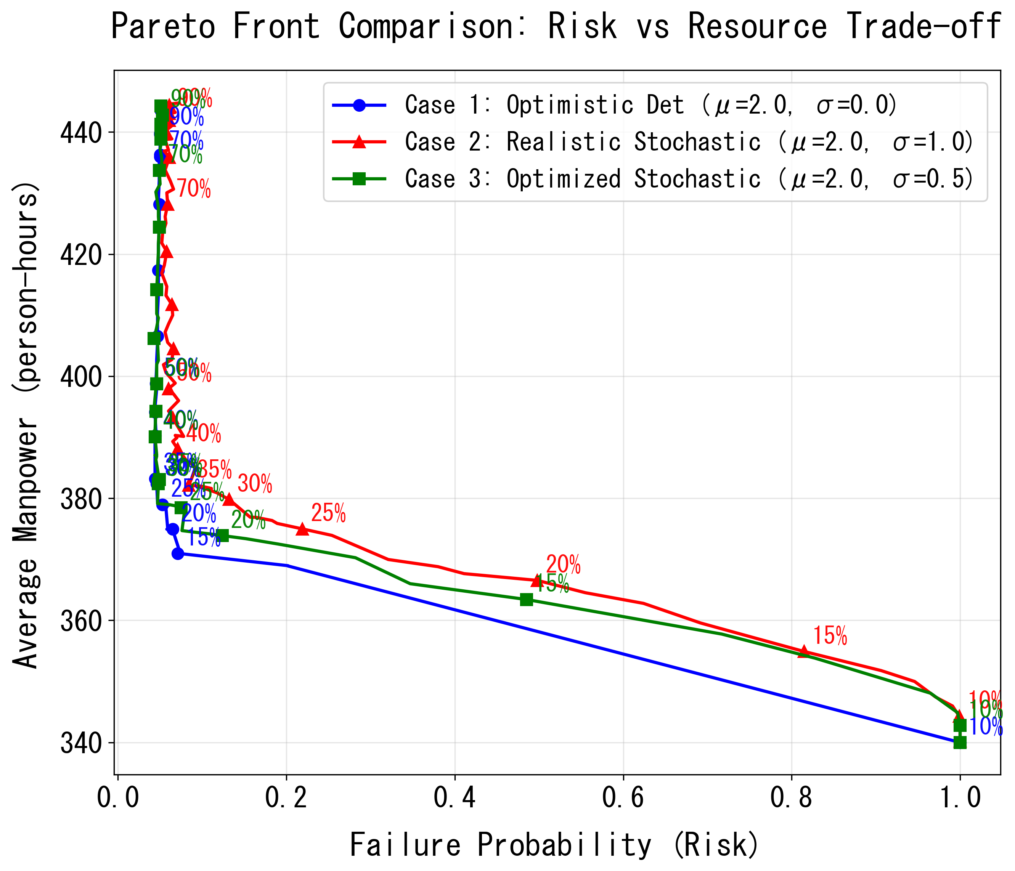
5. Results 1: Risk vs. Resource Pareto Frontiers
Risk-Resource Trade-off (Right Plot):
  - Low Threshold (θ < 15%):
  Fewer switching operations (low resource), but time margin is insufficient, leading to a failure probability of 1.0.
  - High Threshold (θ > 80%):
  Failure probability is minimized, but excessive switching frequency spikes personnel resource usage.
Impact of Variability (σ) Reduction:
  - Transitioning from Case 2 (Red) to Case 3 (Green) shifts the Pareto frontier toward the bottom-left (low risk, low resource).
  - Standardizing operations expands the envelope of viable decisions.
90%
10%
Dynamic PRA-Based Decision-Making Optimization | Slide 6

Slide 7
6. Results 2: Pareto Decision-Making & Knee Point Identification
Decision-Making without Arbitrary Weighting:
  - Knee Point Identification:
  The point of maximum marginal utility where failure probability is minimized without triggering a resource spike.
  In Case 2 (Red), the Knee Point lies around θ = 35%. Beyond this point, increasing θ yields negligible risk reduction.
  - Optimal Threshold Shifts under Safety Goal (e.g., Risk ≤ 10%):
  - Case 1 (Optimistic Det): Predicts θ = 15% is sufficient.
  - Case 2 (Realistic Stochastic): Actually requires θ ≥ 35% (Resources: 382.1 person-hours).
  - Case 3 (Optimized Stochastic): Requires only θ ≥ 23% (Resources: 374.7 person-hours) due to reduced uncertainty.
35%
23%
15%
Dynamic PRA-Based Decision-Making Optimization | Slide 7

Slide 8


7. Quantitative Assessment: Decision Losses, EVPI & EVIU
1. Optimistic Bias Loss (Applying Case 1 θ = 15% to Case 2 Realistic Stochastic Environment):
  - Real Failure Probability: 81.5% (versus 8.4% at the true optimum θ = 35%)
2. EVPI (Expected Value of Perfect Information) ─ Ultimate Theoretical Limit:
  - Baseline (Case 2 Stochastic Optimum, σ=1.0, θ=35%): Expected Cost = 390.52 person-hours
  - Perfect Predictability (Case 1 Deterministic Benchmark, σ=0.0, θ=15%): Expected Cost = 378.08 person-hours
  - ★ EVPI: 12.44 person-hours (3.2%) saved. (Max investment justified for real-time monitoring/prediction tech)
3. EVIU (Expected Value of Including Uncertainty / Training Value) ─ Practical Alternative:
  - Reducing variability by half (Case 2 σ=1.0 → Case 3 σ=0.5): expected cost drops to 382.30 person-hours.
  - ★ EVIU (Uncertainty Reduction Value): 8.21 person-hours (2.1%) saved. (Direct resource saving: 7.4 person-hours)
  - ★ Key Insight: Operator training (EVIU = 8.21) retrieves 66% of the benefit of a perfect prediction system (EVPI = 12.44).
81.5%
* Expected Cost = Average Manpower + [ Failure Probability × 100 person-hours (Penalty Cost) ]
Optimistic Bias Real Risk
66%
Training Efficiency Capture Ratio
EVIU vs. theoretical maximum limit (EVPI)
Dynamic PRA-Based Decision-Making Optimization | Slide 8

Slide 9
8. Practical Value: Justifying Investments in Uncertainty Reduction
Significance of Uncertainty (σ) as a 'Design Variable':
  - Rather than treating uncertainty as a mere uncontrollable 'error' or noise, evaluating it explicitly in PRA is crucial.
  - Optimizing the intervention threshold by modeling σ eliminates excessive, wasteful deterministic conservatism.
Quantitative ROI of Training and Standardization:
  - EVIU (Expected Value of Including Uncertainty = 8.21 person-hours) directly justifies the value of operator training.
  - Training is mathematically proven as a 'productivity investment' that reduces worst-case response times.
Intuitive Analogy: Snow Removal Operations:
  - Scenario A (Speed-focused): Trying to reduce average clearing time (μ) (e.g., buying larger, expensive snowplows) incurs massive capital costs.
  - Scenario B (Reliability-focused): Training operators to eliminate bottlenecks and reduce variability (σ) is low-cost, yet guarantees completion within the required window with high reliability.
  - Insight: Reducing uncertainty (σ) is often far more cost-effective than trying to force the average time (μ) lower.
Dynamic PRA-Based Decision-Making Optimization | Slide 9

Slide 10
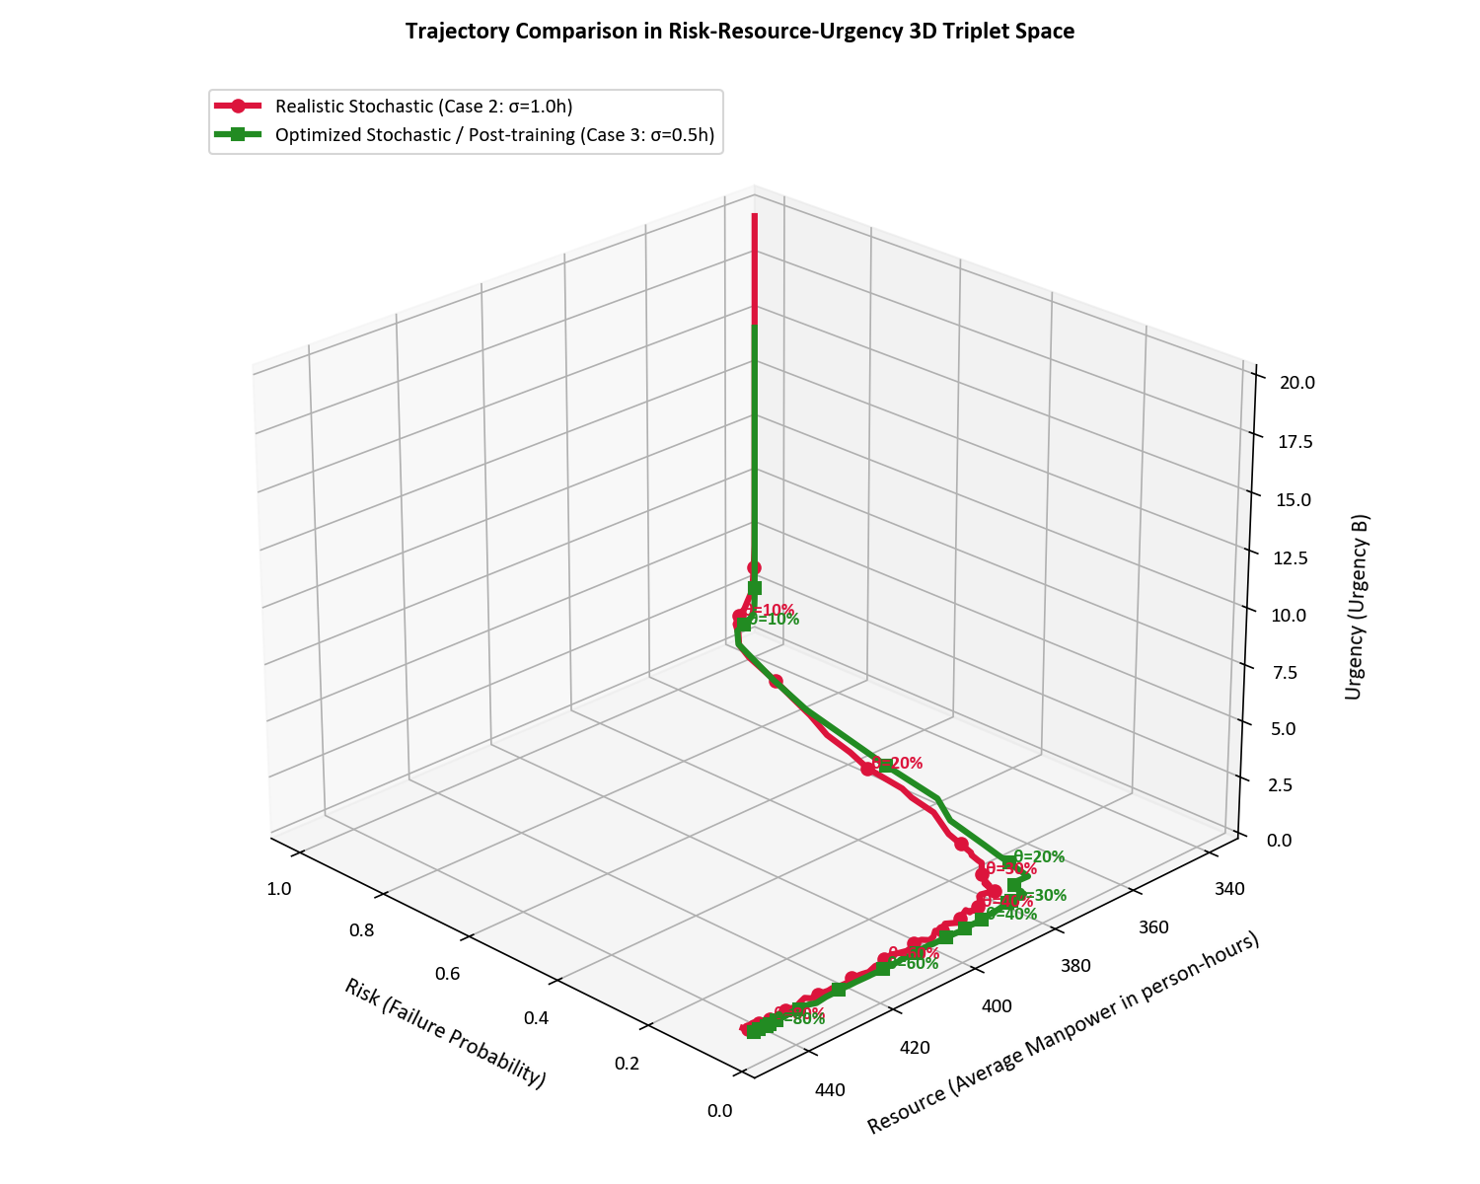
9. Discussion: Modeling Urgency (Urgency B) in Decision-Making
Risk-Resource-Urgency Triplet Optimization:
  - Conventional 2D Pareto frontiers are augmented with 'Urgency' to intuitively capture safety margins.
Draft Formulation of Urgency (An Illustrative Example):
  Urgency_B = (μ + k · σ) / T_available
  - μ : Average switching time (2.0 hours)
  - σ : Operation time standard deviation (variability)
  - k : Conservatism factor ($k = 2.0$, representing the 95% upper limit)
  - T_available : Time available until tank depletion from threshold θ
  ※ Since water level decreases at 5%/h, T_available = θ / 5.0
Physical Interpretation (Ongoing Research Topic):
  - Urgency_B < 1.0 : Safe completion even under worst-case delay.
  - Urgency_B ≥ 1.0 : Risk of tank depletion rises exponentially.
  - ※ This formulation is a preliminary draft; refinement and validation using several options are planned as future work.
Dynamic PRA-Based Decision-Making Optimization | Slide 10

Slide 11
10. Conclusions & Future Outlook
Key Outcomes of this Study:
  1. Framework for Time Uncertainty:
  Dynamic PRA successfully modeled the time-dependent interaction between severe accident processes and human response variability.
  2. Quantification of Deterministic Loss:
  Proved that ignoring uncertainty leads to critical failures (81.5% risk under optimistic bias).
  3. ROI of Operator Training:
  Quantified the value of training as a direct reduction in safety margin (θ*: 35% → 23%) and personnel requirement (7.4 person-hours saved).
Practical Utility for Nuclear Plants:
  - The Risk-Resource-Urgency framework provides a quantitative decision-support tool for nuclear utilities to justify training and procedure improvements not just for 'regulatory compliance' but as 'efficiency investments'.
Dynamic PRA-Based Decision-Making Optimization | Slide 11

