Slide 1

Estimation of Specific Common Cause Factors for Digital I&C Modules
Mariana Jockenhövel-Barttfeld
Yousef Abusharkh
Stefan Karg
Christian Hessler

Slide 2
X
X

Slide 3
Content
1.
Background
2.
TELEPERM XS platform for safety I&C
3.
Data analysis process
4.
Quantitative analysis
5.
Results and conclusions

Slide 4
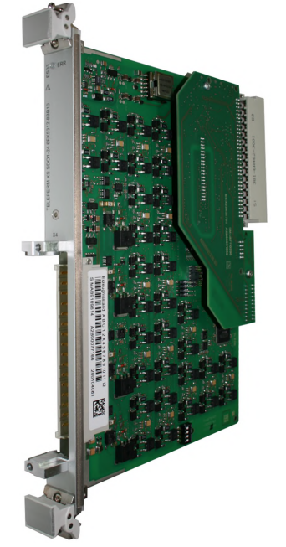
Background
Reliability analyses are conducted during the verification and validation (V&V) of digital I&C systems
  Demonstrate that quantitative safety goals (targets) are fulfilled
  Major contributors are CCF of hardware modules
    Modelled for undetected failures of redundant identical modules
    Accumulation of failures during two periodic tests
Lack of I&C-specific CCF parameters for hardware modules
  Generic parameters for mechanical components are very conservative
  (e.g., NUREG/CR-5497)
  Selection of Beta parameters from IEC 61508 are difficult to justify
Estimation of CCF parameters
  Modules with hardware-specific (embedded) software
  Alpha Factor Model using impact vectors (NUREG/CR-6268)
  Operating experience of the TELEPERM TXS modules
  (input/output modules, priority modules)
TELEPERM® XS
Binary output module SDO1
Notes:
The recommended Beta parameters are selected using a checklist to assess the characteristics of the system.

Slide 5
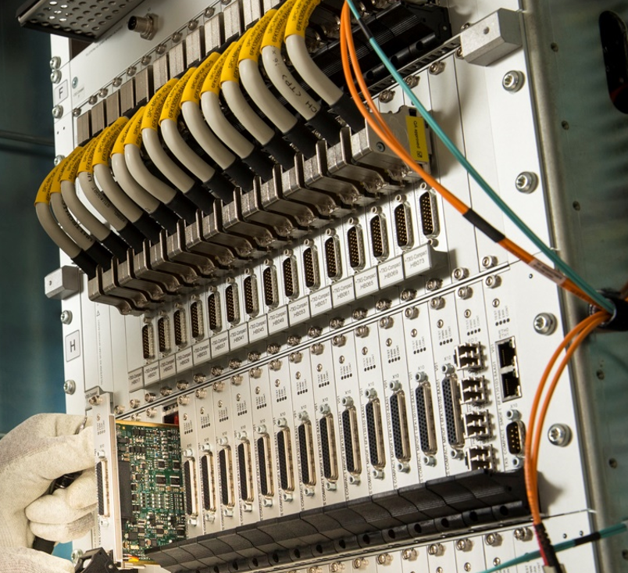
TELEPERM XS Platform
TXS Core
  Platform for safety I&C
  Set of pre-qualified modules to address all type of requirements
    Automation units, signal condition, isolation and distribution, service and maintenance, HMI, …
  More than 3 decades of experience with licensed application in 17 countries
TXS Compact
  New multipurpose platform with a compact, highly versatile, front-access only FPGA-based automation unit
  Qualified to the most stringent safety standards
  Benefits from high-end engineering and service software tools
  Compatible with a wide variety of
  TELEPERM XS modules
Notes:
The recommended Beta parameters are selected using a checklist to assess the characteristics of the system.

Slide 6
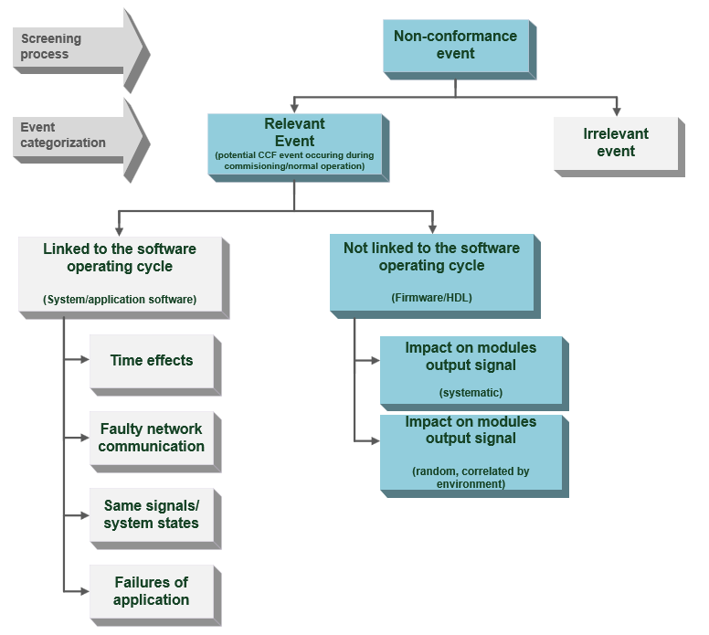
Data Analysis Process
TELEPERM XS operating experience
  Collected from more than 80 NPP worldwide for the
  last 25 years
  Observed events with potential systematic causes:
  non-conformance reports (NCR database)
  NCR screening process
    According to impact on plant safety, availability, …
  NCR categorization process
    Failure mechanism is identified
    Evidence: late stages of commissioning and
    commercial operation
  “Nearly” completeness of customer feedback
  can be claimed
  Pooling of data (scarcity of systematic failure events)
    No evidence of coincident failures of hardware modules
Notes:
The use of operating experience of digital systems for reliability assessments has been analyzed in §7.2 of [1], considering applicability factors for transferring data of a reference to a target system. This analysis allows pooling together operating experience of same/very similar modules to build accumulative collective groups, so-called populations. As pointed out in [1] and supported by NUREG/CR-6268 with “generic” CCF estimations, the main reason for pooling data of similar components for the assessment is the scarcity of systematic failure events.

Slide 7
Quantitative Analysis
Potential CCF event
  One module is identified as faulty
  The failure occurred during commissioning/commercial operation and was revealed by a demand, testing or during normal operation
  Similar redundant items can be identified (not affected) sharing the same failure cause and could be affected by the same coupling mechanism
CCF event is quantitatively recorded using an impact vector for each event (NUREG/CR-6268)
  Treatment of uncertainties for the event classification, i.e.:
    Events with degraded component states
    Events with multiple component failures closely related in time but not simultaneously
    Events with multiple failures for which the presence of a shared cause cannot be established with certainty
  Event classified by a group of I&C experts (consensus)
Alpha parameters are estimated using the impact vector assessment
Populations of four redundant components assumed
  Mapping up/down is possible for other CCF group sizes
Notes:
until reaching consensus
Size 4 → This is a realistic assumption because most of the safety relevant TXS-based systems are built with four redundancies (safety systems)

Slide 8
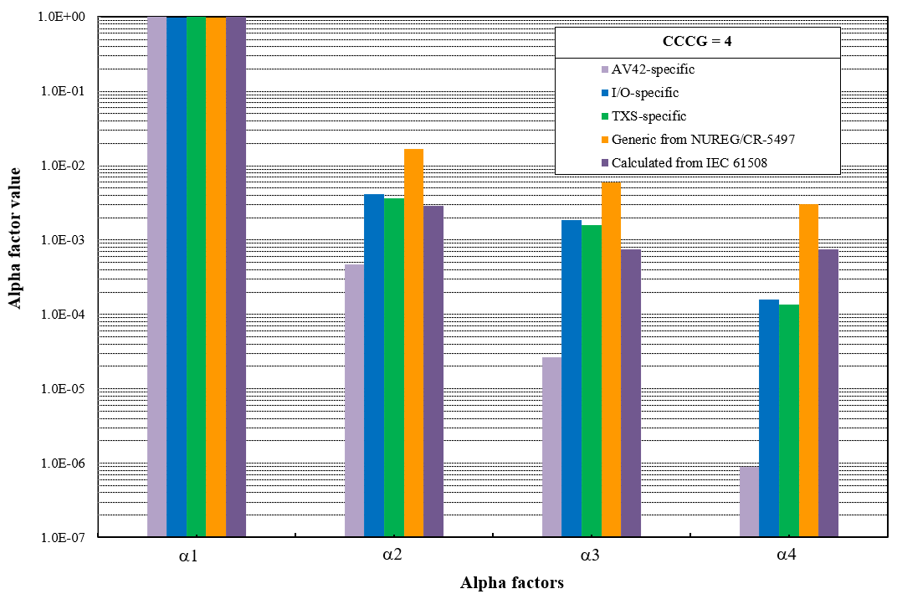
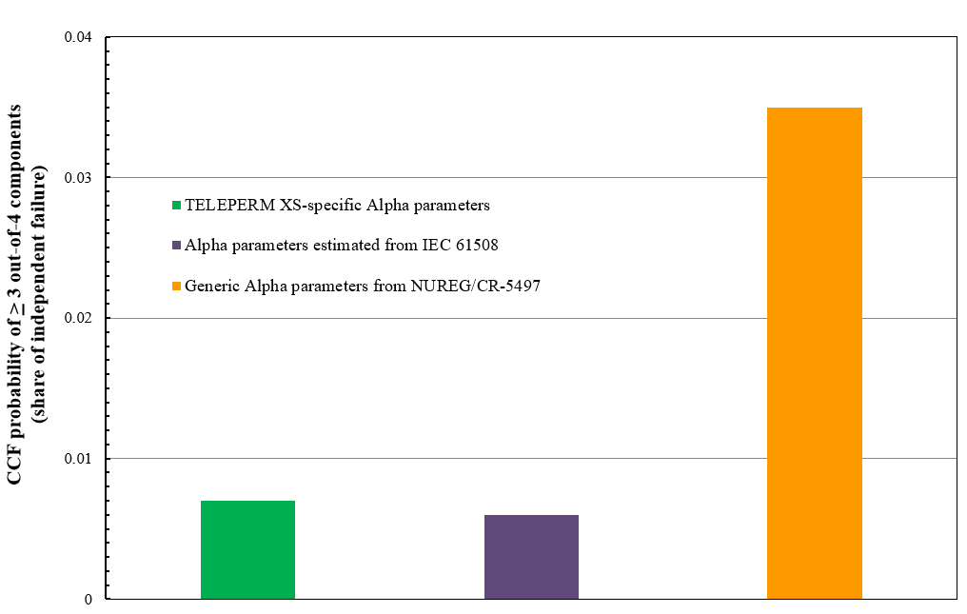
Estimated Alpha Parameters
Alpha factors estimated with the
TELEPERM XS operating experience
CCF probability of >3oo4 failed hardware modules (share of independent failure probability)

Slide 9
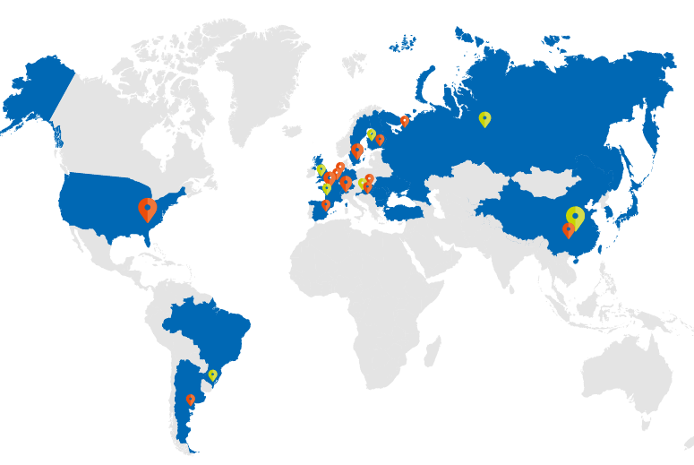

Conclusions
The TELEPERM XS-specific Alpha parameters strongly supports the fulfillment of reliability requirements
  Robust approach for estimating CCF probabilities of digital hardware modules using the TELEPERM XS operating experience
  Considers dependencies given by the embedded software
  Realistic reliability results (avoid overestimations)
  Licensing risks are minimized
  Good acceptance by our customers and safety regulators

Slide 10
Thank You
Contact
Stefan Karg
Stefan.karg@framatome.com
Mariana Jockenhövel-Barttfeld
Mariana.jockenhoevel-barttfeld@framatome.com

