Slide 1

Reliability Analysis of EDG Systems including
Multi-Diesel Configurations
Dr. Mariana Jockenhövel-Barttfeld
Yousef Abusharkh
Manuel Güldner

Slide 2
X
X

Slide 3
Content
1.
Introduction
2.
Reliability of Multi-Diesel
3.
Example for one train
4.
Example for 2oo4 trains
5.
Conclusions

Slide 4
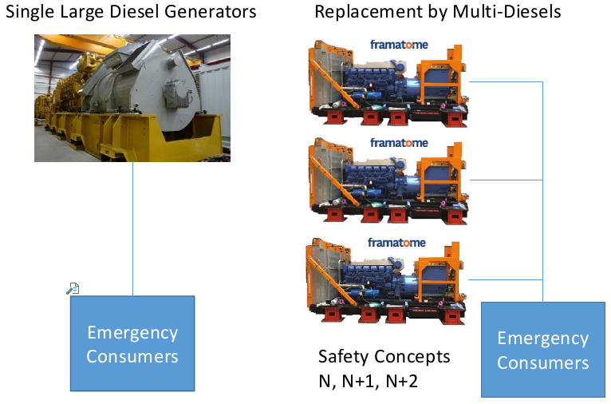
Introduction
Emergency Diesel Generator (EDG) systems at NPP usually involve large redundant EDG sets
  Design capacity of one set → power load required by one NPP train
  Configuration with redundant trains (e.g., 2-out-of-4)
Multi-Diesel configurations
  Multi small EDG sets (< 2 MW) operating in parallel
  Provide at least the same power load as the large EDG set
  Redundant small EDG (backup sets) can be included
Multi-Diesel installation and operational advantages
  Higher reliability/availability than large single sets
  Better maintenance (e.g., repair)
  Lower complexity and efforts for integration, engineering
  and erection
  Easier replacement, flexible for possible power expansion
Notes:
Large diesel generator sets are highly complex
Require high efforts for integration engineering and erection,
Very difficult replacement with other brands due to different footprints and time-consuming
repair activities, requiring extended outages if one large diesel generator set is damaged

Slide 5
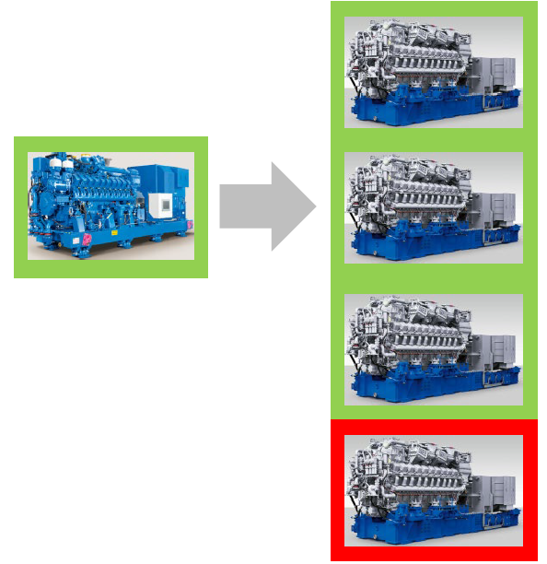
Reliability of Multi-Diesel (1/2)
(N = 3) + 1
Reliability assessment of replacing large EDG sets by multi-diesel sets
  Analyze different configurations with/without backup sets
  Replacement of one/multiple trains of large EDG sets
  Define guidelines (from a reliability perspective) for the selection
  of multi-diesel configurations
Assumptions for the analysis
  A large EDG set of 6 MW is replaced with at least N = 3 small sets
  Fault tree analysis, including repair of failed sets (MTTR = 12 h)
    Failure to start on demand, to operate during the mission time
  N, N+1 and N+2 configurations are analyzed
    All small sets within one train are tested simultaneously (non-staggered)
    Each train tested once a week (TI = 1 month, staggered)
  Backup sets replace any failed set within the paralleled configuration
  Mission times: short-term (2 h), medium term (24 h) and long-term (7 days) LOOPs are considered

Slide 6
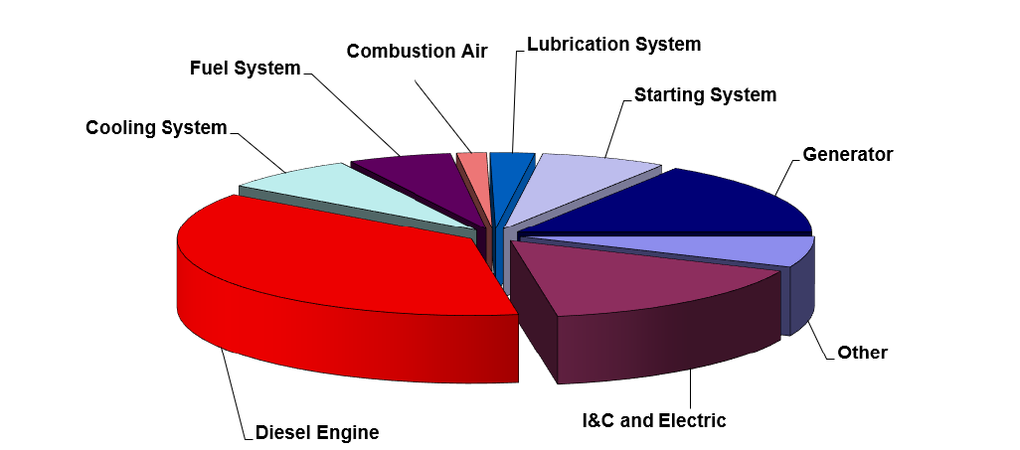
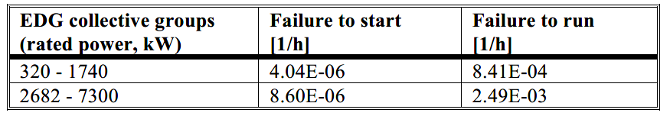
Reliability of Multi-Diesel (2/2)
Reliability data
  Failure rates taken from the Centralized Reliability Database ZEDB
  (operating experience of German nuclear power plants collected from 1976 to 2013)
  Common-cause failures are modeled for redundant sets
    Alpha Factor Model, failure to start/operate from NUREG/CR-5497

Slide 7
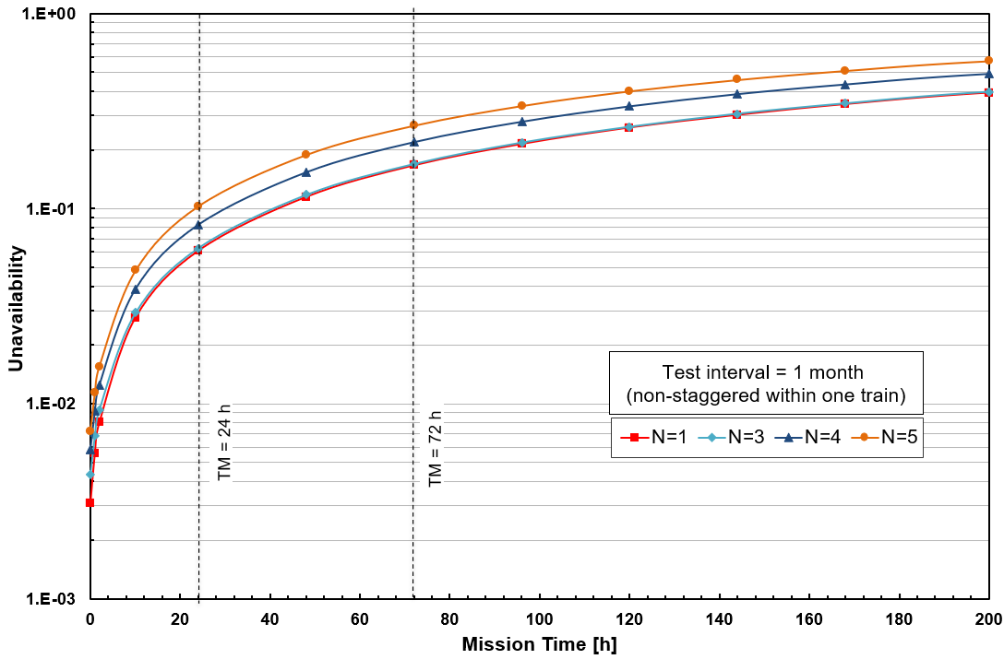
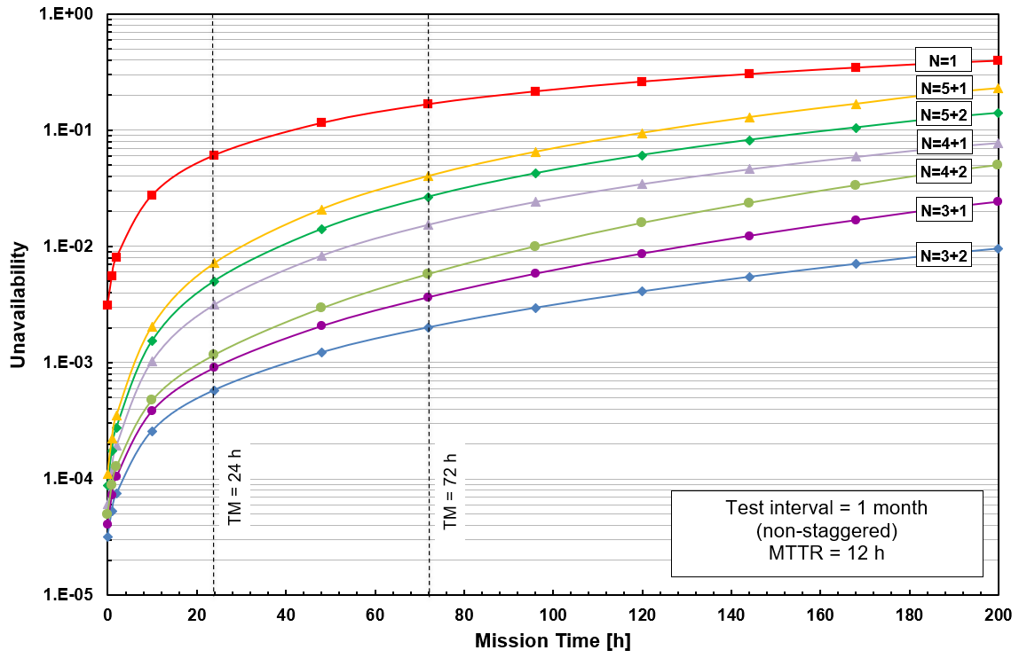
Reliability of Multi-Diesel Configurations
(One Train)
One large EDG in one train is replaced by
N small EDG sets
One large EDG in one train is replaced by
N+1, N+2 small EDG sets
- The EDG availability of one train is downgraded if no
backup sets are included in the configuration
- The smaller the number of sets proving the load,
the higher the availability of the train
- One backup set should be at least included

Slide 8
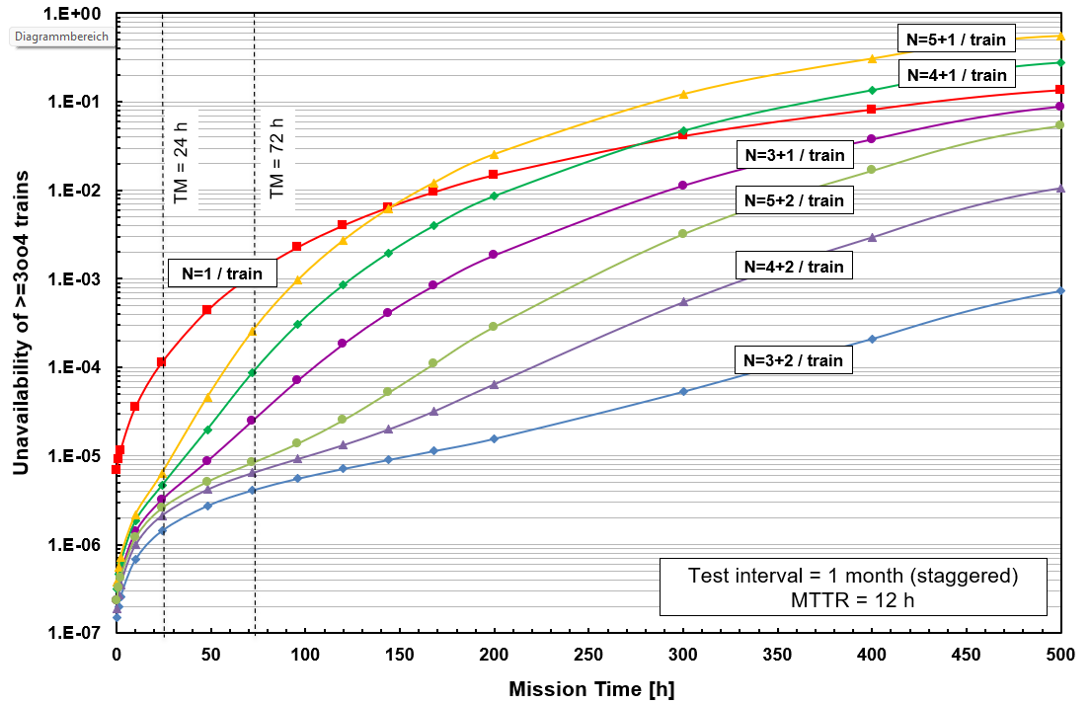
Reliability of Multi-Diesel Configurations
(2oo4 Trains)
One large EDG is replaced by
N+1, N+2 small EDG sets in each of the 2oo4 trains
  - The smaller the number of sets per train providing the load, the higher the system availability
  - Two backup sets greatly improve the system availability

Slide 9
Conclusions
The selection of a multi-diesel configuration depends on
  The total load to be supplied → defines the minimum number of required small sets (N)
  Include the least possible small sets for supplying the required load
  Include at least one backup set (N+1), better are two backup sets (N+2)
  The mission time required for the system operation in the safety case (requirements)
  Cost trade-offs (e.g., investment, maintenance, periodic testing), not yet considered in the analysis
Notes:
Large diesel generator sets are highly complex
Require high efforts for integration engineering and erection,
Very difficult replacement with other brands due to different footprints and time-consuming
repair activities, requiring extended outages if one large diesel generator set is damaged

Slide 10
Thank You
Contact
Manuel Güldner
manuel.gueldner1@framatome.com
Mariana Jockenhövel-Barttfeld
Mariana.jockenhoevel-barttfeld@framatome.com

