Slide 1
Developing a Subset of Staggered Alpha Factor Parameter Estimates
Matthew Degonish matthew.degonish@vistracorp.com

Slide 2
Introduction
A commonly used common cause failure model used in US NPPs is the alpha factor model.
NUREG/CR-5485 denotes differing equations for CCF basic event probabilities when the common cause component group (CCCG) is tested under a non-staggered or staggered test scheme.
Various papers have been developed suggesting that the numerical values of the alpha factors are not equivalent under the different test schemes.
This paper develops a set of alpha factor parameter estimates for emergency diesel generators assuming a staggered test scheme.

Slide 3
Test Schemes
Two main types of test schemes used in U.S. NPPs: staggered and non-staggered testing.
A mixture of test schemes for component may be implemented at a single U.S. NPP.
Technical Specification equipment (such as emergency diesel generators) are tested on a staggered basis to ensure that back-up power supply to a single is still available when testing is performed. Also has explicit requirement to perform follow-up activities.
For equipment not governed by Tech. Specs, a variety of test schemes (i.e., staggered, non-staggered, staggered without follow up) may be implemented.

Slide 4
Non-Staggered Testing
In a non-staggered test scheme:
  For a given test episode, the entire group of m components is tested.
  If any of the components are determined to be failed, they are repaired and returned to service.
  In practice, when components are tested using a non-staggered test scheme, the tests aren’t perfectly simultaneous; however, it is assumed that this type of testing is a good surrogate for an unplanned demand in which all components would be demanded simultaneously
As analysts, we are interested in how the number of failure events in a non-staggered test scheme are distributed.

Slide 5
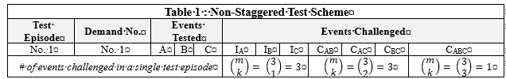
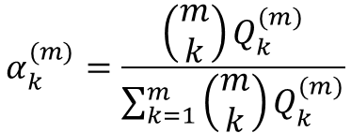
Non-Staggered Testing
Recall! The alpha factor is defined as the fraction of the total frequency of failure events that occur in the system and involve the failure of k components due to a common cause.
$$α_{k}^{(m)}=\frac{\left(\begin{matrix}m \\ k\end{matrix}\right)Q_{k}^{(m)}}{\sum_{k=1}^{m}{\left(\begin{matrix}m \\ k\end{matrix}\right)Q_{k}^{(m)}}}$$

Slide 6
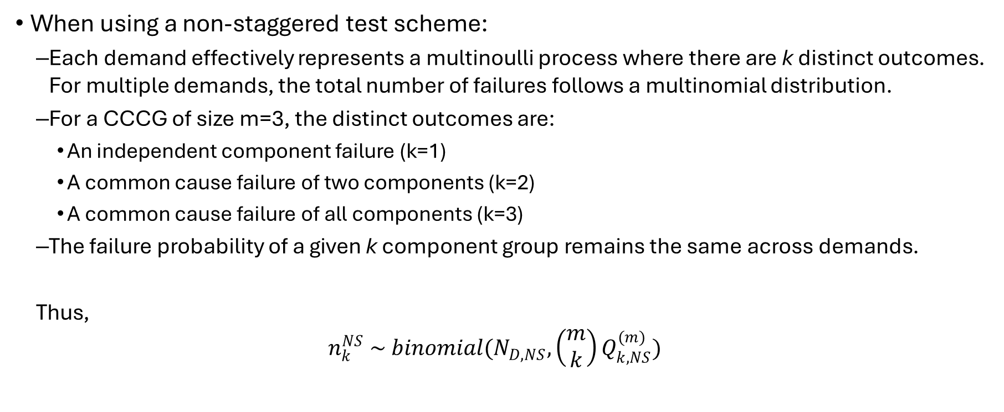
Non-Staggered Testing
When using a non-staggered test scheme:
  Each demand effectively represents a multinoulli process where there are k distinct outcomes. For multiple demands, the total number of failures follows a multinomial distribution.
  For a CCCG of size m=3, the distinct outcomes are:
    An independent component failure (k=1)
    A common cause failure of two components (k=2)
    A common cause failure of all components (k=3)
  The failure probability of a given k component group remains the same across demands.
  Thus,
  $$n_{k}^{NS} \sim binomial(N_{D,NS},\left(\begin{matrix}m \\ k\end{matrix}\right)Q_{k,NS}^{(m)})$$

Slide 7
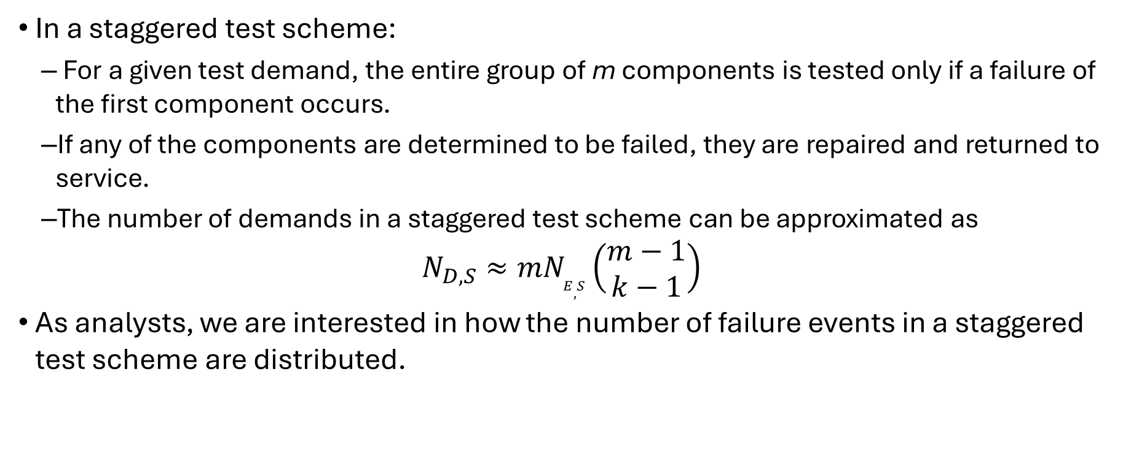
Staggered Testing
In a staggered test scheme:
  For a given test demand, the entire group of m components is tested only if a failure of the first component occurs.
  If any of the components are determined to be failed, they are repaired and returned to service.
  The number of demands in a staggered test scheme can be approximated as
$$N_{D,S}≈mN_{E,S}\left(\begin{matrix}m−1 \\ k−1\end{matrix}\right)$$
As analysts, we are interested in how the number of failure events in a staggered test scheme are distributed.

Slide 8
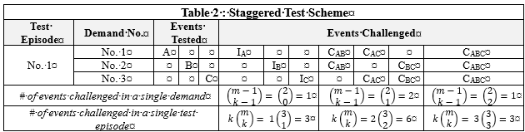
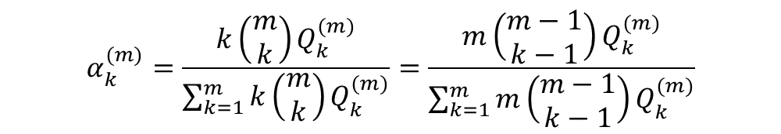
Staggered Testing
Recall! The alpha factor is defined as the fraction of the total frequency of failure events that occur in the system and involve the failure of k components due to a common cause.
$$α_{k}^{(m)}=\frac{k\left(\begin{matrix}m \\ k\end{matrix}\right)Q_{k}^{(m)}}{\sum_{k=1}^{m}{k\left(\begin{matrix}m \\ k\end{matrix}\right)Q_{k}^{(m)}}}=\frac{m\left(\begin{matrix}m−1 \\ k−1\end{matrix}\right)Q_{k}^{(m)}}{\sum_{k=1}^{m}{m\left(\begin{matrix}m−1 \\ k−1\end{matrix}\right)Q_{k}^{(m)}}}$$

Slide 9
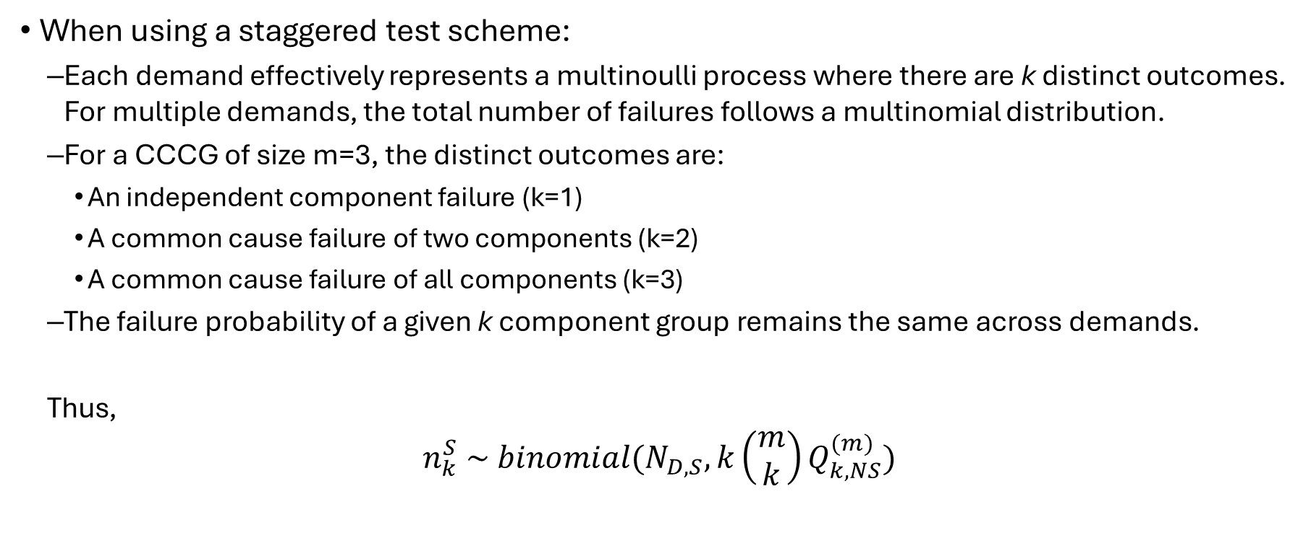
Staggered Testing
When using a staggered test scheme:
  Each demand effectively represents a multinoulli process where there are k distinct outcomes. For multiple demands, the total number of failures follows a multinomial distribution.
  For a CCCG of size m=3, the distinct outcomes are:
    An independent component failure (k=1)
    A common cause failure of two components (k=2)
    A common cause failure of all components (k=3)
  The failure probability of a given k component group remains the same across demands.
  Thus,
$$n_{k}^{S} \sim binomial(N_{D,S},k\left(\begin{matrix}m \\ k\end{matrix}\right)Q_{k,NS}^{(m)})$$

Slide 10
Alpha Factor Parameter Estimates
If not obvious by now, there is an implicit dependence between the observed number of failures and the test scheme from which those failure arose.
Generic CCF parameter estimates usually do not detail the test scheme of the component.
Two obvious assumptions
  Assume the observed failure events represent observations from a non-staggered test scheme
  Assumed the observed failure events represent observations from a staggered test scheme
Regardless of the assumption, the analyst can assess the impact of the alternate test scheme. This provides for a convenient framework.

Slide 11
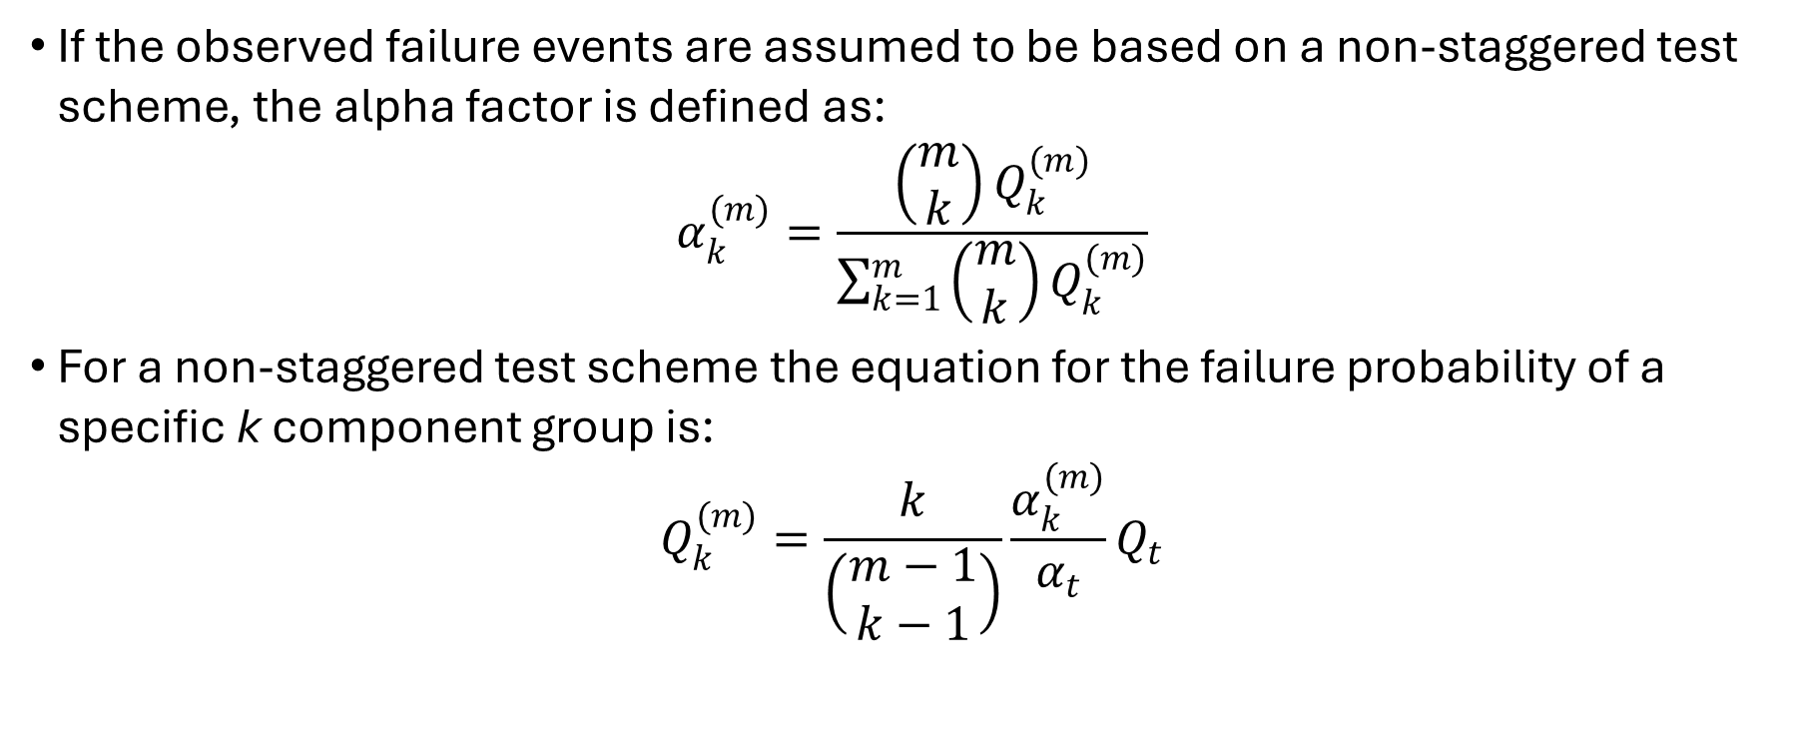
Observed Failures based on a Non-Staggered Test Scheme
If the observed failure events are assumed to be based on a non-staggered test scheme, the alpha factor is defined as:
$$α_{k}^{(m)}=\frac{\left(\begin{matrix}m \\ k\end{matrix}\right)Q_{k}^{(m)}}{\sum_{k=1}^{m}{\left(\begin{matrix}m \\ k\end{matrix}\right)Q_{k}^{(m)}}}$$
For a non-staggered test scheme the equation for the failure probability of a specific k component group is:
$$Q_{k}^{(m)}=\frac{k}{\left(\begin{matrix}m−1 \\ k−1\end{matrix}\right)}\frac{α_{k}^{(m)}}{α_{t}}Q_{t}$$

Slide 12
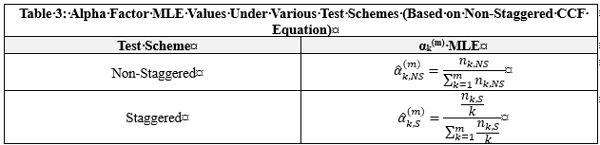
Observed Failures based on a Non-Staggered Test Scheme
Can use the maximum likelihood estimates (MLE) for the probability of a specific k component group to obtain the MLE for the alpha factor.
  Can use non-staggered or staggered MLEs!

Slide 13
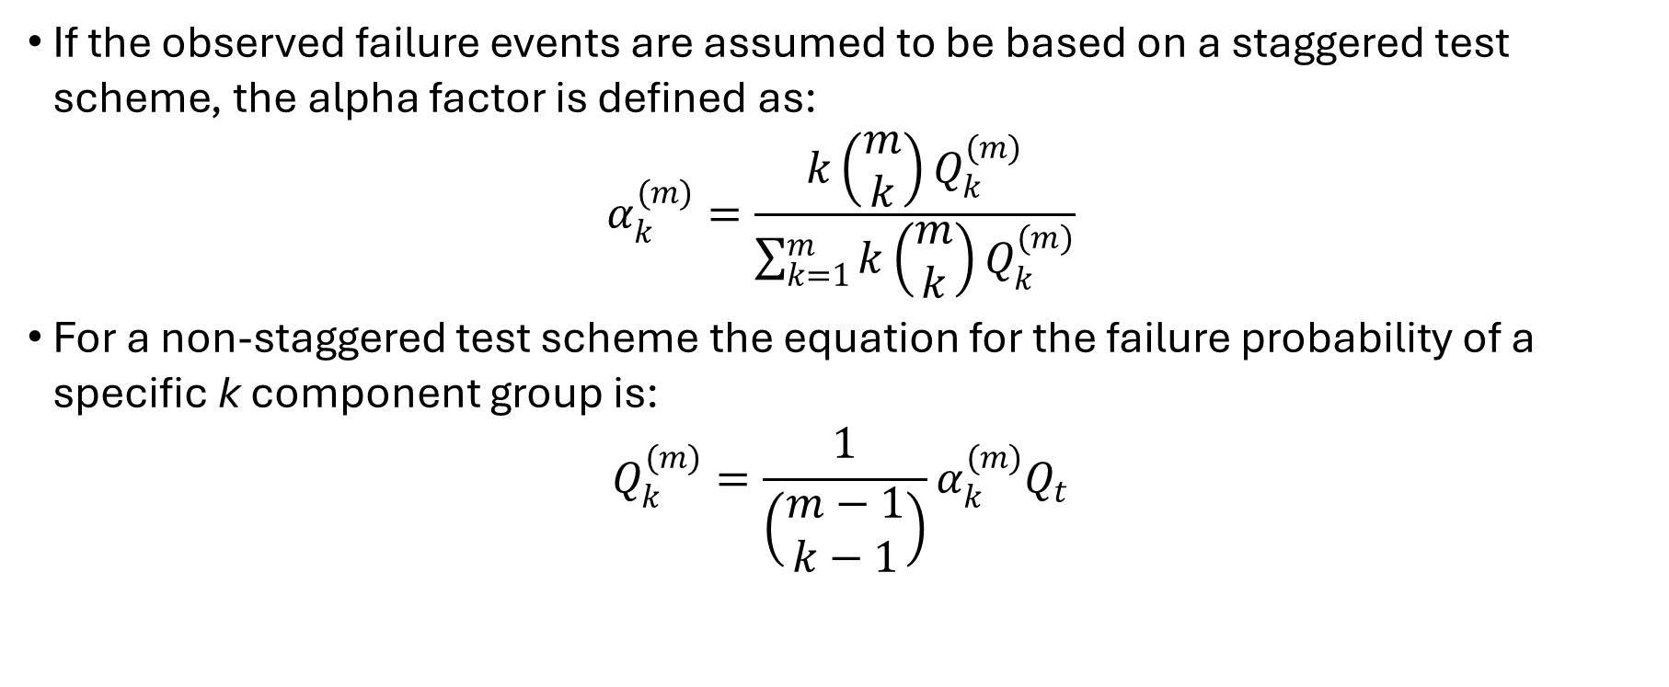
Observed Failures based on a Staggered Test Scheme
If the observed failure events are assumed to be based on a staggered test scheme, the alpha factor is defined as:
$$α_{k}^{(m)}=\frac{k\left(\begin{matrix}m \\ k\end{matrix}\right)Q_{k}^{(m)}}{\sum_{k=1}^{m}{k\left(\begin{matrix}m \\ k\end{matrix}\right)Q_{k}^{(m)}}}$$
For a non-staggered test scheme the equation for the failure probability of a specific k component group is:
$$Q_{k}^{(m)}=\frac{1}{\left(\begin{matrix}m−1 \\ k−1\end{matrix}\right)}α_{k}^{(m)}Q_{t}$$

Slide 14
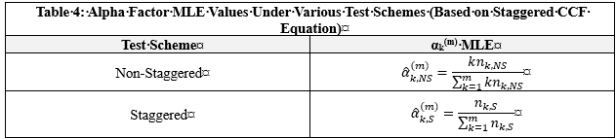
Observed Failures based on a Staggered Test Scheme
Can use the maximum likelihood estimates (MLE) for the probability of a specific k component group to obtain the MLE for the alpha factor.
  Can use non-staggered or staggered MLEs!

Slide 15
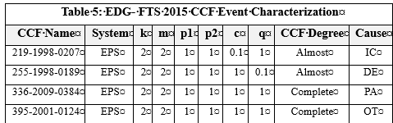
CCF Event Characterization
A critical part of the development of CCF parameters is the characterization of industry CCF events
  As noted before, test scheme isn’t part of this characterization.

Slide 16
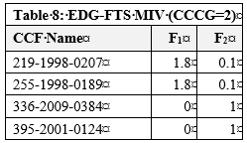
Mapping Impact Vectors
Characterized CCF events will allow us to obtain mapped impact vectors. With mapped impact vectors calculation of MLEs can occur.

Slide 17
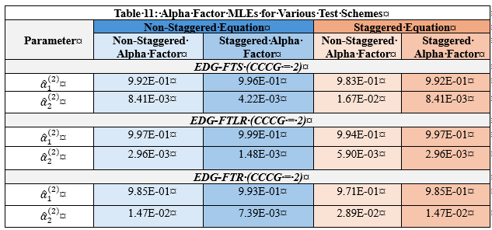
MLE Calculations

Slide 18
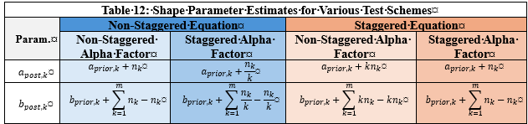

Bayesian Updating
$$a_{post,k}=a_{prior, k}+n_{k}$$
$$b_{post,k}=b_{prior, k}+N_{D}−n_{k}$$

Slide 19
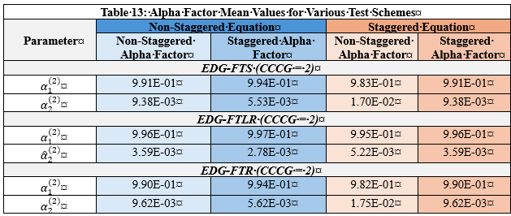
Mean Values

Slide 20
Conclusions
Discussion of non-staggered and staggered testing seems simple, but it’s fairly complicated.
Recommend the following:
  Only make use of the non-staggered equation to calculate CCF basic event probabilities. The resultant probabilities appear to be more conservative regardless of test scheme selection
  By default, make use of the non-staggered alpha factor estimates. The generic CCF parameter estimates developed the NRC/INL should be treated as estimates of non-staggered alpha factors to be used in the non-staggered equation.
  Use staggered alpha factor estimates when it can be justified that the observed CCF events were generated using a staggered test scheme. It is noted that the generic CCF data may need to be reviewed and new calculations performed to generate these estimates.

Slide 21

Questions

