Slide 1

A Dynamic HRA Framework for Persistently Responding to Environmental Changes:
A Preliminary Test of Competing Outcomes Sampling Using the Proposed Concurrent Continuous Markov Chain Monte Carlo (Co-CMMC) Method (#LI105)
Chun-Yen Li, Yukihiro Kirimoto
Nuclear Risk Research Center
2026/07/20
Notes:
Hello everyone, my name is LI. Now I am the member of central research institute of electric power industry.
And then, the topic I will talk about today is …

Slide 2
Outline
Introduction
Methodology
Test Scenario
Scenario-Specific Adaptation
Summary
Notes:
Firstly, I will talk about the background introduction.

Slide 3
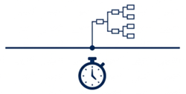
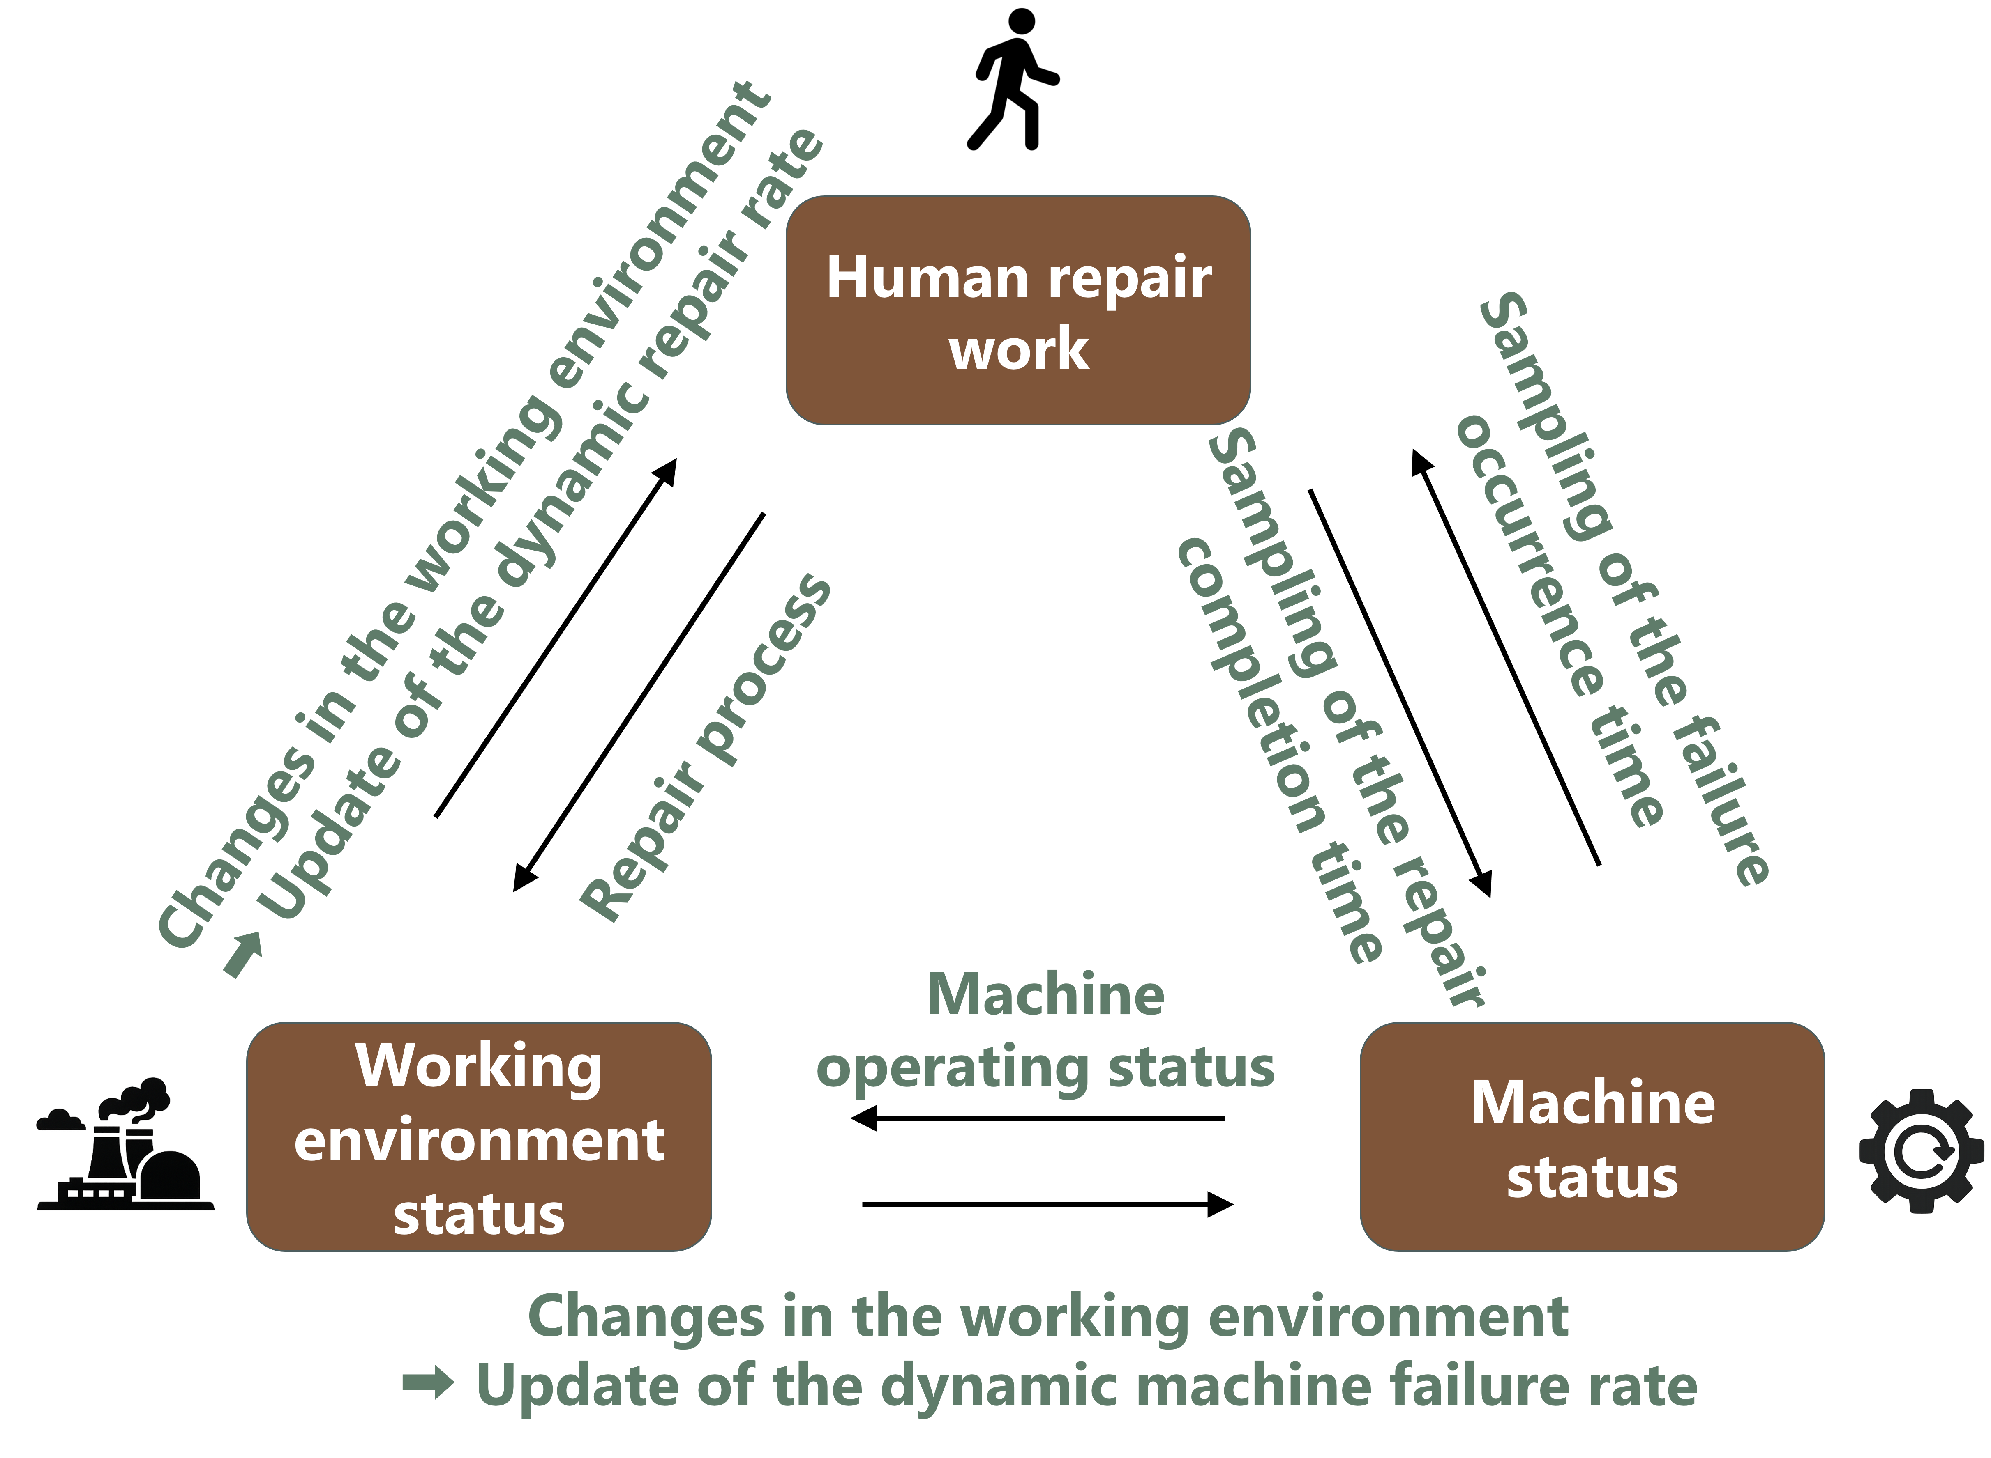
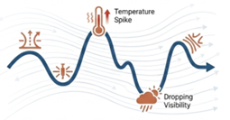
Introduction
Conventional HRA: Relies on predefined, static scenario
Real-world accident: Time-varying; therefore, requires to continuously tracking the human-machine-environment interaction
Objective: To develop a computational framework that captures the dynamic interactions among humans, machines, and the environment over time.
  1. Conventional HRA vs. Real-world
  2. Objective Image
Conventional static consideration
How can we model dynamic human actions together with time-varying machine and environmental conditions?
Real-world dynamics
Notes:
Conventional Human Reliability Analysis often starts from a predefined scenario and fixed conditions.
This is useful for many applications, but real accident conditions may change when the operator is working
For example, the machine may fail or recover. The working environment may become hot, or more contaminated.
Meanwhile, Human actions may also change the machine and the working environment.
Therefore, the objective of this study is to build a computational framework that can simulate the dynamic interactions between humans, machines, and the working environment over time.
So, the main question is: How can we model the dynamic human action together with time-varying machine and environmental conditions?

Slide 4
Introduction
Methodology
Test Scenario
Scenario-Specific Adaptation
Summary
Notes:
And then, I will talk about the methodology.

Slide 5
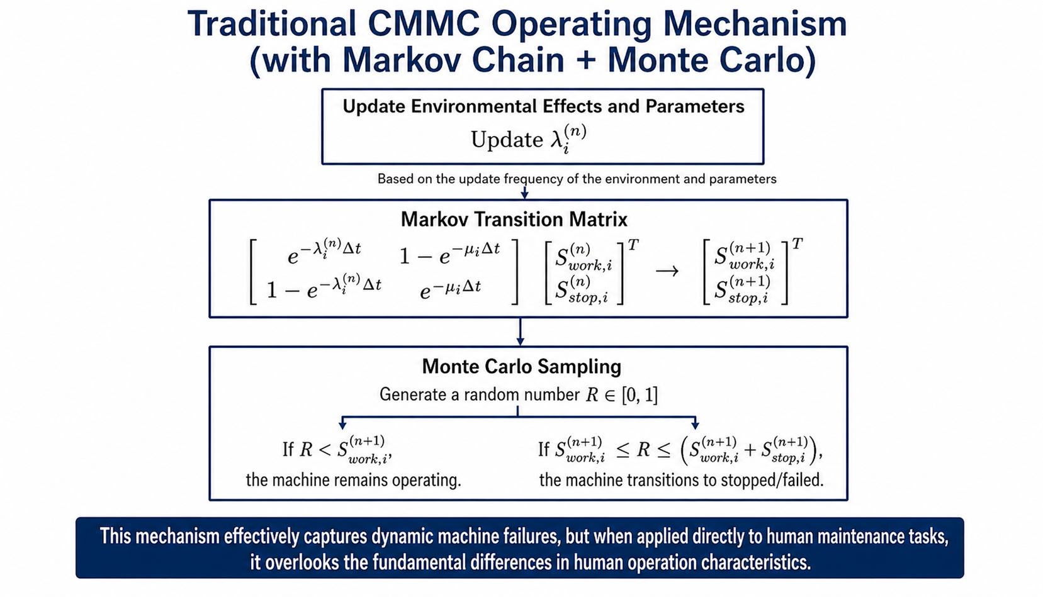
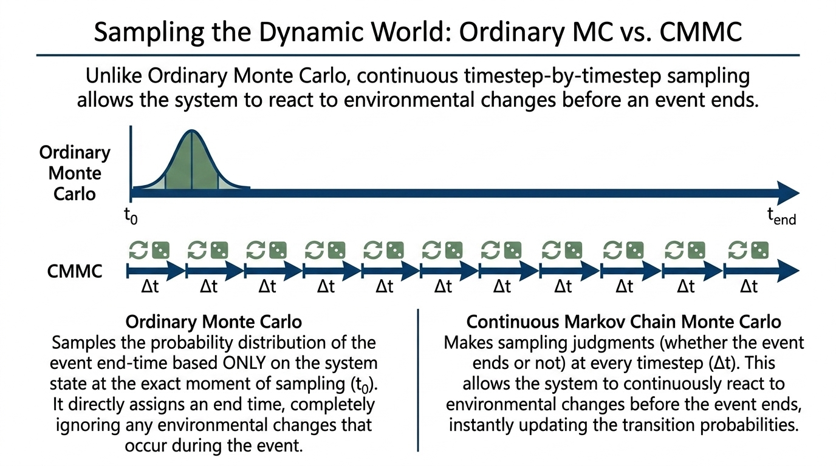
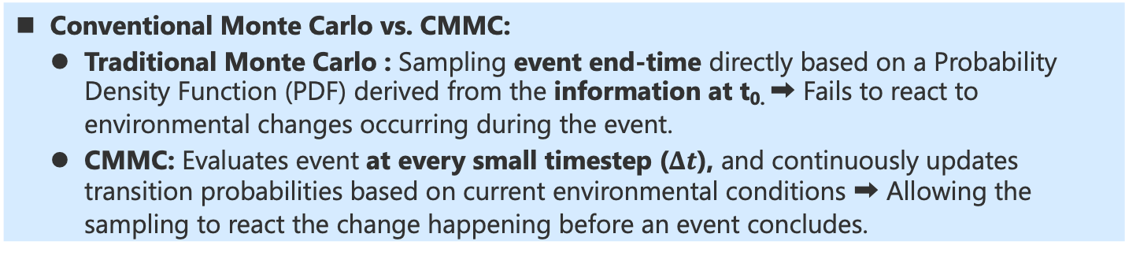

Methodology — Dynamic Event Sampling —
Conventional Monte Carlo vs. CMMC:
  Traditional Monte Carlo : Sampling event end-time directly based on a Probability Density Function (PDF) derived from the information at t_{0.} ➡ Fails to react to environmental changes occurring during the event.
  CMMC: Evaluates event at every small timestep ($Δt$), and continuously updates transition probabilities based on current environmental conditions ➡ Allowing the sampling to react the change happening before an event concludes.
  1. Traditional Monte Carlo vs. CMMC
  2. Formulation of CMMC
(Traditional Monte Carlo)
$$λ, μ$$
State transition prob.
t₀
Event End
Directly sampling the event’s end-time
(CMMC)
Event End
t₀
Evaluates event at every small chosen-timestep ($Δt$)
CMMC: Continuous Markov chain Monte Carlo
Notes:
So, the first idea about the previous question is the dynamic event sampling.
One of option is using the Monte Carlo sampling.
In traditional Monte Carlo sampling, the event’s ending time is sampled directly by using the information available at the time 0, which also means that, the influence of environmental changes just happening later the time 0 would be ignored and cannot be captured.
However, there is another possible option, called the continuous Markov chain Monte Carlo (CMMC) method. It checks if the event is ending or not at every small time-step.
To be more specific, at each time-step, the model will update the state transition probability using the current environmental conditions. And Monte Carlo sampling will use this updated state transition probability to decide whether the event continues or ends.
Although this method is cost than the traditional Monte Carlo sampling, but it would be more suitable for the condition of continuous environment change.
However, if we want to use this CMMC method to simulate the human behavior, such as the repair task, there is still an issue needed to be solved,

Slide 6
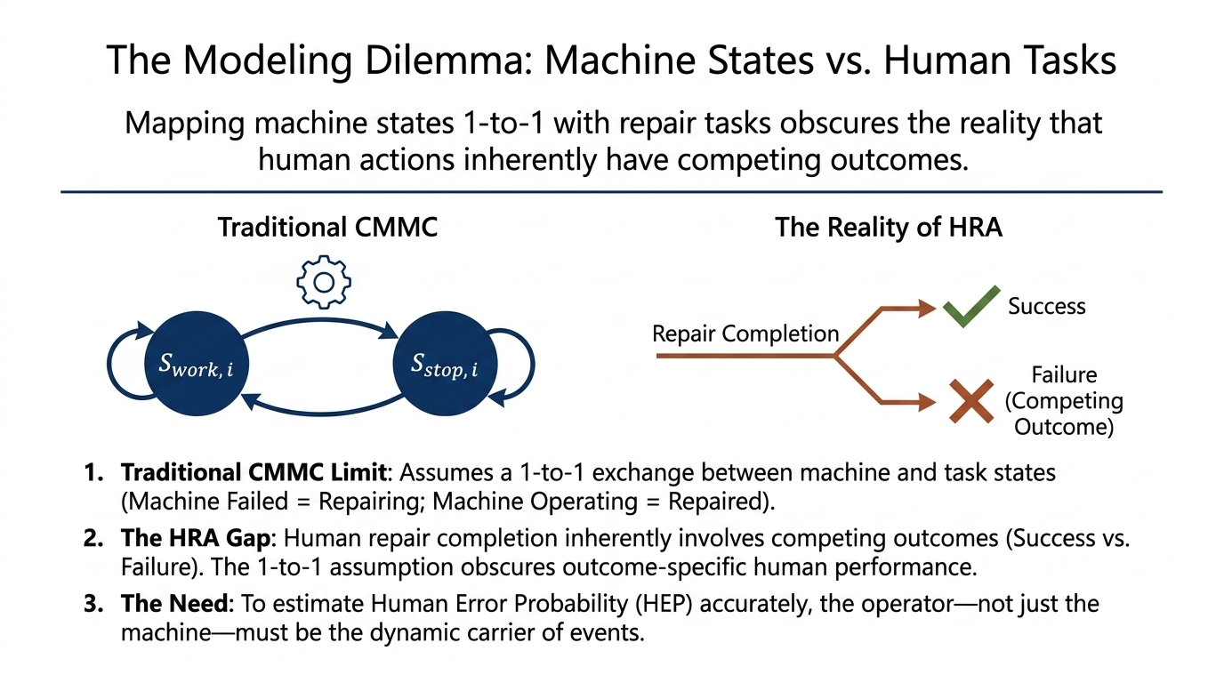
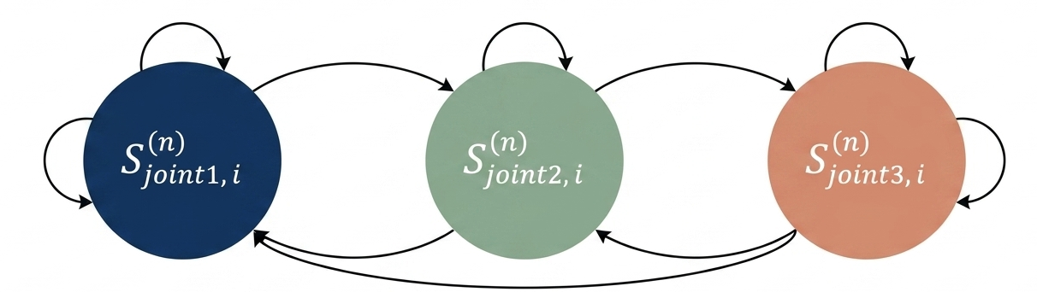
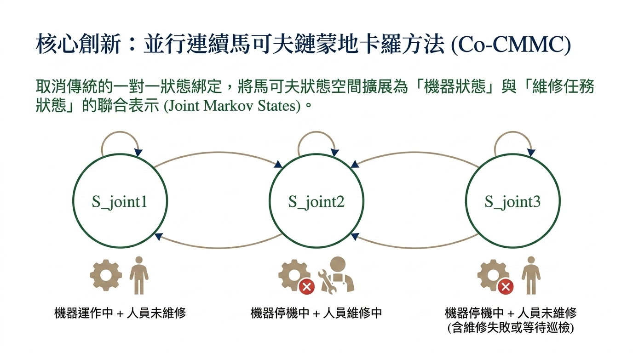
Methodology — Sampling Competing Outcomes —
In CMMC:
  Markov state: Machine state only ➡ Repair status inferred through one-to-one mapping
  ➡ The competing outcomes of Successful repair completion and Failed repair completion cannot be distinguished.
Newly Proposed Co-CMMC:
  By introducing “Joint Markov State”: Machine state + repair-task state ➡ Concurrent tracking
  ➡ Ongoing repair, Successful completion, and Failed completion can be explicitly distinguished.
  1. CMMC (Using Markov State)
  2. New Co-CMMC (Joint Markov State)
Repair task is ongoing?
Repair task is completion and failure?
Repair task is ongoing
Repair task is completion and failure
Repair task is completion and success
Completion and success
Machine is working
Machine is stopped
Machine is working
+ repair task is stopped
Machine is stopped
+ repair task is undergoing
Machine is stopped
+ repair task is stopped
Co-CMMC: Concurrent CMMC
Notes:
In CMMC method, the conventional Markov state generally only can track the machine status, which may be working or stopped.
But for the stopped machine, it cannot tell us the exact repair-task status.
For example, the repair-task may still be ongoing, or it may be completed but failed. However, they cannot be separated.
Therefore, here, we introduce the concept of the Joint Markov State.
For each Joint Markov state, it can describe both the machine state and the repair-task state.
Therefore, this can allow the model to distinguish three different competing possibilities: repair ongoing, repair completed successfully, and repair completed with failure.
Here, we name this method as Concurrent CMMC method (Co-CMMC method), means that both the machine and the repair task can be explicitly tracked at the same time.

Slide 7
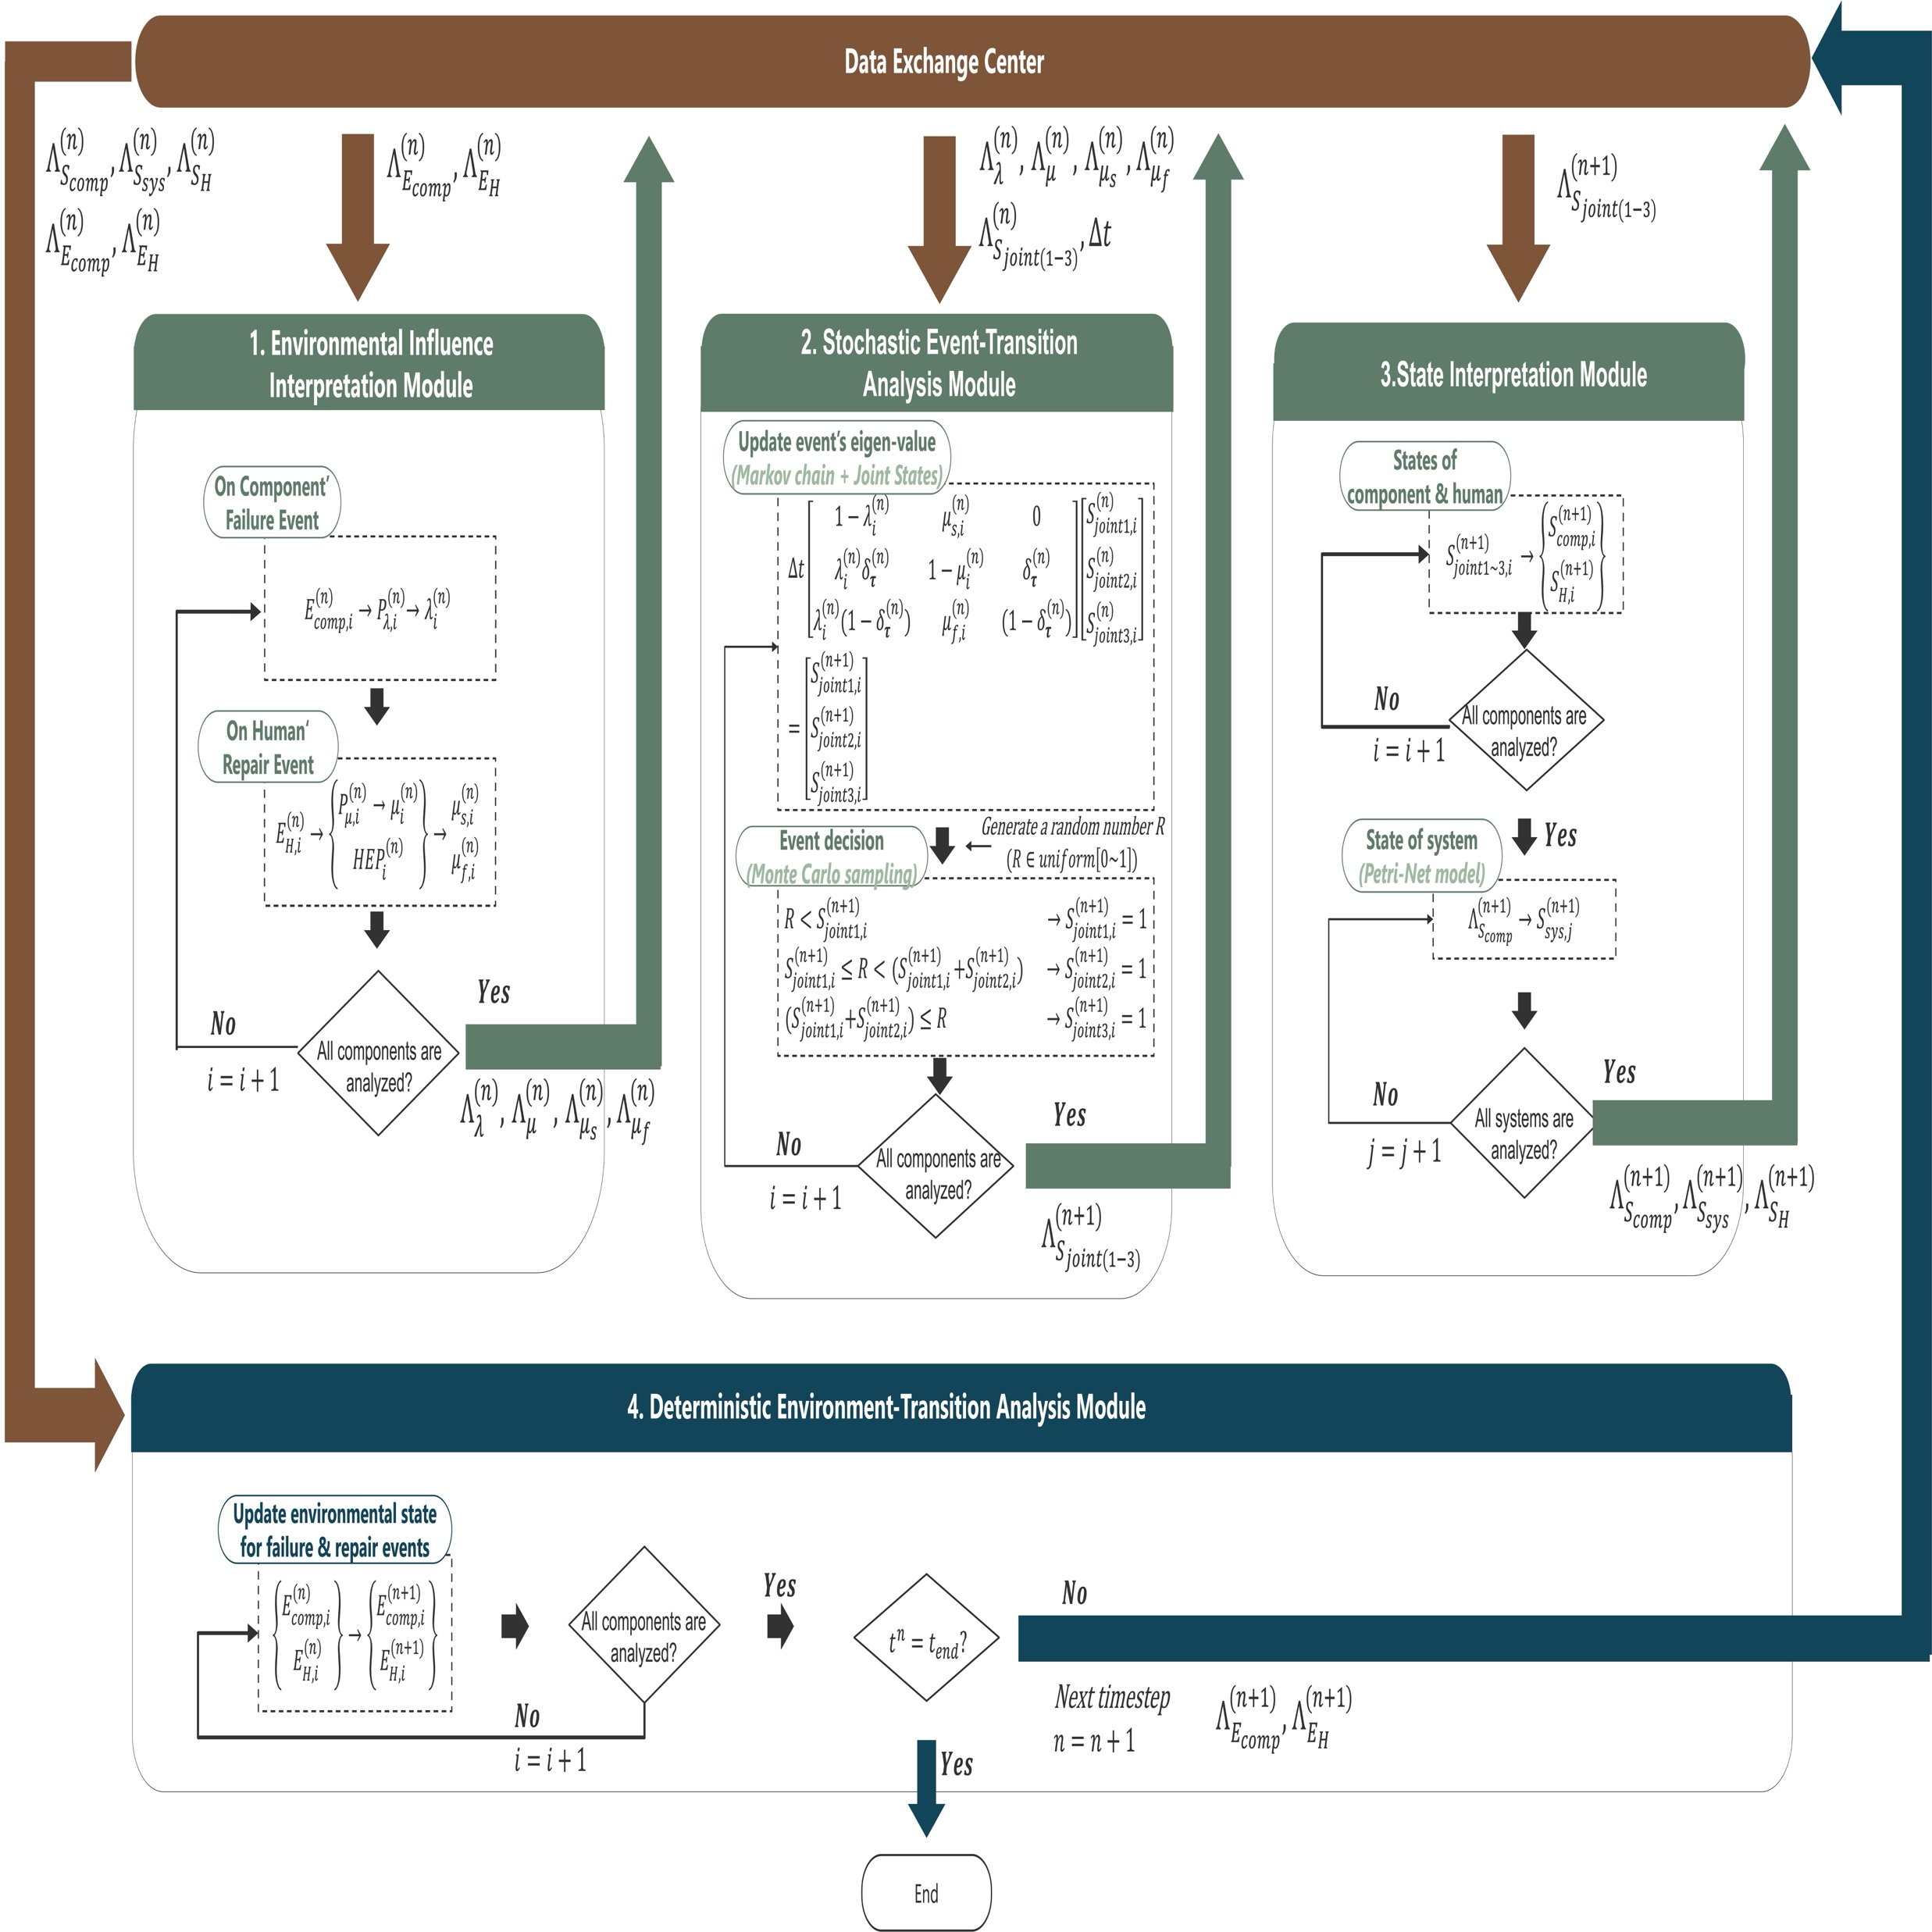
Methodology — Computational Framework Using Co-CMMC (1/2) —
Overview of the Co-CMMC Dynamic HRA Framework
  4 Modules + 1 Data exchange center
  Co-CMMC method = Module1+ Module2
Co-CMMC: Concurrent CMMC
Notes:
And then, we applied this Co-CMMC method, as mentioned in the previous slide, to propose this computational framework, which has the 4 modules and 1 data-exchange center.
For the data-exchange center, it passes the information among these modules. And, the same process of these 4 modules will be repeated at each time step.
As for the details of these 4 modules, in the next slide, I’ll use a timeline diagram to explain how these 4 modules are operated in sequence.

Slide 8
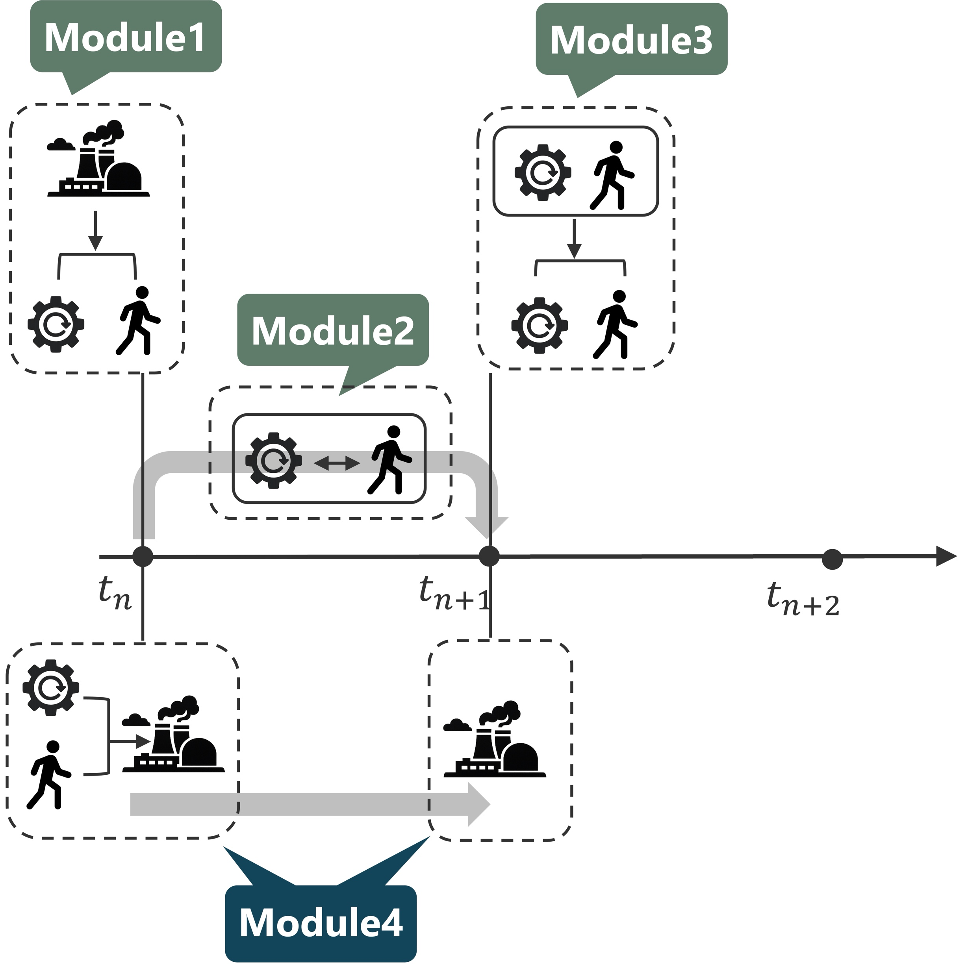
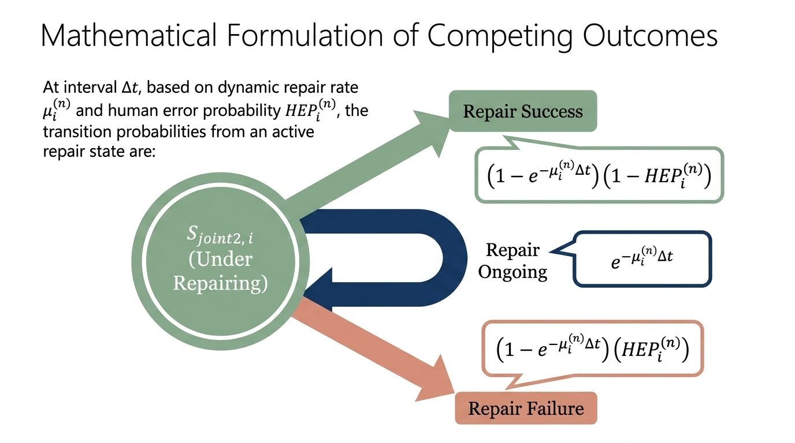
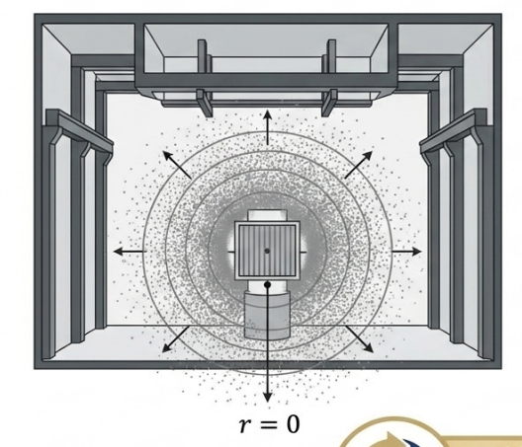
Methodology — Computational Framework Using Co-CMMC (2/2) —
Overview of the Co-CMMC Dynamic HRA Framework (On Time-Line):
  The four modules operate sequentially within each time step, enabling high-temporal-resolution dynamic coupling among humans, machines, and the work environment.
Framework Elements Requiring Scenario-Specific Adaptation:
  Markov chain structure (for Module2)
  Dynamic model of the target environment (for Module4)
  Environmental-variable dependencies of μ and HEP (for Module1)
  Co-CMMC Dynamic HRA Framework: A Timeline Overview
Markov chain structure
Environmental-variable dependencies of μ and HEP
Dynamic model of the target environment
Notes:
As for the Module 1, it read the current environment status to update required parameters for Co-CMMC method, such as the Human Error Probability, and the repair completion rate, mu.
And then, Module 2 will read the information from the Module1 to update the state transition probabilities, in order to sample the newest joint Markov state at the next timestep
Following which, Module 3 will breakdown the updated Joint Markov state into the machine and repair-task status.
Finally, the Module 4 will use the deterministic model to update the working environment status.
So, in this way, the framework not only can connect human and machine status with environmental dynamics, but also enabling higher temporal resolution by operating these 4 modules sequentially within each time step.
On the other hand, although most of modeling elements in this framework are general, but some modeling elements must be adapted to the target scenario, such as the Markov chain structure, the dynamic model of the target environment, and the relationships between environmental variables and Human error probability. The example of these Scenario-Specific Adaptation will be discussed in the following presentation.

Slide 9
Introduction
Methodology
Test Scenario
Scenario-Specific Adaptation
Summary
Notes:
And then, I will talk about the test scenario .

Slide 10
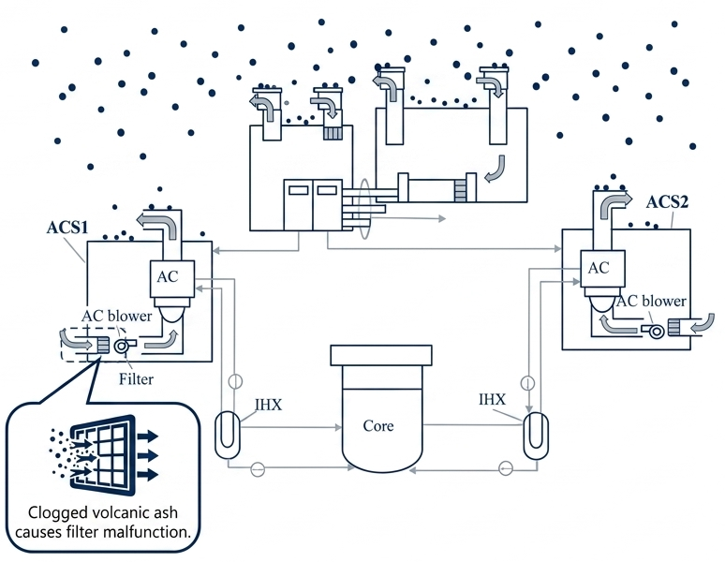
Test Scenario — Volcanic Ashfall Hazard —
  SFR under volcanic ashfall
System
  ACS:
    Air cooler (decay heat removal)
System could be failed due to:
  Ash clogged on the filter
System can be repaired by:
  Replacing the malfunctioning filter with a new one
Point in this study
SFR: Sodium-cooled Fast Reactor;
ACS: Auxiliary Cooling System;
Notes:
The test scenario we consider here is, the volcanic ashfall on the sodium-cooled fast reactor.
There is an important system we want to introduce, which is ACS, that is air cooling system for decay heat removal.
In fact, ACS could have the possibility to be failed due to the volcanic ash clogged on their filters.
However, it can be repaired by replacing the malfunctional filters with a new one, which is also the point we want to discuss in this study

Slide 11
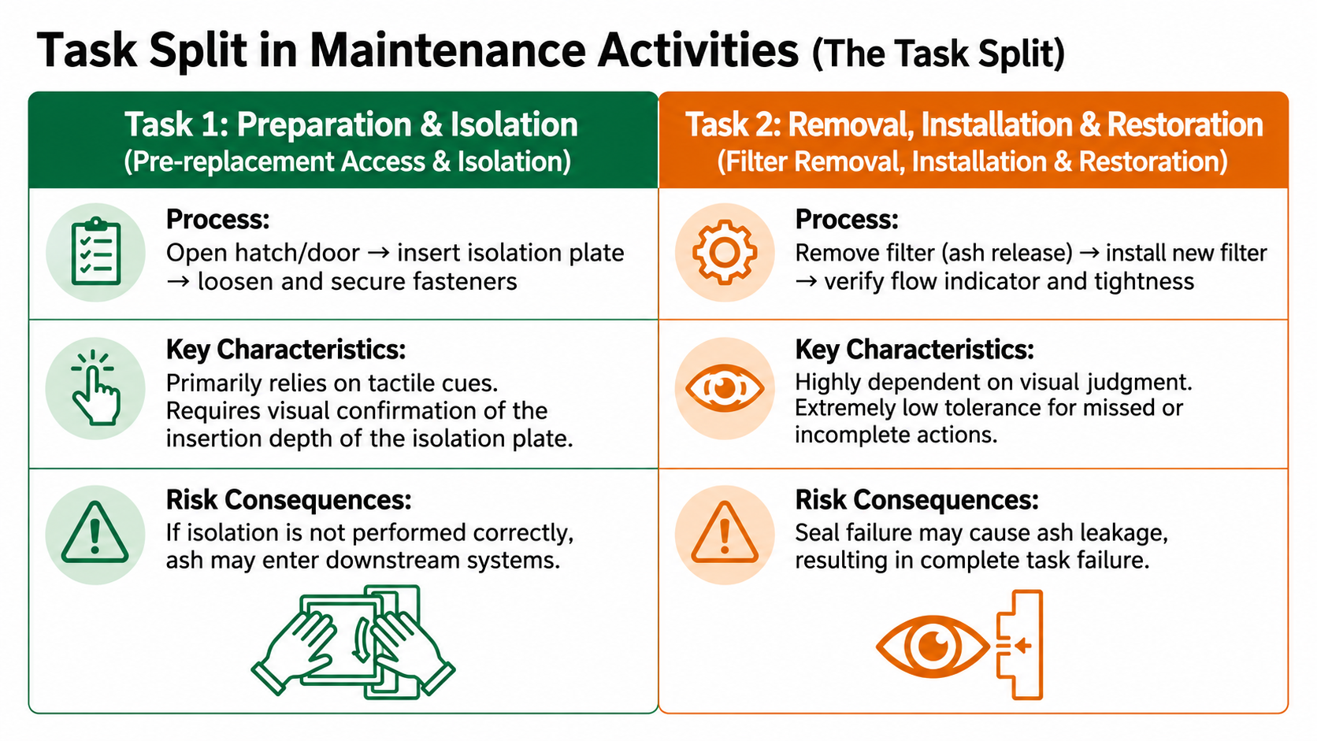
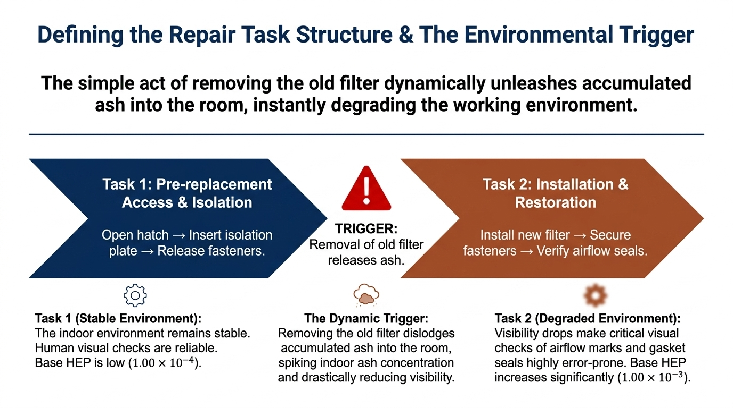
Test Scenario — Repair Task —
Filter Replacement Process
  The filter-replacement procedure is divided into two tasks.
  Task2 alters the working environment by dislodging ash from the filter and releasing it into the workspace.
  In turn, dynamic changes in the working environment affect human performance during both Task1 and Task2.
  Repair Task Explanation: Filter Replacement
The Dynamic Trigger:
Removing the old filter dislodges accumulated ash into the room, spiking indoor ash concentration and drastically reducing visibility.
Process:
Open hatch/door → insert isolation plate → loosen and secure fasteners of
Remove filter (ash release) → install new filter → verify flow indicator and tightness
Key Characteristics:
The task is primarily guided by tactile cues; however, the insertion depth of the isolation plate must be visually verified.
Key Characteristics:
Heavily on visual inspection, including verification of gasket curling or deformation, and the presence of sealing gaps.
Risk Consequences:
If isolation is not performed correctly, ash may enter downstream systems.
Risk Consequences:
Seal failure may cause ash leakage, resulting in complete task failure.
Notes:
The repair task we consider here, which is the filter-replacement process, is divided into two sub-tasks.
Firstly, the task 1 is THE preparation and isolation. In task1, The repair-man will open the hatch, inserts an isolation plate, and loosens the fasteners (fa·suh·nrz).
And then, Task 2 is the removal, installation, and restoration. In task2, the old filter will be removed, and the new filter will be installed, finally the repair-man will check the airflow direction and the sealing condition.
However, the key dynamic trigger will be happened when the old filter is been removed, which would make the accumulated ash on the old filter dislodged into the indoor environment. As a result, the indoor ash concentration will be increased, and making the visibility decrease.
At the same time, in fact, Task 2 is highly depending on the visual inspection, such as checking of the gasket condition, and the any sealing gaps, when inserting a new filter.
Therefore, here, the repair task would change the working environment, and this changed environment will also do the feedback to the repair-man’s performance.

Slide 12
Test Scenario — Anticipated Simulation Traces —
Holistic Output: Executing the Co-CMMC framework generates holistic stochastic histories.
Continuous Reaction: Because the framework samples at every timestep (unlike Ordinary MC), it reacts to the environment change in real-time.
Modeling Elements Requiring Scenario-Specific Adaptation:
Markov chain structure (for Module2); Dynamic model of the target working environment (for Module4); Environmental-variable dependencies of μ and HEP (for Module1)
(Module2)
(Module4)
(Module1)
Notes:
And then, This figure shows the anticipated results that the proposed computational framework is planning to simulate and do the tracking.
Firstly, the top line shows the working environment. You can see that, when the old filter is removed, the ash concentration will suddenly increase and then gradually decrease because the ash diffuses out through the indoor environment.
And then, the middle line shows the human repair process. You can observe that, Task 1 may proceed under relatively normal conditions, however, Task 2 may take a longer time after the visibility becomes poor.
Finally, the bottom line shows the machine status. Here you can see that, the machine remains stopped until the repair is successfully completed.
The important point is that, these history date are connected to each other. The environmental dynamics will change the human transition probabilities, and the human outcome will also change the machine state.
However, it still should be emphasis here, that, this figure only shows an anticipated output of this framework, not the final validated simulation result.
On the other hand, as mentioned before, in order to use this computational framework to simulate this scenario, there are some Scenario-Specific Adaptation needed to be done, which will be discuss in the following chapter.

Slide 13
Introduction
Methodology
Test Scenario
Scenario-Specific Adaptation
Summary
Notes:
And then, I will talk about the Scenario-Specific Adaptation.

Slide 14
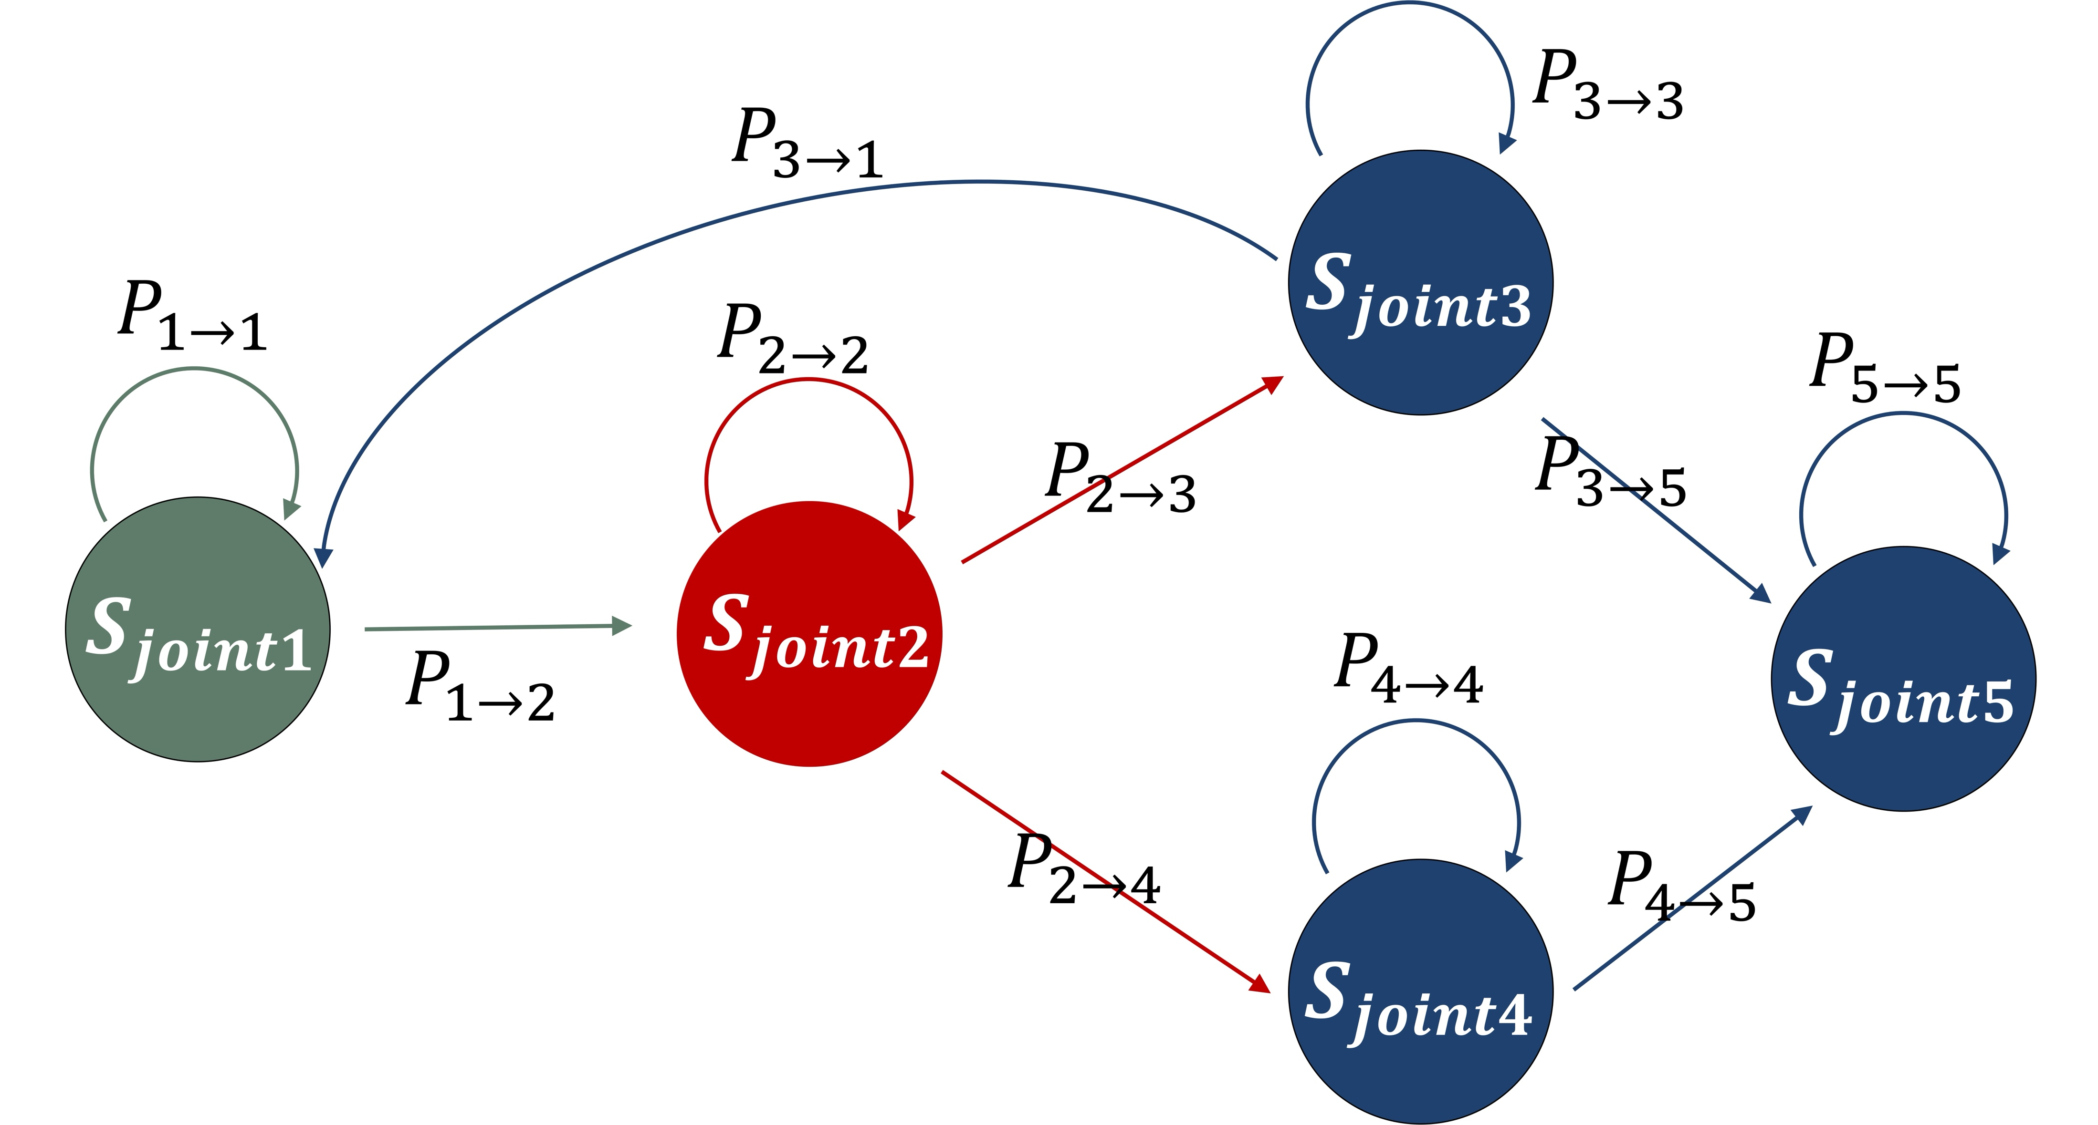
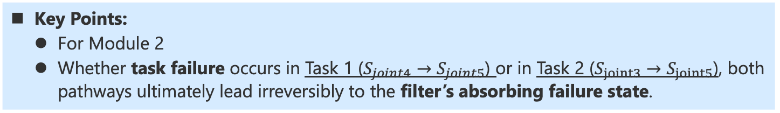
Scenario-Specific Adaptation — Markov Chain Structure —
Key Points:
  For Module 2
  Whether task failure occurs in Task 1 ($S_{joint4}→S_{joint5}$) or in Task 2 ($S_{joint3}→S_{joint5}$), both pathways ultimately lead irreversibly to the filter’s absorbing failure state.
  Markov Chain Structure (Using Joint Markov State)
S_{joint1}
: filter is working,
task1&2 are stopped
S_{joint2}
: filter is stopped,
task1 is undergoing,
task2 is stopped
S_{joint3}
: filter is stopped,
task1 is stopped (success), task2 is undergoing
S_{joint4}
: filter is stopped,
task1 is stopped (failed),
task2 is undergoing
S_{joint5}
: filter is stopped,
task1 is stopped,
task2 is stopped
Notes:
For this scenario, we have defined different joint Markov states.
For the filter part, They describe the filter is working or stopped,
On the other hand, For the repair task, they describe each sub-repair task is in progress, completed with success, or completed with failure.
After defining these joint Markov states, we also set up a Markov chain structure. you can observe that, this structure includes two final failure paths: one is from Task 1’s failure, and the other is from Task 2’s failure.
But, eventually, Both paths will enter the same final failure state, making the process cannot be returned to the normal operation.
Here, it shows one of the advantages of using this Joint Markov states, that is, it can distinguish and record which sub task caused the final failure, even though both paths have the same final outcome.

Slide 15
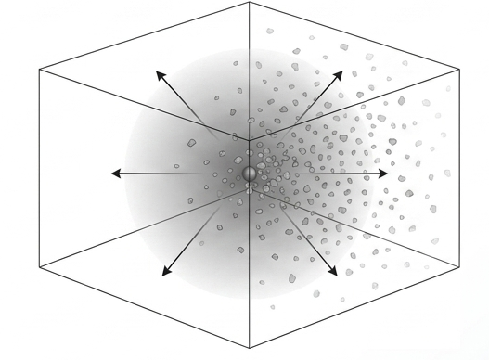
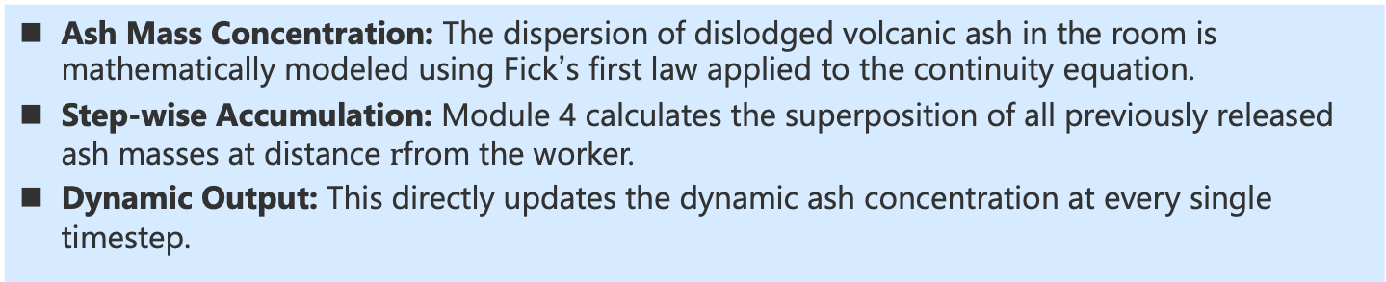
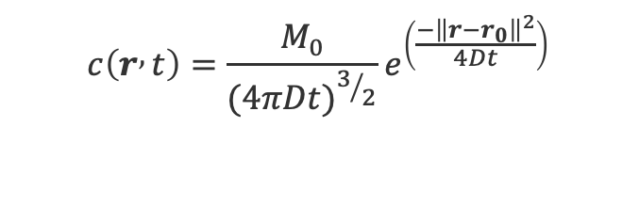
Scenario-Specific Adaptation — Modeling Working Environment —
Ash Mass Concentration: The dispersion of dislodged volcanic ash in the room is mathematically modeled using Fick’s first law applied to the continuity equation.
Step-wise Accumulation: Module 4 calculates the superposition of all previously released ash masses at distance $r$from the worker.
Dynamic Output: This directly updates the dynamic ash concentration at every single timestep.
  Simulation of Volcanic Ash Diffusion in an Indoor Work Environment
Volcanic ash mass concentration [kg/m³] in the working environment as a function of space and time.
Total ash mass [kg] released instantaneously when the old filter is removed in Task 2.
$$c\left(r , t\right)=\frac{M_{0}}{{(4πDt)}^{3/2}}e^{\left(\frac{−{\left\|r−r_{0}\right\|}^{2}}{4Dt}\right)}$$
Diffusion coefficient [m²/s] in air
Notes:
And then, we also modeled the physical working environment.
In this study, we consider that, when the old filter is removed, a mass of volcanic ash will be released from the filter to the indoor working environment .
So Here, We use a three-dimensional diffusion equation based on Fick’s law to calculate the ash concentration as a function of position and time.
In this equation, M0 is the released ash mass, and D is the diffusion coefficient in air,
By using this equation, At every time step, Module 4 will calculate the ash concentration’s spatial distribution with considering all the contribution from each filter replacement
Finally, This physical output, ash concentration, will become the starting point for updating visibility and, in turn, to affect following human performance’s evaluation.

Slide 16
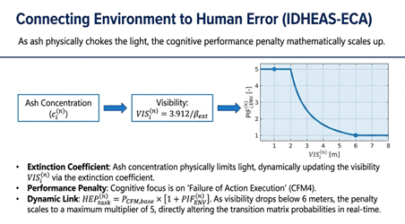
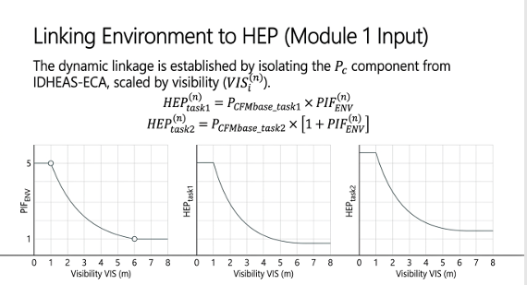
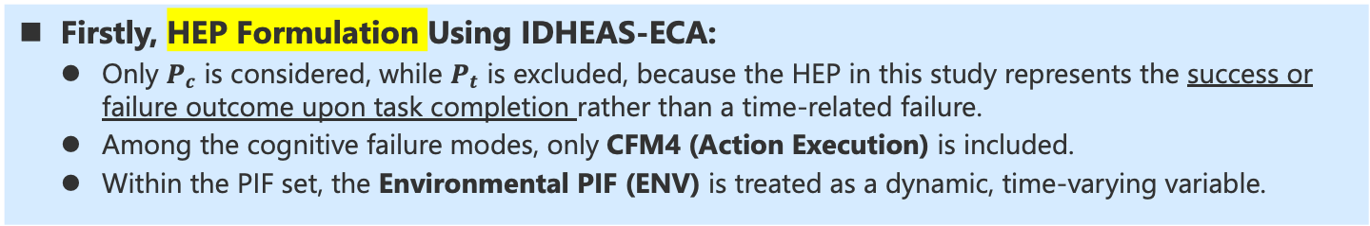


Scenario-Specific Adaptation — Dynamic Environment to HEP (1/2) —
Firstly, HEP Formulation Using IDHEAS-ECA:
  Only $P_{c}$ is considered, while $P_{t}$ is excluded, because the HEP in this study represents the success or failure outcome upon task completion rather than a time-related failure.
  Among the cognitive failure modes, only CFM4 (Action Execution) is included.
  Within the PIF set, the Environmental PIF (ENV) is treated as a dynamic, time-varying variable.
  PIF List for Task1&2 (Excerpt)
PIFs | Task1 (Pre-replacement) | Task2 (Installation)
Scenario Familiarity | SF0 (Base HEP = 0). Professionally trained | SF0 (Base HEP = 0) The same
Task Complexity | C30 (Base HEP = 0). Short, linear execution path. | C31 (Base HEP = 1E-3). More complex steps.
Physical Demands | PD0 (w = 1) | PD2 (w = 2) Filter is heavier.
Environmental PIFs | Dynamic Variable. If visibility ≤ 1m: ENV6 (w=5) penalty. If ≥ 6m: ENV0 (w=1).
$${HEP}_{task1}^{}=1.00E−04[{PIF}_{ENV}^{}]$$
$${HEP}_{task2}^{}=1.00E−03[1+{PIF}_{ENV}^{}]$$
Notes:
And then we will discuss how to link the dynamic environment to the human error probability.
Firstly, I will explain how we formulate the Human Error Probability in this slide.
Here, we use the IDHEAS-ECA approach, with several simplifying choices for this preliminary test.
First, we only consider Pc. This represents the success or failure outcome when the task is completed, which can fit definition of the human error probability model we use in this computational framework; therefore we do not include Pt here.
Secondly , among the cognitive failure modes, we only select CFM4, which represents the Action Execution.
Third, within PIFs we consider here, the environmental PIF is treated as a dynamic, time-varying variable.
Finally, the two repair tasks have different formulation of human error probability, because Task 2 is more complicated and has a higher physical demand than Task 1.
However, for both tasks, human error probability will be updated with environmental PIF corresponding to the current working environment’s states, which will be explained in the following slide.

Slide 17
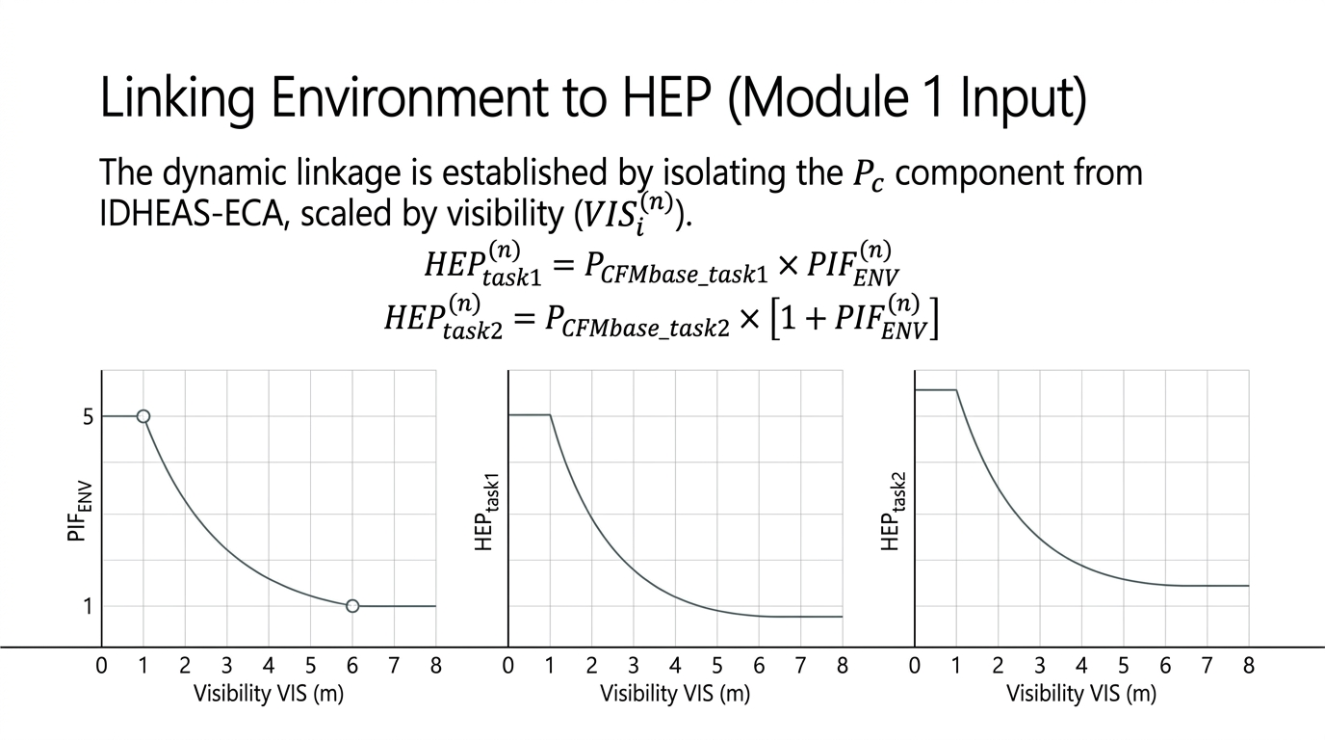


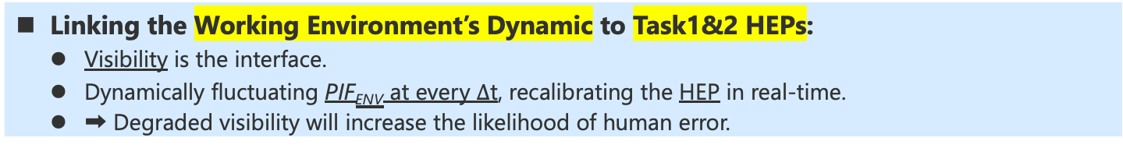
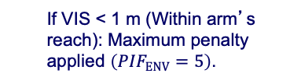


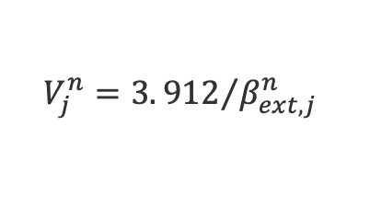
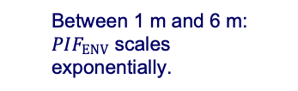
Scenario-Specific Adaptation — Dynamic Environment to HEP (2/2) —
Linking the Working Environment’s Dynamic to Task1&2 HEPs:
  Visibility is the interface.
  Dynamically fluctuating PIF_{ENV} at every $∆$t, recalibrating the HEP in real-time.
  ➡ Degraded visibility will increase the likelihood of human error.
  1. Link to Visibility
  2. Link to ${PIF}_{ENV}$
  3. Link to HEP
  If VIS < 1 m (Within arm’s reach): Maximum penalty applied $\left(PIF_{ENV}=5\right)$.
$${HEP}_{task1}^{}=1.00E−04[{PIF}_{ENV}^{}]$$
  Visibility [m]
  (visible distance)
$$V_{j}^{n}=3.{912}/{β_{ext,j}^{n}}$$
  Between 1 m and 6 m: $PIF_{ENV}$ scales exponentially.
  Extinction coefficient [1/m]
  (related to the ash concentration)
$${HEP}_{task2}^{}=1.00E−03[1+{PIF}_{ENV}^{}]$$
  If VIS > 6 m (clearly perceived):
  No penalty $\left(PIF_{ENV}=1\right)$.
Working Environment’s Dynamic
Notes:
For the repair task we consider
So firstly, we will estimate the ash concentration in the working environment at each time step where the repair-man is located.
And then, the estimated ash concentration will be used to estimate the visibility, which means the visible distance.
Following which, the visibility will be used to estimate the environmental PIF.
When visibility is below to the arm’s reach of 1 meter, useful visual information is almost unavailable. Therefore, here, the maximum penalty of 5 for environmental PIF is applied.
On the other hand, when the visibility is above 6 meters, the surroundings is assumed to be clearly enough. The factor then returns to one, which means no additional penalty for the environmental PIF.
Between 1 and 6 meters, in this research, the environmental PIF is given with a continuous change following the exponential decay.
Therefore, the model is not just giving a fixed human error probability to the entire repair process. Instead, the human error probability responds to the actual environmental dynamics, finally affecting the sampling task is success or failure after the task is completion..

Slide 18
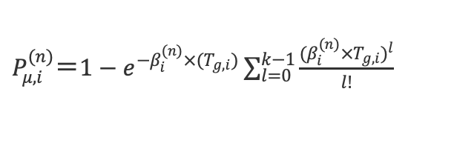




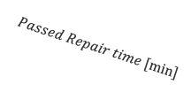




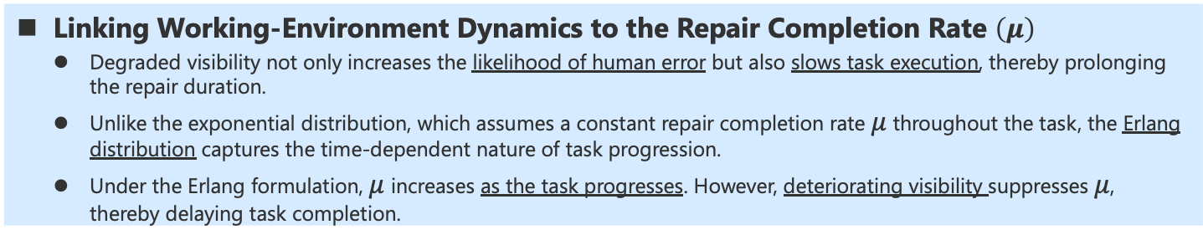


Scenario-Specific Adaptation — Dynamic Environment to μ —
Linking Working-Environment Dynamics to the Repair Completion Rate $\left(μ\right)$
  Degraded visibility not only increases the likelihood of human error but also slows task execution, thereby prolonging the repair duration.
  Unlike the exponential distribution, which assumes a constant repair completion rate $μ$ throughout the task, the Erlang distribution captures the time-dependent nature of task progression.
  Under the Erlang formulation, $μ$increases as the task progresses. However, deteriorating visibility suppresses $μ$, thereby delaying task completion.
  1. Link to Visibility
  2. Link to Erlang Parameter ($β$)
  3. Link to μ
  Visibility [m]
  (updating)
  Completion rate per step ($β$) [1/s] (updating)
  Repair Completion rate (μ) [1/s] (updating)
  # of steps [-]
$P_{μ,i}^{(n)}＝1−e^{−β_{i}^{(n)}×(T_{g,i})}\sum_{l=0}^{k−1}{\frac{{(β_{i}^{(n)}{×T}_{g,i})}^{l}}{l!}}$
$$μ_{i}^{\left(n\right)}＝\frac{{PDF}_{Erlang distribution}}{1−{CDF}_{Erlang distribution}}$$
$$V_{j}^{n}=3.{912}/{β_{ext,j}^{n}}$$
  Completion prob. within grace-time [-] (related to the Visibility)
  Input: (1) the updated $β$
  (2) Cumulative Repair Time
  Extinction coefficient [1/m]
  (related to the ash concentration)
$$μ_{i, task1}^{(n)}[1/min]$$
$$μ_{i, task1}^{(n)}[1/min]$$
$$Passed Repair time [min]$$
$$Visibility[m]$$
$$Passed Repair time [min]$$
$$Visibility[m]$$
Working Environment’s Dynamic
Notes:
Here we consider that, the visibility change also can affect how quickly the repair can be finished, which is related to the repair completion rate, mu.
However, a simple exponential distribution only assumes that the mu remains constant throughout the task, which would be not appropriate, especially for the repair task containing several sequential steps.
Therefore, we start to consider the Erlang distribution.
Although both exponential distribution and Erlang distribution belong to the Gamma distribution’s family, for the Erlang distribution, the mu can increase as the cumulative repair time is increased. In other words, as the repair-man finish more steps, the task will become more close to the task completion.
So, comeback to the environment’s influence, here, updated visibility will used to update the Erlang parameter, beta.
And then, the updated beta and the cumulative repair time will be used to update mu.
Meanwhile, the calculated response surface of mu for task1 and task2 are also shown as below. It can be observed that, although mu can increase as cumulative repair time is increasing, but lower visibility will suppress this increase, making the task would need to take a longer time to be completed.
As a short summary here, therefore, the environment’s change has two effects at the same time.
First, the degraded visibility will increase the human error probability, which can affect the repair task is success or failure after the task is completion.
Second, the degraded visibility also can reduce the repair completion rate, mu, which would make a task would need to take a longer time to be completed.

Slide 19
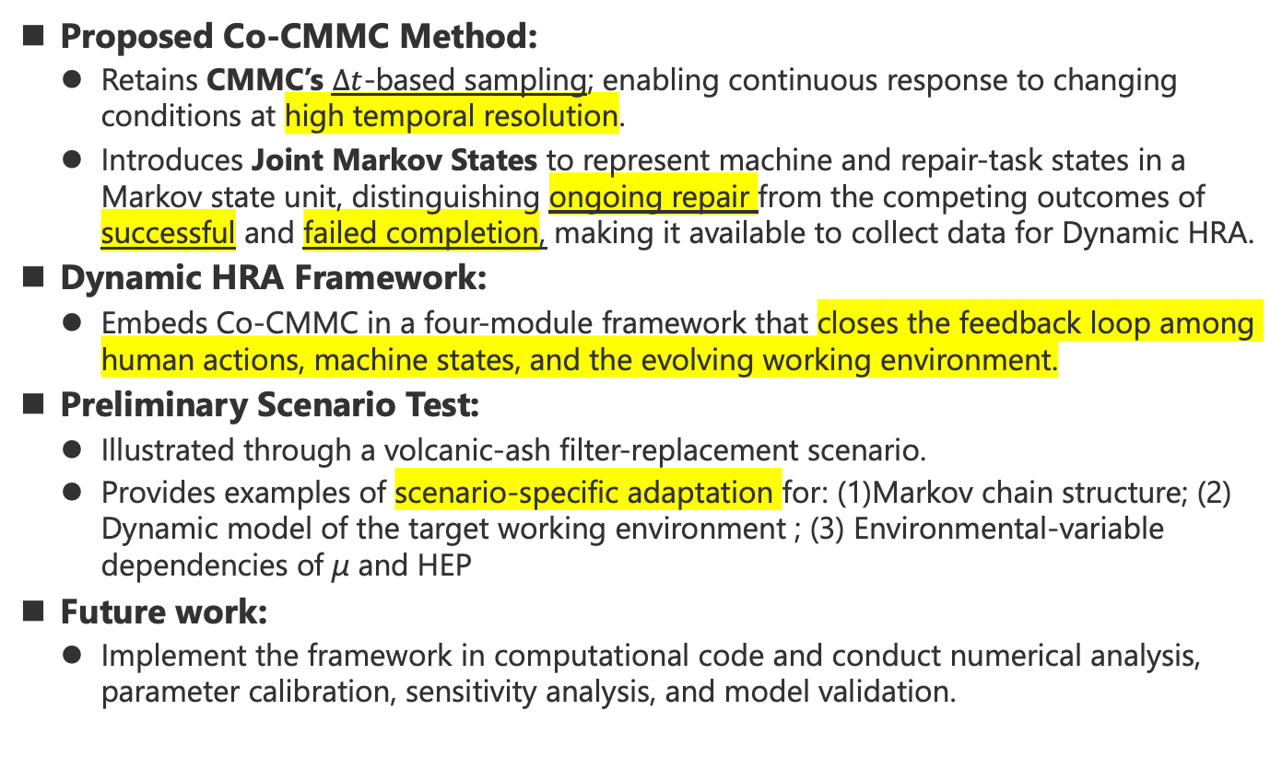
Summary
Proposed Co-CMMC Method:
  Retains CMMC’s $Δt$-based sampling; enabling continuous response to changing conditions at high temporal resolution.
  Introduces Joint Markov States to represent machine and repair-task states in a Markov state unit, distinguishing ongoing repair from the competing outcomes of successful and failed completion, making it available to collect data for Dynamic HRA.
Dynamic HRA Framework:
  Embeds Co-CMMC in a four-module framework that closes the feedback loop among human actions, machine states, and the evolving working environment.
Preliminary Scenario Test:
  Illustrated through a volcanic-ash filter-replacement scenario.
  Provides examples of scenario-specific adaptation for: (1)Markov chain structure; (2) Dynamic model of the target working environment ; (3) Environmental-variable dependencies of μ and HEP
Future work:
  Implement the framework in computational code and conduct numerical analysis, parameter calibration, sensitivity analysis, and model validation.
Notes:
Here is the summary.
In this study, we proposed Co-CMMC method for dynamic HRA.
First, because the Co-Cmmc method keeps the path of sampling at each timestep, so it can respond to a continuously changing condition at a higher temporal resolution.
In addition, one of the characteristics of co-CMMC is that, It introduces the joint Markov states, which makes the repair in progress, successful completion, and failed completion can be separated.
Furthermore, based on this Co-CMMC method, a 4-modules computational framework is also proposed, which closes the feedback loop among human actions, machine states, and the working environment’s dynamic
Finally, this research also used the volcanic-ash-fall scenario as the example to show how to do the necessary **Scenario-Specific Adaptation for enabling this computational framework to do simulation.**
In short, the current work defines the methodology and the scenario settings.
Therefore ,for the future work, we will transcript this current model into coding and conducting numerical analysis. On the other hand, we will also consider how to conduct parameter calibration, sensitivity analysis, and model validation.

Slide 20
Thank you for your attention

