Slide 1




Detecting Crossover Anomalies in Renewable-Powered PEM Electrolyzers Using Electrical Sensor Analytics
Leonardo Andrade Santos¹ ², Caio Souto Maior¹ ³, Márcio José das Chagas Moura¹ ².
¹Center for Risk Analysis, Reliability Engineering, and Environmental Modeling – CEERMA
Federal University of Pernambuco (UFPE), Recife, Brazil
²Department of Production Engineering, UFPE, Brazil
³Center of Informatics, UFPE, Brazil

Slide 2
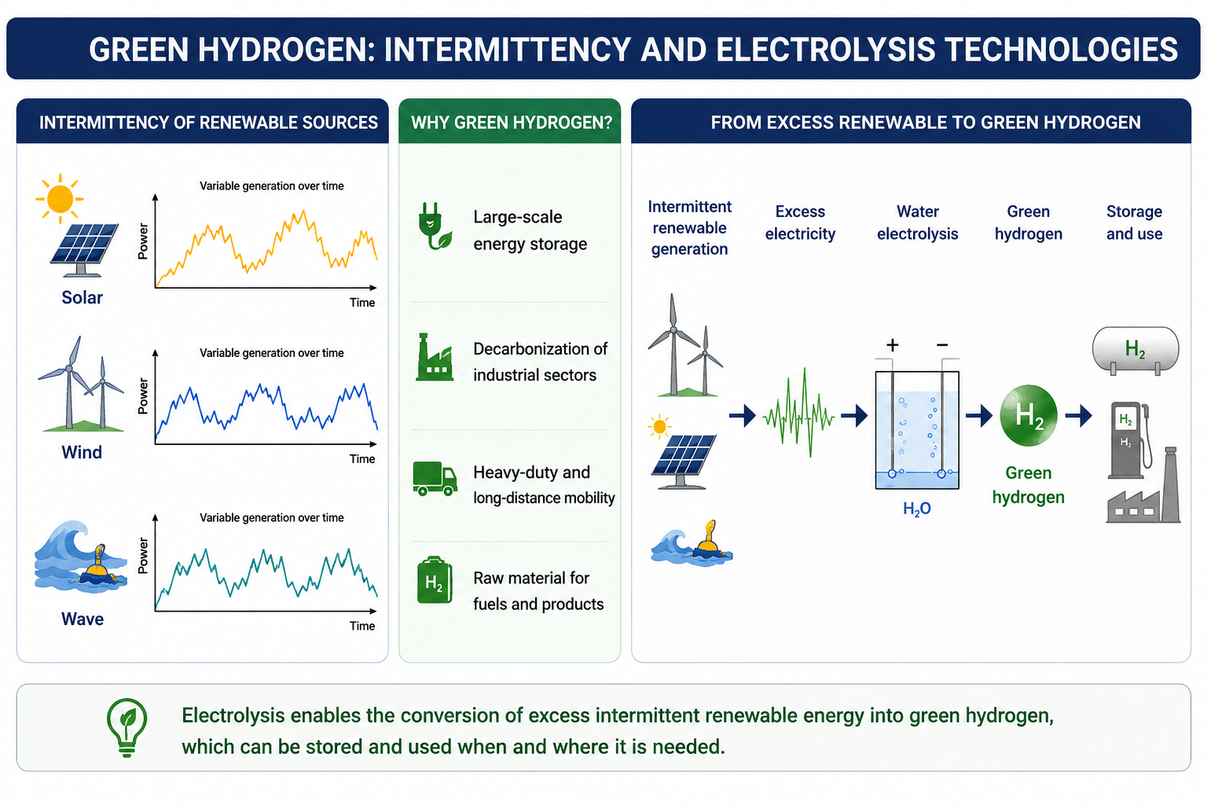
Context
Crossover Anomalies in Renewable-Powered PEM Electrolyzers Using Electrical Sensor Analytics. PSAM 18. Pittsburgh – USA. July 2026.
Caio Souto Maior. Federal University of Pernambuco, Brazil.

Slide 3
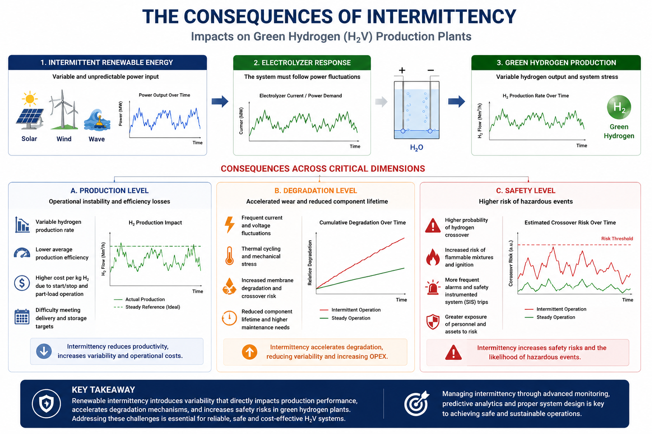
Context
Crossover Anomalies in Renewable-Powered PEM Electrolyzers Using Electrical Sensor Analytics. PSAM 18. Pittsburgh – USA. July 2026.
Caio Souto Maior. Federal University of Pernambuco, Brazil.

Slide 4
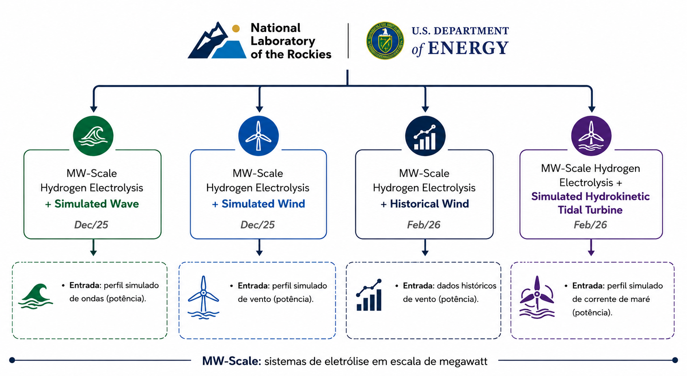
Dataset Presentation
“This dataset represents part of that effort and is intended for academic, national laboratory, industrial, and other stakeholders to plan, design, and validate models of megawatt-scale hydrogen technologies and diverse energy infrastructure nationwide”
Crossover Anomalies in Renewable-Powered PEM Electrolyzers Using Electrical Sensor Analytics. PSAM 18. Pittsburgh – USA. July 2026.
Caio Souto Maior. Federal University of Pernambuco, Brazil.

Slide 5
Dataset Presentation
“This dataset represents part of that effort and is intended for academic, national laboratory, industrial, and other stakeholders to plan, design, and validate models of megawatt-scale hydrogen technologies and diverse energy infrastructure nationwide”
https://doi.org/10.7799/3007836
Crossover Anomalies in Renewable-Powered PEM Electrolyzers Using Electrical Sensor Analytics. PSAM 18. Pittsburgh – USA. July 2026.
Caio Souto Maior. Federal University of Pernambuco, Brazil.

Slide 6
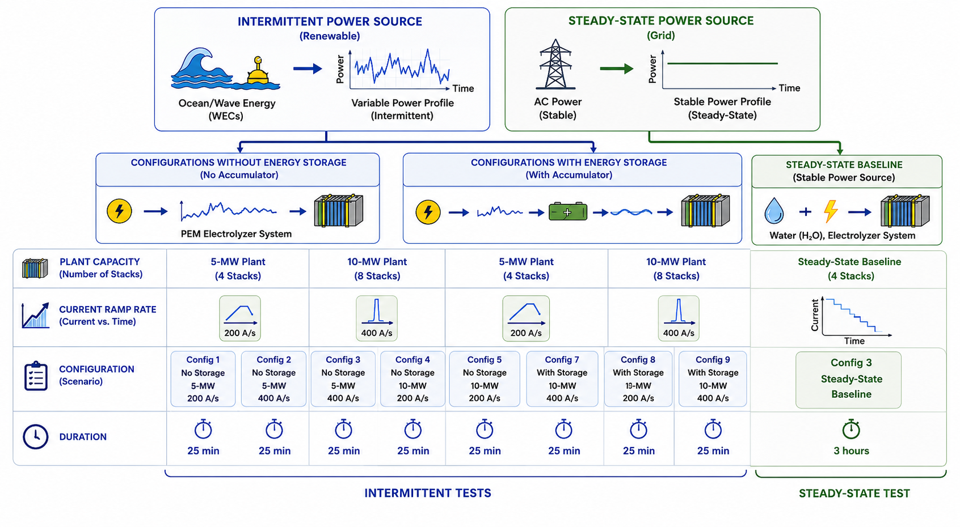
Dataset Presentation
1
2
3
Crossover Anomalies in Renewable-Powered PEM Electrolyzers Using Electrical Sensor Analytics. PSAM 18. Pittsburgh – USA. July 2026.
Caio Souto Maior. Federal University of Pernambuco, Brazil.

Slide 7
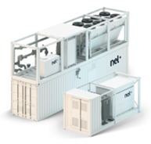
Dataset Presentation
Comercial PEM Electrolyzer
Crossover Anomalies in Renewable-Powered PEM Electrolyzers Using Electrical Sensor Analytics. PSAM 18. Pittsburgh – USA. July 2026.
Caio Souto Maior. Federal University of Pernambuco, Brazil.

Slide 8
Dataset Presentation
  The entire dataset (for wave) comprises 30,006 observations sampled at 1 Hz and 29 variables.
  The dataset was intentionally generated under fault-free operating conditions. Whenever a failure occurred during the experimental campaign, the test was restarted to ensure that only normal operating data were recorded.
  Despite the absence of critical failures, subtle variations in hydrogen crossover can still be observed, providing valuable information for early condition monitoring and proactive decision-making.
  Configuration 3 (1 out of 9) was selected for this study because it exhibits the highest variability in hydrogen crossover, making it the most suitable scenario for investigating crossover-related anomalies.
    Plant capacity: 10 MW; ramp rate: 400 A/s; no accumulator
    3,006 observation in total
Crossover Anomalies in Renewable-Powered PEM Electrolyzers Using Electrical Sensor Analytics. PSAM 18. Pittsburgh – USA. July 2026.
Caio Souto Maior. Federal University of Pernambuco, Brazil.

Slide 9
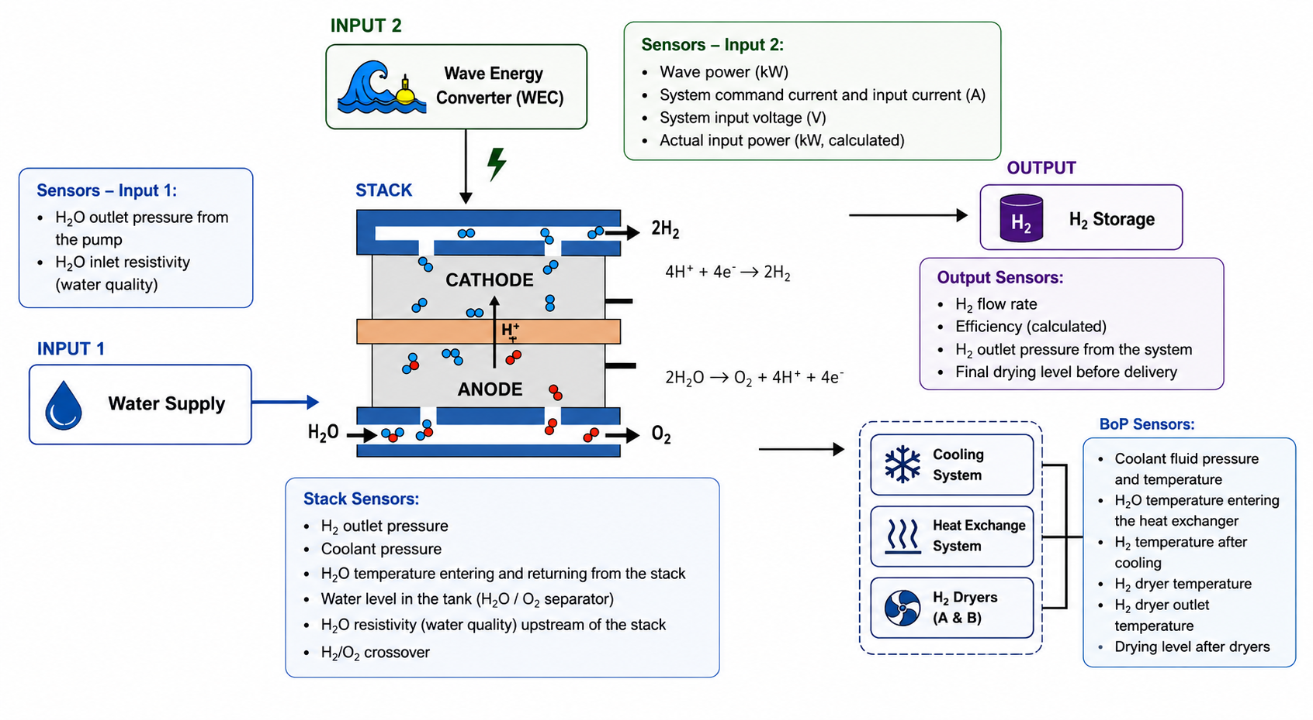
Dataset Presentation
1
2
3
Output
Crossover Anomalies in Renewable-Powered PEM Electrolyzers Using Electrical Sensor Analytics. PSAM 18. Pittsburgh – USA. July 2026.
Caio Souto Maior. Federal University of Pernambuco, Brazil.

Slide 10
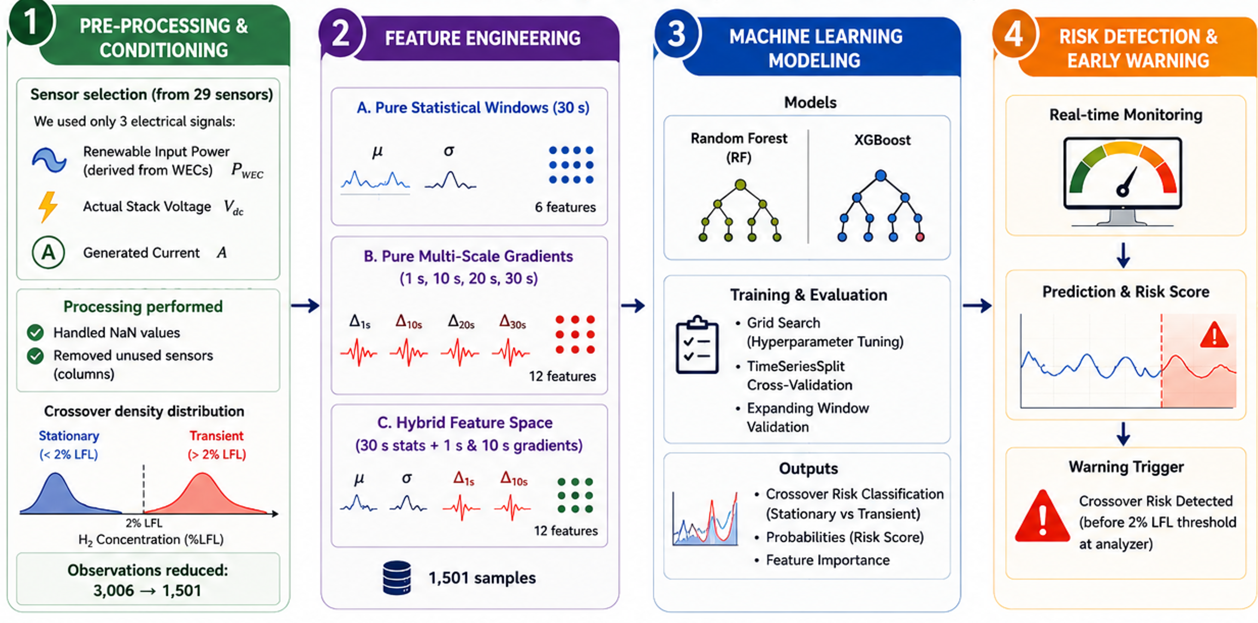
Methodology
Crossover Anomalies in Renewable-Powered PEM Electrolyzers Using Electrical Sensor Analytics. PSAM 18. Pittsburgh – USA. July 2026.
Caio Souto Maior. Federal University of Pernambuco, Brazil.

Slide 11
Results and Discussion
(Gread Search Results)
Input | Model | Hyperparameter | Valeu
Pure Statistical Windows | Random Forest | n_estimators | 100
 |  | max_depth | 15
 |  | min_samples_leaf | 5
 | XGBoost | n_estimators | 100
 |  | max_depth | 8
 |  | learning rate | 0.1
Pure Multi-Scale Gradiantes | Random Forest | n_estimators | 200
 |  | max_depth | 8
 |  | min_samples_leaf | 5
 | XGBoost | n_estimators | 100
 |  | max_depth | 4
 |  | learning rate | 0.05
Hybrid Feature Space | Random Forest | n_estimators | 200
 |  | max_depth | 15
 |  | min_samples_leaf | 5
 | XGBoost | n_estimators | 200
 |  | max_depth | 6
 |  | learning rate | 0.1
  Pure Statistical Windows: Because moving averages and rolling standard deviations smooth out the high-frequency noise induced by wave intermittency, the models required greater depth to segment the subtle interactions and steady-state thresholds of the upstream variables that precede the degradation or crossover events.
  Pure Multi-Scale Gradients: Shallower topologies accompanied by a more conservative learning rate in XGBoost. Deeper trees in this domain would prone the models to memorize high-frequency fluctuations and power command noises.
  Hybrid Feature: the algorithms sought a structural equilibrium to reconcile both static and dynamic features. Both models expanded their ensemble size, indicating the need for greater diversity to accurately map the higher-dimensional space.
Crossover Anomalies in Renewable-Powered PEM Electrolyzers Using Electrical Sensor Analytics. PSAM 18. Pittsburgh – USA. July 2026.
Caio Souto Maior. Federal University of Pernambuco, Brazil.

Slide 12
Results and Discussion
Input | Model | Accuracy | Precision | Recall | F1-Score
Pure Statistical Windows | Random Forest | 86.03% | 85.84% | 85.45% | 85.65%
 | XGBoost | 88.91% | 88.64% | 88.64% | 88.64%
Pure Multi-Scale Gradiantes | Random Forest | 58.98% | 56.55% | 68.64% | 62.01%
 | XGBoost | 59.20% | 56.87% | 67.73% | 61.83%
Hybrid Feature Space | Random Forest | 86.70% | 88.46% | 83.64% | 85.98%
 | XGBoost | 87.80% | 90.24% | 84.09% | 87.06%
  XGBoost consistently outperformed Random Forest in all feature spaces.
  Pure Statistical Windows achieved the best overall performance.
  Hybrid Feature Space achieved the highest Precision, reducing false alarms.
  Pure Multi-Scale Gradients alone showed limited predictive capability (Accuracy ≈ 59%).
Crossover Anomalies in Renewable-Powered PEM Electrolyzers Using Electrical Sensor Analytics. PSAM 18. Pittsburgh – USA. July 2026.
Caio Souto Maior. Federal University of Pernambuco, Brazil.

Slide 13
Future Research
Investigate membrane degradation using stack voltage signatures to identify long-term degradation trends and remaining useful life (RUL).
1
Extend the crossover investigation by evaluating additional dataset configurations and assessing the proposed methodology under different renewable energy sources.
2
These studies are part of a broader research program aimed at developing a risk and reliability assessment framework for renewable-powered green hydrogen plants, supporting decision-making under different information scenarios using Bayesian inference to incorporate expert knowledge, literature, experimental data and operational evidence.
Crossover Anomalies in Renewable-Powered PEM Electrolyzers Using Electrical Sensor Analytics. PSAM 18. Pittsburgh – USA. July 2026.
Caio Souto Maior. Federal University of Pernambuco, Brazil.

Slide 14










Thank you!
caio.maior@ufpe.br
ACKNOWLEDGMENTS

