Slide 1
Resilient Operation Algorithm for Abnormal Conditions
PSAM 18 | Pittsburgh, PA | July 22, 2026
Gwanwoo Kim, Jonghyun Kim*
Nuclear I&C Autonomous Operation (NICA) Lab.
Department of Nuclear and Quantum Engineering (NQe)
Korea Advanced Institute of Science and Technology
Notes:
Good afternoon, everyone. My name is Gwanwoo Kim, from the NICA Lab in the Department of Nuclear and Quantum Engineering at KAIST. Today I will present our work on a resilient operation algorithm for SMR abnormal conditions, based on multi-agent reinforcement learning and the abstraction hierarchy.

Slide 2
Contents
01
Introduction
02
iPWR Functional Decomposition
03
Multi-Agent Reinforcement Learning Design
04
Training and Results
05
Conclusion
2
Notes:
Here is the outline of my talk. I will begin with the background and the goal of this research. Then I will present the functional decomposition of the iPWR, followed by the multi-agent reinforcement learning design built on top of it. After that, I will show the training setup and preliminary results, and close with the conclusion and future work.

Slide 3
1. Introduction
Notes:
Let's start with the introduction.

Slide 4
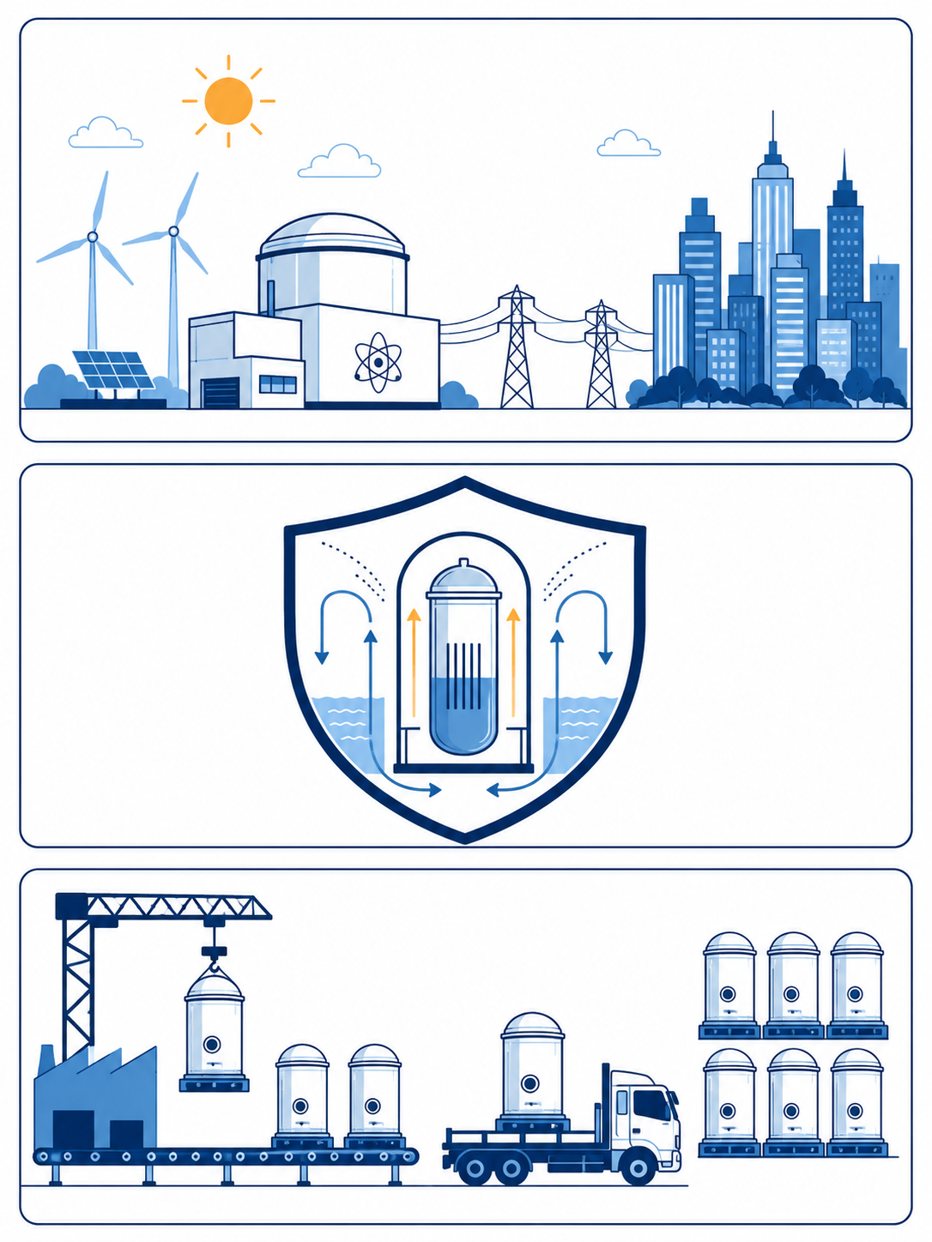
1. Introduction
Background of Small Modular Reactor(SMR)
  Growing Energy Demand
    Rapid expansion of AI data centers driving unprecedented electricity needs
    Existing grid infrastructure struggling to meet surging baseload demand
  SMR as a Strategic Solution
    Stable & Flexible Power Supply
      24/7 carbon-free baseload generation, independent of weather conditions
      Load-following capability complements intermittent renewables (solar, wind)
      Modular design allows incremental capacity addition suited for distributed grids
    Enhanced Safety
      Passive safety systems reduce reliance on active operator intervention
      Smaller core inventory limits potential accident consequences
    Economic Competitiveness
      Factory fabrication enables cost reduction through standardization
      Scalable deployment lowers financial risk compared to large-scale NPPs
Key advantages of SMR deployment
Notes:
As you all know, electricity demand is growing rapidly, driven in particular by the expansion of AI data centers, and existing grid infrastructure is struggling to absorb this growth. Small modular reactors are emerging as a strategic solution to this challenge. (그림 가리키며) As shown here, SMRs sit between large conventional reactors and microreactors in capacity, and they bring three key advantages. First, a stable and flexible power supply: carbon-free baseload generation around the clock, with load-following capability that complements solar and wind. Second, enhanced safety through passive safety systems and a smaller core inventory. And third, economic competitiveness, since factory fabrication and scalable deployment lower both cost and financial risk.

Slide 5
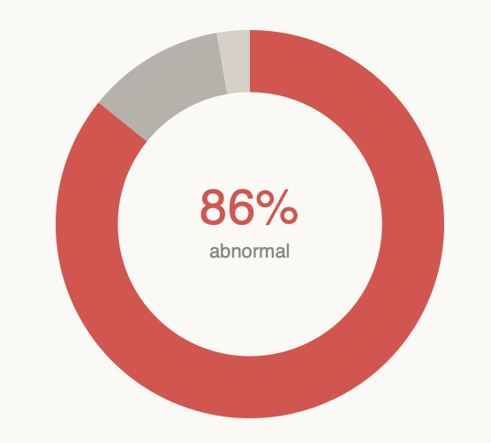
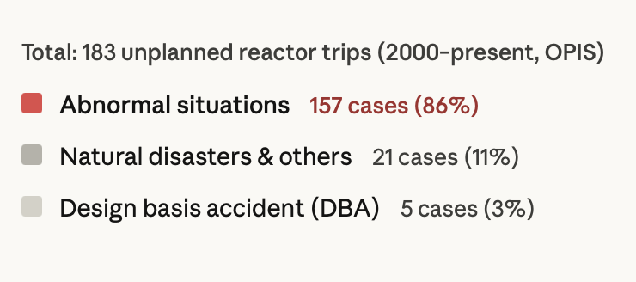
1. Introduction
Challenges in Abnormal Operation
  Responding to abnormal conditions is widely recognized as one of the most demanding tasks for operators
    Extensive number of AOPs: APR1400 at Shin-Kori Unit 3 has 82 AOPs, each covering multiple event types
    Operators must be trained to accurately assess abnormal conditions for each event type
    Requires familiarization with alarms and symptom patterns associated with each event type
  Abnormal operation is the most frequent among the four operating regimes
    Occurs in diverse, unpredictable forms
    Make consistent and accurate operator response inherently difficult
  Accurate judgment and prompt response are critical; some abnormal situations can trigger reactor trip
    Among 183 unplanned reactor trips in domestic NPPs since 2000 (OPIS): 157 cases (86%) were triggered by abnormal situations
Causes of unplanned reactor trips in Korean NPPs since 2000 (OPIS)
Notes:
So far, SMRs look promising. But there is one challenge that remains common to all nuclear power plants — whether large conventional reactors or SMRs: abnormal operation. Responding to abnormal conditions is widely recognized as one of the most demanding tasks for operators. To give you a sense of the scale, the APR1400 at Shin-Kori Unit 3 has 82 abnormal operating procedures, and each procedure covers multiple event types. Operators must be trained to recognize each event from its alarms and symptom patterns. On top of that, abnormal operation is the most frequent of the four operating regimes, and it occurs in diverse and unpredictable forms, which makes a consistent and accurate response inherently difficult. (그림 가리키며) The operational data confirms this: among 183 unplanned reactor trips in Korean plants since the year 2000, 157 cases — that is 86 percent — were triggered by abnormal situations. Design-basis accidents account for only 3 percent. And keep in mind — these are numbers from large plants with full operating crews.

Slide 6
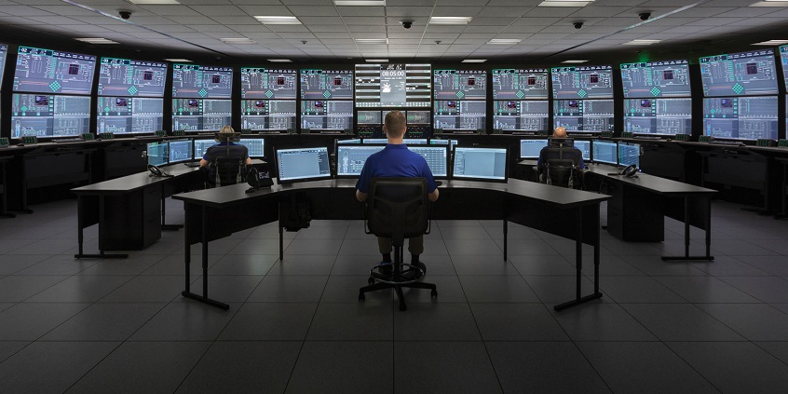
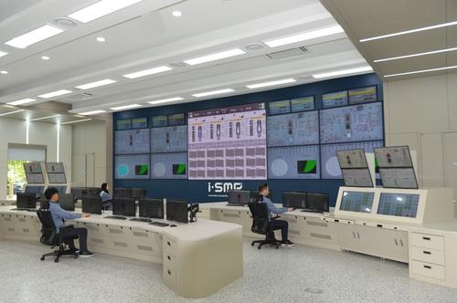
1. Introduction
Necessity of Automation in SMR Operations
  SMR Control Room & Operational Characteristics
    Single control room manages multiple modules with significantly reduced staffing
      iSMR: 3 operators for 4 modules
      NuScale: 3 operators for up to 12 modules
    Passive safety systems reduce active intervention, but increase monitoring complexity
    Advanced monitoring and decision support systems are prerequisite
    High-level automation or semi-autonomous operation is inherently required
  Why Abnormal Operation Automation is Critical
    Reduced staffing amplifies the risk of inadequate response in abnormal situations
    Intelligent automation is essential to offload operator workload and ensure safety
NuScale Power Module control room — 3 operators managing up to 12 modules simultaneously [1]
iSMR Power Module control room — 3 operators managing 4 modules simultaneously [2]
[1] “Energy Exploration (E2) Centers | NuScale Power.” Accessed: Mar. 22, 2026. [Online]. Available: https://www.nuscalepower.com/products/e2-centers
[2] J. Kwon, "KHNP to build simulator for i-SMR operation verification," Energy News. Accessed: Mar. 22, 2026. [Online]. Available: https://www.energy-news.co.kr/news/articleView.html?idxno=203896
Notes:
These challenges become even more critical in the SMR context. (사진 가리키며) In an SMR, a single control room manages multiple modules with significantly reduced staffing — the i-SMR plans 3 operators for 4 modules, and NuScale up to 12 modules with 3 operators. Passive safety systems reduce the need for active intervention, but they actually increase the monitoring burden, because operators must infer the state of many modules at once. So advanced monitoring and decision support are not optional here — high-level automation is inherently required. And abnormal operation is exactly where this matters most: reduced staffing amplifies the risk of an inadequate response, so intelligent automation is essential to offload the operators and ensure safety.

Slide 7
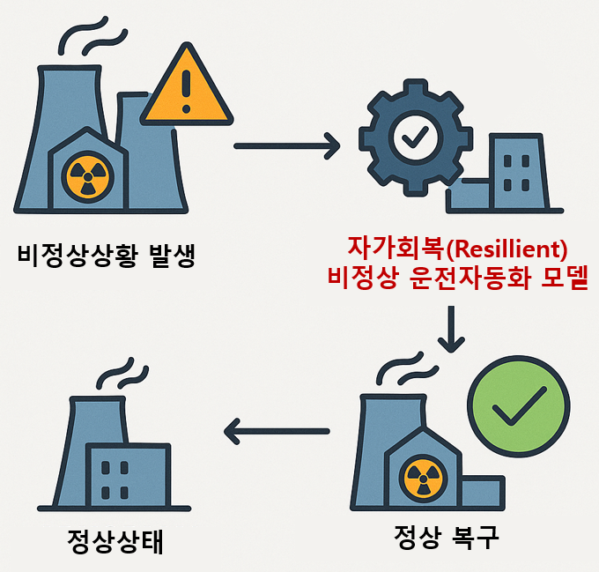
1. Introduction
Goal: Resilient Autonomous SMR Operation
  Concept of Resilient SMR Operation
    Definition: An autonomous SMR capable of self-recovery from unforeseen abnormal conditions without external intervention.
    Automatically activates when operational variables deviate from the normal range.
  Key Capability: Diagnostic-Independent Recovery
    Achieves self-recovery solely based on real-time operational variables, independent of pre-defined diagnostic procedures or EOPs
    Enhances system resilience by prioritizing the restoration of safety functions over identifying the specific root cause of failures.
Abnormal Condition Occurrence
Resilient Abnormal Operation Automation Model
Abnormal Condition Occurrence
Normal Condition
System Restoration
Self-recovery concept of the resilient operation model
Notes:
This brings me to the goal of our research: resilient autonomous SMR operation. We define this as an autonomous SMR capable of self-recovery from unforeseen abnormal conditions, with minimal or no external intervention, within a predefined operational envelope. (개념도 가리키며) As this diagram shows, the model activates automatically when operational variables deviate from the normal range, and drives the plant back to normal conditions. The key capability is what we call diagnosis-independent recovery. Instead of first identifying the specific cause of a failure, the system prioritizes restoring the degraded safety functions, based solely on real-time operational variables. This makes the approach robust against events that were never explicitly anticipated. (스크린샷 가리키며) The framework is developed and validated on the iPWR simulator, a training-purpose SMR simulator distributed by the IAEA.

Slide 8
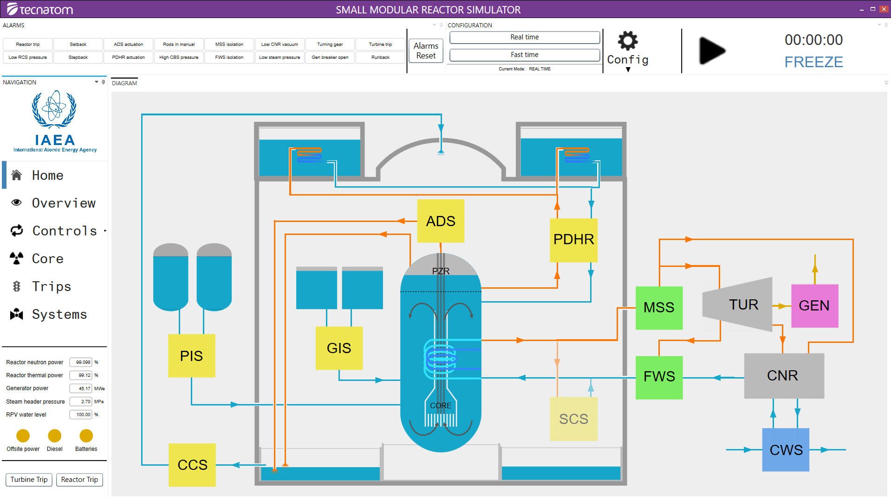
1. Introduction
Goal: Resilient Autonomous SMR Operation
  Target Platform: iPWR Simulator
    The model is developed and validated using the iPWR simulator
    iPWR is a training-purpose SMR simulator distributed by the IAEA
Image of iPWR simulator
Notes:
This brings me to the goal of our research: resilient autonomous SMR operation. We define this as an autonomous SMR capable of self-recovery from unforeseen abnormal conditions, with minimal or no external intervention, within a predefined operational envelope. (개념도 가리키며) As this diagram shows, the model activates automatically when operational variables deviate from the normal range, and drives the plant back to normal conditions. The key capability is what we call diagnosis-independent recovery. Instead of first identifying the specific cause of a failure, the system prioritizes restoring the degraded safety functions, based solely on real-time operational variables. This makes the approach robust against events that were never explicitly anticipated. (스크린샷 가리키며) The framework is developed and validated on the iPWR simulator, a training-purpose SMR simulator distributed by the IAEA.

Slide 9
1. Introduction
Staged Development of the Resilient Operation Algorithm
  The resilient operation algorithm is developed through four sequential stages
AH-Based Functional Decomposition of iPWR
Hierarchical Multi-Agent RL Design Grounded in AH Structure
Training Execution and Preliminary Performance Evaluation
Construction of Parallel Simulation Platform for Reinforcement Learning
01
02
03
04
Notes:
The algorithm is developed through four sequential stages.
Stage one is the AH-based functional decomposition of the iPWR.
Stage two is the design of the hierarchical multi-agent reinforcement learning framework.
Stage three is the construction of a parallel simulation platform, and stage four is training and performance evaluation. In the talk, stages three and four are presented together in the Training and Results section. The two key ideas running through all of this are the diagnosis-independent self-recovery concept, and the quantitative use of the abstraction hierarchy as a learning signal.

Slide 10
2. iPWR Functional Decomposition
Notes:
So let me start with the first stage, the functional decomposition.

Slide 11
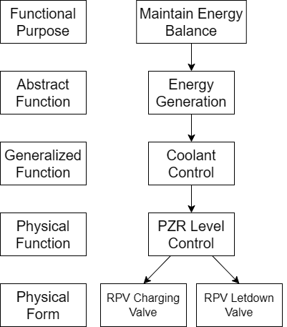
2. iPWR Functional Decomposition
Development of AI Methodologies for the Automation Model
  Strategic Necessity of Abstraction Hierarchy on iPWR Modeling
    Achieving resilient autonomous operation requires control logic that functions even without explicit fault diagnosis
    To enable diagnostic-free control, the control logic must prioritize the maintenance of Functional Purposes over the monitoring of individual Physical Forms
    AH provides a structural framework to map raw physical data to high-level functional information
  Overview of Abstraction Hierarchy
    A multi-level framework proposed by Jens Rasmussen, decomposing the system into 5 levels
    Link between levels:
      Bottom-Up (How): Explains how physical components implement system functions
      Top-Down (Why): Explains why specific components are needed for safety goals
Five abstraction levels of the AH
Notes:
Why do we need the abstraction hierarchy? Because resilient operation requires control logic that works even without explicit fault diagnosis. To enable that, the control logic must prioritize maintaining functional purposes, rather than monitoring individual physical components. The abstraction hierarchy provides exactly this: a structural framework that maps raw physical data to high-level functional information. (그림 가리키며) It is a multi-level framework proposed by Jens Rasmussen, decomposing a system into five levels, from physical form at the bottom up to functional purpose at the top. Adjacent levels are connected in two directions: bottom-up, explaining how physical components implement system functions, and top-down, explaining why specific components are needed for the safety goals.

Slide 12
2. iPWR Functional Decomposition
iPWR AH Model Development for Energy Balance Maintenance
Level | Description | Representative Example in iPWR
Functional Purpose | Ultimate operational goal | Overall energy balance across core, SG, and secondary side
Abstract Functions | How energy flows through the system | Energy Generation / Conversion / Dispatch
Generalized Functions | Physical balances maintained per subsystem | Core Heat Removal, Coolant Control
Physical Functions | Measurable control states vs. reference values | PZR Pressure/Level Control, Feedwater Control System
Physical Form | Actuators determining physical function outputs | RCPs, control rod banks, valves, pumps
Notes:
This table shows how the five levels apply to the iPWR. At the top, the functional purpose is the overall energy balance across the core, the steam generators, and the secondary side. The abstract functions describe how energy flows — generation, conversion, and dispatch. The generalized functions are the physical balances each subsystem must maintain, such as core heat removal and coolant control. Below that, the physical functions are measurable control states, like pressurizer pressure and level control, and at the bottom, the physical form is the actual actuators — pumps, control rod banks, and valves.

Slide 13
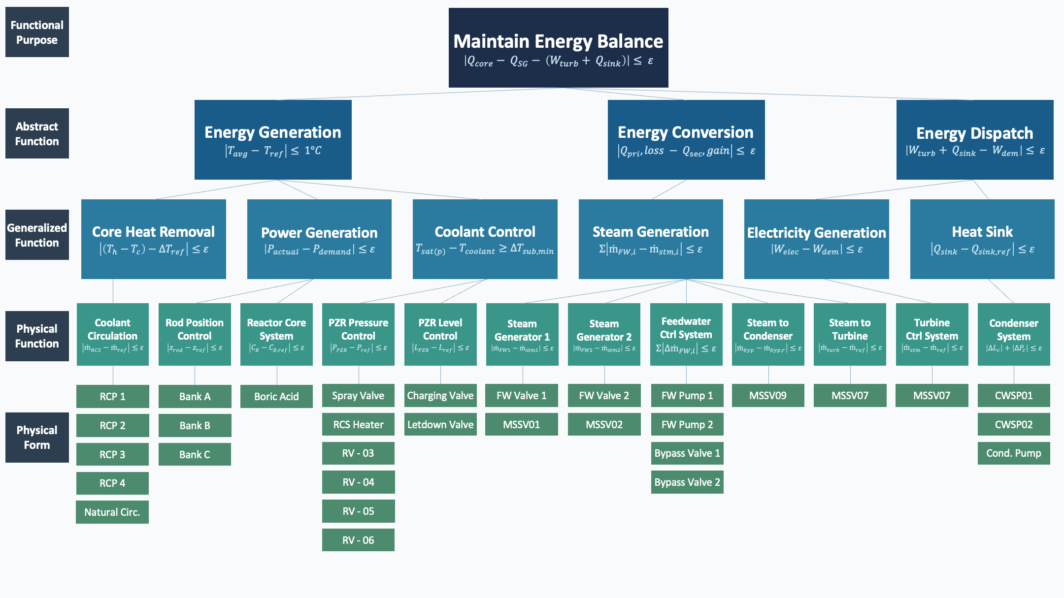
2. iPWR Functional Decomposition
Full AH Model of iPWR for Abnormal Operation Control
Notes:
Applying this to the whole plant gives us the complete abstraction hierarchy of the iPWR, covering all major subsystems relevant to abnormal operation control. Each box here is one functional node. And one thing I would like you to notice: every node carries a mathematical expression. This model is not just a qualitative picture — it is the structural backbone for the reinforcement learning design, which brings me to the next slide.

Slide 14
2. iPWR Functional Decomposition
Quantitative Formulation of AH Nodes
  Purpose
    Qualitative node descriptions alone are insufficient for autonomous control
    Operational indicators with tolerance margin ε assigned to each AH node
  Role in Abnormal Operation Detection
    Deviation from each reference condition identifies which layer of the hierarchy is disrupted
  Role in AI Model Design
    Formulations directly feed into RL reward design
    Enables state assessment across multiple abstraction levels, not only components
AH Level | Node | Functional Indicator
Functional Purpose | Maintain Energy Balance | |Q_{core} − Q_{SG} − (W_{turb} + Q_{sink})| ≤ ε
Abstract Function | Energy Conversion | |Q_{pri,loss} − Q_{sec,gain}| ≤ ε
Generalized Function | Steam Generation | Σ|ṁ_{FW,i} − ṁ_{stm,i}| ≤ ε
Physical Function | Steam Generator 1 | |ṁ_{FW1} − ṁ_{stm1}| ≤ ε
Physical Function | Steam Generator 2 | |ṁ_{FW2} − ṁ_{stm2}| ≤ ε
Physical Function | Feedwater Control System | Σ|Δṁ_{FW,i}| ≤ ε
Physical Function | Steam to Condenser | |ṁ_{byp} − ṁ_{byp,r}| ≤ ε
Physical Function | Steam to Turbine | |ṁ_{turb} − ṁ_{ref}| ≤ ε
Representative quantitative formulations for selected AH nodes
Notes:
A qualitative description alone is not sufficient for autonomous control. So we assign each AH node an operational indicator with a tolerance margin epsilon. These formulations play two roles. First, for detection: when an indicator deviates beyond its reference condition, it tells us which layer of the hierarchy has been disrupted. Second, for the AI design: the formulations feed directly into the reward design of the reinforcement learning agents, so the system can be evaluated across multiple abstraction levels, not only at the component level. (표 가리키며) The table shows representative formulations along the energy conversion path, which is the scope of our preliminary case study — for example, steam generation is maintained when the feedwater and steam flows of each steam generator stay balanced within epsilon.

Slide 15
3. Multi-Agent Reinforcement Learning Design
Notes:
Now, the second stage: the reinforcement learning design.

Slide 16
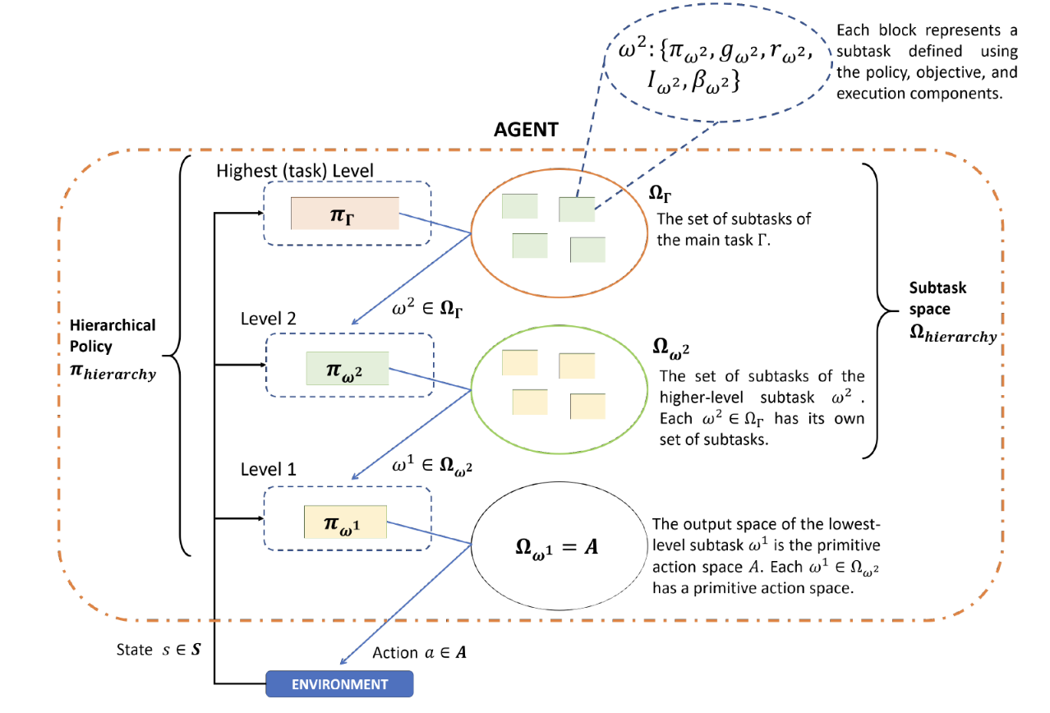
3. Multi-Agent Reinforcement Learning Design
Hierarchical Multi-Agent Reinforcement Learning (H-MARL)
  Background
    Single-agent RL becomes intractable in the multi-system iPWR (RCS, FWS, CVCS), where the joint action space is high-dimensional
    Multi-Agent RL distributes control across cooperative agents, each responsible for a subset of the action space
    Hierarchical RL introduces a goal-conditioned structure where upper-level agents set subgoals for lower-level agents
    H-MARL combines both, with multiple agents cooperating within a hierarchical goal-means structure
  Key Characteristics
    Upper-level agents dynamically reassign subgoals based on the current system state, and lower-level agents optimize local actions to satisfy them
    Upper agents operate on longer timescales than lower agents, providing temporal abstraction
The Concept of Hierarchical Reinforcement Learning [1]
[1] S. Pateria, B. Subagdja, A. Tan, and C. Quek, “Hierarchical Reinforcement Learning: A Comprehensive Survey,” ACM Comput. Surv., vol. 54, no. 5, p. 109:1-109:35, Jun. 2021, doi: 10.1145/3453160.
Notes:
Why a hierarchical multi-agent approach? A single RL agent becomes intractable in a multi-system environment like the iPWR, where the joint action space is high-dimensional. Multi-agent RL solves part of this by distributing control across cooperative agents, each responsible for a subset of the actions. Hierarchical RL adds a goal-conditioned structure, where upper-level agents set subgoals and lower-level agents act to achieve them. (그림 가리키며) H-MARL combines both: multiple agents cooperating within a hierarchical goal-means structure — which, as you will see, matches the abstraction hierarchy almost perfectly.

Slide 17
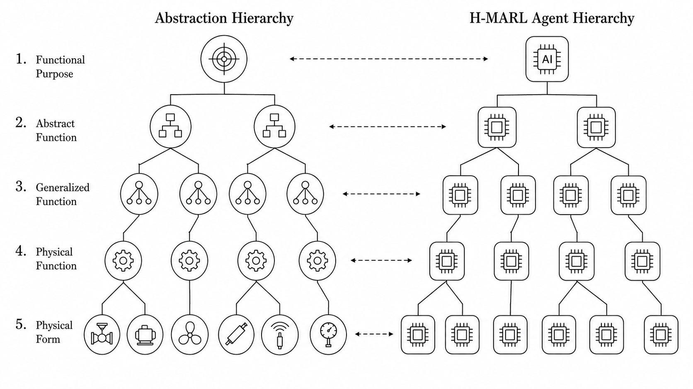
3. Multi-Agent Reinforcement Learning Design
Design and Development of the Automation Model
  AH-to-H-MARL Mapping
    Each AH node is instantiated as one RL agent, and the goal-means structure of the AH defines the upper-lower agent relationship
    Upper agents propagate functional goals downward, while lower agents report physical states upward to update goal assignment
  Agent Design
    Upper-level agents, spanning Functional Purpose to Generalized Functions, monitor functional balance and reassign subgoals when a deviation is detected
    Lower-level agents, spanning Physical Functions to Physical Form, drive actuators to satisfy the assigned subgoals
    Each agent evaluates its own node using the quantitative formulation defined in the previous section
  Training Algorithm: APPO (via Ray RLlib)
    An asynchronous variant of PPO that allows each agent to train in parallel without being bottlenecked by slower simulator instances
AH-to-agent mapping structure
Notes:
Here is the central design choice of this work: each AH node is instantiated as one RL agent, and the goal-means structure of the AH becomes the communication structure of the agents. Upper agents propagate functional goals downward, and lower agents report physical states upward. In terms of roles, the upper-level agents monitor the functional balance of their branch and reassign subgoals when they detect a deviation, while the lower-level agents directly drive the actuators to satisfy the assigned subgoals. And each agent evaluates its own node using the quantitative formulation I showed in the previous section. For training, we use APPO through Ray RLlib — an asynchronous variant of PPO that lets every agent train in parallel without being bottlenecked by slower simulator instances.

Slide 18
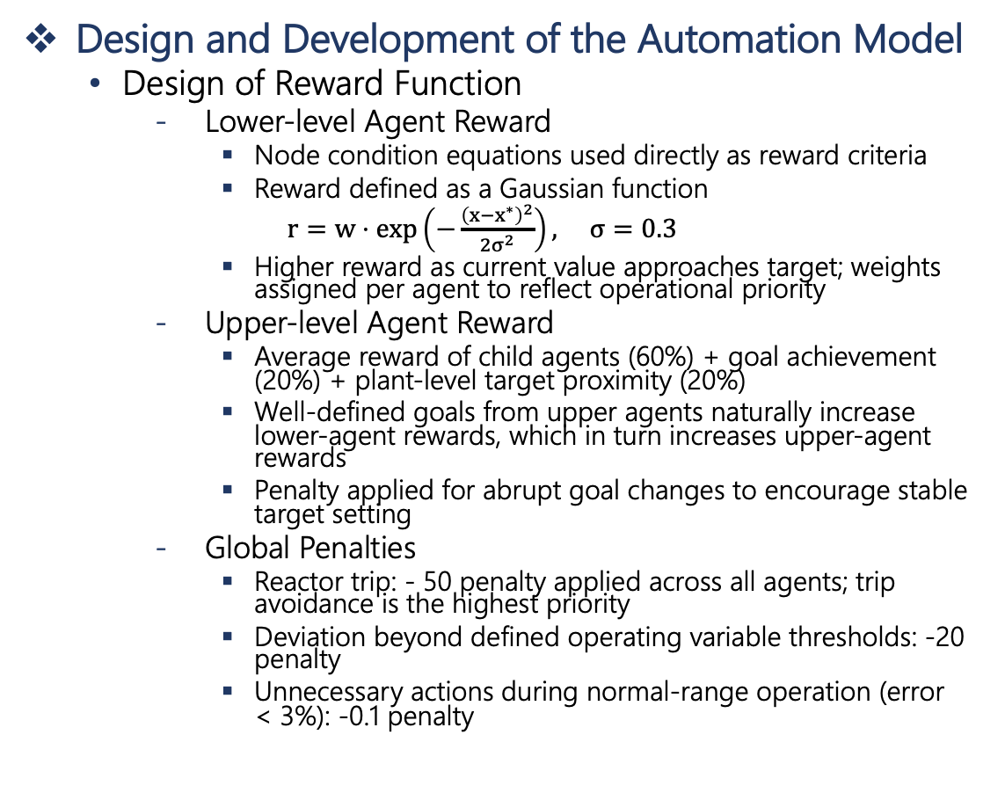
3. Multi-Agent Reinforcement Learning Design
Design and Development of the Automation Model
  Design of Reward Function
    Lower-level Agent Reward
      Node condition equations used directly as reward criteria
      Reward defined as a Gaussian function
      $r=w⋅\exp\left(−\frac{{\left(x−x^{∗}\right)}^{2}}{2σ^{2}}\right), σ=0.3$
      Higher reward as current value approaches target; weights assigned per agent to reflect operational priority
    Upper-level Agent Reward
      Average reward of child agents (60%) + goal achievement (20%) + plant-level target proximity (20%)
      Well-defined goals from upper agents naturally increase lower-agent rewards, which in turn increases upper-agent rewards
      Penalty applied for abrupt goal changes to encourage stable target setting
    Global Penalties
      Reactor trip: - 50 penalty applied across all agents; trip avoidance is the highest priority
      Deviation beyond defined operating variable thresholds: -20 penalty
      Unnecessary actions during normal-range operation (error < 3%): -0.1 penalty
Upper- level agent
Lower- level agent
Upper- and lower-level agent boundaries in the AH
Notes:
This slide shows how the rewards are designed. (그림 가리키며) First, the boundary: the upper-level agents span from the functional purpose down to the generalized functions, and the lower-level agents cover the physical functions. For the lower-level agents, the node condition equations are used directly as the reward criteria — the reward is a Gaussian function that grows as the current value approaches its target, with per-agent weights reflecting operational priority. The upper-level agents are rewarded mainly through their children: 60 percent from the average reward of the child agents, plus goal achievement and plant-level target proximity at 20 percent each, with a penalty for abrupt goal changes. And on top of these, global penalties apply to all agents: a reactor trip costs minus 50 — trip avoidance is the highest priority — threshold violations cost minus 20, and unnecessary actions in the normal range receive a small penalty.

Slide 19
4. Training and Results
Notes:
Let me move on to the training and the results.

Slide 20
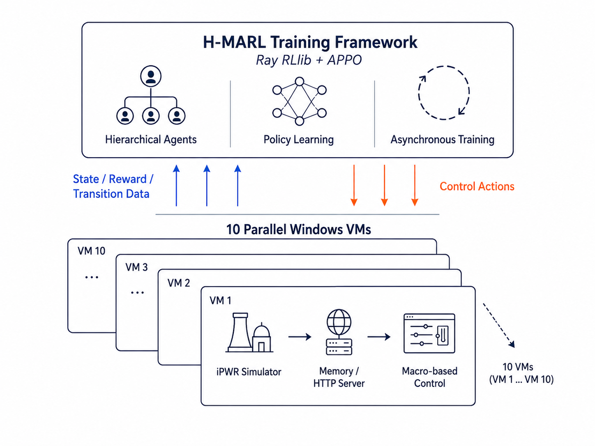
4. Training and Results
Training Environment Setup
  Simulation Platform
    iPWR (integral Pressurized Water Reactor) simulator used as the training environment
  Why Parallel Environment
    iPWR simulator does not support step-based control natively; real-time simulation only
    Speed-up beyond 2x is unstable, making acceleration-based approaches infeasible
    Parallelization across multiple independent simulator instances adopted as the only viable approach to accelerate training
  Environment Configuration
    Windows VMs running simultaneously on a single server
    Each VM runs an independent iPWR simulator instance, ensuring fully isolated training environments
  Communication Architecture
    Each VM runs an HTTP server that interfaces directly with the simulator
    HTTP server reads and manipulates simulator memory to implement RL actions
    Actions not achievable via memory manipulation are implemented through macros
    RL training process (Ray RLlib) communicates with each VM via HTTP, collecting observations and dispatching actions asynchronously
Parallel training platform with ten iPWR simulator VMs
Notes:
First, the platform. The iPWR simulator only runs in real time, and speeding it up beyond two times becomes unstable. So instead of accelerating one simulator, we parallelized many: ten Windows virtual machines run simultaneously on a single server, each hosting an independent, fully isolated simulator instance. (그림 가리키며) Inside each VM, an HTTP server reads and manipulates the simulator memory to implement the RL actions — anything not achievable through memory is done with macros — and the Ray RLlib training process communicates with all ten VMs asynchronously.

Slide 21
4. Training and Results
Abnormal Operation Training Scenarios
  Training Scenarios Selection
    2 scenarios selected for model training: HX tube rupture and FW pump performance reduction
    FW pump performance reduction included as a common scenario shared across participating institutions
    Both scenarios involve the L4_FWCS agent as the primary responding agent
    Both scenarios considered well-suited for demonstrating the objectives of H-MARL training
  Scenario Randomization for Robust Training
    Ramp Time and Severity randomized across episodes to improve generalization
    Prevents the model from overfitting to a fixed disturbance profile
    Enables the agent to learn a robust recovery policy across a range of abnormal condition intensities and onset speeds
No. | Component Name | Failure Type | Reactor Symptom | Ramp Time | Severity
1 | Intermediate Heat Exchanger | Tube rupture | Feedwater leakage | 0 ~ 30s | 50 ~ 100%
2 | Feed Water Pump 1 | Performance reduction | FW flow reduciton | 0 ~ 30s | 30 ~ 60%
3 | Reactor Coolant Pump | Electrical Failure | 50% power reduction | -- | --
Abnormal scenarios and randomization ranges
Notes:
For training, we selected two abnormal scenarios: an intermediate heat exchanger tube rupture, and a feedwater pump performance reduction, which is a common scenario shared across the participating institutions. Both involve the feedwater control system as the primary responding agent. (표 가리키며) And importantly, the ramp time and severity of each fault are randomized on every episode, within the ranges shown in the table. This prevents overfitting to a fixed disturbance profile and forces the agents to learn recovery policies that work across a range of fault intensities and onset speeds.

Slide 22
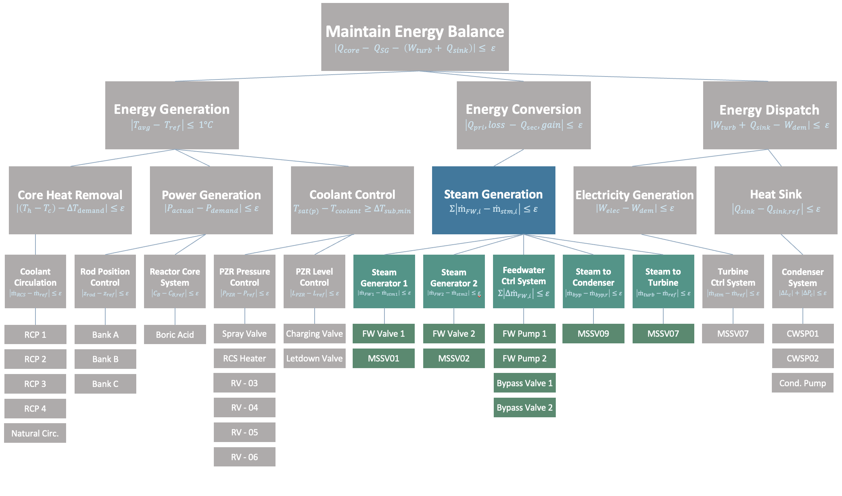
4. Training and Results
Training Execution
  Overall Agent Configuration
    Designed with 22 agents covering L1–L4, excluding L5 (Physical Form) of the AH model
    Currently active training scope: 6 agents within the Steam Generation subsystem
    Remaining 16 agents kept inactive
      To be progressively activated as systems and scenarios are expanded
  Active Agent Hierarchy
    Steam Generation (Generalized Function) acts as the manager agent
      Outputs continuous actions as subgoals to 5 subordinate worker agents, dynamically adjusting operational targets
    Steam Generator 1, 2, Feedwater Control System, Steam to Condenser, Steam to Turbine (Physical Function) act as worker agents
      Continuous control devices (feedwater valves, steam valves, etc.): opening adjusted via discrete delta actions of {−2%, 0, +2%}
      Latch valves and pumps (HX bypass valve, feedwater pump): implemented as Open/Close or On/Off actions
Active agents within the full 22-agent hierarchy
Notes:
On the agent side, the full AH model yields 22 agents covering levels one through four — level five, the physical form, serves as actuation endpoints rather than agents. In the current preliminary scope, the six agents of the steam generation subsystem are active, (그림 가리키며) while the remaining sixteen stay inactive and will be progressively activated as we expand.

Slide 23
4. Training and Results
Agent Configuration
Agent | Role | Obs. Dim. | Hidden Layer | Actuators | Action Space
Steam Generation | Manager | 20 | [128, 64] | - | Continuous (5)
Steam Generator 1 | SG1 feedwater valve control | 6 | [64, 32] | FWV1, MSSV01 | Discrete (9)
Steam Generator 2 | SG2 feedwater valve control | 6 | [64, 32] | FWV2, MSSV02 | Discrete (9)
Feedwater Control System | HX bypass & feedwater pump control | 12 | [128, 64] | HXBypass2, FWP2 | Discrete (4)
Steam to Turbine | Turbine control valve control | 5 | [64, 32] | MSSV09 | Discrete (3)
Steam to Condenser | Condenser control valve control | 5 | [64, 32] | MSSV07 | Discrete (3)
Notes:
The detailed configuration of each agent — observations, network sizes, actuators, and action spaces — is summarized here for your reference. (시간 여유가 있으면: "Steam Generation acts as the manager with continuous subgoals, and the workers use small discrete valve adjustments or on-off actions.")

Slide 24
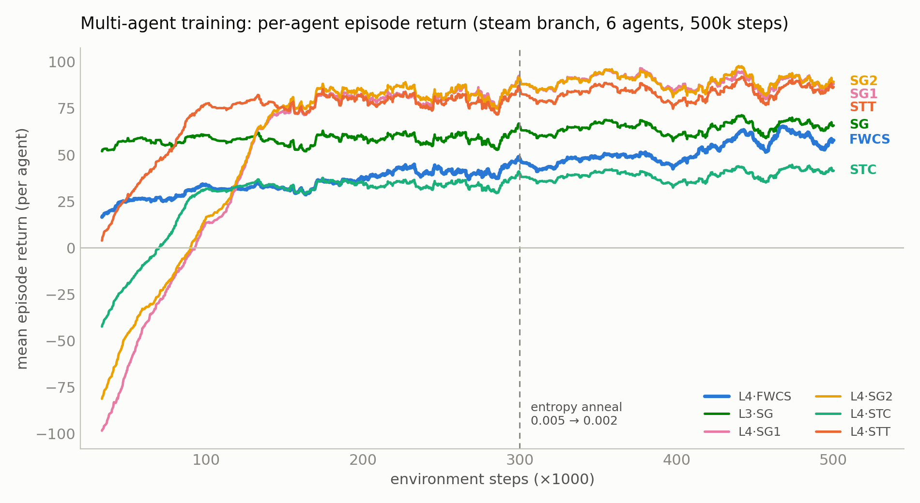
4. Training and Results
Training Results: Convergence over 500k Steps
  All six agents reached positive, stable returns over 500,000 training steps
    L4 agents recovered from large negative returns (about −100) to around +85 by suppressing unnecessary actuation
    L3_SG learned setpoint adjustment, and L4_FWCS learned the fault-recovery task
    Entropy coefficient annealed from 0.005 to 0.002 at 300k steps to stabilize the learned policies
Per-agent episode return over 500,000 training steps
Notes:
Over 500,000 training steps, all six agents reached positive, stable returns. The L4 agents started around minus 100 and recovered to around plus 85 as they learned to suppress unnecessary actuation. L3_SG adjusts setpoints, and FWCS learned the actual fault-recovery task. At 300k steps we annealed the entropy coefficient from 0.005 to 0.002, which stabilized the learned policies.

Slide 25
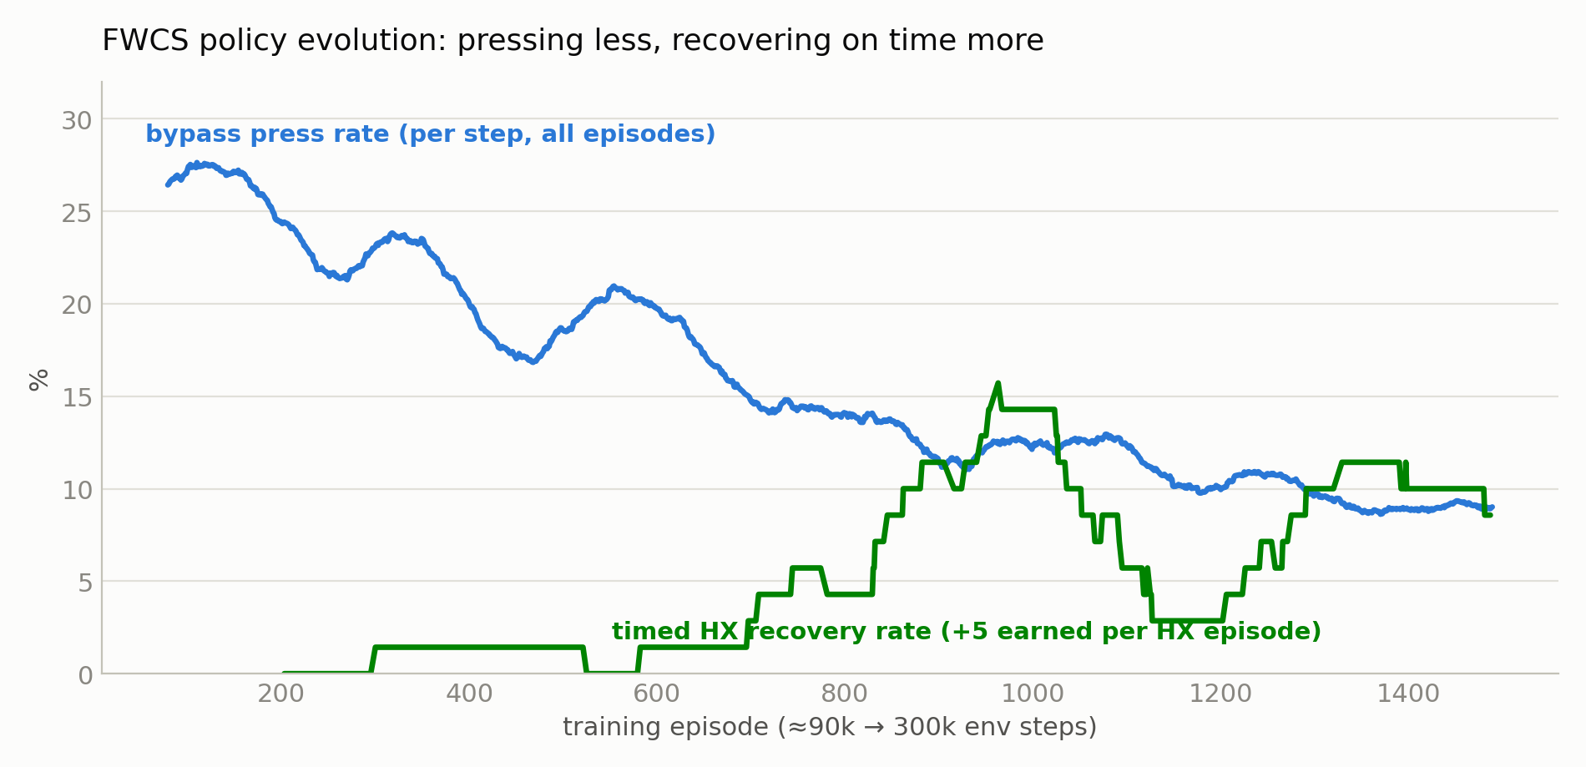
4. Training and Results
FWCS Policy Evolution during Training
  The FWCS agent learned to press less, and to press at the right time
    Unnecessary bypass actuation decreased from about 27 percent to 9 percent of steps
    Timed HX recovery, rewarded with a +5 bonus, rose from zero to about 10 percent of HX episodes
Bypass press rate and timed HX recovery rate during training
Notes:
This slide shows behavioral evidence of what the FWCS agent learned. The blue curve is the bypass press rate, which decreased from about 27 percent to 9 percent of steps. The green curve is the timed HX recovery rate, which earns a plus-5 bonus, rising from zero to about 10 percent of HX episodes. In short, the agent presses less overall, and presses at the right time.

Slide 26
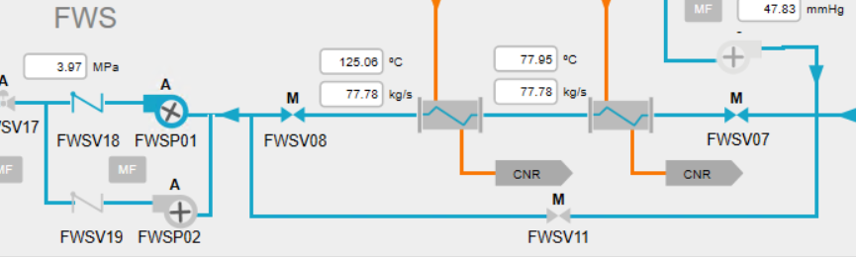
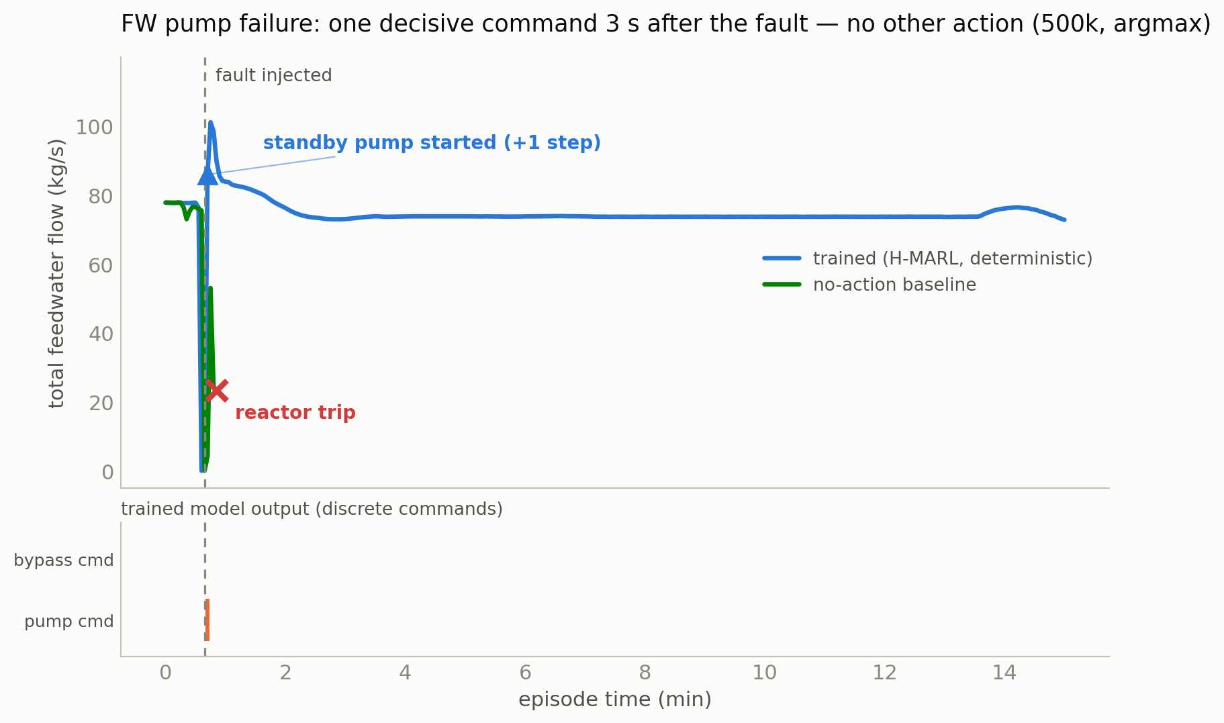
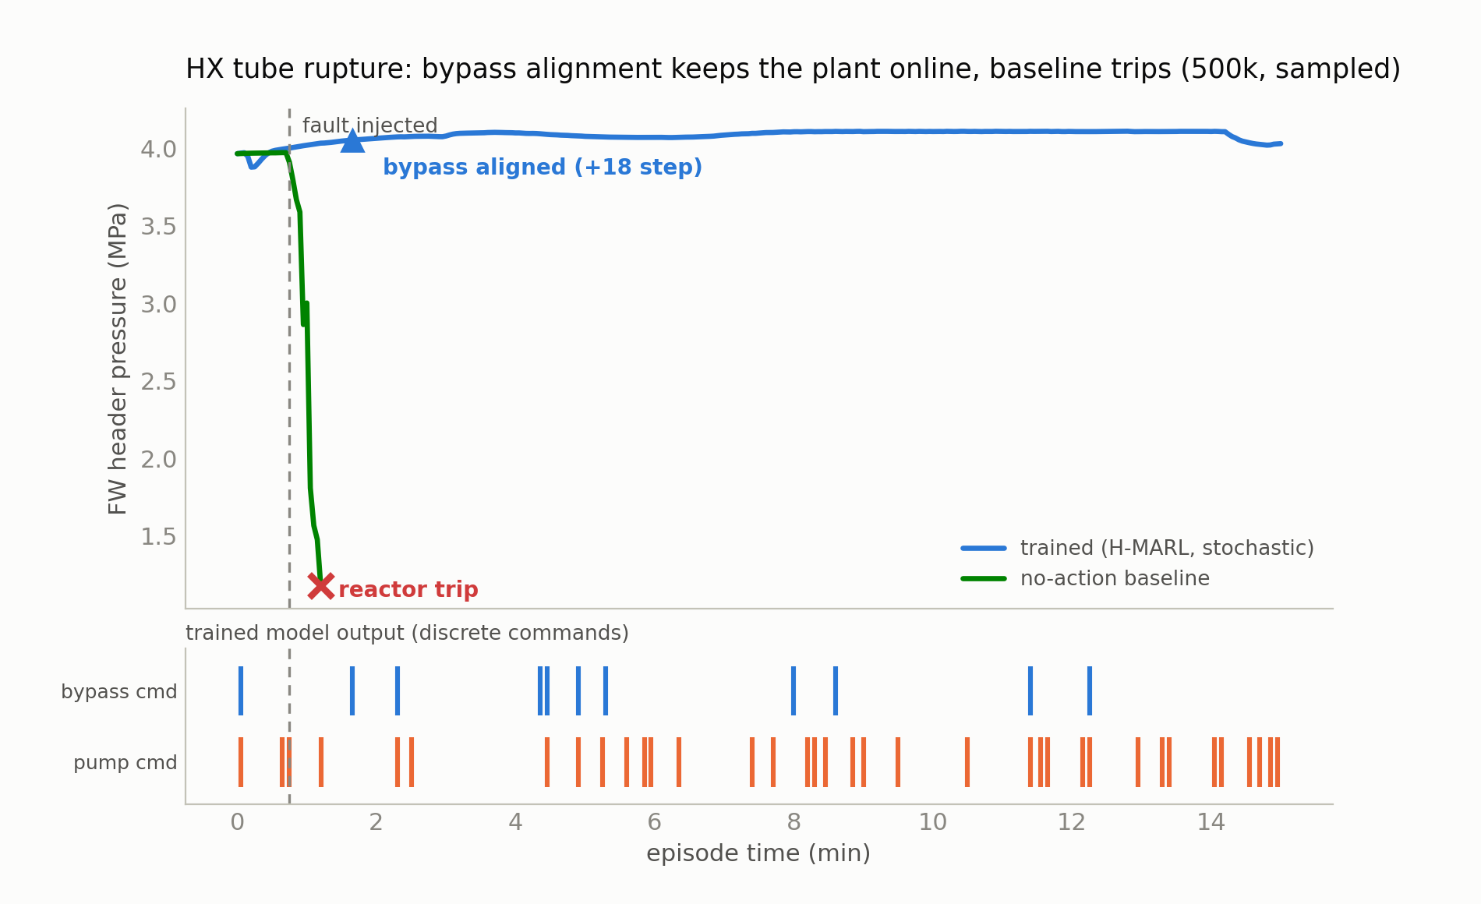
4. Training and Results
Autonomous Recovery vs. No-Action Baseline
  FW Pump Performance Reduction
    A single pump start command is issued 3 seconds after the fault, with no other action
    Feedwater flow returns to the normal range, while the no-action baseline ends in a reactor trip
  HX Tube Rupture
    Bypass realignment keeps the plant online
Notes:
In the FW pump case, with the deterministic policy, the agent issues exactly one pump start command 3 seconds after the fault and takes no other action. The feedwater flow returns to normal, while the no-action baseline ends in a reactor trip. In the HX tube rupture case, with the stochastic policy, the agent realigns the bypass and the plant stays online; left unattended, the header pressure collapses and the reactor trips within 40 to 90 seconds. (Q&A note: under the deterministic argmax policy the HX case currently takes no action — urgency fine-tuning is in progress; survival here comes partly from preemptive bypass opening.)

Slide 27
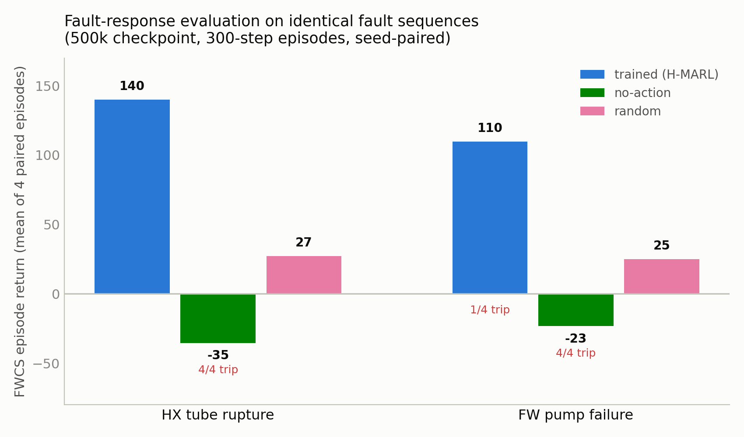
4. Training and Results
Paired Evaluation on Identical Fault Sequences
  Policies were evaluated on identical, seed-paired fault sequences
    Only the trained policy achieves positive returns: 140 for HX tube rupture and 110 for FW pump failure
    The no-action baseline ends in a reactor trip in all 8 paired episodes, with negative returns
    Random actuation avoids some trips but cannot restore the degraded functions
FWCS episode return, mean of 4 paired episodes per scenario
Notes:
We also ran a paired evaluation on identical fault sequences from the 500k checkpoint. Only the trained policy achieves positive returns — 140 for the HX case and 110 for the pump case. The no-action baseline trips the reactor in all eight episodes and ends negative. Random actuation avoids some trips but cannot restore the degraded functions. (Q&A note: the timed plus-5 bonus was not earned in these evaluation episodes, and some residual pressing remains in clean scenarios.)

Slide 28
5. Conclusion
Notes:
Let me conclude.

Slide 29
5. Conclusion
Conclusion
  Summary of the Proposed Framework
    Proposed a resilient abnormal-operation automation framework for iPWR-based SMRs, integrating a quantitative Abstraction Hierarchy with hierarchical multi-agent reinforcement learning
    The framework follows a diagnosis-independent self-recovery concept, prioritizing the restoration of degraded safety functions over identifying the specific root cause
    AH node formulations served as deviation-detection criteria and reward-design inputs, and agents were trained with APPO across ten parallel iPWR simulator instances
  Key Findings
    The six active agents of the steam-generation subsystem converged to positive, stable returns over 500,000 training steps
    Trained agents recovered in both abnormal scenarios — while the no-action baseline tripped in every paired episode — without scenario-specific rules
    The results serve as a preliminary proof of concept on a single subsystem rather than a complete performance demonstration
Notes:
To conclude: we proposed a resilient abnormal-operation automation framework integrating a quantitative Abstraction Hierarchy with hierarchical multi-agent RL, based on diagnosis-independent self-recovery. The six active agents converged over 500,000 training steps, and the trained policy recovered in both abnormal scenarios while the no-action baseline tripped in every paired episode — without scenario-specific rules. These results are a preliminary proof of concept on a single subsystem. Future work covers robustness, scenario expansion, activation of the remaining 16 agents, and safety mechanisms — with operator-approval decision support as the near-term role.

Slide 30
5. Conclusion
Future Work
  Model Convergence and Robustness
    Continue training to achieve stable convergence across all agents
    Validate robustness over varying fault intensities and onset speeds
  Scenario and Agent Expansion
    Extend training to additional abnormal scenarios such as the reactor coolant pump trip
    Progressively activate the remaining sixteen agents to demonstrate scalability in multi-system abnormal situations
  Toward Deployment
    Introduce safety mechanisms such as action masking and constraint-based filters
    Near-term deployment is envisioned as operator-approval decision support
Notes:
Future work proceeds in three directions. First, continued training for stable convergence, and validation of robustness across fault intensities and onset speeds. Second, expansion: additional scenarios such as the reactor coolant pump trip, and progressive activation of the remaining sixteen agents. And third, toward deployment: introducing safety mechanisms such as action masking and constraint-based filters — with the near-term role envisioned as operator-approval decision support.

Slide 31
Thank you
Notes:
That concludes my presentation. Thank you for your attention, and I am happy to take any questions.

