Slide 1
Probabilistic Safety Assessment and Management PSAM 18, July 19-July 24, 2026, Pittsburgh, Pennsylvania
Zoltan Kovacs, Pavol Hlavac and Robert Spenlinger
RELKO Ltd., Engineering and Consulting Services
Racianska 75, 83008 Bratislava, Slovakia
(kovacs@relko.sk)
Modeling Safety Impact of the Tornado-Borne Missiles
for the Slovak NPPs

Slide 2
Contents
Introduction
The missiles risk analysis method
Site walk downs
Frequency of tornadoes
Characteristics of targets and missiles
Deterministic analysis
Tornado PSA
Results
Conclusions

Slide 3
Introduction
A tornado is an extreme form of a storm with the most intense wind speeds.
However, the probability of its occurrence in Slovakia is low compared to other extreme weather conditions.
The costs of designing and constructing structures resistant to the effects of tornadoes are significantly higher than the expected losses associated with the risk of a tornado.
The consequences of structural failure due to tornadoes would be particularly severe in the case of nuclear power plants.
Therefore, the tornado resistance must be demonstrated.

Slide 4
Introduction
The effects of a tornado can be divided into three groups:
  wind pressure caused by the direct aerodynamic effect of airflow (extreme wind speed) on the structure,
  effects of changes in atmospheric pressure, and
  impact forces caused by missiles (projectiles) carried by the tornado.
Extreme wind speeds can cause mechanical damage to buildings and failure of safety systems.
Pressure changes (sudden drops and increases in atmospheric pressure) can affect the structural integrity of buildings and lead to damage to building seals. These effects of tornadoes on the J. Bohunice and Mochovce NPP sites are covered by the effects of direct extreme wind in the stability analyses of structures. Therefore, they will not be the subject of analysis according to missiles impacts.
The presentation is dedicated to the identification and analysis of the impact of missiles caused by tornadoes.

Slide 5
Introduction
There are no national or European standards available for assessing the resistance of structures to loads caused by tornado missiles in ordinary civil and industrial buildings.
The EUROCODES system of design standards does not include loads caused by tornado missiles.
Europe is a region with a relatively low occurrence of destructive tornadoes. Although tornadoes of higher intensity on the Fujita scale do occur, they have a very low frequency of occurrence.
For nuclear power plants, where the effects of tornadoes must be evaluated, it is necessary to follow foreign guidelines and standards, mostly from the USA.

Slide 6
The missiles risk analysis method
The method enables a conservative assessment of the risk posed by missiles generated by a tornado to NPP operations. The method consists of two key approaches:
  a deterministic approach to support determination of the probability that SSCs will be struck and damaged by a missile generated by a tornado, and
  a probabilistic approach to assess the impact of SSC damage by a missile on the core damage frequency and the frequency of large early releases of radioactivity into the environment.

Slide 7
The missiles risk analysis method
Tornado Missile Risk Evaluator (TMRE) Industry Guidelines Document, NEI Technical Report, September 2017
The analysis method has the following main steps:
  Site walkdowns to gather relevant information regarding safety related SSCs that are not protected against tornado-generated missiles and the characteristics of the missiles.
  Deterministic modelling of barriers.
  Calculation of the failure probability of exposed SSCs critical to NPP safety using Exposed Equipment Failure Probability (EEFP).
  This calculation takes into account the number of missiles that damage SSCs, the exposed area of the SSC, and the Missile Impact Parameter (MIP), which relates to the probability of a missile hitting a target based on tornado intensity. If a damaging missile strikes an exposed SSC with sufficient force, it is assumed that the SSC will fail.
  Calculation of the increase in the core damage frequency (ΔCDF), the fuel damage frequency in the spent fuel storage pool (ΔFDF), and the large early release frequency (ΔLERF). Assessment of the protective measures.

Slide 8
Site walkdowns
The walkdowns are conducted to collect data related to sensitive, non-compliant, and safety related SSCs, and to identify any other SSCs that are not protected against tornadoes or missiles.
In addition, the inspection is conducted to determine the inventory of missiles used in EEFP calculations.
Main steps:
  Pre-walkdown activities
  Walkdown of vulnerable SSCs
  Walkdown of missiles

Slide 9
Frequency of tornados in the vicinty of the plant

Slide 10
Frequency of tornados in the vicinty of the plant
The F´ scale probabilities used in the tornado missiles impact risk analysis method are based on site-specific Fujita scale data.
These data are used to derive a site-specific hazard curve equation, which is then used to calculate the annual exceedance probabilities for each F´ range.
The frequencies of tornado occurrence for the Slovak NPPs are calculated by Slovak Hydro-Meteorological Institute.

Slide 11
Characteristics of targets and missiles
The probability of failure of exposed SSCs is calculated using the exposed equipment failure probability (EEFP). EEFP is the conditional probability that an exposed SSC will be struck and fail as a result of a tornado of a given size. For each SSC, EEFP values are calculated, one for each tornado
category. EEFP is defined as:
EEFP = (MIP) x (number of missiles) x (exposed target area) x vulnerability
The Missile Impact Parameter (MIP) represents the probability of a tornado missile striking the target, the target area, the missile, and the tornado. Generic MIP values are provided as part of the methodology.

Slide 12
Characteristics of targets and missiles

Slide 13
Characteristics of targets and missiles
The total number of generic missiles is 240,000.
Since many missiles originate from building demolition, which varies depending on tornado intensity, the total number of missiles changes depending on tornado intensity. Table 2 lists the total missiles inventory according to the F´ scale.
If a site survey confirms that 240,000 is the site limit, then the missile count parameter in EEFP calculations equals the values listed in Table 2 for targets not defined as robust.
The types of robust targets are listed in the methodology, and the percentage of the total number of missiles for each type of robust target is provided.
These percentages have to be applied for the total number of missiles in each F´ scale. This is the way to reduce the number of missiles used in EEFP calculations for robust targets.
The basis for the total number of missiles and the inventory of robust missiles are provided in the methodology.

Slide 14
Characteristics of targets and missiles
MIP can be considered as the flow of missiles per unit area, as shown in Figure 1.
The MIP values were developed to be applicable to all nuclear power plants.
They were derived based on published data from the TORMIS program in EPRI Report NP-768.

Slide 15
PSA tornado model
The PSA tornado model is used to calculate the risk associated with SSC failures that are not protected from the impact of missiles. The model is developed based on the PSA model of Level 1 and Level 2 for internal events. The key steps in the development of the PSA tornado model are:
  Selection of event trees and failure trees for tornado modeling from the PSA model of internal events (typically LOP failure sequences).
  Replace the LOP event with tornado events.
  Remove recovery and repair logic (or set the failure probability to 1.0) for power supply from the external grid, as recovery and repair are not considered.
  Add SSC failures caused by tornado missiles as needed in the fault tree logic.
  Set the probability of human error to 1.0 for certain interventions outside the main control room and verify the feasibility of the path for other interventions.

Slide 16
PSA tornado model

Slide 17
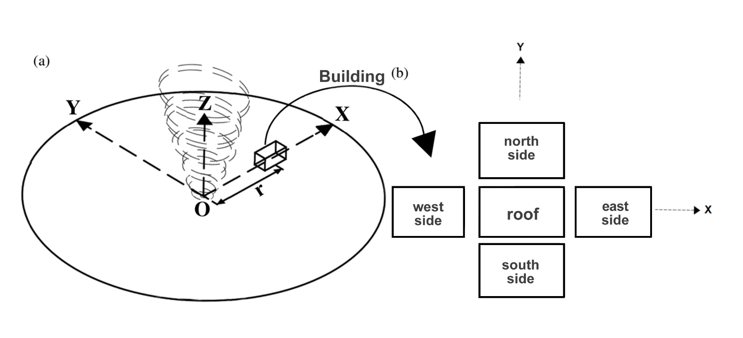
Application of the methodology

Slide 18
Application of the methodology

Slide 19
Application of the methodology

Slide 20
Application of the methodology

Slide 21
Application of the methodology

Slide 22
Deterministic modeling
Input data:
  Wind speed [m/s]: 60
  Simulation duration [s]: 30
  Projectile mass [kg]: 50
  Angle of impact [deg]: 0 (perpendicular to the wall)
  Wall thickness [m]: 0.25
  Wall type: aerated concrete
Projectile dimensions:
  Volume: 0.071 m³,
  Diameter: 0.302 m,
  Length: 1.00 m
  Automatically calculated impact area: 0.071 m²
Results:
  Impact velocity: 38.04 m/s
  Kinetic energy: 36,181.78 J
  Effective penetration: 0.1903 m
  Normal force: 190.11 kN
  Normal pressure: 2.66 MPa

Slide 23
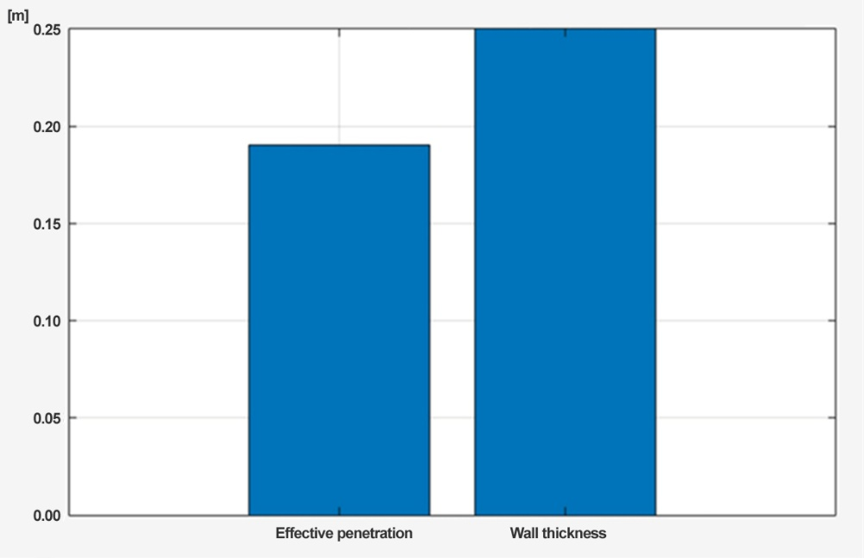
Deterministic modeling

Slide 24
EEFP
The walls of the DG building are able to withstand the impact of missiles. However, the steel doors are penetrated by a wooden missile. The probability of damage to exposed equipment (DG) in the DG building is calculated according to the following equation, presented above for EEFP.
The steel doors are near ground level. MIP = 1.2E-9. The number of missiles is 155,000 . The total area of the steel doors on the DG building is 178.44 m².
EEFP1(F´2) = 1.2E-9 × 155,000 × 178.44 = 3.3E-2/tornado.
Potentially, all DGs will be lost, despite being separated. The doors to each cell can be breached. DGs are robust targets, but small missiles will enter the building through the openings and damage their support systems.

Slide 25
Results

Slide 26
Conclusions
The DG building was presented as an illustrative example.
Detailed analyses were performed for all buildings following the completed site walkdowns, evaluation of the walkdown findings, and completion of all deterministic and probabilistic calculations.
The results were subject to sensitivity analyses.
Safety measures were proposed to increase the tornado resistance for the nuclear units of the Slovak NPPs.

Slide 27
Thank you for your attention !

