Slide 1
PSAM18
Pittsburgh - 2026, July 19 to 24
Multi-Unit Probabilistic Safety Assessment (MUPSA) Regulatory Framework Development in Korea
Korea Institute of Nuclear Safety
Kyungmin KANG

Slide 2
CONTENTS
1
MUPSA Research Initiative : How It Began
2
Overview of MUPSA Research Project by NSSC
3
Research Results & Key Findings
4
Follow-Ups : Current Status
5
Conclusion

Slide 3
Need for research: Rising interest in Multi-Unit sites
NSSC(Nuclear Safety and Security Commission) recommended multi-unit risk assessment during the deliberation process on Saeul Unit 1 OL and Saeul 3&4 CP application
  Recommendations from the ‘Multi-Unit Risk Review Committee’ under NSSC
    Methodology development for site risk assessment based on probabilistic approach
    Regulatory framework development for site risk
NSSC launched a research project for the safety assessment of multi-unit Site.
  5 year (2017~2026) project to develop:
    Regulatory framework for site risk
    MUPSA model for regulatory purpose

Slide 4
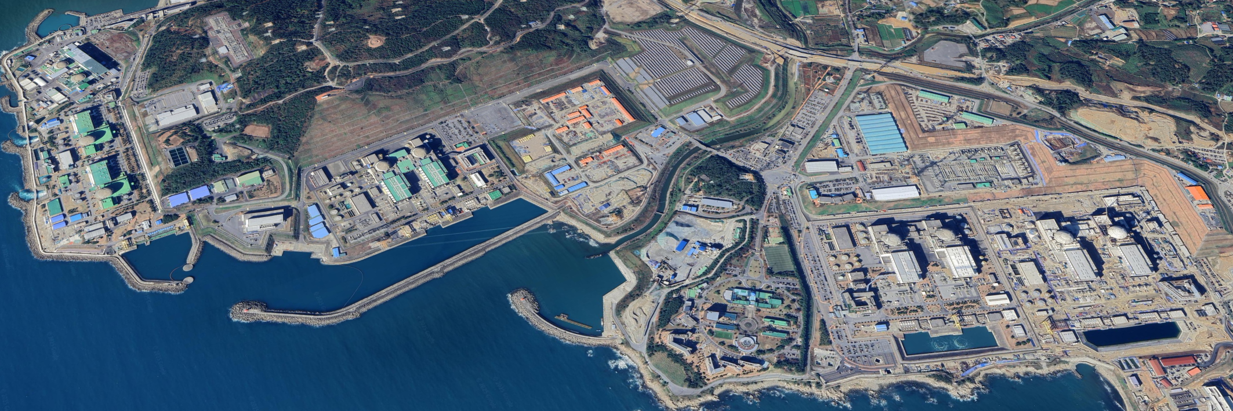
The Scope of the project
SRA Reference NPP site : Kori
  Total 9 units including the plants under construction
  Type of plants : WH600(K2), WH900(K3,4), OPR1000(SK1,2), APR1400(SU1,2,3,4)
K1
K2
3.14km
K3
1.14km
K4
SK2
SK1
1.38km
SU1
SU2
SU3
SU4

Slide 5
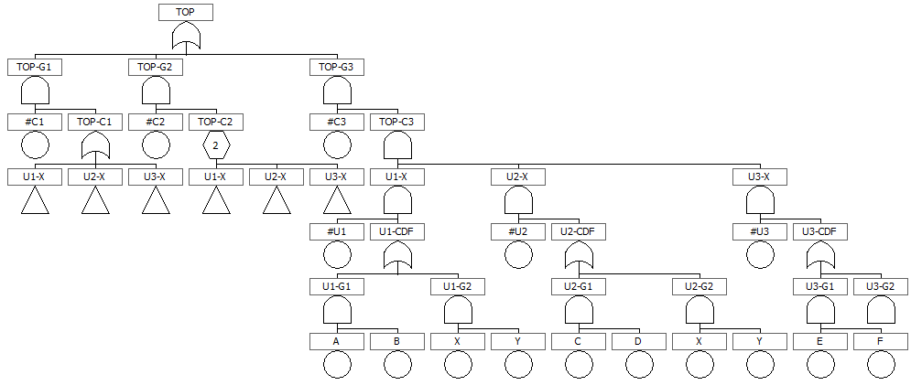
The Scope of the project
Level 1~3 MUPSA is conducted for internal and seismic event.
  Some external events such as loss of off-site power by typhoon are modeled as internal event frequency
  Low-power-shut-down operation modes are considered
  Level 1 and 2 MUPSA is conducted based on large fault tree approach with interdependent factors between the units
    Multi-unit IE, Inter-unit CCF, Component sharing, Inter-unit dependent human error, seismic correlation
  Each source term of the plant is evaluated by MELCOR code and,
  The radiological consequences are assessed by MACCS code with grouped source term.

Slide 6
The Scope of the project
1
2
3
Define “site risk”
& initiating event (IE)
(ex. “6-unit site CDF
due to MU-LOOP)
Estimate the IE frequency
Construct the “top logic” for MUPSA model (Single-Top fault tree)
Level 1
4
5
6
Develop each unit model & integrate into the top logic
(based on the “single-unit” L1 PSA model)
Reflect inter-unit dependencies
(IE, shared SSCs, inter-unit CCFs, seismic correlation, HFEs)
Quantify the accident seq. frequencies
(Scenario: Unit # + Seq. # + PDS #)
Site CDF,
Scenarios
7
8
Extend MU scenarios using L2 PSA results
(Scenario: Unit # + Seq. # + PDS # + STC #)
Consequence analysis (L3)
(for each scenario)
Level 2&3
Risk Profile

Slide 7
Follow up study : Phase 3
Phase 1 (2017~2019)
Phase 2 (2020~2021)
Phase 3 (2023~2026)
Development of Preliminary Site Risk Assessment Technology and Site Safety Goals
Development of Preliminary SRA model for regulation verification
Feasibility Analysis of Site Safety Goals
Advancement of Site Risk Assessment model for Regulation and Development of Requirements
Development of advanced SRA model
Development of a draft regulation standards and guidelines for the site of nuclear power plants.
Additional Case study with potential external hazard
Evaluation of other external hazards (tsunami, external Fire) in SRA model
MUPSA Application to the other site in Korea considering the site characteristics

Slide 8
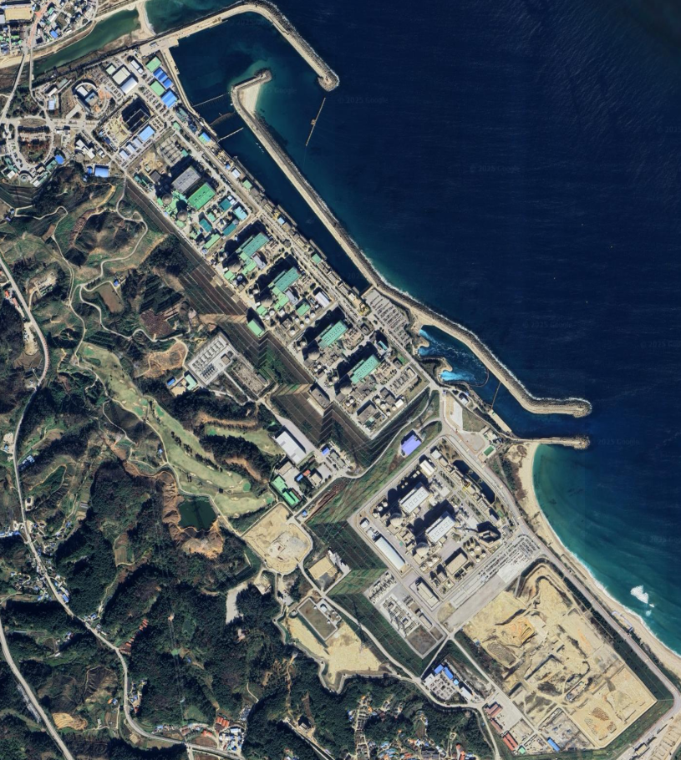
Follow up study : Phase 3
Research Institutions
  KINS, KAERI, FNC Corp.
Supported by NSSC, KoFONS
Objectives of the Research
  SRA methodology application to the Uljin site (10 Unit) considering the type of the NPPs
  Development of the tsunami and external fire SRA methodology
  Site Risk Metrics and regulatory approach development
HU1
HU2
HU3
HU4
HU5
HU6
SHU1
SHU2
SHU3
SHU4

Slide 9
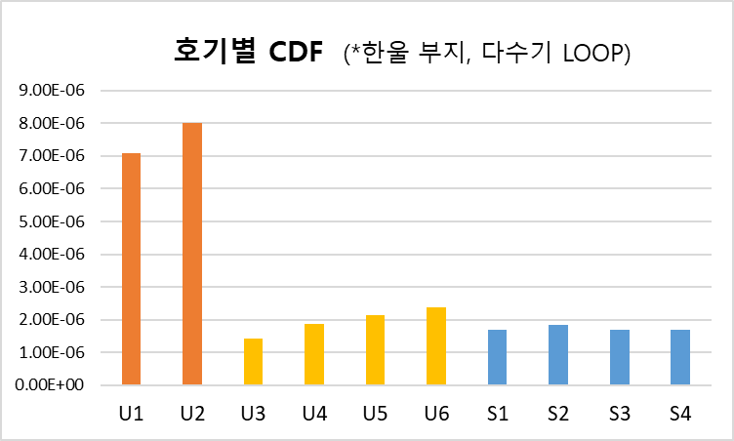


Quantification Results of Multi-unit LOOP
    Quantification cut-off: 1E-13/yr
    CDF differences by reactor type
    Framatome(7.55E-6/yr) >> OPR1000 (1.95E-6/yr) > APR1400 (1.72E-6/yr)
    Multi-unit CDF: Higher contribution from OPR and APR units → due to the large number of inter-unit CCF combinations
Number of Units | CDF (/site-yr) | Ratio
1 | 2.55E-05 | 92.8%
2 | 1.72E-06 | 6.3%
3 | 2.42E-07 | 0.9%
4 | 1.74E-08 | 0.1%
5 units or more | - | -
Site-CDF | 2.75E-05 | 100.0%
MUCDF | 1.98E-06 | 7.2%

Slide 10
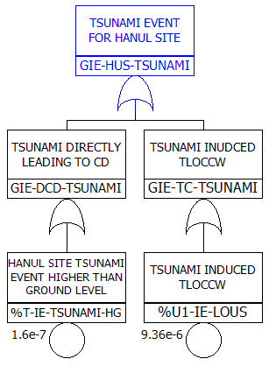
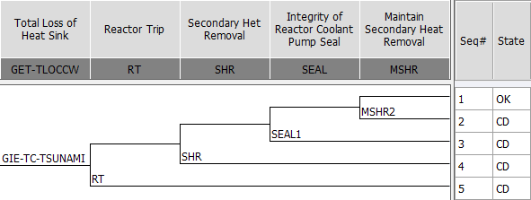
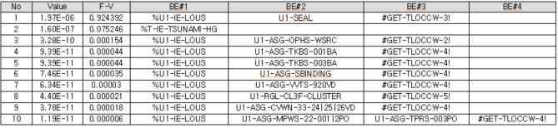
Development of Tsunami PSA Model for Hanul Units
Development of Tsunami-induced Initiating Event Models
Tsunami exceeding 10 m: Assumed to directly cause core damage
Tsunami less than 5 m: Not considered
Tsunami between 5–10 m: Applied by multiplying the occurrence frequency of 5–9 m tsunami by the seawall failure probability (0.39)
Modeling of Loss of Ultimate Heat Sink (LUHS) Events
Developed event sequences for LUHS caused by tsunami
Addressed inoperability of RCP seal injection due to charging pump failure from loss of charging pump cooling
Treated inoperability of equipment affected by LUHS failure

Slide 11
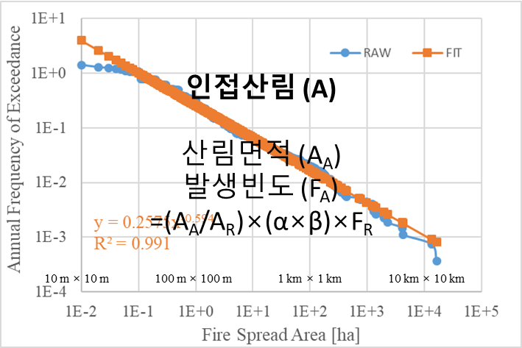
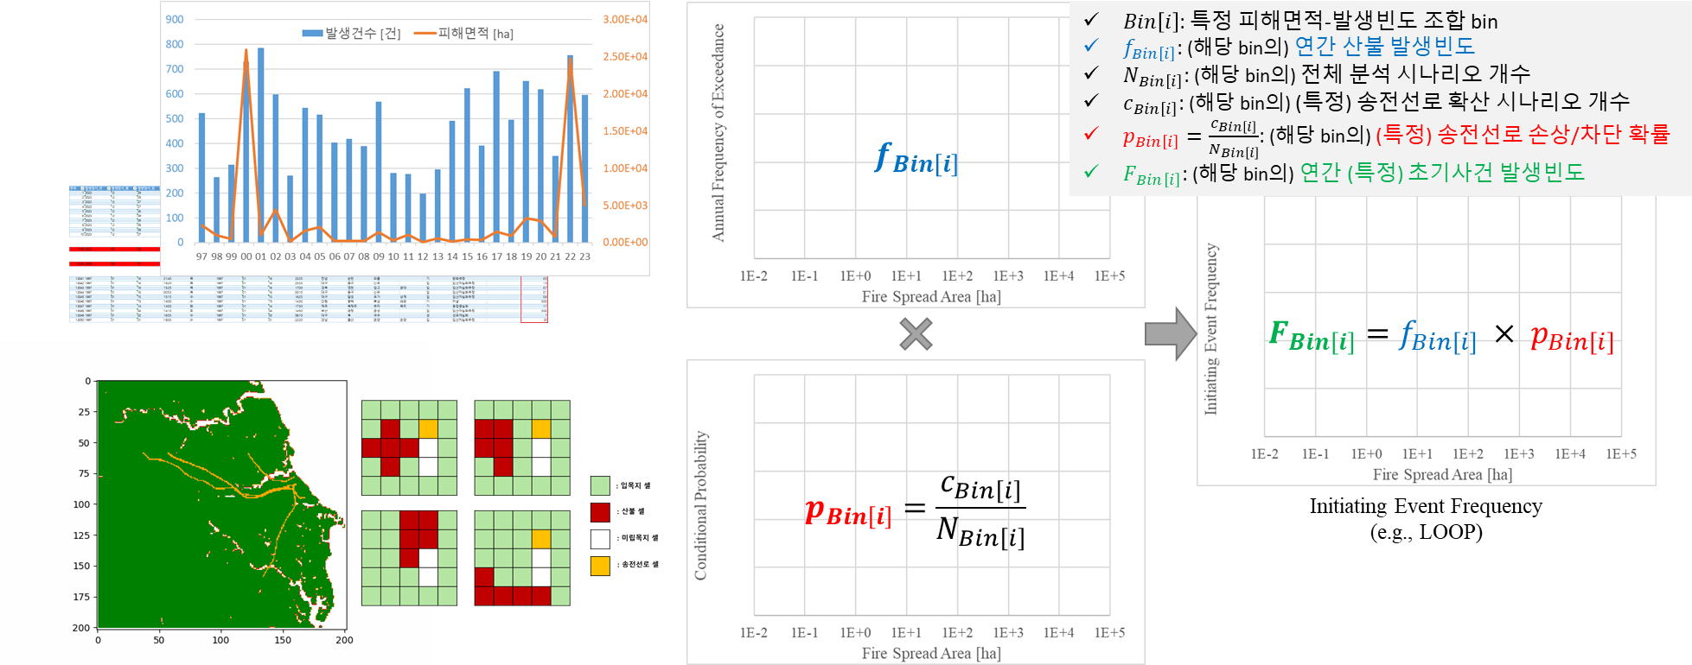
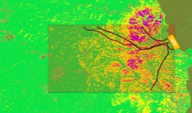
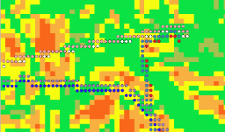
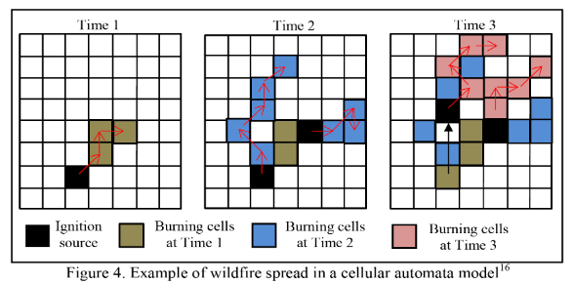
Development of External Fire PSA Methodology
    Collection and organization of domestic wildfire occurrence data
    Development of wildfire occurrence curve for the Hanul NPP site
    Derivation of linkage approach for wildfire occurrence and transmission line impact analysis
    Development of transmission line impact analysis methodology considering fire spread aspects and wildfire characteristics
    Development of internal impact analysis methodology for the Hanul NPP site

Slide 12
Conclusion
NSSC launched Site risk assessment research project and conducted in 2017~2021 for regulatory purposes.
The research targeted to assess the site risk of the 9 units of Kori-site, derived out the quantitative result by full-scope MUPSA.
The result showed the characteristic of each IE and the margin to the safety goal which have been applied to the single unit.
Follow-up research project on the other site is on-going

Slide 13
Thank you for your Attention

