Slide 1
Completion of EPRI Credible Dependent Failure Mechanisms (CDFM) HRA Dependency Methodology
Kaydee Gunter – Jensen Hughes
Eric Thornsbury - EPRI
Jeffrey Julius, Pierre Macheret, Annika Macleod – Jensen Hughes
Probabilistic Safety Assessment & Management Conference (PSAM) 2026,
Pittsburgh PA, USA
Notes:
First of 2 presentations on EPRI CDFM.

Slide 2
Presentation Overview
Status Of EPRI Credible Dependent Failure Mechanisms (CDFM)
Overview of Methodology
Example of Dependent Combination Events (DCEs)
  Identification and Definition
  Quantification
Next Steps for CDFM
Notes:
Benefits include technical considerations as well as resource considerations.

Slide 3
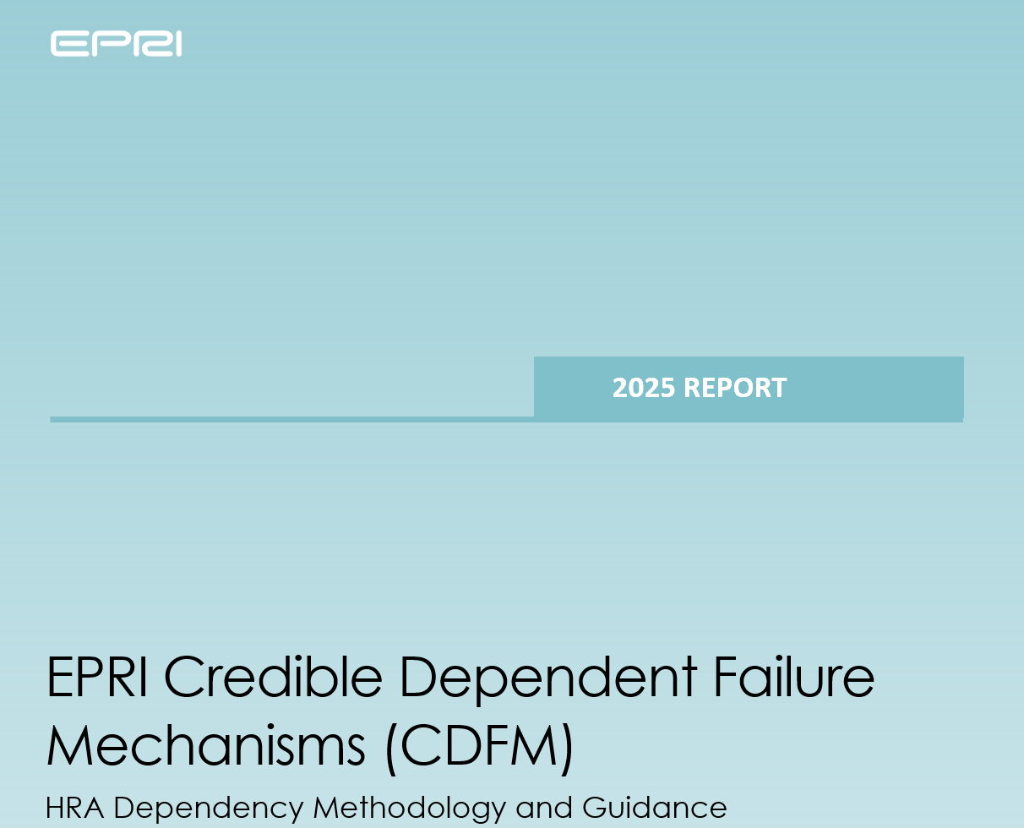
Status Of EPRI Credible Dependent Failure Mechanisms (CDFM)
EPRI Technical Report Published 2025
EPRI CDFM HRA Dependency
Methodology and Guidance
  Initially published in 2024 as a Technical Update
  Method and Guidance published November 2025
HRA dependency methodology has not changed from 2024
Newly Developed Method (NDM) peer review
Review performed in March 2026
Final report issued July 17, 202 (PWROG-26009-P)
EPRI is currently working towards F&O Closure of Findings
Pilots
EPRI lead pilots were performed during development of CDFM (2023-2025)
2 Utility lead pilots are being performed in 2026
EPRI 3002032023 (2025)
EPRI 3002029330 (2024)

Slide 4
EPRI CDFM NDM Review
NDM Results
  Documentation requires more documentation to support the acceptance of the technical basis
  11 Findings
Key Insights Regarding CDFM
  No technical flaws for the method to be applicable
  Identification of the dependent combination events is the key novelty
    Technical basis requires more clarity and documentation
  CDFM is expected to be applicable for all modes and hazards
    Additional testing and considerations/guidance for external hazards is needed
EPRI is working to resolve open F&Os in 2026 with support from industry pilots.
Notes:
Key NDM process insights
Fuzzy line between method documentation and more detailed implementation guidance which may be developed later.
Package for review should have been more extensive to include additional information from training materials, example calculations, etc.
Improve training and expectations on NDM process for both defenders and reviewers.

Slide 5
Overview of Methodology - Background
HFE1
``
Move from:
Insert a fault tree gate where each HFE is modeled
Explicitly break out and model two types of dependent contributions
  Add new events representing “dependency due to the known, credible causes” such as functional similarities or same procedure/goal
  Add a separate Joint HFE for “dependency due to unknown causes” (joint minimum HEP)
Revised HFE represents the independent portion
  For example, Execution actions
HFE1 split into 3 pieces
Individual
HFE (independent)
Dependency due to Known Causes (if applicable)
Dependency from Unknown Causes
Explicitly
model
contributions:
HFE1
DCE
UDCE
New structure is similar to CCF modeling of component fail to start
Notes:
This new structure facilitates and fits with the new Identification
Identify groups of HFEs with the same function or same system
Add new events representing “dependency due to the known, credible causes” such as functional similarities or same procedure/goal
Add a separate, a Joint HFE for “dependency due to unknown causes” (joint minimum HEP)
These new events (DCE and UDCE) represent the common dependent portion of multiple HFEs and are modeled explicitly

Slide 6
Overview of Methodology – Process Steps
Step 1: Identify HFE Combinations
  Dependent Combination Events (DCE) from event tree functions and support systems
  Combinations of HFEs failed due to unidentified causes (UDCE)
  DCE should be defined such that they are independent.
Step 2: Quantify DCE (2025 change)
  2 Detailed Quantification Approaches
Step 3: Model Incorporation
  Incorporate DCE into fault tree logic
  Incorporate UDCE into fault tree logic
Detailed Quantification Approaches
Approach 1 – use existing cognitive HEP development
  Used when cognitive HEPs are similar
  Test for homogeneity
  Select the lowest Pcog and assign as the DCE probability
Approach 2 – Develop DCE using existing EPRI HRA methodologies (CBDT, HCR/ORE)
  Appendix C provides guidance on how to evaluate the CBDT trees for a DCE
  Add new failure mode of mis-prioritization if CBDTM provides negligible results.
Notes:
Left side shows steps in HRA process.
Right side shows how accomplished in CDFM
Bottom line, net impact of new approach:
- Technical improvements by focusing the HRA Dependency on credible combinations. This improves model realism (not quantifying all combinations, instead you now have 2 categories.
- Reduced resources (level of effort and schedule) for each PRA update (but there are some upfront costs to implement)

Slide 7
Example of DCE Identification and Definition
Individual HFE Name | Summary of HFE Context
RCPTRIP-LATE - Operators fail to trip of RCP to prevent seal damage (late) | Late RCP trip avoiding significant seal leakage after RCP seal cooling loss.
SWFANSTRT - Operators fail to start of service water cooling tower fan | Increased heat loads require the start of a cooling tower fan to ensure service water maintains appropriate cooling capability. Loss of service water eventually leads to loss of component cooling water (CCW) and of cooling to the charging pumps, leading to the loss of RCP seal injection and thermal barrier cooling.
RCPTRIP-EARLY - Operators fail to trip of RCP to prevent seal damage (early) | Early RCP trip allowing minimum seal leakage after RCP seal cooling loss.
CCWPMPSTRT - Operators fail to start of alternative CCW pump given failure of running pump | Upon loss of the normally operating CCW pump, the standby pump automatically starts. The action here models the manual start of that pump should auto-start fail. Loss of CCW causes loss of thermal barrier cooling and charging pump injection, thereby challenging RCP seal integrity.
ALTCCWPUMPSTRT Operators fail to start of alternative charging pump given failure of thermal barrier cooling | The CCW system which cools the thermal barrier also cools the normal charging pump. The loss of the CCW system requires starting another charging pump, cooled by a different system. In absence of both thermal barrier cooling and charging, RCP seal integrity is lost.
RWSTALIGN - Operators fail to transfer charging pump suction from VCT to RWST | During normal operation, a charging pump takes suction from the volume control tank (VCT). Upon low VCT level, suction is transferred to the refueling water storage tank (RWST). The action here ensures that transfer. If failed, charging would be lost, challenging the RCP seal integrity function.
CHGALIGN Operators fail to align safety grade charging | Loss of instrument air causes loss of the normal charging path. Safety grade alignment provides an alternative charging path that does not rely on instrument air. Failure of that alignment leads to the loss of charging, challenging the RCP seal integrity function.
DCE – Operators fail to maintain RCP Seal Integrity and Thermal Barrier Cooling
Group consists of 7 HFEs all supporting the same goal
All HFEs required within the short time frame of 30 minutes or less.
Group was identified using bottom-up approach of grouping HFEs based on goal of each HFE, systems and procedures.

Slide 8
Example of DCE Quantification Approach 1
HFE Name And Description | Pcog | Total HEP
RCPTRIP-LATE - Operators fail to trip of RCP to prevent seal damage (late) | 1.4E-04 | 5.7E-04
SWFANSTRT - Operators fail to start of service water cooling tower fan | 4.4E-04 | 9.3E-04
RCPTRIP-EARLY - Operators fail to trip of RCP to prevent seal damage (early) | 1.4E-03 | 1.8E-03
CCWPMPSTRT - Operators fail to start of alternative CCW pump given failure of running pump | 2.0E-03 | 3.7E-03
ALTCCWPUMPSTRT - Operators fail to start of alternative charging pump given failure of thermal barrier cooling | 2.7E-02 | 3.5E-02
RWSTALIGN - Operators fail to transfer charging pump suction from VCT to RWST | 2.7E-02 | 3.5E-02
CHGALIGN - Operators fail to align safety grade charging | 2.7E-02 | 3.5E-02
Pcog HEPs Range from 1.4E-4 to 2.7E-2
This range is > 1 order of magnitude.
The Pcog values are not homogenous without additional review of the development of the individual HFEs.
Move on to Approach 2

Slide 9
Example of DCE Quantification Approach 2 – CBDT and HCR/ORE
Pca (data not available) and Pcd (information misleading): No common set of instrumentation for all HFEs; Both trees are not applicable.​
Pcb (failure of attention): Multiple alarmed and visible indications support RCP seal integrity monitoring; probability of failure to notice is negligible, even under high workload.​
​Pcc (misread/miscommunicate data) and Pch (deliberate violation): Not applicable for a mature PWR and BWRs (>30 years operation) with robust HMI and communication protocols.​
Pce (skip a step in procedure) Pcf (misinterpret instruction) and Pcg (misinterpret decision logic): No single common procedure for step the group of HFEs; trees are not applicable.​
HCR/ORE – Average TSW = 17 minutes, Tcog = 1 minute HEP = Negligible
CBDT and HCR/ORE Evaluates to Negligible!

Slide 10
Example of DCE Quantification Approach 2 –
Mis-prioritization or incorrect goals
Additional failure mode not explicitly covered by CBDT.
  Represents a fundamental failure to properly assess the situation, leading the operators to focus their efforts on tasks or issues that are unrelated to the event of interest.
For long-term DCEs (time available for recovery greater than 1 hour) a value of 5E-05 is recommended.
For shorter-term DCEs (time available for recovery less than 1 hour) 5E-04 is recommended.
Mis-prioritization HEP is 5E-4
Time for recovery for all HFEs is less than 1 hour
Notes:
In both pressurized water reactors (PWRs) and boiling water reactors (BWRs), design features, operational principles, and operating experience have reduced the likelihood of this failure mode. However, in principle, no combination of actions is immune to it. Therefore, if the quantification method of the DCE leads to negligible results or all other failure modes have been determined to not be applicable, the failure mode of mis-prioritization or incorrect goals should be included. Regarding its quantification, the following considerations apply:

Slide 11
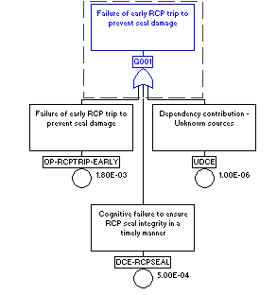
Example of DCE Quantification Conclusions
DCEP Summary
  Approach 1 – DCEP - 1.4E-04
  Approach 2 – DCEP - 5E-04
Both approaches are on the same order of magnitude. Approach 2 will be used as the final DCEP – 5E-4.
Final DCEP should be reviewed as part of reasonableness check in ASME/ANS PRA Standard supporting requirement HR-G7.
The UDCE is incorporated into the PRA model in addition to the DCEP.
Notes:
Ee should take 5E-04 or 5E-05 as an absolute. This is a recommended value, that’s all. It can be changed. What matter is in the end is that SR HR-G6 of the ASME/ANS 2009 Standard is met (that’s the SR about consistency and reasonableness of HEPs against each other). In my opinion, the example in the slide shows that 1.4E-04 could be used instead of 5E-04 for that specific plant.
I am not sure that CDFM would lead to a change in risk in the wrong direction when equipment is taken out of service. With each HFE of the DCE group carrying the DCE under an OR gate, is that possible? Maybe. But if that ever occurs, this would be only for cases where the total HEP (cognitive + execution) is less than 5E-04. We should investigate further to get a definite answer. But there is always the option to use the answer in the bullet above, for this specific presentation.

Slide 12
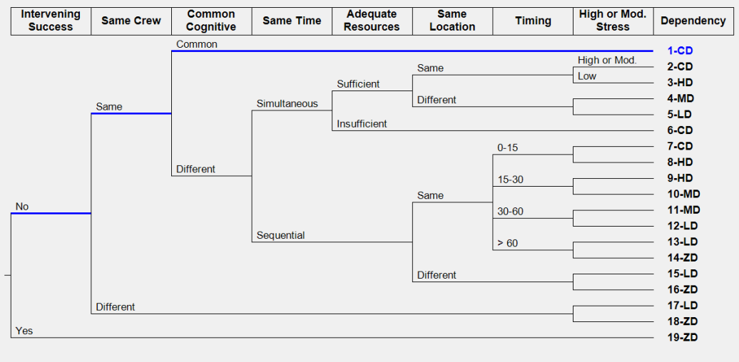
Comparison of Example DCE to HRA Calculator JHEP
THERP uses pairwise comparison approach and when order sequentially the first HFE will dominate the JHEP. The first HFE could range from 9.3E-04 to 3.5E-2
For the example DCE each action after the first HFE would result in Complete or High Dependency since all HFEs, take place within 15 minutes and same location (MCR)
THERP JHEPs could range 4.65E-4 to 1.7E-2 depending on the specific HFEs in Combinations
CDFM results in 5E-4 for possible combinations
Notes:
I only included 2 HFEs in my THERP JHEP calculations
9.3E-4*.5 and 3.5E-2
Slide 12 shows that CDFM and the initial HRA Calculator approach simply have different ways to partition the HRA risk. Both have pros and cons. The example shows that the CDFM provides some sort of intermediate value that is representative of the values obtained from the range of combinations. This can be seen as an improvement over the HRA Calculator method, since that latter method produces thousands of combinations that cannot be realistically reviewed one by one. In contrast, CDFM provides a single story per DCE, which can be reviewed and analyzed in depth. It has a narrative and therefore can be refined if need be.

Slide 13
CDFM Next Steps
CDFM is ready for industry adoption!
EPRI is working to resolve NDM Peer Review F&Os. F&O’s will be resolved by publishing EPRI knowledge base articles
  Additional guidance on applying CDFM to external hazards
  Additional documentation on the technical basis
  Additional examples of identification of DCEs
Industry pilots are being performed in 2026 and are planning to undergo focused scope peer review in 2027.

Slide 14
CDFM Development Team
EPRI HRA Dependency Contacts
  Eric Thornsbury (ethornsbury@epri.com)
  Mary Presley (mpresley@epri.com)
Jensen Hughes Contacts
  Kaydee Gunter (kgunter@jensenhughes.com)
  Jeff Julius (jjulius@jensenhughes.com)
  Pierre Macheret (pmacheret@jensenhughes.com)
  Annika MacLeod (Annika.macleod@jensenhughes.com)

Slide 16
CDFM Overview (Quantification of DCE Prob. cont’d)
Detailed Quantification cont’d
Approach 2 – use same method as individual HFE development
Section 5.4.2 and Appendix C
  Case 1. Given a single, common cue or common procedure for the constituent HFEs (Apply CBDTM to evaluate the common cue or procedure similar to individual HFE)
  Case 2. Multiple cues or multiple procedures
  Following quantification, check for an additional failure mode modeling
  mis-prioritization (Section 5.4.3)
    Used if Case 1 or Case 2 is too low or if both Approach 1 & 2 are not applicable.
Step 1: Identify HFE Combinations
  Dependent Combination Events (DCE) from event tree functions and support systems
  Combinations of HFEs failed due to unidentified (UDCE)
Step 2: Quantify DCE (2025 change)
  Streamlined Approach
  Detailed Approach
Step 3: Model Incorporation
  Incorporate DCE into fault tree logic
  Incorporate UDCE into fault tree logic
Quantification of DCE – Approach 2 uses Existing Methods for Cognitive HEPs
Notes:
Left side shows steps in HRA process.
Right side shows how accomplished in CDFM
Bottom line, net impact of new approach:
- Technical improvements by focusing the HRA Dependency on credible combinations. This improves model realism (not quantifying all combinations, instead you now have 2 categories.
- Reduced resources (level of effort and schedule) for each PRA update (but there are some upfront costs to implement)

Slide 17
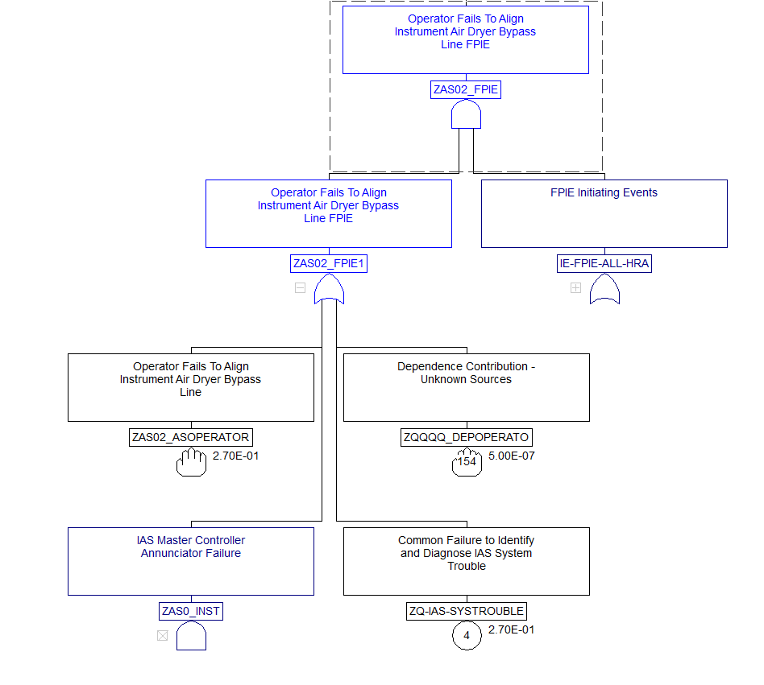
CDFM Overview (Model Incorporation)
Step 1: Identify HFE Combinations
  Dependent Combination Events (DCE) from event tree functions and support systems
  Combinations of HFEs failed due to unidentified (UDCE)
Step 2: Quantify DCE (2025 change)
  Streamlined Approach
  Detailed Approach
Step 3: Model Incorporation
  Incorporate DCE into fault tree logic
  Incorporate UDCE into fault tree logic
UDCE
Event
(Minimum
JHEP)
Individual HFE
New DCE
Example of Fault Tree Modeling
Notes:
Left side shows steps in HRA process.
Right side shows how accomplished in CDFM
HFE combos are modeled directly in the Fault Tree along side of the original HFE.
Fault tree (FT) modeling reduces the number of recovery rules.
Reduced iterations because the HRA dependency is front-loaded into the HRA portion of the PRA update
Bottom line, net impact of new approach:
- Technical improvements by focusing the HRA Dependency on credible combinations. This improves model realism (not quantifying all combinations, instead you now have 2 categories.
- Reduced resources (level of effort and schedule) for each PRA update (but there are some upfront costs to implement)

Slide 18
CDFM Pilot and Testing Summary
Testing was conducted using a variety of analysts over 2-years:
  Model owners
  External consultant
  Analysts that were inexperienced and experienced in HRA
Stress testing of models
  1 full model (internal events, internal fire, internal flood)
    Seismic hazards follows the same approach, will describe in a KB article
  1 fire model, and portions of 2 other models
  Configuration Risk Management sensitivity cases
    Front line component out of service
    Support system component out of service

Slide 19
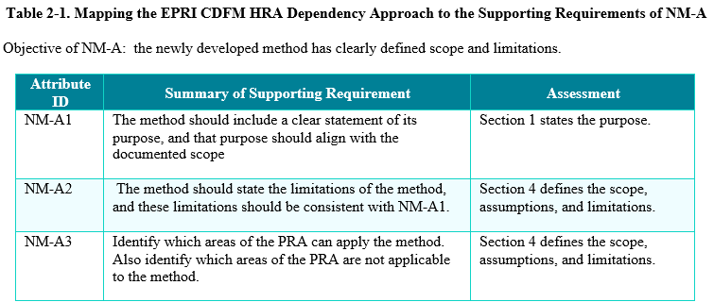
Self-Assessment
CDFM was assessed against Requirements
  NDM requirements
  ASME/ANS requirements in the PRA Standard (2009 and 2024)
Separate document provides a mapping to the EPRI report
  High-level requirements
  Supporting requirements
Show mapping tables

Slide 20
Conclusions: Benefits of implementing CDFM
Reduced PRA maintenance updates – easier to maintain by focusing on changes
Reduced PRA quantification times by reducing recovery rules and eliminating seed values
Tested and no issues seen with PRA model convergence
  Demonstrated in our pilot models
Eliminates problems with CRM and applications where the quantified risk decreases when systems removed
Complies with PRA Standard HR-G and QU-C HRA dependency requirements
Sets up the PRA for future PRA Standard requirements (e.g., 2024 supporting requirement for a joint minimum HFE)
Notes:
Reduces resources (staff hours, schedule time) to conduct HRA dependency once implemented in the PRA.

Slide 21
Conclusions: Benefits of implementing CDFM cont’d
CDFM applies upfront effort to improve PRA realism
DCE joint HEP builds upon the human performance characteristics used to develop the cognitive HEPs of the constituent events
Consolidating unidentified combinations into a single HFE eliminates model “noise”
  Noise that can mask contributors
  Thus, improves insights
Improved communication with operations as CDFM focuses on safety functions and associated systems
  Improves the credibility of the HRA and PRA
Notes:
Reduces resources (staff hours, schedule time) to conduct HRA dependency once implemented in the PRA.
Left side shows steps in HRA process.
Right side shows how accomplished in CDFM.
Bottom line, net impact of new approach:
- Technical improvements by focusing the HRA Dependency on credible combinations. This improves model realism (not quantifying all combinations, instead you now have 2 categories. Consolidating unidentified combinations in a single HFE eliminates model noise. The 2016 models had TONs of noise. Other approaches still can have many combinations that are indistinguishable and add noise to the PRA. While not guaranteed for all models, elimination of the noise has resulted in reduced risk of several PRAs.
- Reduced resources (level of effort and schedule) for each PRA update (but there are some upfront costs to implement). Generic list of event tree functions for PWR and BWR added to the report, showing examples that were identified during testing.

