Slide 1



PSAM 18 · Probabilistic Safety Assessment & Management
Normalcy Bias in Search
and Rescue Decisions
Reverse Information Bias in a Sequential 3-Way Signal Detection Task
Kevin Kapadia¹ Robin Dillon² Richard S. John¹
¹ University of Southern California ² Georgetown University
Notes:
Title slide. Briefly introduce yourself and the collaboration between USC and Georgetown. One-line hook: emergency-response failures often come not from missing information but from how ambiguous signals get interpreted. Set expectation: ~12 minutes, motivation → framework → design → four findings → implications.

Slide 2



MOTIVATION
When warning signals are read as “normal”
Emergency-response failures rarely come from missing information.
They come from how ambiguous warning signals are interpreted in the moments before a crisis is confirmed.
Normalcy bias is the systematic tendency to read weak or atypical signals as consistent with normal, non-threatening conditions, delaying protective action.
DOCUMENTED ACROSS RISK DOMAINS
Natural disasters
Evacuation delayed despite credible early warnings
Emergency response
Prolonged information-gathering when speed mattered
Normalcy bias not indifference. It is a distortion in how evidence is reviewed in real time
Defense & security
Anomalous signals discounted against expectations
2
Notes:
Motivation. Lead with the core idea: failures rarely stem from missing info or apathy. Define normalcy bias plainly — reading weak/atypical signals as 'normal,' which delays action. Use the right-hand examples (disasters, emergency response, defense) to show it generalizes. Emphasize: it's a predictable cognitive distortion, not negligence.

Slide 3
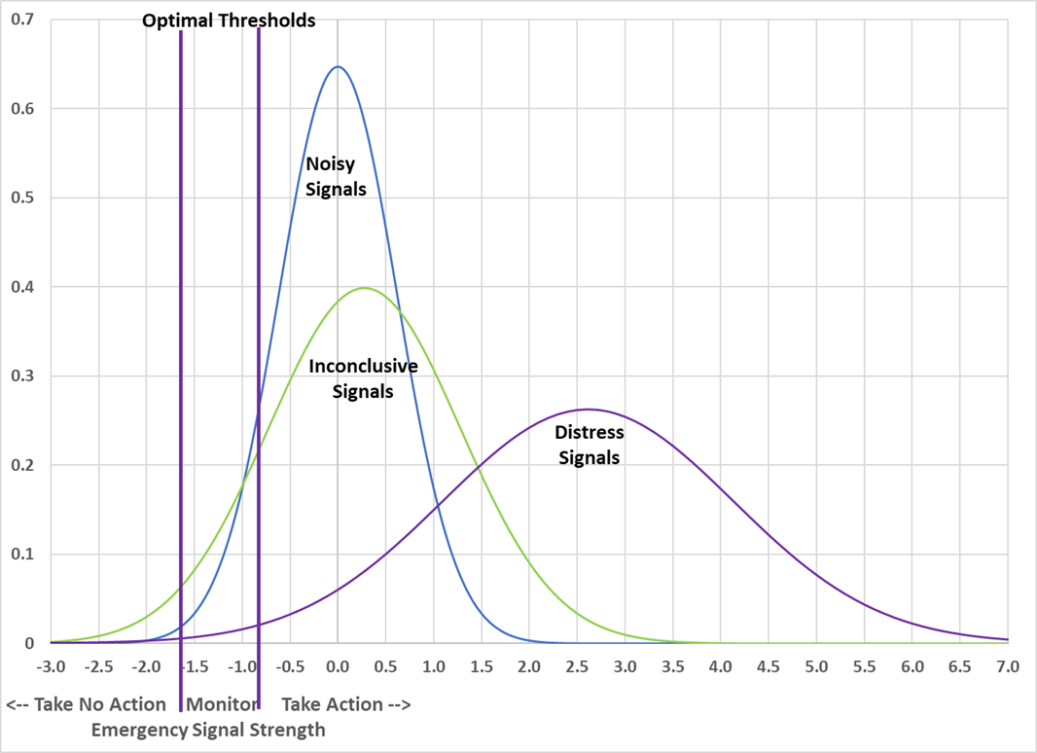

THEORETICAL FRAMEWORK
A three-way signal detection model
Signal Detection Theory treats each cue as a noisy signal arising from either a distress or a benign state.
1
Diagnosticity
A signal’s likelihood ratio sets how much it moves the odds of distress.
2
Two thresholds
Coast Guard watch-standers monitor until evidence crosses a launch or a stand-down threshold.
3
Normative anchors
Optimal thresholds depend on the base rate of distress and the relative cost of false negatives vs. false positives.
→ drop in paper Figure 1
3
Notes:
Framework. Explain SDT in one breath: cues are noisy signals from a distress or benign world; the likelihood ratio is how diagnostic a cue is. Stress the THREE-way extension — not just launch vs. not, but a monitoring/inconclusive zone with TWO thresholds (stand-down and launch). Note thresholds should depend on base rate and error costs. Point to Figure 1 (drop in your own figure).

Slide 4



THEORETICAL FRAMEWORK
Where normalcy bias enters the model
Within 3-way SDT, bias takes three forms, each pushing toward inaction:
Misread signals
Launch threshold too high
Stand-down too soon
Diagnostic cues are diluted or discounted; nondiagnostic cues are over-weighted as if they cancel evidence.
Neglecting a high base rate or steep false-negative cost demands stronger evidence than warranted to launch.
Setting stand-down too close to launch narrows the monitoring window, ending the search prematurely.
Contributing mechanisms: base-rate neglect · conservatism in updating · averaging of nondiagnostic cues · anchoring & recency
4
Notes:
Where bias enters. Walk the three cards left to right: (1) misreading/averaging signals, (2) launch threshold set too high, (3) standing down too early. Mention the supporting mechanisms along the bottom (base-rate neglect, conservatism, averaging, anchoring/recency) but don't dwell — they recur in the findings.

Slide 5

METHODS
The search-and-rescue decision task
Role-play a Coast Guard officer
Deciding whether to launch a SAR mission after a hurricane in South Florida, with resources already stretched thin.
SIGNAL STRUCTURE
8 matched signal pairs
Debris · Radio · Flare · Radar · Move · Growth · Call · Sheen
1
Receive a signal
One warning signal arrives from a junior officer.
Diagnostic
Nondiagnostic
Concerning cue
raises distress odds
Same context
no added evidence
2
Decide or wait
Launch, stand down, or request another signal.
3
Up to 8 signals
Each scenario offers a maximum of eight cues.
Distress scenarios: 80% diagnostic
Benign scenarios: 80% nondiagnostic
4
Rate the call
Give confidence and posterior probability of distress.
6
Notes:
Methods — the task. Set the scene: role-play a Coast Guard officer after a hurricane, resources stretched. Walk the 4-step loop (receive → decide/wait → up to 8 signals → rate confidence + posterior). Then explain the signal structure: 8 matched diagnostic/nondiagnostic pairs; distress scenarios are 80% diagnostic, benign 80% nondiagnostic, so every scenario stays ambiguous.

Slide 6
METHODS
A 3 × 3 between-subjects design
BASE RATE OF DISTRESS
25%
50%
75%
Scoring rule
FN Severe
Penalties define error cost from a 500-point start:
FN Severe (−150 / −50) · Balanced (−100 / −100) · FP Severe (−50 / −150)
SCORING RULE
Base rate
Balanced
Prior probability of distress, stated each scenario, also set the mix of the four scenarios (e.g., 25% → 1 distress / 3 benign).
FP Severe
Two samples
476
326
800+
Georgetown
(Sample 1)
USC
(Sample 2)
Total
participants
9 conditions
7
Notes:
Methods — design. The 3×3: scoring rule (FN severe / balanced / FP severe) crossed with base rate (25/50/75%). Note the 500-point start and penalties. Explain base rate also set the scenario mix (25% → 1 distress/3 benign). Mention two samples — Georgetown (476) and USC (326), 800+ total — and that a manipulation check confirmed the base-rate manipulation worked.

Slide 7
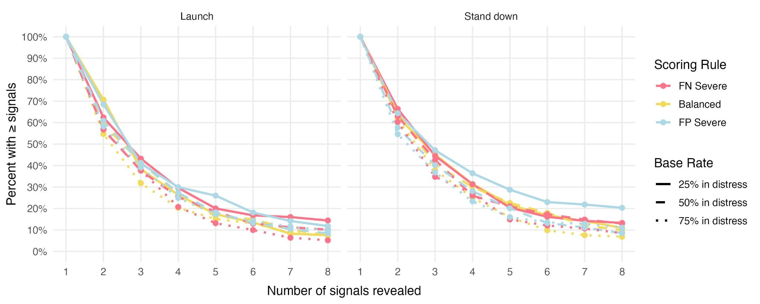

FINDINGS · 1 OF 4
A reverse information bias
Despite being free to request up to eight signals, most participants stopped after only one or two additional cues.
Censored Bayesian Regression Findings
IRR = 0.95
More confident participants gathered fewer signals
FIGURE 2
IRR = 1.11
Higher base rate (75% vs 25%) gathered slightly more
ICC = 0.71
Most variation was stable individual differences
8
Notes:
Finding 1 — reverse information bias. The headline: ~3 of 8 signals collected despite no penalty for more. Stopping was front-loaded. From the brms censored negative-binomial model: more confident → fewer signals (IRR 0.95); higher base rate → slightly more (IRR 1.11); ICC 0.71 means most variance is stable individual differences. Point to Figure 2 (your decumulative plot).

Slide 8
FINDINGS · 2 OF 4
What drives the decision to launch
Odds ratios from the binary logistic mixed-effects model (significant predictors)
READING THE MODEL
Responsive to evidence. Perceived probability and distress scenarios were by far the strongest drivers.
Sensitive to incentives. Launches rose when false negatives were costlier and when the base rate was high.
The confidence paradox. More confident participants were less likely to launch and gathered less evidence.
OR > 1 increases launch odds · OR < 1 decreases them
9
Notes:
Finding 2 — launch drivers. Read the OR chart: perceived posterior probability (7.29) and distress scenarios (6.49) dominate — people DO respond to evidence. Incentives matter too: FN-severe and high base rate raise launching. The striking result is the confidence paradox — more confident participants launched LESS and gathered less. Prior water-job experience also lowered launching.

Slide 9

FINDINGS · 3 OF 4
Base rate shifted judgments, scoring rule did not
Partial base-rate sensitivity
Posterior judgments rose with the stated base rate, but far less than the manipulation implied.
The scoring rule had no effect on probability judgments, evidence of base-rate under-weighting.
10
Notes:
Finding 3 — base rate vs. scoring rule. Posterior judgments rose with the stated base rate but far less than the 25→75% manipulation implied — partial sensitivity / under-weighting. Scoring rule did NOT move probability judgments at all. (Chart values are illustrative of the reported means; swap in your exact figure if preferred.)

Slide 10
FINDINGS · 4 OF 4
Performance: average score only halfway to optimal
300
★ 397 mean observed
500
Random
guessing
optimal ignoring all signals ≈ 389
Perfect
accuracy
~74%
76%
71%
scenarios answered correctly
accuracy in benign scenarios
accuracy in distress scenarios
Performance landed about halfway between chance and perfection, and only marginally above a strategy that ignores every signal and uses base rate plus error penalties alone.
11
Notes:
Finding 4 — performance. Scores ran 300 (chance) to 500 (perfect); observed mean ~397 — about halfway. The key punchline: that's only marginally above a strategy that ignores every signal and uses base rate + penalties alone (~389). Accuracy ~74% overall, a bit higher in benign than distress scenarios. So signals added little net value.

Slide 11
SYNTHESIS
Normalcy bias as premature closure
1
2
3
Stop too early
Under-weight priors
Over-trust confidence
Decisions came after only 2–3 signals, thresholds reached before enough evidence accrued.
Base rate moved judgments only partially; the scoring rule barely moved them at all.
Confidence rose faster than accuracy, cutting search short and lowering launch rates.
Bias here is not ignored warnings; it is ambiguous evidence judged “not yet enough” to act.
12
Notes:
Synthesis. Tie the four findings into one story: premature closure. (1) stop too early, (2) under-weight priors, (3) over-trust confidence. The reframing to land: normalcy bias here is not ignoring warnings — it's ambiguous evidence judged 'not yet enough' to act on. This is the conceptual contribution.

Slide 12

IMPLICATIONS
Why it matters and what comes next
Practical implications
LIMITATIONS & FUTURE WORK
Design decision aids
Prompt operators to keep sampling and to weight base rates and asymmetric error costs explicitly.
Train against premature closure
Make the confidence-accuracy gap visible so confidence is not mistaken for sufficiency.
Calibrate to consequences
In high-stakes SAR, low launch thresholds are warranted when missed rescues are far costlier.
Student samples with little SAR training, experts may differ.
Hypothetical scenarios without real operational stakes or competing priorities.
Sequential, isolated signals real cues arrive clustered and at uneven intervals.
Next: test trained professionals, correlated signals, and richer operational context.
13
Notes:
Implications & limitations. Implications: build decision aids that prompt continued sampling and explicit base-rate/error weighting; train against premature closure by exposing the confidence–accuracy gap; calibrate thresholds to consequences. Be candid on limits: student samples, hypothetical scenarios, isolated sequential signals. Future: experts, correlated signals, richer context.

Slide 13
CONCLUSION
Bias from how evidence is gathered, not whether it is seen
Across two samples, participants collected on average 3 of 8 signals, under-weighted base rates, and let confidence outrun accuracy, terminating the search early and anchoring on normal conditions.
These dynamics can delay escalation in real emergency response, and should inform operator training and decision support for first responders.
Kevin Kapadia · kevinkap@usc.edu · University of Southern California
14
Notes:
Conclusion. One-sentence takeaway: the bias is in how evidence is gathered and weighed, not whether it's seen. Restate the three behavioral signatures. Connect to real SAR / first-responder training and decision support. Thank the audience and invite questions; show contact info.

